Slide 1
Do Robert’s Rules Really Create Order?
While you wait for today’s training to start please type your name and county in the chat box.
If you are watching a recorded version of this training please contact your local Extension Office to have this training added to your leader profile.

Slide 2
Objectives:
Look at Robert’s Rules of Order.
Discuss alternative ways to make decisions.
Arm you with tools to simplify Robert’s Rules of Order.

Slide 3
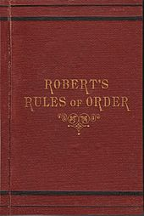
Who the heck is this Robert guy?
U.S. Army General Henry Martyn Robert.
Published a book on Parliamentary Procedure in 1876.
Rules for conducting a successful meeting.
Allows efficiency in making decisions and voice their opinion.

Slide 4
Parliamentary Procedure Goals:
Extend courtesy to everyone.
Focus on one thing at a time.
Observe the rule of majority.
Ensure the rights of the minority.

Slide 6
Is this type of meeting realistic? Does your club meeting look like this?

Slide 7
How does parliamentary procedure fit the VISION of the Wyoming 4-H program?
VISION
The vision of the Wyoming 4-H Program is to develop a world in which youth and adults learn, grow and work together as catalysts for positive change.
In support of this vision the Wyoming 4-H Program:
Provides opportunities for formal and non-formal community-focused experiential learning.
Helps youth develop skills that benefit them throughout life.
Fosters leadership and volunteerism in youth and adults.
Works to strengthen families and communities.
Uses research-based knowledge available from the land grand university system and other sources.

Slide 8
How does parliamentary procedure fit the EXPERIENCE that the Wyoming 4-H program looks to provide youth?
THE YOUTH EXPERIENCE
As a member of the Wyoming 4-H Program, we look to provide the following experiences to youth:
The opportunity to set goals, keep records, and reflect on their learning in a project area.
A caring adult to provide the support needed to develop like skills through project work.
Opportunities for hands-on learning experiences.
A place to publicly display their learning in one or more project areas.
Opportunities to use the skills learned in their club and project work at a county, regional, state, national, and international level.

Slide 9
Alternative Decision Making Processes:
Unilateral
Decisions by Minority
Majority Rule
Consensus

Slide 10
Gaining Ideas for Decision Making:
Note and Vote
-Members develop ideas on their own for one minute (this could also be done in pairs).
-Member or pair shares their favorite (or two favorite ideas).
-Out of all the ideas each person chooses a favorite from the list and writes it down.
-The ideas with the most “votes” is discussed as the chosen idea.

Slide 11
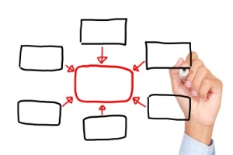
Gaining Ideas for Decision Making:
Mind Mapping
Park
Clean Up
Donate
Veterans
Community Service

Slide 12
Gaining Ideas for Decision Making:
Popcorn
-Members ideas pop out of their heads and they share ideas as they come up with them.
-All ideas are written down.
-Ideas that are not feasible to the group are eliminated.
-The group votes or reaches consensus on one of the ideas.

Slide 13
Gaining Ideas for Decision Making:
Gallery Walk
-Posters are placed around the room with discussion topics on them.
-Members go around the room and write or drawn answers to the questions on the posters.
-To make a decision the poster is read unrealistic ideas are elminiated.
-The group reaches a consensus or votes on the one they like most.

Slide 14
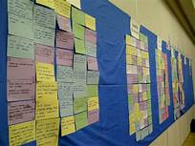
Gaining Ideas for Decision Making:
Word Wall
-Members write ideas on slips of paper around a question or need.
-Members place items of paper on a wall, similar concepts are grouped together.
-Idea groups are discussed.
-Members reach consensus or vote on desired outcome.

Slide 15
Gaining Ideas for Decision Making:
Committee Work
-Committees meet outside of the meeting to present members with an idea for an activity or event.
-Clubs with larger membership forms committees during meetings to make more decisions in a short period of time.
-Committees can present one idea based on their research and time or two to three ideas for members to reach consensus on or to vote on.

Slide 16
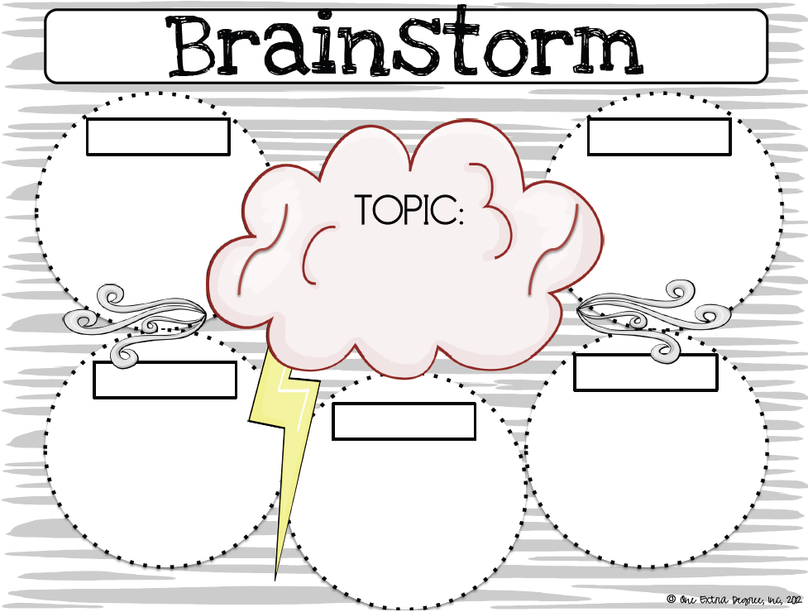
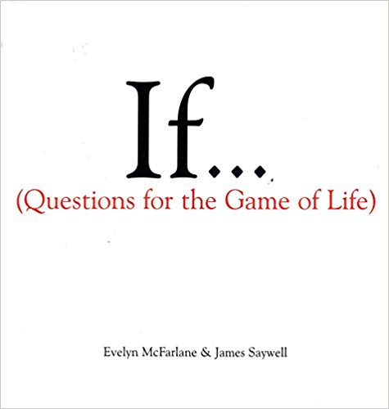
Gaining Ideas for Decision Making:
-Create Top 10 List
-Use a Brainstorming Worksheet
-Play games that encourage brainstorming
-Madlibs
-What if questions?
-Role Play or acting
-Other?

Slide 17
Reaching a Consensus:
Clearly outline the decision you are making with the focus that you are picking what is best for the group in order not to create a us vs. them mentality.
Generate solutions or ideas –all ideas are valid when looking to generate ideas.
Use set criteria to eliminate idea (cost, time, date, distance, relationship to organization mission, etc).
Ask for feedback or concerns before coming to consensus.
Address feedback and concerns.
Reach unanimous consent or a super majority.

Slide 18
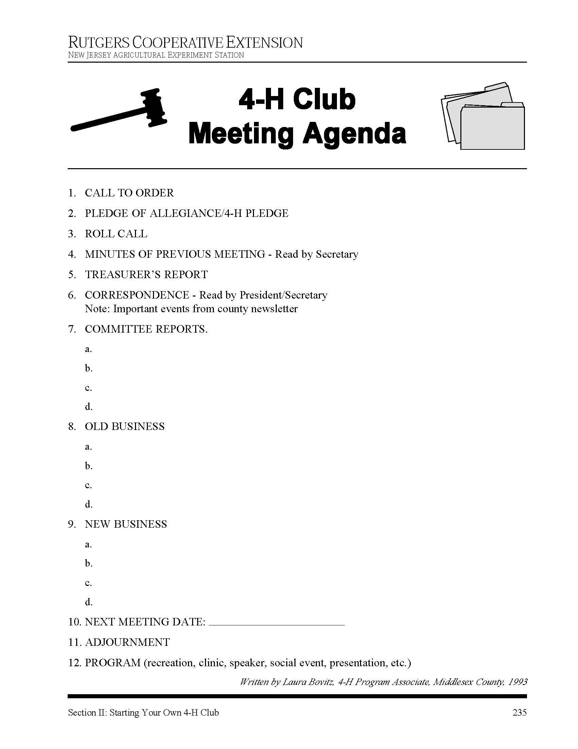
Organization is key:
Have an agenda.
Share the agenda.
Explain the agenda.

Slide 19
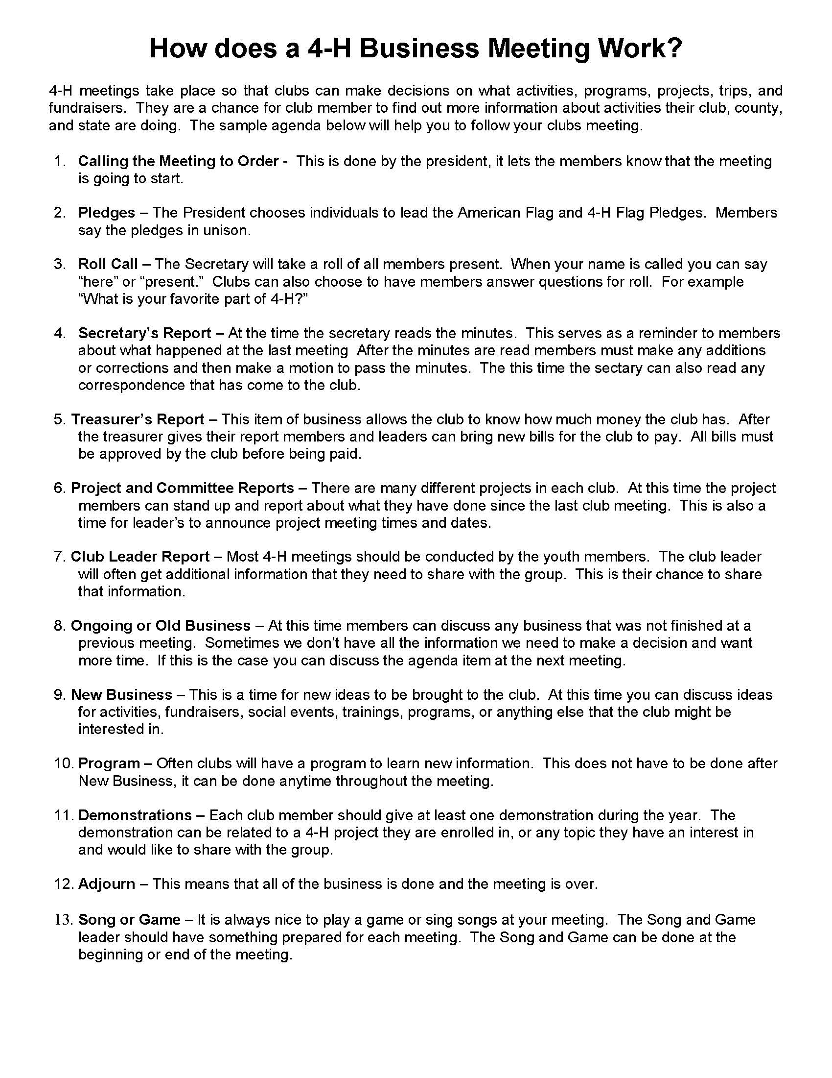

Slide 20
Parli Pro Education:
Parts of a meeting cards.
Voting cards.
Motion Potion
Parli Pro cards for members.

Slide 22
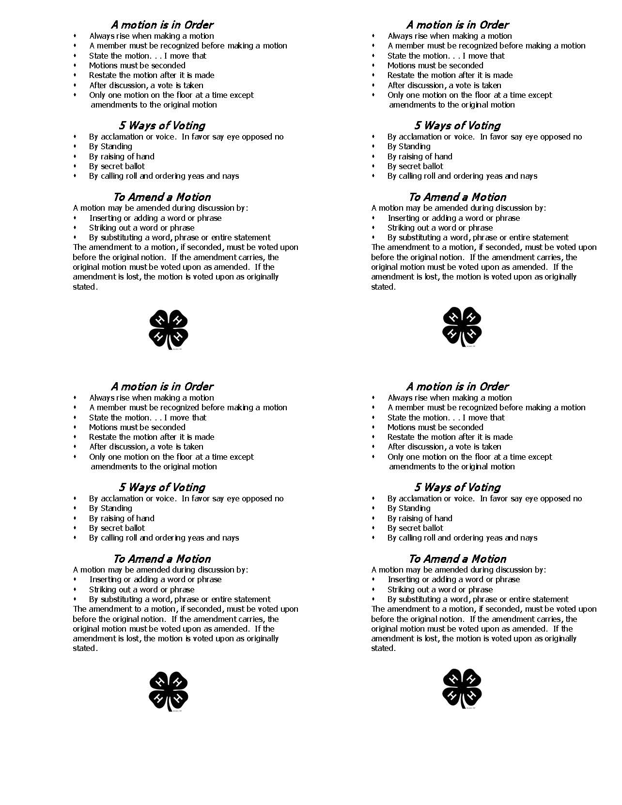
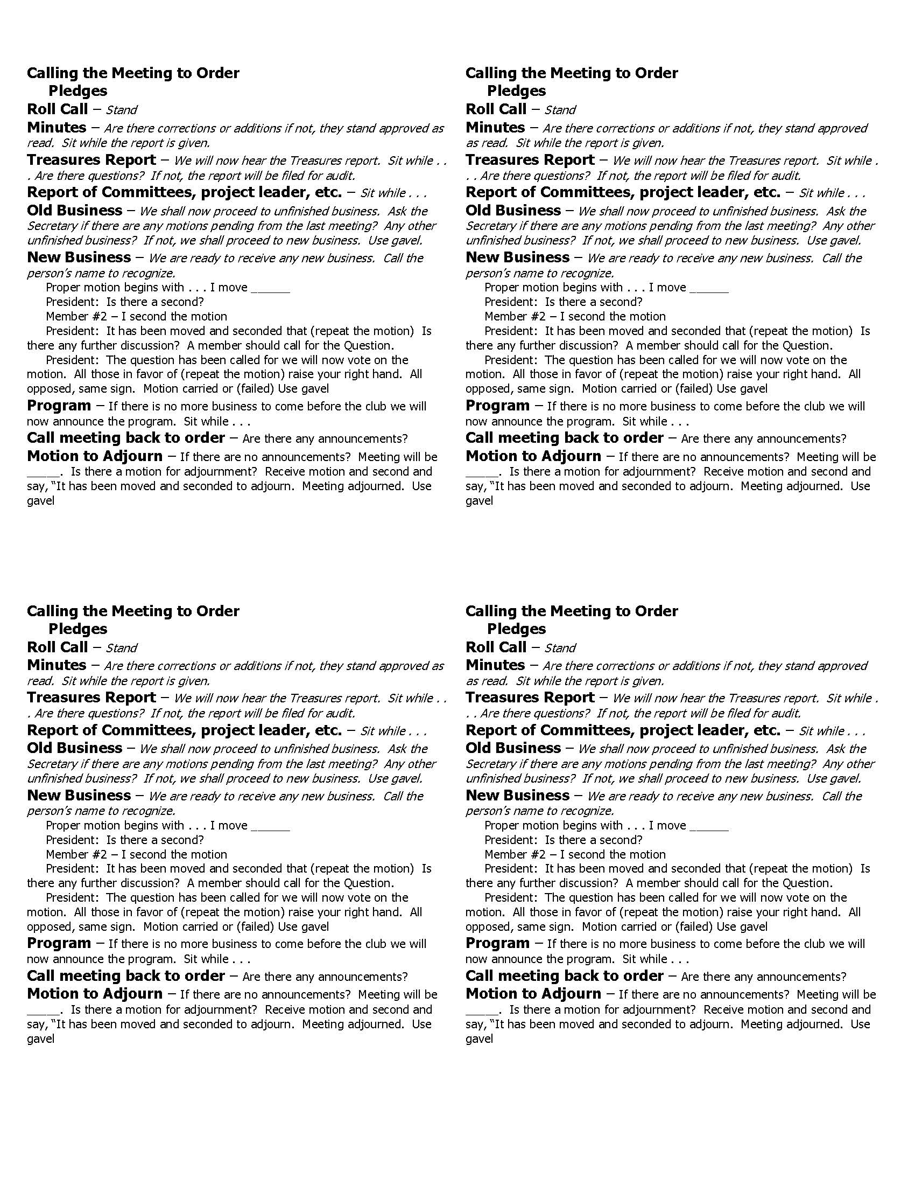

Slide 24
Things to remember:
Use a method of decision making that works for your club, don’t force Robert’s Rules of order!
If your stuck on using official Parli Pro use a revised version that works for your club members.
Provide education to members to help them know what they are doing and why, no matter what method you use.
Being able to make a motion and run a business meeting is not a goal of the 4-H program, youth engaged and learning is.
Figure out what you can do to make meetings organization but fun and engaging.

Slide 25
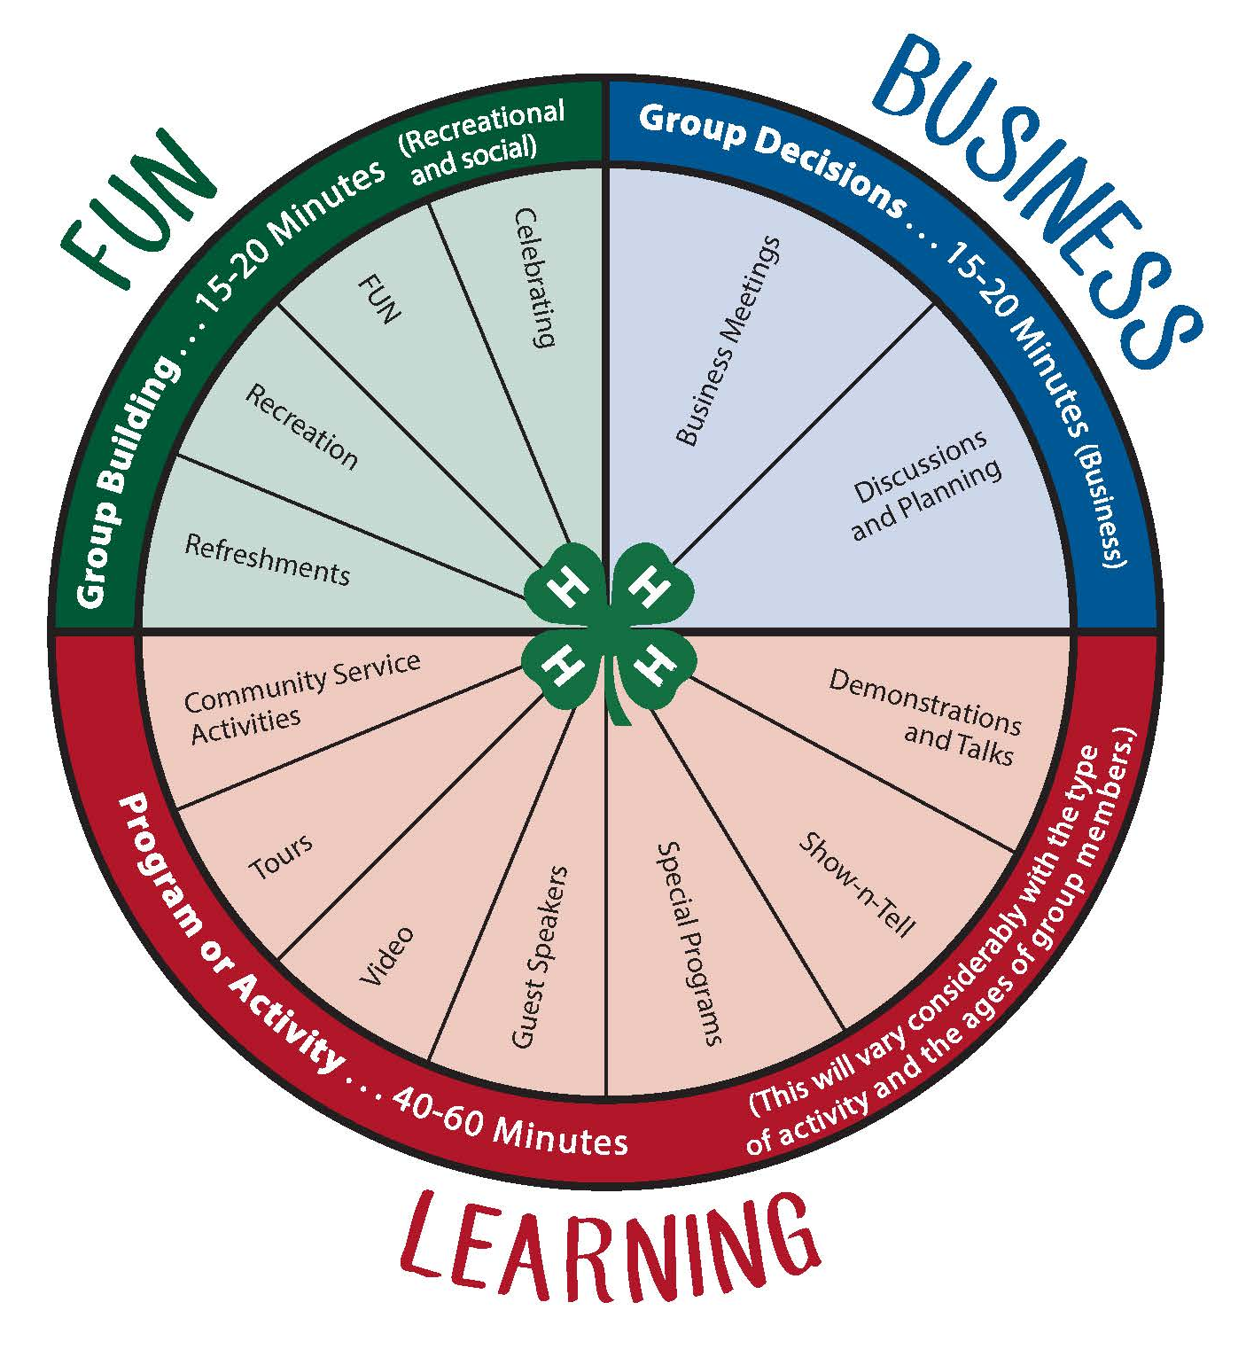

Slide 26
Questions? Comments?
If you need more information about this topic or other Volunteer related topics please contact me at storbert@uwyo.edu

