Slide 1
SO many Oppportunities

Slide 2
Levels of 4-H participation
Club
County
Region
State
National

Slide 3
How do I find out more?
Club
Attend club meetings.
Communicate with club leader.
Social Media
Find a mentor parent or teen.

Slide 4
How do I find out more?
County / Regional
Read your newsletter
Social Media
E-mails from County Educator
Call your Extension Office
ASK QUESTIONS

Slide 5
What does the state offer?
Read Your Newsletter
Social Media
Call your County Educator
State 4-H Website
Read your 4-H online e-mails

Slide 6
Wool and meat Judging April 27 - 28

Slide 7
Wool and Meat Judging
Individual Contest – County Teams are designated
Wool is on Friday night
Meat is on Saturday
Awards are on Saturday
OPEN TO ANYONE, do not need to be enrolled in a certain project to participate
Participate to see what it is about, even if you are not proficient
No county qualification needed
WOOL JUDGING - http://www.uwyo.edu/4-h/get-involved/contests/wooljudging/index.html
MEAT JUDGING - http://www.uwyo.edu/4-h/get-involved/contests/meatjudging/index.html
Top Wool team gets $1000 to do to Sonora, Texas Contest
Top two Meats teams get money to compete at National Contests representing Wyoming

Slide 8
Showcase Showdown offers an opportunity for youth to explore various industries through contests and workshops. The event takes place at the University of Wyoming in Laramie, Wyoming. Youth can participate in contests, workshops, tours and activities over the course of three days. There are also two award ceremonies that recognize youth for their efforts.
http://www.uwyo.edu/4-h/showcaseshowdown/index.html
Showcase Showdown June
26-28

Slide 9
Showcase Showdown June
26-28
Food Cook Off

Slide 10
Food Cook-Off
Team Contest – 2 to 5 youth per age group
Wednesday or Thursday competition
Teams must plan and entree using certain ingredients around a theme
Cooking happens on location
Top Senior team can compete at Food Challenge in Dallas, Texas
4-H Foundation provides $1000 scholarship to help cover costs

Slide 11
Showcase Showdown June
26-28
Produce Judging

Slide 12
Produce Judging
Individual Contest
Counties can designate teams
Tuesday competition
Evaluation of 8 classes of produce (fruits and vegetables)
Younger members are asked questions about the classes
Older members give reasons about classes
Youth identify different types of produce
Top two Seniors get $500 trip scholarships

Slide 13
Showcase Showdown June
26-28
Robotics Contest

Slide 14
Robotics Contest
Individual Contest (can be teams but teams are treated as individual entries)
Wednesday morning competition
Three challenges
Construction
Robots are constructed and pre-programmed to perform a certain task.
Mini-Sumo
Robots are designed to force another robot out of a circle.
Mission Challenge
Robots are given a series of challenges and programmed on site to complete these challenges

Slide 15
Showcase Showdown June
26-28
Cake Decorating

Slide 16
Cake decorating
Individual or Team Contest
Tuesday afternoon competition
Decorate foam cakes around a theme that is announced at competition
Foam cakes and frosting (white) provided
One hour to complete creation
Junior and Intermediate individuals get help frosting cakes
Coaches can help during 5 minutes of design phase

Slide 17
Showcase Showdown
Livestock Skillathon
Horse Judging
Hippology
Dog Skillathon
Table Setting
Presentations

Slide 18
Livestock Skill-a-thon
Team only contest – teams of youth work together
Teams of 3 to 5 members
Tuesday afternoon contest
Contest sections
Breed ID: cattle, sheep, swine, and goats
Quality Assurance
Feed Identification
Animal Evaluation (placing classes of animals)
Equipment Identification
Group Process – teams are given a problem that they have to solve, questions are posted one week prior to contest
Seniors will also have Technology, Wool, and Meat Science
Top Team gets $1000 to go to National Contest

Slide 19
Horse judging
Individual Contest – Counties can identify teams
Wednesday afternoon contest
Youth evaluate halter classes and performance classes
Junior answer questions and can give reasons
Intermediates answer questions and give reasons
Seniors give reasons
Top 3 Senior teams get money to travel to National Competitions representing Wyoming

Slide 20
HIppology
Team Contest only
Teams consist of 2 to 5 people
Wednesday morning contest
Phase 1 – evaluate a class
Phase 2 - stations (27 options)
Types / Parts of saddles
Bridles
Grooming
Breeds
Phase 3 – exam
Top team will get $1000 to compete at Western National Roundup

Slide 21
Dog Skill-a-thon
Team and Individual Contest
Thursday morning contest
Four Part Contest
Jeopardy 25 questions
Breed Identification
Part Identification, internal organs, skeletal structure
Hands on stations and scenarios

Slide 22
Table Setting
Individual Contest
Thursday morning contest
Properly set a table for one guest at a meal or event
No food, but menus are needed

Slide 23
presentation
Individual Contest (can have teams but they will be treated as individuals)
Wednesday Contest
Impromptu
Draw three topics, pick one
3 minutes to organize thoughts
Notecards allowed
Prepared
Any topic
Can use powerpoint or other props if you want
Top two Seniors in each contest above will get $500 leadership trip scholarships

Slide 24
Showcase Showdown Wednesday morning
Fishing Trip

Slide 25
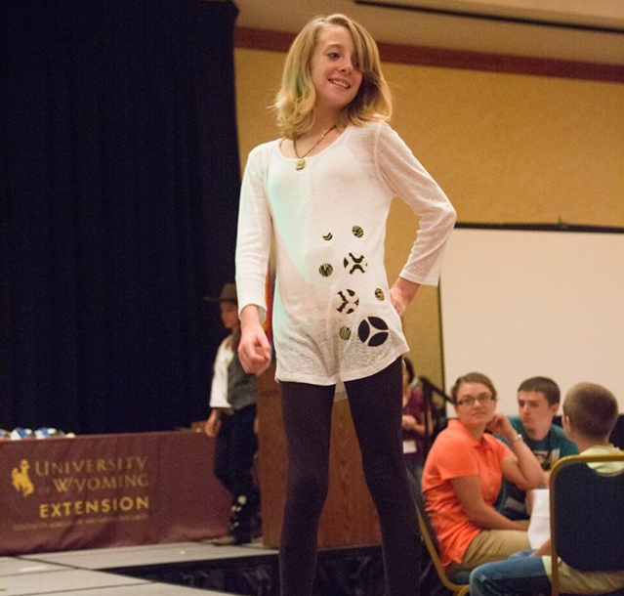
Showcase Showdown Wednesday
Project Runway

Slide 26
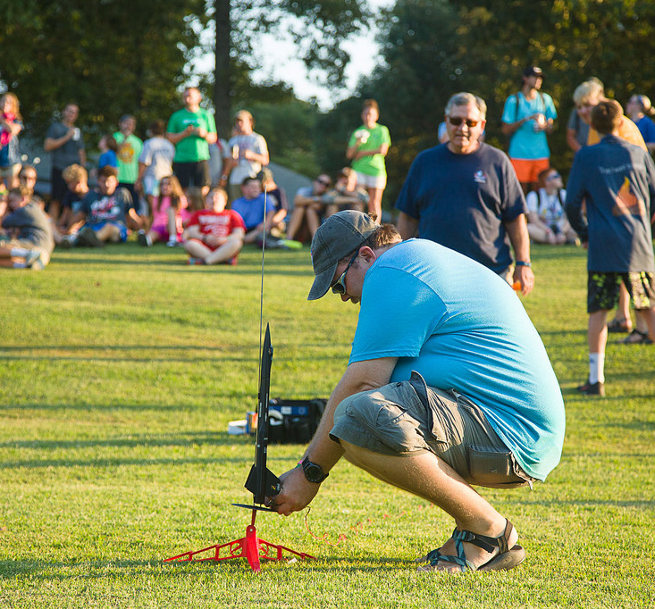
Showcase Showdown Thursday morning
Rocket Workshop
And Launch

Slide 27
Horse camp June

Slide 28
Horse Camp
Designed for youth in horse project
Camp for Horse and Rider
Held at State Fairgrounds in Douglas
Starts with skills assessment youth are put into similar skill groups
Topics covered include
Showmanship
Horse Care and Health
Leads
Performance Classes
Bits and Equipment
http://www.uwyo.edu/4-h/get-involved/horsecamp/index.html

Slide 29
State Shoot JuLY
5-8

Slide 30
State shoot
Contest for Individuals with Counties designating teams
Must be in 4-H shooting sports and be deemed safe per your county requirements
Held in Douglas, Wyoming
Competition in all shooting disciplines
Camping and Dorms available
Dance on Saturday night
Awards on Sunday
12 Senior youth are selected to attend Raton Award Trip
http://www.uwyo.edu/4-h/get-involved/contests/stateshoot/index.html

Slide 31
Raton,
New Mexico
Shooting Sports Trip SEPTEMBER

Slide 32
Raton, New Mexico
12 youth selected through shootings performance at State Shoot
2 youth selected from portfolio submissions
Open to Senior aged youth (14-18)
Held at NRA Whittington Center
Youth shoot a wide array of firearms
http://www.uwyo.edu/4-h/projects/shootingsports/raton.html

Slide 33
State Fair August
Livestock Judging

Slide 34
Livestock Judging
Contest for Individuals with Counties designating teams
Held Wednesday of the Wyoming State Fair in Douglas, Wyoming.
Youth evaluate classes of beef, sheep swine, and market goats.
Juniors answer questions and can give reasons
Intermediates answer questions and give reasons
Seniors give reasons.
The top three senior teams get monetary awards to represented Wyoming at National events.
http://www.uwyo.edu/4-h/get-involved/contests/livestockjudging/index.html

Slide 35
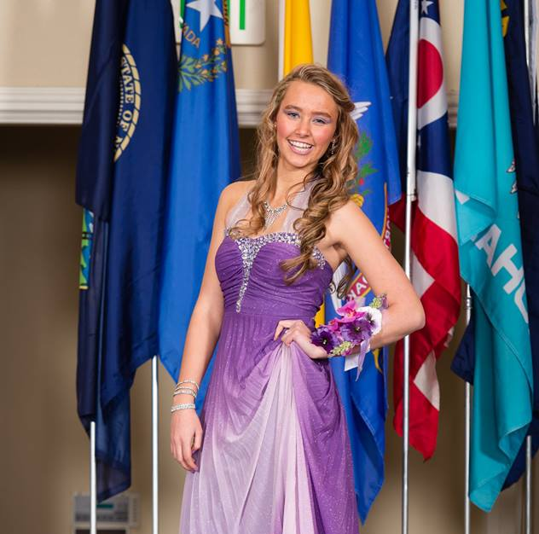
State Fair August
Fashion Revue

Slide 36
Fashion Revue
Contest for Individuals
Two contest
Ready to Wear
Constructed
Judging is Friday and Saturday of the Wyoming State Fair
Public Fashion Show on Saturday evening
Top two seniors in each category above win $500 trip scholarships.
http://www.uwyo.edu/4-h/get-involved/contests/fashionrevue/index.html

Slide 37
Other State Fair Opportunities
Animal Shows
Anyone can enter, there is no qualification for State Fair
Certain animals have showing restrictions
Animal Identification / Tagging requirements
Dog Safety requirements
Static Exhibits
Qualify through exhibition at County Fair.
http://www.uwyo.edu/4-h/statefair/index.html

Slide 38
First Time Deer Hunt NOVEMBER

Slide 39
First Time Deer Hunt
Open to youth ages 14-18
Preference given to:
First time hunters
4-H shootings sports members
Northeastern Wyoming at the Solitude Ranch (near Devil’s Tower)
Whitetail deer with 98% success rate
http://www.uwyo.edu/4-h/get-involved/travel/deer-hunt/index.html

Slide 40
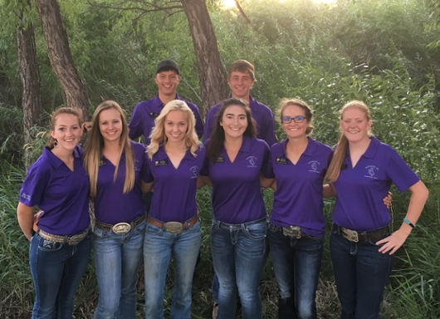
State
Leadership Team

Slide 41
State Leadership team
Open to youth ages 14-18
Seven youth chosen
Serve as the “face” of the Wyoming 4-H program.
http://www.uwyo.edu/4-h/get-involved/leadershipteam/index.html

Slide 42
Citizenship Washington Focus
(CWF) JUNE
16-23

Slide 43
Citizenship Washington Focus
For youth ages 14 -18
Stay at National 4-H Center
Meet youth from other states
Learn about leadership
Tour Washington, D.C.
APPLICATIONS DUE MARCH 2nd
http://www.uwyo.edu/4-h/get-involved/travel/cwf/index.html

Slide 44
Leadership Washington Focus
(LWF) JULY

Slide 45
Leadership Washington Focus
For youth in 6th – 8th grade
Stay at National 4-H Center
Meet youth from other states
Introduction to leadership and citizenship
Tour Washington, D.C. including Air and Space Museum in Virginia
APPLICATIONS DUE MARCH 2nd
http://www.uwyo.edu/4-h/get-involved/travel/lwf/index.html

Slide 46
National
4-H Conference APRIL

Slide 47
National 4-H Conference
For youth ages 14-18
Focus on policy development and government process
Youth research issue and develop policy presentations for government officials
http://www.uwyo.edu/4-h/get-involved/travel/national4hconference/index.html

Slide 48
National
4-H congress November

Slide 49
National 4-H Congress
For youth ages 14 - 18
Focus on diversity and community service
Held in Atlanta, Georgia
Famous guest speakers
Try new foods and participate in unique experiences
http://www.uwyo.edu/4-h/get-involved/travel/national4hcongress/index.html

Slide 50
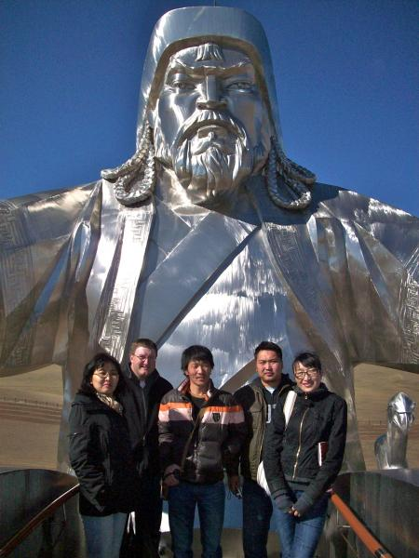
International opportunities

Slide 51
International
For youth ages 14 – 18
Different countries each year
Ghana
Mongolia
Samoa
Finland
Learn something new and share your traditions with others
http://www.uwyo.edu/4-h/international/index.html

Slide 52
Western national Roundup
New this year – Open to any youth age 14-18
Includes team and individual competitions – need to qualify to compete
Leaders seminars, banquets, and dance
Attend stock show
State’s night out
http://www.uwyo.edu/4-h/get-involved/roundup/index.html

Slide 53
What Else?
College scholarships
http://www.wyoming4h.org/4hfoundation/scholarships/
Internships for college students at local Extension Office
https://wyoming4h.formstack.com/forms/internapp
Foundation Shooting Fundraisers
http://www.wyoming4h.org/4hfoundation/fundraisers/
Boulder Big Draw (Archery near Pinedale)
Platte River Shootout (Shotgun near Saratoga)
Apache Clear Creek Shootout (Shotgun near Ucross)

Slide 54
Your Role?
Make youth aware of opportunities
Encourage them to attend
Help with raising funds – don’t let money stand in their way
Coach a team
Serve as a chaperone
Invite youth to share their experience at a meeting (club or county)

