Slide 1
WORKSHOP FOR DEPARTMENT HEADS 2015 – Day 3

Slide 2
Questions from the first session
Is the EEO text statement that is included in search ads mandatory or can it be edited?
When an endowed chair is vacant, shouldn’t filling the chair be automatically approved?
What happens and what can you do if a Dean overrules your adjustment of job description and teaching loads?

Slide 3
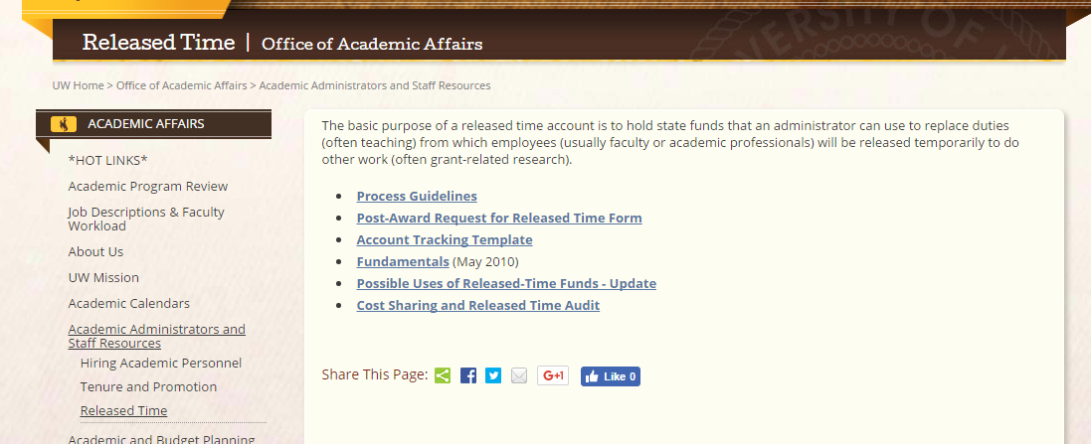
Questions from the first session
What are the rules governing the buying out released time from grants, etc.?

Slide 4
Example 1: a full time academic year employee is to be released from one three-credit course, and the teaching must be replaced. Since a 100 percent teaching responsibility is 24 credits per academic year, the amount of section 1 salary to be released is:
(3/24) × (AY salary),
.
Example 2: the same employee is to be released from one four-credit course, and the teaching must be replaced. The amount of salary to be released is:
(4/24) × (AY salary).
Example 3: a full-time academic year employee whose job description includes 10 percent in service duties is to be released from all service duties for half of the academic year, and the duties must be replaced. The amount of salary to be released is:
0.1 × ½ × (AY salary).
Please note- The amount to be released from Section 1 must be in the grant budget as regular salary.)

Slide 5
Reappointment, Tenure and Promotion
American Association of University Professors (AAUP) Recommended Institutional Regulations on Academic Freedom and Tenure (http://www.aaup.org/report/recommended-institutional-regulations-academic-freedom-and-tenure)
University Regulations (http://www.uwyo.edu/generalcounsel/new-regulatory-structure/index.html) UW 5-1 Academic Personnel UW 5-803 Reappointment, Tenure and Promotion Procedures for Academic Personnel UW 5-408 Guidelines for Establishing Academic Professionals UW 7-631 Regulations of the University Libraries UW 7-490 Regulations of the American Heritage Center
UW Pythian Papers on Academic Careers (http://www.uwyo.edu/acadaffairs/faculty-resources/tenure_promotion.html) Best Practices for Making Tenure Decisions: Philosophy, Criteria, and Expectations Best Practices for Promotion to Full Professor Considering Collegiality and Service as Components of Academic Performance
UW College and Department Expectations for Reappointment, Tenure and Promotion

Slide 6
Tenure Track Faculty Career Path⁺
Annual probationary
reappointment or
nonrenewal
Ongoing excellence and impact through research, teaching and service
6
Additional Period of Growth
0
Tenure and promotion to Associate Professor, or termination
Promotion to Professor (optional)
Hired as Assistant Professor
⁺ Similar Career Path for Academic Professionals on Extended Term Track (6-year probationary period, 6-year extended terms with review for next term in year 5, promotion in rank tied to productivity and not years of service)

Slide 7
The key question:
Does the candidate’s record reflect both the commitment and the promise to sustain a career-long record of effective teaching, scholarship at the forefronts of knowledge, and effective service?
It’s not a matter of clearing the bar.
Tenure is not the finish line.

Slide 8
Review Processes
External peer review
Department
Department faculty review
Department head’s recommendation
College-level faculty review
College
College Dean’s recommendation
University-level faculty review
University
Review by Academic Affairs
Review by President (on appeal)
Trustees’ action

Slide 9
Department-level review
Your role in preparation for the review
Early in academic year, meet with candidate to discuss
Performance goals
What you will look for and how you will evaluate performance
Strategies for helping candidate continually improve performance (e.g., formative assessment – ongoing teaching evaluation, periodic self-assessment, etc.)
What can I do to help you be successful?
How often would you like to receive feedback?
How frequently would you like to meet with me so that you feel supported but not micromanaged?
Develop your own plan for record keeping and systematic evaluation!
http://www.uwyo.edu/acadaffairs/faculty-resources/tenure_promotion.html

Slide 10
Department-level review
First Year Reviews
How can you make first year reviews relevant and meaningful?
Review of Teaching
Does your department have a formalized peer review process?
Is it ongoing?
Early and often, if the intent is to improve teaching and not just make a judgement about it.
http://www.uwyo.edu/acadaffairs/faculty-resources/tenure_promotion.html

Slide 11
Department-level review
Your role in preparation for the review
Check your department protocols to form peer group
Protocols established by majority vote of all tenured and tenure track members
Case-by-case basis for additional group members with written approval by candidate
If APs allowed, non-tenured tenure track faculty must be allowed.
Insure written statement regarding permission to vote is included in candidate’s packet.
Check your department expectations document for making reappointment, tenure and promotion decisions.
Ensure that job description is up-to-date, accurate and sufficiently detailed.
Do expectations align with new job descriptions/workload?
Job descriptions – outline duties/load
Expectations – describe how well duties should be completed
http://www.uwyo.edu/acadaffairs/faculty-resources/tenure_promotion.html

Slide 12
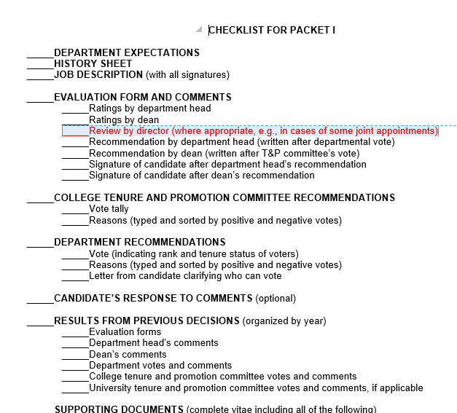
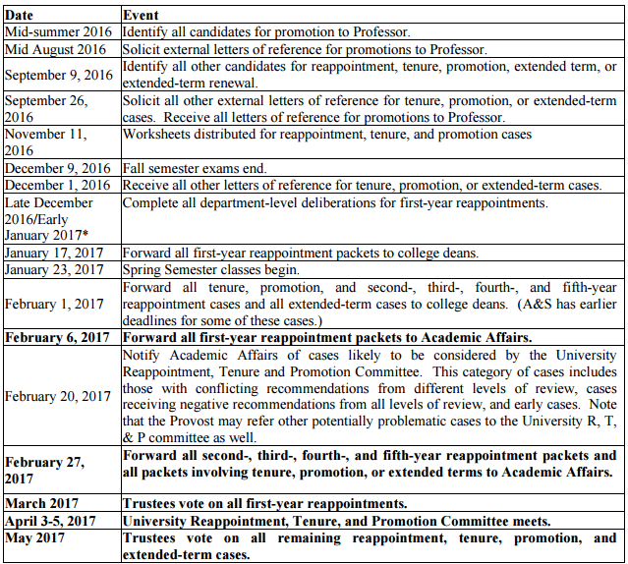
Department-level review
Your role in preparation for the review
5. The department head, in full consultation with the candidate, will assemble materials for the candidate’s folder by the required deadline.
E-packets for Yr 1
April 3-5
http://www.uwyo.edu/acadaffairs/faculty-resources/tenure_promotion.html

Slide 13
Department-level review
Your role in preparation for the review
6. Solicitation of external reviewers for evaluation of research and/or creative contributions
You
Provide list of at least 6 possible reviewers; May delete up to 3 from candidate’s list
Contact/confirm reviewers
Prepare cover letter and send packet to reviewers
Specify if candidate has waived right to see letter; state degree of confidentiality of their response
Avoid asking for statement regarding tenure decision at their institution
Prepare summary statement describing process for solicitation of reviewer letters.
Candidate
Provide list of at least 6 possible reviewers; May delete up to 3 from your list
Prepares packet for reviewer
Vita, representative examples of work
Additional documents
Insert written statement in packet if waived write to see letters.
http://www.uwyo.edu/acadaffairs/faculty-resources/tenure_promotion.html

Slide 14
Tenure Review
UW Regulation 5-803 requires a minimum of 4 external letters from “arm’s-length” experts.
“[The] scholarship is bold in treating major authors and issues, careful in its close reading of primary texts and its consideration of secondary literature, and scrupulous in its honesty and clarity. I have found his work of genuine value for my own teaching and writing.” [From Duke University]

Slide 15
External Letters – When right to see them is waived by candidates
Candidates retain the right to see the texts of these letters that have been edited in such a way as to preclude identification of their respective authors.
When can they see the excerpts?
How do you handle original letters for the review in your department?

Slide 16
Department-level review
Your role in preparation for the review
Call a formal meeting of the appropriate faculty group.
Identify a faculty member to chair the meeting (per department protocol)
Ensure the process for collating recommendations provides confidentiality for voters.
http://www.uwyo.edu/acadaffairs/faculty-resources/tenure_promotion.html

Slide 17
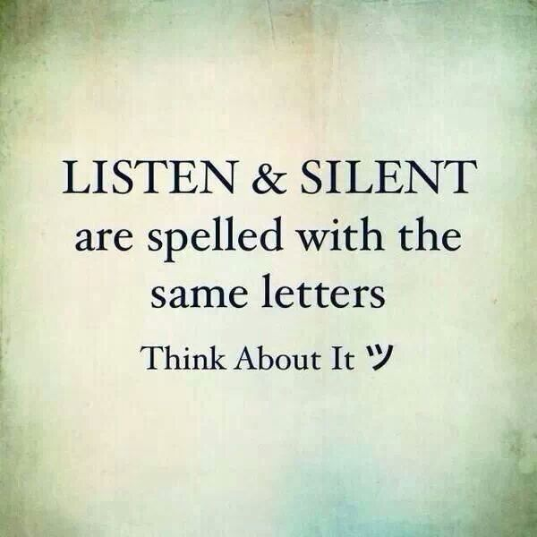
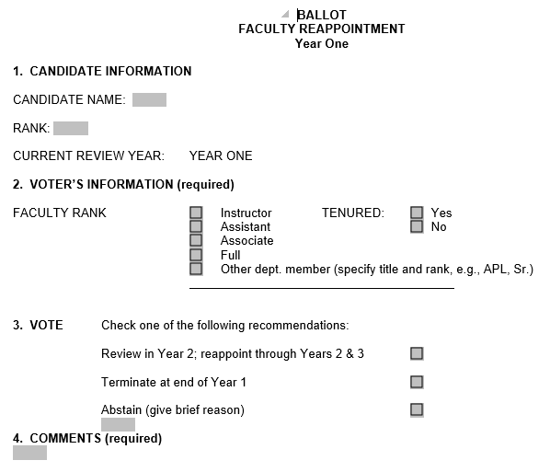
Department-level review
Your role in the department meeting
Faculty role after department meeting
Each faculty member will cast a written ballot containing reason(s) for the vote within 72 hours of the end of the meeting (excluding weekends and holidays)

Slide 18
Department-level review
Your role in following the department meeting
Synthesize department results (as per department protocol)
The total vote of each faculty group (i.e., tenured faculty vote, non-tenured faculty vote, faculty with same or higher rank for which a candidate is nominated, and faculty with lower rank for which the candidate is nominated) along with comments, will be recorded on the appropriate forms. The department head shall not vote.
Complete your evaluation/recommendation
http://www.uwyo.edu/acadaffairs/faculty-resources/tenure_promotion.html

Slide 19
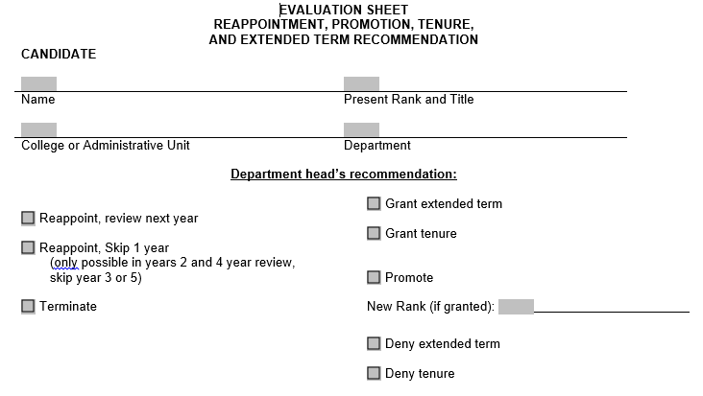
Department-level review
Review the folder and make written recommendation, which shall immediately be communicated to the candidate.
http://www.uwyo.edu/acadaffairs/faculty-resources/tenure_promotion.html

Slide 20
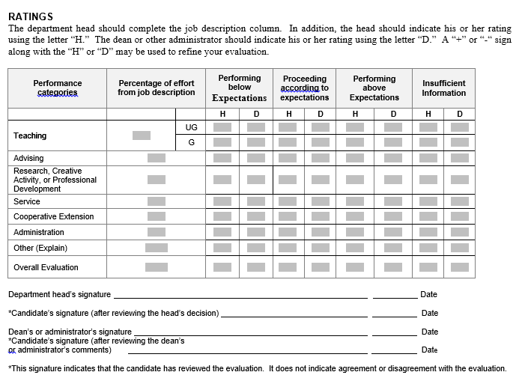
Department-level review
http://www.uwyo.edu/acadaffairs/faculty-resources/tenure_promotion.html

Slide 21
Department-level review
Writing your evaluation
Summarize department vote/rationale
Present information objectively
Connect your comments to job description and department/discipline expectations
Avoid horns and halo effect (i.e., don’t let recent events color your judgement)
Describe your efforts to address any weaknesses in performance.
Meeting with Candidate
Provide written evaluation in advance of meeting
Consider the spirit of the meeting in your approach
Ask candidate to initial all pages of your written commentary and sign evaluation form.

Slide 22
The Job Description
Tenure Track Faculty Job Duties
Teaching⁺ (Preparation, direct/indirect instruction, direct UG/G learning & research, supervising clinical internships & programs, evaluating artistic presentations, etc.)
Advising (Time spent meeting with students regarding academic, curricular & career matters)
Research and Creative Activity⁺⁺ (Creating/adding to knowledge in a field, including the advancement of new theories & principles; Expansion & interpretation of existing ideas, theories, & principles; Improvement & application of knowledge, especially in new settings; Sustained artistic endeavor in composition, production or performance)
Service (Serving on Faculty Senate and university, college & departmental committees; using academic & professional expertise to serve the profession, community, state, nation and world)
Cooperative Extension (Identifying current needs, communicating research results, and applying expertise to support Extension Educators; providing leadership, research-based information & education to people of the state; developing interdisciplinary approaches and collaborations, etc.)
Administration (Major service assignments within a department or college, such as acting as a department/division/school head or associate dean)
Sample Job Descriptions % of Effort
65% | 6%
5% | 4%
25% | 25%
5% | 5%
NA | 60%
NA | NA
⁺ Teaching is a fundamental responsibility of all faculty member. Adjustments to teaching responsibilities are made based on college’s workload policy regarding type of courses taught and extent of responsibilities in other areas.
⁺⁺ Open dissemination and professional peer review are essential features of research productivity and creative activity.

Slide 23
Interdisciplinarity
A vehicle for expanding research communities at UW
A strong current motif in many disciplines
A key competitive advantage for a small university
A natural mode of inquiry at land-grant institutions
A way to influence hiring outside the department.

Slide 24
Your department has a fourth-year faculty member who’s toxic in department meetings and who has a habit of showing up to class unprepared. She seems perennially at odds with her students, who tend to do poorly in her courses. Whenever anyone discusses these issues with her, she mentions her attorney.
The majority of the department faculty members vote against her reappointment case. One of their comments dwells on the fact that she’s a woman in a field where men have traditionally been more successful. After reading their remarks, she tells you she’ll sue you for discrimination if you recommend against reappointment.
What should you do?

Slide 25
Your department has a fourth-year faculty member who’s a highly charismatic teacher. His scholarly record is thin -- barely acceptable by department standards. His CV lists 15 works in progress. While it’s hard to document, you have serious concerns about his honesty:
You think he stretches the truth in reporting his own research accomplishments;
His colleagues report that his teaching, while immensely popular with students, is filled with basic errors;
In his 3.5 years at UW, he has launched three grievances against you and your associate department head. Hearing committees have dismissed all of them.
He routinely recruits graduate students to take sides in his disputes with senior faculty members.
What’s your recommendation for reappointment?

Slide 26
6. Personnel problems
Collegiality: The willingness to work with colleagues in a civil, productive fashion that advances the mission of the department and university.
Collegiality matters in the community of scholars. The academic enterprise depends upon trust and the robust exchange of ideas.
Gunsalus, 2006, p. 52
Failure to contribute to the university’s mission – and interference with it – are grounds for poor performance appraisals, including reappointment denials.
Document … Discuss … Document … Intervene …

Slide 27
Faculty grievances, discrimination, harassment,
student complaints
Best defenses:
Get sexual harassment training. (It’s mandatory.)
When a problem arises, consult the dean or EPO.
Treat people honestly, fairly, and respectfully. When you make decisions they don’t like, explain your reasons.
Know the Department, College, and UW Regulations!
Base decisions on your academic judgment, not on legalistic grounds. UW has an indemnity clause that protects your good-faith academic judgments.
When in doubt, do what’s right.

Slide 28
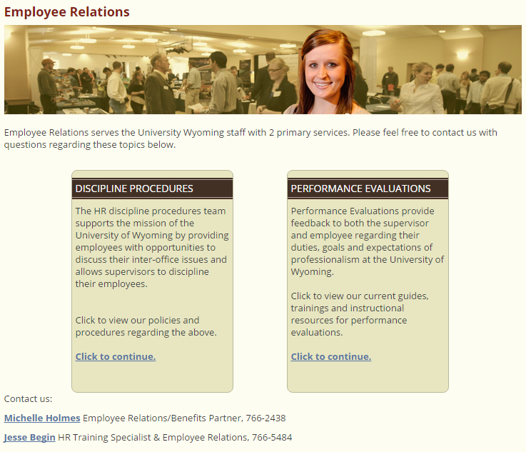
Office of Diversity & Employment Practices (EEO)
Human Resources – Staff Issues
Complaints (Protected Classes)
Sexual Harassment
Civil Rights
Violence & Threats of Physical Violence in the Workplace
ADA/Disabilities
Trainings
PD 4-2016-1 Investigative Process for Complaints of Harassment, Hostile Environment, and Retaliation (non-Protected Class)
Faculty Dispute (UW 5-35)*
Informal resolution
Consultation with Faculty Conciliator
Formal resolution
* Excludes civil rights complaints, complaints against President, matters subject to 5-801 (i.e., cause for dismissal). Complaints related to reappointment, evaluation, promotion, or granting tenure restricted to process issues (UW 5-803).
Rule of Thumb -- Follow your reporting structure: Deans Academic Affairs

Slide 29
Personal problems
People (including department heads) are fragile and fallible. Family difficulties, messy relationships, substance abuse, medical problems, and ethical lapses are as common in academia as elsewhere.
Be sensitive; maintain confidentiality; protect the legitimate interests of others (including the institution); try to approach problem constructively instead of punitively. Remind us to do the same.
Get advice and help. You can’t handle everything yourself.

Slide 30
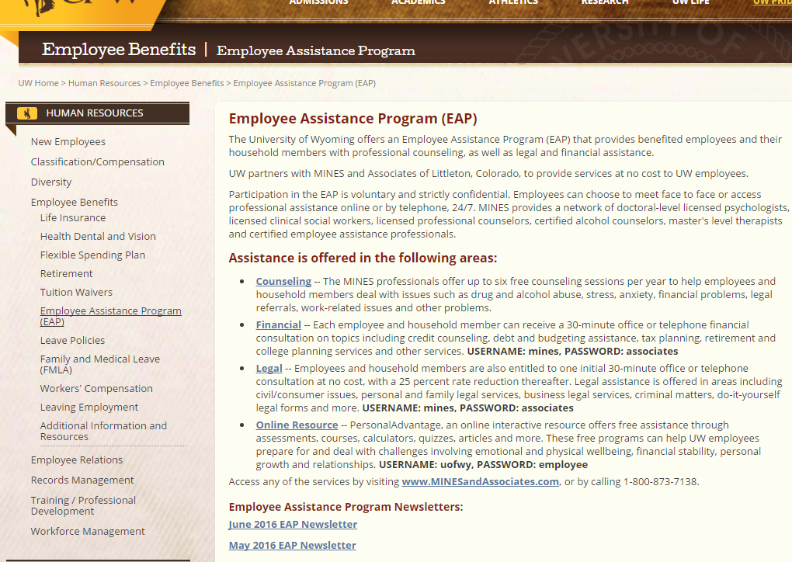
http://www.uwyo.edu/hr/employee-benefits/employee-assistance-program/index.html

Slide 31
Would you like another session on…
Conducting performance evaluation
Hiring (Online process, procedures, job descriptions, offer letters)
EEO (Procedures for investigations on protected and non-protected classes, conducting searches)
Facilitating program assessment
Managing and resolving conflict (and dealing with bullies)
Other?

Slide 32
Questions?

