Slide 1
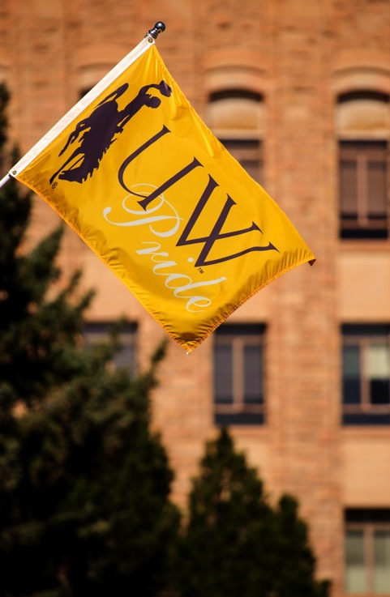

UWYO Honors:
Moving Forward

Slide 2
Recruitment
Of the 18 schools, listed by the College Board as our major competitors for high achieving students, 11 have Honors Colleges
  As universities seek to attract high-achieving students, the move to an Honors College has become a national trend.

Slide 3
Enriched Undergraduate
Experience
The Honors College would infuse and formalize High Impact Practices (HIP) throughout the Honors experience.
  HIP, as defined by the Association of American Colleges and University (AAC&U), are teaching and learning practices “widely tested and... shown to be beneficial for college students from many backgrounds, especially historically underserved students, who often do not have equitable access to high-impact learning.”
    AAC&U

Slide 4
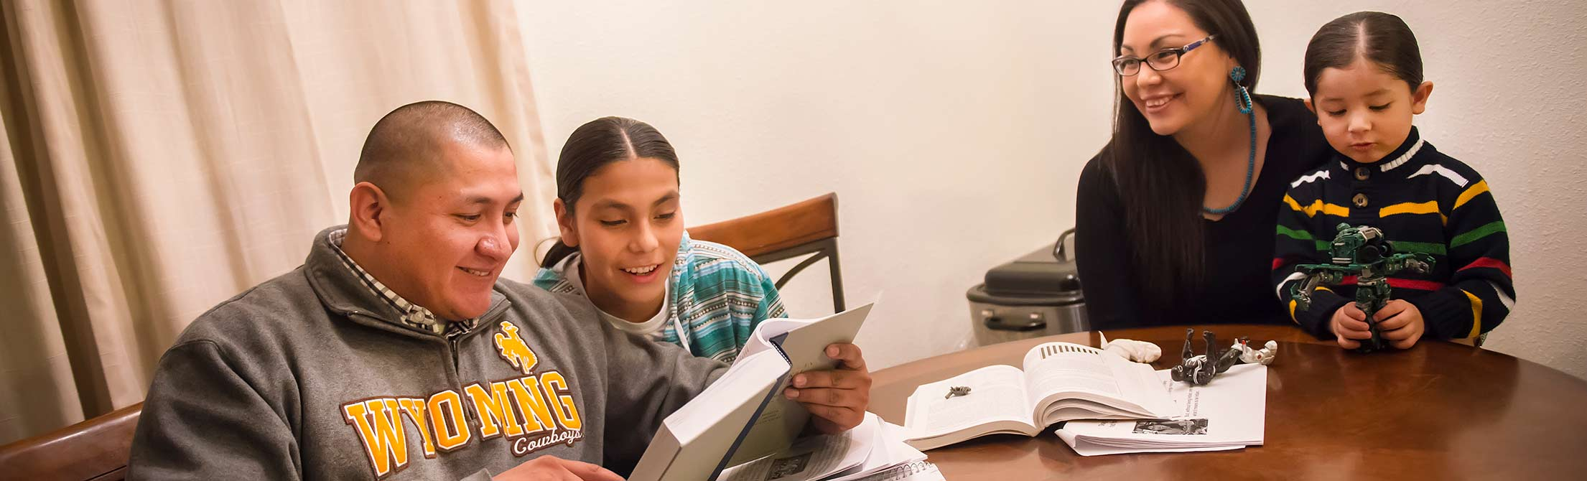
HIP Defined
First-Year Experiences
Common Intellectual Experiences
Learning Communities
Writing-Intensive Courses
Collaborative Assignments and Projects
Undergraduate Research
Diversity/Global Learning
Service Learning, Community-Based Learning
Internships
Capstone Courses and Projects

Slide 5
Markers of HIPs Done Well
Expectations set at appropriately high levels
Significant investment of time and effort
Interactions with faculty and peers
Experiences with diversity
Frequent and constructive feedback
Periodic and structured opportunities for reflection
Relevance through real-world applications
Public demonstration of competence
  (Kuh, 2008; Kuh & O’Donnell, 2013)

Slide 6
Characteristics of HIPs that make them effective with students
Practices Increase Odds That Students Will:
Invest time and effort
Interact with faculty and peers about substantive matters
Experience diversity
Get more frequent feedback
Discover relevance of their learning through real‐world applications
Experience a context of coherent, academically challenging curriculum
High Impact Practices: Promoting Engagement and Student & Academic Affairs Collaboration, ACPA Annual Conference, March 27, 2011 Jillian Kinzie, Associate Director NSSE Institute for Effective Educational Practice

Slide 7
Positioning Students for
Academic Success
The HC Dean will invite colleges and departments to identify – if appropriate to departmental circumstances - an Honors track in discipline with upper division courses – which can be existing courses – to fill out the track. Honors in field will:
  Allow students to document their discipline-specific Honors education
  Provide support for students working on their capstone research projects.
  Prepare students for professional and graduate school success.

Slide 8
Positioning Students for
Professional Success
Provide structured HIP– an Experiential Learning Portfolio (Passport)
  As employers look for evidence of students’ experiences beyond the classroom, many university are implementing “passports” or ”engagement” credentials showing they’ve been engaged in HIP.
  Of our competitors, only Boise State has a defined program, although a few others, such as the University of Washington, require a service or experiential learning component.

Slide 9
Timeline
Multiphase staged approach.
August 2017: Near term
  Hire Honors Dean and one supporting staff (added to current Program Coordinator in HP).
Fall 2017-Spring 2018: Startup Phase
  Honors Dean strategically evaluates all previous studies, current landscape, and develops their collaborative vision for curriculum and programming
Fall 2018 – Spring 2020: Incubation Phase
  Advising and instructional staffing, fundraising, and curriculum development
Fall 2020 forward: Established Phase
  Honors College is fully established; departments and colleges have developed curriculum with Honors Dean’s assistance; HIP portfolio fully deployed

Slide 10
Recommended Phase-In
Startup phase: By August 2017
Convert Honors Program Director position to Honors College Dean position. Fill position.
  (Current Honors Program Director is interim and going back to faculty at end of AY 2016-17)
Hire Office Associate to augment support staff (one FTE program coordinator, currently)

Slide 11
Recommended Phase-In
Startup phase: Fall 2017 – Spring 2018
Actions/Projects for Honors Dean
Working with departments and colleges, coordinate upper division courses and college tracks
Develop advisory committees
Begin fundraising and develop naming opportunities for Faculty Fellows and curriculum buildout with colleges

Slide 12
Recommended Phase-In
Incubation phase: Fall 2018-Spring 2020
Hire Associate Dean
Hire one new Honors faculty member
Hire three 50/50 College liaisons
Hire three faculty Fellows

Slide 13
Recommended Phase-In
Incubation phase: Fall 2018 – Spring 2020
Actions/Projects for Honors Dean
Begin developing and managing Experiential Learning portfolio with formalized HIP
Continue developing tracks in colleges
Continued fundraising for Faculty Fellows and other programming

Slide 14
Recommended Phase-In
Established phase: Fall 2020 and forward
Hire one new Honors faculty member
Hire three 50/50 College liaisons
Hire three faculty Fellows, continue as funding available.

Slide 15
Recommended Phase-In
Established phase: Fall 2020 and forward
Actions/Projects for Honors Dean
Manage and expand Experiential Learning portfolio with formalized HIP’s
Develop 2+2 agreements with community colleges
Continue to develop college tracks and other curricular options
Continued fundraising for Faculty Fellows and programming options

Slide 16
Ancillary Information

Slide 17
Near Term (by August 2017)
Replace the Program Director with an Honors College Dean
  This person will work be charged with strategically evaluating implementation recommendations, 3 previous studies, current landscape, and moving the HC forward
Hire an office assistant

Slide 18
How:
Honors in Field – Examples of Possibilities
In colleges
    Honors Agriculture; Honors Business; Honors Sciences; Honors Liberal Arts; Honors Health Sciences; Honors Engineering
3+2 programs
    Law, MBA, Nursing, MA programs across campus
Certificates
    Computer Science, Sustainability, Global Studies, Data Science
Departments
    English, Chemistry, COJO, Physiology, Marketing. The departments decide.

Slide 19

Engineering Honors
How:
Develop Honors in Field
Example in Development
Engineering Honors

Slide 20

Engineering Honors Program Objectives
Recruiting competitiveness
Enhanced experience
Distinguish top performers
Complement existing UW Honors

Slide 21
Goals of the Engineering Honors Program
In the creation of an Engineering Honors program it is the goal of the College of Engineering & Applied Science to provide Honors students with an enhanced educational experience within the CEAS that complements the liberal arts curriculum currently offered by the Honors Program. This experience should foster creativity and critical thinking, and also provide distinction for HP EN students.

Slide 22
Engineering Honors Course Options
 | UW Honors Program Requirements | CEAS Honors Program Requirements
General | HP Colloquium (3)[COM1 or H] HP Colloquium (3)[COM2] HP 215 (3) [H] HP 315 (3) [H] HP 415 (3) [H] | Required: HP EN Independent Study/Research (3) [HP, UL EL] or HP EN Methods/Seminar (3) [HP, COM3, UL EL] Select for 6 CREDIT HOURS: HP EN Independent Study/Research (3-6) [HP, UL EL] HP EN Methods/Seminar (3) [HP, COM3, UL EL] HP EN Study Abroad (3) (w/ advisor approval) HP EN Grad (3-6) [HP,UL EL] HP EN HONR sect (3) [HP]

Slide 23
Engineering Honors Specific Program Options
EN Honors Class Options
Methods/Seminar (3) [HP, UL Elective, COM3]
Independent Study/Research (3) [HP, UL Elective]
Interdisciplinary EN Honors Class Options
ARE 3030 (3) [H, HP 315 Mode of Understanding]
Identified EN Honors Section Courses
ARE 1600 (3) [HP for ARE]
Graduate Level Course (3) [HP, UL Elective]
Existing Course Honors Section (3) [HP, UL Elective]
EE 4620 (3) [HP UL Elective]
COSC 1020 (3) [Q, HP for COSC]
Independent study required or methods/seminar class open to all HP EN students
HP EN students able to choose from EN Honors class options to make up the additional 6 required credit hours
Honors section courses can be a separate section with designation for HP EN students or a cross listed course

Slide 24
Future Engineering Honors Course Options
HONR section of multiple section ES courses
FY Seminar Honors Courses
Internship
New Engineering Courses

Slide 25
Eligible Students
GPA 3.70 or 28 ACT com—First time freshman
GPA 3.50—EN transfer students
3.50 GPA for AY 2017-2018 EN students currently enrolled in the UW Honors Program
3.50 GPA Maintenance required for Engineering Honors students continuing in the EN Honors program
  Leniency suggested in the 1st year
  One semester probation for GPA recovery

Slide 26
Program Incentives for Students
Up to $1000 to EN HP Students
  Use toward EN HP study abroad or technical conference experience
  Application required for $1000 award
  Benefit applied to actual costs only
  Can be applied to multiple events up to the $1000 award amount

Slide 27
Impact on Faculty Teaching Load
6 credit hours of HP UG research per year = 1 grad student per year
HP UG research efforts require an “Honors Thesis”
  Formally written
  Documented and reproducible
No fiscal compensation

Slide 28
CEAS DATA
FR EN Full Time | > or = to 3.75
ARE | 13
CHE | 11
COSC | 13
CPEN | 6
CVLE | 9
EE | 7
ENUN | 32
ME | 20
PETE | 10
Total | 122
AY 2015-2016—of the 349 graduates, number of students able to maintain GPA level all semesters of attendance
AY 2015-2016 Graduates
GPA | # of Students
3.75 | 19
3.5 | 23
3.25 | 39
AY 2016-2017—Number of first time freshman by department eligible to participate in the Honors program

Slide 29
CEAS DATA
Current EN Honors Students
ARE | 10
CHE | 25
COSC | 32
CPEN | 6
CVLE | 10
EE | 13
ENUN | 2
ESE | 4
ME | 4
PETE | 7
Total | 152
AY 2016-2017—Current Honors Program enrollment by grade level
Current EN Honors Students
Freshman | 40
Sophomore | 37
Junior | 31
Senior | 43
Total | 152
AY 2016-2017—Current Honors Program enrollment by department

Slide 30
Broader Institutional Honors College Benefits
@Recruit: Faculty participation in lower division courses, either the colloquium or small Honors-specific sections of large introductory classes, provides a great opportunity to recruit majors, and Honors in field can provide those students with tempting options.
@Retain: Honors students can help upper-division courses meet enrollment requirements, thus smoothing the path to graduation for all students in your major.
@Faculty and majors: Benefit from smaller Honors and Majors sections of gateway classes.
@Colleges and departments: Provide your best majors with increased academic and co-curricular opportunities and develop your own Honors tracks.

Slide 31
Broader Institutional Honors College Benefits
Smaller sections of large courses could rotate through the colleges so departments are not overtaxed
Upper-division tracks need not be all ”new courses.”
  A specified curriculum to increase depth or breadth and program rigor
  Required graduate hours
  Languages, internships, study abroad
  Attending conferences
  Specified clusters of courses for tracks

Slide 32
High Achievers
Our competitors for these students – according to College Board:
  Montana State, University of Montana
  Washington State, University of Washington
  Colorado State, University of Colorado, Colorado School of Mines, UNC
  Utah State and University of Utah
  Boise State and University of Idaho
  Texas A&M and Texas Tech
  Arizona State and NAU
  Oklahoma State
  University of Maine
  UNM and NMSU

Slide 33
Baseline Administration
1 Honors Program Director
+ 1 Program Coordinator
+ 1 Honors faculty member
+ Program ops budget and other funding to cover programming, course coverage, etc.
Total Current Budget: $384,454 + Director salary
Director is interim and will return to faculty at end of AY 2016-17. Regardless of whether this is a program or a college, the director (if program)/dean (if college) position will need refilled.

Slide 34
Baseline Administration
The Honors Program has grown exponentially at the behest of previous administrations.
However, the growth was an unfunded mandate. The Honors Program budget has been essentially stagnant for more than a decade.
The program is at its limit.
Whether or not we move forward to a different structure, there must be buy-in University-wide.
Otherwise, we will not have an Honors program. That is not an option as we compete with other universities for the best students.

