Slide 1
Program Curriculum Mapping
I promise, it’s not as scary as it seems!
Credit to Heather Webb and Dr. Steve Barrett for some slides and structure

Slide 2
Why are we here?
Curriculum maps will be included in the Program Assessment Reports for all undergraduate programs in June 2023.
Today we will discuss:
how curriculum maps fit into assessment
how to write program student learning outcomes
what a curriculum map includes
conversations that help the process
how to map student learning
types of student learning assessment

Slide 3
What is it?
And why should we do it?

Slide 4

What is the goal of a degree Program?
Produce students who have the knowledge and skills necessary to be successful in their career fields after graduation

Slide 5

Learning outcomes
Based on that goal, we have to first identify the necessary knowledge and skills, or learning outcomes, our students need to gain while in our program.

Slide 6
Curriculum Mapping
Once your learning outcomes are identified, curriculum mapping then allows you to identify where in your curriculum you are scaffolding student learning in those areas.

Slide 7
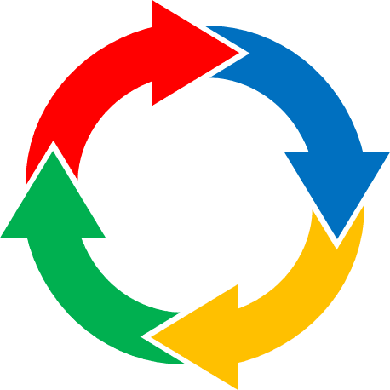
Assessment
We can then use our curriculum map to identify assessments in our courses that measure specific learning outcomes.

Slide 8
When used as an ongoing feedback loop, programs can use learning outcomes, curriculum mapping, and assessment to make informed curricular changes that ensure student success.
Develop/revise learning outcomes
Map curriculum
Design
Implement
Analyze
Use
Assessment
Cycle
Adapted from Berkeley’s Center for Teaching and Learning https://teaching.berkeley.edu/resources/assessment-and-evaluation

Slide 9
Tell me more
How do we do this?

Slide 10
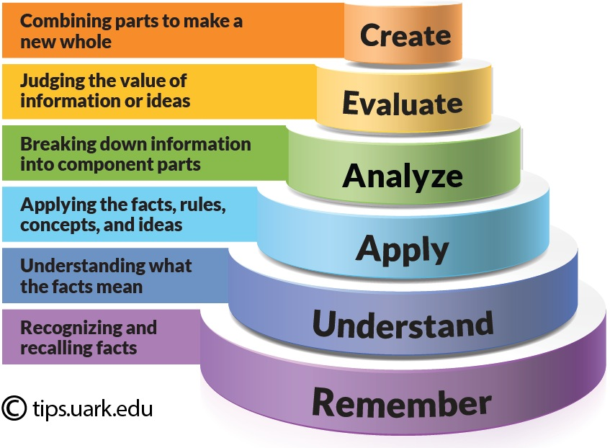
Where to start:
Program Student Learning Outcomes (SLOs)
Bloom’s Taxonomy
  Essential knowledge and skills we want students to have gained/mastered by graduation
  Should be:
    A short but comprehensive list
    Clear, easily understood, rely on verbs
    Assessable, observable/measurable
    Learning is scaffolded in the curriculum
  Ideas can come from professional associations, accrediting bodies, industry, potential employers
Resources:
https://www.learningoutcomesassessment.org/wp-content/uploads/2019/08/A-Brief-Guide-to-Creating-Learning-Outcomes-_-Presence.pdf
https://teaching.berkeley.edu/resources/assessment-and-evaluation/state-learning-goals

Slide 11
Thoughts on Program SLOs
Meaningful & Manageable Program Assessment
“One reason we need student learning outcomes is that they are essential for understanding and improving student learning.” (p. 23)
“The process of specifying learning outcomes for your program helps you and your faculty colleagues to develop a shared understanding of what students are supposed to accomplish.” (p. 23)
Credit to Heather Webb and Dr. Steve Barrett

Slide 12
Examples
Poor: "Students should know the historically important systems of psychology
  What systems? Which ideas about these systems?
Better: Students should know the psychoanalytic, gestalt, behaviorist, humanistic, and cognitive approaches to psychology.
  Specifies which theories
Best: Students should be able to recognize and articulate the foundational assumptions, central ideas, and dominant criticisms of the psychoanalytic, gestalt, behaviorist, humanistic, and cognitive approaches to psychology.
  Clear, specific, clarifies how knowledge is demonstrated, allows faculty a standard to compare student performance to
*Italicized sections quoted from University of Arizona’s Assessment Resources, content referenced from same source
https://assessresources.oia.arizona.edu/content/42

Slide 13
Other Examples
Natural Sciences
  Students can apply scientific methodology in a research proposal.
  Students can evaluate the validity and limitations of theories and scientific claims in experimental results.
  Students can evaluate the relevance and application of science in everyday life.
History
  Students can list major events in American history.
  Students can describe major events and trends in American history.
  Students can apply their knowledge of American history to examine contemporary American issues.
*Quoted from the University of Arizona’s Assessment Resources, https://assessresources.oia.arizona.edu/content/42

Slide 14
Curriculum Map
Identifies where knowledge and skills (program SLOs) are:
  introduced
  reinforced
  assessed
Can help programs discover:
  curricular gaps
  issues with course sequencing
  prerequisite concerns
  excessive overlap
Resources:
https://www.learningoutcomesassessment.org/wp-content/uploads/2019/02/MappingLearning.pdf
https://assessment.trinity.duke.edu/sites/assessment.trinity.duke.edu/files/site-images/Curriculum%20Mapping%20-%20Assessment%20Round%20Table.pdf

Slide 15
Curriculum Map Examples
Basic Curriculum Map (“Overview Map”)
Map of Learning Progression & Development (“Levels Map”)
I = Introduced | M = Mastered
I = Introduced | D = Developed (Reinforced) | M = Mastered (Summative Assessment)
Map of Assessment Measures (Student Evidence/Artifacts)
Indicate assessment measure(s) where M is indicated (reflective essay, oral presentation, case study, group project, exam question, etc.).
 | Course 1 | Course 2 | Course 3
SLO 1 | X | X
SLO 2 |  | X | X
 | Course 1 | Course 2 | Course 3
SLO 1 | I | M
SLO 2 |  | I | M
Credit to Heather Webb and Dr. Steve Barrett

Slide 16

Curriculum Map Checklist
Program Student Learning Outcomes (SLOs)
Program Course List
Course Syllabi
Assessment Measurement
Student Evidence/Artifacts
Credit to Heather Webb and Dr. Steve Barrett

Slide 17
Program Course List Course Syllabi
Decision: Which courses to list?
All versus/or Core
Action: List courses across top row
To Know: UW does not require program-level student learning outcomes in course syllabi
Starting Point: Reflect on your course syllabi & how they fit here.
Next Step: Create shared folder (Teams, OneDrive, etc.)
Outreach: Ask faculty to provide their course syllabi (make easy to increase participation and buy-in).
Credit to Heather Webb and Dr. Steve Barrett

Slide 18
Assessment Measurement Student Evidence/Artifacts
Indicate assessment measure(s) where M is indicated on your “Levels Map.”
-Reflective essay,
-Oral presentation,
-Case study,
-Group project, and
-Exam question.
“The point here is that mapping provides a visualization for how various pieces fit together related to learning outcomes. It allows a conversational space and lens through which to examine our educational design” (NILOA).
Direct & Indirect Assessment
Direct - student evidence/artifacts
Where “M” is located on your map.
Indirect - pre & post knowledge surveys
Where “I” is located on your map.
What best reflects/demonstrates student learning in your program?
Degrees That Matter
“Our maps need multiple layers that reveal not just where outcomes are addressed, but how, how often, and in what ways students demonstrate their learning” (p. 84).
“Instructors analyze course learning outcomes semantically to see if the expected level of performance was occurring based on verbs used in the outcome statements” (p. 85).
Credit to Heather Webb and Dr. Steve Barrett

Slide 19
What might this look like all together?

Slide 20

Checking-In
In a consensus-based approach to curriculum mapping, before mapping begins, reflective conversations need to take place to address the following questions:
-Purpose: What are we mapping and why?
-Scope: What parts of the learning system are included or left out by this approach?
-Participation: Who should be involved in the conversation?
-Form: How many layers do our maps need to address educational complexity?
-Limitations: What ways of seeing are we excluding in our maps?
Degrees That Matter, p. 88
Credit to Heather Webb and Dr. Steve Barrett

Slide 21
What’s in it for us?

Slide 22
Numerous benefits include:
Learning outcomes and program value are easy to identify and explain to students, parents, administrators, and stakeholders.
Graduates can easily identify the skills and knowledge they can offer employers.
Curricular decisions are proactive and easier to make as they are data driven.
Ensures curricular efficiency, reduced redundancy, and clarifies for faculty how their courses fit into the larger curriculum.
External assessment tools identify necessary changes to learning outcomes, ensuring programs meet current demands.

Slide 23
Assessment Culture - Connections for Successful Curriculum Mapping
Assessment success is built on engaging faculty as active participants in the process.
Coming to Terms with Student Outcomes Assessment, p. 149
Listening to Faculty!
Advancing Assessment for Student Success, Ch. 4
Faculty come together to identify which courses or programmatic learning experiences align with which outcomes or where various learning outcomes are addressed.
It is a process of discussion, conversation, and building a single map collectively, based on shared understanding of the role of each learning experience within the larger picture. This also generally entails examination of alignment of assessments with learning outcomes and experiences.
NILOA, Mapping Learning: A Toolkit of Resources
When curriculum maps become the centerpiece of collective reflection about the learning students are building and where they build it, mapping becomes a potentially transformative exercise.
Degrees That Matter, p. 81
Credit to Heather Webb and Dr. Steve Barrett

Slide 24


Slide 25


Dr. Steve Barrett
Vice Provost Undergraduate Education
steveb@uwyo.edu
Heather E. Webb Springer, M.A.
Associate Director of Assessment | ECTL
hwebb1@uwyo.edu
Dr. Chrissy Wade
Department Head, FCS
cwade@uwyo.edu

Slide 26

References
Meaningful and Manageable Program Assessment: A How-To Guide for Higher Education Faculty (Massa & Kasimatis, 2017)
Coming to Terms with Student Outcomes Assessment (Edited by Peggy L. Maki, 2010)
Advancing Assessment for Student Success (Driscoll, Graff, Shapiro, & Wood, 2021)
Improving Student Learning at Scale: A How-To Guide for Higher Education (Fulcher & Prendergast, 2021)
Degrees That Matter: Moving Higher Education to a Learning Systems Paradigm (Jankowski & Marshall, 2017)
National Institute for Learning Outcomes Assessment. (2018, March). Mapping learning: A toolkit of resources. Urbana, IL: University of Illinois at Urbana-Champaign, National Institute for Learning Outcomes Assessment (NILOA).
Resources
UW Assessment for Student Learning Website
UW Assessment Matrix Pilot Year Program (AY 22/23) - see next slide
National Institute on Learning Outcomes Assessment Website

