Slide 1
Ellbogen Center for Teaching & Learning

Slide 2
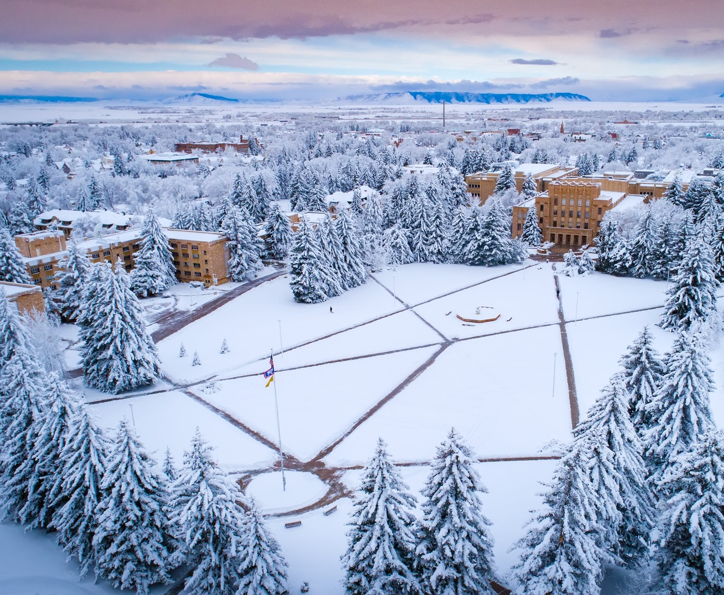
CRITICAL
&
CREATIVE THINKING
Fulfilling Our Promise

Slide 3
“The active, persistent, and careful consideration of any belief or supposed form of knowledge in the light of the grounds that support it and the further conclusions to which it tends.”
-John Dewey, 1900,
“The School in Society”
WHAT IS CCT?
An ability to answer a question through an analysis and evaluation of the assumptions, limitations, interpretations, and validity of evidence.
-Steven Pearlman, Critical Thinking Initiative

Slide 4
CCT as an Intellectual Virtue
Logical, evidence-based reasoning
Fair-mindedness, sensitivity to others’ points of view
Curiosity, openness, following an argument where it leads, willingness to revise one’s view

Slide 5
CCT in UW’s USP Curriculum
Access diverse information through focused research, active discussion, and collaboration with peers.
Separate facts from inferences and relevant from irrelevant information, and explain the limitations of information.
Evaluate the credibility, accuracy, and reliability of conclusions drawn from information.
Recognize and synthesize multiple perspectives to develop innovative viewpoints.
Analyze one’s own and others’ assumptions and evaluate the relevance of contexts when presenting a position.
Communicate ideas in writing using appropriate documentation.
First Year Seminar
(must meet all 6)
Physical & Natural World
(must meet 2)
Knowledge of Human Culture (must meet 2)
U.S. & Wyoming Constitutions
(must meet 2)

Slide 6
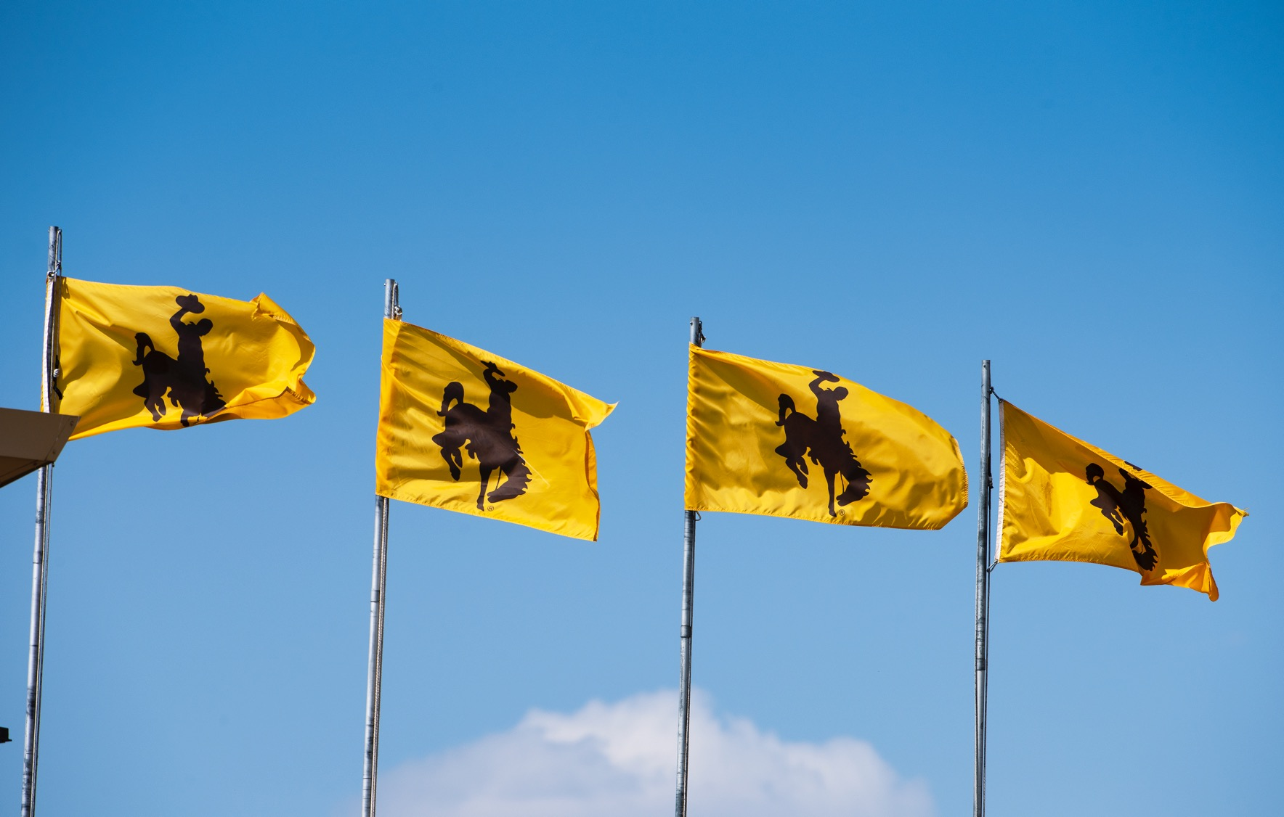
CCT is . . .
• Important to the state of WY
• Demanded by employers
Required by UW’s accreditation body
• Necessary for informed and engaged citizenship
• The backbone of a liberal education
THE VALUE OF CCT

Slide 7
Important to the State of Wyoming
WY Dept. of Education includes both creativity and critical thinking in the performance standards for the state’s public secondary schools as part of their Common Core of Skills
Important for adapting to changing economic realities, new occupational sectors require prepared workers

Slide 8
Demanded by Employers
American Council of Trustees and Alumni’s “What Will They Learn?” Project, 2019
We must “help students develop skills that can apply to future jobs, such as a general knowledge of college-level math, critical thinking, and the ability to communicate clearly.”
AAC&U’s annual survey of employers consistently identified the importance of critical thinking, along with problem-solving, teamwork, and communication through writing and speaking

Slide 9
Required by UW’s Accrediting Body (HLC)
Requires the University to offer programs that engage students in collecting, analyzing, and communicating information; in mastering modes of intellectual inquiry or creative work; and in developing skills adaptable to changing environments.

Slide 10
Necessary for Informed & Engaged Citizenship
Cultivates a climate of rational discourse
Helps resist groupthink, tyrannical authority
Urgently needed for tackling social problems such as:
fast-paced technological change
global political conflict
political polarization
crisis in public trust in the social institutions that undergird our democracy

Slide 11
The Backbone of a Liberal Education (USP)
AAC&U’s LEAP Initiative of 2005
Liberal education for reasons of employment, civic engagement, and personal flourishing
CCT is central to other important abilities: information literacy; digital and media literacy; intercultural competence; climate literacy; financial literacy; conscientiousness; personal responsibility; character development

Slide 12
WHERE IS CCT TAUGHT OUTSIDE OF USP? THESE UNITS MENTION IT EXPLICITLY IN THEIR POSTED STUDENT LEARNING OUTCOMES
Ecosystem Science & Management
Family & Consumer Sciences
Veterinary Sciences
African American & Diaspora Studies
Chemistry
Gender & Women’s Studies
Geology & Geophysics
Life Sciences
Modern & Classical Languages
Philosophy
Religious Studies
Kinesiology & Health
Social Work
Environment & Natural Resources
Energy Resource Management & Development

Slide 13
Importance of Faculty Development Around CCT
“Studies demonstrate that most college faculty lack a substantive concept of critical thinking. Consequently, they do not (and cannot) use it as a central organizer in the design of instruction. . . . They, therefore, usually teach content separate from the thinking students need to engage in if they are to take ownership of that content.”
-Foundation for Critical Thinking
Ellbogen Center for Teaching & Learning CCT Division
Faculty Learning Communities
First Year Seminar Faculty Development Workshops

Slide 14
OUR MESSAGE

Slide 15
DISTINCTLY WYOMING

Slide 16
First Year Seminar
The one course that intentionally teaches all six dimensions of USP’s CCT learning outcomes
An AAC&U “high-impact practice”
Develops students’ intellectual and practical capacities, preparing them for progressively more complex challenges
Emphasizes to new students the truth-seeking mission of the university
Develops faculty members’ pedagogical competencies, reverberating across campus

Slide 17
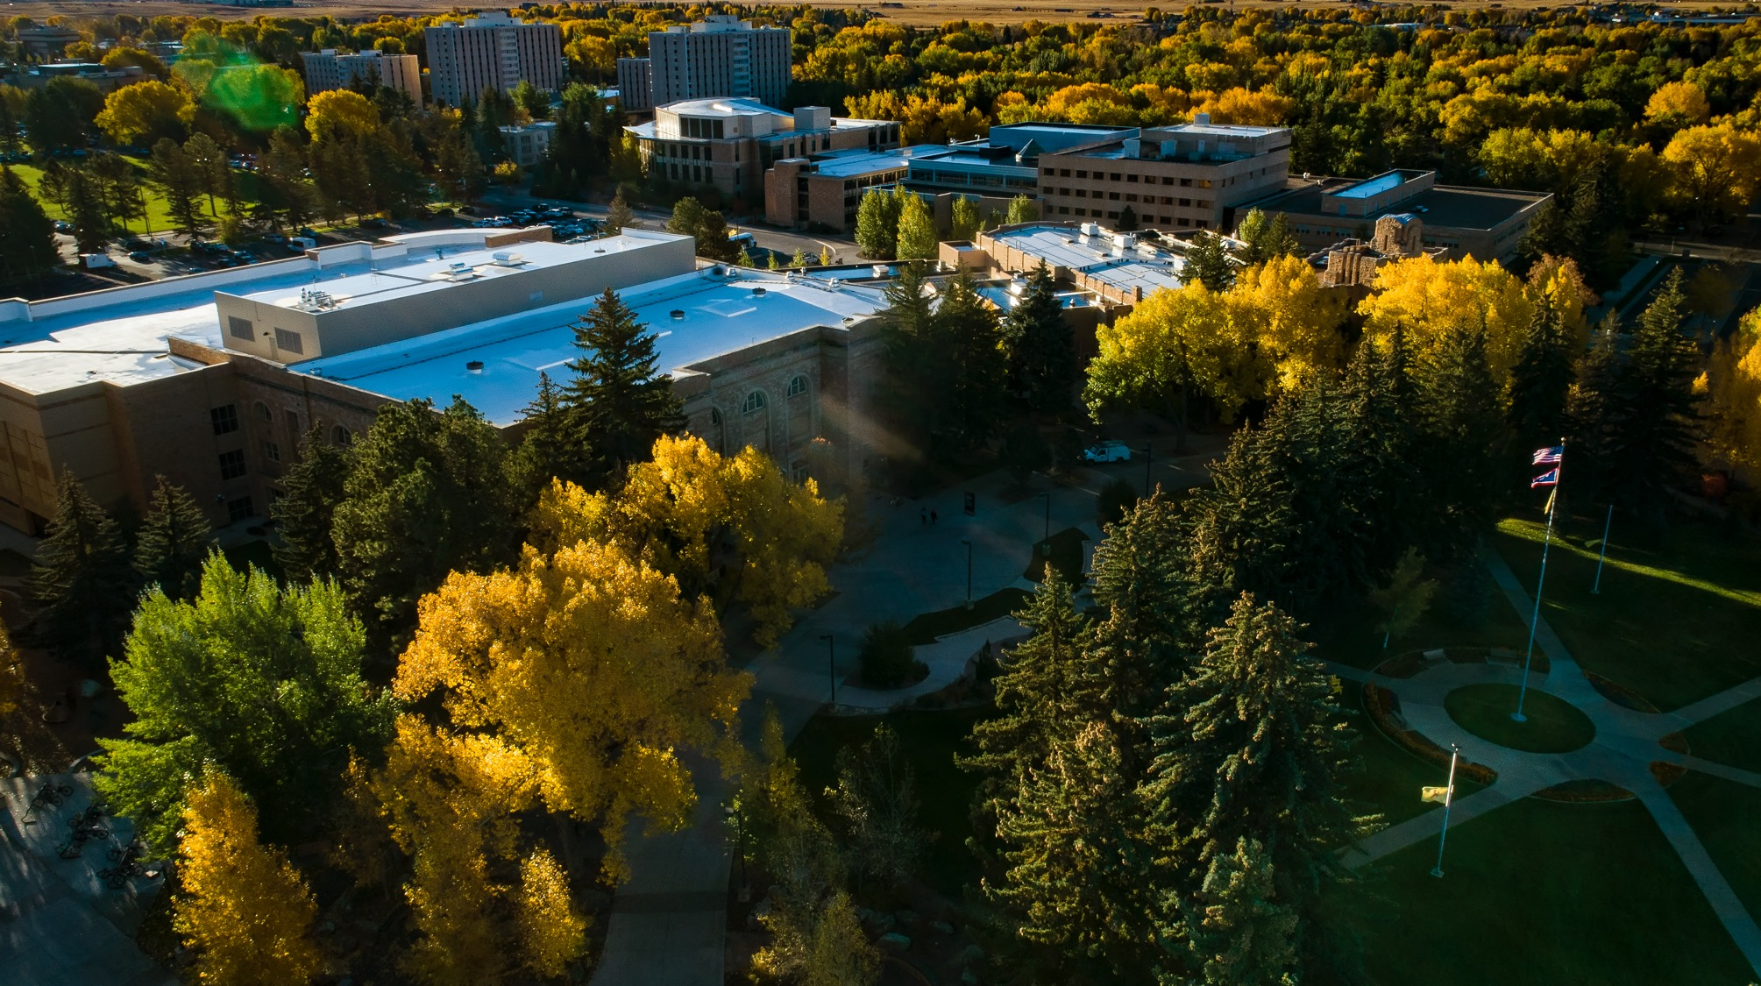
Have more explicit discussions of CCT across campus
Assess students’ learning of CCT
Improve implementation and faculty development efforts
Assess these efforts
Allow the results of assessment to inform further efforts
MOVING FORWARD

Slide 19
Extra Slides
COMMUNICATTE

Slide 20
• Click text to edit
• Click and drag box around text to move
• To change image
Double Click photo
In the upper left properties bar click “Change Picture”
• To add College/Dept. logo on every slide
Click “View” in the task bar (At the very top of screen)
Hover mouse over “Master”
Click “Slide Master”
Click in the text box to edit
*Make sure the first slide is selected*
For more help, visit
support.office.com/en-us/article/basic-tasks-for-creating-a-powerpoint-presentation-efbbc1cd-c5f1-4264-b48e-c8a7b0334e36
EDITING INSTRUCTIONS

