Slide 1
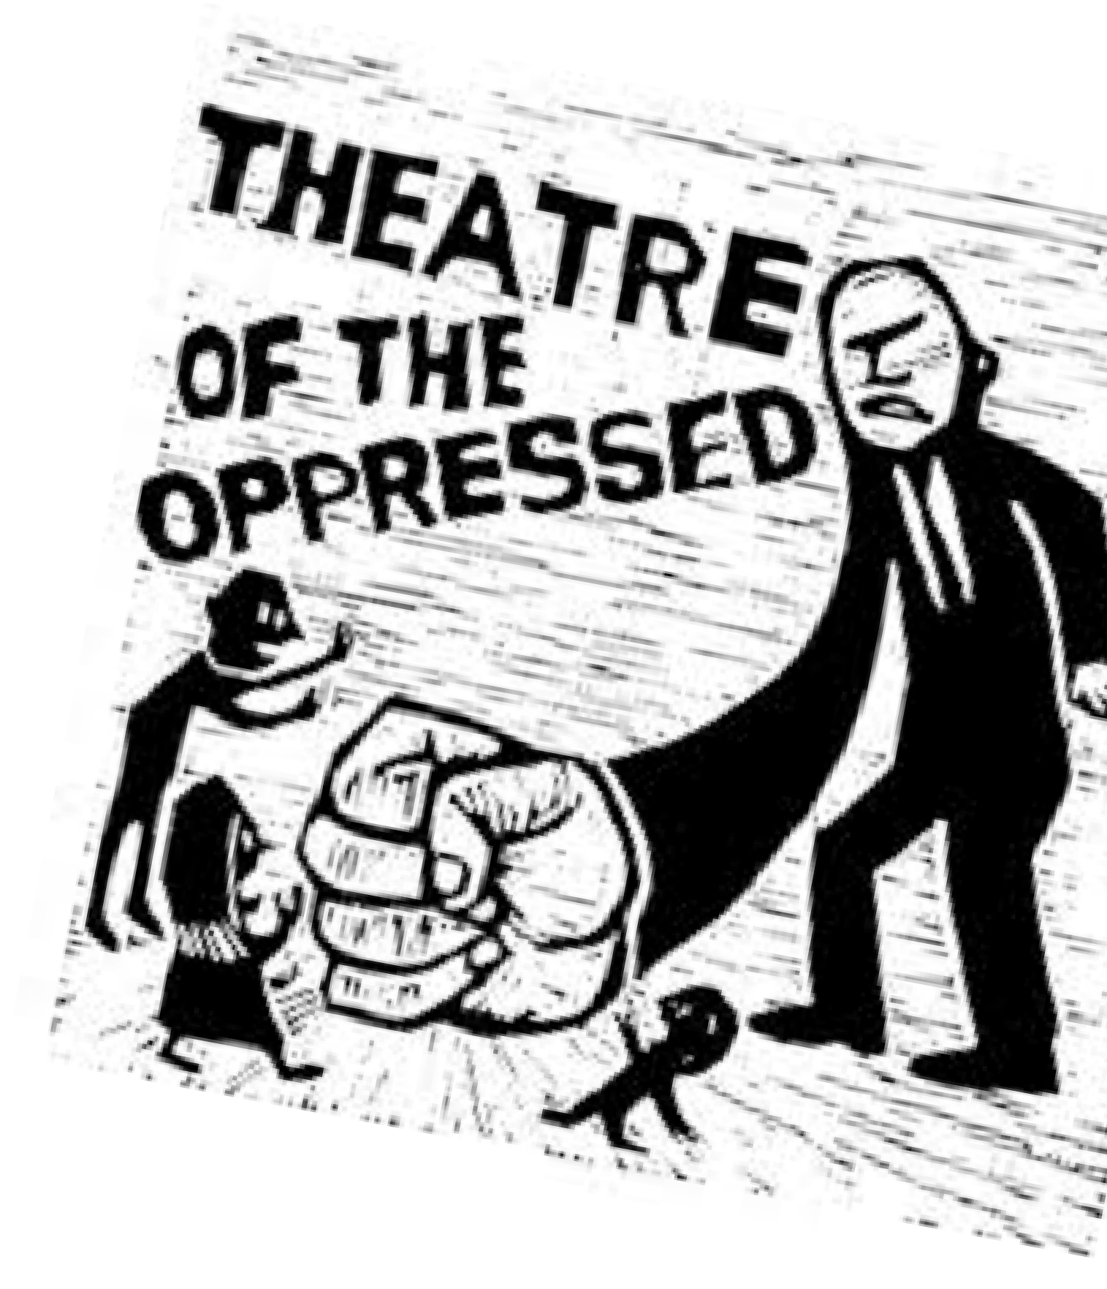
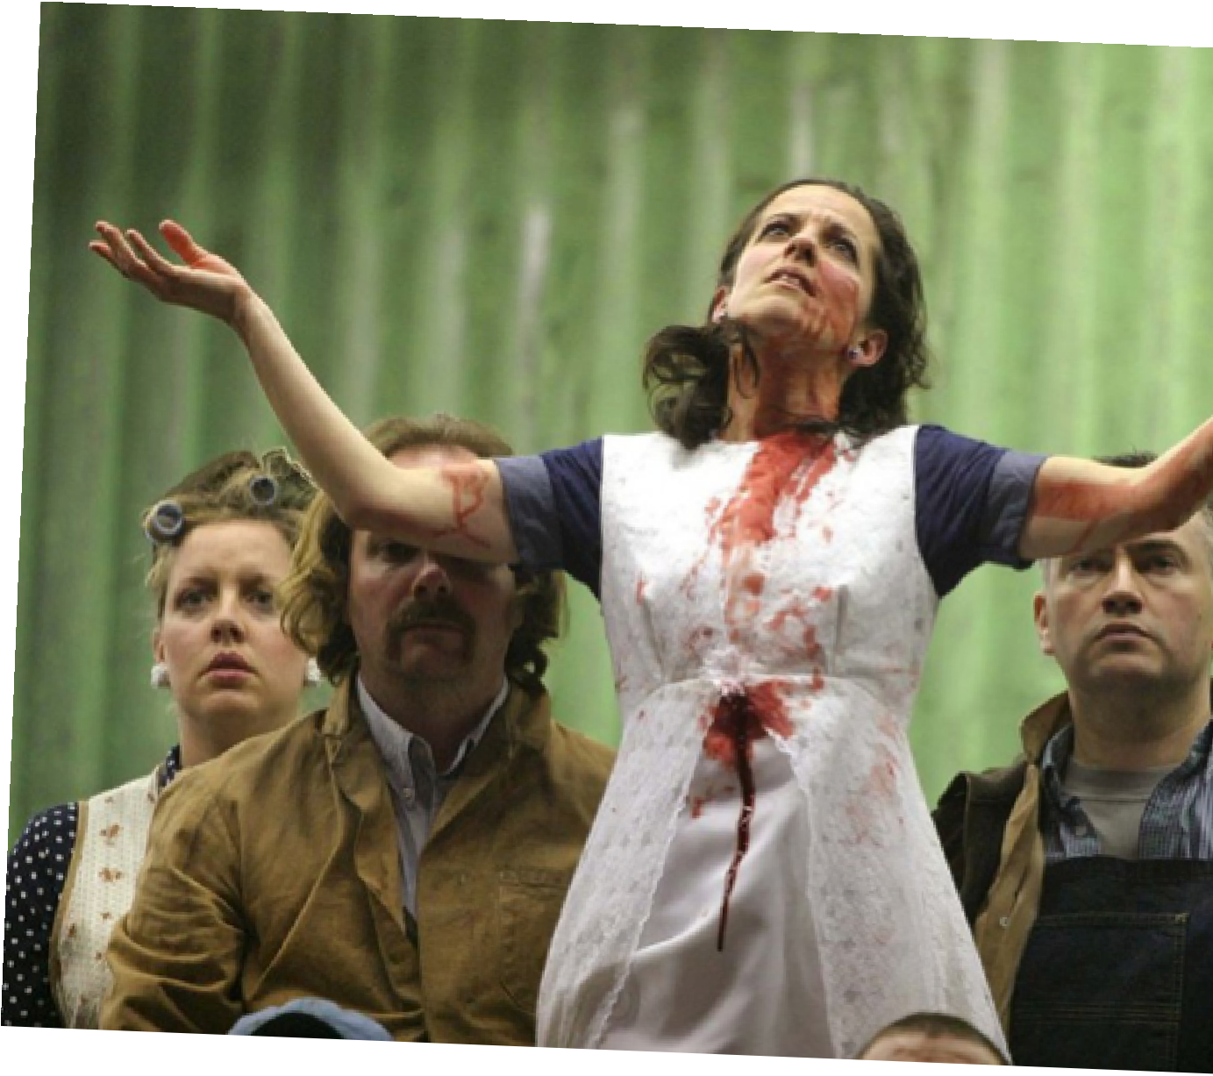
THEA 3910: 20th - 21st CENTURY THEATRE DIVERSITY Fall 2020, T-R 1:20 – 2:35 p.m., Room 1138 BCPA Diversity Credit, Upper Level Division Professor: Dr. Aragon - ccaragon@uwyo.edu
Learn About:
Theatre and Sexuality
Theatre and Race
Theatre and Human Rights
Theatre and Violence
Teaching techniques: films, short videos, research, classroom performance, monologues, and community engagement. We examine concepts of diversity in plays such as Rent, Rocky Horror Picture Show, performances inspired by George Floyd’s death, and BLM street theatre, performance art pieces.

