Slide 1
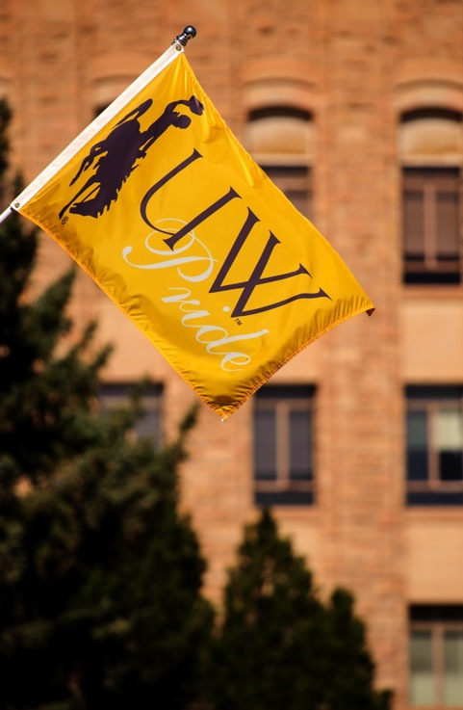

Wyoming’s
Post-Secondary Education
Attainment Goal
Board of Trustees
November 2017
Laurie Nichols, Jim Rose, & Mary Aguayo

Slide 2
Statewide Educational Attainment
By 2025, 60% of the nation’s workforce will need a post-high school credential, but Wyoming has just 46%
ENDOW has identified the improvement of educational attainment as critical to meeting the state’s future workforce needs and to diversify the economy

Slide 3
National Comparison
Wyoming
United States
High School Graduates: 92.3%
Among population 25 and older
RANKS #3 NATIONALLY
Bachelor’s Degree or Higher: 25.7%
RANKS #40 NATIONALLY
Advanced Degrees: 8.6%
Master’s, Professional, or Doctoral
RANKS #40 NATIONALLY
High School Graduates: 87.1%
Among population 25 and older
Bachelor’s Degree or Higher: 30.6%
Advanced Degrees: 11.6%
Master’s, Professional, or Doctoral

Slide 4
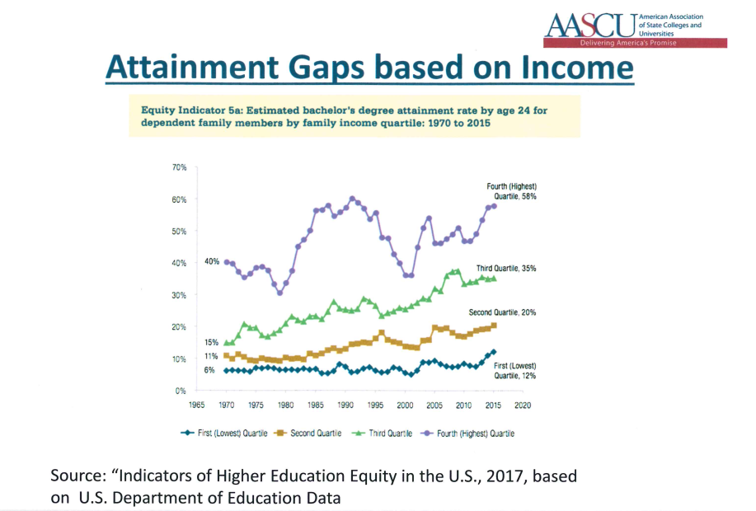

Slide 5
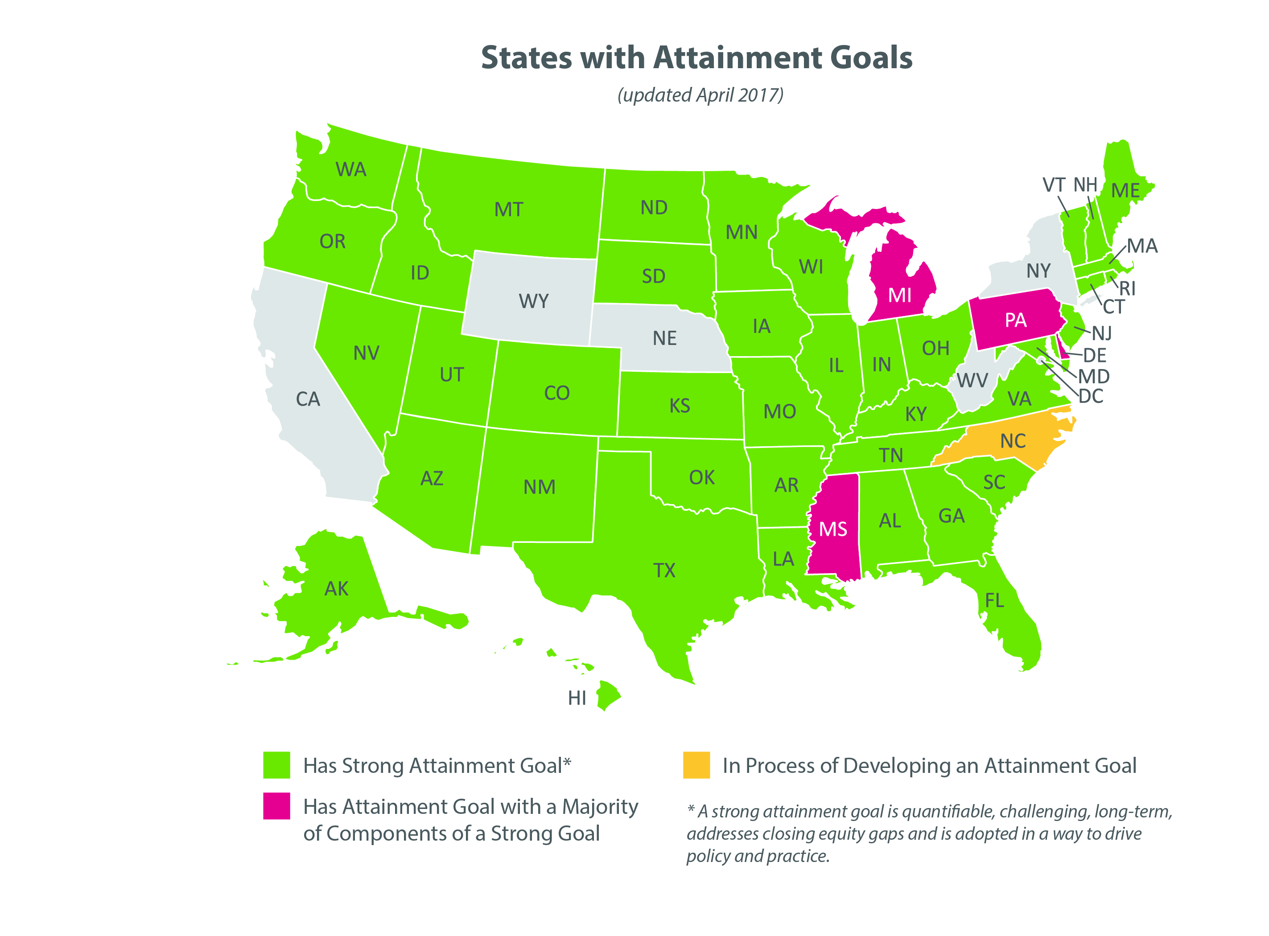
Image Courtesy of the
Lumina Foundation

Slide 6
Support from ENDOW
Draft Recommendations from ENDOW
If the proposed attainment goal is approved, the December ENDOW report recommends:
  Governor to endorse by executive order and Legislature to support the goal
  Actions to achieve the goal should be aligned with priority sectors
  ENDOW should adopt the goal as a performance benchmark

Slide 7
Support from Lumina Foundation
The Lumina Foundation is the nation’s largest private foundation focused on increasing Americans’ success in higher education
  Goal 2025 maintains that by 2025, 60% of Americans will hold a high-quality postsecondary degree
Provides funds and consulting support
  The funds can be used to present and learn about higher education policy information, research and nonpartisan analysis to advance Goal 2025

Slide 8
Setting the Goal
Three ways to formalize:
  Joint Resolution (ex: Wisconsin)
  Law (ex: Minnesota)
  Governor’s executive order (ex: South Dakota)

Slide 9
Resolution Progress
A Resolution to Establish a Statewide Goal for Higher Education Attainment in Wyoming was:
  Jointly drafted by all 8 public college presidents
  Unanimously approved by the Wyoming Community College Commission and signed by Chair Meyer on October 31, 2017
  Awaits endorsement from UW’s BOT

Slide 10
The Goal
Increase the percent of the working population 25-64 years old that possess a valuable post-secondary credential (degree or certificate) to:
  60% by 2025, and to
  75% by 2040.

Slide 11
Next Steps
UW Board of Trustees endorsement of attainment goal sets the goal
Stakeholders will co-create an implementation plan with assistance from Lumina
  Timeline Development & Annual Updates

Slide 12
Questions?

