Slide 1
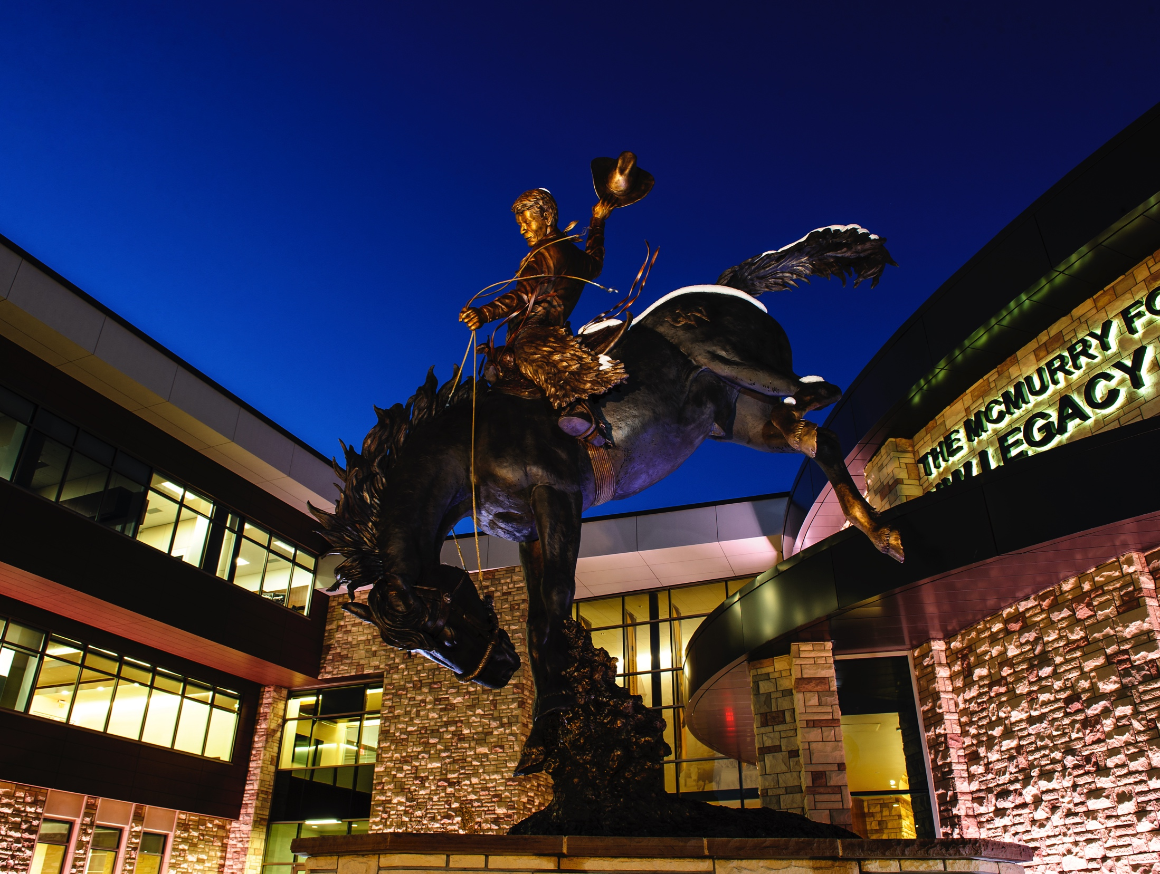
A Partnership
with the

Slide 2
Aligning our brands
A partnership opportunity
University of Wyoming will be an Official Partner of the National Western Stock Show.
We built a customized partnership together that:
Aligns our missions and cultures
Celebrates western lifestyle and agriculture
Showcases University of Wyoming in the Denver and agricultural markets as an educational leader
Achieves a “Return On Objective” through various partnership assets

Slide 3
sponsorship
A 2-year agreement
The sponsorship provides a venue through which the University of Wyoming and more specifically the College of Agriculture & Natural Resources can meet four objectives:
1) Branding and Name Recognition
2) Student Recruitment
3) Donor & Industry Relations
4) Educational Opportunities

Slide 4
Uw night at the rodeo
Wednesday, January 17, 2018
UW will receive 350 tickets to invite UW alumni and guests. There will also be a special ticket offer for UW Students and alums. During this event, there will be a stage coach ride and UW Flag presentation as well as the opportunity to distribute UW merchandise at the Coliseum.

Slide 5
Catch-a-calf co-presenters
In just over 70 years, the Catch-A-Calf Contest has awarded nearly 3,000 steers to 4-H members hailing from the western United States. The program is designed so successful participants catch a calf, feed it, and return with the animal one year later as a market steer.
These youth participants come from Colorado, Kansas, Nebraska and Wyoming to compete in National Western Stock Show’s longest running program of practical beef cattle management.
In 2018, there will be four Catch-A-Calf contests and UW will have the ability to include Pistol Pete at this event as our mascot as well as provide contestants with UW Branded shirts.

Slide 6
Female commercial sale
Presented by UW
On Wednesday, January 17, National Western will host the highly popular Commercial Female Show and Sale.
This premier event sells over 200 head of bred and open heifers. UW will have a full-page ad in the commercial female catalog, which is distributed to 2,000 attendees. In 2017, the Commercial Female Sale finished with a grand total of $289,635 in sales.

Slide 7
Processing tent
Presented by UW
The National Western Processing Tent is located in the Stockyards north of the Stockyards Arena. The processing tent is the location where all animals shown or sold in the Stockyards must pass through to be processed.
In 2017, five different cattle breeds and over 400 beef animals made their way through the Processing Tent.

Slide 8
hospitality
UW will receive $1,000 ticket bank for horse, rodeo, or special events. In addition, UW will also receive four Sponsor badges providing unlimited grounds admissions, four Sponsor Lounge badges, and four VIP parking passes.

Slide 9
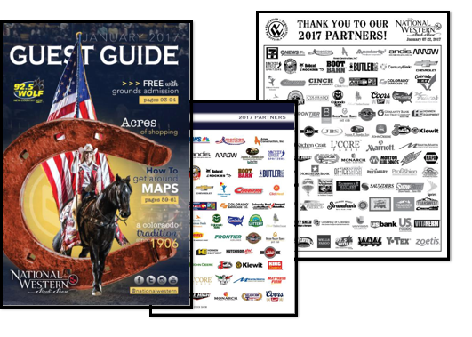
Branding opportunities
THROUGHOUT THE NWSS
DIGITAL AND PRINT MEDIA
The University of Wyoming will be branded on NWSS digital assets including the website, banners throughout the complex (some with year-round placement), and full-page ads in the NWSS Guest Guide.

Slide 10
Trade show exhibit
UW will receive one prime exhibit space within the Expo Hall building or Events Center.
UW will have access to over 500,000 people as they walk through the Expo Hall during the 16-day event.

Slide 11
Additional elements
For maximum exposure for UW
Including the prime exhibit space, UW will have the following branding opportunities:
One railing banner in the Stadium Arena
One Paddock bangboard sign (YEAR-ROUND exposure)

Slide 12
A Partnership
with the

