Slide 1
Office of Diversity, Equity, and Inclusion at the University of Wyoming
Emily Monago, MPA, Phd
chief Diversity Officer

Slide 2
Five priorities National @ UW Trends
Recruit, hire, and retain diverse and underrepresented faculty & staff;
Recruit, enroll, retain, and graduate diverse and underrepresented undergraduate and graduate students
Expand an inclusive campus community environment
Improve communication regarding diversity, equity, and inclusion
Provide more diversity education for the campus community
Diversification of employees
Recruit, hire, retain, tenure, and promotion of women, underrepresented, veterans, and individuals with disabilities
Diversification of students
Recruit, enroll, retain & graduate
Assess and improve campus climate
Strategic planning and campus-wide diversity & inclusion initiatives
Curricular and co-curricular engagement of students
Notes:
The campus conversations/meetings
Where do you see the campus currently as it relates to diversity, equity, and inclusion and where do you envision it going?
In your opinion, what are the greatest diversity, equity, and inclusion challenges and opportunities for the University of Wyoming and the surrounding community?
What are some of your goals and how can the Office of Diversity, Equity, and Inclusion support these goals?
Is there anything that was not asked that you would like to add?
Other comments and questions?

Slide 3
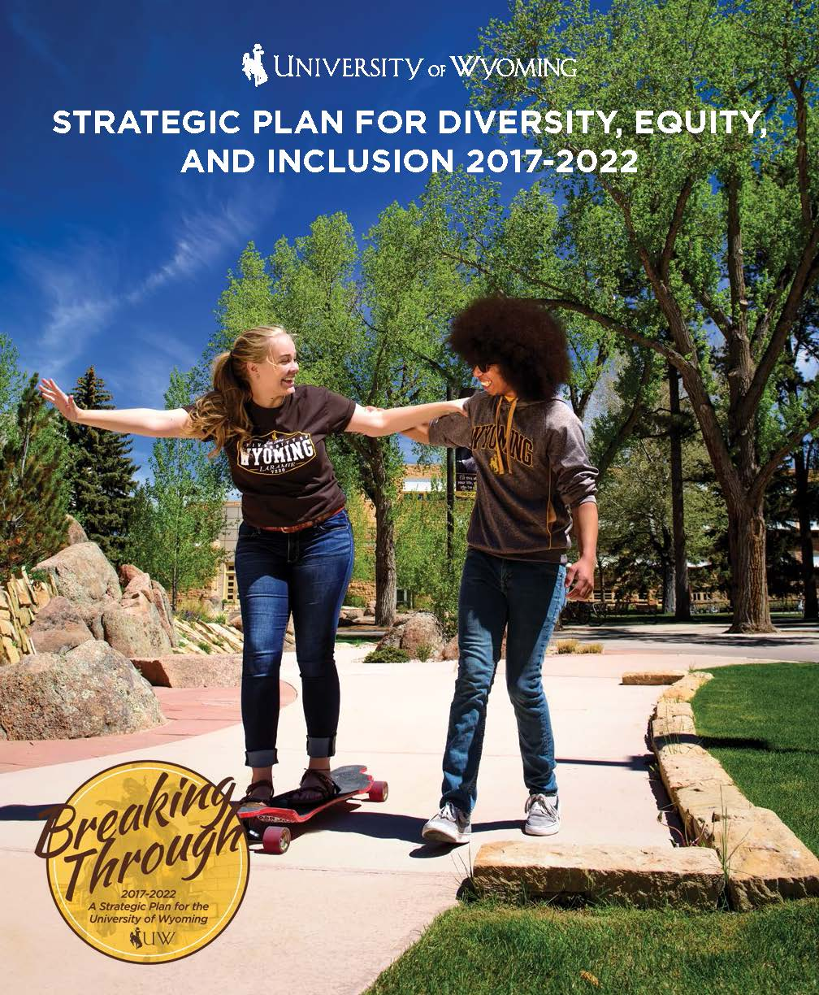
Council on Diversity, Equity, and Inclusion
The 2017-2018 – Development Phase:
Council chaired by Chief Diversity Officer
Inventory and evaluate current campus diversity and inclusion programs, activities, and other educational efforts and identify opportunities for future development
Selected highlights of Council on Diversity, Equity, and Inclusion accomplishments:
Development of UW Diversity, Equity, & Inclusion Plan 2017-2022
Special Council meeting with Victors & Spoils and Institutional Marketing & Communications regarding:
The World Needs More Cowboys marketing campaign
Gratitude for opportunity to have a impact to make the marketing campaign even more inclusive than originally planned
June 2018 Retreat
Foundation for Implementation Phase
Notes:
Council was formed in September 2017 about 2.5 months after starting work at UW
Had first meeting October 2017 and developed the strategic plan by winter break in December
Hardworking and committed team that I have to acknowledge and the strategic plan would not have been created without them
Conversations:
Campus & community conversations
Faculty, staff, students, community, athletes/coaches
UW colleges, schools, department meetings
Leadership of Faculty Senate, Staff Senate, and ASUW
Multicultural Affairs Town Hall, Rainbow Resource Center
Keepers of the Fire, College Republicans, Spectrum, etc.
Survey with 120 respondents from campus & community
Historical documents, President Nichols and past UW President’s campus communications on diversity/inclusion
Charge:
The Chief Diversity Officer reviews the charge annually.
Evan Johnson, Associate Professor - Kinesiology and Health (Faculty Senate Representative)
Jacquelyn Bridgeman, Interim Director, School of Culture, Gender & Social Justice / Kepler Professor of Law

Slide 4
Council on Diversity, Equity, and Inclusion
The 2018-2019 Charge – Implementation Phase:
Three subcommittees with faculty leadership:
Campus Climate Survey: Dr. Evan Johnson, Assistant Professor, Kinesiology and Health and the Faculty Senate Representative
Community Engagement: TBD - However, efforts are moving forward in this area
Recruitment and Retention: Dr. Jacquelyn Bridgeman, Interim Director, School of Culture, Gender, & Social Justice / Kepler Professor of Law
Continue to work collaboratively with the Office of Diversity, Equity, and Inclusion to implement strategies outlined in the strategic plans and develop new ones as needed based on survey results
Continue to offer advice and feedback on challenges and opportunities to advance diversity, equity, and inclusion on campus and in the community

Slide 5
One Year Update: Other Highlights for 2017-2018
Diversity workshops October 2017 – June 2018 had 613 participants
Office of Diversity, Equity, and Inclusion workshops: 214 participants (students, faculty and staff)
Dr. Kathy Obear workshops: 399 (students, faculty, staff, and community)
Gratitude for the support of the Provost, VPSA, and Director of Athletics for the Obear workshops both financial support and their partnerships with ODEI for the excellent attendance
Update of search committee support and Search Committee Handbook
Campus-wide open search committee training sessions in addition to the ongoing individual department sessions
November 2017 – March 2018 there were 112 participants in the campus-wide open training sessions (Participants are not included in 613 total above.)
Everfi Online Course: “Harassment and Discrimination Prevention”
Replaced the “Sexual Misconduct and Duty to Report” training
More comprehensive and nuanced - overwhelmingly positive attendee feedback
Partnership with Ellbogen Teaching and Learning for Diversity, Equity, and Inclusion Certification program
Partnership with Hillel, Student Affairs, and Anti-Defamation League of Denver for an antisemitism and inclusion workshop for students, faculty, staff, and community members (Participants are not included in 613 total above.)
Several keynote presentations, panel participation, guest lectures, and other campus and community collaborative efforts
Notes:
Gratitude for the support of the Provost, VPSA, and Director of Athletics for the Obear workshops both financial and their partnership for the excellent attendance
Developing an online library of diversity education resources accessible to faculty and staff
EVERFI Online harassment and discrimination, ADA, and diversity and inclusion courses

Slide 6
The future is bright: Highlights for 2018-2019, Continued
Implement Campus Climate Survey
Recruitment and Retention initiatives:
Develop of a UW collaborative employee recruitment & retention plan that creates shared marketing materials
Development of affinity groups to support UW diverse employees’ recruitment and retention
Make information easier to find, i.e. preferred name process, diverse local and regional resources, etc.
Acting Co-Director for the Social Justice Research Center with Eric Teman, JD, PhD
Dr. Teman, Assistant Professor of Educational Research, College of Education
Implement programs/services for academic year
UW representation in National Association of Diversity Officers in Higher Education
Voted in as member of the Colorado Association of Diversity Officers in Higher Education
Notes:
LGBTQ+
Parents of children with disabilities
Race/ethnic support groups, etc.

Slide 7
One Year Update: Highlights for 2017-2018, Continued
Development of templates to provide Affirmative Action Plan (AAP) information to units, colleges, schools, and departments to support progress on goals in AAP and Strategic DEI Plan and Breaking Through UW Strategic Plan
UW Accessibility Committee
Chair for committee: Janean Forsyth Lefevre, Equal Employment Opportunity and Diversity Specialist
Hand controls for UW rental vehicles
WATR Partnership with Coe Library to address assistive technology needs
Planning for accessibility at commencement
Creating a “Service Animals at-a-Glance” factsheet for front-line staff and faculty
Providing accessibility “walk-throughs” for campus departments and events
Physical spaces, accessibility of materials and activities
UW Accessibility Committee partnering to develop tactile maps to help the blind and visually impaired with surroundings on campus
Special recognition to Amanda O’Brien, Director for Disability Student Services and
Felicia Arce, Senior Assistive Technology Specialist, Wyoming Institute for Disabilities for their leadership on this initiative
Notes:
Helps the blind and visually impaired have a concept of their surroundings
Visitors and students can use them to more easily learn the UW environment
Braille and large font makes them bulky but they contain useful information
With the aid of a Live Scribe Talkpen the maps can "talk“
Special recognition to Amanda O’Brien (DSS) and Felicia Arce (WIND) for their efforts

Slide 8
The future is bright: Highlights for 2018-2019, Continued
Provide data campus-wide to support implementing AAP
Updates to search committee training and providing ongoing training and support to reach department and AAP goals
Launch an employee Everfi online courses on the Americans with Disabilities Act and supporting students and employees with disabilities
Launch an Everfi diversity and inclusion course for employees
Student Affairs is launching an online Everfi diversity and inclusion course for students
Visits to Wyoming Community Colleges for collaborative efforts and sharing of resources
Seek more opportunities such as the two-hour diversity workshop provided at the 2018 Wyoming Library Association Conference in August for Wyoming librarians in higher education, K-12, and community libraries
Guest lecture for classes, keynote addresses on campus and in the community, panels, and support for several underrepresented and diverse student organizations’ programs/events
Notes:
Everfi: “Diversity: Inclusion in the Modern Workplace”
Sets a common baseline and tone for UW DEI efforts
Know the law related to ADA and personal responsibilities

Slide 9
The future is bright: Highlights for 2018-2019, Continued
Matthew Shepard Memorial Group programs and events for 20th Memorial of Matt’s murder
Co-Chair: Jess Fahlsing, UW Undergraduate Student (Psychology – Gender and Women Studies)
More programming in collaboration with Student Affairs, Shepard Symposium on Social Justice, Social Justice Research Center, and others for MLK Days of Dialogues programs/events
Free speech presentation and panel on September 18th additional monthly dialogue topics determined by the planning committee
Shepard Symposium on Social Justice collaborations and support
Opportunity to host Colorado Association of Diversity Officers in Higher Education meeting
Ongoing programs and support for research through efforts of the Social Justice Research Center
Ongoing diversity workshops and educational opportunities for campus community

Slide 10
The future is bright: Highlights for 2018-2019, Concluded
Market professional development opportunities at UW broadly to include everyone while targeting diverse and underrepresented prospective student, faculty, and staff participation
Use UW, regional and national events as recruitment opportunities to develop relationships
CDEI executive team in discussion regarding submitting a bid to host NADOHE 2020
Raise the profile of UW efforts through national recognition programs and awards
More efforts underway or in process
Thank you for your commitment and support!
Notes:
The arrow below represents is the stages of Multicultural Organization Development.
This is the underlying theory being used to create the campus community outlined in the UW Strategic Diversity, Equity, and Inclusion Plan.
This theory is organization development theory merged with social justice
Or the creation of socially just workplaces in institutions of higher education.
Credit for this theory goes to the research of scholars Drs. Baily Jackson, Rita Hardiman, and Evangelina Holvino
Multicultural Organization –
Monocultural
Exclusionary and Club
Blatant exclusion or token presence of marginalized group members
Non-Discriminating Organization
Compliance and Affirming
Marginalized groups members are encouraged to be part of the organizations but expected to fit in and maintain the status quo
Multicultural Organization
Redefining and Multicultural
Culture, climate and system experience fundamental, sustainable change
This is a process that requires commitment, passion, self-reflection and continual effort.

