Slide 1
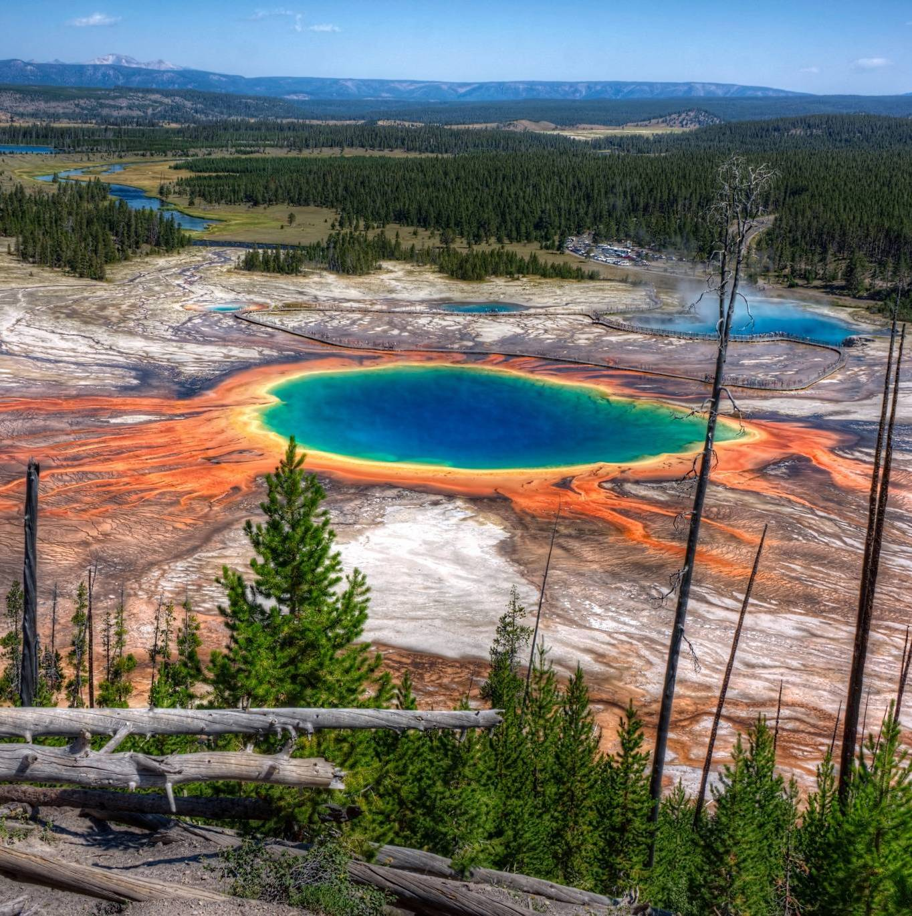
Transformative microbial biodiversity science at UW
Brent Ewers, PI
Naomi Ward, coPI
Linda van Diepen, coPI
Cynthia Weinig, coPI
Alex Buerkle, coPI
Notes:
Brent

Slide 2
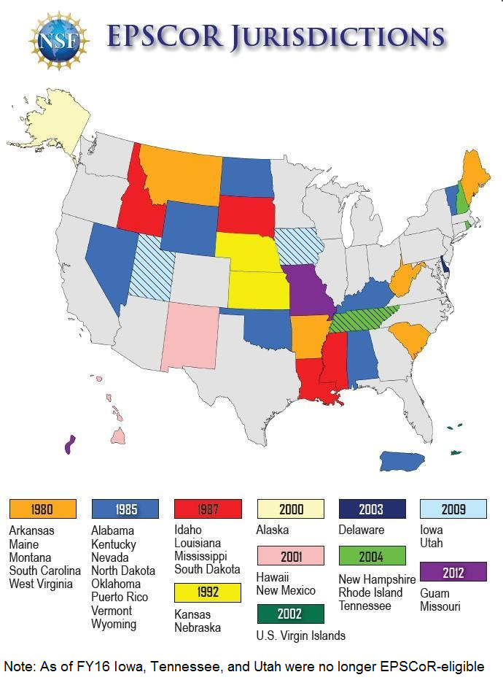
NSF EPSCoR’s infrastructure
outcomes at UW
Aligns with State Science and Technology Plan (water, energy, computation)
UW leveraged EPSCoR investments for:
Department of Chemistry
Energy Resources
Wyoming Geographic Information Science Center
Program in Ecology
Stable Isotope Facility
Hydrology and Geophysics
Science Initiative
St. Clair et al Science 2015
Notes:
Brent

Slide 3
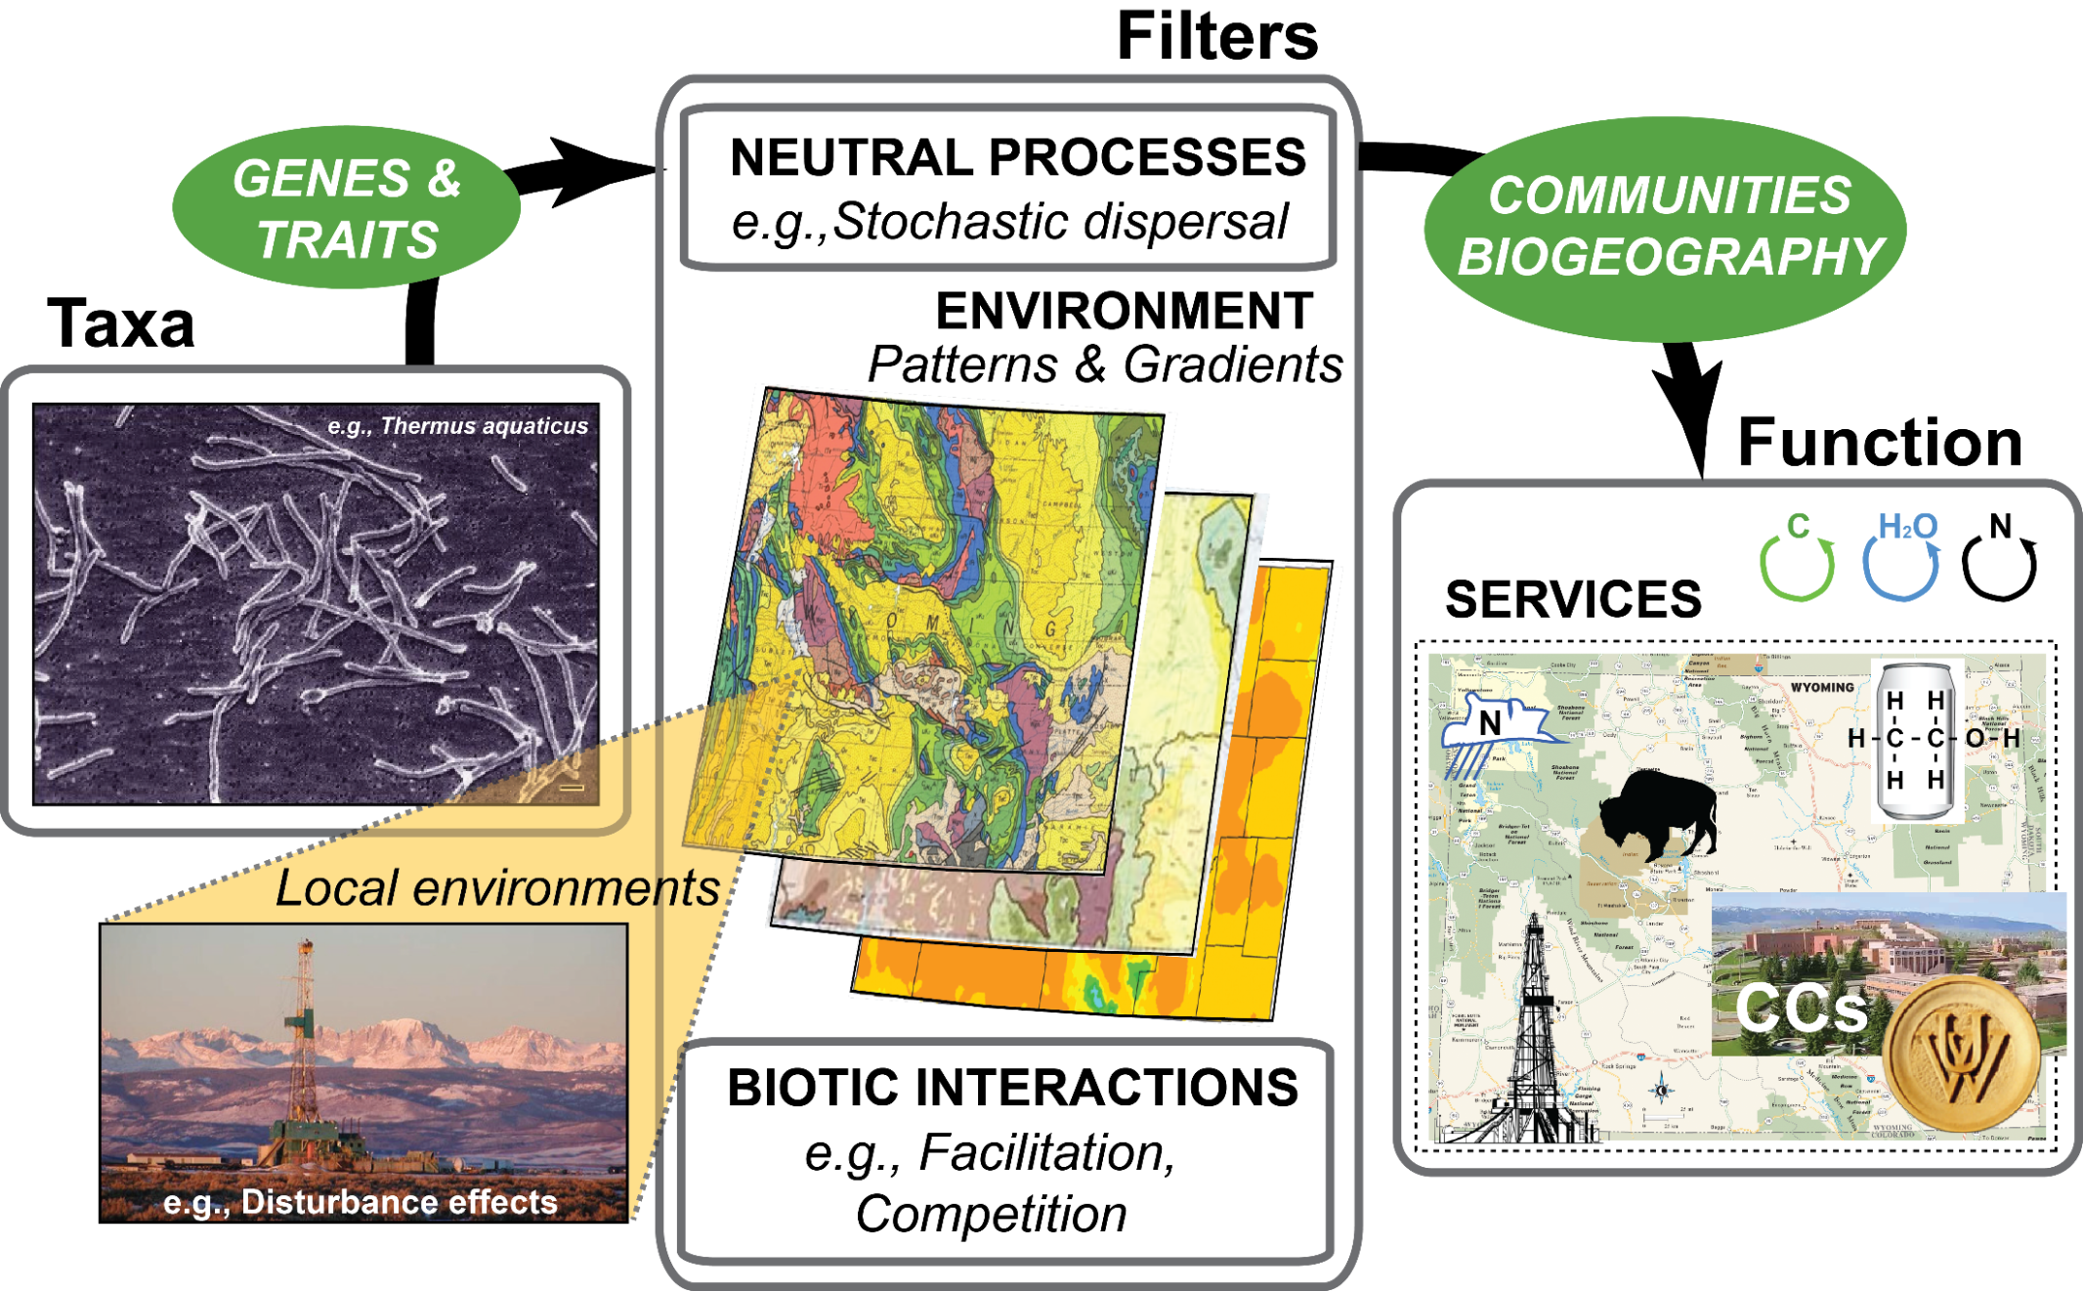
Linking microbial life to ecosystem services across Wyoming’s dynamic landscape

Slide 4
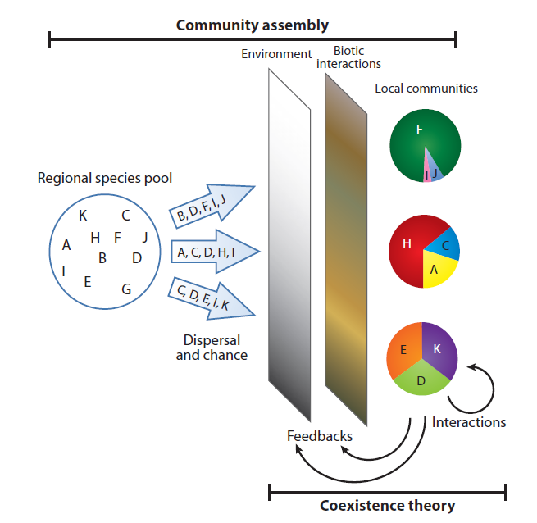
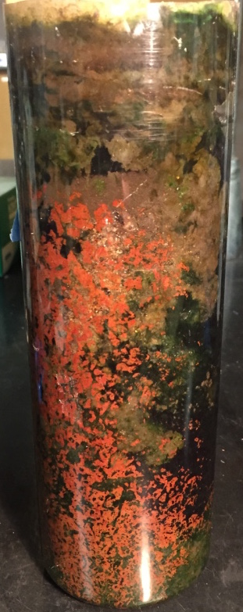
Discover rules of microbial life along natural and anthropogenic gradients.
Who lives where and when? A fundamental question of biodiversity and biogeography
What are they doing? A fundamental question of function
Winogradsky column
Hille Ris Lambers et al. 2012

Slide 5
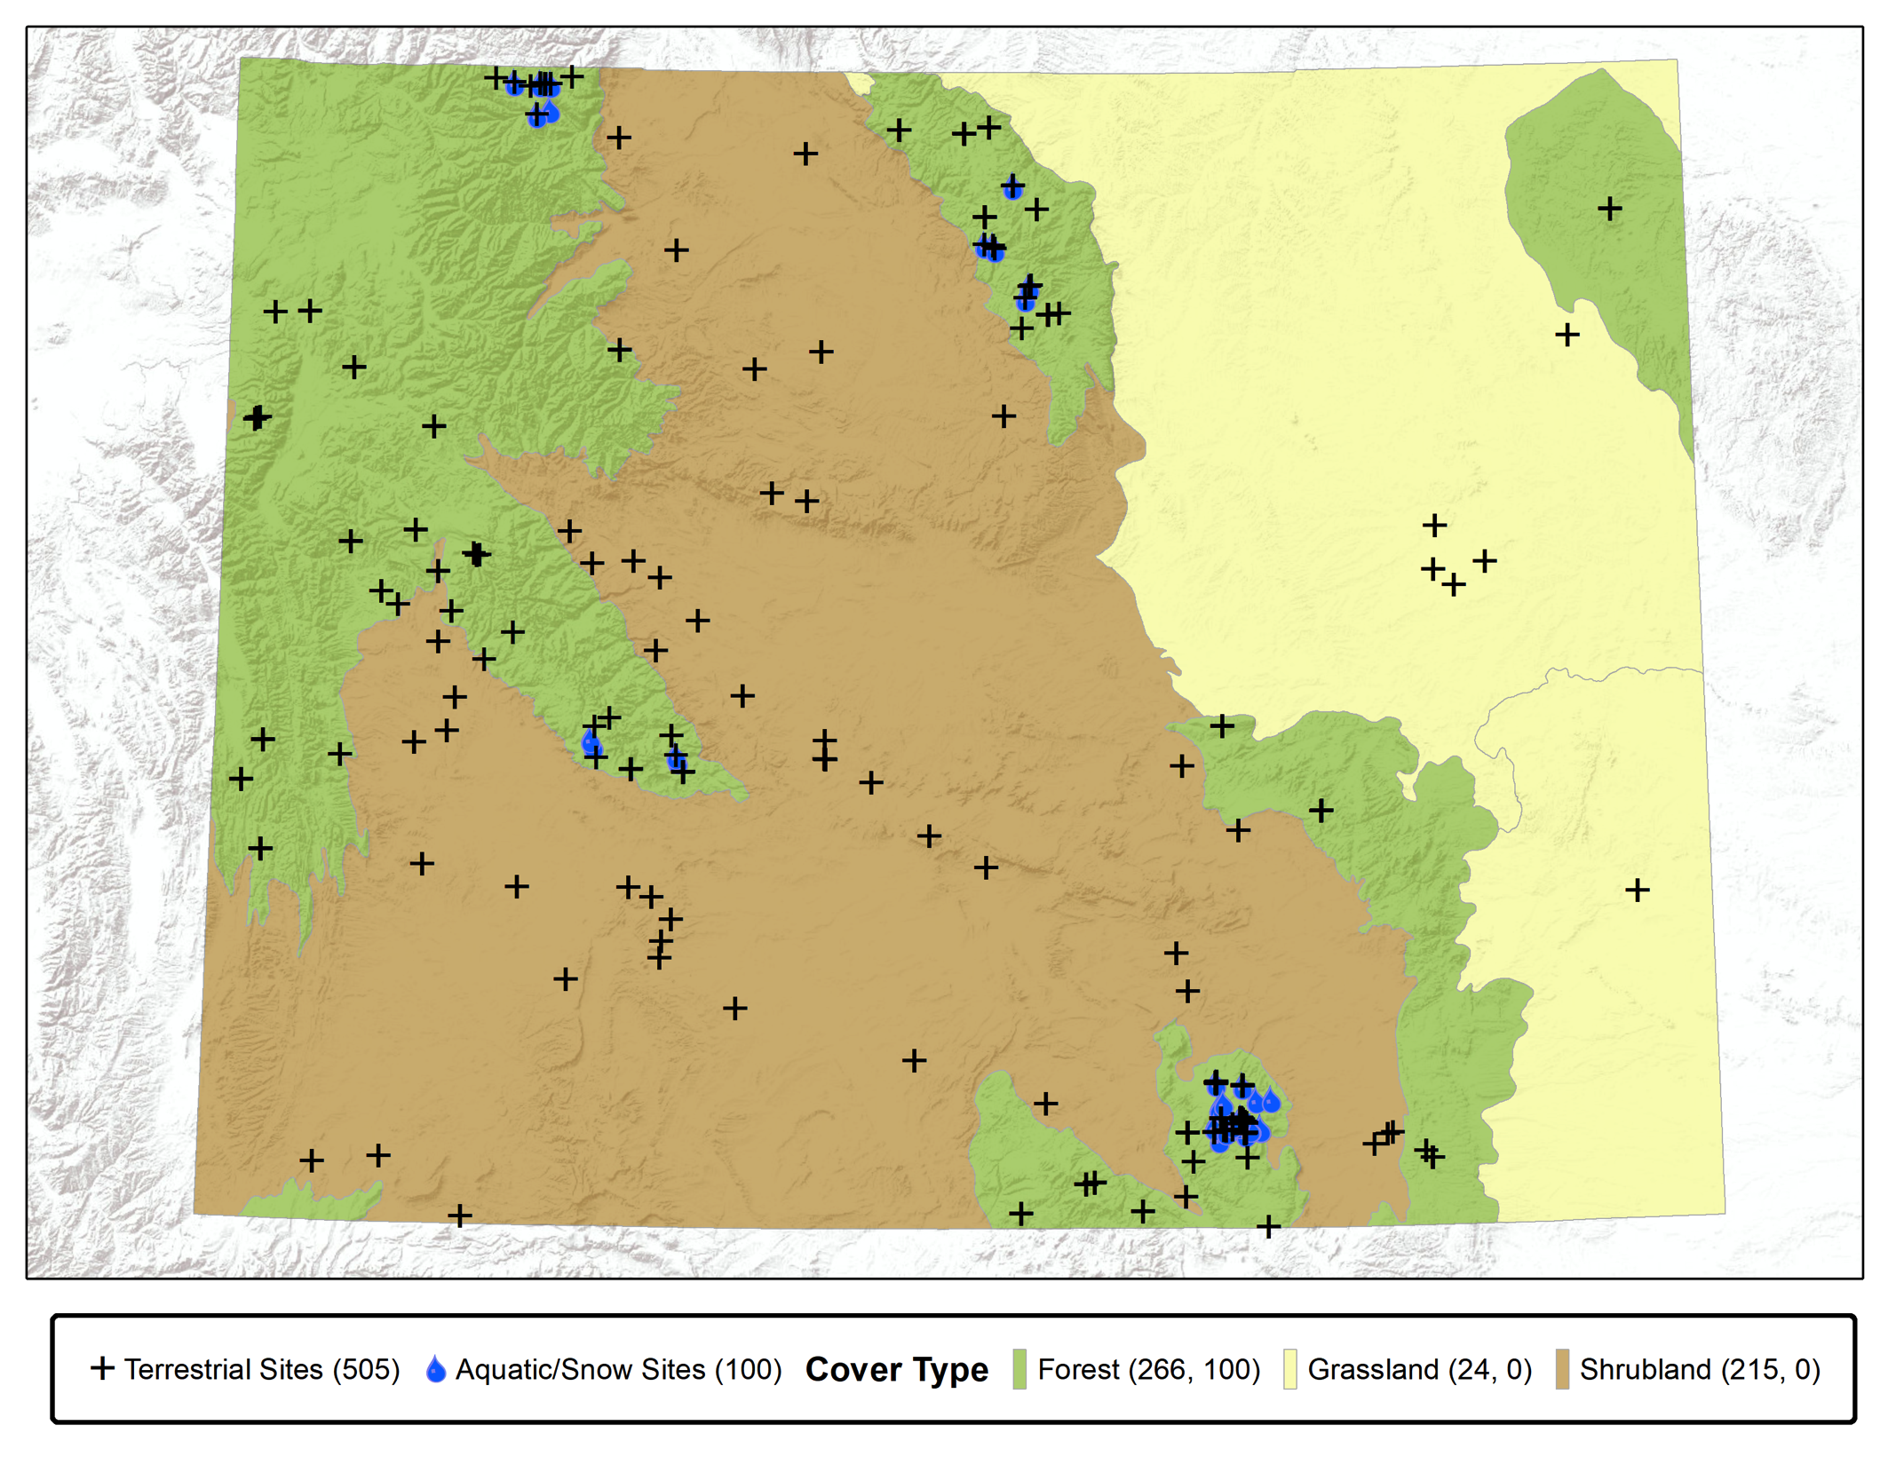
Who lives where and when? A fundamental question of biodiversity and biogeography
What are they doing? A fundamental question of function
Proposed
(for Years 1-5):
19,225 samples to be collected at 400 sites.
Currently:
>5,200 samples collected at >1100 sites.

Slide 6
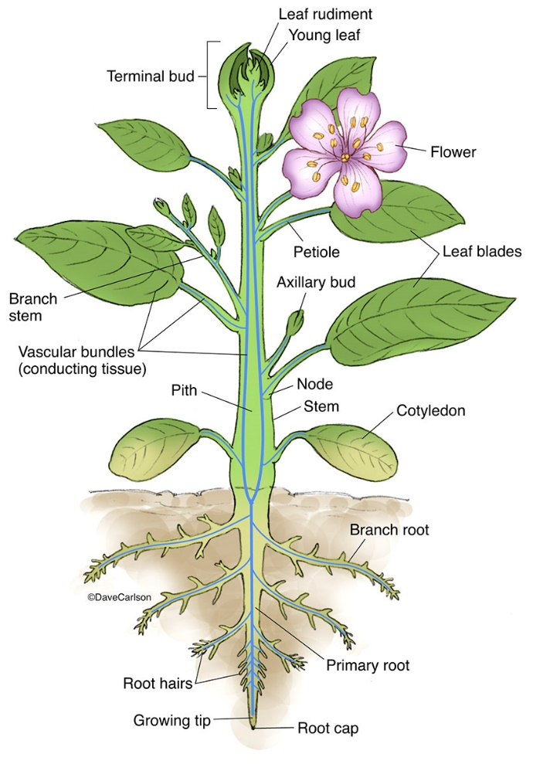
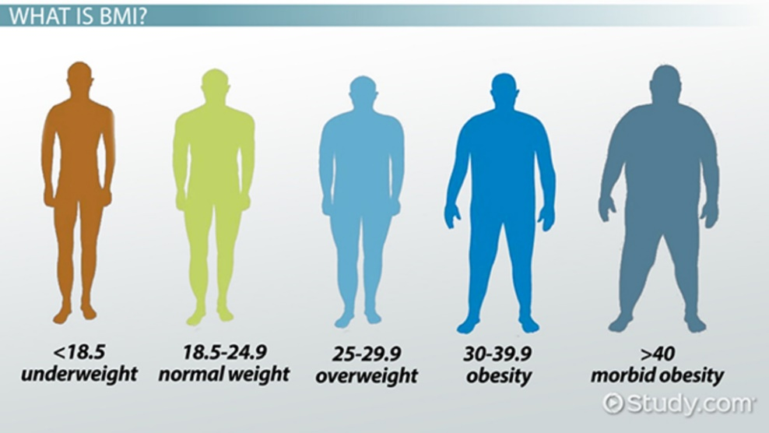
What are the consequences of microbes, to other organisms and economically?
Microbiome has a larger effect on human health than genetics
Notes:
Microbiome effect
(30% improvement in BMI prediction relative to human genetics)

Slide 7
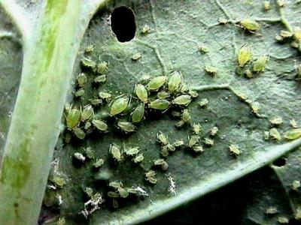
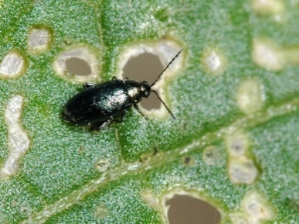
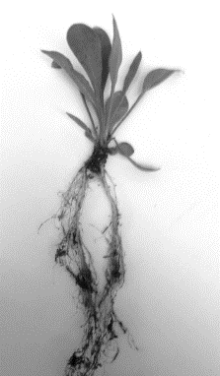
Plant genetics determines susceptibility to herbivores, but to a lesser degree than microbes!
Aphids Myzus persicae Flea beetles
Phyllotreta cruciferae
Nutrient Access
Pathogen defense
Herbivore defense
Tolerance of abiotic stress
Scientists focused on crop improvement should work as much (more?) on microbes
as plant genetics.
Notes:
Fundamental science: The effect on susceptibility of microbes is much greater than that of plant genetic pathways. This result is similar to the greater magnitude of effect of gut microbes on human BMI (in comparison to human genetic effects).

Slide 8
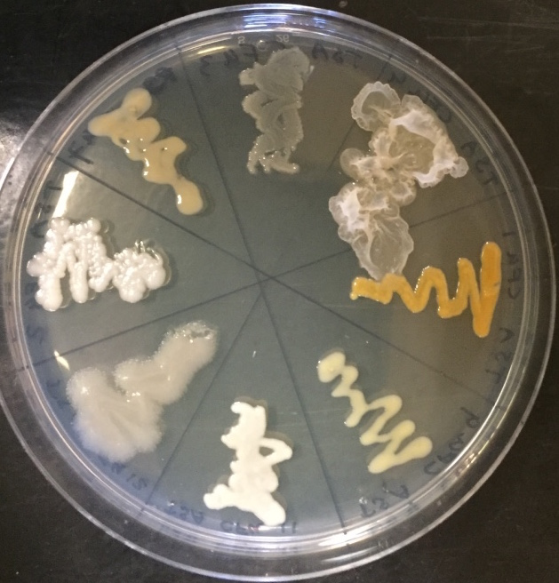
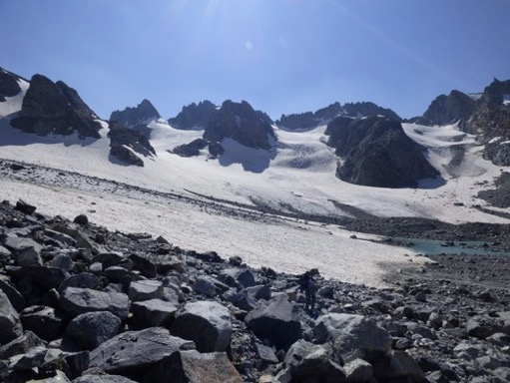
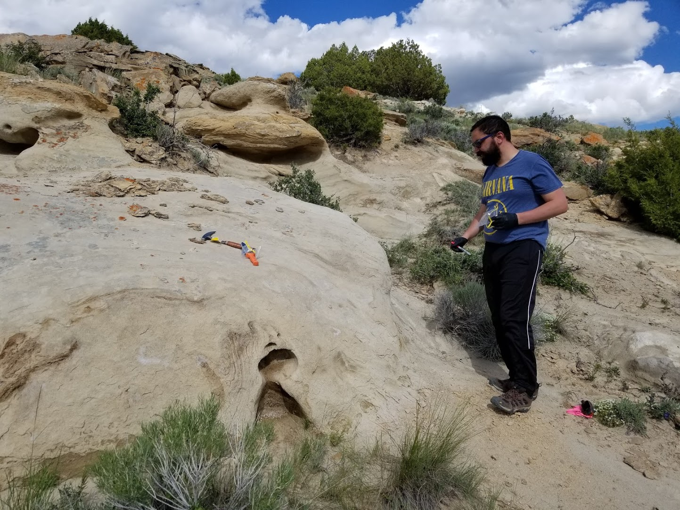
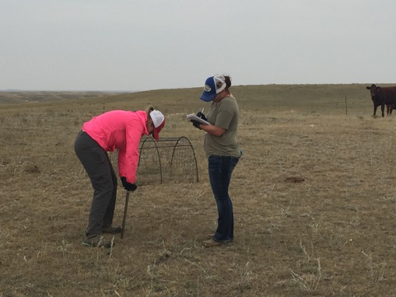
Microbial functional prospecting
Microbial taxa from:
developing soils after glacial retreat
agricultural soils in long-term grazing plots
plant roots and leaves
rock substrates
Notes:
add cultures and rock pictures

Slide 9
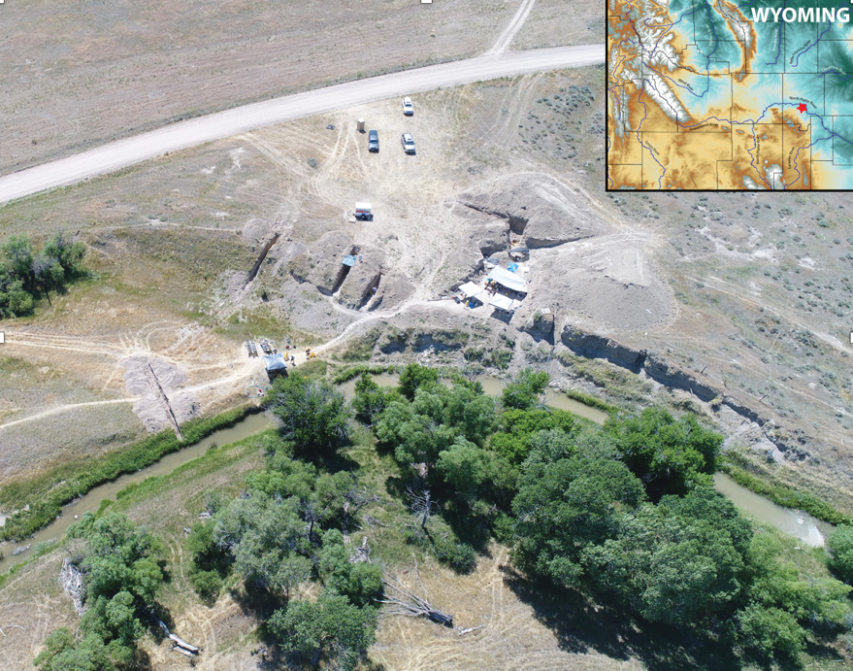
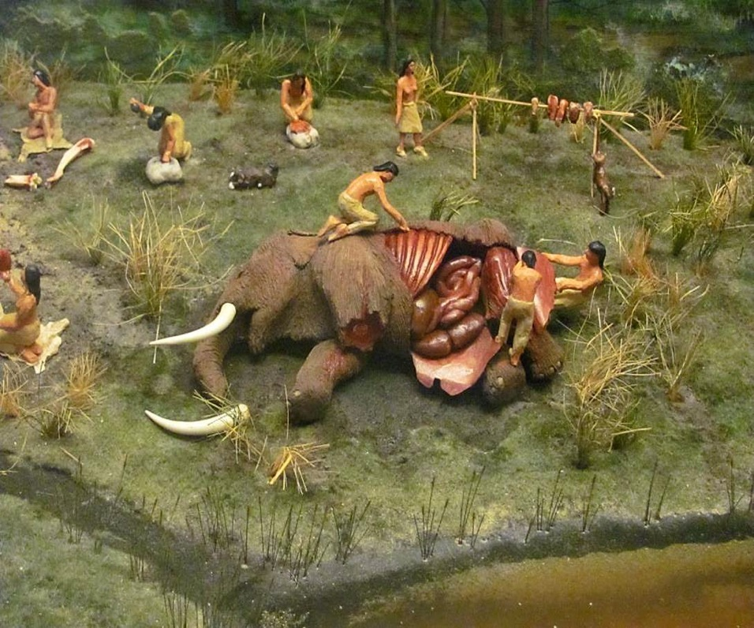
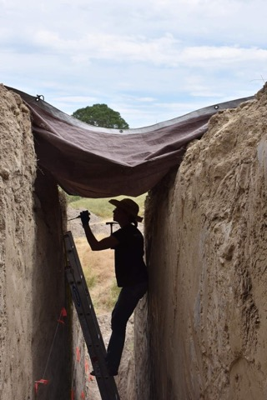
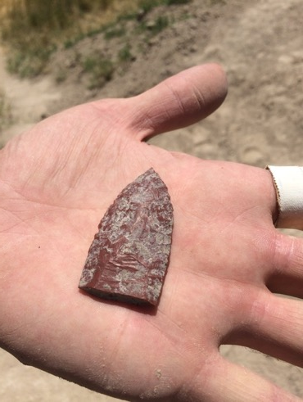
Microbes, climate, and human migration: paleomicrobiology at the
La Prele Creek mammoth kill site
Notes:
remove graph and resize pictures and change some pics

Slide 10
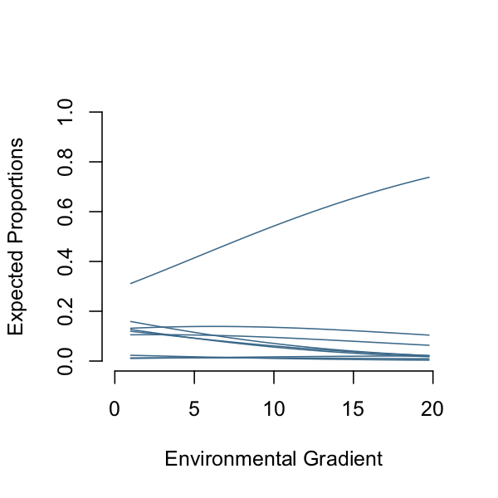
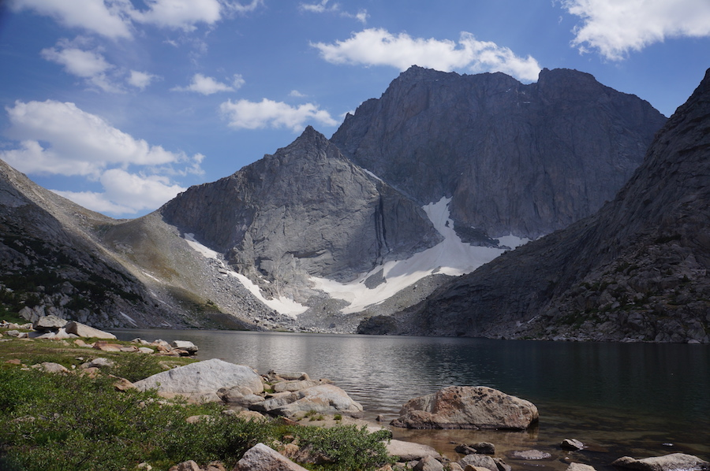
Novel computational statistics that leverage research computing
Notes:
point out that our computational models outperform existing appraoches

Slide 11
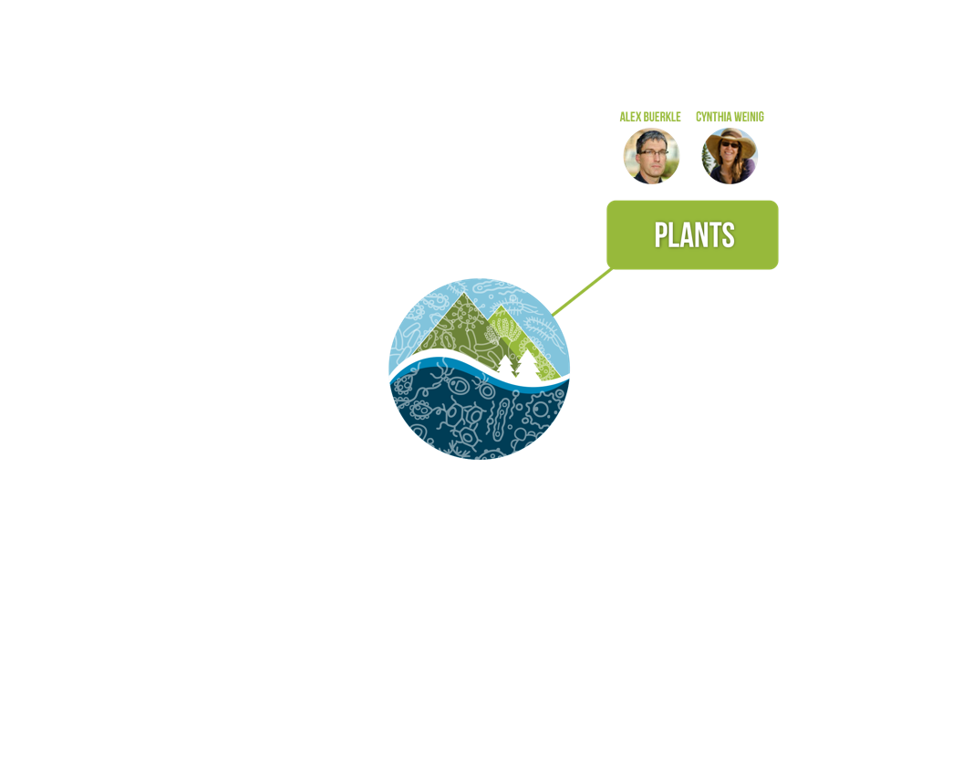
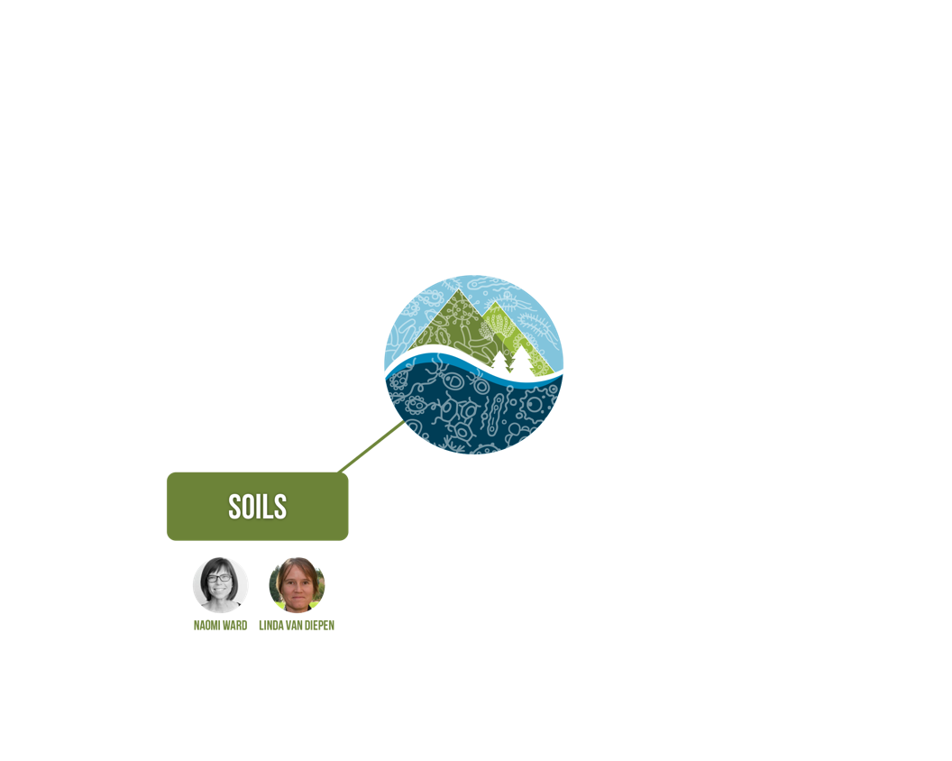
8 groups across 3 colleges & 5 departments, 2 core labs

Slide 12
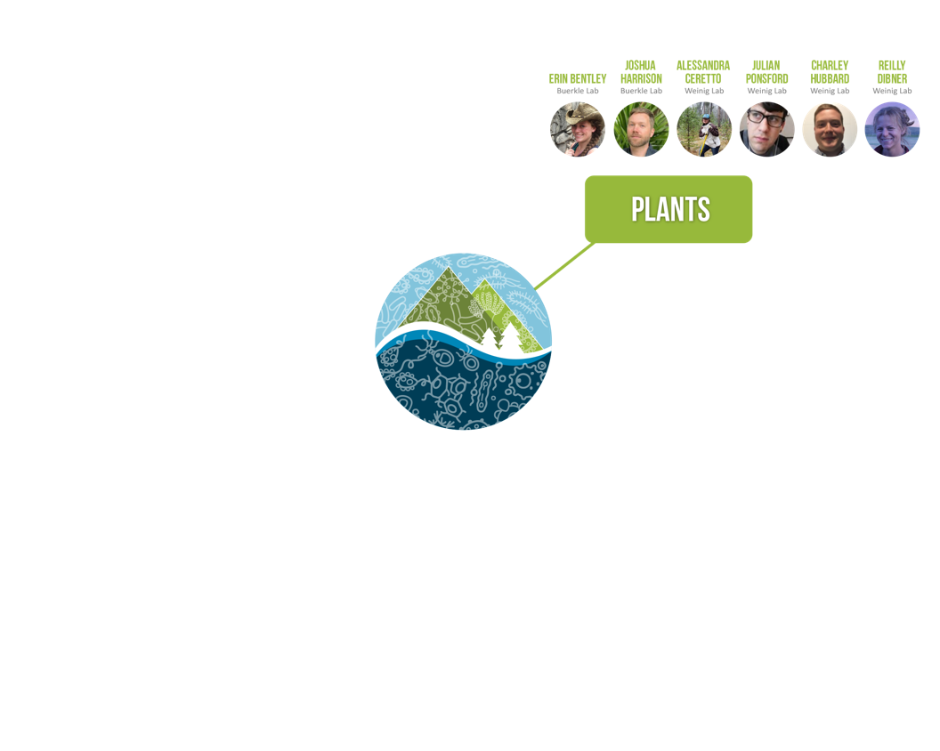
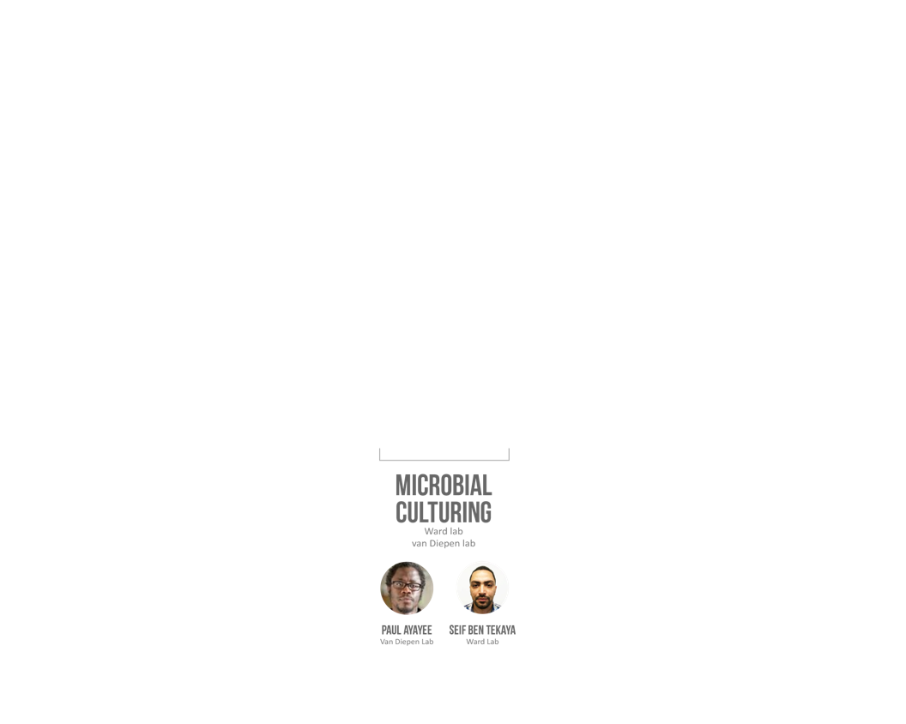
30 undergraduates, 15 graduate students,
7 postdocs, 4 new faculty

Slide 13
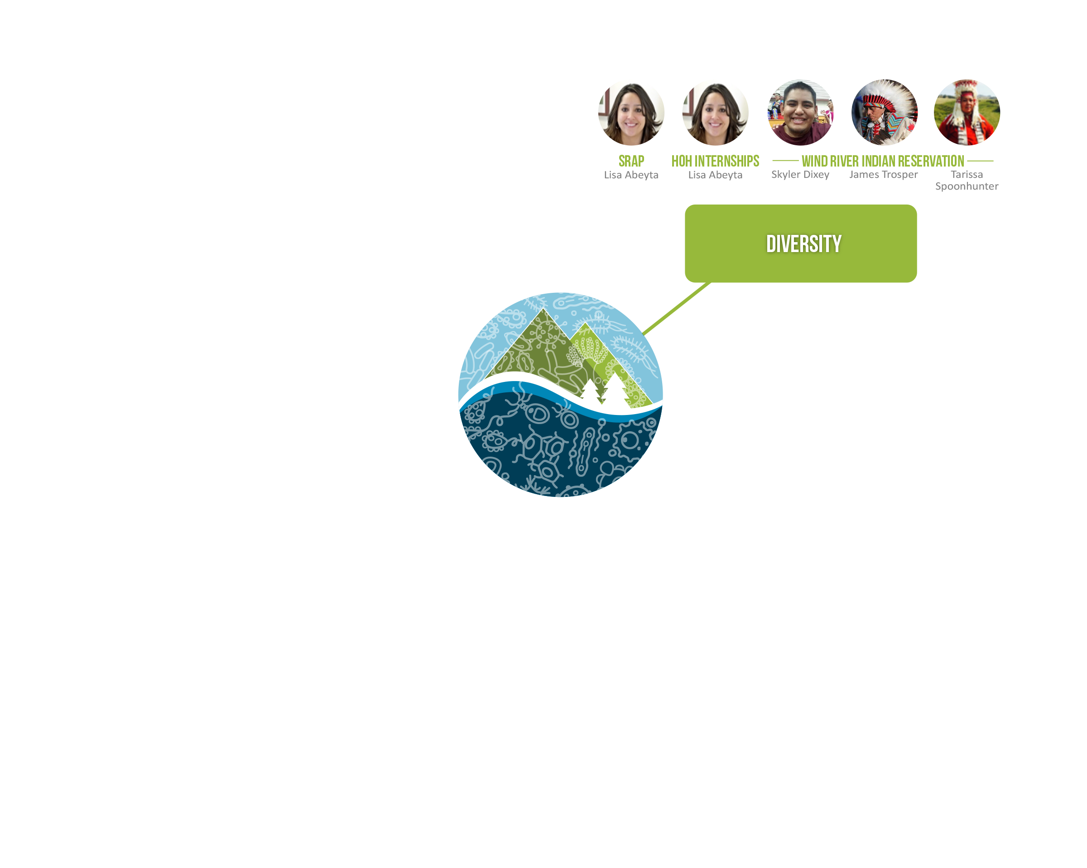
Leveraging research to benefit people in Wyoming and the nation
Notes:
Broader impacts

Slide 14
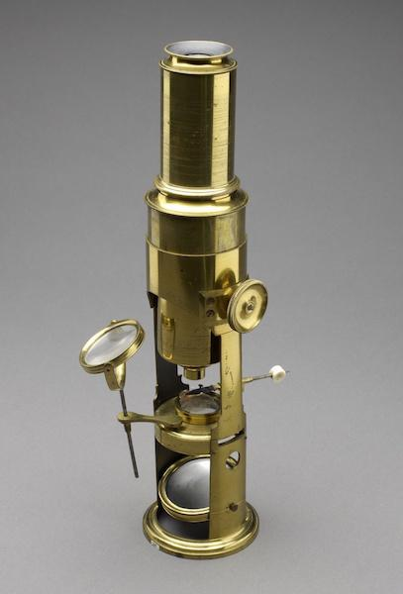
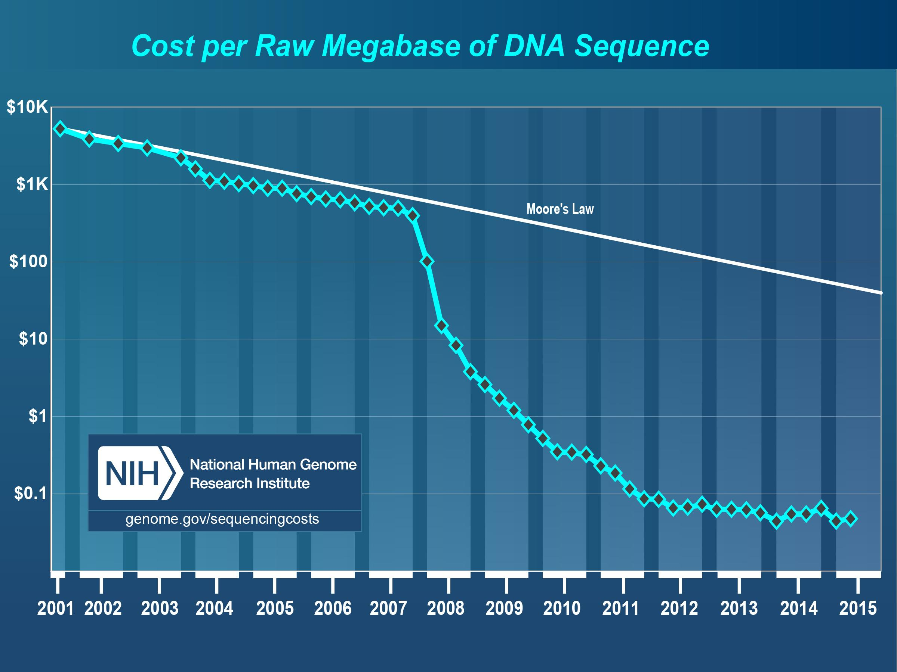
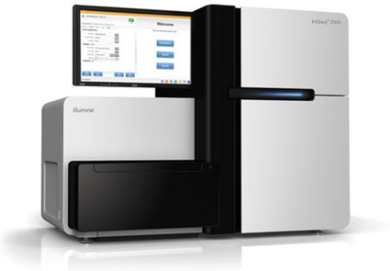
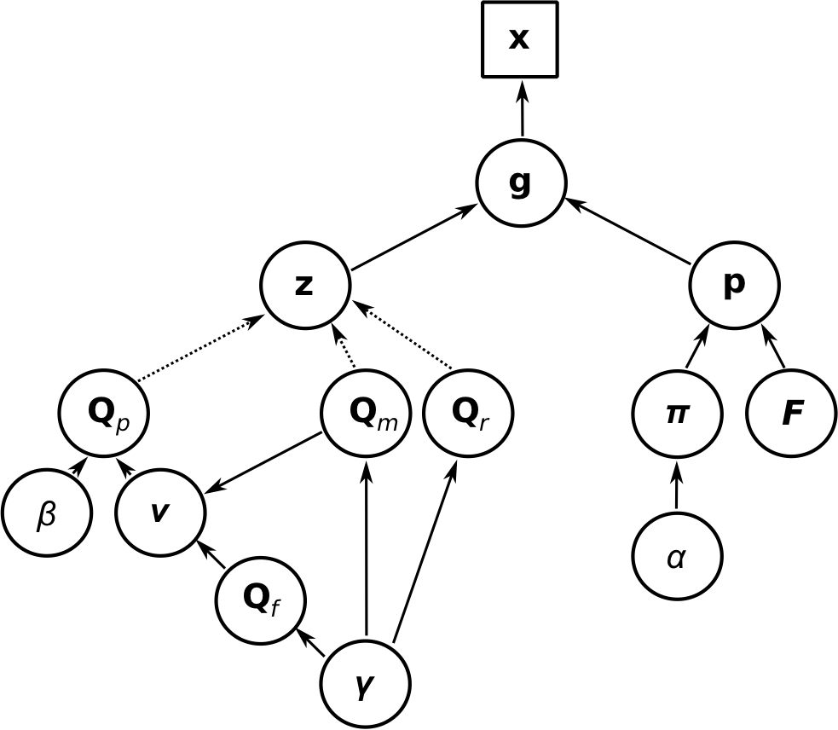
Transformational data science for Wyoming
Notes:
Internships with WEST … want to expand to other businesses and government agencies
Working group has interacted with data scientists at Plenty, Trihydro, WEST Inc. in Wyoming
FICO, IRS, and other government agencies
Help researchers at all levels overcome obstacles to productive analysis of data
Project-based semester courses, short courses, internships
Data science working group
Open office hours for consulting
Space for meetings and collaborative work
Substantial upgrade to shared computing system, Teton

Slide 15
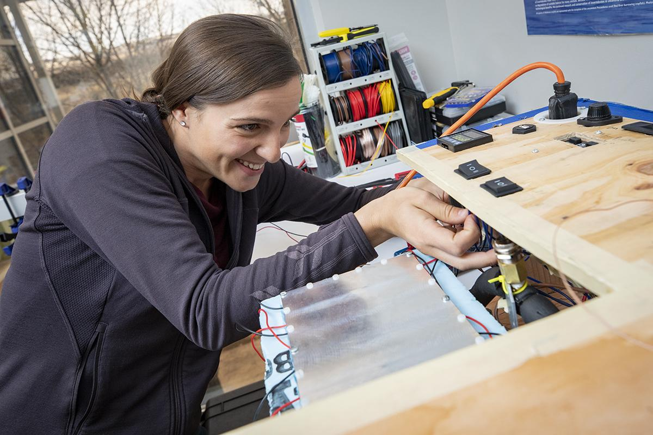
Wyoming Technology and Business Center: Entrepreneurial Competition
Microbial Ecology Collaborative Launchpad
Convert Micro research into businesses
Targets Wind River Indian Reservation and entire state
$50K competitions in years 3 and 4
1-3 teams chosen and coached in business model development and implementation
Notes:
Convert Micro research into commercial or non-profit businesses
Target Wind River Indian Reservation, a perennially underserved community that has had little access to a sustained effort at transforming concepts that might exist within that community into commercial outcomes
$50K competitions in years 3 and 4, requiring no business experience

Slide 16
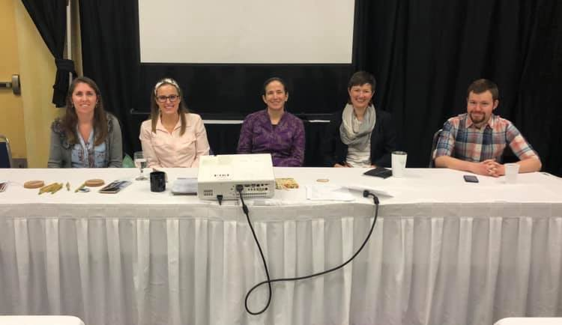
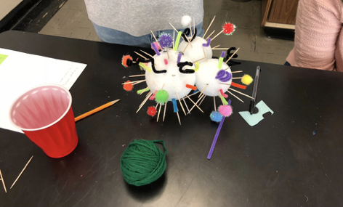
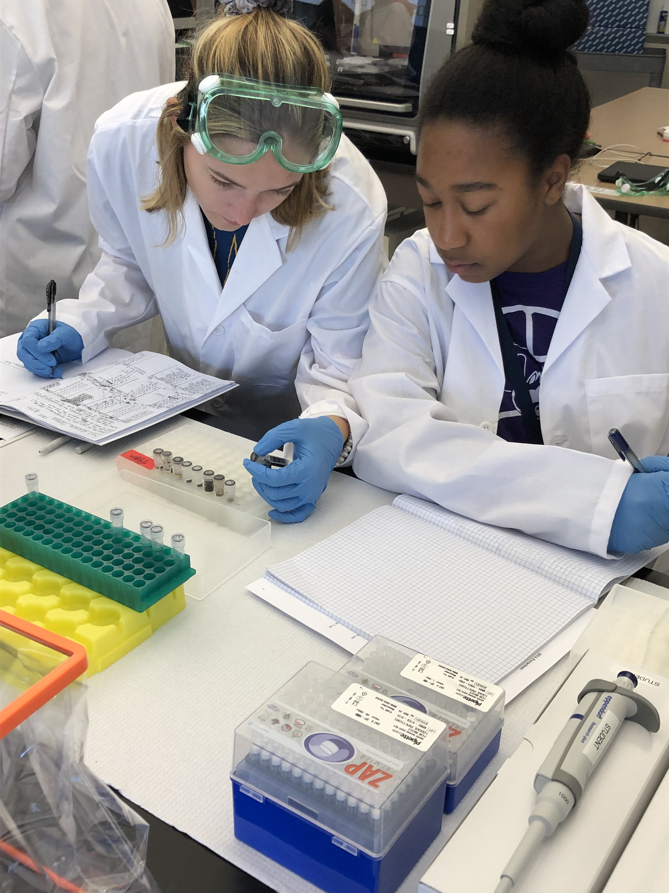
Novel Approaches to Outreach & Education
Art: Microbestiary and Science Loves Art
Communication: Science Journalism
Education: K-12, Teachers, Hard of Hearing, Science Fair
Workforce Development: WEST Data Science Internships and Community Colleges
Notes:
Improve science reporting through traditional print and social media via internships and science communication workshops
An art-science education and outreach project
Deaf and hard of hearing internships show that UW accommodates all students
High school program recruits and illustrates STEM careers

Slide 17
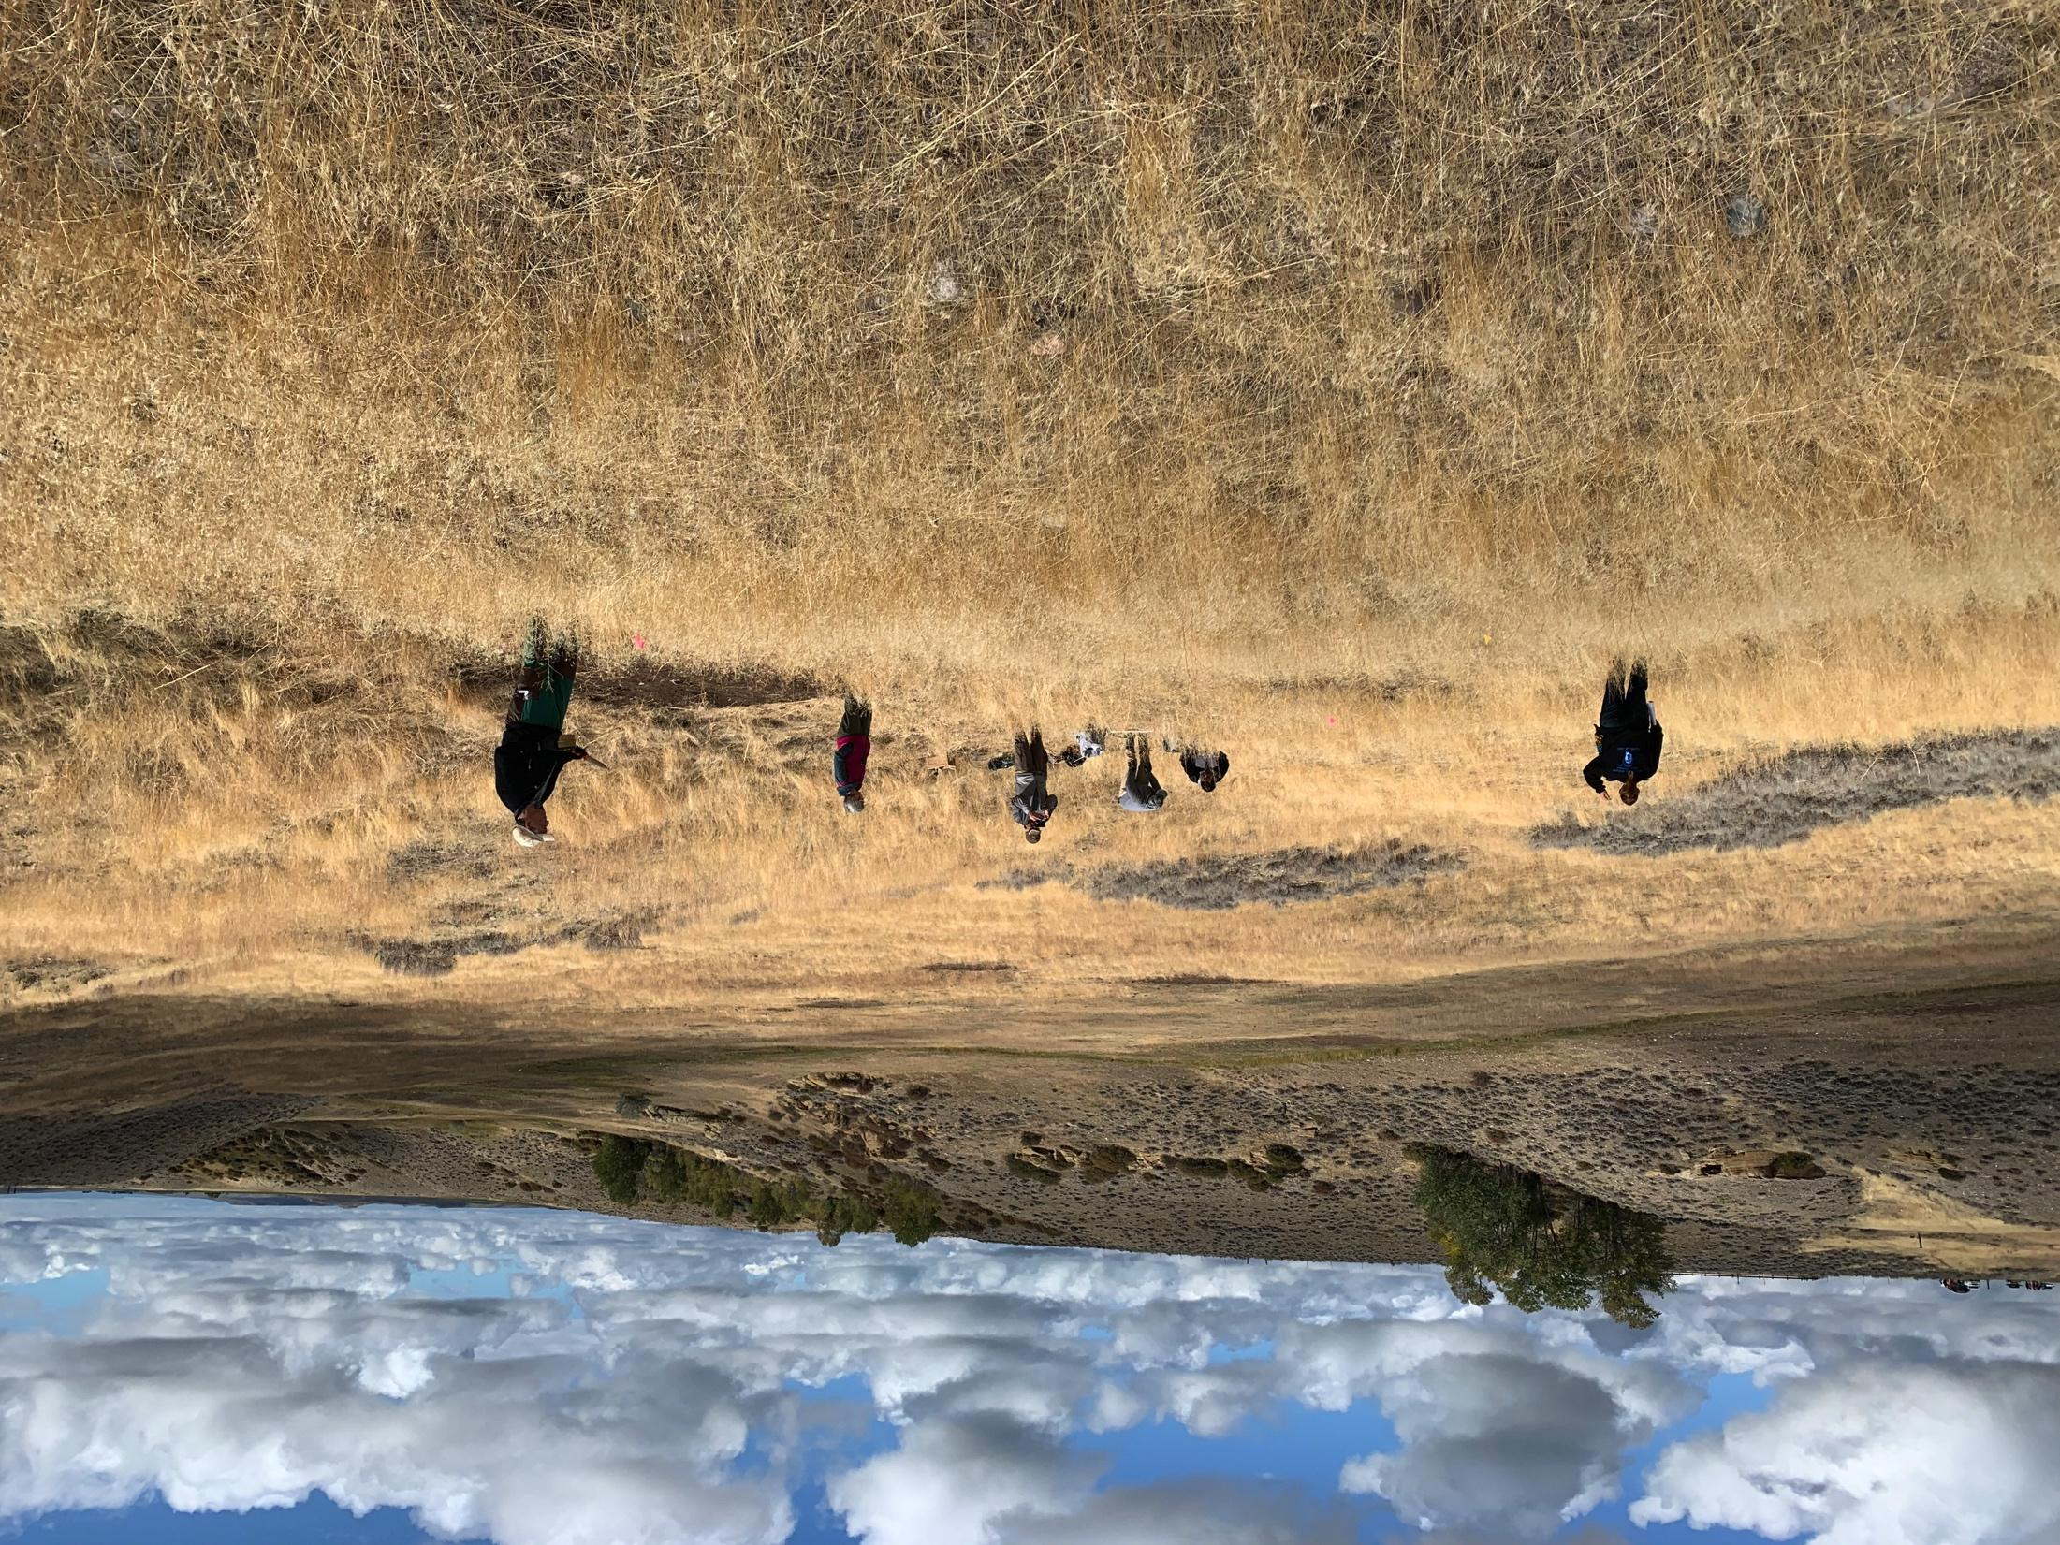
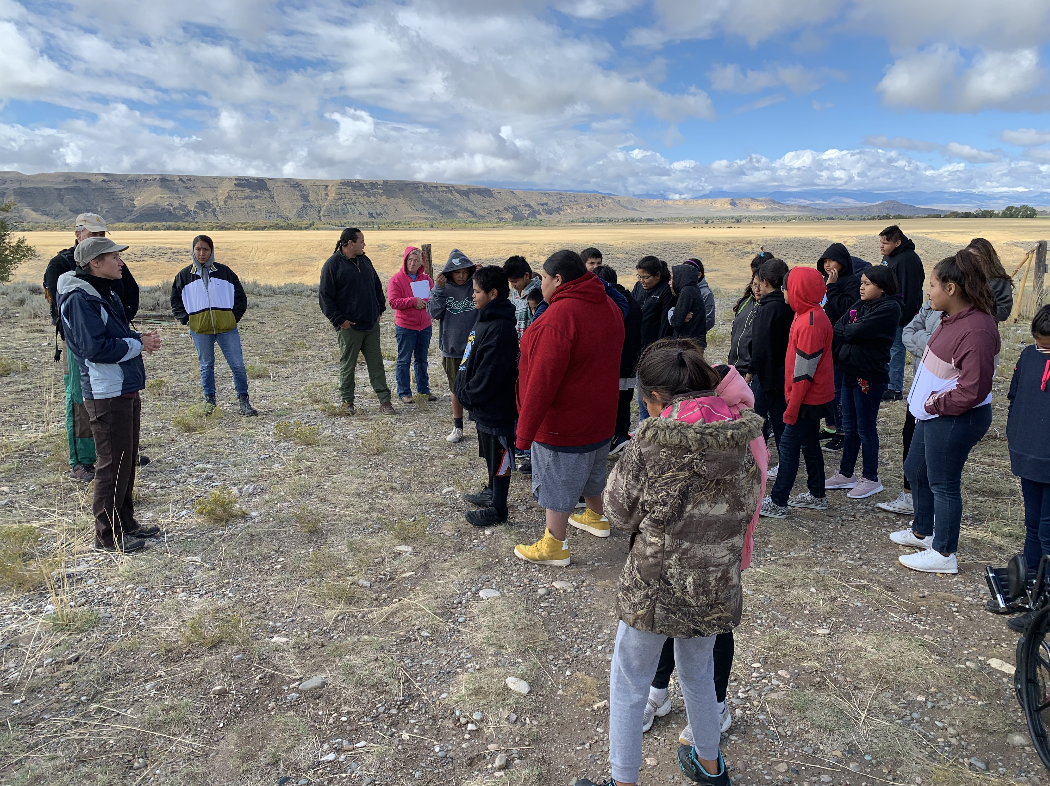
Research and Education Collaboration with Sovereign Tribes of Wind River
All work is initiated by tribal partners with resources provided to support sovereignty

Slide 18
Integration of EPSCoR Investments into Current and Future UW Initiatives
-Biodiversity Institute (BI) is incorporating many of the lessons from the EPSCoR approach to building UW and Wyoming
-Process for the next NSF EPSCoR Track 1 proposal begins Fall 2020
-EPSCoR proposal must leverage investments in Grand Challenges, AMK Ranch, Science, Ag. and Education Initiatives and others
Notes:
Winogradsky Column replace hot spring

Slide 19
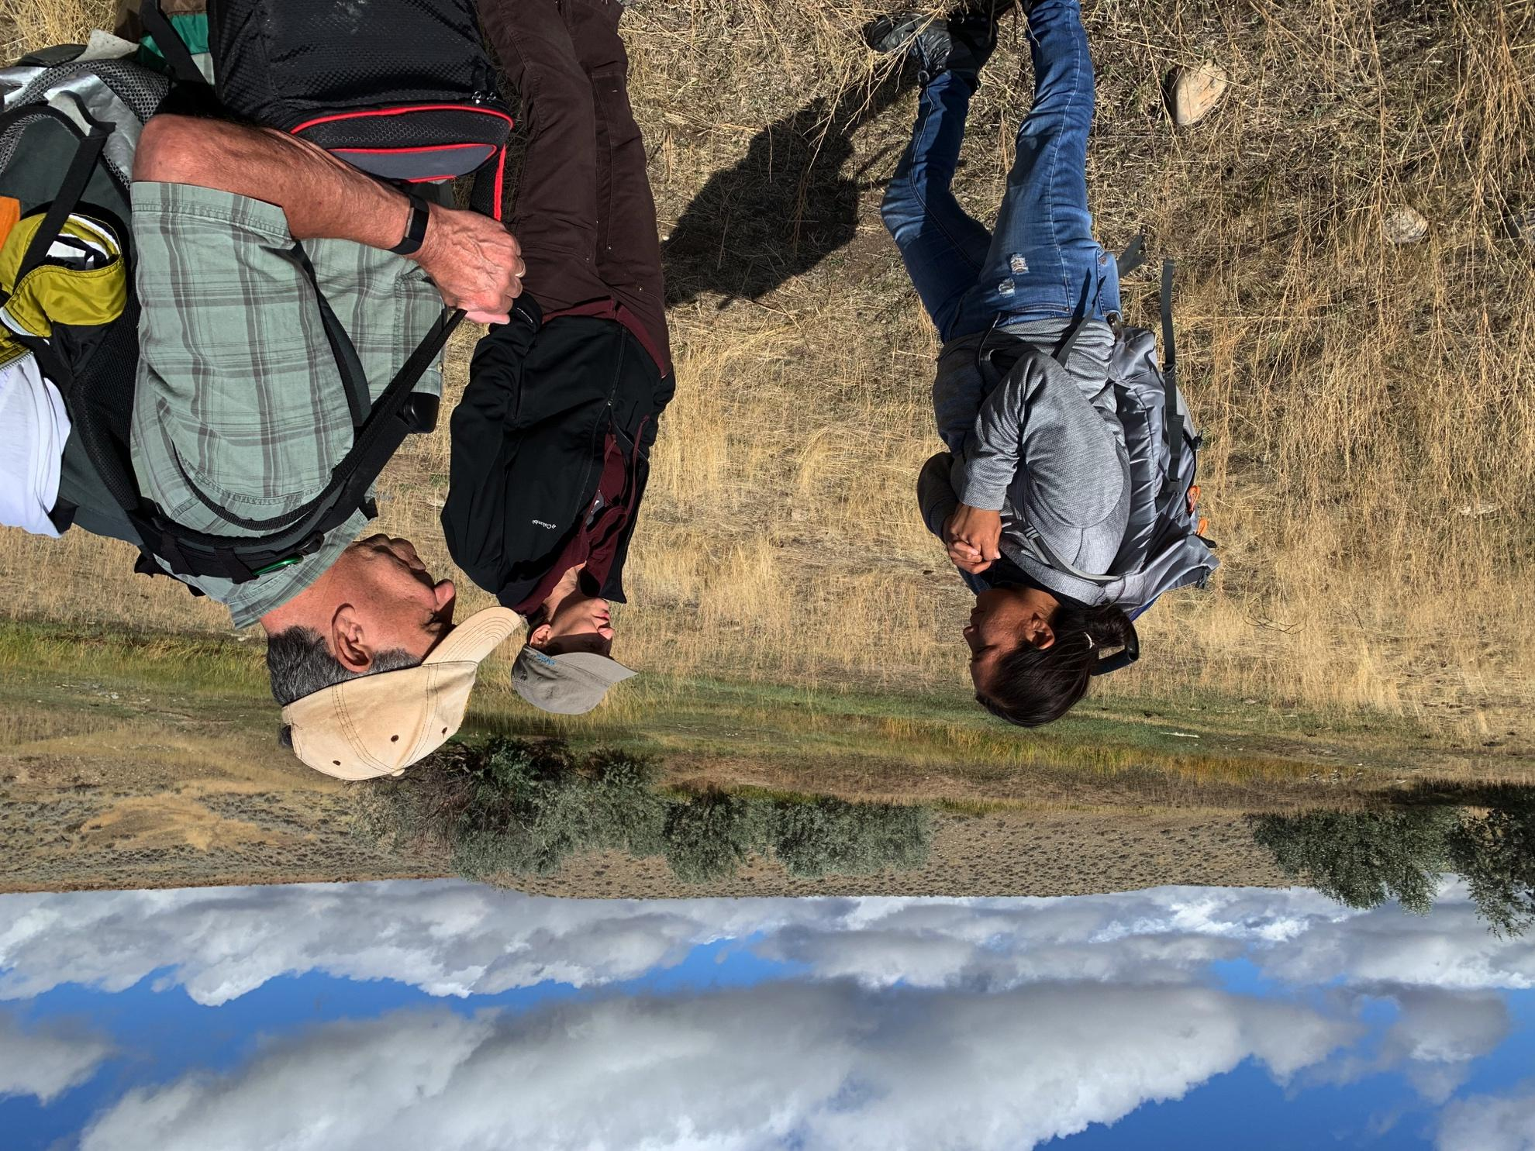
Discussion

