Slide 1
BEYOND The County: SO many Opportunities

Slide 2
Levels of 4-H participation
Club
County
Region
State
National

Slide 3
How do I find out more?
Club
Attend club meetings.
Communicate with club leader.
Social Media
Find a mentor parent or teen.

Slide 4
How do I find out more?
County / Regional
Read your newsletter
Social Media
E-mails from County Educator
Call your Extension Office
ASK QUESTIONS

Slide 5
What does the state offer?
Read Your Newsletter
State Facebook Page
State 4-H Website
State Opportunities Page
Contact Your Local 4-H Office

Slide 6
Wool and meat Judging April 19 - 20

Slide 7
Wool and Meat Judging
Individual Contest – County Teams are designated
Wool is on Friday night
Meat is on Saturday
Awards are on Saturday
OPEN TO ANYONE, do not need to be enrolled in a certain project to participate
Participate to see what it is about, even if you are not proficient
No county qualification needed

Slide 8
Showcase Showdown offers an opportunity for youth to explore various industries through contests and workshops. The event takes place at the University of Wyoming in Laramie, Wyoming. Youth can participate in contests, workshops, tours and activities over the course of three days.
Showcase Showdown June
18-20

Slide 9
Showcase Showdown June
18-20
Food Cook Off

Slide 10
Food Cook-Off
Team Contest – 2 to 4 youth per age group
Tuesday competition
Pick your own recipe around a theme. This year’s theme (2024) is Disney
Cooking happens on location
Top Senior team can compete at Food Challenge in Dallas, Texas
4-H Foundation provides $1000 scholarship to help cover costs

Slide 11
Showcase Showdown June
18-20
Produce Judging

Slide 12
Produce Judging
Individual Contest
Counties can designate teams
Thursday competition
Evaluation of 8 classes of produce (fruits and vegetables)
Younger members are asked questions about the classes
Older members give reasons about classes
Youth identify different types of produce

Slide 13
Showcase Showdown June
18-20
Robotics Contest

Slide 14
Robotics Contest
Team Contest
Tuesday during the day – Mission Challenge
Robots are given a series of challenges and programmed to complete these challenges
Tuesday evening – Sumo
Robots are designed to force another robot out of a circle.

Slide 15
Showcase Showdown June
18-20
Cake Decorating

Slide 16
Cake decorating
Individual Contest
Wednesday competition
Decorate foam cakes around a theme that is announced at competition
Foam cakes and frosting (white) provided
One hour to complete creation
Junior and Intermediate individuals get help frosting cakes
Coaches can help during 5 minutes of design phase

Slide 17
Showcase Showdown
Livestock Skillathon
Horse Judging
Hippology
Dog Skillathon
Table Setting
Presentations

Slide 18
Livestock Skill-a-thon
Team only contest – teams of youth work together
Teams of 3 to 5 members
Tuesday afternoon contest
Contest sections
Breed ID: cattle, sheep, swine, and goats
Quality Assurance
Feed Identification
Animal Evaluation (placing classes of animals)
Equipment Identification
Group Practicum
Seniors will also have Technology, Wool, and Meat Science
Top Team gets $1000 to go to National Contest

Slide 19
Horse judging
Individual Contest – Counties can identify teams
Wednesday afternoon contest
Youth evaluate halter classes and performance classes
Junior answer questions and can give reasons
Intermediates answer questions and give reasons
Seniors give reasons
Top 3 Senior teams get money to travel to National Competitions representing Wyoming

Slide 20
HIppology
Team Contest only
Teams consist of 2 to 5 people
Wednesday morning contest
Phase 1 – evaluate a class
Phase 2 - stations (27 options)
Types / Parts of saddles
Bridles
Grooming
Breeds
Phase 3 – exam
Top team will get $1000 to compete at Western National Roundup

Slide 21
Dog Skill-a-thon
Team and Individual Contest
Thursday morning contest
Four Part Contest
Jeopardy 25 questions
Breed Identification
Part Identification, internal organs, skeletal structure
Hands on stations and scenarios

Slide 22
Table Setting
Individual Contest
Thursday morning contest
Properly set a table for one guest at a meal or event
No food, but menus are needed

Slide 23
presentation
Individual Contest (can have teams but they will be treated as individuals)
Wednesday Contest
Impromptu
Draw three topics, pick one
3 minutes to organize thoughts
Notecards allowed
Prepared
Any topic
Can use powerpoint or other props if you want
Top two Seniors in each contest above will get $500 leadership trip scholarships

Slide 24
Maker Space Workshops
Fashion Workshops
Freezer Jam
Barn Quilt Art
Quilting
Paper Craft
Square Dancing
Leadership
And More!
Showcase Showdown WORKSHOPS
Rocket Workshop
And Launch

Slide 25
State Shoot JuLY
11-14

Slide 26
State shoot
Contest for Individuals with Counties designating teams
Must be in 4-H shooting sports and be deemed safe per your county requirements
Held in Douglas, Wyoming
Competition in all shooting disciplines
Camping and Dorms available
Dance on Saturday night
Awards on Sunday
Senior aged youth are selected to attend Raton Award Trip and National 4-H Shoot

Slide 27
Raton,
New Mexico
Shooting Sports Trip SEPTEMBER

Slide 28
Raton, New Mexico
Youth selected through shootings performance at State Shoot
Youth selected from portfolio submissions
Open to Senior aged youth (14-18)
Held at NRA Whittington Center
Youth shoot a wide array of firearms
http://www.uwyo.edu/4-h/projects/shootingsports/raton.html

Slide 29
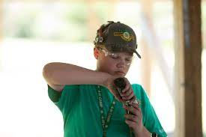
National 4-H Shoot June

Slide 30
Grand Island, nebraska
Youth selected through shootings performance at State Shoot
We look to fill 8 different teams
Open to Senior aged youth (14-18)

Slide 31
State Fair August
Livestock Judging

Slide 32
Livestock Judging
Contest for Individuals with Counties designating teams
Held Tuesday of the Wyoming State Fair in Douglas, Wyoming.
Youth evaluate classes of beef, sheep swine, and market goats.
Juniors answer questions and can give reasons
Intermediates answer questions and give reasons
Seniors give reasons.
The top three senior teams get monetary awards to represented Wyoming at National events.

Slide 33
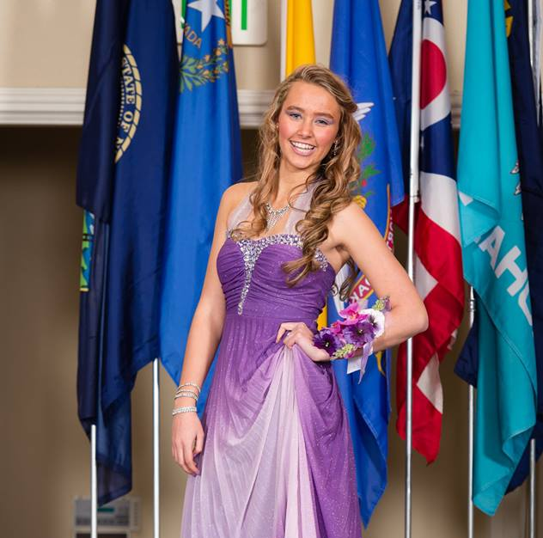
State Fair August
Fashion Revue

Slide 34
Fashion Revue
Contest for Individuals
Two contest
Ready to Wear
Constructed
Judging is Friday and Saturday of the Wyoming State Fair
Public Fashion Show on Saturday evening
Top two seniors in each category above win $500 trip scholarships.
http://www.uwyo.edu/4-h/get-involved/contests/fashionrevue/index.html

Slide 35
Other State Fair Opportunities
Animal Shows
Anyone can enter, there is no qualification for State Fair
Certain animals have showing restrictions
Animal Identification / Tagging requirements
Dog Safety requirements
Static Exhibits
Qualify through exhibition at County Fair.

Slide 36
State
Leadership Team

Slide 37
State Leadership team
Open to youth ages 14-18
Serve as the “face” of the Wyoming 4-H program.
Attend state activities, events and fundraisers.
Teach workshops.
Promote 4-H

Slide 38
Citizenship Washington Focus
(CWF) JUNE

Slide 39
Citizenship Washington Focus
For youth ages 14 -18
Meet youth from other states
Learn about leadership
Tour Washington, D.C.

Slide 40
IGNITE March
Washington, DC

Slide 41
IGNITE
Youth ages 14-18
Explore Healthy Living, STEM, Agriscience, and Career Readiness
Meet youth from other states

Slide 42
National
4-H Conference APRIL

Slide 43
National 4-H Conference
For youth ages 14-18
Focus on policy development and government process
Youth research issue and develop policy presentations for government officials
http://www.uwyo.edu/4-h/get-involved/travel/national4hconference/index.html

Slide 44
National
4-H congress November

Slide 45
National 4-H Congress
For youth ages 14 - 18
Focus on diversity and community service
Held in Atlanta, Georgia
Famous guest speakers
Try new foods and participate in unique experiences
http://www.uwyo.edu/4-h/get-involved/travel/national4hcongress/index.html

Slide 46
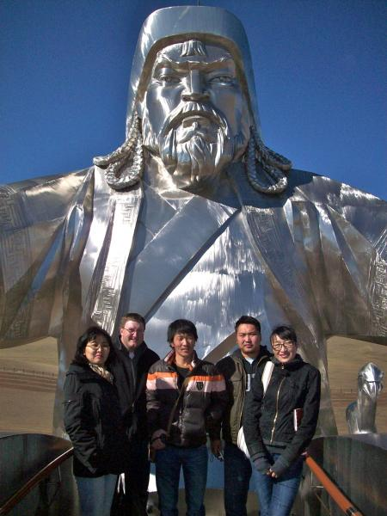
CROSS - CULTURAL opportunities

Slide 47
International
For youth ages 14 – 18
Different countries each year
Belize (2024)
Hawaii (2024)
Italy (2025)
Finland (2025)
Learn something new and share your traditions with others

Slide 48
Food
Fun
4-H

Slide 49
Cook in your home
Families who sign up get monthly recipes with educational materials to prepare together.
Families who prepare at least two dishes from the recipe packet get a free kitchen utensil.
Promote family time and cooking.

Slide 50
307 Judging Series

Slide 51
Travel the state
Youth attend contests throughout the state to accumulate points.
Youth with most points at State Fair contest make all state team.
Senior All State team travels to National Contest together.

Slide 52
Teen Summits

Slide 53
Teen Leadership Summit
Held in a variety of locations in Wyoming
For youth ages 13 and older
Leader new skills
Team building
Meal Etiquette
Financial Management
Career Exploration
Still Happening in Casper on May 4-5!

Slide 54
What Else?
College scholarships
AmeriCorps experience for college students and adults at local Extension Office
Foundation Shooting Fundraisers
Boulder Big Draw (Archery near Pinedale)
Platte River Shootout (Shotgun near Saratoga)
Apache Clear Creek Shootout (Shotgun near Ucross)
Counties Host experience for Region or State

Slide 55
What are counties / states offering?
Virtual Career Night – March 19
Shooting Sports Jackpot – April 6 (Gilette)
Creative Arts Project Palooza – April 6 (Lusk)
Small Animal Project Palooza – April 13 (Casper)
Catch a Calf – Sign up by December 15th for 2025 (Denver)

Slide 56
Your Role?
Make youth aware of opportunities
Encourage them to attend
Help with raising funds – don’t let money stand in their way
Coach a team
Serve as a chaperone
Invite youth to share their experience at a meeting (club or county)

Slide 57
Let’s take a closer look
Where can you find this information?

