Slide 1
Helping 4-H Members Reflect Please type your name and county in the chat so we can record who was here for Leader Training.

Slide 2
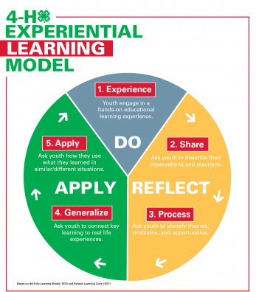

Slide 3
Experience – “Do It”
What does this look like in 4-H?
Perform or Do the Activity
Making something
Playing a game
Presentation
Working with your animal
Motions at club meetings

Slide 4
Share – “What Happened?”
What does this look like in 4-H?
Talk about the results, reactions, and observations
Discuss feelings
Talk freely
What did you do?
What happened?
What did you see? Hear? Feel? Taste?
What was easy? Difficult?

Slide 5
Process– “What’s Important?”
What does this look like in 4-H?
Discuss, analyze, reflect on the experience.
How was the experience carried out.
What problems or issues occurred.
What were members personal experiences?
What reoccurring themes emerged?
What problems or issues occurred over and over?
What similar experiences have you had?

Slide 6
Generalize – “So What?”
What does this look like in 4-H?
Connect experiences with real life.
Find trends and common truths.
Capture the learning – key terms, life skill terms.
What did you learn about yourself through the activity?
Why is (life skill) so important in your daily life?
How does what you learned relate to other parts of your life?

Slide 7
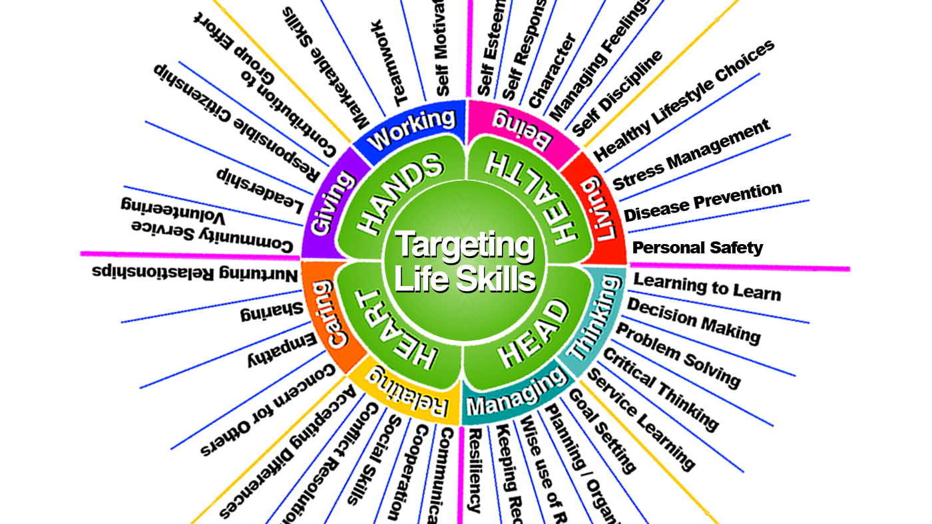

Slide 8
Apply – “Now What?”
What does this look like in 4-H?
Apply to similar learning.
Learn from past experiences?
How can it be used in the future?
Create ownership for what was learned.
How can you apply what you learned to a new situation?
How can you act differently in the future?
How could you apply (a skill) learned through this activity in the future?

Slide 9
Test Your Knowledge…
What advice would you give to someone who wants to learn more about teamwork?

Slide 10
Test Your Knowledge…
What did you do to plan your project?

Slide 11
Test Your Knowledge…
How will you act differently in the future as a result of this experience?

Slide 12
Test Your Knowledge…
Playing a teambuilding game.

Slide 13
Test Your Knowledge…
What made this a good project for our club?

Slide 15
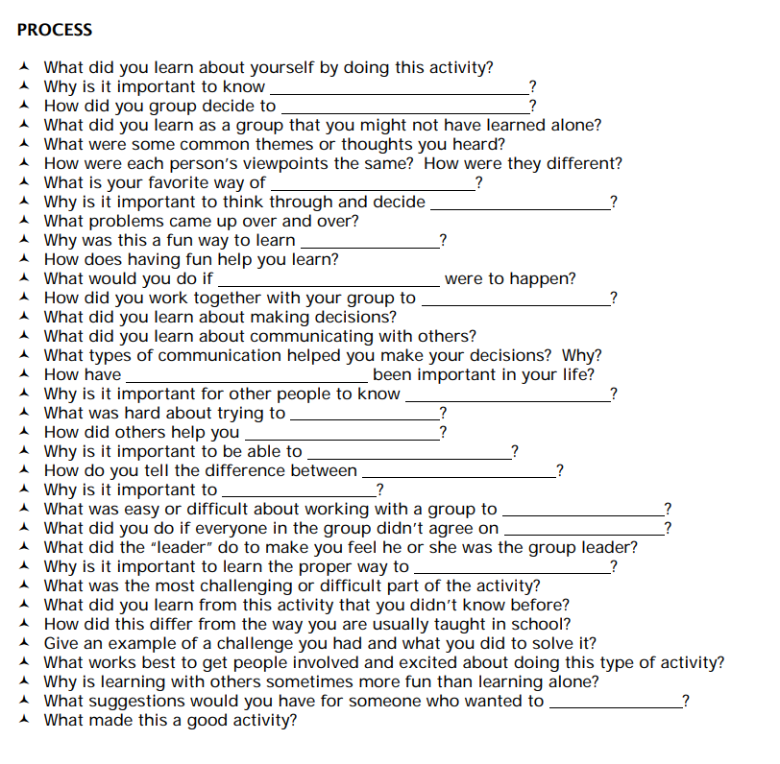
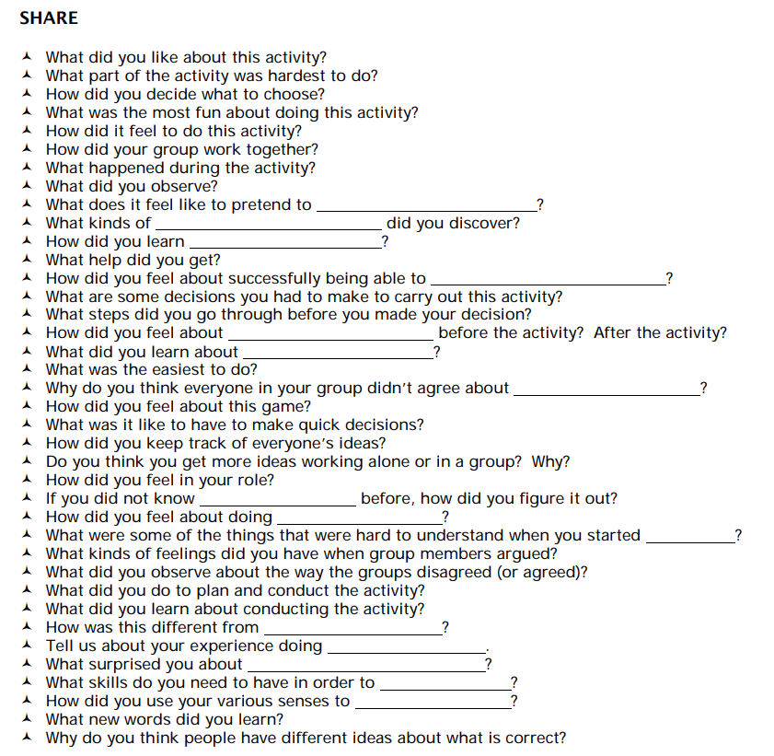
Lots of Questions

Slide 16
How else can you process with a group of 4-H youth?
Journaling in words or pictures.
Interview each other about how things went and then report back to the group.
Worksheets with prompt questions to take home, discuss at next meeting.
Debriefing Activities

Slide 17
The Experience itself is neither productive nor nonproductive, it is how you reflect on it that makes it significant or not significant.”
-Gavin Bolton, 1979

Slide 18
Debriefing Activities

Slide 19
Alphabet Block
Notes:
On the next screen you will see a collection of letters, in this case they are scrabble tiles, but when doing this with your 4-H members you could use anything that has letters.
You would toss them out towards the group and let them know that only the ones facing up are the letters they can use.
On the next slide as a group I want you to work to create connections or even make words from the various letters that help talk about what you have learned so far this evening…or even things you have learned as a 4-H leader or parent….ready…..

Slide 21
Crossword Ending
Notes:
On the next page you will see a word in the middle that describes something about this workshop. As a group we are going to make a crossword puzzle of things we have learned today or words that describe today. I am going to do my best (or you can) to add the words using the zoom annotation…we will see how this goes.

Slide 22
REFLECT

Slide 23
Food for Thought
Notes:
On the next page you will see a word in the middle that describes something about this workshop. As a group we are going to make a crossword puzzle of things we have learned today or words that describe today. I am going to do my best (or you can) to add the words using the zoom annotation…we will see how this goes.

Slide 24
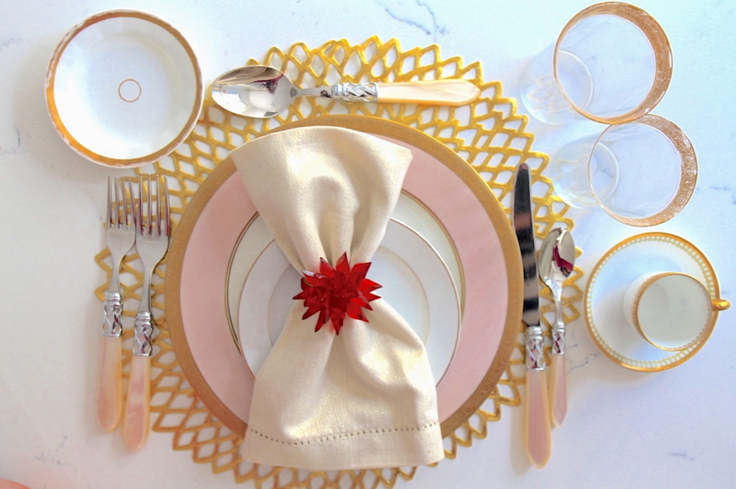
REFLECT
Notes:
What kind of things might be on your plate after today?
What kinds of things do you want to take a stab at?
What kinds of things do you want to cover?
What kinds of things are cutting away at your time or may be barriers?
What things would you like spoon fed – help with?

Slide 25
Picture Cards
Notes:
On the next page you will see a word in the middle that describes something about this workshop. As a group we are going to make a crossword puzzle of things we have learned today or words that describe today. I am going to do my best (or you can) to add the words using the zoom annotation…we will see how this goes.

Slide 27
Other debriefing “games”
All My Neighbors
Clay Sculptures
Fear in a Hat
Group Drawing
Notes:
All my nieghbors – have you ever….
Clay sculptures
Fear in a hat – a the beginning of your meeting or activity have each youth (or adult or both) write a concern, fear, or question they ahe about the topic your planning to cover…read the fears after mixing them up. At the end of the day talk about fears, if they were addresses, etc.

Slide 28
Questions?

