Slide 1
APPRECIATION AND RECOGNITION
While you wait for the meeting to start please type your name and county in the chat box.

Slide 2
Why is this important?
Everyone in some way desires to be recognized.
Positive recognition brings about positive attitudes and behaviors.
Youth become active in 4-H because they benefit from it personally, not because they see the big picture of the 4-H program.
Recognition can be a motivator for youth and adults to excel and take risks.
Recognition provides youth and adults with feedback.

Slide 3
Basic Beliefs about Recognition in 4-H Programs:
A balance between intrinsic (self-evaluation) and extrinsic (rewards given by others) recognition is essential.
Everyone needs to be recognized at some time for their efforts.
Recognition is more meaningful when it occurs soon after it is earned and is related to a specific task.
Appropriate recognition for an individual varies depending on their age, past experiences, family lifestyle, community and cultural heritage.
Recognition is more meaningful when given by someone closely related to the person.
Individual choices in learning and participation need to be allowed and recognized.

Slide 4
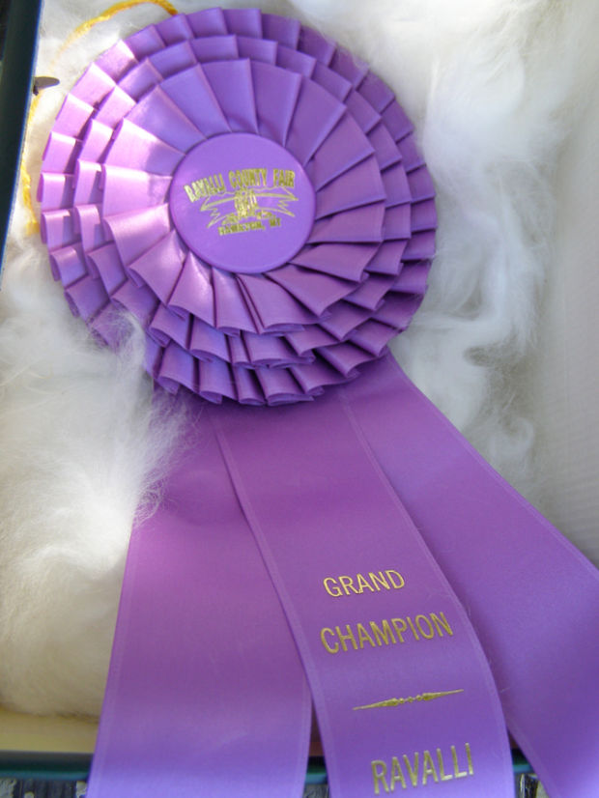
What does this mean?
Not everyone will win a Grand Champion Ribbon.
Not everyone will win Volunteer of the Year
Not everyone will be the President of their 4-H club.
Everyone needs somethings, but it doesn’t have to be the biggest and best award to meet the needs youth and adults have for recognition.

Slide 5
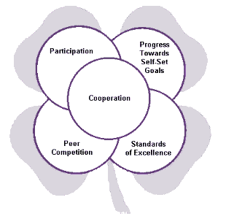
4-H Recognition Model

Slide 6
Peer Competition
A concrete time and place.
Best team or individual wins, other lose.
First, second, third, fourth, etc. place ribbons used.
Can be highly motivating for some youth.
High risk recognition, make optional and minimize if possible.
Leader / Parent attitude determines the intensity of the competition.
Research shows it is not appropriate for youth under 8.
Where do you find peer competition in Wyoming 4-H?

Slide 7
What does this recognition look like?
Youth / Volunteers / Families get a – plaques, medals, pins, certificates, tangible award
Record Books
Best in Something
Contests
Showing Animals
Scholarships
Volunteer of the Year
Family of the Year
Club of the Year

Slide 8
Progress Toward Set-Goals
Youth, Parents, Families and Volunteers can set goals, this is not just for members!
Need to check in on progress.
Recognition makes us feel good about progress and it can make us want to continue.
Examples: positive feedback, pins, certificates, handwritten notes.
Where do you see this in Wyoming 4-H?

Slide 9
What does this recognition look like?
Positive feedback
Public reception, club picnic, some event
Names in newspaper, newsletter, bulletin board, family refrigerator
Send letter to member or parents
Certificate
Have member write a letter to a leader congratulating them
Show and tell for club or community
Tangible “award”, met goal for sewing get new fabric

Slide 10
Achieving Standards of Excellence
The work youth are doing are compared to standards.
Awards would be blue, red, and white; no ranking of individual projects.
Often standards are written so youth know what they need to do to achieve.
Where do you see this in Wyoming 4-H?

Slide 17
Practice Judging Classes at Meetings to help in understanding Standard of Excellence

Slide 18
Cooperation
Young people working together allows them to examine their own skills.
Working together lets a young person explore solutions beyond their own ideas.
Society (school and business) is turning to cooperative learning, this is giving 4-H member an outlet to prepare for real life.
Where do you see this in Wyoming 4-H?

Slide 19
Offering 4-H Skillathons at meetings can help to encourage Cooperation

Slide 20
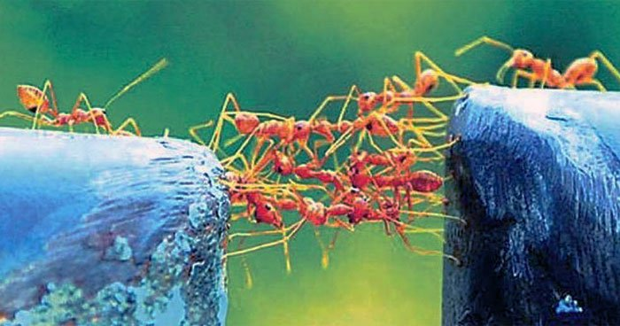
What does this recognition look like?
Positive feedback
Picnic or fun event
Certificate

Slide 21
Participation
Recognizes kids for being involved in experiences.
For some just being part of 4-H is an accomplishment.
Builds self-esteem.
Where do we see this in Wyoming 4-H?

Slide 22
WHY is this part of the recognition model?
Recognizing a youth for participating tells them that they are important people because of what they have learned and contributed to a 4-H learning experience. Recognizing youth for their participation also gives them a sense of belonging and that the 4-H organization values their membership. Recognizing youth participation helps build a 4-H member’s self-esteem.

Slide 23
What does this recognition look like?
Membership Card
Folder
Certificate
Celebration
Year completion pins
Letters / Notes
Shirts
Small tokens – cookie cutter, gift certificate
Birthday celebrations / birthday cards
Name badges
High fives
Acknowledgement of attendance
Say the 4-H / American Flag Pledge

Slide 24
Appreciation
Goes hand in hand with recognition, show people you care and that you value them as part of the 4-H program, or even as part of your life.

Slide 25
Why is appreciation important?
Makes people happy (those who initiate appreciation and those who receive appreciation)
Increases cooperation and motivation to be part of the group or team.
Builds trust.
Shows respect and helps to gain respect.
Appreciation is a form of currency.
Increases engagement and creativity.
It creates a story with a future.

Slide 26
Who to appreciate in 4-H?
Members
Volunteers
Parents
Donors
Money
Space
Materials
Guest Speakers
Cooperating Businesses

Slide 27
How to show appreciation:
Say it.
Say good job, thank you, I appreciate you, etc.
Show it.
Smile
Body language – high five, hug, elbow bump, fist bump
Write it.
Thank you notes
Give it.
Random acts of kindness
Baked goods
Gift certificates

Slide 29
Writing a Thank You Note
A statement to the people you are thanking. Is it one person? A couple? Mother and daughter? An entire family? A business? A donor? Always address the note to an individual.
Who is doing the thanking? (You alone? On behalf of your club or county 4-H? Your family?) If only one person’s writing that person should thank on behalf of everyone involved.
Mention something noteworthy about the event or gift. (Great food! Good music! Pretty flowers on the table. Usefulness of the gift. What you learned. How the donation was used. How many people were reached?) This is the time to tell the person details.
It's nice to remark about the thoughtfulness of the giver or donor.
Always end in an upbeat, pleasant tone.

Slide 30
Some practical ideas:
Elect or appoint a Corresponding Secretary or Committee to write thank you notes.
Buy them thank you notes and stamps.
Spend time at each meeting talking about at least one person to write to.
Get them a subscription to the local newspaper if possible.
Include recognition and appreciation in your club operating guidelines or at least in your meeting agenda.
Find time to celebrate. Spend your club funds on this, it’s important!
Create an awards committee.
Recognize EVERYONE in your group, parents, members, volunteers, donors.
Plan cooperation, stand of excellence, and progress toward goal time into your meeting, even if it is only for a few minutes.
Use a bulletin board or social media outlet to congratulate youth on a job well done in and outside of 4-H.

Slide 32
Questions?

