Slide 1
Helping YOuth with Record Books
While you wait for the meeting to start please type your name and county in the chat box.

Slide 2
Today’s goals
Better understand types of competition and how record keeping fits into the recognition model.
Better understand what you as a volunteer can do to assist in a successful record keeping experience.
Take a look at Zingbooks, our new record book system.

Slide 3
4-H recognition model

Slide 4
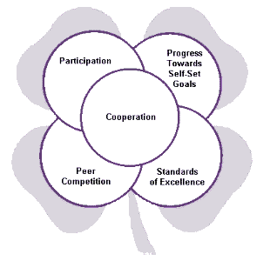

Slide 5
Peer Competition
A concrete time and place.
Best team or individual wins, other lose.
First, second, third, fourth, etc. place ribbons used.
Can be highly motivating for some youth.
Where do you find peer competition in Wyoming 4-H?

Slide 6
Participation
Recognizes kids for being involved in experiences.
For some just being part of 4-H is an accomplishment.
Builds self-esteem.
Example: stickers, pins, certificates, news articles, shirts, etc.
Where do we see this in Wyoming 4-H?

Slide 7
Progress Toward Set-Goals
Volunteers help youth set goals and then work to achieve them.
Need to check in on progress.
Recognition makes them feel good about progress and it can make them want to continue.
Examples: positive feedback, pins, certificates, handwritten notes.
Where do you see this in Wyoming 4-H?

Slide 8
Achieving Standards of Excellence
The work youth are doing are compared to standards.
Awards would be blue, red, and white; no ranking of individual projects.
Often standards are written so youth know what they need to do to achieve.
Where do you see this in Wyoming 4-H?

Slide 9
Cooperation
Young people working together allows them to examine their own skills.
Working together lets a young person explore solutions beyond their own ideas.
Society (school and business) is turning to cooperative learning, this is giving 4-H member an outlet to prepare for real life.
Where do you see this in Wyoming 4-H?

Slide 10
Wyoming 4-H Experience

Slide 11
Why Do We keep records?
Record keeping is a valuable life skill.
Records can be used to complete future applications (scholarship, job, school clubs, etc).
Can serve as a great reminder of positive 4-H experiences.
Allows for participation, peer competition, achieving standards of excellence, and progress toward set goals.
Honors Club membership.

Slide 13
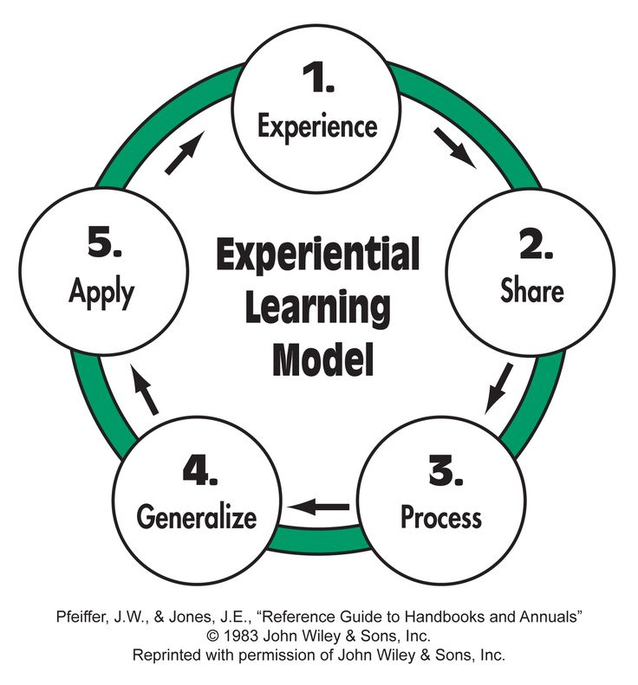
http://oces.okstate.edu/sedistrict/educators-only/protected/4-h-resources/4-h-times-newsletters/learningmodelquestions.pdf

Slide 14
Goal Setting
Iowa State has a helpful reference…
https://www.extension.iastate.edu/hancock/sites/www.extension.iastate.edu/files/hancock/setting%204-H%20goals.pdf
Goals need to be
Specific
Meet your needs and interests
Talk about what you want to learn
Achievable / Achievable in reasonable time frame
Show progress

Slide 15
Goal Setting
3 parts
ACTION – HOW you are going to meet your goal.
RESULT – WHAT you will do.
TIMETABLE – WHEN you will do it
The 3 parts make up the Project Plan portion of the portfolio
TAKE AWAY – Spend time with youth, first or second meeting setting goals.
TAKE AWAY – Spend time with youth at every meeting reviewing goals and their progress toward the goal.

Slide 16
Ideas for Keeping Records
Notebook with sections.
Goals – include goals and information from project plan, write each week or month what you have done related to goal.
Events, Meetings, Activities – project related and non-project related
Expense and Income
Learning – tape a picture of the life skill wheel here, write goals here, include questions from experiential learning model
Exhibits – talks, shows, fairs, displays, etc.
Awards – things you earned, maybe have a place to include what project it was for, or if it was not for a project
Leadership – did you help anyone, did you organize anything
Community Service – what did you do, who did you do it with, who did you do it for?

Slide 17
Ideas for Keeping Records
Calendar
Make a sheet with the previous information for the “picture page” so members remember what to write.
Smart Phone App
Google Keep
Google Drive
Google Classroom
Trello
Set up Facebook Group
Accordion filing system
Monthly form – hang on refrigerator
Event form to help develop 4-H story

Slide 18
Honors club
The highest level of achievement in the Wyoming 4-H program.

Slide 19
How?
Members must obtain 19 points to be inducted into the Honors Club.
$500 trip award scholarship for honors club members.
Gold = 3 points
Silver = 1 point

Slide 20
A Look at Zingbooks

Slide 21
Questions?

