Slide 1
Recruiting and Retaining 4-H Members
Please type your name and county in the chat box to receive credit for attending this workshop. If you are watching this online please call your 4-H Educator upon completion.

Slide 2
The Messaging
https://youtu.be/eTJb4dkTzTU

Slide 3
The Data

Slide 4
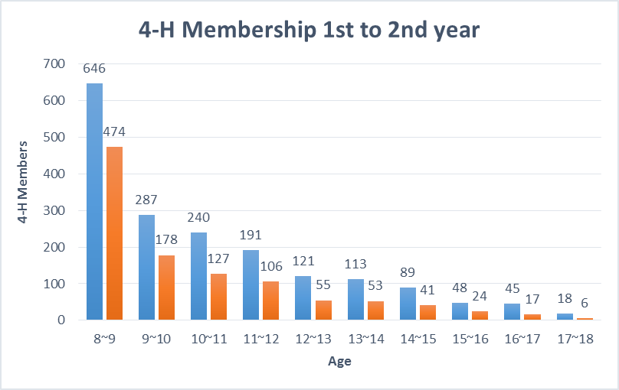
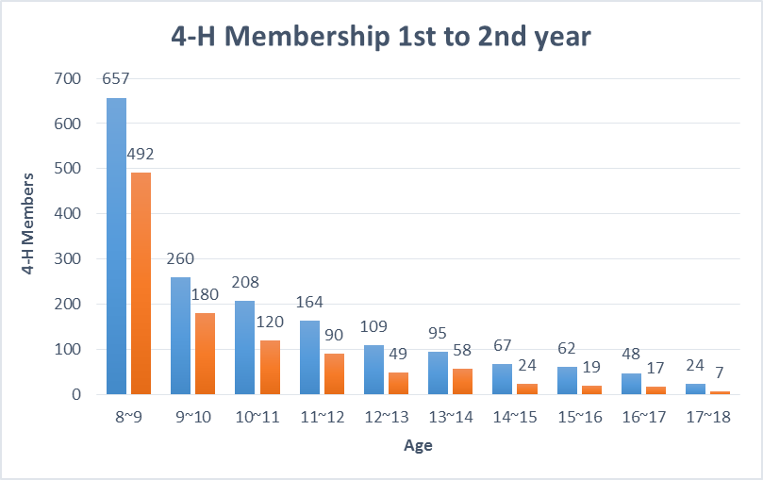
Wyoming 4-H Online Enrollment Data
2012 - 2014
2012-2013 4-H Year
2013-2014 4-H Year

Slide 5
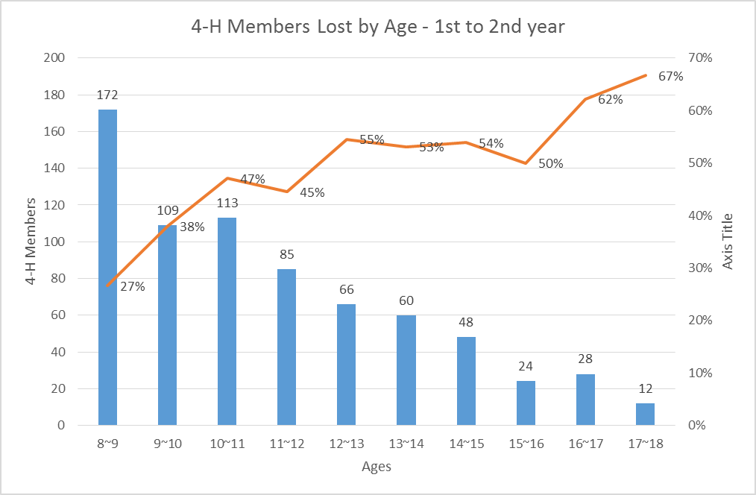
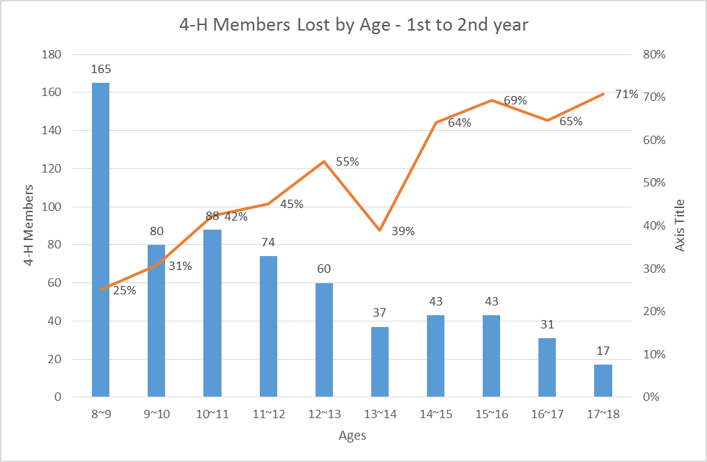
2012 – 2013
1st to 2nd – combined 44%
2nd – 3rd – 19%
3rd – 4th – 17%
4th – 5th – 17%
5th – 6th – 19%
6th – 7th – 18%
7th – 8th – 19%
8th – 9th – 22%
9th – 10th – 35%
2013 – 2014
1st to 2nd – combined 42%
2nd – 3rd – 25%
3rd – 4th – 20%
4th – 5th – 19%
5th – 6th – 18%
6th – 7th – 19%
7th – 8th – 19%
8th – 9th – 21%
9th – 10th – 31%

Slide 6
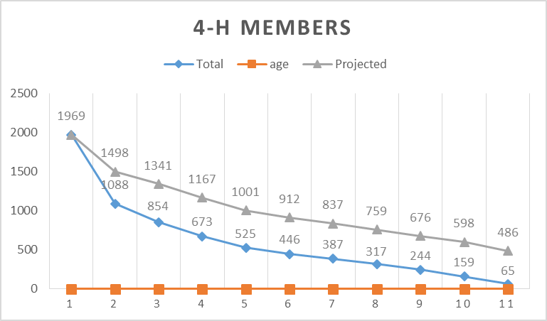
2014
Actual enrollment = 7,155
(Blue line)
Reducing attrition of 1st year members by half (44% to 22%) 2012 – 2014
Projected enrollment = 11,234

Slide 7
Youth Retention Study
2014-2018
Notes:
Kendra & JoLynn introduce themselves

Slide 8
States involved
 | 2014-15 Survey | 2015-16 Survey | 2016-17 Survey | 2017-18 Survey
California | X | X | X | X
Idaho | X | X | X | X
Montana |  | X
New Jersey |  | X | X | X
Wyoming |  |  | X | X
Florida |  |  |  | X
Washington |  |  |  | X
Louisiana |  |  |  | X
New Mexico |  |  |  | X
Alaska: part of the 2014-15 planning team
University of Guam: joined planning team in 2018
Notes:
KENDRA

Slide 9
Topics from surveys
Why joined 4-H
How they heard about 4-H
Intent to re-enroll
Family history in 4-H
Expectations (adult only; open ended)
Changes they’d make (open ended)
General experience (scale)
Best part of 4-H (open ended)
Reasons may not return (youth only)
Notes:
JOLYNN

Slide 10
​Why did you join 4-H?
​
Try new things (58%)
Have fun (48%)
Family History 36%)
Skill Building (32%)
Notes:
KENDRA
Quantitative
Participants could choose more than one
Other choices were:
Had a friend in 4-H: 27%
Make friends: 32%
Show at fair: 29%
Community service: 26%
Personal growth: 28%
Other: 7%

Slide 11
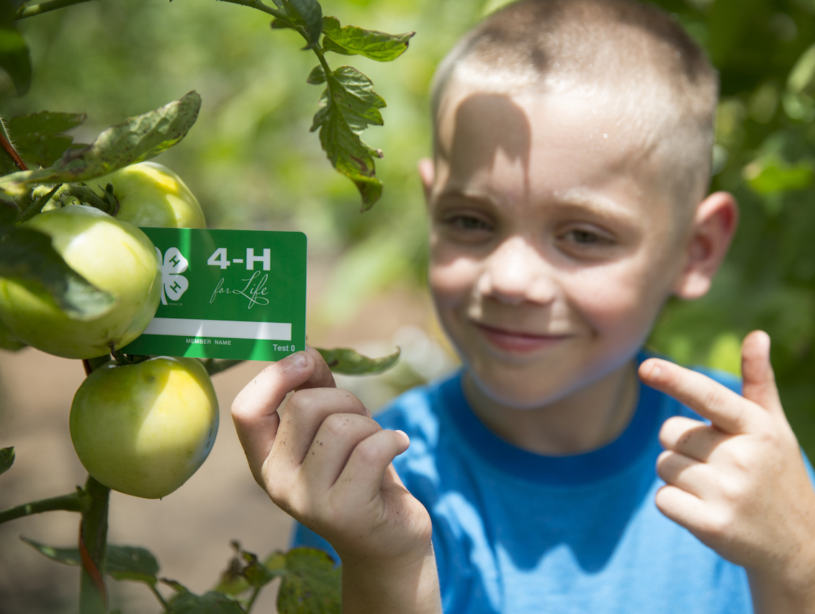
What is the best part about 4-H?
Project activities (34%)
Fair/Showing animals (18%)
New people and friendships (15%)
Learning opportunities (13%)
Notes:
JOLYNN
Based on qualitative (open-ended data)….

Slide 12
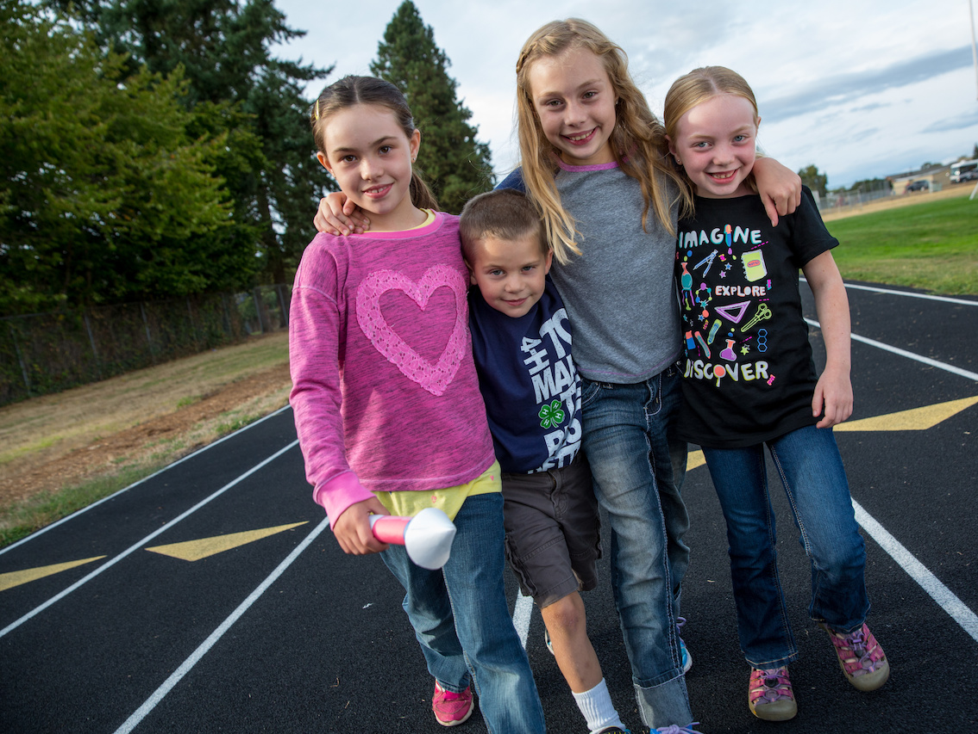
What would you change about 4-H?
Meetings (20%)
Nothing (19%)
Lack of organization (12%)
Communication issues (10%)
Notes:
JOLYNN
Based on qualitative (open-ended data)….
Communication and organization: matches adult responses from previous years
Meetings: too long, boring, not fun, meet more often

Slide 13
Why youth might not come back…
Didn’t feel connected to other youth (19%)
Don’t have time (15%)
Didn’t know when club or project met (12%)
% represents % that said “a little true” or “completely true”
Notes:
JOLYNN
First started asking these questions in 2016-17

Slide 14
Adults: Expectations
-“Learn something and achieve goals”
-“Guidance and leadership on 4-H and project subject matters”
-“Meet people with similar interests”
-“To learn valuable skills”
55%
had expectations
Of those, 57% felt expectations were met
Notes:
JOLYNN
Lack of guidance and instruction, negative communication, and negative organization have been consistently key issues and ways that expectations have not been met. Similar to other qualitative findings about issues with the program.
Responses to question: “If you or your child had expectations, what were they?”

Slide 15
What Can We Do?

Slide 16
Your Personal Experience
What group or organization have you belonged to that you truly enjoyed?
How long were you involved in group?
What made you want to stay involved?

Slide 17
Loading Up Your Car!
Think about strategies to reach the clusters of youth and families in your community.
Where are the kids?
Where are the families?
Where are the members that may not know anything about 4-H?

Slide 18
What Do Your Billboards Say?
“Why 4-H?”
Youth perspective
Parent perspective
Community perspective

Slide 19
Roadblocks and Exits
What are the Exits?
What are the Roadblocks?

Slide 20
Indicators of Success
Club/Group Processes - Overall:
Youth are engaged organizing and planning club/group events
Parents are engaged in supporting roles
Youth are becoming self-governing
Youth are having fun while learning and achieving success in leadership
Community and club/group are becoming supportive of each other
Club/Group Organization – Engaging Youth:
Youth are engaged in establishing the rules and by-laws
Youth are in leadership and/or officer roles
Youth are involved in creating club program plans/calendars

Slide 21
Indicators of Success
Club/Group Organization – Engaging Parents:
Parents are invited and engaged within the club/group for support responsibilities
Family events and activities are encouraged and planned by the club/group
Parents are communicated with and recognized
Club/Group Youth Leadership and Self-Governance:
Club rules and by-laws are real, living documents, and reviewed annually by the youth (Not just a rubber stamp activity)
Club program responsibilities involve ALL youth – the club is not led by the adults, rather the youth
Club officers are participating in training, and recognizing their role, not just their position
Youth are being encouraged and supported to become active in county, district and state 4-H programs

Slide 22
Indicators of Success
Club/Group: Fun, Learning Environments:
Volunteers are using age appropriate and experiential learning techniques when teaching and supporting youth
The club uses the balance of business, education and recreation with every meeting
Social activities are part of the club program plan
Club Group: Community Engagement:
Community representatives are invited to participate in club meetings for a particular purpose
The club/group participates in service learning projects
Youth, parents, families and volunteers are being recognized for their contributions
Club/Group Recognition:
Youth, parents, families and volunteers are being recognized for their contributions

Slide 23
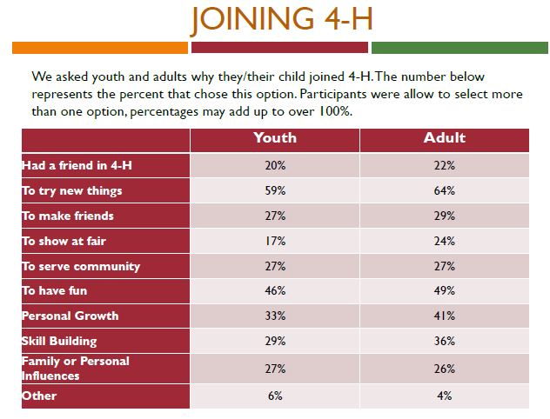
Develop A Plan - Recruitment
What should we consider when looking to recruit members?
What does our billboard look like?

Slide 24
Develop a Plan - Retention
What were your success indicators? What does your club need to work on?
What are the roadblocks?
Why do youth leave 4-H?
Does our promotional message meet expectations?
What experiences do youth enjoy most about 4-H?

Slide 25
Why Youth leave 4-H
 | Overall Mean
1. I was bullied by other youth in my club or project | 1.14
2. I was bullied by adults in my club or project | 1.14
3. I didn’t feel connected to other youth in the club | 1.99
4. I didn’t feel welcomed in my club | 1.57
5. 4-H isn’t for kids like me | 1.21
6. Parents in 4-H don’t get along | 1.29
7. I don’t have time for 4-H because of my other activities (like sports, church, Boy Scouts, Girl Scouts, FFA) | 1.93
8. 4-H is too expensive | 1.48
9. I didn’t know when my club or project met | 1.62

Slide 27
Were Expectations Met?
Code Key | % of responses with this code
Communication | 25%
Interests/topics/subject matter/content specific | 13%
Guidance/instruction/mentoring (e.g., instructions in project, guidance for learning) | 41%
Sense of belonging (e.g., feeling welcomed) | 24%
4-H policies and structure (e.g., paper work, record keeping) | 2%
Organization (e.g., chaotic meetings, unorganized meetings/projects) | 30%
Participation/attendance | 5%
New skills/opportunities/experiences/knowledge (e.g., learning new things, having new experiences) | 7%

Slide 28
Take Aways
Work to make sure that we are walking the talk, does our messaging match what is happening at the club and county level.
Communication is key.
Families have expectations, find out what they are, meet them or change them.
Youth enjoy hands on learning, not meetings. Work to make project work a priority.

