Slide 1
What’s My Job? Roles to play in the Wyoming 4-H program.
Thank you for joining us, while you wait, please put your name, county, and your current 4-H role in the chat box (parent, club volunteer, chaperone, not sure, etc.)

Slide 2
Job Interview

Slide 3
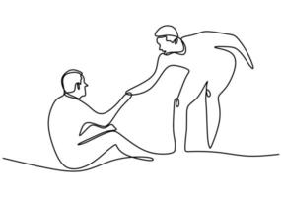
Things you should consider…
What skills do you have that would benefit the 4-H program?
Do you really need skills to be a 4-H volunteer?
Think beyond project-based skills…
Help others
Spend time with your kids
You want to learn something too
You are a good organizer
You are willing to learn
Good listener
What is your motivation for becoming a volunteer?
What questions do you have for 4-H? If they are your “employer” what do you want to know about their business.

Slide 4
Being a 4-H volunteer is not about teaching a kid to show a lamb…it’s about using a lamb to teach a kid about life.

Slide 5
So, what roles are there in Wyoming 4-H?

Slide 6
Project Volunteer Club Volunteer Activity Volunteer Chaperone Coach Committee Member

Slide 7
Project Volunteer
Purpose: Help youth develop skills around a specific project.
Measures of Success:
Development of project and life skills.
Members can communicate learning.
Member and families receive communication about ways to participate.
Specific Job duties?
Help members establish learning goals.
Plan and prepare project meetings to teach project skills and meet goals.
Communicate
Time Commitment: 6-10 hours monthly (depending on project and members)

Slide 8
Club Volunteer
Purpose: Provide leadership to a club.
Measures of Success:
Club sets and meets goals.
Member and families receive communication about 4-H activities at all levels.
Youth leadership is displayed at club meetings.
Member are having fun and engaged.
Specific Job duties?
Have a club that meets regularly. Engaging in education, recreation, and business at each meeting.
Maintain relationship with Extension Office and disseminate information.
Recruit leaders to help and members to join.
Time Commitment: 10-15 hours monthly (depends on club size and support system)

Slide 9
Activity Volunteer
Purpose: Assist members in community service, recreation, fundraising, transportation, or other 4-H related events.
Measures of Success:
Families feel supported in activities that are carried out by the volunteer.
Families are participating.
Specific Job duties?
Provide guidance to a specific task or activity.
Help in planning a specific activity or task.
Other duties as assigned.
Time Commitment: 1-15 hours total

Slide 10
Coach
Purpose: To provide leadership and education to youth interested in judging opportunities around a specific subject.
Measures of Success:
Youth are participating in local, regional, state, and even national judging opportunities.
Youth are informed about judging related activities.
Specific Job duties?
Coordinate local practice opportunities and take youth to other opportunities.
Provide feedback if needed.
Recruit new members.
Time Commitment: 10 plus hours

Slide 11
Chaperone
Purpose: To provide overnight supervision of youth.
Measures of Success:
Youth have a positive experience.
Youth are provided with a safe environment to learn and grow.
Specific Job duties?
Take chaperone training.
Set a good example.
Problem solve.
Know emergency procedures
Time Commitment: 2-7 days

Slide 12
Committee Member
Purpose: Serve on a committee to help in planning, implementing, and evaluating county 4-H programs and activities.
Measures of Success:
Completion of educational activities and events related to the committee's purpose.
Cooperation by committee members in task achievement.
Specific Job duties?
Identify problems needs and concerns, and makes plans to address them.
Attend committee meetings and events.
Identify and help secure resources needed for committee success.
Give leadership where needed.
Time Commitment: 1-5 hours per month

Slide 13
Wyoming 4-H Policies
No matter what role you play in the 4-H program, everyone should be aware of the Wyoming 4-H Policies.

Slide 14
Policy Highlights
Chaperones need to be 21 and have to take an extra training.
A certified volunteer needs to be at each event. Each volunteer needs to use 2 deep leadership. We also practice a 1:10 ratio of youth to adults at events.
There are lots of extra rule about money.
There are specific policies about communicating with members.
Shooting sports and horse have project specific rules.
QUESTIONS?

Slide 15
Positive Youth Development
Volunteers should be aware of positive youth development concepts and work to incorporate them into 4-H experiences.

Slide 16
PYD Basics
Helping Youth THRIVE
Ages and Stages
Essential Elements
Experiential Learning Model
Life Skill Development
4-H Recognition Model

Slide 17
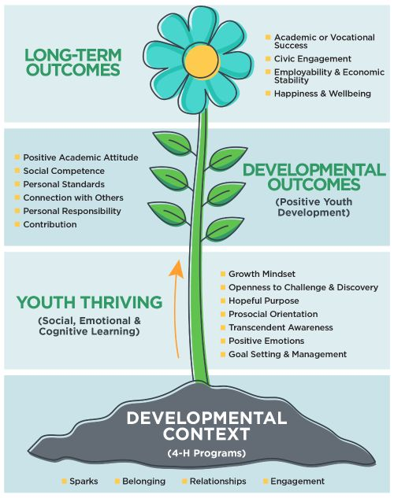

Slide 18
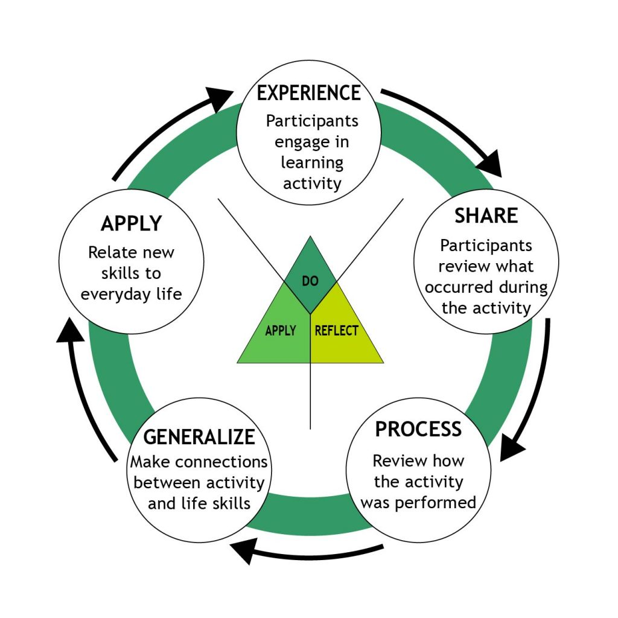

Slide 19
What does it take to be a volunteer?
Enroll in Zsuites.
Complete a background check through Verified Volunteers (Sterling company).
Engage with your 4-H Educators.
Possibly complete the MVR training.
Work with kids.

Slide 20
Are there resources to help me?
Curriculum
4-H Website
Events and Opportunities
Fact Sheets
4-H Educator
Meeting space
Money for project work
Stuff – tangible project aids
Training
Be honest about what you need, no matter how small or big the request.

Slide 21
Conclusion
You don’t need a specific project skill to be a volunteer, you just need the willingness to do it.
There is some way for everyone to help.
Check out the different job descriptions.
Ask questions, like a job interview.
Follow Wyoming 4-H policies
Include PYD in the work that you do
Ask for help, please!

Slide 22
Questions?

