Slide 1

USING 4-H
CURRICULUM

Slide 2
Why is 4-H Different?
PYD

Slide 3
Positive Youth Development

Slide 4
The Nuts and Bolts of PYD
Youth involved and engaged as PARTNERS.
Youth are connected to positive experiences, relationships, and environments.
Youth are valued.
Youth can attend, actively participate, contribute and lead.

Slide 5
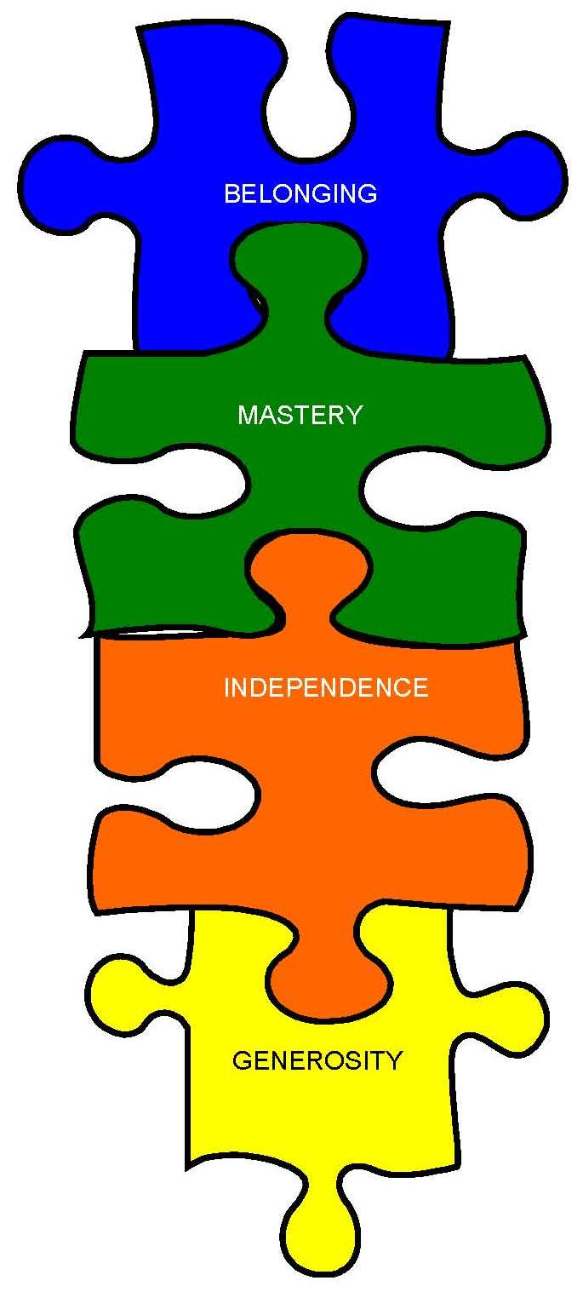
Four Essential Elements
Independence
Belonging
Generosity
Mastery
Notes:
Independence
Youth need to see themselves as active participants in their future and able to determine what they will become. They need to understand that when they have independence, they must also take responsibility for their decisions and actions.
4-H helps young people recognize the connection between independence and responsibility. In a successful 4-H club, youth can learn to set priorities as they develop their club program. They can also learn to manage their time so that they can choose among many worthwhile opportunities.
Belonging
Youth have a strong need to be a part of a safe group of friends who accept them for who they are. Youth also need at least one positive relationship with a caring adult. The need to belong is so strong that if youth don’t have access to positive groups, they will join less desirable ones such as gangs.
Positive groups like 4-H help fulfill this need to belong. Volunteer leaders and club members provide this fellowship by showing interest in, actively listening to and encouraging 4-H youth.
Generosity
Youth need to feel that their lives have meaning and purpose. They need opportunities to connect to their communities and learn how to give back to others. Service builds bonds between youth and the community, and doing something valued by others helps youth feel worthy and competent.
By taking part in 4-H community service and citizenship activities, youth can connect with and serve their communities. 4-H helps youth develop concern for others and take action to demonstrate that concern.
Mastery
Youth need to feel they are capable and successful. Mastery means that youth develop skills, knowledge, and attitudes followed by the competent demonstration of these skills and knowledge. When young people realize they are capable, they develop self confidence and a sense that they matter.
4-H youth develop mastery through the Experiential Learning Process. In this process, they experience, share what happened, process what was important, generalize the experience to the real world and apply what was learned to other situations. They develop a sense of mastery or achievement through 4-H project work such as building a birdhouse, preparing a meal or participating in a positive evaluation experience.
Through projects and activities, youth master skills to make positive career and life choices. Youth need to explore many topics thoroughly to be able to pursue their own interests. 4-H strives to create opportunities for youth to experience a sense of belonging, develop independence, and follow their interests to levels of mastery. In addition, the 4-H program encourages both youth and adults to value and practice service to others. Volunteers provide safe and supportive boundaries for positive youth development to occur.
The Wisconsin 4-H Program hopes that all youth experience the 4 essential elements of positive youth development: independence, belonging, generosity and mastery!

Slide 6
Project And Activity Skills
Getting them “hooked”
Project Skills
  Woodworking – measuring, sawing a straight line, sanding, applying finish
  Clothing – Cut a pattern, lay out material, threading a machine.
Notes:
Many types of activities can be used to provide a learning experience, including 4-H project work. Project work appeals to youth because they have many projects from which to choose: beef, clothing, foods, arts and crafts, shooting sports, woodworking, electricity and many more. Discovering and exploring 4-H project work is the "hook" to get youth involved in 4-H. While they are having fun, they learn. As youth learn, they are acquiring two sets of skills: project skills and life skills.
Project Skills
To complete a project item or exhibit, 4-H members learn a multitude of skills related to the subject matter of the project. For example, skills learned through a woodworking project would be measuring, sawing a straight line, sanding and applying a finish. In a clothing project, skills acquired would be learning to lay out then cut out a pattern, thread the sewing machine and make a buttonhole.

Slide 7
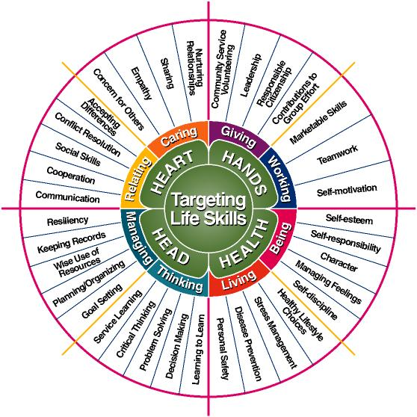
Targeting Life Skills Model
Notes:
Life Skills
When youth participate in a project, activity, or club meeting, they develop knowledge, skills, and attitudes that are needed for life long success—no matter what job, career, or interest. For example, leadership in a 4-H club and giving presentations can lead toward mastery in communication, a life skill. Over the years, there have been thousands of 4-H members who have acknowledged that their skill of communication was acquired as a result of their participation in 4-H projects and exhibits. Communication is one of the most important life skills youth learn in 4-H. Did you know that some resources state that as many as 40 percent of American adults fear public speaking more than death?
Life skills are divided into five major categories: subject matter knowledge, self-awareness, decision-making, social interaction and physical skills.

Slide 8
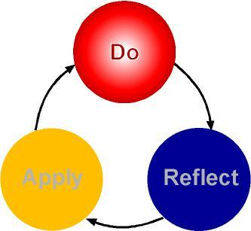
Experiential Learning Model
Notes:
In 4-H, young people learn by doing something such as learning how to use a saw and cut a straight line or making a boot jack or birdhouse. Youth develop skills through 4-H projects, demonstrations or activities. Learning continues beyond the actual project skills because 4-H uses a deliberate process that allows youth to learn through a "doing" experience that is then followed by leader led discussion. This method of Do, Reflect and Apply is referred to as the Experiential Learning Model (Kolb, 1984).

Slide 9
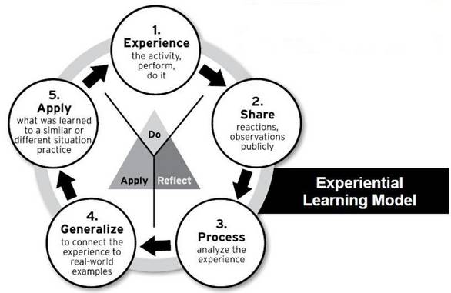
Notes:
4-H Youth Development expanded this model to include five steps (listed as a - ebelow) to teach life skills. The sequential steps of the model help youth identify what they have learned from a 4-H experience and to apply that learning to other experiences or situations. The model requires that the volunteer leader be very clear about the targeted skill or concept. The follow up processing questions are not closed ended questions that can be answered with a pat yes or no response. Instead, the questions are open ended and shared to support the learning goals.

Slide 10

Curriculum Here to Help!
Latest Research Based Knowledge
Hand On
Do Reflect Apply
Generosity, Mastery
Life Skill Related

Slide 11
When Curriculum is GREAT
A volunteer has limited knowledge of the subject.
A volunteer knows a lot about the subject, but unsure how to teach lesson to youth.
A youth doesn’t have a leader and wants to learn more.

Slide 12
When you might need to be more creative with the curriculum
You have youth with a wide knowledge and age range.
You have an idea of what you want to share and the curriculum doesn’t match your vision.
You have older youth who are wanting to branch out and do more.

Slide 13
What is the purpose of curriculum?
Provide educational knowledge about a project area.
It does not teach you how to show an animal.
It does not teach you how to gain a competitive edge.
It does not give you step by step instructions for fair project.

Slide 14
Let’s Take a Look
4-H Curriculum Scavenger Hunt
  What is the name of the lesson?
  What type of Life Skills might a 4-H member learn from this lesson?
  What project skills will a 4-H member learn from this lesson?
Are we able to find the Experiential Learning Model in the book?
Do you think that youth would be interested in using curriculum books?
How do you see yourself as a leader and/or parent able to use these books?

Slide 15
Other Teaching Techniques
Setting Project Goals
Demonstrations
Judging Classes
Skill-a-thons
Quiz Bowl
Field Trips
Creating Projects for Fair

Slide 16
Use the Curriculum to Identify…
Demonstrations Ideas
  A demonstration is an opportunity for a 4-H member to prepare, organize and present an idea by using visual aids and teaching skills. Such things as showing a friend how to tie a knot, take a picture or play cribbage are all examples of giving a demonstration.

Slide 17
Use the Curriculum to Identify…
Judging Class
  4-H judging is making decisions related to your 4-H project. Youth work to use their best judgment to make choices. In judging, you learn the standards of quality for goods and services. Then, you observe, compare and make decisions based on the facts you have collected.

Slide 18
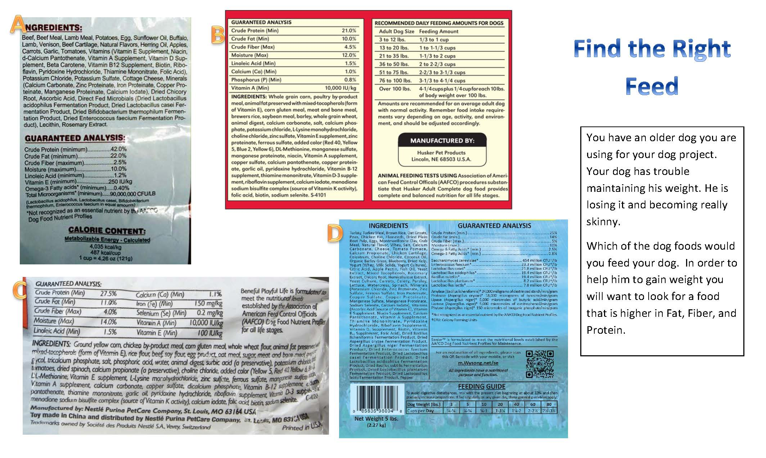

Slide 19
Use the Curriculum to Identify…
Skillathon
  Learning stations that involve 4-H members in challenging, fun, learn- by-doing activities. This educational method develops problem solving, communication, and technology skills.

Slide 20
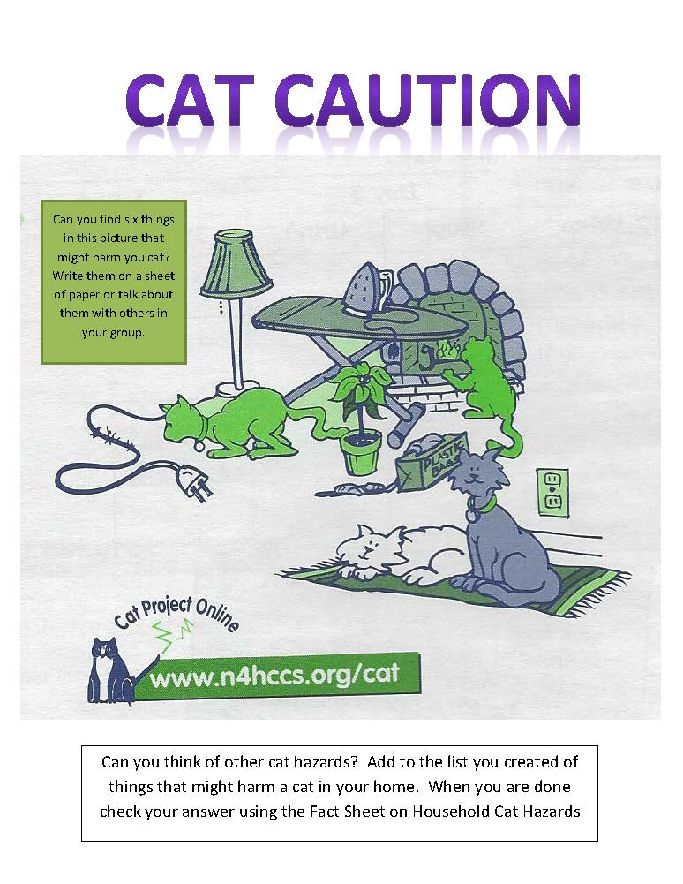

Slide 21
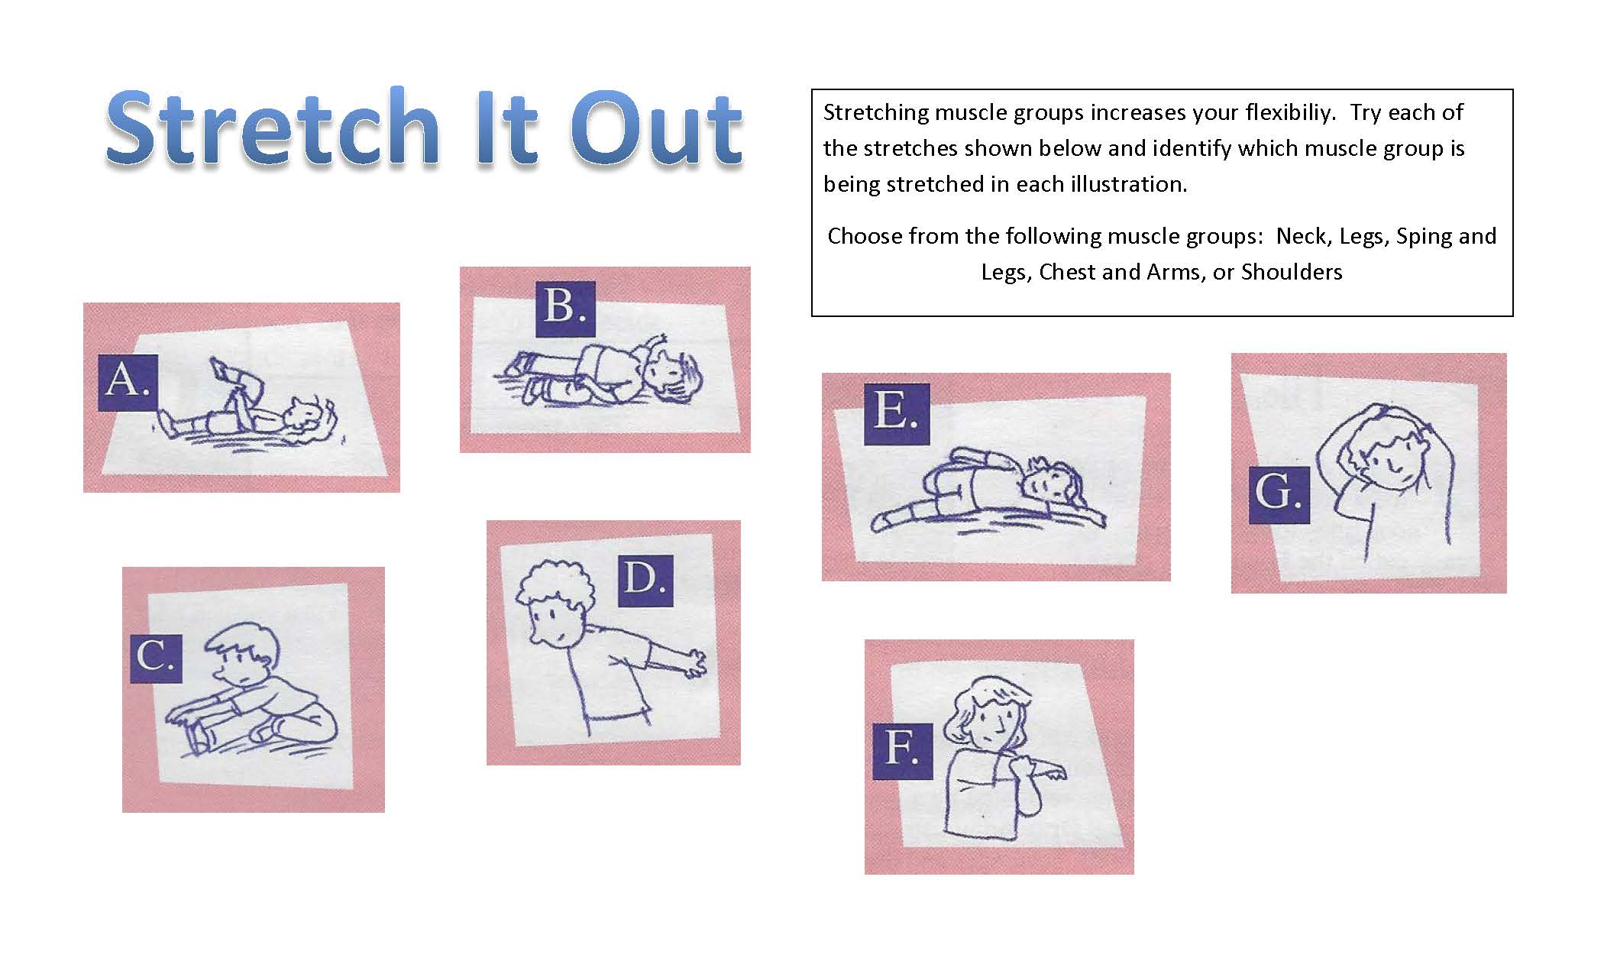

Slide 22
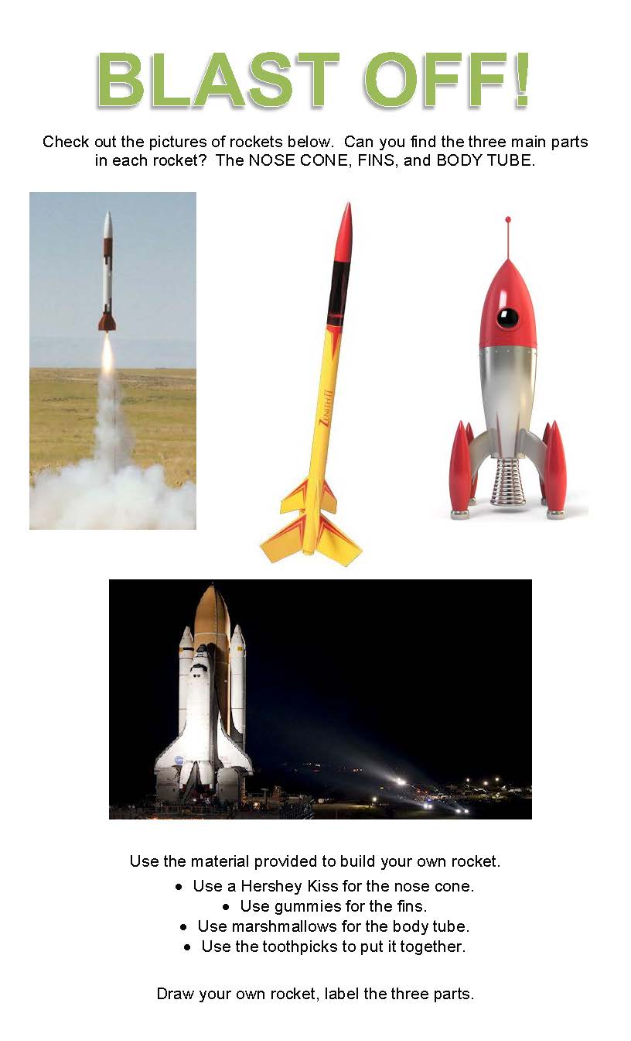

Slide 23
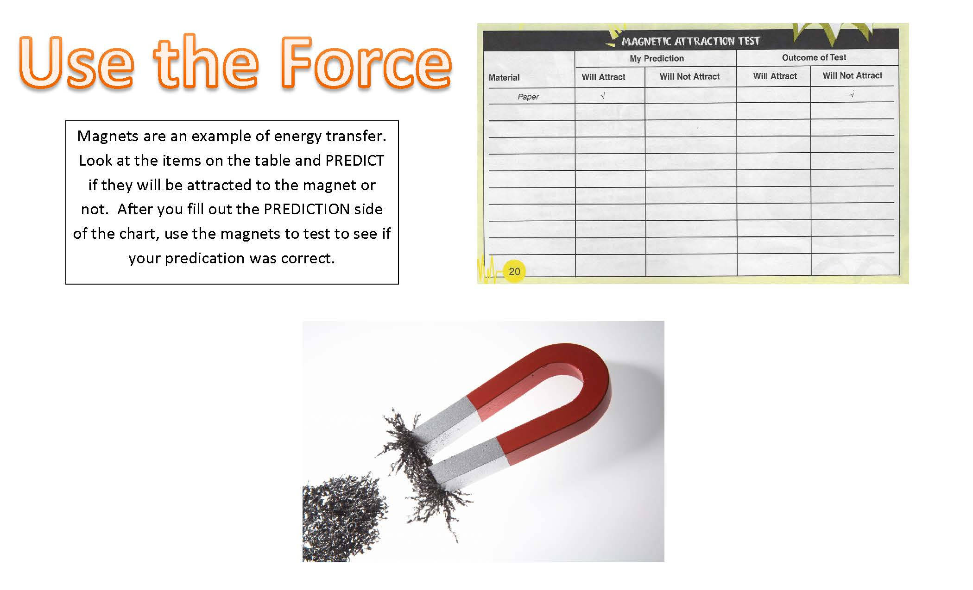

Slide 24
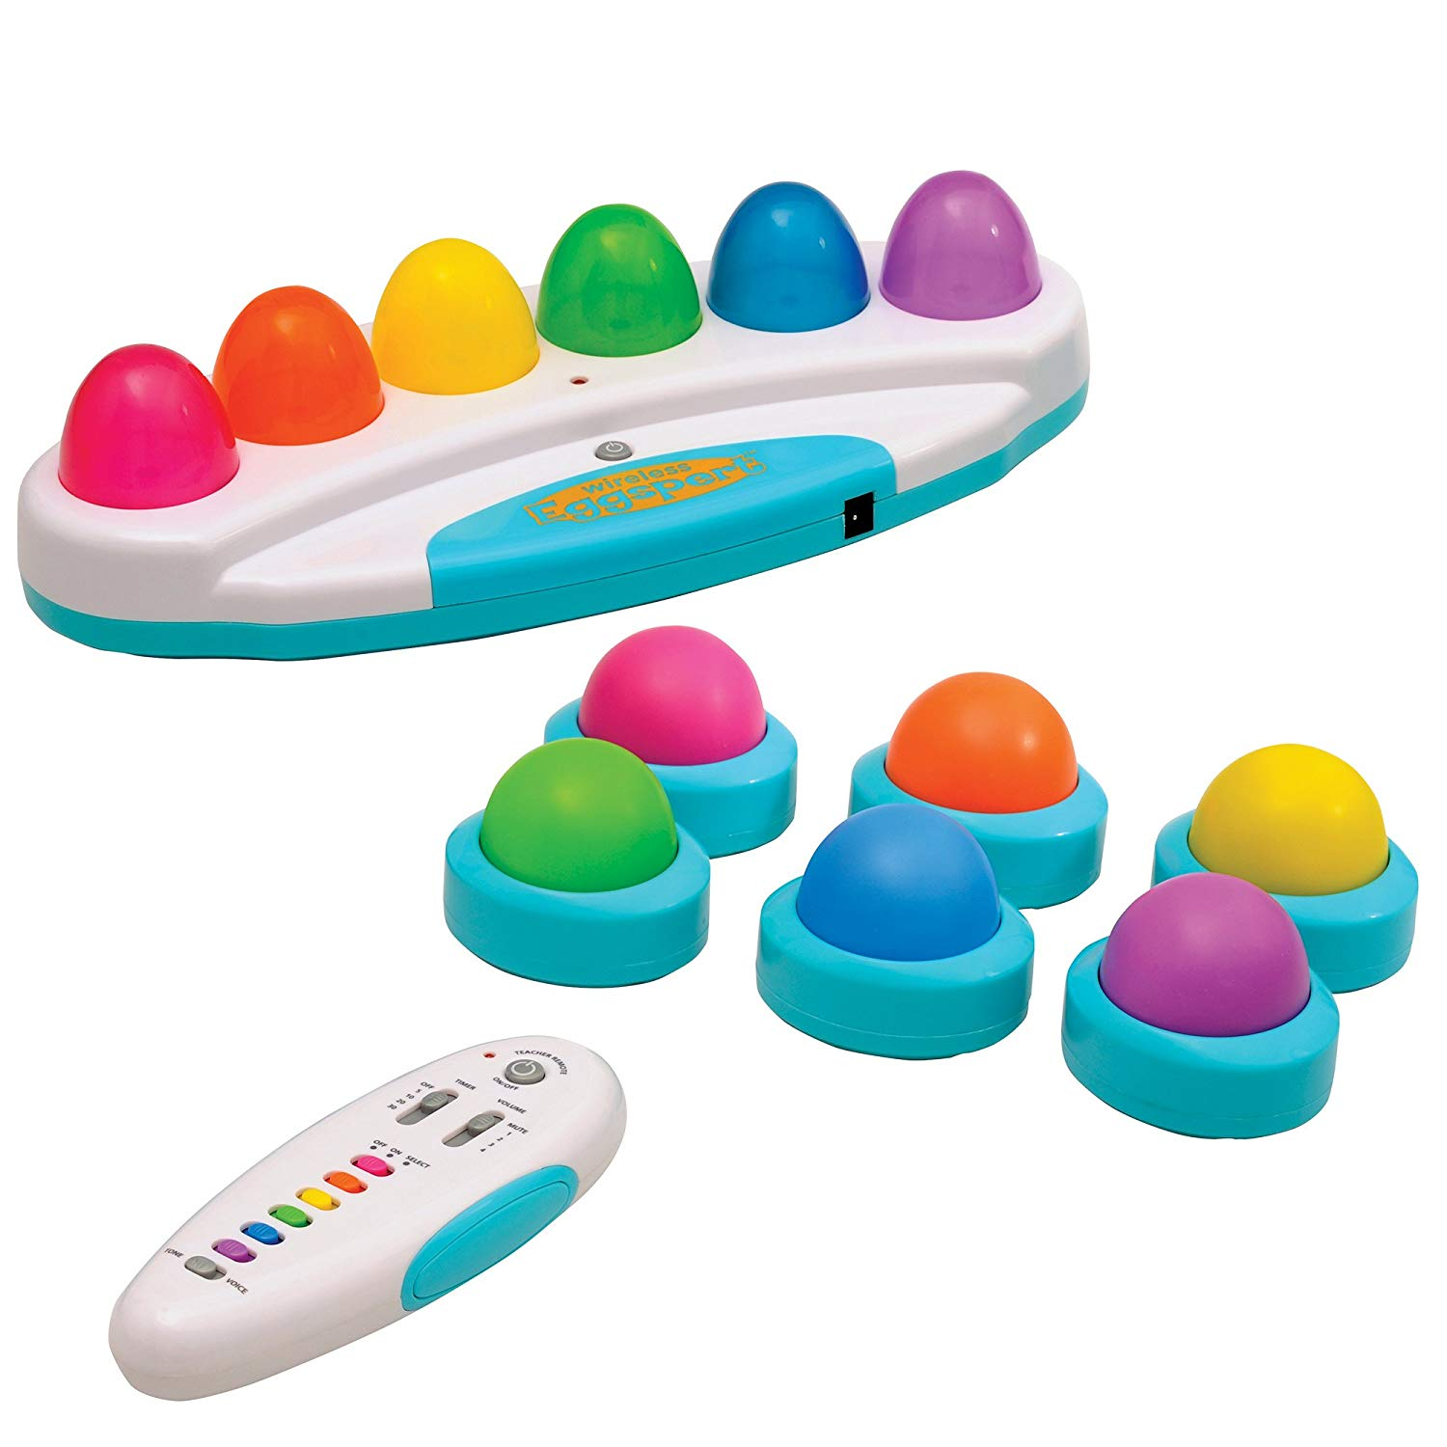
Use the Curriculum to Identify…
Quiz Bowl Questions
  A quiz bowl is a head to head competition in which 4-H member answer questions about all aspects of their project.

Slide 25
Use the Curriculum to Identify…
Field Trips
Fair Projects

Slide 26
Going Beyond Curriculum
Project Sheets on website
Ask an expert
Pintrest
Other states
  Missouri 4-H Skillathon and Judging by projects
Ask your 4-H Educator

