Slide 1
Utilizing club officers
When you arrive please type your name and county in the chat box. If you are watching a recording of this training please call your local Extension office to get “credit” for this training.

Slide 2
Tonight’s Agenda
Prepare your club and members
Benefits to the club of each office
Materials to support club development
Materials to support officers

Slide 3
My story – what I observed on a recent club visit
While listening to the story type in the chat box things that the club I observed could have changed to make this a more positive experience for the members and their club.

Slide 4
Prepare
Start officer elections the month before you elect new officers
Provide parent and members with a list of different offices
Provide parents and members with an outline of the duties of each officer
Decide if you are having a slate of officers or nominations
Slate of officers requires a nominating group or committee
Provide members with any specific criteria for officer election
Age
Number of years in 4-H
Previous experience

Slide 5
Prepare
At home review the Duties of each office
Help members understand their strengths and weaknesses related to each office
Help members understand the commitment they are making when taking on an office
Have members develop reasons they want to be an officer
Enjoy writing
Like taking pictures
Good at playing games

Slide 6
Prepare
at the meeting
decide if you want to do nominations or have members volunteer if they are interested
Explain the process to the group, new families might be unfamiliar with the overall process of elections or at least your club’s way of conducting elections
Introduce each office, explain the major duties of the office before asking for nominations or volunteers
Have each youth introduce themselves and answer a question or give a short speech
Name one thing you can do that would make you a good President?
What experience do you have that would make you a good historian?
Why did you choose to run for the office of song and game leader?
What is one game you would play with a group as the song and game leader?

Slide 7
How can each officer help your club?

Slide 8
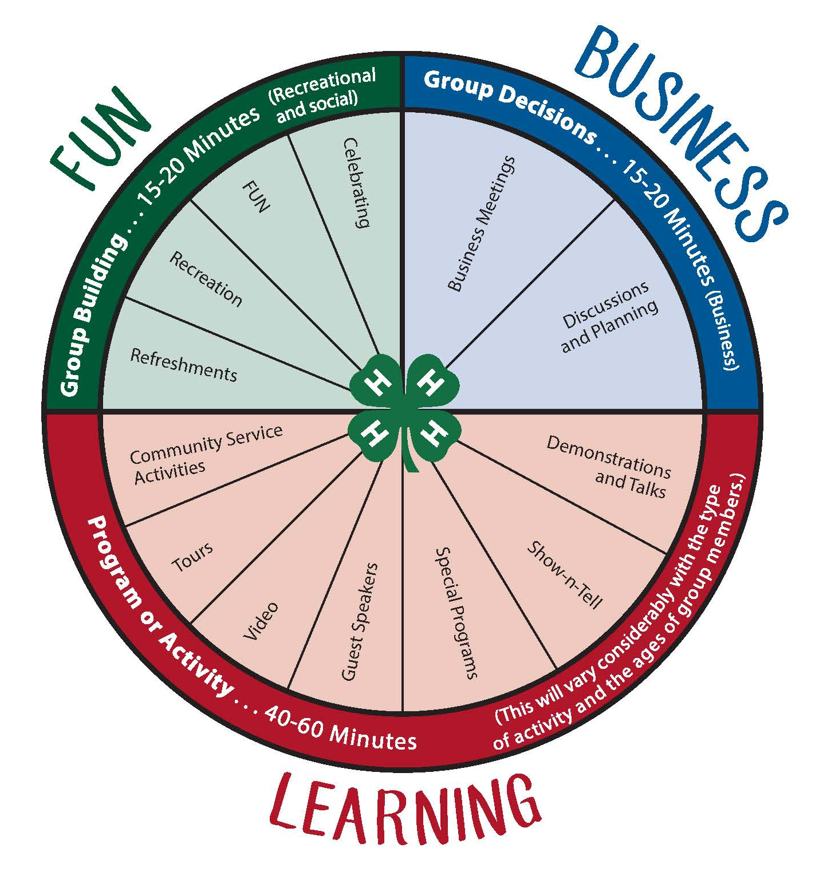
Use officers to guide the club meeting wheel

Slide 9
president
Prepares the agenda
Keeps meeting order
Sets a good example for other members
Leadership
Communication
morality

Slide 10
Vice president
Plans educational programs
Sets rotation schedule
Demonstrations
Snacks
Pledges
Sets up the meeting room

Slide 11
treasurer
Prepares a financial report for each meeting
Creates a club budget for the next year
Knowing the agenda items can share past experiences
Sets up an audit committee

Slide 12
secretary
Keeps attendance, can come up with attendance questions or ways to complete attendance
Writes thank you letters
Reads correspondence
Keeps minutes so you know what happened at the last meeting, this needs to be shared with president to develop agenda for next month – timing is Everything

Slide 13
reporter
Writes up items for newsletter
Sends articles and photos to the local newspaper
Makes newspaper aware of events they might want to cover
Shares meeting report with local extension office
Can be in charge of checking the newspaper to see what club events or even member events occur in the newspaper

Slide 14
historian
Takes photos or arranges to get photos from club members
Puts together a historical record of the club’s year
Enter club historical Record in the county fair under Club project – if desired
Works with reporter to get news articles for historical record

Slide 15
Song / Game Leader
Provide recreation at each meeting
Before meeting
After meeting
Plan social events for club members – Picnic, club fair, camping, etc
Be in charge of singing happy birthday to member

Slide 17
Take a quiz – identify club needs
Take time for a club check-up
Does your club have efficient leadership
Do you have adequate facilities and physical arrangements
Do you have well planned education programs?
Do you have active and involved members?
4-H Club Member Survey
What thing are members gaining from your club?
What skills are members practicing in your club?
Use your Club Officers to address identified needs! Are they all playing their role?

Slide 18
Provide or seek out needed tools
President
Do they have a gavel?
Do they have a script to help them with parli-pro
Do they have meeting agenda examples?
Vice President
Do they know what the meeting room is supposed to look like?
Do they take home the flags and banners if needed?
Do they have a script to help them with parli-Pro?
Do they have a copy of the meeting wheel?
Can you provide them with examples of programs or ask them to form a committee to work with them?

Slide 19
Provide or seek out needed tools
Treasurer
Do they have the checkbook?
Do they have a copy of the treasurer’s Book?
Do they need a special pen, file folder, 3 ring binder?
Do they have a receipt book or receipt pages?
Do they have a reimbursement form?
Do they have an outline of a treasurer’s Report?
Secretary
Do they have a copy of the Secretary’s Book?
Do they know how to write a thank you note?
Do they need a special pen, folder, or binder?
Do they have thank you notes and stamps?
Do they have a list of club members in a form they can use for taking attendance?

Slide 20
Provide or seek out needed tools
Reporter
Do they have contacts for the local newspaper / radio or other media outlets?
Do they get a subscription of the local newspaper to look for 4-H events?
Historian
Do they have a camera?
Do they have a scrapbook or something to create a historical record?
Do they have the materials to put in the book, is the club expecting them to pay for everything?
Do they have access to get pictures from other members / parents?

Slide 21
Provide or seek out needed tools
Game leader
Do they have books or places to get ideas for games to play at club meetings?
Games and Activities – North Dakota
Group building ideas for 4-H Clubs
Does the club provide supplies for all games, or is the officer supposed to get everything on their own?
Song Leader
Do you have any type of instrument for them to use?
Do you have any song books or song sheets?
When are they expected to perform their duties?

Slide 22
Provide of seek out needed tools
provide all of the items the day they take office
so they are prepared for the year!
Have an installation ceremony at the meeting after elections – make it feel important
Have a new officer meeting before the next meeting to present needed materials and go over duties – encourage or require parent involvement

Slide 23
Questions?

Slide 24
Tonight we covered…
How Prepare your club and members
Start early
Provide expectation
Benefits to the club of each office
Use officers to run meetings, plan programs, and help your club to follow the club wheel
Materials to support club development
Do a club check up or member assessment to understand the gaps in your club
Use officer roles to fill gaps
Materials to support officers
Be sure that every officer has what they need to be successful starting at the beginning of the year

