Slide 1
Working Together
For this training you will need a pen and paper. While your waiting please be sure to have it ready.
While your waiting you can also type your name and county in the chat box.

Slide 2
Important
Know yourself to know others.
We all display similar personality trait, but the level of display is different for everyone.
Defining who you are doesn’t put you in a box to always act that way.
We need to remember everyone has strengths and weaknesses and working together is the important piece to complete the puzzle.

Slide 3
Know Yourself - What’s Your Personality
Myer-Briggs
True Colors
Color Matrix
Disc Assessment
Human Whole Brain
Enneagram

Slide 5
Lion – Column 1
This personality likes to lead.
The lion is good at making decisions and is very goal-oriented.
They enjoy challenges, difficult assignments, and opportunity for advancement.
Because lions are thinking of the goal, they can step on people to reach it.
Lions can be very aggressive and competitive.
Lions must learn not to be too bossy or to take charge in other’s affairs.

Slide 6
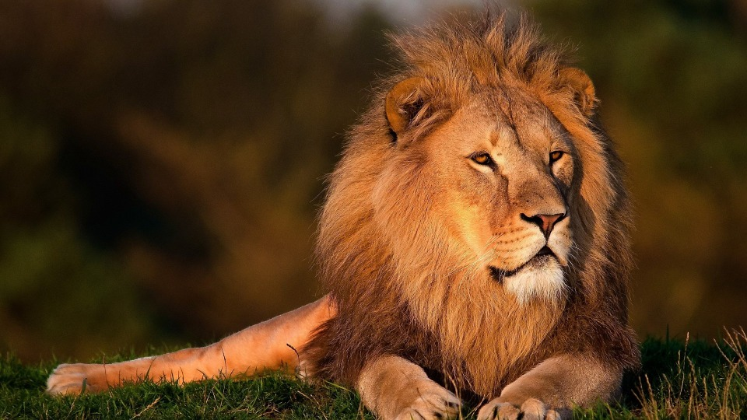
Strength: Goal-oriented, strong, direct
Weakness: Argumentative, too dictatorial
Limitation: Doesn’t understand that directness can hurt others, hard time expressing

Slide 7
Otter – Column 2
Otters are very social creature. Otter personalities love people.
They enjoys being popular and influencing and motivating others.
Otter can sometimes be hurt when people do not like them.
Otter personalities usually have lots of friends, but not deep relationships.
They love to goof-off.
They are notorious for messy rooms.
Otters like to hurry and finish jobs. (Jobs are not often done well.)
The otter personality is like Tigger in Winnie The Pooh.

Slide 8
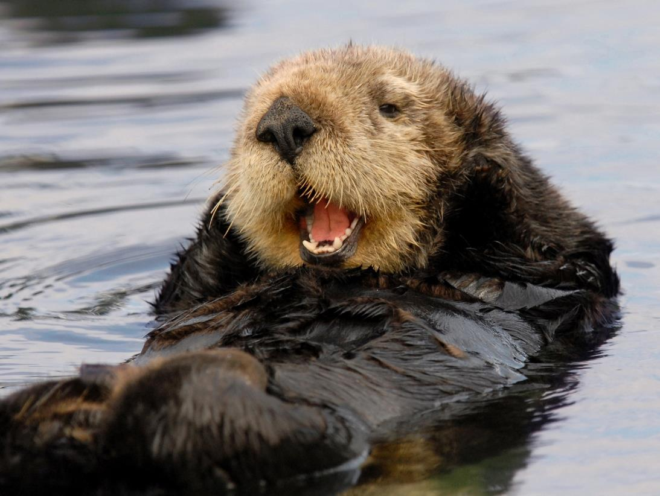
Strength: People person, open, positive
Weakness: Talks too much, too permissive Limitation: Remembering past commitments, follow through with discipline.

Slide 9
Golden Retriever – Column 3
Good at making friends.
Very loyal.
Retriever personalities do not like big changes. They look for security.
Can be very sensitive. Very caring.
Has deep relationships, but usually only a couple of close friends.
Wants to be loved by everyone.
Looks for appreciation.
Works best in a limited situation with a steady work pattern.
> Strength: Accommodating, calm, affirming > Weakness: Indecisive, indifferent, unable to express emotional, too soft on other people > Limitation: Seeing the need to be more assertive, holding others accountable

Slide 10
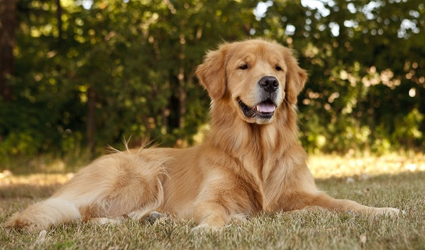
Strength: Accommodating, calm, affirming Weakness: Indecisive, indifferent, unable to express emotional, too soft on other people Limitation: Seeing the need to be more assertive, holding others accountable

Slide 11
Beaver – Column 4
Organized.
Beavers think that there is a right way to do everything and they want to do it exact that way.
Beaver personalities are very creative.
They desire to solve everything.
Desire to take their time and do it right.
Beavers do not like sudden changes.
They need reassurance.

Slide 12
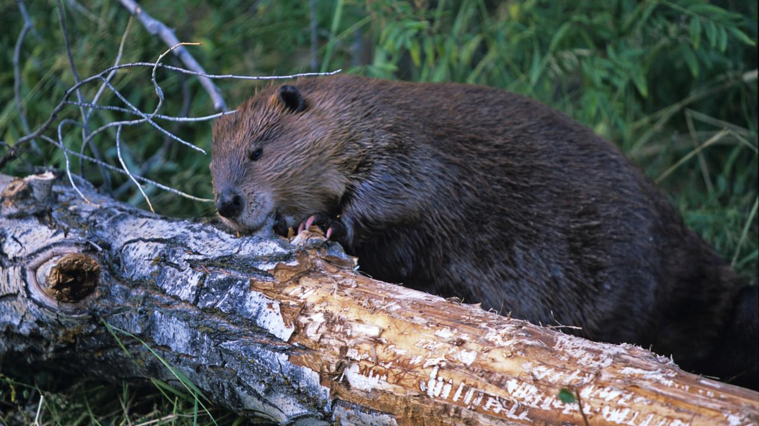
Strength: High standards, order, respect Weakness: Unrealistic expectations of self & others, too perfect. Limitation: Seeing the optimistic side of things, expressing flexibility

Slide 13
4-H Volunteer Lions
Pros
They will get a lot accomplished.
They are willing and quick to make needed improvements, as long as they see the need.
They are not easily offended.
Cons
They will have high expectations for your ability.
They will not provide a lot of feedback.
They are likely to neglect helping you when you need help and other “soft skills”.

Slide 14
4-H Volunteer Otters
Pros
They have a knack for influencing others.
They have a great network of people in the community.
They will build strong alliances and rally the troops.
Cons
They will not stay focused on one task.
They lack the commitment to follow-through.
They might verbally attack.

Slide 15
4-H Volunteer Golden Retreivers
Pros
They will take an interest in you as a person.
They will be available and open to hear from you and take your opinion into consideration.
They are good communicators.
Cons
They’re desire to relate interferes with the need to get things done.
They procrastinate.
They avoid conflict to a fault.

Slide 16
4-H Volunteer Beavers
Pros
They will do quality work.
They focus without getting distracted.
They learn from past mistakes.
Cons
It takes them a long time to get something done.
They nit-pick everything.
They don’t take risks.

Slide 18
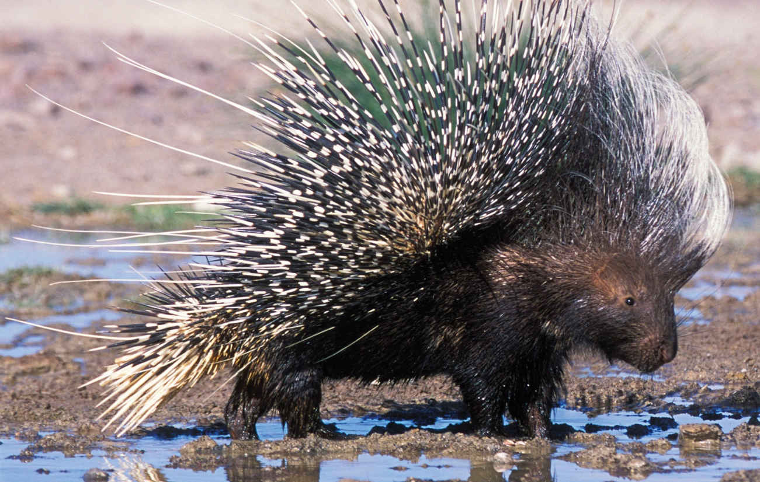
And the….Porcupine
The porcupine represents the perfect metaphor for a toxic personality. Some people are like quills on a porcupine’s back. They wound all who come in contact with them. Much like their cousin the skunk, porcupines live an unapproachable life!
From the book “How to Hug a Porcupine: Dealing with Toxic and Difficult to Love Personalities” by Dr. John Lewis Lund.

Slide 19
Porcupine Behaviors
Constant criticism or fault finding
Unrealistic expectations of self or others
Manipulating by guilt
Judgmental
Rejects others suggestions immediately
Belittles others
Orders others around
Lacks compassion
Always playing the devil’s advocate
Constantly correcting others
Martyr
Always displays regret or past failure
Thinks everything is unfair
Mad, angry or upset
Always sarcastic
Negative attitude toward life
Have to walk on egg shells in order to no offend them
Easily offended
Interrupts other

Slide 20
Difficult people learn to be difficult because their behavior has worked for them in the past, they have created a successful pattern. Their behaviors keep others in their lives off balance and to some extent allows them to be in control.

Slide 21
How to deal with a Porcupine?
Be calm, stay calm, remain calm
Define you needs
Communicate your needs
Listen, really listen
Brainstorm – involve a larger group to help find a solution
Evaluate alternatives
Try a solution
Re-evaluate

Slide 22
Getting Specific
Complainer
Super Agreeable
Negativist
Silent Unresponsive
Indecisive
Hostile
Know it All

Slide 23
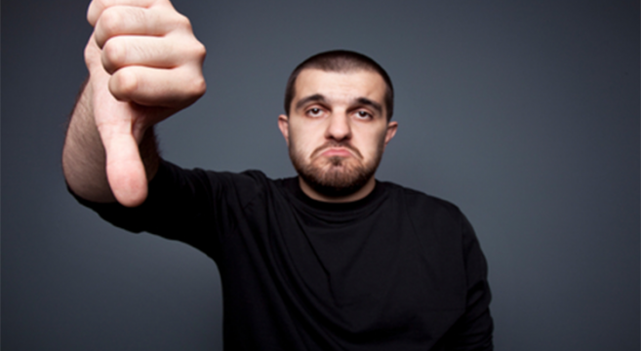
Complainer
Feel powerless in the management of their own lives.
Have ideas of how things ought to be and a sense of injustice that they are not that way.
Persistent complaints about others and situations make them appear blameless…at least to themselves.
Listen attentively.
Be prepared to interrupt and take control of the situation. Complainers love to ramble. Switch to problem solving.
Change the complainer's train of thought to something productive. They then become part of the solution instead of part of the problem.

Slide 24
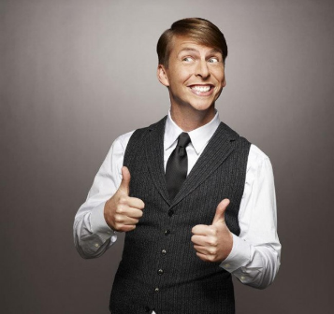
Super Agreeable
Have an unusually strong need to be liked by others.
Try to avoid open conflict (by always agreeing) because of fear of losing approval or acceptance.
Difficulty arises when they are less than candid. You believe that they are in agreement with you, but they let you down.
Make honesty non-threatening. They are afraid you don't want to hear truth.
Don’t allow them to make unrealistic commitments when you know they couldn’t possibly fulfill them.
Listen to their humor. They often hide their truth there.

Slide 25
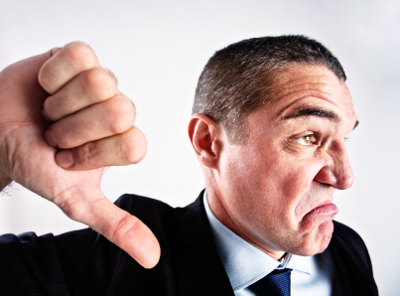
Negativist
Object to everything.
Assert that whatever you propose wont work or is impossible.
May completely deflate any optimism you might have for a project.
Avoid getting into their attitude.
Don’t hurry to propose solutions.
Use the approach of being devil's advocate. Try saying "what if we…"

Slide 26
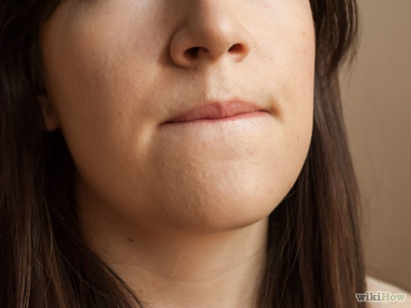
Silent Unresponsive
React by not responding when asked a question or need a commitment.
Some use this approach to avoid unpleasant interpersonal situations.
Others use it as a type of aggression in refusing to talk to others who want to communicate with them.
Some quiet people are simply good listeners and should not be considered non-responsive.
Ask open-ended questions, not yes/no.
You can sometimes get them to participate by commenting on what is happening in the discussion, for example, "Sharon, you haven’t said too much today. What are your ideas on this topic?" Then implementing using the "friendly, silent stare."

Slide 27
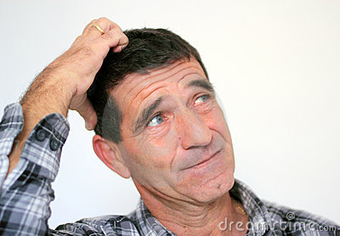
Indecisive
Can ruin a program because they put you off until it is too late to do anything about it.
They put off making a decision until the decision is made for them.
They also won’t let go of anything until it is perfect, which is never.
Place all the alternatives in rank of importance.
Give them lots of support after they have finally made a decision.
They need to experience a success in what they attempt to do.

Slide 28
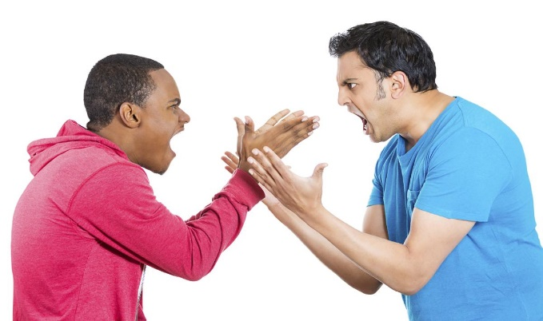
Hostile and/or Aggressive
Need to demonstrate that they are always correct.
Are inpatient with others who don’t share their beliefs.
They are irritated when others resist their ideas.
Have a strong sense of what is best for others.
They "put down" (demean) others to demonstrate strength and/or confidence.
It is very important to not surprise this person. This action could get you hurt or injured. If you take him or her by surprise, he may just spin around and hit you.
Give them time to run down. If at all possible, get them to sit down. This will make them less aggressive.
Lower your voice and both of you sit down. This puts you both at the same level. When they are calm, discuss the problem and express your opinion; don’t attack them.

Slide 29
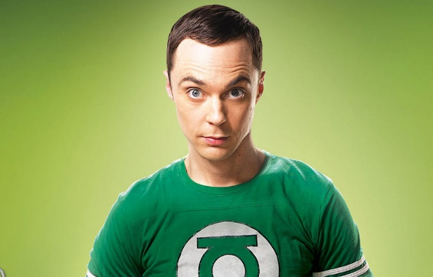
Know-It-All Expert
They believe and want you to believe that they know all there is to know about anything worth knowing.
They are usually condescending, imposing or pompous.
They may work at defeating your self esteem.
Do your homework on the subject. If information is written somewhere, find the source in advance and show it to them in writing.
Listen to and acknowledge what they say, but you don’t have to agree.
Avoid being a counter-expert and let them be the expert they think they are.

Slide 30
We can each be difficult people in the right situation!

Slide 31
Be Prepared and Head Off Conflict
Set expectation early.
Look for warning signs.
Stay in control.
Keep a positive outlook.
Maintain a sense of humor.
Understand the root of the conflict.

Slide 32
Be Prepared and Head Off Conflict
Think win-win.
Eliminate emotions.
Concentrate on what you can control.
Ask for help.

