Slide 1
Budget Planning
University of Wyoming Board of Trustees
January 22, 2009

Slide 2
National Look at Economic Conditions
In a December 2008 survey of over 200 public and private four-year institutions, it is evident that the economy has afflicted campuses:
1 in 10 institutions have laid off employees
26% are considering laying off employees
5% have imposed total freezes on hiring faculty members
7% have imposed total freezes on hiring staff
40% have imposed partial freezes on faculty hiring
6% have reduced benefits of current employees
18% are considering reducing benefits
Source: Blumenstyk, Goldie. “Colleges Protect Workers and Cut Elsewhere.” The Chronicle of Higher Education. 9 Jan. 2009: A1.

Slide 3
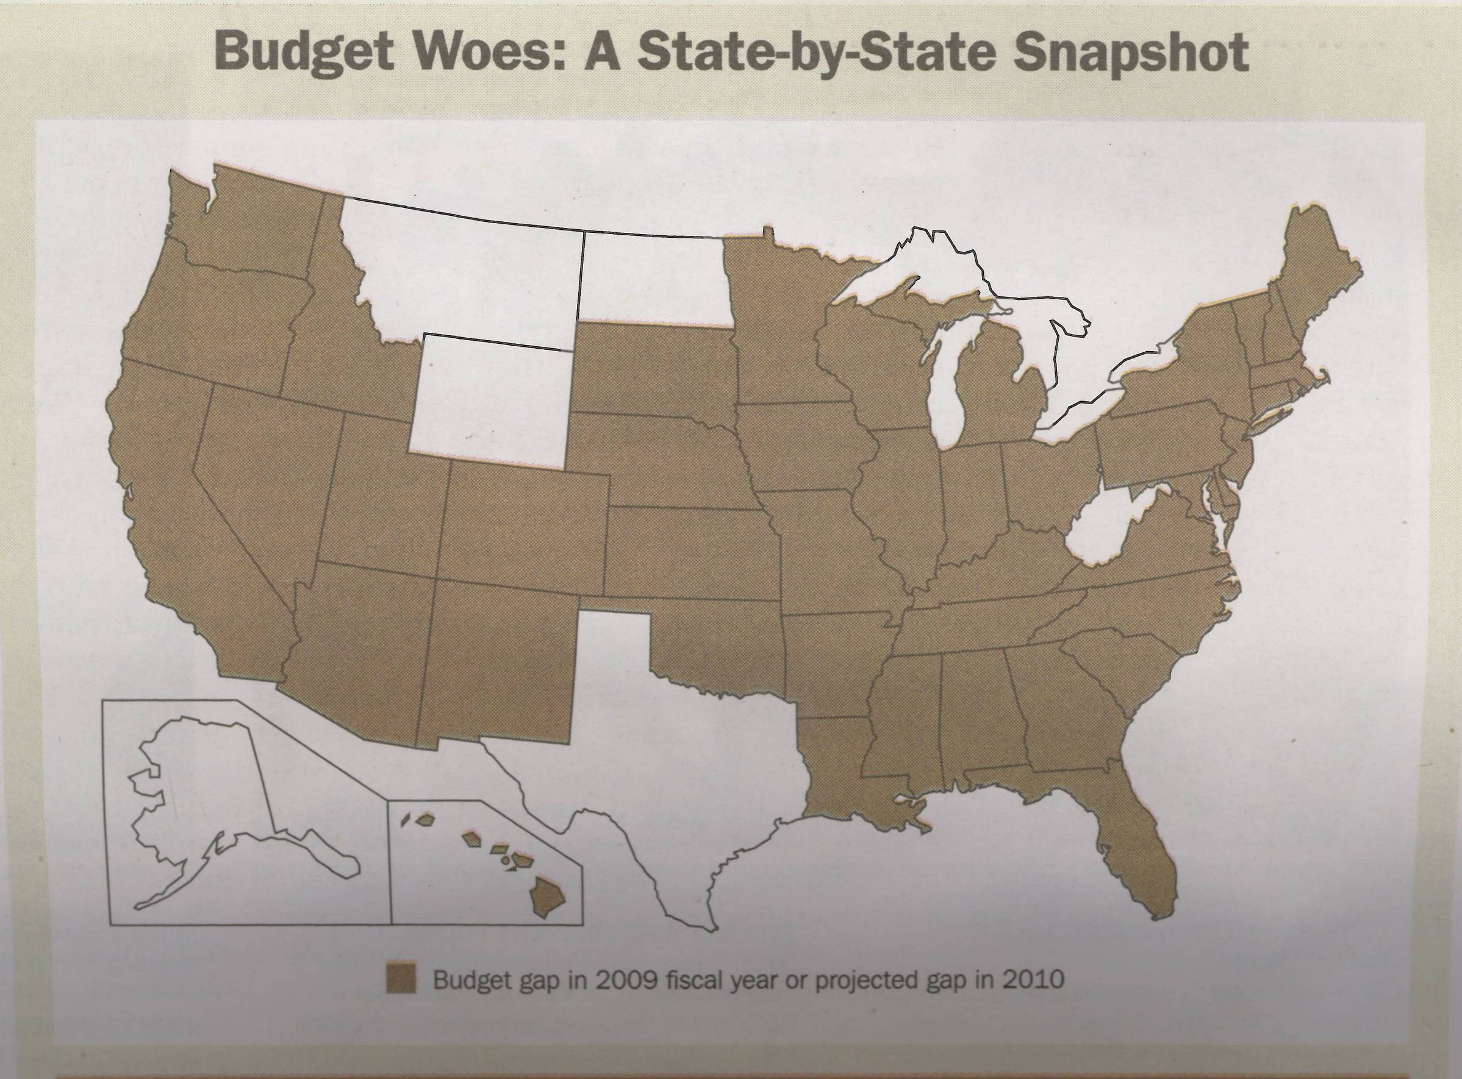
Budget Woes: A State-by-State Snapshot
Source: “Budget Woes: A State-by-State Snapshot.” The Chronicle of Philanthropy. 15 Jan. 2009: 21.

Slide 4
Fiscal 2009 Estimated Budget Gaps
Estimated Budget Gaps
Alabama | $1.2B
Arizona | 3.1B
Arkansas | 107M
California | 36B
Colorado | 604M
Connecticut | 542M
Delaware | 369M
District of Columbia | 227M
Florida | 5.7B
Georgia | 2.7B
Hawaii | 232M
Idaho | 131M
Illinois | 3.8B
Indiana | 763M
Iowa | 450M
Kansas | 141M
Kentucky | 722M
Louisiana | 341M
Maine | 265M
Maryland | 1.5B
Massachusetts | 3.3B
Michigan | 617M
Minnesota | 1.4B
Estimated Budget Gaps
Mississippi | $114M
Missouri | 342M
Nevada | 1.4B
New Hampshire | 250M
New Jersey | 3.7B
New Mexico | 454M
New York | 6.4B
North Carolina | 800M
Ohio | 1.9B
Oklahoma | 114M
Oregon | 142M
Pennsylvania | 1.6B
Rhode Island | 802M
South Carolina | 804M
South Dakota | 27M
Tennessee | 1.4B
Utah | 620M
Vermont | 125M
Virginia | 2.3B
Washington | 509M
Wisconsin | 998M
TOTAL | $89.2 billion
Source: “Budget Woes: A State-by-State Snapshot.” The Chronicle of Philanthropy. 15 Jan. 2009: 21.

Slide 5
National Look at Economic Conditions
Higher education institutions are being impacted in several areas:
State appropriations
Fundraising
Enrollment levels
Student loan capital and demand for student aid
Institutional liquidity
Long-term investments (endowment)
Long-term debt
Campus communications/perception
Sources: National Association of College and University Business Officers (NACUBO), Association of Governing Boards of Colleges and Universities (AGB)

Slide 6
President’s Statement to the Campus on the Economy
It is painfully evident to all of us that the U.S. economy has suffered a significant downturn. With its ample energy resources and prudent state leadership, Wyoming has thus far been shielded from the worst effects of the economic decline. Consequently, the University of Wyoming has been spared from the serious fiscal challenges that confront so many of our friends and colleagues at other universities and colleges in most other states.
We certainly hope that the state’s currently strong fiscal situation will last long enough to see UW and Wyoming through the nation’s current economic difficulties. Nevertheless, we don’t know how long the downturn will last, and as long as it does, Wyoming won’t be immune from the world-wide effects of falling energy prices and a stagnant economy. History tells us that Wyoming will be slow to feel the impacts from a national recession and slow to recover.
Last week, the Wyoming Consensus Revenue Estimating Group (CREG) released a report indicating that Wyoming can anticipate a quarter of a billion dollars in excess revenue this year. This is a significant amount of money and far more than most other states can expect, but it is a significantly smaller surplus than the CREG projected last fall. In response, the Governor has modified his recommendations for the 2010 supplemental budget. This does not mean our budgets are being cut. It does mean that there will be fewer surplus dollars for the legislature to distribute during this non-budget legislative session.
I want to be as clear as possible about what the reduced CREG estimates imply for UW’s budget. The estimated surplus is the amount in excess of what is required to fund the state-agency budgets passed by the legislature during the 2008 budget session. UW’s state budget currently remains stable, and in particular I anticipate being able to distribute dollars earmarked in last year’s biennial budget session for salary increases this spring.
However, current economic trends bring to light a very real question – what impacts might UW experience if Wyoming were to continue to experience declines in state revenues? Moreover, unlike other state agencies, UW receives its funding as a “block grant.” The expectation of the Governor and the legislature is that we at UW can and should regularly evaluate our spending to ensure it supports our highest priorities and how we pursue them. That expectation is particularly strong in light of the very generous support UW has received in recent years (continued on next page).
6

Slide 7
President’s Statement (continued)
For these reasons, I believe it is prudent for the UW community to begin a discussion about the university’s priorities and how those priorities should guide our future budget decisions in concert with our university planning efforts. If the current state fiscal strength outlasts the downturn, we will be a better institution for having asked questions that we haven’t asked ourselves for several years as we focused on restoring competitiveness and excellence. Not only will we be a better institution, we will continue to merit the confidence that state policymakers have placed in us. But if not, we’ll be better prepared for the hard conversations that may ensue.
I have asked UW Provost Myron Allen to lead a thoughtful and deliberate university-wide discussion about our institutional priorities. I also hope we will take this opportunity to explore economies or efficiencies that might be achieved through changes in our policies and practices. These conversations of course will be open to the entire campus community, and I encourage you all to voice your opinion. And of course, we will engage all of our campus constituent groups including my Executive Council, deans, directors, Faculty Senate, Staff Senate, and ASUW. I will ask Provost Allen to report back to me with conclusions and recommendations from these discussions by June 1.
I want to propose two ground rules for the discussion. First, let’s not frame it in a way that causes us to lose ground. UW has made remarkable strides in academic quality and stature in the past ten years, largely through a combination of the state’s favorable budgets and a level of credibility established through focused planning and follow-through. The furthest thing from our minds should be budget measures – such as across-the-board reductions – that will dissipate our progress and diminish our distinctiveness. Second, let’s bear in mind the vision established in our own planning documents. The most succinct statement of this vision appears in Creation of the Future 3, distributed last September by the Office of Academic Affairs: “to explore, create, and share knowledge, in areas that are meaningful to our constituencies and at a level of accomplishment that garners international recognition.” Our teaching, research, and service missions lie at the core of this vision, and they should be the last of our endeavors to suffer from budget reductions, should we ever have to manage them.

Slide 8
Campus-Wide Discussion
Ground Rules
Respect UW’s priorities and maintain core mission
“Will to prioritize” block grant responsibility
No across-the-board reductions
Multiple budget reduction scenarios
Adhere to UW’s vision articulated in Creation of the Future 3: “To explore, create, and share knowledge, in areas that are meaningful to our constituencies and at a level of accomplishment that garners international recognition.”

Slide 9
Perspective: UW’s 4 Agency Accounts
Program | FY10 General Fund Appropriation | 1% | 2.5% | 5% | 7.5%
University of Wyoming | 183,001,782 | 1,830,017 | 4,575,045 | 9,150,089 | 13,725,134
UW-Medical Education | 14,515,206 | 145,152 | 362,880 | 725,760 | 1,088,640
WICHE | 2,726,700 | 27,267 | 68,168 | 136,335 | 204,503
EORI | 3,055,413 | 30,554 | 76,385 | 152,771 | 229,155

Slide 10
Perspective: Tuition
Current revenue from tuition = around $45M (FY09)
1% tuition increase = $450,000 per year
2.5% tuition increase = $1.125M per year
5% tuition increase = $2.25M per year
7.5% tuition increase = $3.375M per year

Slide 11
Perspective: Tuition
To compensate for a 1% reduction in UW’s FY10 general fund budget ($1.8 million) . . .
Tuition would have to increase by 4.1%
To compensate for a 2.5% reduction in UW’s general fund budget ($4.6 million) . . .
Tuition would have to increase by 10.2%
To compensate for a 5% reduction in UW’s general fund budget ($9.2 million) . . .
Tuition would have to increase by 20.3%
To compensate for a 7.5% reduction in UW’s general fund budget ($13.7 million) . . .
Tuition would have to increase by 30.5%

Slide 12
Perspective: FY 2009 Section I Funding

Slide 13
Budget Planning
Core elements of UW’s mission
Enhancements
High-priority activities that support the core

Slide 14
Process/Timeline – Spring 2009
February 1: Begin campus-wide dialogue, led by Provost
February: Conversations with constituent groups
Executive Council
Deans
Directors
Faculty Senate
Staff Senate
ASUW
March 13: Initial recommendations by constituent groups to Provost
April 3: Feedback from Provost to constituent groups
April 30: Revised recommendations by constituent groups to Provost
June 1: Final recommendations by Provost to President

