Slide 1
2021 Annual Evaluation for Faculty

Slide 2
Who needs to complete an annual evaluation?
All benefited faculty need to complete an annual evaluation.
If you have not gone through the Reappointment, Tenure or Promotion process this academic year you will need to participate in a full annual evaluation.
If you have gone through the Reappointment, Tenure or Promotion process this year you will only need work with your supervisor to determine your workload for AY 2022-2023.

Slide 3
Wait for email saying your case has been created.
The “View Case” link will take you to a sign-in page at www.interfolio.com. Click on “Partner Institution”
Type ‘Wyoming’ in the search box and select University of Wyoming. This will take you to the UW log in screen.
You can also access WyoFolio/WyoVita anytime via WyoWeb

Slide 4
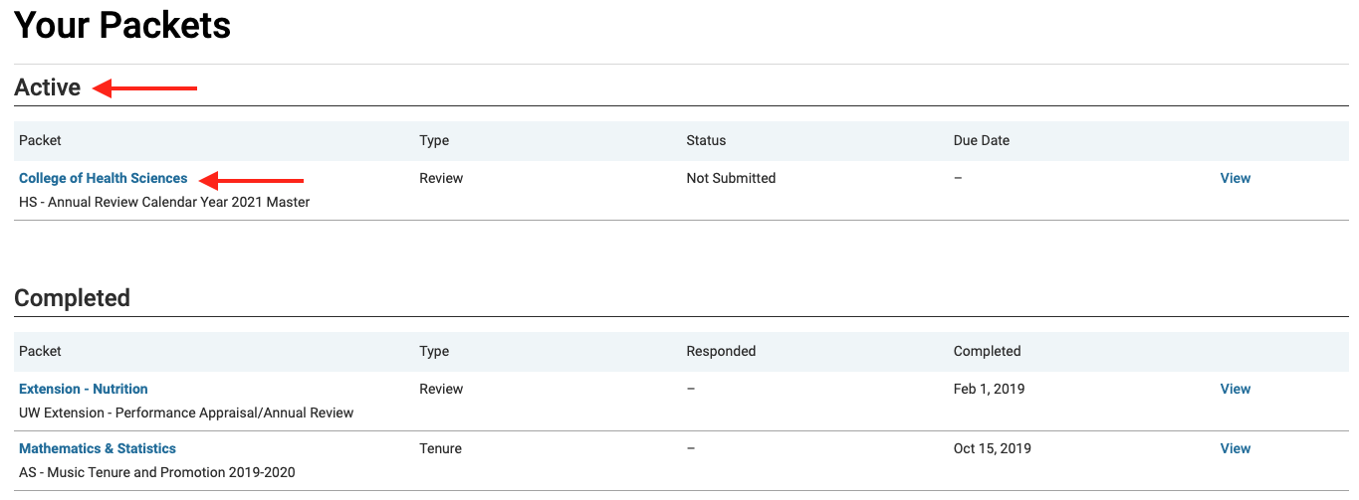
Once you have logged in click on ”Your Packets” in the upper left hand corner. There you will find “Active” and ”Completed” cases. Click on your annual review under “Active”.

Slide 5
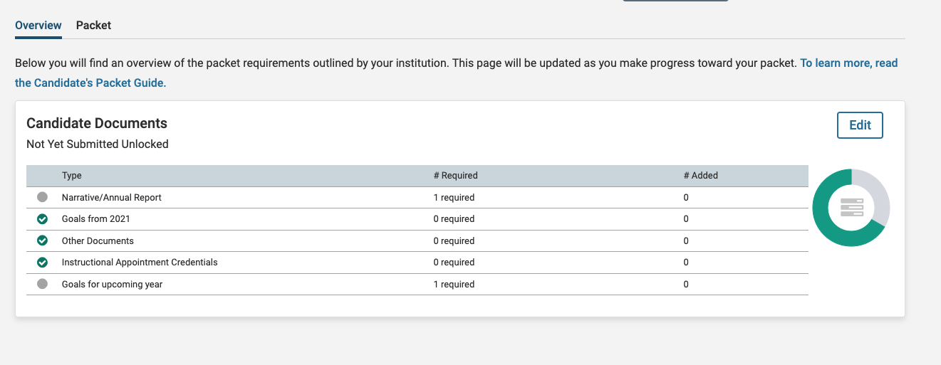
On the Overview (default) window, you will see a list of documents you are required to submit. This will vary from unit to unit. Academic Affairs will require a WyoVita CV, a brief narrative, and your goals from the previous year. You will also be asked to complete your goals for calendar year 2022. Colleges and Units may ask for more information. If you have questions speak with your supervisor.
Note: If you have already sent in your transcripts to Academic Affairs or you have added them to WyoFolio in the past, you do not need to complete the “Instructional Appointment Credentials” section.

Slide 6
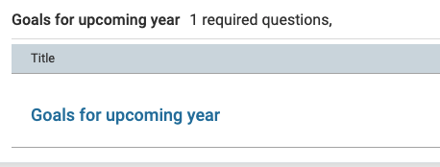
Finding your 2021 goals
To find the goals that you submitted last year during your annual review, you will click on ”Your Packets”. You will find your 2020 annual review under “Completed”. Click on ”Packet” and scroll to “Candidate Documents” and click “Goals for upcoming year”. This will bring up your materials from last year and you will be able to view your goals. From there you can copy and paste your goals.

Slide 7
How to Add Materials
Click “Edit”
If you have recently updated your WyoVita, you will want to “Regenerate” your CV to ensure that your CV is up to date. You will be able to regenerate as frequently as you would like until you hit “Submit”. Once you hit “Submit” this section will lock.

Slide 8
How to Add Materials
You will see the required documents, plus optional documents, again this will vary by unit. For each requirement click on “Add”. This will open a window that will allow you to upload a new document.
Once you see ‘success’ click ‘Add’. (Note: Program will automatically convert document to a PDF to ensure integrity of the document)

Slide 9
Adding Goals for 2022
To add your goals for calendar year 2022, click “Fill Out Form”. If you have questions about your 2022 goals, please work with your supervisor. When you have completed your goals click “Return to Packet”.
You can edit your goals by clicking “Edit Form” or “Edit”. You will be able to edit your goals until you submit your materials.

Slide 10
Submitting your materials
Once you have uploaded all your required materials you will need to hit “Submit” on the WyoVita section AND the Candidate Documents section. You can preview your materials by clicking “Preview Packet” at the top of the page.
Note: Your case will lock once you have submitted your materials and you will not be able to make additional edits. If you need to make an edit to your documents, you need to contact your dean/director’s office to unlock your case.

Slide 11
Reviewing and Acknowledging Your Annual Review
The faculty member will have an opportunity to acknowledge the annual review submitted by the supervisor. You will receive an email when you need to acknowledge. Below is a sample of what that email will look like.

Slide 12
Reviewing and Acknowledging Your Annual Review
Once you have signed the form you will need to upload it into WyoFolio. To do this you will log into WyoFolio and click on “Your Packets”. Select the case that has a yellow box stating “Open for Response”. Click on “Shared Committee Files”. There you will be able to view the document(s), download or copy to Dossier. When you are ready to upload your acknowledgement click “Send Response”.

Slide 13
Reviewing and Acknowledging Your Annual Review
The acknowledgment form can be found in the Annual Review section on the Academic Affairs website http://www.uwyo.edu/acadaffairs/academic-personnel/reviews/annual.html
Faculty should review and meet with their supervisor BEFORE uploading the acknowledgement.
Faculty must also upload an acknowledgement that they have seen the secondary level of review (e.g., Dean, Director or Vice President). No meeting is needed unless requested by the faculty member or secondary level reviewer.

Slide 14
Reviewing and Acknowledging Your Annual Review

Slide 15
I am stuck and I need help, what do I do?
First, visit the Academic Affairs website. http://www.uwyo.edu/acadaffairs/academic-personnel/reviews/annual.html. Most questions can be answered by either reviewing one of the trainings, looking at the FAQs, or using the quick reference guides.
If you still have questions, contact the college WyoFolio/WyoVita liaison; this is usually a staff member in the Dean’s office. You may also contact Aneesa McDonald (aneesamc@uwyo.edu) in Academic Affairs.
If you are having technical difficulties, contact Interfolio Scholar Services at 1-877-997-8807 option 2. The Scholar Service Center can be reached M-F 9am-6pm Eastern Time or help@interfolio.com.

Slide 16
For additional help with any of these steps click the arrow by your name in the upper right corner and select Product Help. Select “Help for Interfolio Review, Promotion and Tenure” for a variety of help documents.

