Slide 1
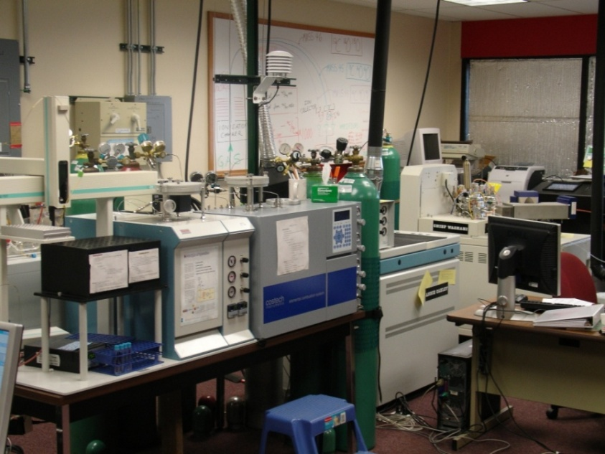
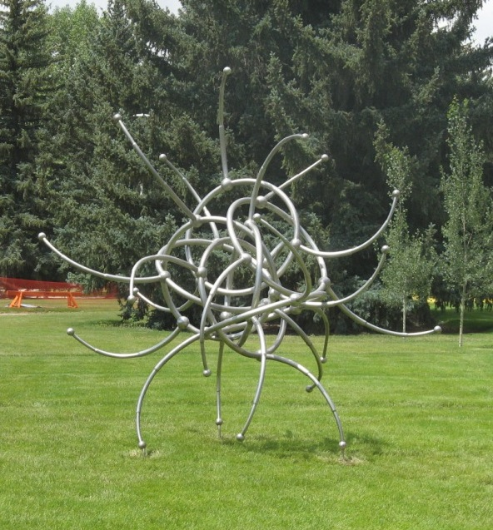
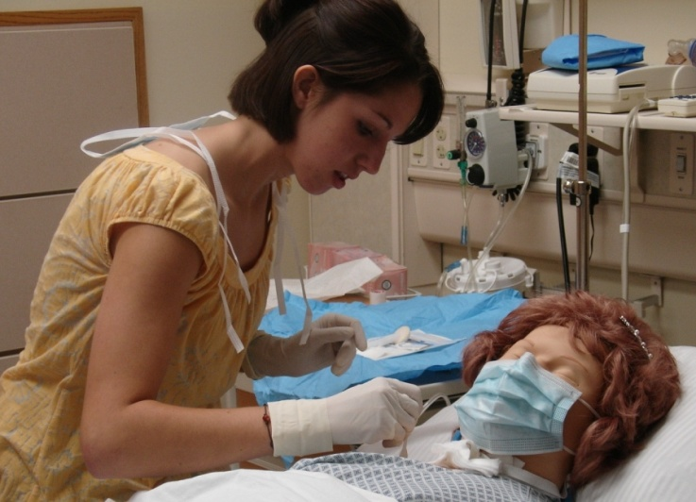
UW Planning Retrospective: 1999-2008
Myron Allen
Academic Affairs

Slide 2
The Context: in 1998
UW’s budgets had been flat or slow-growing for a decade, with cuts in at least 2 years.
Enrollments were declining.
The statewide political discourse treated UW as an expense, not an investment.
For nearly 2 decades, the closest thing to a planning document was a 1992 Academic Reallocation Committee report.
There was little central guidance on the institution’s major scholarly directions and weak connections to key issues in the state and region.
Research and graduate education had little visibility (in contrast to some earlier eras).

Slide 3
What planning has done for UW
Identified areas of distinction:
Critical areas of science & technology
Cultural assets, arts, & humanities
Environment & natural resources
History & culture of the Rocky Mountain west
Life sciences
Professions critical to the state & region
Provided a tool for strengthening these areas: Central Position Management

Slide 4
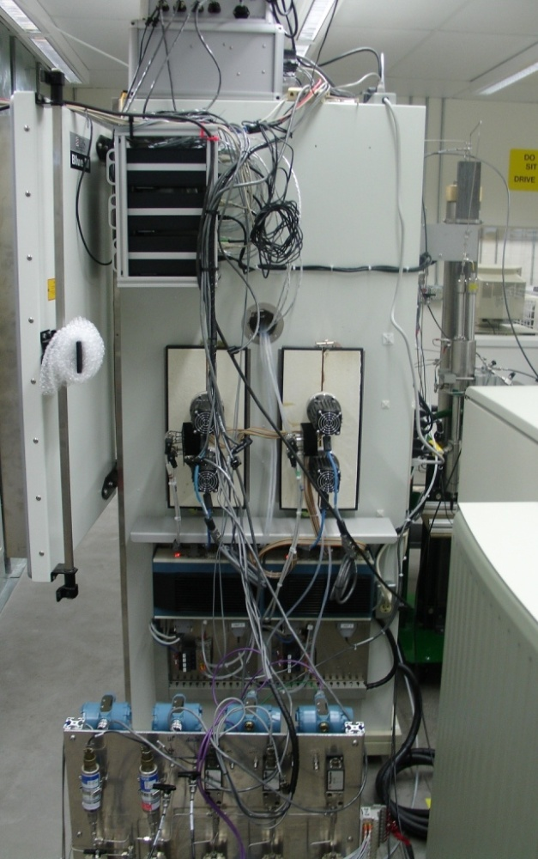
Highlights of specific advances
Critical areas of science & technology:
  School of Energy Resources
  Partnership with NCAR
  Revitalized EORI
Cultural assets, arts, humanities:
  MFA in Creative Writing
  Eminent writer-in-residence
  Art Museum outreach
  Planning for new Fine Arts facilities

Slide 5
ENR:
  new undergrad & grad degrees, joint JD-MS
  increased Haub School funding
  Cline & Spicer chairs
History & culture of Rocky Mountain west:
  PhD in Anthropology
  Increase in AIST-related faculty
  Transfer agreements with NOLS, Teton Science School
Life Sciences:
  Interdisciplinary PhD programs
  Revised undergraduate core
  Core facilities (WyGISC, Microscopy, NAEF, Stable Isotopes, …)

Slide 6
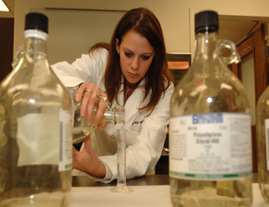
Professions critical to state & region:
Education:
  STEM-related hiring
  Concurrent majors in secondary ed.
Health care:
  Accelerated BSN (2nd bachelors)
  Online RN-BSN completion
  Increased FMRC funding
  WIND degree program

Slide 7
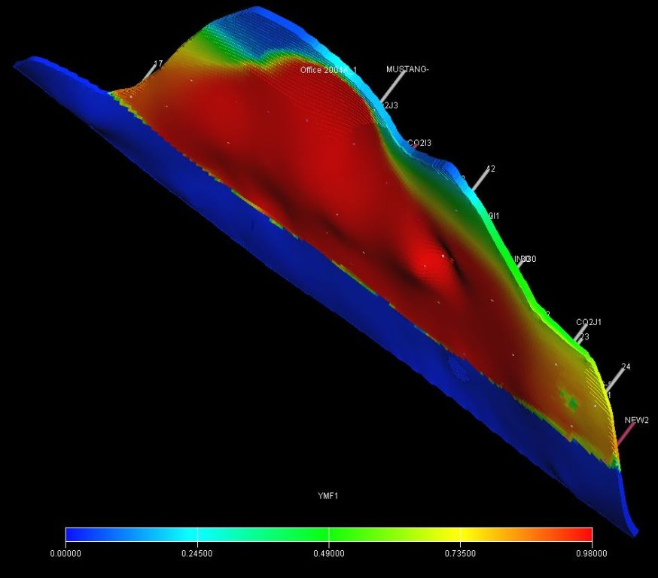
Engineering:
  Reinstatement of BS in Petroleum Engineering
  New focus on energy & computation
  Stable funding for Engineering Summer Program
Business:
  Executive MBA program
  Focus on natural resources, entrepreneurship, sustainability

Slide 8
Diversity-related initiatives
Diversity funding pool in AA
PACMWA
Permanent visiting position in AAST
Associate VP for Diversity
Stable funding for
  Shepard Symposium
  MLK Days of Dialog
  Social Justice Center
  Rainbow Resource Center
Routine salary equity checks & salary equity analysis

Slide 9
Internationalization
  Cheney center & scholarships
  Legal staff support for employees
  International partnerships (Russia, China, Guatemala, Australia, …)
  New attitudes!
Academic Success
  LeaRN
  Stable funding for Writing Center, Oral Communications Lab, Math Lab
  Increased funding for Honors Program
  Synergy

Slide 10
Support for UW’s mission
  Increased Library funding
  Remarkable endowment growth
  Funding records in sponsored research
Institutional practices
  Improved practices in faculty hiring T&P
  Use of course management software
  Systems for awarding financial aid
  Implementation of Banner software

Slide 11
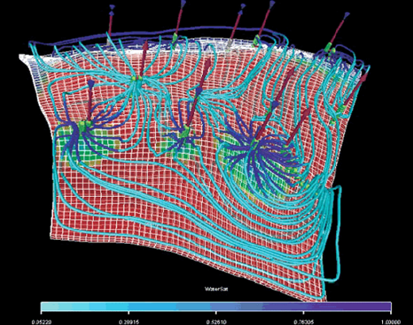
Statewide outreach & service
  Increased discipline-level articulation
  Statewide agreements on general education
  Stronger administrative relationships
  Online UW (1999)
  P-16 Council
  EORI
  Wyoming Technology Business Center
  Economic development initiatives (RPC, SBDC, etc.)

Slide 12
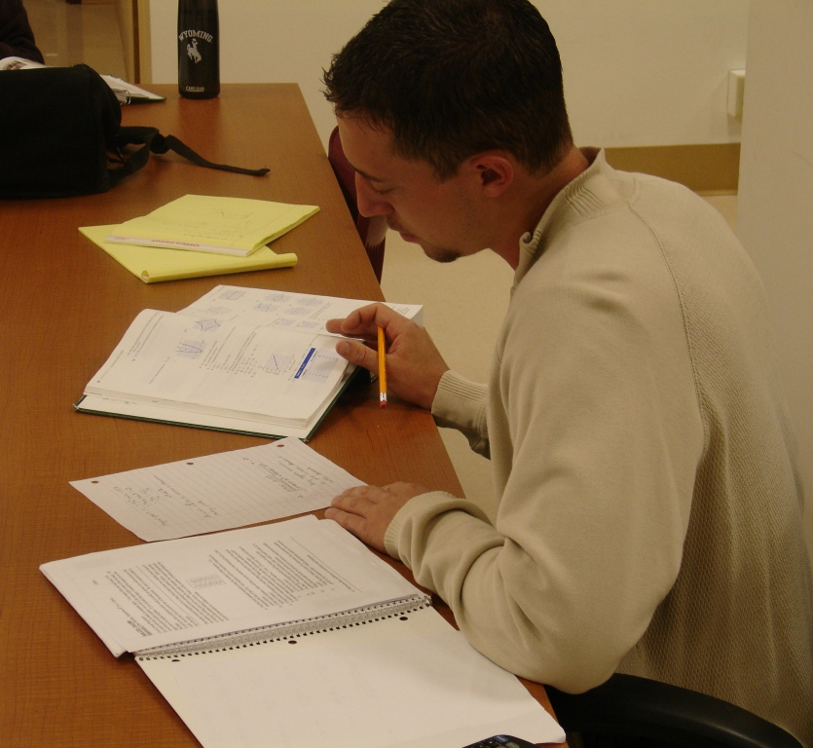
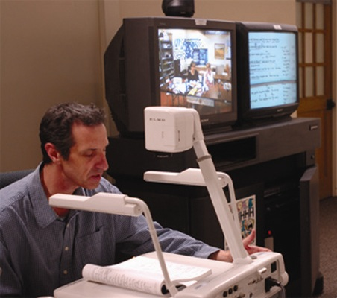
Enrollment and workforce trends

Slide 13
Systematic enrollment management has led to a recovery in UW enrollment and increased access for site-bound students…
…and increased pressure on support budgets

Slide 14
Legislative support, SER, and the Endowment for Excellence have restored UW’s faculty strength

Slide 15
UW’s faculty salaries have become more competitive, but the “finish line” is moving, too.

Slide 16
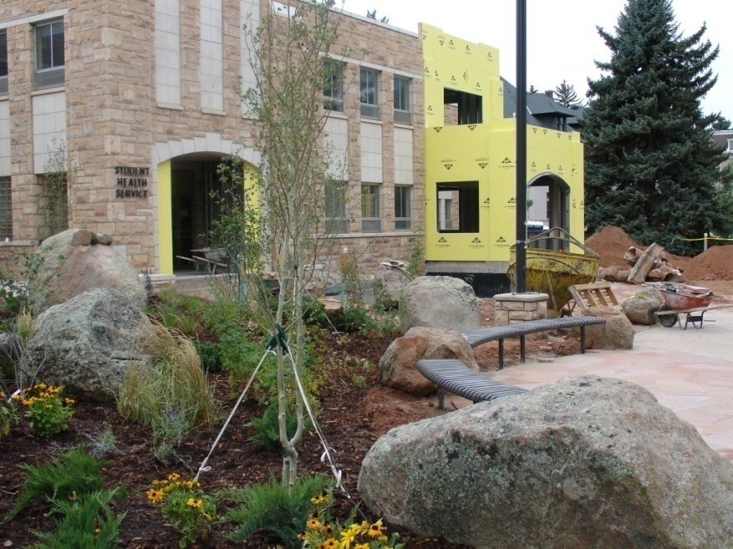
Major new facilities since 1999
  Health Sciences complex
  Early Care Center
  Library expansion
  Anthropology building
  Indoor Practice Facility
  Hotel-Conference Center
  WTBC
  Classroom Building renovation
  IT building*
  Honors House*
  College of Business Expansion*
  College of Law Expansion*
  Cheney International Center*
*construction under way

Slide 17
The big picture:
Planning has given UW’s faculty and staff a greater sense of our distinctiveness, our deep connections to the state, our major directions, and the pathways to a better future.
Planning and follow-through have helped strengthen UW’s credibility with state leaders.
Planning has given UW’s leaders, from department heads to deans, a set of principles upon which to make difficult decisions about curriculum, people, and resources.

Slide 18
Questions?

Slide 19
Spring 1998: UW’s President calls for a university-wide academic plan.
Spring 1999: Academic Affairs writes AP1 (1999-2004)
    major institutional themes
    168 action items
        Other divisions release 1st Support Services Plan (2000), Capital Facilities Plan (2001)
Spring 2004: Academic Affairs writes AP2 (2004-2009)
        6 areas of distinction
        141 action items
Spring 2005: 2nd Support Services Plan, updated Capital Facilities Plan
Spring 2006: First discussions of UP3 with BoT

