Slide 1
The Effects of Scenic and Environmental Amenities on Agricultural Land Values
James Wasson, Donald M. McLeod,
Christopher T. Bastian and Benjamin S. Rashford
Ag.& Appl. Econ. University of Wyoming
AAEA 2010 Organized Symposium:
“Quantifying the Determinants of Land Values:
The Impacts of Irrigation, Recreational Amenities
and off-Farm Income.”
Acknowledgements: USDA NRI & WY AES
Notes:
Western States facing population growth, drought, competition for resources particularly land.
What is fueling this competition?
What land is most sought after?
How
might individual planning, land use planning and tax policy benefit from this inquiry?

Slide 2
Overview
Issues
Context
WY Lands
HPM
Results
Intrepretation

Slide 3
Problem Motivation
Land Supply Concerns
Demand Considerations
Ex-urban (Suburban) Development Pressure
Consistent/Precise HPM
Notes:
Supply
Prodn Costs Rising
Aging Operators
Nuisance from NonAg Landowners
Demand
Population Growth
2nd Home Growth
Wealth Magnet
Development of Important Ecological and Recreational Parcels
Distant from the Central City
Consistent/Precise HPM
Parcel Specific Attributes utilizing GIS
Small But Detailed Data Set
Sample of WY Ag Parcels

Slide 4
Previous Work
Spahr & Sunderman, 1998: AG Amenities & Taxes
Bastian et al., 2002; Torrell et al. 2006: Improved HPM Specification w/Quantifiable Amenity Measures (GIS)
Bergstrom, 2002; Open Space Values
Randall, 2003: Multifunctionality
Plantinga et al. 2002; Livanis et al. 2006: AG Land Values primarily Production Attributes
Notes:
Study in WY, Land Econ
Study in WY, EcoEco
Conceptual pieces indicating multiple views of value(s) associated with Agricultural Lands
Research with Measures indicating Ag Land Values primarily driven by Production Characteristics

Slide 5
Overview of WY Land Attributes
Environmental Amenity Value
Commodity Production Value
Spatially Defined Land Markets
Preferential Tax for Agricultural Land
Notes:
Env Amenity
Public Lands
Wildlife
Recreation
Scenery/Open Space
Prodn value
Soils (AUM basis)
Water
Improvements
Geog Mkts
Basin & Range/Watershed
Amenity clusters
Policy to Maintain Ag Viability
Productivity Intent

Slide 6
HPM Framework
$/acre = f (β^{AG} X^{AG}; β^{AMENITY} X^{AMENITY} )
FGLS Model: Joint Correction of Spatially Correlated Errors & Heteroskedasticity (Unknown Source)
Composite error term:
  U_{i} = e + u_{h} + u_{sa}
      e = the random error
      u_{h} = the decomposed heteroskedastic error term
      u_{sa} = the decomposed spatial error term
Notes:
HPM
Reduced form model indicating price discovery as a function of both Prodn + Amenity determinants of price (multiple land market demand segments)
FGLS Model:
Residual Plots (nonspherical errors)
Outliers (yes but not the remedy)
Mulitcollinearity (NO)
OLS w/Whites Adjustment (persistent nonspherical errors)
HETEROSKEDASTICITY!!!
SPATIAL AUTOCORRELATION!!!
Spatial Autocorrelation Detected
Spatial Correlated Errors
Distance Band of 54 miles to Weight Nearby Parcels
Persistent Heteroskedasticity
Unknown source
Residual Weights (Absolute Value)

Slide 7
Production Only v. Full (w/Amenity) Model
R²: Prodn Only = 0.45; Full Model = 0.68
Productivity Values: Irrigated Lands, Improvements
Off-parcel Amenity Values: View and Landscape Components; Proximity to Federal Lands
On-parcel Amenity Values: Big Game Habitat; Angling Availability
Notes:
Incorporating Amenity Values into Land Value Model yields greater explanatory power
Variables tended to share signs and significance (ROBUSTNESS) Across Many Models (Linear Fn Form as best)
Adjustments/Transformations of Var/Co-VAR matrix via FGLS
Improves accuracy (reduces SE) of parameters
Indicates Specific Parcel features that add or subtract value (Amenity – Dis-amenity)

Slide 8
Performance of HPM
Mean Land Values ($/acre)
Region | Observed | Statute | Predicted
West | $691.57 | $476.64 | $673.11
Central | $406.09 | $304.75 | $348.48
East | $313.62 | $325.34 | $325.77
State | $461.87 | $374.74 | $451.26
Notes:
Note how well the Predicted Model performs relative to State Statute valuation

Slide 9
Percent of Amenity Contribution to Land Value (%)
Region | Amenity % | Amenity/Production Attributes
West | 56.20 | 2.57
Central | 10.40 | 0.30
East | 7.30 | 0.17
State | 32.50 | 1.07
Notes:
Amenity values constitute roughly 5-60% of a given parcel’s value with the average parcel consisting of nearly 1/3 amenity driven value;
Note the variability across regions and the importance of Amenities to Western WY Land Prices

Slide 10
Amenity Premiums (+$/acre)
Region | Alpine View | Roughness of View | Fishing Quality
West | $93.52 | $202.64 | $82.44
Central | $0.32 | $7.28 | $28.59
East | $0.01 | $5.53 | $18.16
State | $31.29 | $71.82 | $43.08
Notes:
View components (Alpine Vistas); Roughness of Horizon; on-parcel angling offer per unit premiums relative to the mean value;
This is particularly the case for western Wyoming
1% change in view component
10 meters of elevation change
Improvement in fishing quality from one quality level to the next

Slide 11
Dis-Amenity Penalties (-$/acre)
Region | Land Cover | Distance from Federal Lands | Wildlife
West | -$58.06 | -$43.77 | -$28.92
Central | -$38.09 | -$56.90 | -$13.06
East | -$20.80 | -$114.58 | -$4.84
State | -$38.09 | -$71.75 | -$15.16
Notes:
View components (Shrub as Sagebrush, Deciduous Trees as Cottonwoods or Willows); Distance from Federal Lands and Big Game Wildlife Habitat exact per unit price penalties relative to the mean value; Again this is most notable for western Wyoming
1% change,
1 mile change per acre impact,
1% change in amount of habitat

Slide 12
Land Value & Tax Assessment
Improved Tax Assessment = Tax Efficiency/Equity
Estimated Land Prices yield Regional (and sub regional) Differences: Heterogeneous Spatial Markets
Notes:
Assessed value the basis of determining Taxes due by Parcel
Imprecise assessment leads to inaccurate (inequitable) taxation
Consider how model performs across state
Evidence that there are regional land markets using a pair-wise test of means via WCE
(consistent w/attributes and distance band ala basin and range/watersheds)

Slide 13
Land Value & Tax Assessment (cont.)
WY State-Statute: Productive Value Assessment
FGLS Model vs. State-Statute Model Estimates
Differences between Western (Amenity-rich Region) FGLS Estimates and State-Statute Model: Amenity-relevant Tax Burden
Notes:
WY State-Statute Approach
Assessed value of land is determined by production attributes
Comparison of State v. FGLS HPM approach
State approach is adequate for Central, Eastern Regions
Amenities play important role in determining land values in the Western part of WY
Ignoring their contribution may lead to inaccurate assessed valuation

Slide 14
Implications
Property Tax Mechanisms
Land Use Planning & Policy
Multiple Enterprise Rents
Notes:
Are amenity rich parcels under taxed relative to highly productive lands w/fewer amenities?
What is agricultural land use?
Lands in demand (amenity) may become lands sold, subdivided and fragmented: might this be a means to detect lands at risk of conversion from Ag into other less socially beneficial uses?
Might it be the target of conservation/preservation efforts/$$??
Land attributes of value may be opportunities for landowners to secure rents from agro-tourism, fee hunting/fishing;
or as a criteria for enrollment in public land preservation programs OR nonprofits land trust contracts.

Slide 15

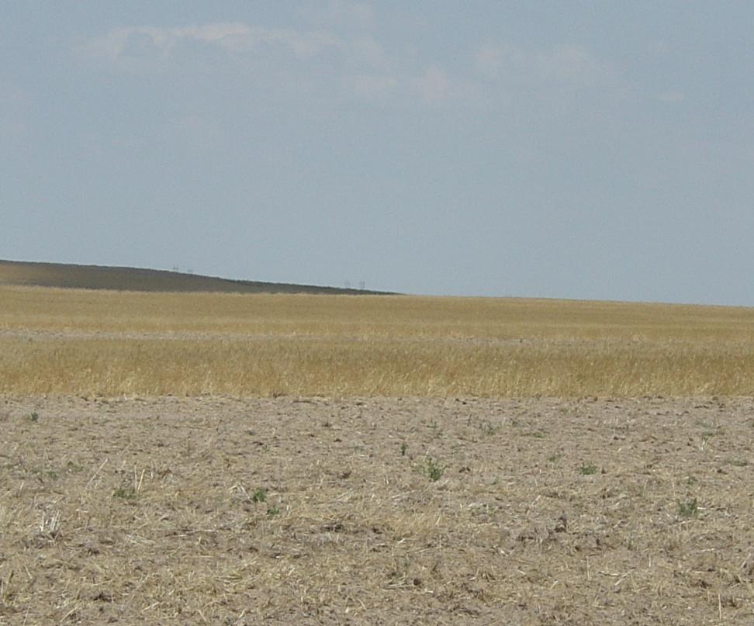
Questions?
Western Wyoming Parcel
Eastern Wyoming Parcel

