Slide 1
Determining the Relationship Between Development Pattern and the Costs of Public Services
in the Mountain West
Donald M. McLeod, Scott N. Lieske
Project Director Meeting
Prosperity for Small and Medium-Sized Farms and Rural Communities Programs
February 21 – 22, 2013
10:30 AM
Panel #1 Rural Development
Holiday Inn Capitol
550 C. Street,
Washington, DC 20024
Notes:
Introductions: Don and Scott (co- PIs) with invaluable assistance of Roger and Anna
Over the past four year’s we’ve developed a framework for modeling the Relationship Between Development Pattern and the Costs of Public Services in a spatially explicit fashion
We received a NIFA seed grant to expand assess the state of data that could allow us to expand our modeling efforts to multiple public services across MT, WY and CO.
This is an overview of these efforts.

Slide 2
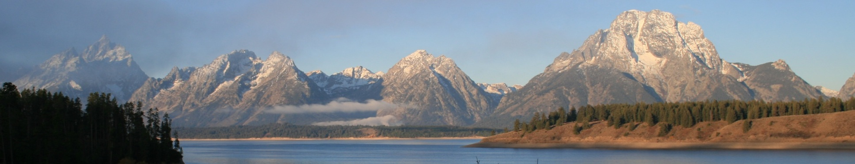
Today’s Agenda
Rationale and Objectives
Prior Research
Data for historical land-use modeling
The state of data for econometric modeling
Outcomes
Timeline for finishing
Notes:
The purpose of our grant is to access data availability for expanding our research from an initial pilot project to more broadly across CO, MT and WY.
In order to put the project in context I’ll being with an overview of the goals, rationale, objects and prior research.
Then discuss key elements of our seed grant, data for historical land-use model which is the data we need for our econometric modeling
Then go over our outcomes both achieved and anticipated
And wrap up with our next steps and timeline for finishing

Slide 3
Rationale
USDA Goals:
Priority in U.S. Agriculture 6. Agriculture Economics and Rural Communities (AE&RC)
The Situation:
Most local governments do not know the cost of development decisions and do not know if their land use plan is fiscally sustainable .
Rationale:
Economic efficiencies may improve if governments can be made aware of the relationship between the built environment and costs of service provision.
Rural Communities benefit from Agriculture; protecting agricultural lands secures agriculture and associated environmental amenities and in turn supports economic robustness of rural communities
Research Opportunities:
Protect Agricultural Lands by Indicating Fiscally Efficient (and inefficient) areas for development
Evaluation of development with regard to environmental attributes.
Notes:
Current (2013)
The USDA AFRI identifies a need to enhance optimal land use decisions the protect the rural environment and promote economic development etc…
The Situation: Most local governments do not know the cost of development decisions and do not know if their land use plan is fiscally sustainable
Rationale: Economic efficiencies may improve if governments can be made aware of the relationship between the built environment and costs of service provision. If results continue along the lines of what we’ve fund thus far this is a strong economic argument for agricultural lands protection.
Research Opportunities: 1) Our primary focus is protecting agricultural lands by Indicating Fiscally Efficient (and inefficient) areas for development in a spatially explicit fashion. In the future we have a goal of integrating
Local government fiscal modeling, environmental attributes and the built environment in an overall economic welfare analysis.

Slide 4
Objectives
1. To examine data in Colorado, Montana and Wyoming in order to determine which county datasets contain the necessary attributes for spatially explicit fiscal modeling of local government services.
2. To examine local government time series expenditure data and associated time series level of service measures in Colorado, Montana and Wyoming for county government services that may have a spatial component to the cost of service provision.
3. To investigate the availability of spatially attributed panel data that capture environmental characteristics (e.g. prime agricultural lands, big game species habitat, wildland urban interface).
Notes:
The overall aim of this application is to assess the availability of data, methodologies and expert collaboration in preparation for a standard AFRI grant application. … With this seed grant application we will have the necessary data to model the spatial component of the costs of public services provision for counties in Colorado, Montana and Wyoming. The proposed modeling will allow county level governments in these states to evaluate public expenditures associated with each parcel as influenced by size, location and land-use classification. This research also enables the evaluation of the fiscal implications of changes to parcel sizes and land use.
Our objectives in this research are there to
Examine and obtain data in three states Examining what data we can get, and the subset of the data we can get that have the attributes we need.
We need both expenditure and level of service data for local governments.
Pursuant to the future research opportunity of incorporating environmental and other attributes in a broader analysis.

Slide 5
Prior Research
Lieske S.N., McLeod D.M., Coupal R. and Srivastava S. 2012. ‘Determining the relationship between urban form and the costs of public services.’ Environment and Planning B 39(1).
Notes:
Prior Research.
Over the past 5 years we’ve developed a framework for modeling the relationship between development pattern and the costs of public service provision.
The framework is demonstrated in this evaluation of the cost of policing services in Albany County, Wyoming.
(optional: production function framework)
We’ve quantified the built environment with a spatial statistical measure
This measure of urban form is a statistical significant determinant of the cost of a public services.
By incorporating regression results into a spatially differenced cost function (or, by feeding results back in the GIS as part of a spatial model) we are able to map areas that are efficient and inefficient for the provision of policing services in the county.
This research was published in 2012.

Slide 6
Objective 1: Data for historical
land-use modeling
1. Parcel boundaries (GIS layer)
2. Parcel ID number (attribute)
3. Land-use designation (often tax code classification)(attribute)
4. Year of construction (attribute)
5. Building Value; the assessed valuation of structures in dollars (attribute)
6. Land Value; the assessed valuation of land in dollars (attribute)
7. Assessed valuation (attribute)
8. Tax District (GIS layer or attribute)
Notes:
In support of our first objective we are looking for
Parcel boundaries, make the analysis spatially explicit
Parcel ID, allows us to link geographic to tabular data.
Land use is the basis of the spatial index
Year of construction is necessary to do historical land use modeling
Other attributes may be used to fill in the gaps in attributes 3-4.
Building values is used as a surrogate for the intensity of the built environment.
Building value, land Value, total value, assessed value and tax district are components of the revenue model.

Slide 7
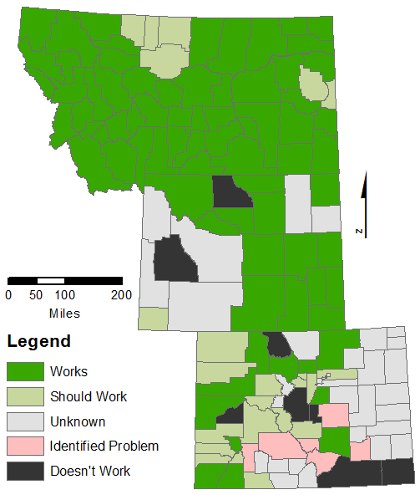
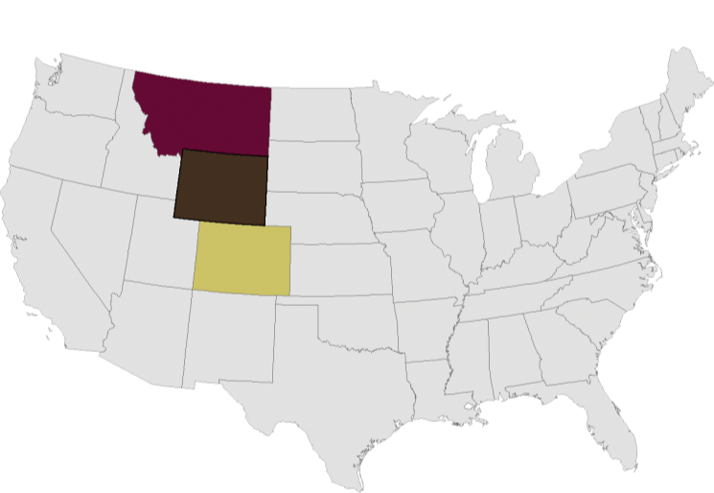
Objective 1 Outcomes:
Data for
Historical
Land-Use Change Modeling
(as of 4 Feb. 2013)
Notes:
The three states that are the focus of our research vary considerable in the data they have available.
Montana data are available for the entire state. Needed attributes are available for most counties.
In Wyoming appx. 2/3 of counties have digital data. Due in part to established connections, most are willing to share, sometimes for a fee.
CO is a county by county challenge. The idea of an identified problem in Colorado is sometimes associated with a large fee.

Slide 8
Objective 2: Time Series Expenditure Data and Level of Service Measures
Wyoming is the only state that compiles county level budget/expenditure, socioeconomic data, and crime data at the state level.
Data for Colorado and Montana is kept at the county-level, and is generally more problematic.
Issues associated with the data include:
Data gaps – (FBI, Colorado and Boulder County are unreported in the uniform crime reporting system).
Inconsistent collection methods
Discrepancies between data reported in multiple locations
Inconsistent time frames--we have data for our years of interest for some things
Notes:
Read wyoming….
Read data for Colorado and Montana etc.…
Identified problems with these data include gaps, inconsistent collection , discrepancies lack of consistency across the time frames of interest (generally 1990 – present) …
Will address data gaps by attempting to access local government fiscal and service measure data stored at local libraries. Could mention hiring a Tech
Other supporting data, for example population, unemployment, cost of living etc.. are relatively easy to obtain at the county level.

Slide 9
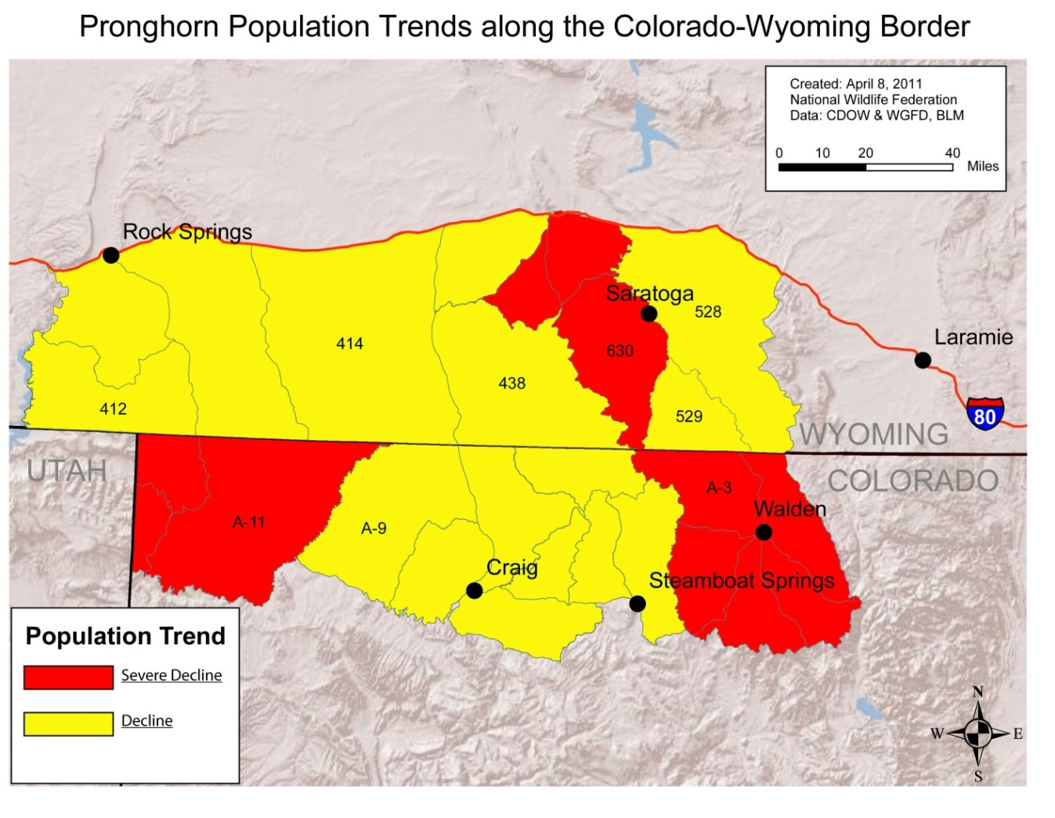
Objective 3:
Time-series Environmental Data
Notes:
Time series environmental data are something we’ve been looking for a long time. Finally found some, a consulting firm compiled 30 years worth of state agency big game statistics. These data link spatially explicit herd units with longitudinal population estimates. These data will allow us to better assess by expanding fiscal efficiency evaluation into an overall analysis.

Slide 10
Objective 3 (cont.)
Additional Community Service Issues: Land Use Planning and Fire
Wildland Urban Interface
Land Use Choices by Counties
Fire Suppression Costs borne by Federal Agencies
Residential Development and Increasing Costs of Fire Suppression
Notes:
Additional Community Service: Land Use Planning and Fire
Wildland Urban Interface
Land Use Choices by Counties
Fire Suppression Costs borne by Federal Agencies
Residential Development and Increasing Costs of Fire Suppression

Slide 11
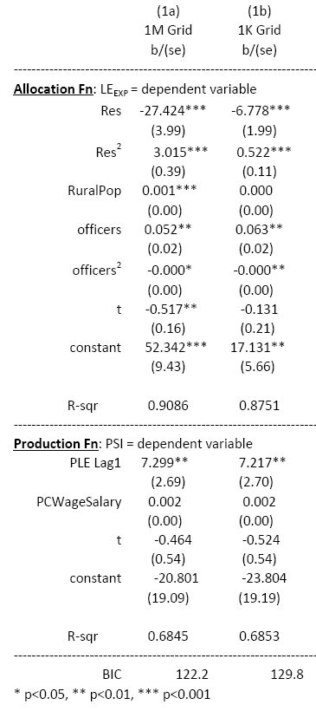
Outcomes:
Research
And
Education
Notes:
In addition to data gathering we’re pushing forward with the core research
In developing a second detailed model of policing services, this time in Laramie County, Wyoming, we’re finding similar results between the pattern of the built environment and costs of service provision
In putting together the publication we’re confronting economic theory issues by developing the model into a cost function. Once data are gathered and our economic theory issues are resolved we’ll be able to quickly produce a number of analyses for Montana, Wyoming and Colorado.

Slide 12
Outcomes: Research, Education and Extension
Research
Lieske S.N., McLeod D.M., Scofield A.M. and Coupal, R.H. 2011.(In Development). Modeling Costs of Public Service Provision.
Lieske S.N. and Gribb, W.J. 2012. ‘Modeling high-resolution spatiotemporal land-use data.’ Applied Geography 35(1-2), 283-291.
Lieske S.N. and Gribb W.J. 2011. Cadaster-based temporal land use modeling with Python. The Association of Collegiate Schools of Planning 52nd Annual Conference.
Lieske S.N., McLeod D.M. and Scofield A.M. 2011. Determining fiscally efficient locations for public service provision. 58th Annual North American Meetings of the Regional Science Association International and Second Conference of the Regional Science Association of the Americas.
Education
Scofield, A. (In Development) The Relationship Between Development in the Wildland Urban Interface and Federal Wildland Fire Suppression Costs. Thesis (M.S) University of Wyoming. Laramie.
Extension
Lieske S.N., Coupal R.H., Hamerlinck J.D., McLeod D.M., Scofield, A.M. (Accepted) ‘Planning support system enabled spatially explicit local government fiscal modeling’ in Planning Support Systems for Sustainable Urban Development (Edited Volume) Springer Academic Publishers.
Notes:
Research outcomes include the economic theory and second case example which is in developing
A methods paper on using cadastral data for high resolution spatiotemporal land-use modeling
On the education side we’ve hired a grad student. She’s both gathering data for this research and researching the Relationship Between Development in the Wildland Urban Interface and Federal Wildland Fire Suppression Costs.
On the extension side we’ve been working with the Laramie County planning office on an update of their comprehensive plan (separately funded) and integrated our research by looking at the fiscal implications of future growth as specified in the guidelines of the developing plan

Slide 13
Timeline
We extended seed grant through July 2013 are applying for a standard AFRI Foundational Program grant in May 2013.
For More Information:
Donald M. McLeod Scott N. Lieske
DMcLeod@uwyo.edu lieske@uwyo.edu

Slide 15
Data Partnerships
Numerous Municipal and County Governments
Wyoming Department of Revenue
Wyoming Division of Economic Analysis
Wyoming Wildlife Federation
Research Partnerships
The Nature Conservancy
USDA Regional Research Committee Member
W-2133 Benefits and Costs of Public and Private Lands Mgmt.
Universities:
Colorado State University
Idaho State University
Montana State University
University of Colorado
University of Montana
University of Wyoming
Notes:
Part of the seed grant is developing data and research partnerships.
CSU David Theobald, UC William Travis, Ida St Matt Germino; Roger Coupal and Steve Praeger at UW.

