Slide 1
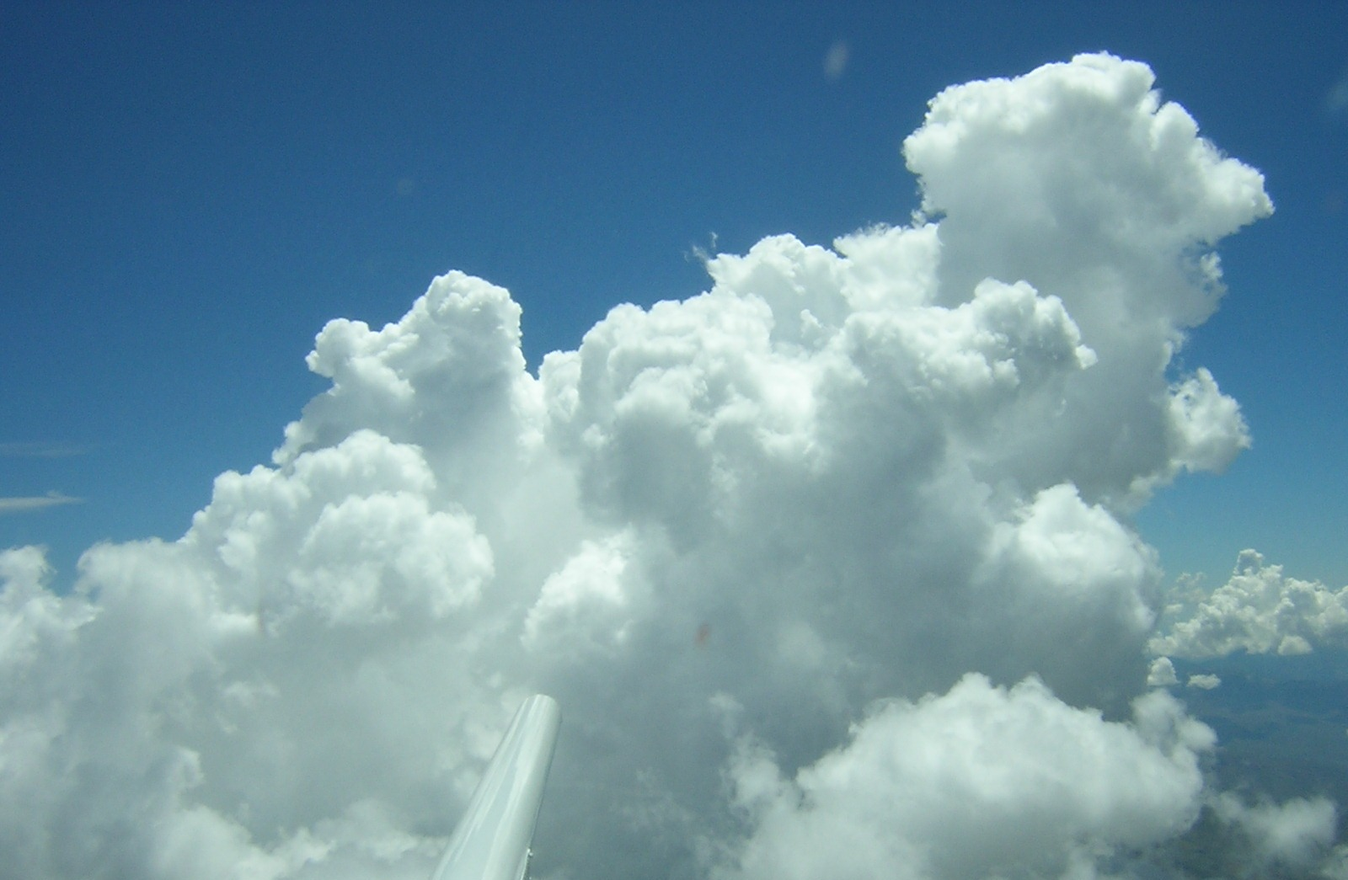


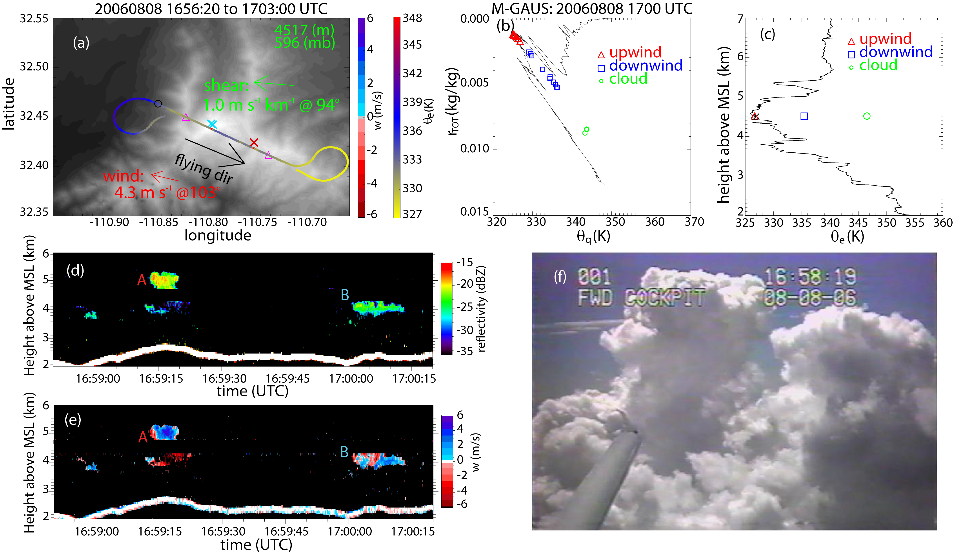
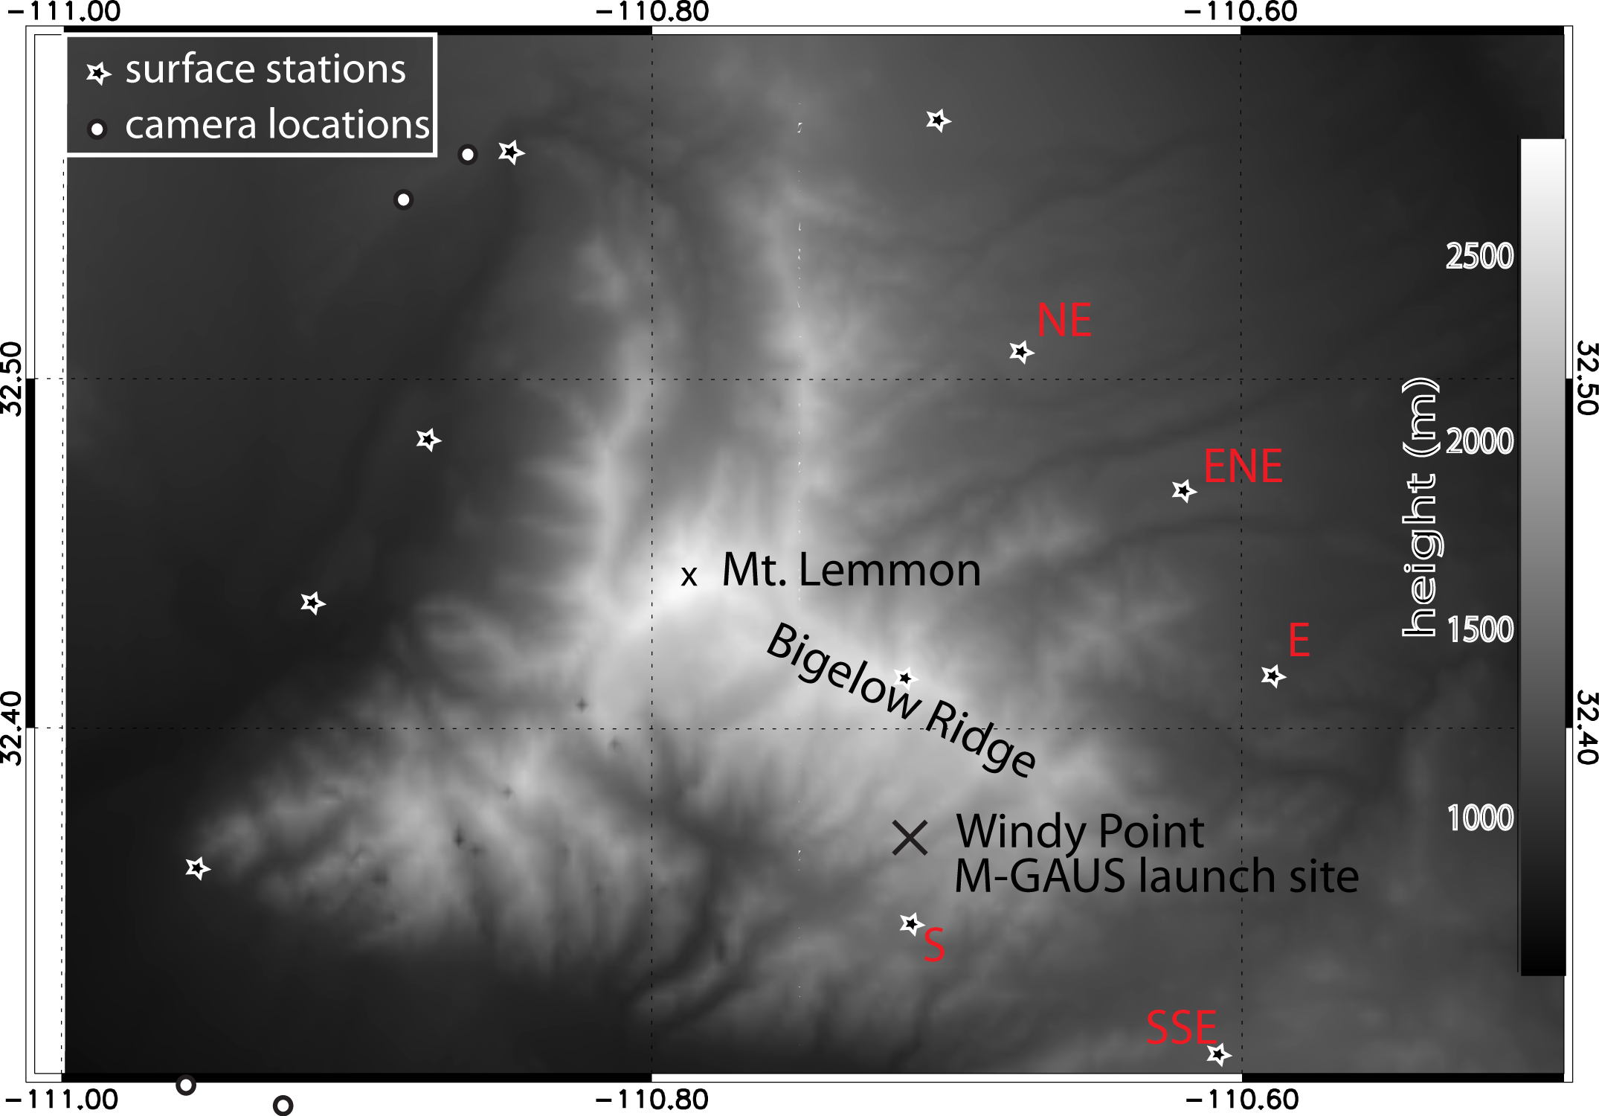
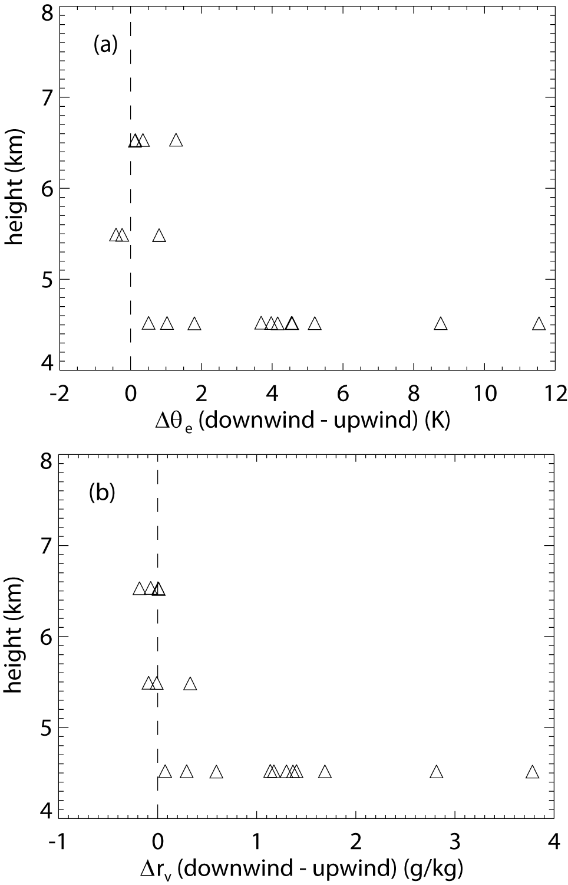
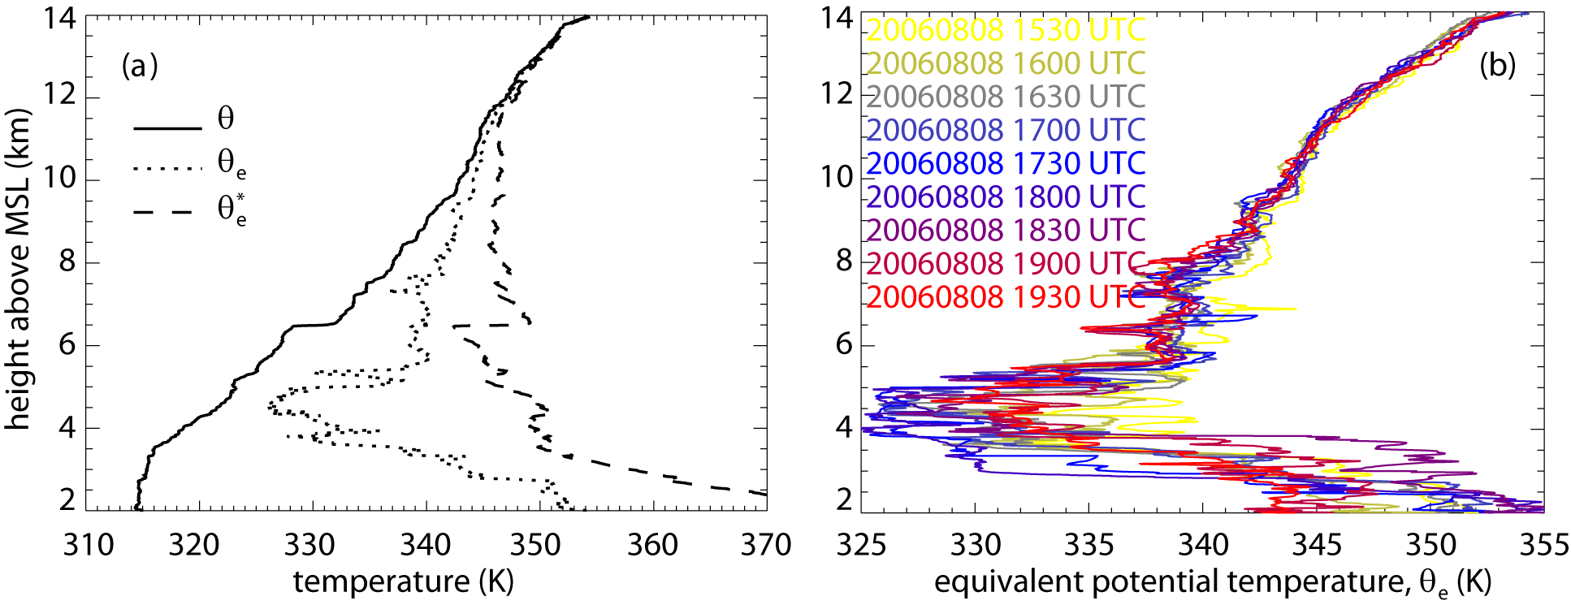
Observations of the Impact of Orographic Cumulus Clouds on the Ambient Flow
Yonggang Wang and Bart Geerts
University of Wyoming, Laramie, Wyoming, 82071, wyg@uwyo.edu
1. Introduction
The effect of detraining cloudy air on the surrounding clear air has been studied mainly using numerical simulations.
Relatively few observational studies have described the cloud-scale process of Cu detrainment in terms of changes to the environment.
The hypothesis of moisture-convection feedback (the immediate environment of Cu clouds is modified by preceding convective towers such that Cu growth is facilitated) has not been experimentally verified.
4. Result: example of cumulus detrainment analysis, 1656:20 to 1703:00 UTC August 2006
Fig. 3: (a) Map of the flight track, colored by _{e} over a terrain map. Also shown is the flight-level vertical air velocity (colored crosses).
(b) Paluch diagram showing WKA cloud penetrations and out-of-cloud WKA data along the flight turns on the downwind and upwind sides of the orographic convection.
(c) Average _{e} on the downwind and upwind sides of the orographic convection.
(d) Vertical transect of WCR reflectivity.
(e) WCR vertical velocity.
(f) Cu photo taken by a forward-pointing camera in the cockpit of the WKA.
2. Data source
The Cumulus Photogrammetric, In-situ and Doppler Observations (CuPIDO-06) campaign: flight of Aug 08, 2006 chosen for case study.
The flight-level measurements from Wyoming King Air (WKA)
Wyoming cloud radar data (WCR)
Mobile GPS Advanced Upper-air Sounding (M-GAUS)
Integrated Surface Flux Facility (ISFF) stations
Stereo-photogrammetric data
5. Composite results: 18 cases
6. Conclusions
A clear enrichment signature is present in the downwind environment of Cu clouds.
This enrichment reduces potential instability but increases ambient humidity, thus it may render the environment more conductive to penetrative convection.
The moisture-convection feedback mechanism does not explain the commonly observed gradual deepening of daytime orographic convection.
Fig. 1: Terrain map of the Santa Catalina Mountains in southeastern Arizona showing CuPIDO-06 measurement sites.
Downwind θ_{e} increases, thus potential instability reduced.
3. Environment
Downwind ambient humidity increases.
Fig. 2: (a) Profiles of θ, θ_{e}, and θ_{e}* at 1700 UTC on 08/08/2006. (b) Changes in θ_{e} profiles between 1530-1930 UTC on 08/08/2006.
Fig.4: Scatter plot of the average (a) θ_{e} difference, (b) water vapor mixing ratio (r_{v}) difference between downwind and upwind loops as a function of flight level.

