Slide 1



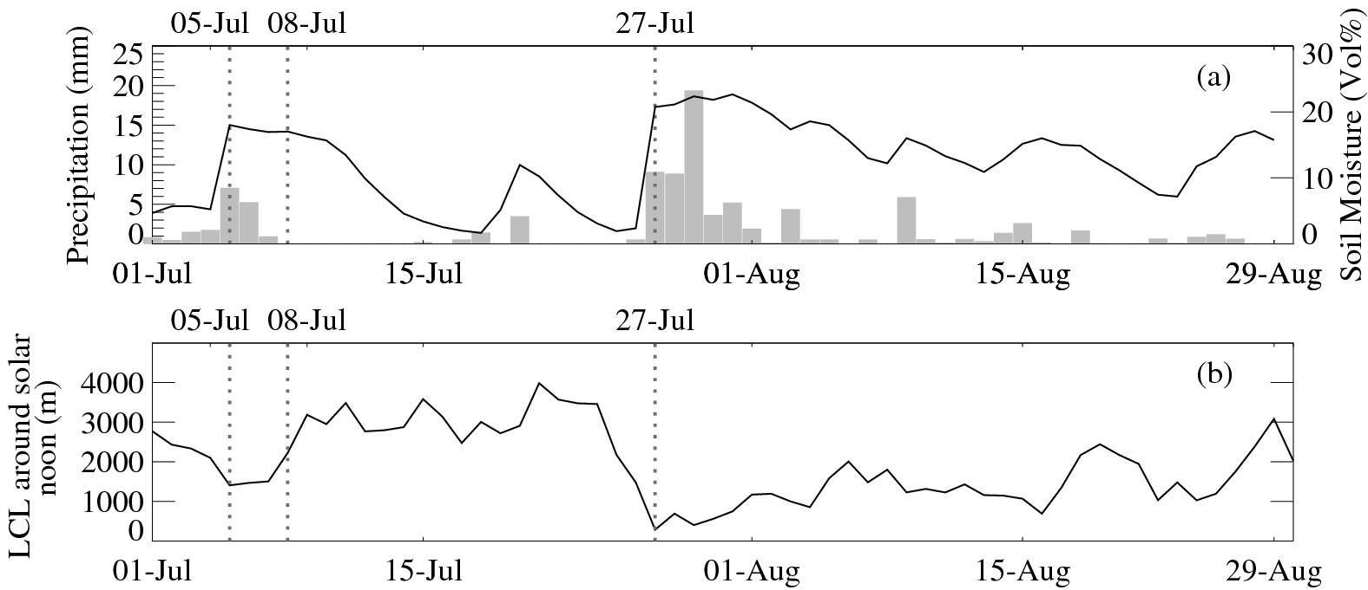
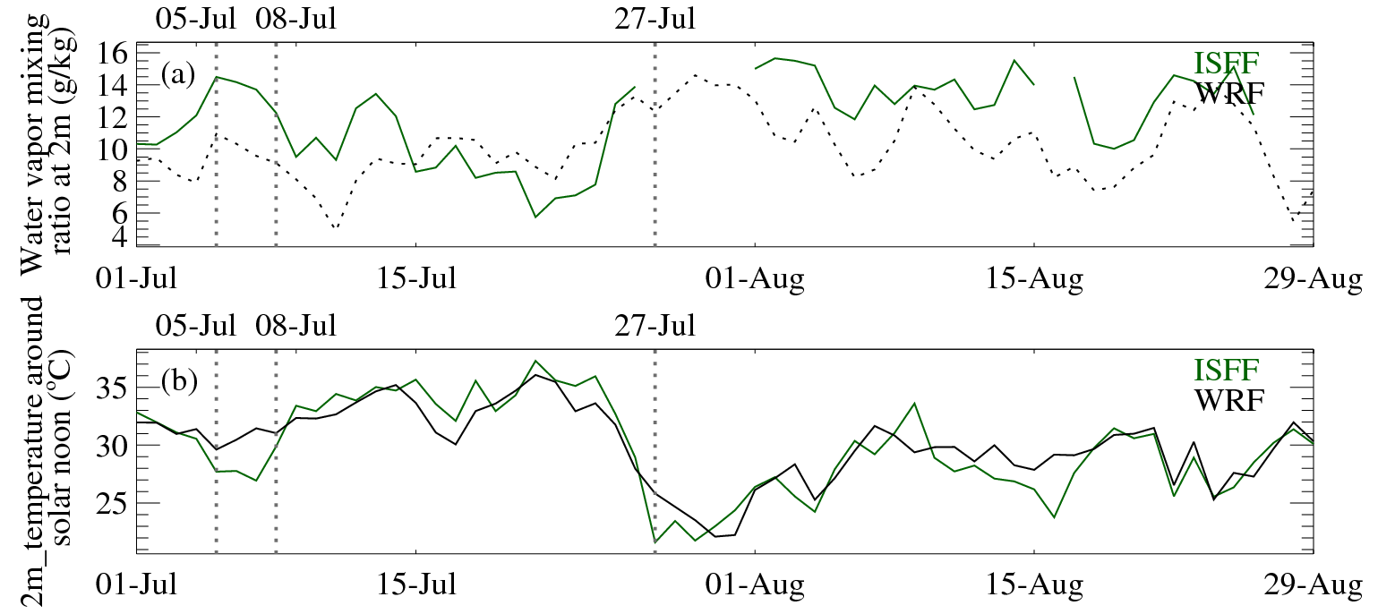
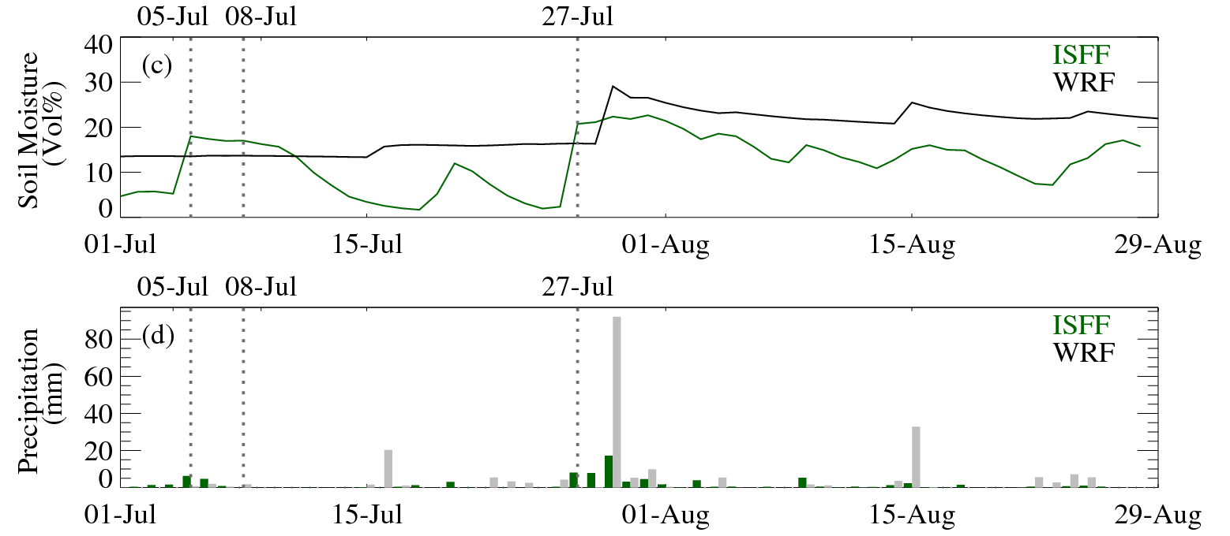
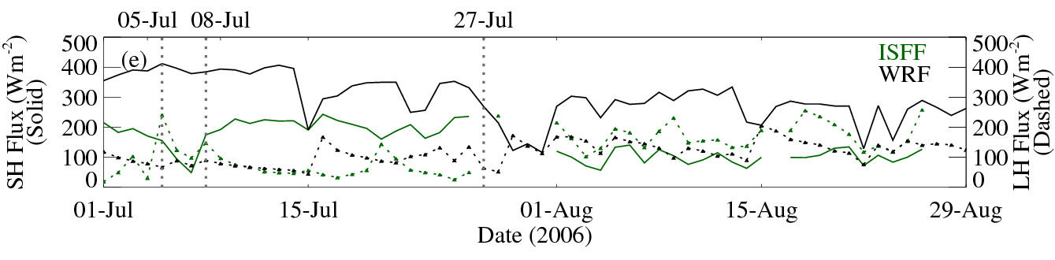
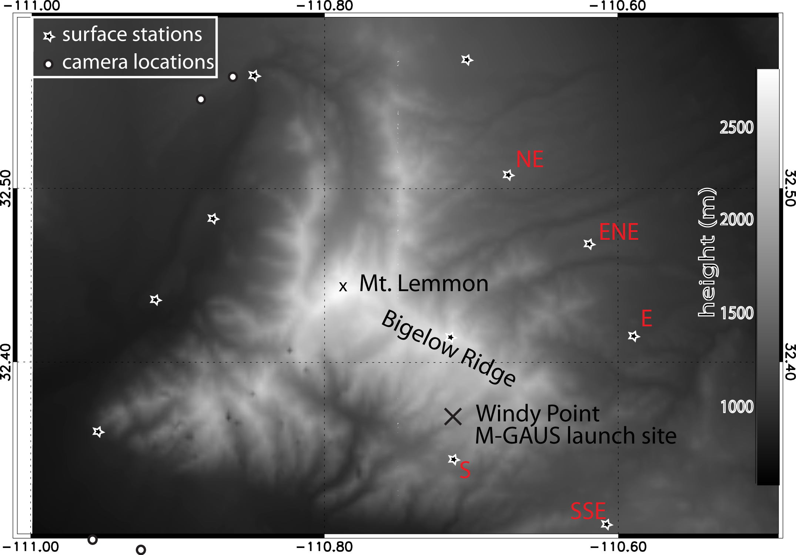
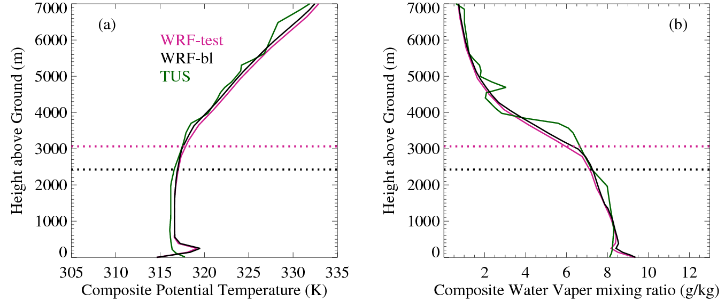
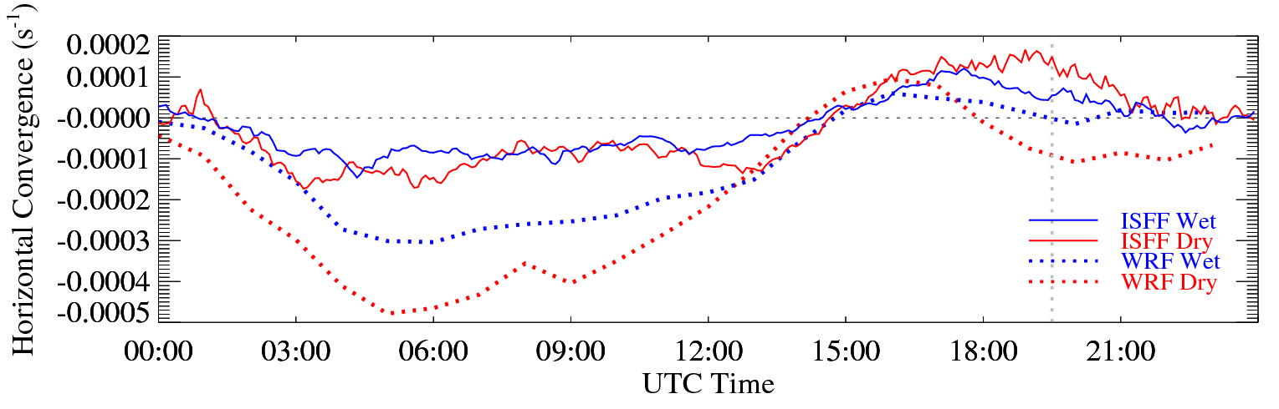
Assessing the impact of soil moisture on the diurnal evolution of the PBL and on orographic cumulus development over the Santa Catalina Mountains during the 2006 Arizona monsoon
Xin Zhou, Bart Geerts
University of Wyoming, Laramie, Wyoming, 82071
Introduction
The influence of soil moisture on planet boundary layer (PBL) evolution and orographic cumulus development over complex terrain is investigated by numerical simulation validated with Measurements. A two month period simulation (Jul - Aug) was conducted using the WRF model v3.2 and Noah LSM at 1km horizontal resolution with the inner domain centered at the mountain peak.
Results suggest that a better control of soil moisture, radiation and related parameters might be needed in the simulation.
3. Wet and dry periods
The whole period was divided into 2 categories based on ISFF measurements and some parameters calculated around solar noon
(19:30Z +/- 2hr) .
5. The 2 Month Simulation and validation
10 grid points that are the nearest to the ISFF stations were picked from WRF output of 2 Month Simulation for validation.
Based on the division of Wet and Dry periods in section 3, diurnal horizontal convergence around the mountain was estimated by divergence theorem (Holton 2004) separately for 10 ISFF stations and 10 grid points nearest to ISFF stations from WRF output. The simulation did reveal weak convergence around solar noon and divergence during the night. However, the magnitude and duration are largely biased away from the ISFF values.
In general, the 2 month simulation reveals a relative dry spell followed by a wet spell. However, they do not match the ISFF measurements well in timing or peak value, especially for soil moisture and daily precipitation. Also, the simulated sensible heat flux is dramatically larger than ISFF data while the latent heat fluxes are about the same. This leads to a larger Bowen Ratio and may lead to an overall different effect on convection initiation.
Dry Periods (22d):
Jul 01 – Jul 04
Jul 09 – Jul 26
Wet Periods (38d):
Jul 05 – Jul 08
Jul 27 – Aug 29
Fig. 2: Area mean of ISFF measurements. (a) Time series of soil moisture around solar noon (solid line) and accumulated daily precipitation (gray bars). (b) Time series of LCL around solar noon.
2. Data source
Measurements of the 10 Integrated Surface Flux Facility (ISFF) stations around Santa Catalina Mountains in southern Arizona during Cumulus Photogrammetric, In Situ, and Doppler Observations (CuPIDO) Campaign, Jul 01- Aug 31 2006.
Soundings measured at Tucson which locates at the southwest side of Catalina foothills twice a day at 00Z and 12Z.
WRF(V3.2) Parameters Setting and outputs comparison
A 9-Days test run started from Jul 01 was conducted, then it followed by a 2-Months simulation (started from Jul 01) on Bluefire in CISL at NCAR. Both simulations were two-way nested runs centered at the peak of the mountain. The inner most domains are the particular ones to be focused on.
Composite vertical profiles were compared among Tucson measurements and the 2 simulations. It shows that Bluefire Run is closer to the observation and has lower PBL on average.
Key Parameters | Test Run (9 days) | Bluefire Run (2 months)
Size (inner most dom) | 60km X 60km | 96km X 96km
Resolution (inner most dom) | 1km | 1km
Microphysics | Lin scheme | Thompson scheme
Longwave Radiation | RRTM scheme | RRTM scheme
Shortwave Radiation | Dudhia scheme | Dudhia scheme
Surface Layer | Eta similarity | Eta similarity
Land Surface Model | Noah LSM | Noah LSM
Boundary layer | MYJ scheme | MYJ scheme
Cumulus Parameterization | No | No
Numerical Integration | RK 2nd order | RK 3rd order
Table 1: Schemes and settings used for model configuration in test runs and Bluefire Run.
Fig. 4: Area mean of ISFF measurements and corresponding WRF outputs. (a) Time series of water vapor mixing ratio around solar noon, (b) Time series of 2m temperature around solar noon, (c) Time series of soil moisture around solar noon, (d) Daily accumulated precipitation, (e) Time series of sensible heat flux and latent heat flux around solar noon.
Fig. 3: Composite profiles and PBL height (dashed) for the first 9 days WRF outputs and TUS observation at 00Z starting from Jul 01. (a) Composite potential temperature (b) Composite water vapor mixing ratio.
Fig. 1: Terrain map of the Santa Catalina Mountains in southeastern Arizona showing CuPIDO-06 measurement sites. The ISFF Stations are indicated with stars
Fig. 3: ISFF and WRF composite diurnal horizontal convergence around mountain for the wet and dry periods. Solar noon is at 19:30Z

