Slide 1


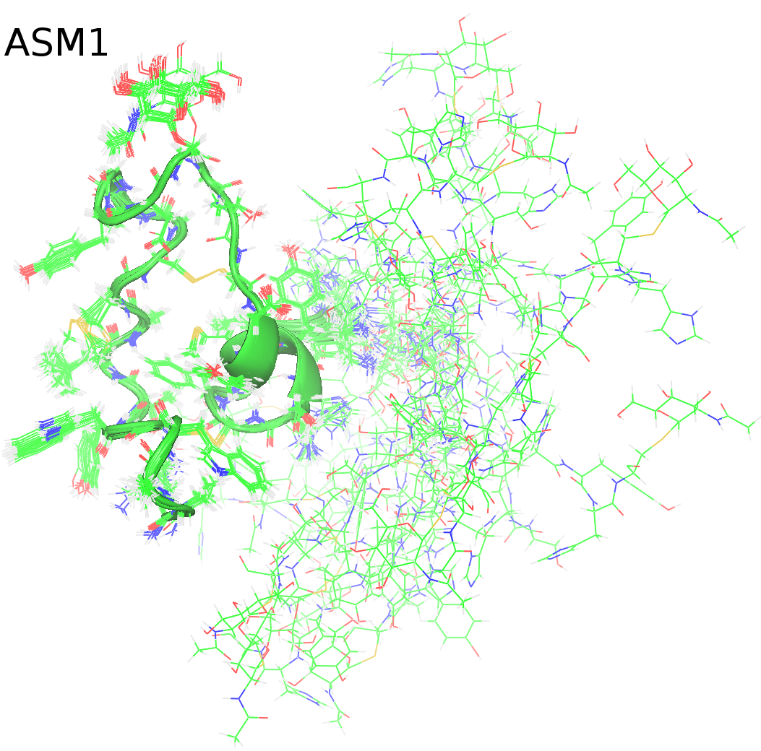
Picture
Alexander K. Goroncy, Ph.D.
Manager, NMR Facility
Department of Chemistry
Physical Science Building, Room 303
agoroncy@uwyo.edu
307-766-2093
http://www.uwyo.edu/chemistry/directory/alexander-goroncy.html
Structure-function relationships of inorganic or organic polymers, proteins, drug delivery systems; soil organic matter; conversion of coal and oil to value-added chemicals and clean fuels,
enhanced oil recovery.
Nuclear magnetic Resonance (NMR), Magnetic Resonance Imaging (MRI), EPR, MS
I have been involved in numerous interdisciplinary research projects involving many students, e.g.,
- Center of Mechanistic Control of Water-hydrocarbon-Rock Interactions in Unconventional and Tight Oil Formations (Department of Energy, DE-SC0019165, $11,750,000 over 6 years)
This is a collaboration of Stanford Univ., SLAC National Accelerator Lab, Univ. of Illinois, Univ. of Southern California, Univ. of Wyoming; I work in high-field NMR and MRI characterizations of rocks.
- Deciphering the Role of Microbial- and Plant-derived Carbon Compounds in the Formation of Stable Soil Organic Matter (EPSCoR Wyoming Microbial Ecology Collaborative RFP, NSF award EPS-1655726, $50,000). I am co-PI in this collaboration with PI Mengqiang Zhu (Ecosystem Science and Management), and Co-PIs Franco Basile (Chemistry), Linda van Diepen (Ecosystem Science and Management), and work on the spectroscopic characterization of carbon compounds in soil by NMR analysis, and lignin quantification.
- Development of new drug delivery systems to combat infectious diseases
The tuberculosis work with nanoprobes has been with the National University of San Marcos, Peru.
- Structural-functional roles of proteins Yih1 and ASM1 by NMR spectroscopy
This work is in collaboration with Massey University, Palmerston North, New Zealand.
This is a MRI image of ~15 mm Solution structure
wide Madison limestone, water is of S-glycosylated
yellow, solid material is red. MRI bacteriosin ASM1
allows to visualize pores in the determined by
sample though which water NMR (or oil) can flow. Spectroscopy/
Selected co-authored publications:
- Characterization of isoniazid incorporation into chitosan-poly(aspartic) nanoparticles. International Journal of Polymeric Materials and Polymeric Biomaterials (accepted for publication)
- Probing ethane phase changes in bead pack via high-field NMR. Chemical Engineering Science 261, 117969, 2022
- Removal of ions from produced water using Powder River Basin Coal. International Journal of Coal Science & Technology 9, 1, 2022
- Acid demineralization effect on the sonication-assisted solvent extraction of vitrinite coal of the Powder River Basin. Fuel 308, 121989, 2022
- Experimentally based structural model of Yih1 provides insight into its function in controlling the key translational regulator Gcn2. FEBS Letters 595, 324-340, 2021
- Analysis of ZTE MRI Application to Sandstone and Carbonate. AIChe Journal 67, e17074, 2021
- Effects of mixtures of CO2 and CH4 as pyrolysis atmosphere on pine wood pyrolysis products. Renewable Energy 162, 1243-1254, 2020
- Structural characterization of the S-glycosylated bacteriocin ASM1 from Lactobacillus plantarum. Magnetochemistry 6,16, 2020
- Crosslinker length dictates step-growth hydrogel network formation dynamics and allows rapid on-chip photoencapsulation. Biofabrication 12, 3, 035006, 2020
- Effect of transfer agent, temperature and initial monomer concentration on branching in poly(acrylic acid): A study by 13C NMR spectroscopy and capillary electrophoresis. Polymer 114, 209-220, 2017
- Microbial mat communities along an oxygen gradient in a perennially ice-covered Antarctic lake. Applied and Environmental Microbiology 82, 620-630, 2016

