Slide 1
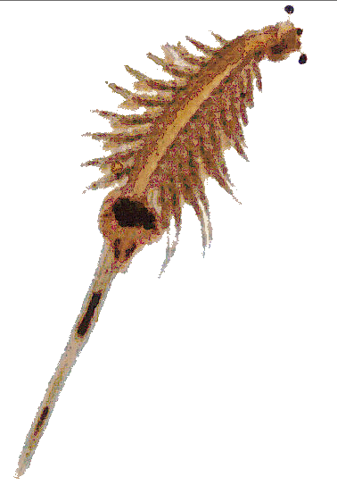
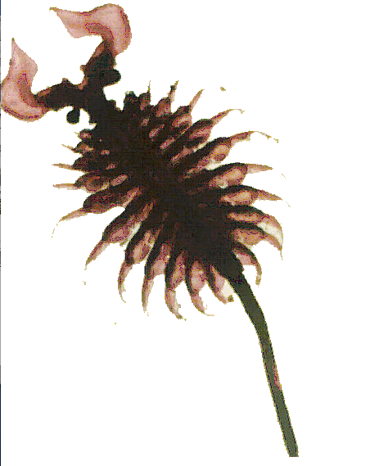
Osmoregulation and
water balance
Chapter 42

Slide 2
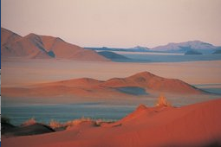
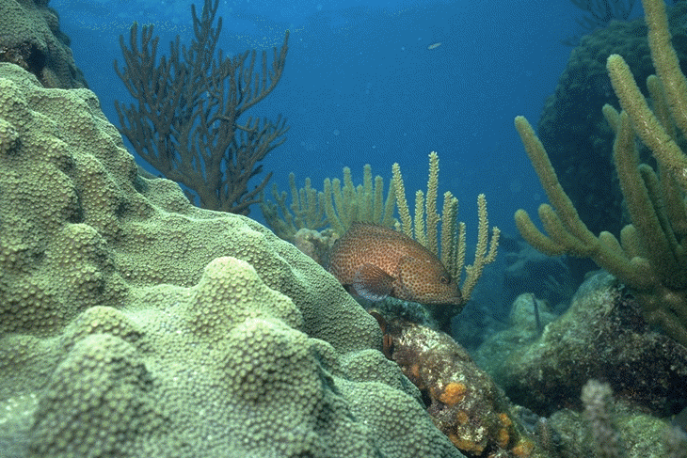
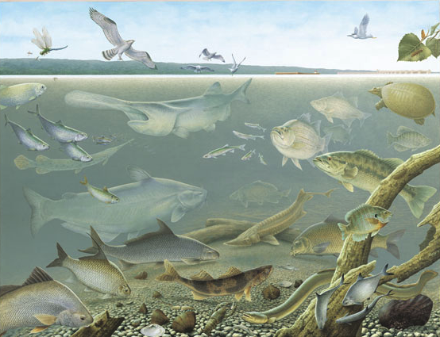
Terrestrial environments
(dehydration)
Oceans and hyper-saline
environments
(high salts)
freshwater
habitats
(low salt, excess water)

Slide 3
Outline
-Osmosis (please review, it is stuff from LIFE 1010!)
-Body fluids and compartments
-The dilution principle
-Aquatic environments (fresh- and seawater)
-Osmoconformers and osmoregulators
-The composition of body fluids in animals (intra- and extracellular)
-Teleost fish in fresh and saltwater
-Salt glands
-The water balance of a terrestrial animal
-Metabolic water
-Nitrogenated waste products
-All sorts of osmoregulatory organs
-Kidneys
-Hemodialysis
-Nephrons and their parts
-U/P ratios
-How do mammals concentrate urine
-ADH

Slide 4
Necessary background from LIFE 1010…Mostly a review (please read chapter 6 in your book!!)
Definitions:
-A solution is a homogeneous mixture of two or more substances in a single phase (liquid in this course).
-The solvent is the component present in the largest amount (water in this course).
-Solutes are the components present in the least amount.
-Colligative properties are properties of a solution that depend on the relative number of solvent and solute molecules (not on the identities of the solute molecules).

Slide 5
Units of concentration
-Molarity is the number of moles of solute per liter of solution. One calculates molarity (M) as
M = moles/Liter
One mole equals the grams of pure substance containing 6.023X10²³ molecules (Avogadro’s number). A mole of a substance equals it molecular mass in grams.
-Molality is the number of moles of solute per kilogram of solvent.
-Weight percent is the mass of one component divided by the total mass of the mixture multiplied by 100.

Slide 6
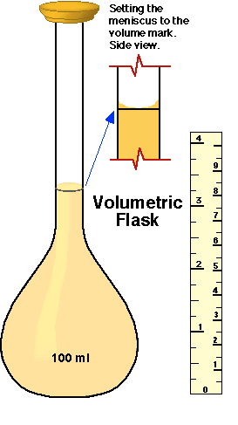
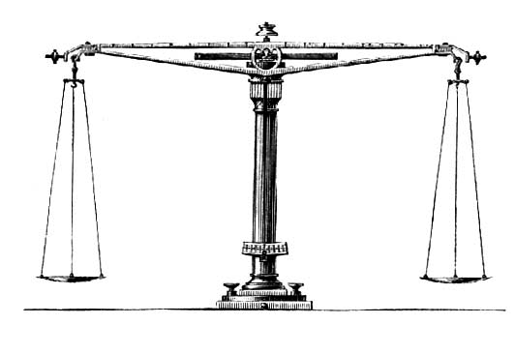
Example
-Molarity is the number of moles of solute per liter of solution. One calculates molarity (M) as
M = moles/Liter
One mole equals the grams of pure substance containing 6.023X10²³ molecules (Avogadro’s number). A mole of a substance equals it molecular mass in grams.
18.105 g of water (H₂O) contain one mole
2X1.008 + 15.99 = 18.05
How do we make a 0.5 M solution of sucrose (MW=342.3)
0.5 moles of sucrose = 0.5 moleX342.3 (grams/mole)=171.5 grams
We place 171.5 g of sucrose in a volumetric flask and add water up to a liter.

Slide 7
Example
The molecular weight (MW) of glucose is 180.2. How many millimoles are in a solution containing 0.1802 grams per liter.
A) 0.1 mole/L
B) 1 mMole/L
C) 0.01 mole/L
D) 10 mMole/L

Slide 8
Example
The molecular weight (MW) of glucose is 180.2. How many millimoles are in a solution containing 0.1802 grams per liter.
A) 0.1 mole/L
B) 1 mMole/L
C) 0.01 mole/L
D) 10 mMole/L
0.1802 (g/L)/(180.2 g/mole) =0.001 mole/L
0.001 mole/LX1000 mmole/mole=1 mM/L
In physiology we will often use millimoles (mM). A millimole is a mole/1000. Thus a 1 M solution contains 1000 millimoles (we say it is 1000 mM).

Slide 9
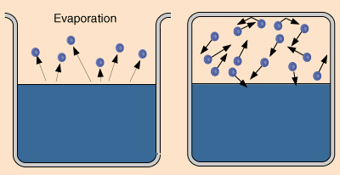
The three colligative properties of importance for physiology are:
Osmotic pressure (next slide)
2) Freezing point: The temperature at which a liquid changes state to a solid.
and
3) Saturation water vapor pressure: The pressure exerted by water in a closed container when there are as many molecules returning to the liquid state as escaping it.

Slide 10
If a solution surrounding a cell is hypotonic relative to the inside of the cell, how will water move:
A) It will move into the cell via osmosis
B) It will move out of the cell via osmosis
C) It will not move because the two sides are at equilibrium
d) It will evaporate from the cell surface more rapidly

Slide 11
Which of the following must be true for osmosis to occur?
A) Water must be at room tremperature or above
B) Solutions with the same concentration of solutes must be separated by a selectively semipermable membrane
C) Solutions with different concentrations of solutes must be separated by a selectively permeable membrane.
D) Water must be under pressure.

Slide 12
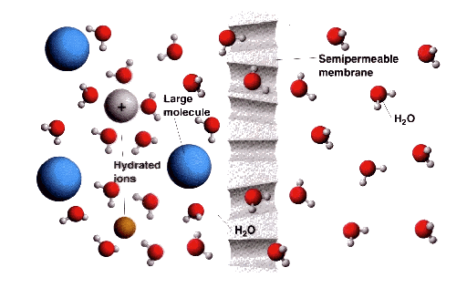
Osmosis: is the net movement of water through a selectively permeable membrane from a region of of high solvent potential to a region of low solvent potential. The partially permeable membrane must be permeable to the solvent, but not to the solute, resulting in a pressure gradient across the membrane.

Slide 13
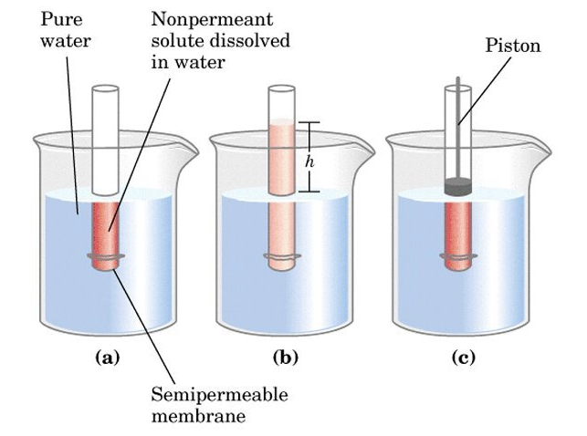
Three things to remember about osmosis:
1) Osmotic pressure is the pressure necessary to reverse osmosis and return to the initial condition
2) Osmotic pressure is proportional to the concentration (molarity) of solutes in the solution.

Slide 14
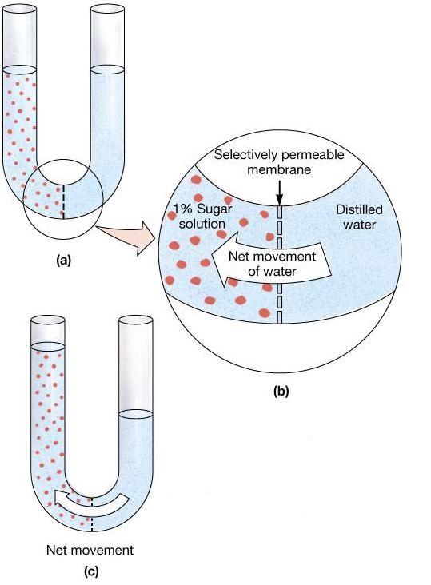
Three things to remember about osmosis:
3) The direction of osmotic solvent flow is always from the more dilute to the more concentrated side of the membrane.
hyperosmotic
hypoosmotic

Slide 15
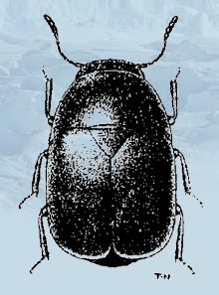
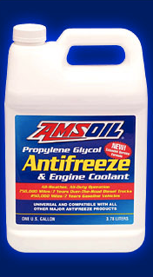
The three colligative properties of importance for physiology are:
Osmotic pressure
2) Freezing point:
3) Saturation water vapor pressure
The three colligative properties of a solution are related. Increasing osmotic pressure decreases the freezing point of a solution and decreases its vapor pressure (and elevates it boiling point). You will learn the math (really nice and simple) of these phenomena in chemistry (hopefully!)
An appplication: Many animals increase the concentration of organic solutes (glycerol, sorbitol, and mannitol) in their fluids to avoid freezing. These solutes are called colligative antifreezes. Up to 30% of the weight of a beetle in winter can be glycerol!

Slide 16
To Remember
-Molarity is the number of moles of solute per liter of solution.
-You estimate the molarity of 1 L of a solution as
M = (grams/L)/MW
-The three colligative pressures of aqueous solutions of importance for physiology are a) osmotic presure, b) freezing point, and c) saturation vapor pressure.
Osmosis: is the net movement of water through a selectively permeable membrane from a region of high solvent potential (low [] of solutes) to a region of low solvent potential.
-Osmotic pressure is the pressure necessary to reverse osmosis and return to the initial condition
Osmotic pressure is proportional to the concentration (molarity) of solutes in the solution.
The direction of osmotic solvent flow is always from the more dilute to the more concentrated side of the membrane.

Slide 17
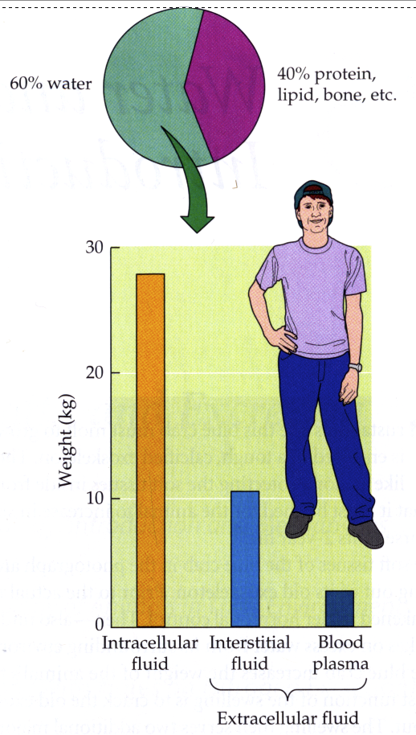
Animals are made up mostly of water. Water contributes to about 60% of the body mass of an adult human. Water can contribute up to 95% of the body mass of an animal.
We can divide an animal’s body fluids into 2 compartments: intracellular fluid and extracellular fluids. In vertebrates, the volume of intracellular fluids exceeds that of extracellular fluids (it ranges from 70 to 80%). But in some invertebrates (mollusks and crustaceans), the volume of extracellular fluid can exceed that of intracellular fluids.
BROAD PRINCIPLE
The extracellular fluids can be subdivided into interstitial fluid and plasma.

Slide 18
Important clinical note
During dehydration, mammals “defend” (i.e. maintain relatively constant) the volume of the intracellular fluid compartment.

Slide 19
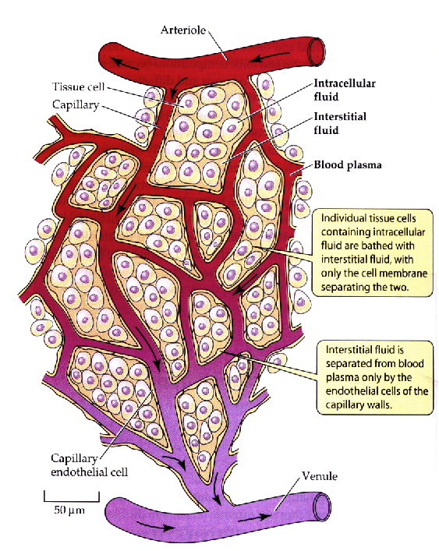
The three major types of body fluids are very closely juxtaposed. Indeed, there is remarkable exchange among them.

Slide 20
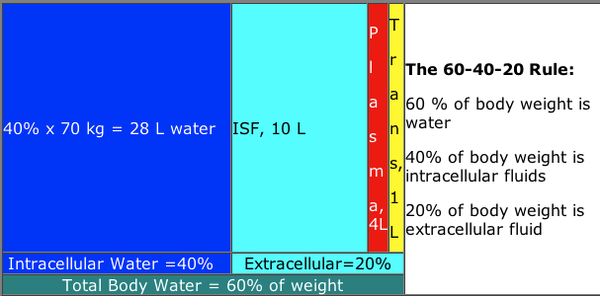
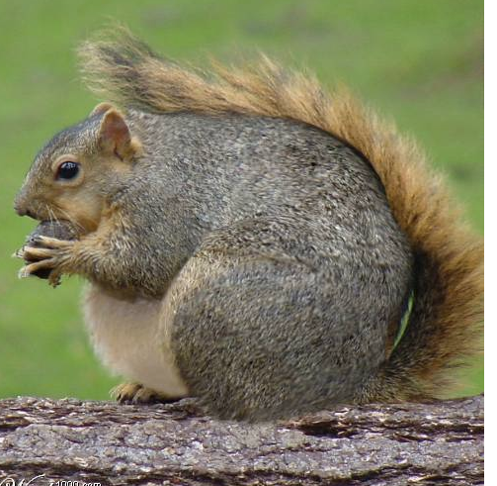
For those of you who care about humans, there is a nice mnemonic rule: The 60-40-20 rule. It is a rule, because there is a lot of variation. The main determinant of variation in body water content is lipid content. Fat animals tend to have relatively less water.
Why?
Because lipids are hydrophobic and can be stored without a lot of associated water!

Slide 21
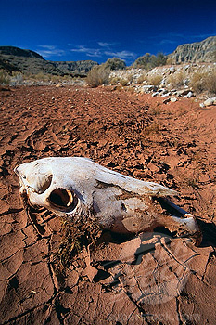
The 60-40-20 rule applies to horses as well as to humans. How many liters of fluid are in the extracellular fluids of a 475 kg mare? How many in the intracellular compartment.
A) 190 L and 95 L
B) 285 L and 190 L
C) 190 L and 285 L
D) 95 L and 190 L

Slide 22
The 60-40-20 rule applies to horses as well as to humans. How many liters of fluid are in the extracellular fluids of a 475 kg mare? How many in the intracellular compartment.
A) 190 L and 95 L
B) 285 L and 190 L
C) 190 L and 285 L
D) 95 L and 190 L
Extracell= 0.2X475 =95
Intracell=0.4X475 =190

Slide 23
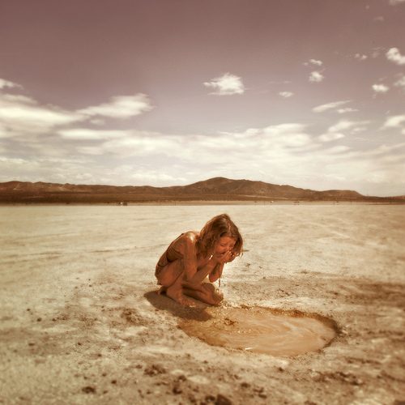
If humans loose more than 20% of their body fluids by dehydration they die. A 55 kg person in the desert lost 10% of her total body water when she was found. She originally had 22 liters of water in the intracellular space and 11 in the extracellular space. Estimate the volume of extracellular fluid in the extracellular space after dehydration. (Hint: During dehydration, mammals “defend” (i.e. maintain relatively constant) the volume of the intracellular fluid compartment).
A) 7.7 L
B) 5.94 L
C) 9.9 L
D) 3.7 L

Slide 24
If humans loose more than 20% of their body fluids by dehydration they die. A 55 kg person in the desert lost 10% of her total body water when she was found. She originally had 22 liters of water in the intracellular space and 11 in the extracellular space. Estimate the volume of extracellular fluid in the extracellular space after dehydration. (Hint: During dehydration, mammals “defend” (i.e. maintain relatively constant) the volume of the intracellular fluid compartment).
A) 7.7 L
B) 5.94 L
C) 9.9 L
D) 3.7 L
Before dehydration she has 11+ 22=33 L,
after dehydration she has 33-0.1x33=29.7 L,
of these 22 remain in the intracellular compartment.
Thus 29.7-22=7.7 remain in the extracellular space.

Slide 25
To remember
-We can divide body fluids into 2 compartments: intracellular and extracellular fluids.
-The extracellular fluids, in turn, have two components: interstitial fluid and plasma.
-In many mammals we can use the 60:40:20 rule (body water = 0.6M, intracellular Vol.= 0.4M, extracell volume =0.2M).
-Fat animals have less body water.
-Many animals defend theintracellular volume in the face of dehydration.

Slide 26
How do we know how much water/blood/salt,…etc. an animal/person has?

Slide 27
How do we know how much water/blood/salt,…etc. an animal/person has?
By a method that relies on a simple principle (called the dilution principle):
Concentration = Amount/Volume
Note units!
Therefore
Volume = Amount/Concentration
BROAD PRINCIPLE

Slide 28
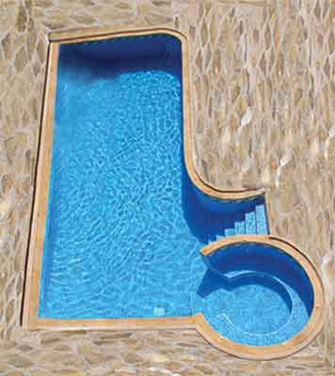
Example with a swimming pool
You place 1 kg of red dye in the pool, measure the concentration (with a spectrophotometer), find that it is 0.05 g/L …
What is the volume of the swimming pool?

Slide 29
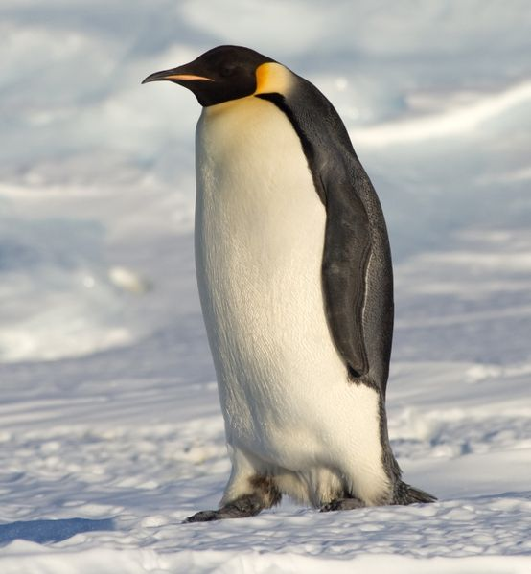
To measure water volume we use ³H₂O or D₂O
Polyethylene glycol and sodium thiosulfate can be used as markers for extracellular volume
Example with body water...
A 30 kg female emperor penguin is injected with 1000 cpm (counts per minute) of ³H₂O. After 15 minutes of equilibration, a blood sample was taken and after extracting the water from the sample it was found that it contained 60.6 cpms/L. This means that body water represents ________ of the penguins body mass.
A) 60%
B) 45%
C) 55%
D) 75%

Slide 30
To measure water volume we use ³H₂O or D₂O
Polyethylene glycol and sodium thiosulfate can be used as markers for extracellular volume
Example with body water...
A 30 kg female emperor penguin is injected with 1000 cpm (counts per minute) of ³H₂O. After 15 minutes of equilibration, a blood sample was taken and after extracting the water from the sample it was found that it contained 60.6 cpms/L. This means that body water represents ________ of the penguins body mass.
A) 60%
B) 45%
C) 55%
D) 75%
V = amount/concentration
=1000 (cpm)/60.6 (cpm/L)= 16.5 L
16.5/30 =0.55, 55%

Slide 31
To Remember
-One can use the dilution principle to estimate volumes:
C=A/V, then V=A/C
As we will see the same principle can be used to measure how big a population is.

Slide 32
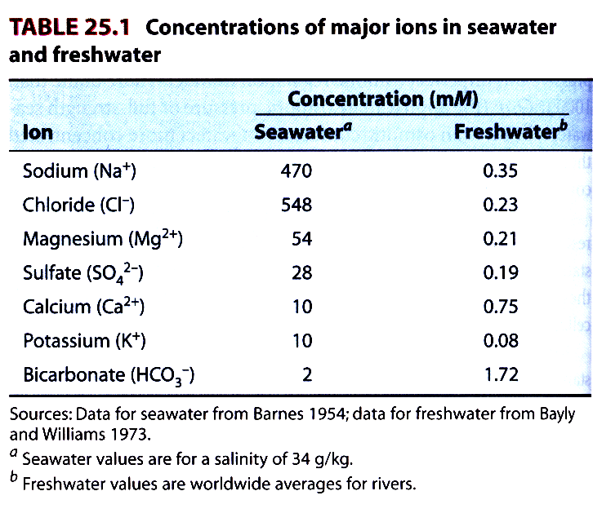
BROAD PRINCIPLE
The characteristics of aquatic environments
1,122 1.125

Slide 33
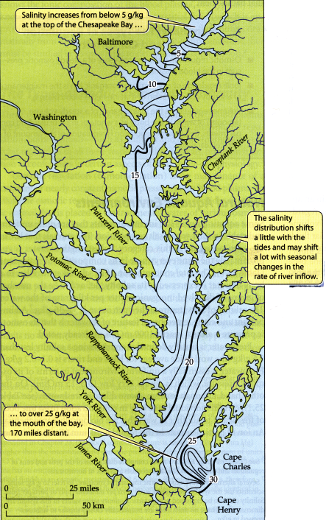
Animals that live in marine and freshwater environments face, very different osmotic challenges.

Slide 34
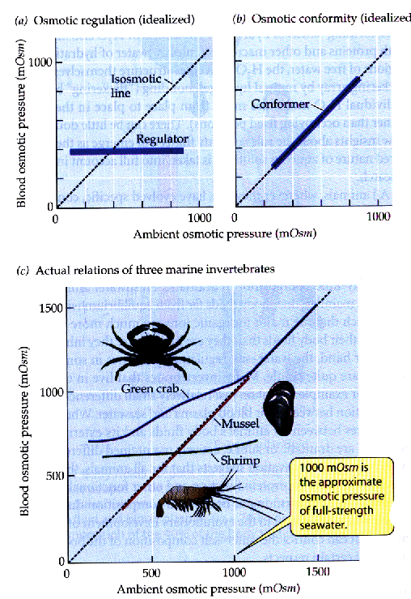
The term osmotic regulation (or osmoregulation) refers to the maintenance of a constant (or nearly constant) osmotic pressure in body fluids.
At the extremes animals can be characterized as “osmoconformers” and “osmoregulators”. Of course, many animals fall between these two extremes.

Slide 35
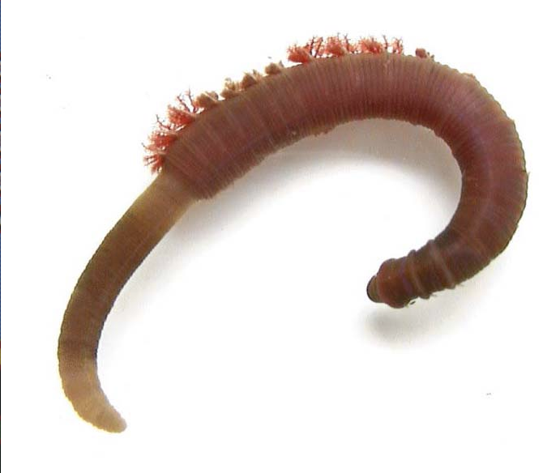
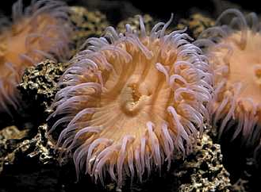
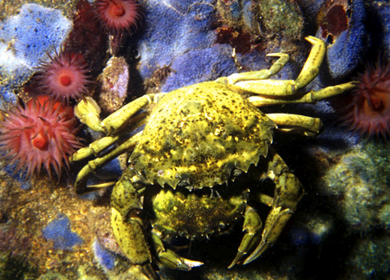
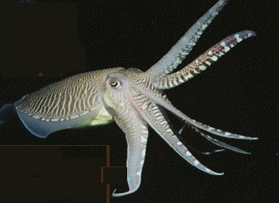
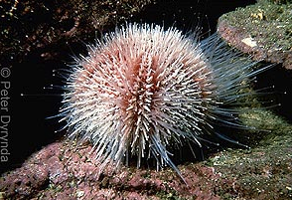
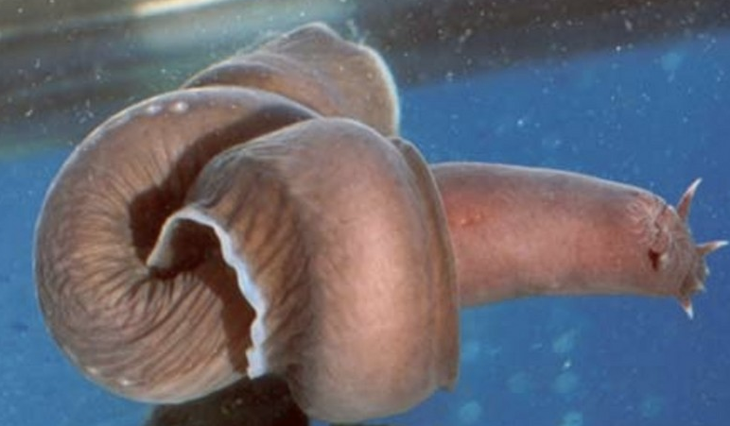
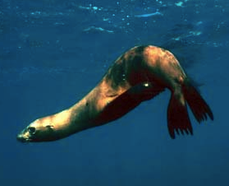
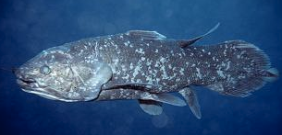
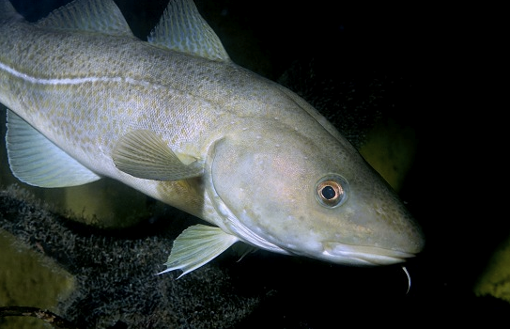
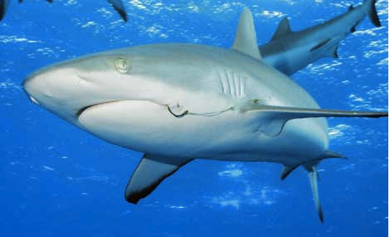
The vast majority of marine invertebrates are osmoconformers.
Whereas, most, but not all, marine vertebrates are osmoregulators.
Please identify the phyla
coelacanth
Most bony fishes
Osmoconformers
Osmoregulators

Slide 36
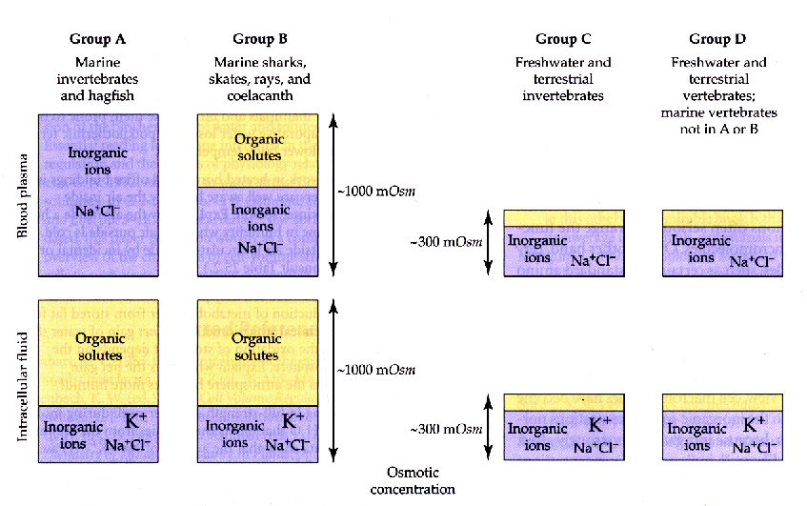
Although the osmotic concentration of the fluids of marine osmoconformers is similar to that of seawater, the composition of the fluids can be very different. The intracellular fluids contain organic solutes (free amino acids) rather than Na+ and Cl-.

Slide 37
Although the osmotic concentration of the fluids of marine osmoconformers is similar to that of seawater, the composition of the fluids can be very different. The intracellular fluids contain organic solutes (free amino acids) rather than Na+ and Cl-.

Slide 38
BROAD PRINCIPLE
TWO VERY IMPORTANT OBSERVATIONS
The concentration of K ⁺is higher in intracellular than in extracellular fluids.
The concentration of Na+ in extracellular fluids is higher than that in intracellular fluids.
WHY?

Slide 39
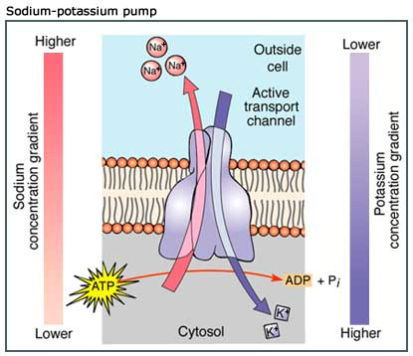

Slide 40
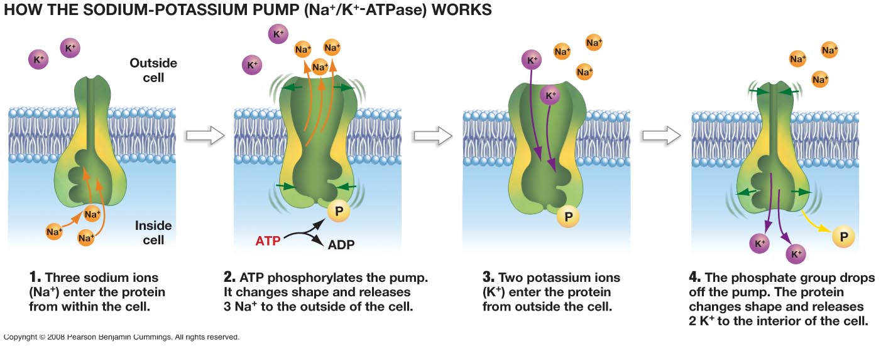

Slide 41
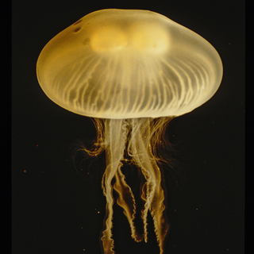
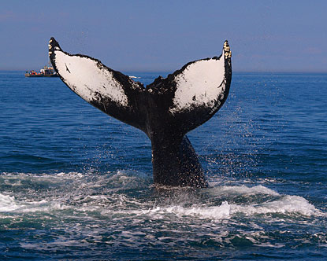
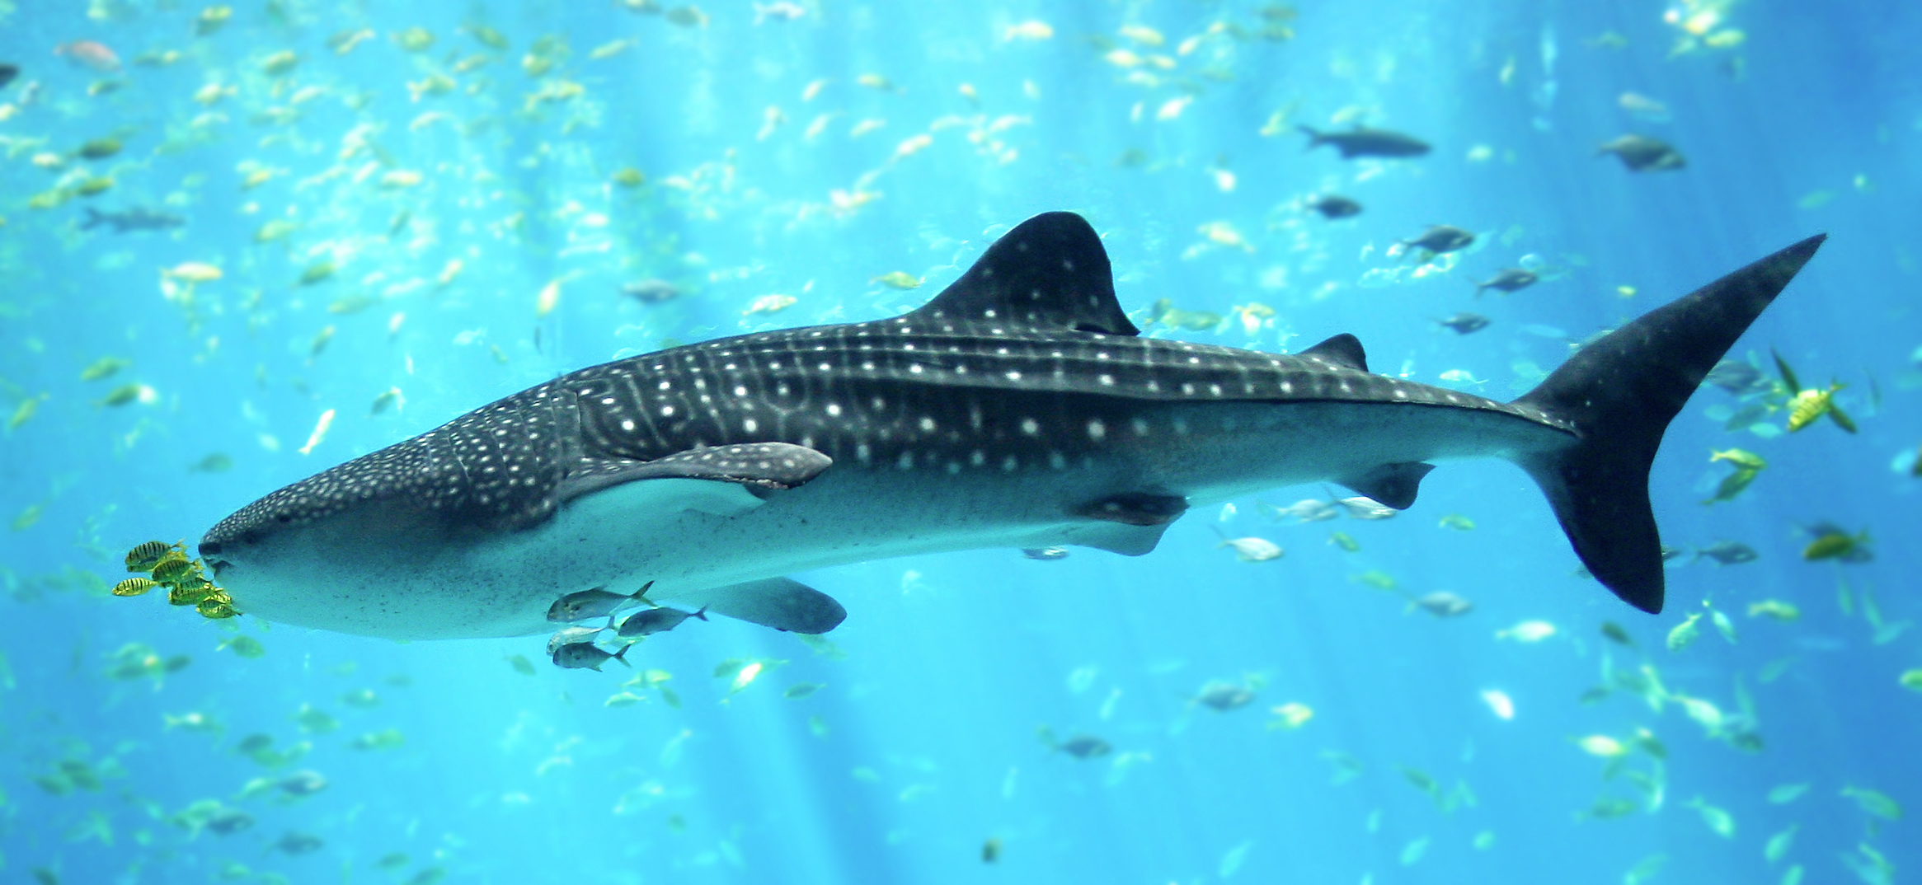
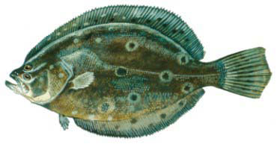
Skin
This image represents the ionic composition in the cells and ECFG of which of these animals
A
B
C
D
ECF
OP = 1100
Na = 470
K = 10
Cl = 550
Ca = 10
Cell
OP = 1100
Cl = 100
Na = 70
Ca <1
Na⁺
K⁺
OP = Total Osmotic Pressure (mOsm/kg)
ECF = extracellular fluid (blood)

Slide 42
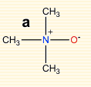
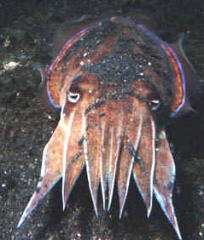

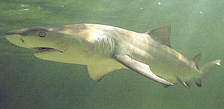
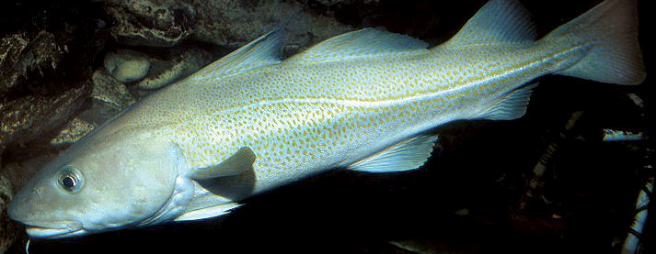
Why shark meat can taste like urine
Elasmobranchs (sharks and rays) are peculiar because their plasma is hyperosmotic to seawater. Sharks have large quantities of urea in their blood and a substance called TMAO (trimethylamine n-oxide) which offsets the toxic effects of urea.
Na+ Cl- Urea TMAO
(mM)
Seawater 470 548 0 0
Squid 456 578 0 0
Shark 286 246 351 71
Gadus 174 170 0 0
(a “normal” marine teleost)
TMAO
urea

Slide 43
To Remember
Animals that live in salt and freshwater face remarkably different osmotic challenges.
The main slats in sea water are Na, Cl, and sulfate (but there are others!)
The osmotic concentration of water is ≈ 1,120 mM/L, that of freshwater is about 1.125 mM/L (1000 times lower!)
Animals can be divided into osmoregulators and osmoconformers (and everything in between).
Most marine invertebrates are osmoconformers.
Hagfishes, lampreys, and sharks are osmoconformers.
All other marine vertebrates are osmoregulators.
In marine osmoconformers, organic solutes make up the bulk of the osmotically active solutes within cells.
The plasma of sharks and rays is slightly hyperosmotic relative to seawater. Sharks use urea and TMAO as “osmolytes”.

Slide 44
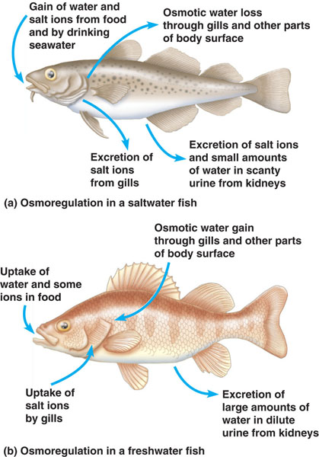
How do marine teleosts (bony fishes) osmoregulate?
Because the body fluids of these fish are hypo-osmotic relative to sea-water, they are always losing water. To remain in neutral water balance, these fish drink large amounts of seawater and excrete salts (Na⁺ and Cl⁻) through the gills. Marine teleosts excrete little urine.
BROAD PRINCIPLE

Slide 45
Osmoregulation in freshwater

Slide 46
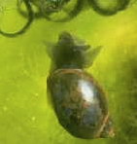
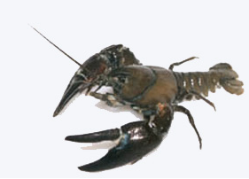
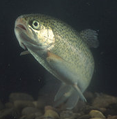
The body fluids of freshwater animals are hyperosmotic relative to the water they live in.
Animal [Osmotic] Na+ Cl+
[plasma]
Snail 76 34 31
Crayfish 436 212 199
Trout 326 161 119
River H₂O 0.5-10 0.4 0.1

Slide 47
Because the fluids of freshwater fish (and other freshwater animals) are hyperosmotic, the animals gain water. The kidneys (or equivalent organs) of freshwater animals excrete large amounts of water. The gills actively take up salt ions (Na⁺ and Cl⁻).
BROAD PRINCIPLE

Slide 48
To remember
-The body fluids of teleosts (bony fishes) are hypo-osmotic relative to sea-water.
-Marine bony fish drink large amounts of seawater and excrete salts (Na⁺ and Cl⁻) through the gills and excrete little urine.
-The body fluids of freshwater fish (and other freshwater animals) are hyperosmotic.
-The kidneys (or equivalent organs) of freshwater animals excrete large amounts of water. The gills actively take up salt ions (Na⁺ and Cl⁻).

Slide 49
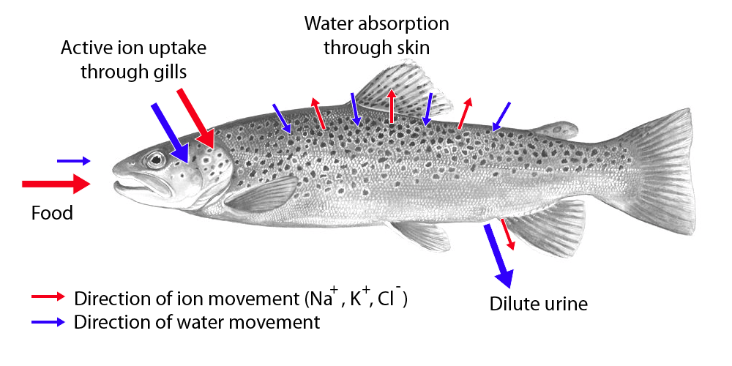
The arrows in this image represent the magnitude of relative ion and water fluxes. The image represents
A) A fish living in salt water
B) A fish living in fresh water
C) An osmoconformer

Slide 50

Many seabirds (albatross, seagulls, Puffins…) have structures called salt-glands. These structures have many tubules lined with an epithelium with cells that pump salt out. Blood flows in the opposite direction to that of the salt-containing fluid (sounds familiar?). This countercurrent arrangement enhances the transfer of salt to the lumen of the tubules.
Lower salt
High salt

Slide 51

Marine iguanas also have salt glands
But we don’t….

Slide 52

Why we cannot drink seawater, but seabirds can?
“Water, water everywhere nor any drop to drink”
Drinking seawater dehydrates you because the maximal concentration of Cl⁻ that the human kidney can produce is less than the concentration in seawater. Thus, if you drink seawater, you must get rid of the Cl- that you ingest. To do so you not only have to excrete the seawater that you drank, but also water from your body fluids. Hence, you dehydrate!
Why seabirds can? (although they have kidneys with low concentrating ability)?

Slide 53
To Remember
Marine birds can drink sea water because they have nasal salt glands that excrete concentrated brine.
Some marine reptiles have salt glands.
Humans cannot drink seawater because our kidneys are unable to concentrate Cl (to get rid of it we use all the water that we drank plus more from our body fluids).

Slide 54
Terrestrial environments
Terrestrial animals must maintain water balance. This means that water losses must be balanced by water gains.
Gains | Drinking (pre-formed or free water) Metabolic water (more on this later)
Losses | Cutaneous (through the skin) Respiratory (through the respiratory tract) Urinary Fecal

Slide 55

BROAD PRINCIPLE

Slide 56



Slide 57


Slide 58
Message
Animals gain water by drinking or ingesting it with food (preformed water) and by water produced by metabolic processes (metabolic water). The catabolism of carbohydrates, lipids, and proteins generates a significant amount of water.
Animals lose water in feces, in urine, and by evaporation (through the skin and through the respiratory tract. These are called “insensible” losses).

Slide 59
Metabolic Water
When organic molecules are catabolized aerobically, water is formed:
C₆H₁₂O₆ + 6O₂ -----> 6CO₂ + 6 H₂O
____________________________________________
Foodstuff Grams of H₂O formed per
gram of foodstuff
____________________________________________
Carbohydrate 0.56
Lipid 1.07
Protein (urea production) 0.40
Protein (uric acid) 0.50
_____________________________________________
To excrete the waste-products of nitrogen (urea and uric acid), terrestrial animals must use water. Thus, eating high levels of protein can be dehydrating (the water loss depends on how good the nimal’s kidney concentrates urine)
BROAD PRINCIPLE

Slide 60
The role played by metabolic water in the water budget of an animal, depends on the capacity of the animal to conserve body water.
__________________________________________
Category of water loss Kangaroo Rat Lab Rat
__________________________________________
Metabolic H₂O from
air-dried barley (g/g) 0.54 0.54
Losses
Respiratory 0.33 0.33
Urinary 0.14 0.24
Fecal 0.00 0.03
_______ ________
Gain - loss 0.54-0.47=0.07 0.54-0.6 = -0.06
__________________________________________

Slide 61

The ingredients (gains and losses) of a water budget vary a lot among terrestrial animals (both among and within species)

Slide 62

One of the major determinants of the water budget in an animal is the excretion of nitrogenated (nitrogen-containing) “waste” products. When animals catabolize (break) protein, they have to deal with the nitrogen in the amino acids. Animals excrete nitrogen in 3 forms:
BROAD PRINCIPLE

Slide 63
Characteristics of the three main nitrogenated waste products
Product Solubility Toxicity Cost
________________________________________________
Ammonia very high very high low
Urea high intermediate intermediate
(5 ATP/molecule)
Uric Acid low low high
(10-20 ATP/molecule)
Type of habitats
Ammonia
Urea
Uric Acid
aquatic
terrestrial

Slide 64
-Animals that excrete ammonia are called “ammonotelic”
-Animals that excrete urea are called “ureotelic”
-Animals that excrete uric acid are called “uricotelic”

Slide 65




Many animals change the type of nitrogenated excretion product during ontogeny (development).
Tadpole Toad
(ammonotelic)----------------> (ureotelic)
Dragonfly larvae adult
(ammonotelic)-----------------> (uricotelic)

Slide 66
To Remember
In terrestrial animals water balance is the result of gains (drinking, food, metabolic water) and losses (insensible (sweat, respiration), urine, feces).
The catabolism of organic molecules yields metabolic water.
Animals excrete 3 types of nitrogenated products ammonia, urea, and uric acid.
These three molecules differ in toxicity, solubility, and manufacturing costs.
Aquatic animals are ammonotelic and excrete the most toxic and soluble form (ammonia).
Terrestrial animals excrete urea (mammals) or uric acid (reptiles and birds).
Animals that shift from aquatic to terrestrial habits shift in the form of nitrogenous waste.

Slide 67

Although the problems of water balance are very different in salt water, fresh water, and in land solving them requires regulating the movement of solutes and fluids between the internal and external environment. These movements are handled by excretory systems, all of which are filtering tubes.
Excretory tubes collect “filtrate” from blood or hemolymph.
Transport epithelia recovers valuable substances (glucose, amino acids)
They also secrete other substances (toxins, excess ions,…,etc)
BROAD PRINCIPLE
Filtrate leaves the body with wastes, excess water,…,etc.

Slide 68
Excretory systems do 4 things
1) Filtration
2) Reabsorption
3) Secretion
4) Excretion
BROAD PRINCIPLE

Slide 69


There are a variety of excretory systems…They range from
to
Kidneys
Contracting vacuoles in Paramecia

Slide 70

Protonephridia are found in a variety of invertebrates (fresh water platyhelminthes, some annelids, larvae of mollusks, and lancelets).

Slide 71


Slide 72

Earthworms have “metanephridia”

Slide 73

Insects and other terrestrial arthropods have organs called Malpighian tubules. The dead-end tips are immersed in hemolymph. They empty in the gut where excretory products are mixed with its contents.

Slide 74


Slide 75
To Remember
-Many invertebrates have protonephridia as excretory organs, others have metanephridia.
-Insects have Malpighian tubes that end in the gut.
-All excretory organs have the following ingredients/functions: 1) filtration, 2) secretion, and 3) recovery.

Slide 76

Vertebrates have kidneys. Kidneys are made of units called nephrons (this is a mammalian kidney).

Slide 77

Messages:
1) at the most coarse level, we can divide the kidney into 3 broad areas: Cortex (Greek for “bark” ), Medulla (Gr. “pith”), and Pelvis (Latin “basin”).
2) Bundles of nephrons are organized in “cones”, called renal pyramids.
3) Nephrons (about 10⁶ in humans) are the filtering functional units of the kidney.

Slide 78
Things to Remember
Cortex
Medulla
Nephron

Slide 79

Before we get lost in the nomenclature: a brief and simplistic overview of what nephrons do (they do 3 things)
2) Tubular reabsorption
1) Glomerular filtration
3) Tubular secretion

Slide 80

net secretion
Some reabsorption
Complete reabsorption
Materials can be secreted and reabsorbed within nephrons
The relative importance of these processes depends on the chemical identity of the molecule in question…
BROAD PRINCIPLE

Slide 81
Message
Some substances are only filtered by the kidney (inulin)
Some substances are filtered and reabsorbed by the kidney (glucose)
Some substances are filtered and secreted by the kidney (many antibiotics)

Slide 82

Hemodialysis (how does it work?)
Hemodialysis
High concentration
of solutes and waste
Tubing made of cellophane membrane is permeable to small MW solutes but not to protein
and cells.
Low concentration
of solutes and waste

Slide 83


Slide 84



Two types of nephrons
Cortical with short loops of Henle
Juxtamedullary with long loops of Henle
Both participate in filtration, but juxtaglomerular nephrons also function in the maintenance of an osmotic gradient in the medulla that is crucial to produce concentrated urine and hence to conserve water.

Slide 85
Remember
-Bowman’s capsule
-Glomerulus
-Proximal convoluted tubule
-Proximal straight tubule
-Descending limb of loop of Henle
-Thin ascending limb of loop of Henle
-Distal convoluted tubule
-Collecting duct

Slide 86


Slide 87


Slide 88


Slide 89



Slide 91
The proximal tubule is the main site for reabsorption of nutrients, salts, and water in the nephron.
Its epithelium has microvilli just like the cell in the.....

Slide 92
To Remember
-Mammalian/avian kidneys have 3 regions: cortex, medulla, and papilla.
-The functional filtering units of the kidney are called nephrons.
-Nephrons filtrate, recover, and secrete materials.
-Mammals and birds have two types of nephrons: cortical (short-looped) and juxtamedullary (long-looped).
-Nephrons have:Bowman’s capsule, Glomerulus, Proximal convoluted tubule, Proximal straight tubule, Descending limb of loop of Henle, Thin ascending limb of loop of Henle.
-The filtrate of many nephrons collects in the collecting duct.

Slide 93


Slide 94

Cortical (short looped)
Juxtamedullary
(long looped, concentrating)
BROAD PRINCIPLE

Slide 95
Long-looped nephrons are important in urine concentration,
short looped nephrons are important in the recovery (reabsorption) of filtered nutrients, electrolytes, and water.
Only mammals and birds have two types of nephrons! Reptiles and amphibians have only short-looped nephrons.
What is the consequence?

Slide 96


Most (albeit not al) mammals can produce urine that is more concentrated than plasma. The ratio of the osmolarity in urine relative to plasma measures the ability of a mammal to concentrate urine.
In mammals maximal U_{osm}/P_{osm} ranges from 1.7 to 16
U_{osm} ≈ 493 mOsm/kg
U_{osm} ≈ 5500 mOsm/kg
Homo
U_{osm} ≈ 1500
4 < Max U/P < 5

Slide 97
The plasma osmolality of humans and kangaroo rats is about the same (≈ 300 mOsm/kg of fluid). However, the U/P ratios of these two species differ vastly. In humans maximal U/P ratios are about 5 whereas those of some kangaroo rats can be as high as 16. What is the maximal concentration of urine in humans and kangaroo rats?
A) human 60 mOsm/kg, K. rats 18.75 mOsm/kg
B) human 4,800 mOsm/kg, K. rats 1,500 mOsm/kg
C) human 1,500 mOsm/kg, K. rats 4,800 mOsm/kg
U/300 = 5, U= 300x5 =1500,
U/300 =16, U = 300x16 = 4,800

Slide 98
To Remember
-A good index of the capacity of an animals to concentrate urine is the U/P ratio (that is the ratio of the osmotic concentration of urine to the osmotic concentration of plasma)

Slide 99

HOW DO MAMMALS CONCENTRATE URINE?
Urine is concentrated in the collecting duct.
Urine is concentrated when water flows out of the collecting duct as a result of a very large osmotic gradient from the kidney’s cortex to the medulla
Urea
And NaCl
This leads to more questions than answers!!!
BROAD PRINCIPLE

Slide 100
The ingredients for urine concentration.
1) A large gradient in the concentration of interstitial fluids between the cortex (≈ 300 mOsm/kg) and the medulla (≈1500 mOsm/kg in humans).
2) A water-permeable epithelium of the collecting duct.
If the medulla is relatively large, the gradient can be large as well.

Slide 101
A review of kidney gross morphology: Please focus on the papillae.

Slide 102


papillae
pelvis
The ability of a mammal to concentrate urine can be diagnosed by the morphology of their kidneys.
Sand rat

Slide 103
Mammals with large renal papillas and a relatively large medulla (with lots of concentrating long-looped, juxtamedullary nephrons) are capable of concentrating urine to very (very!) high levels.

Slide 104

In general, aquatic species have small papillae, whereas desert inhabitants have huge papillae.
The size of the papillae reflects the fraction of kidney tissue allocated to concentrating medulla rather than to cortex.

Slide 105

More quantitatively, the maximal concentration of urine that a species can achieve (I.e. the maximal U/P ratio) increases with relative medullary thickness (RMT).
RMT = 100X(volume of medulla)/(total kidney volume)

Slide 106
Only mammals and birds have two types of nephrons! Reptiles and amphibians have only short-looped nephrons.
What is the consequence?
A) The U/P ratios of mammals and birds are lower than those of reptiles and amphibians
B) The U/P ratios of mammals and birds are higher than those of reptiles and amphibians
C) The U/P ratios of mammals and birds are equal to those of reptiles and amphibians

Slide 107

Hummingbirds drink astounding amounts of nectar (sugar water), and they are completely unable to concentrate urine. This observation suggests that their kidneys have
A) No long-looped nephrons
B) No short-looped nephrons
C) Very high relative medullary thickness
D) Very high U/P ratios

Slide 108
To Remember
-Urine/Plasma osmotic ratios measure the ability of an animal to concentrate urine.
-In mammals U/P ratios range from about 1.7 to 16.
-Mammals (and birds, but to a lesser extent) rely on an osmotic gradient to concentrate urine.
-Water flows from the collecting duct into the medulla (the medulla has a very high concentration of salt and urea).
-The ability to concentrate urine increases with “relative medullary thickness” (the fraction of the kidney that is medulla -long-looped nephrons).
-Animals that live in arid environments have higher relative medullary thickness than animals that live in “mesic” environments.

Slide 109

How do we make dilute urine?
We make concentrated urine by having a collecting duct that is permeable to water
We make dilute urine by having a collecting duct that is impermeable to water
How is the water permeability of the collecting duct modulated?
diluting
concentrating
.
diuresis
antidiureis

Slide 110


Slide 111
Message
-Urine is concentrated when the epithelium of the collecting duct is very permeable to water. We call the production of concentrated urine anti-diuresis. We (and other mammals) concentrate urine when we are dehydrated.
-Urine is diluted when the epithelium of the collecting duct is impermeable to water. We call the production of dilute urine, diuresis. We dilute urine when we are overhydrated.
How is the water permeability of the collecting duct modulated?

Slide 112

The water permeability of the collecting duct is modulated by ANTI-diuretic hormone (ADH)
The water permeability of the collecting duct is modulated by ADH (antidiuretic hormone) through a G-protein mediated signalling pathway. The outcome of ADH stimulation is the recruitment of aquaporin 2 into the apical membrane. Recall that aquaporins are water channels.
Aquaporin 2 is recruitable into the apical membrane.
Aquaporin 3 is constitutive and found in the basolateral membrane.
How is the secretion of ADH regulated?
Animals secrete ADH when they are dehydrated!!

Slide 114
Remember the woman that lost 10% of her body water in the desert? Do you expect her ADH levels in plasma to be high or low?

Slide 115
Messages
-If ADH goes up, the permeability of the epithelium of the collecting duct increases leading to anti-diuresis.
-ADH acts by stimulating the “recruitment” of aquaporin 2 (water channels) into the apical membrane of the cells of the lining of the collecting duct.
-The action of ADH is mediated by a G-protein.
How is the secretion of ADH regulated?

Slide 116
To answer all these questions, we need to talk about
HORMONES
Please read chapter 47

Slide 117


Slide 118
To Remember
-The production of dilute or concentrated urine depends on the permeability of the epithelium of the collecting duct for water.
-If the epithelium is impermeable, urine is dilute (diuresis).
-If the epithelium is permeable, urine is concentrated (antidiuresis).
-The epithelium’s permeability is modulated by the hormone ADH (antidiuretic hormone).
-When the animal is dehydrated, ADH levels increase and aquaporins are recruited into the apical membrane of epithelial cells making them permeable (antidiuresis).
-When the animal is hydrated, ADH levels decrease and the permeability of the membrane to water is low (diuresis).

Slide 119
Review

