Slide 1
Hormones
(Chapter 47)

Slide 2
We have seen several examples of homeostatic physiological processes:
Vertebrates regulate the concentration of glucose in their blood at relatively constant levels.
They produce lost of dilute urine when they are over-hydrated, but they produce little very concentrated urine when they are dehydrated.
How are these processes regulated?

Slide 3
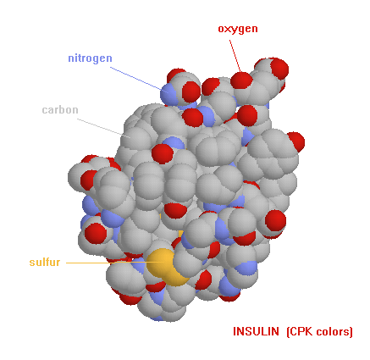
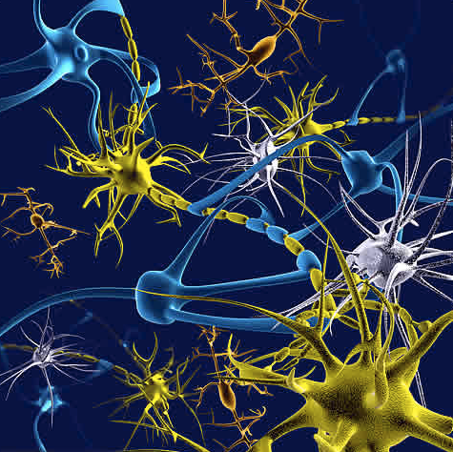
Physiological functions are regulated by two systems: The endocrine system (hormones) and the nervous system. These are the two systems of communication within an animal’s body.
Endocrine system Relies on hormones which coordinate slower and sometimes longer-acting responses to stimuli such as stress, dehydration and low/high blood glucose levels. It also coordinates and regulates longer-term developmental processes (growth, sex determination, seasonal changes).
Nervous system Conveys high-speed electric signals along specialized cells (neurons). These rapid messages control body movements in response to sudden environmental changes (your pupils dilate in the dark, you jerk your hand out from a hot surface).
The differences, as we shall se are not hard and fast.

Slide 4
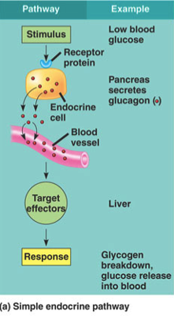
Elements of the simplest possible endocrine response
A gland responds to a stimulus by secreting a hormone.
The hormone (messenger) circulates in blood to one (or many) target organ(s)
Receptors in the cells of the target tissue bind to the hormone and the cells (or effector) respond.
Only cells that have receptors for the hormone respond. Receptors are like tags (or addresses) that make an organ a target for a hormone.

Slide 5
TO REMEMBER
-The two systems that control homeostatic processes are the endocrine system and the nervous system.
-The endocrine system is slower than the nervous system (this is a cartoonish view of the world).
-The endocrine system consists of glands, hormones, receptors, and target organs.

Slide 6
In addition to secreting insulin and glucagon, the pancreas secretes
Sucrase
Maltase
Pepsin
HCO₃⁻
Bile salts

Slide 7
The stimulus that elicits the release of glucagon by the pancreas is _______________. Glucagon stimulation makes liver cells _______________
hyperglycemia, release glucose
hyperglycemia, take up glucose
hypoglycemia, release of glucose
hypoglycemia, take up glucose

Slide 8
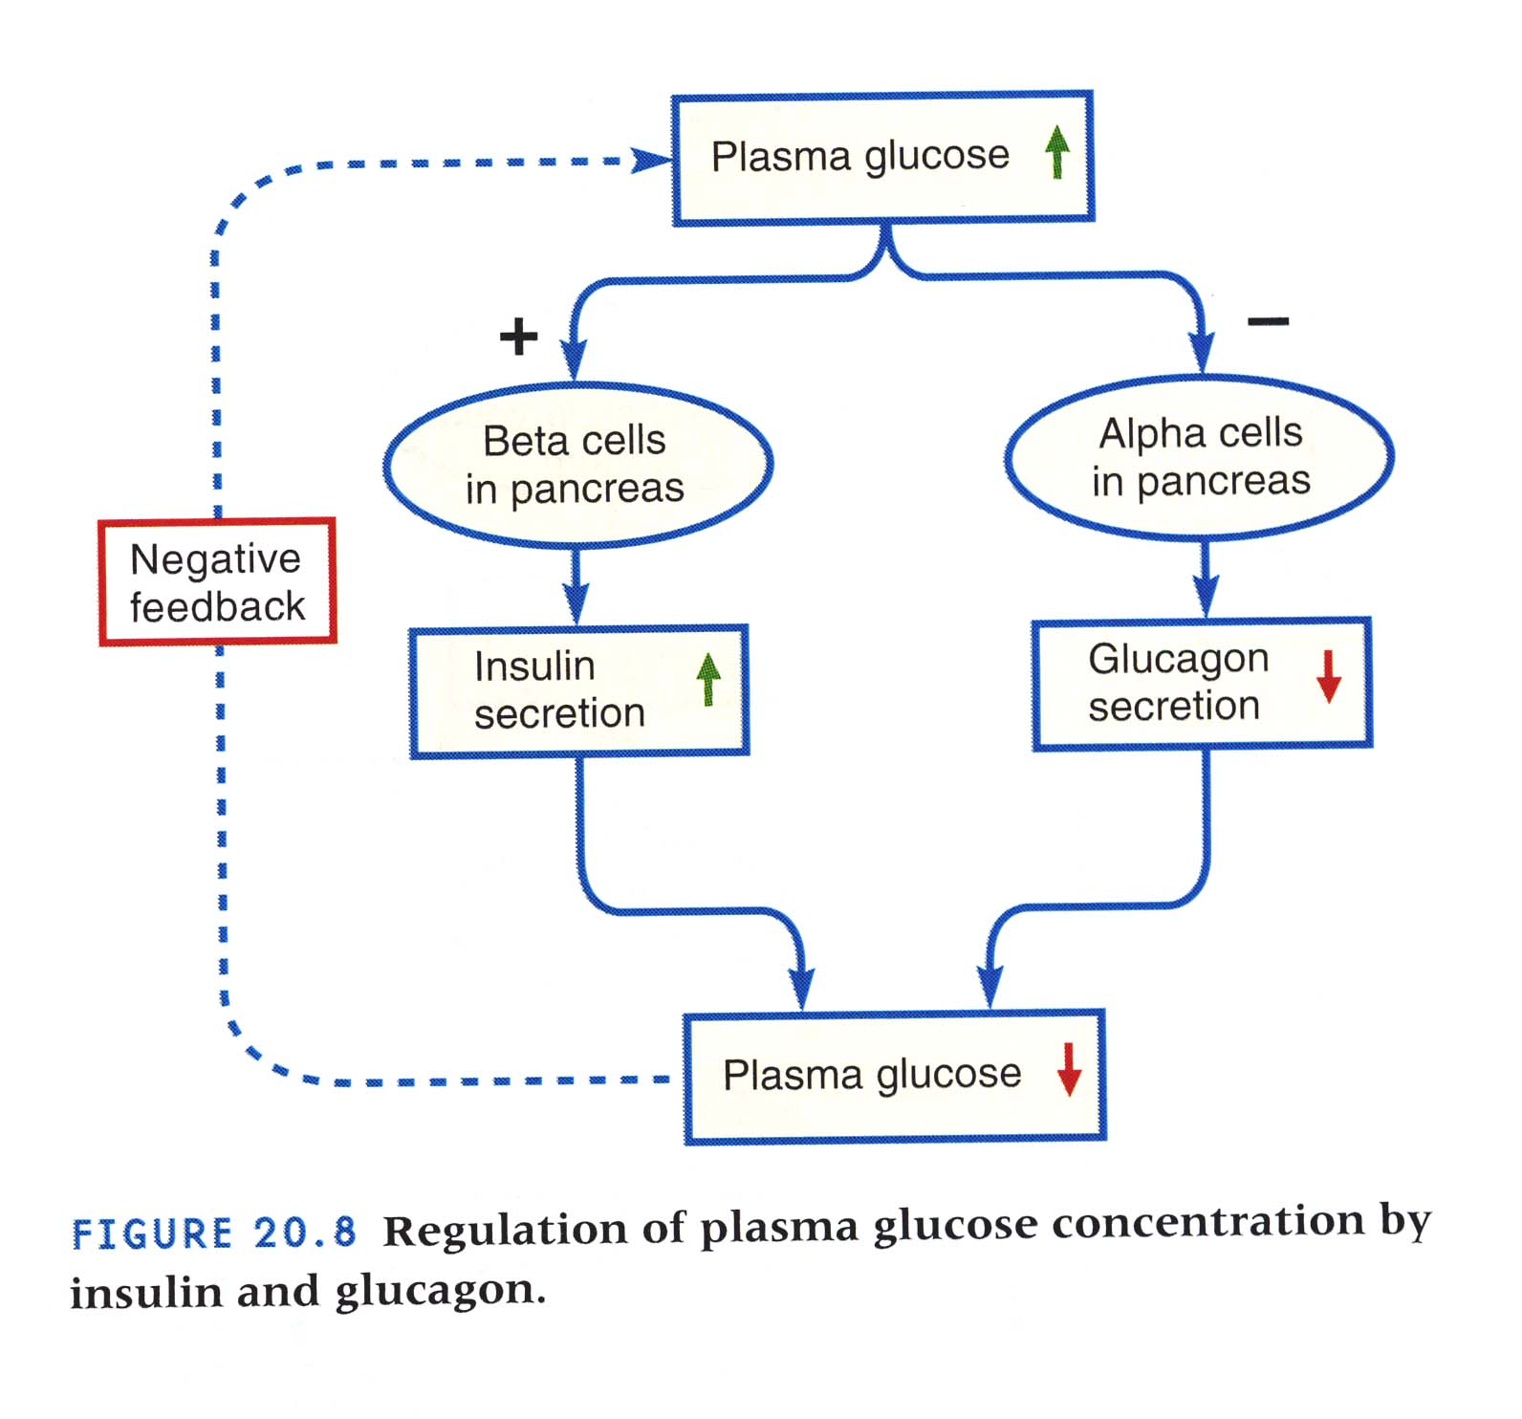
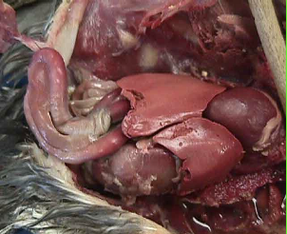
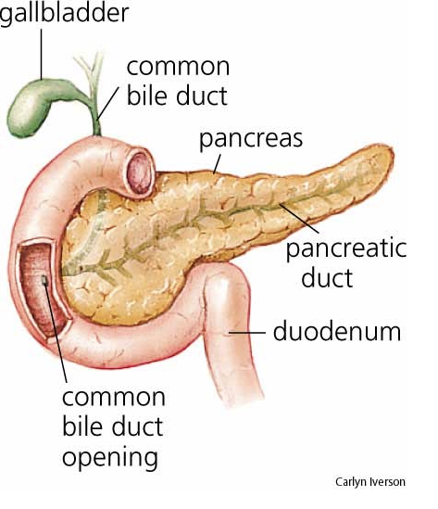
pancreas

Slide 9
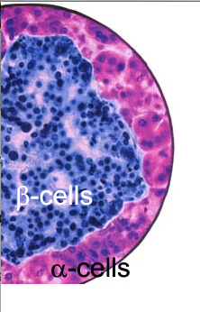
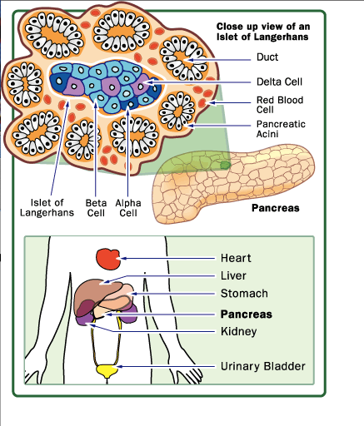
The pancreas is both an endocrine and an exocrine organ (it also secretes digestive enzymes!). Alpha cells secret glucagon, beta cells secrete insulin.

Slide 10
To Remember
The pancreas is both an endocrine (secretes hormones) and an exocrine organ (it also secretes digestive enzymes!).
The hormones insulin and glucagon are secreted by cells located in the Islets of Langerhans
Alpha cells secret glucagon, beta cells secrete insulin.

Slide 11
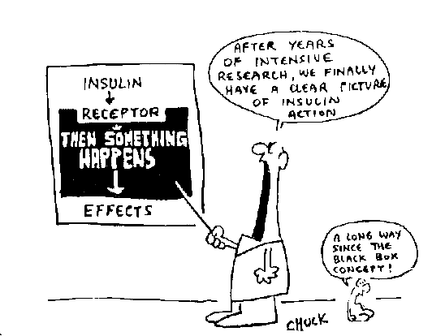

Slide 12
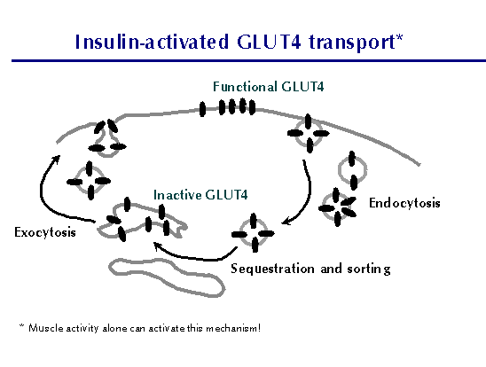
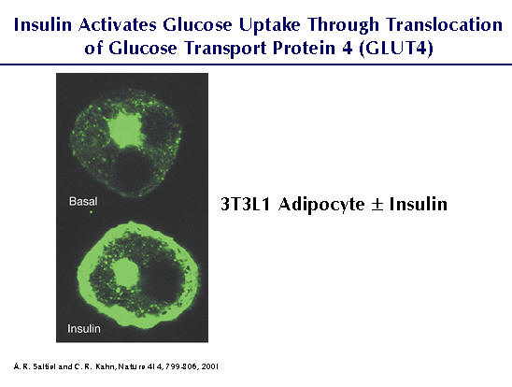

Slide 13
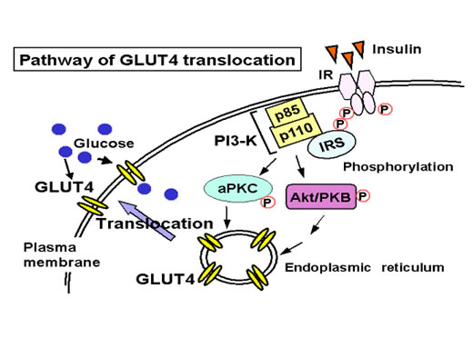

Slide 14
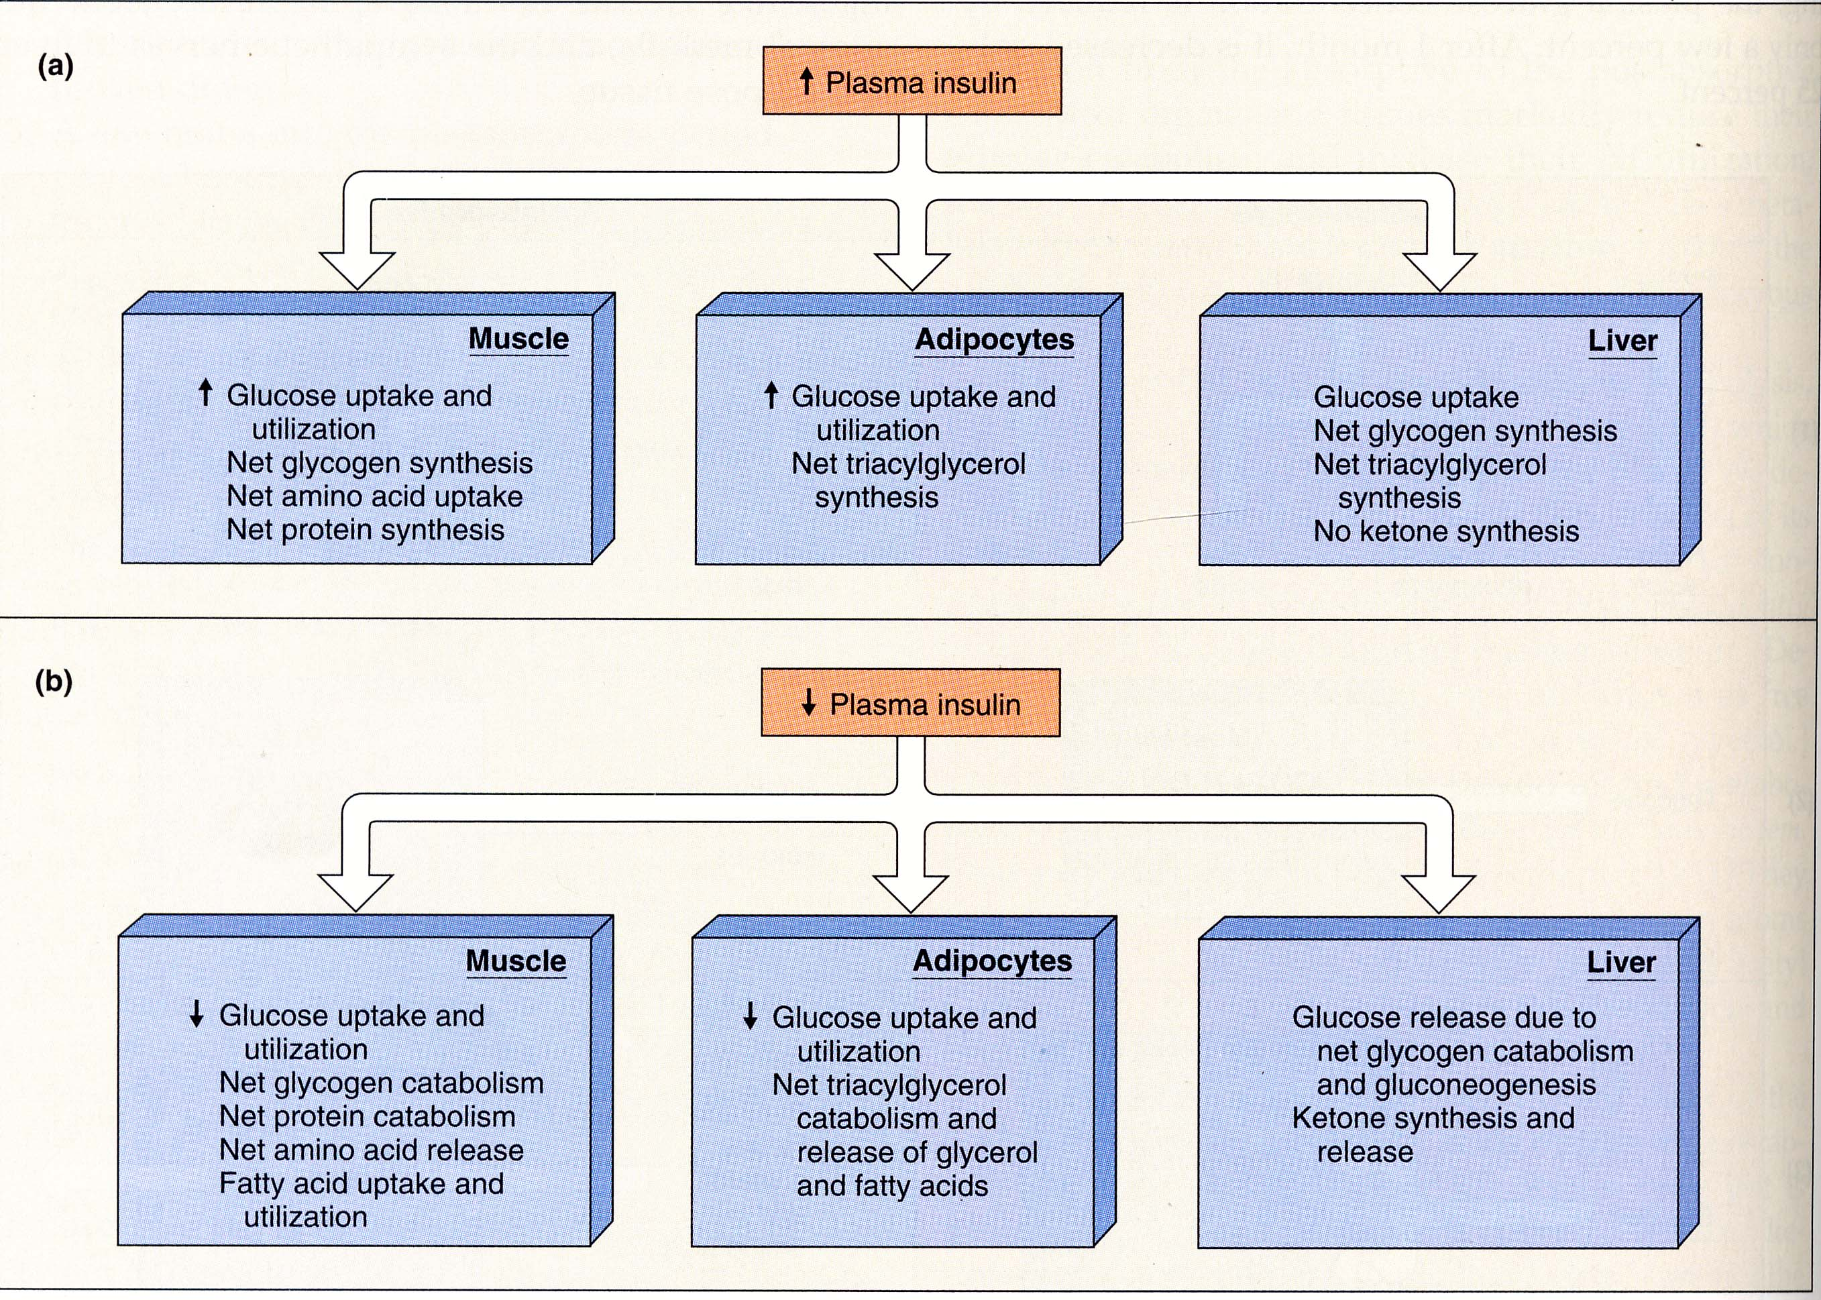
Insulin has different effects on different tissues. It stimulates glucose uptake and the synthesis of glycogen, fats, and protein. It is an anabolic hormone.
Anabolic means that it promotes synthesis (or anabolism)

Slide 15
How come insulin has different effects on different tissues?
Because the same message can elicit a different physiological set of processes. The hormone is the same, the receptors are the same, but the effectors are different.

Slide 16
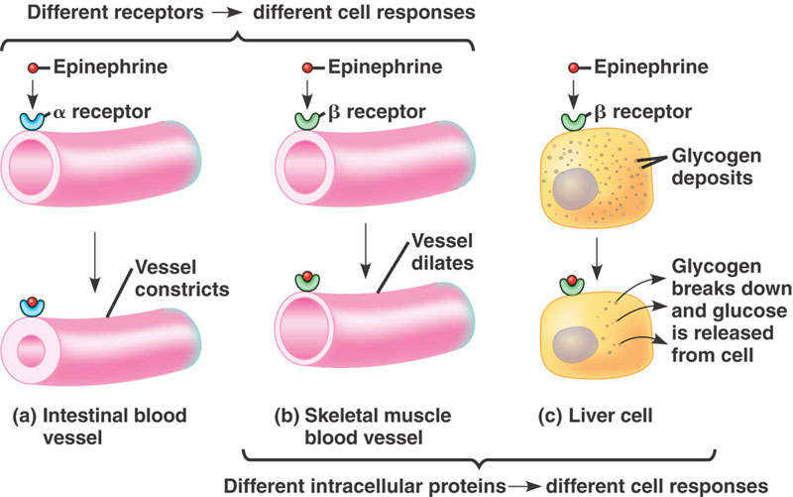
By changing the nature of the signal transduction pathway, a hormone can have a very different effect on different cells/tissues.
Epinephrine is secreted by the medulla of the adrenal glands.
epinephrine = adrenaline

Slide 17
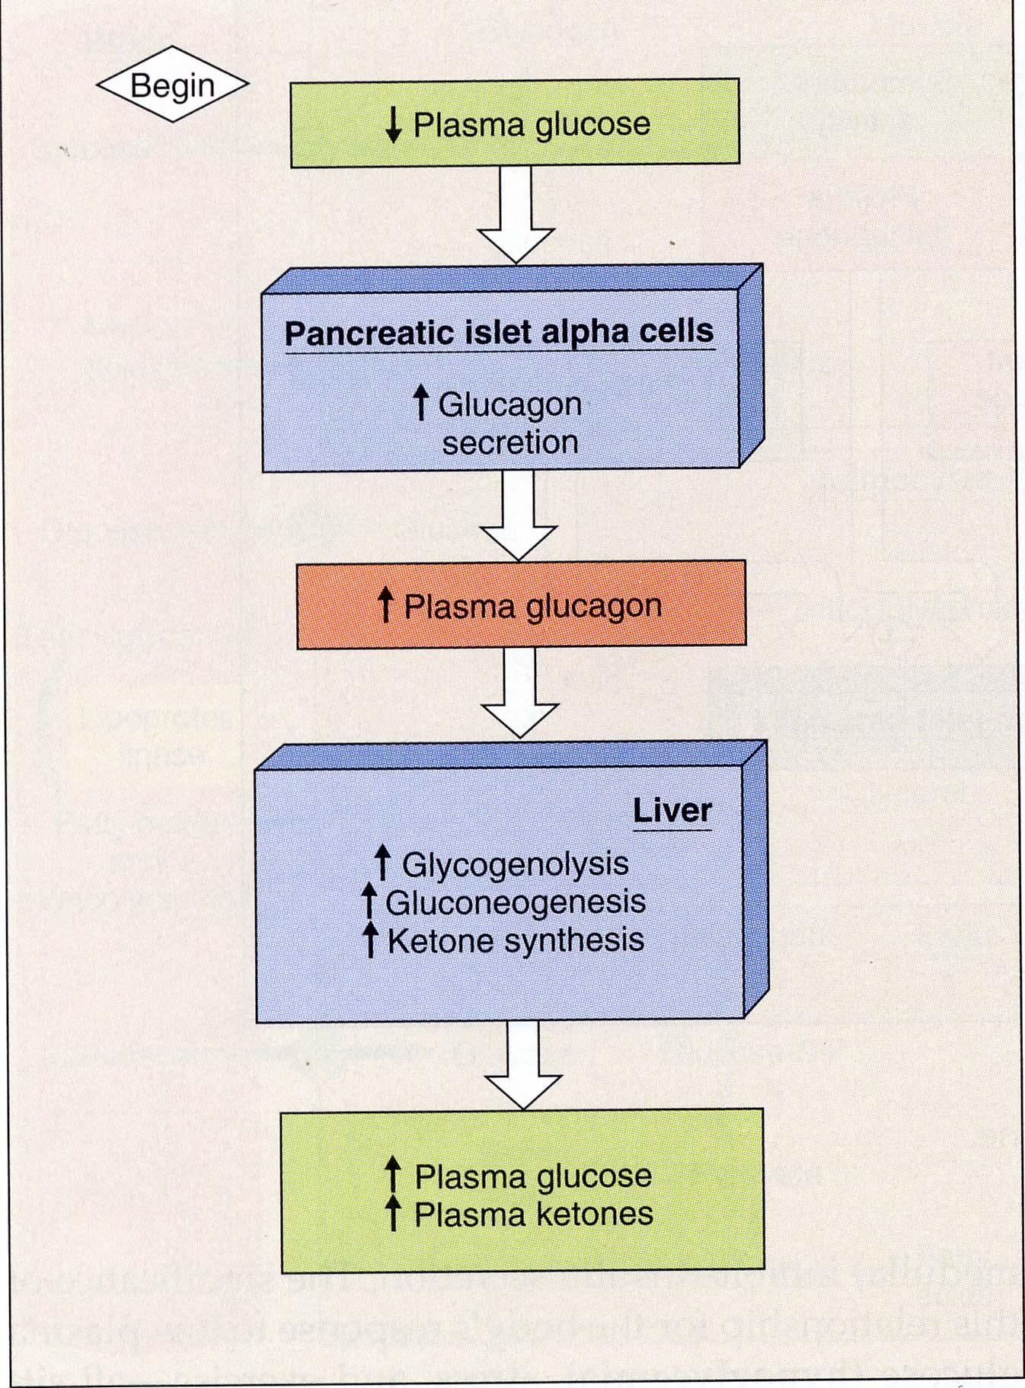
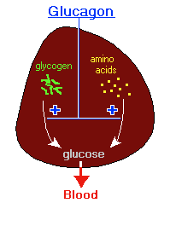
Catabolic means that it promotes breakdown (or catabolism).
Glucagon is a catabolic hormone.

Slide 18
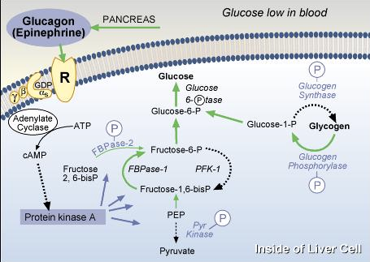
How does glucagon work?
Do not even try to remember the details!!!
1) Activation of “kinases”, --> 2) phosphorylation of enzymes.

Slide 19
Insulin and glucagon are water-soluble hormones (both are proteins).
They act relatively rapidly and their effect is short-lived (transient). They bind to a receptor in the target cell’s membrane. The receptor either:
Initiates a series of biochemical changes that make the cell do something (often amplifying the signal in a metabolic cascade). This is called “signal transduction”.
and/or
2) Sometimes (not always) send a signal to the nucleus to start a nuclear (or genomic) response.
Why can the effect of these hormones be so fast and (often) intense?

Slide 20
Insulin and glucagon are water-soluble hormones (both are proteins).
They act relatively rapidly and their effect is short-lived (transient). They bind to a receptor in the target cell’s membrane. The receptor either:
Initiates a series of biochemical changes that make the cell do something (often amplifying the signal in a metabolic cascade). This is called “signal transduction”.
and/or
2) Sometimes (not always) send a signal to the nucleus to start a nuclear (or genomic) response.
Why can the effect of these hormones be so fast and (often) intense?

Slide 21
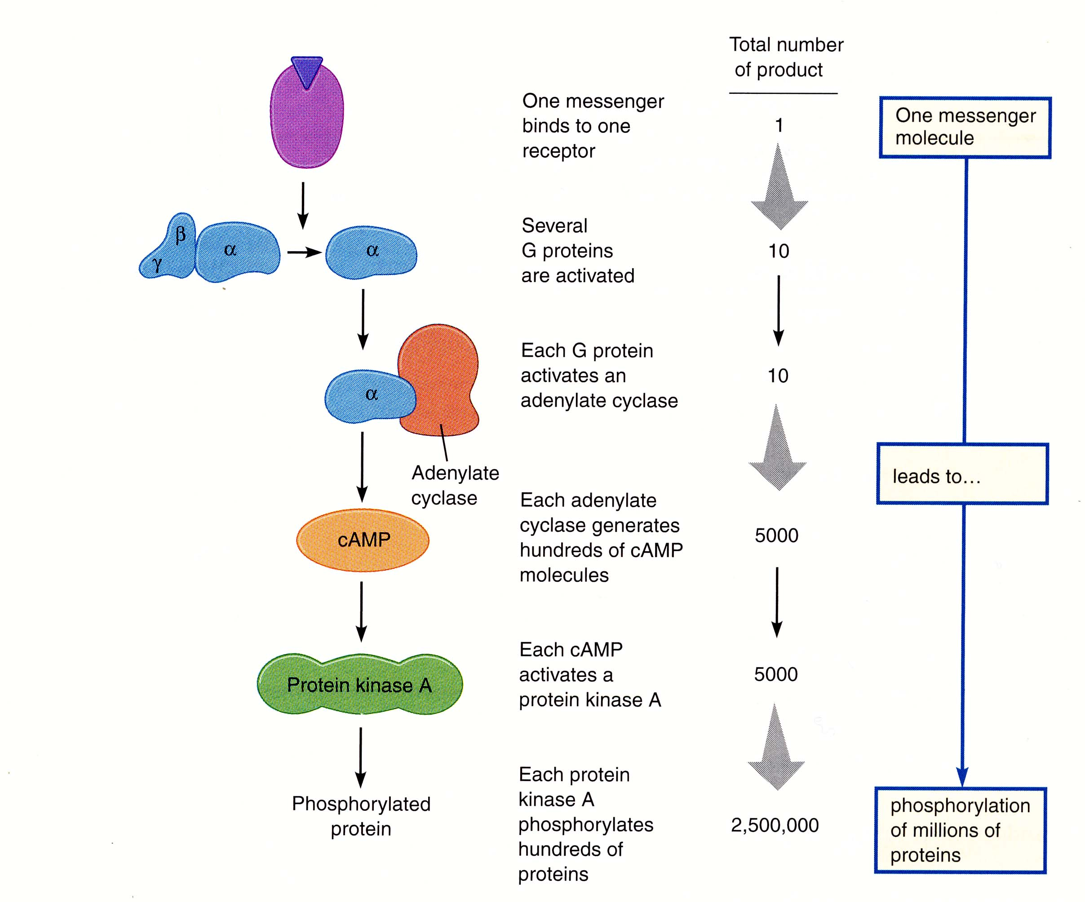
This is what I mean by a metabolic cascade, and the reason why water soluble hormones can have very rapid effects.

Slide 22
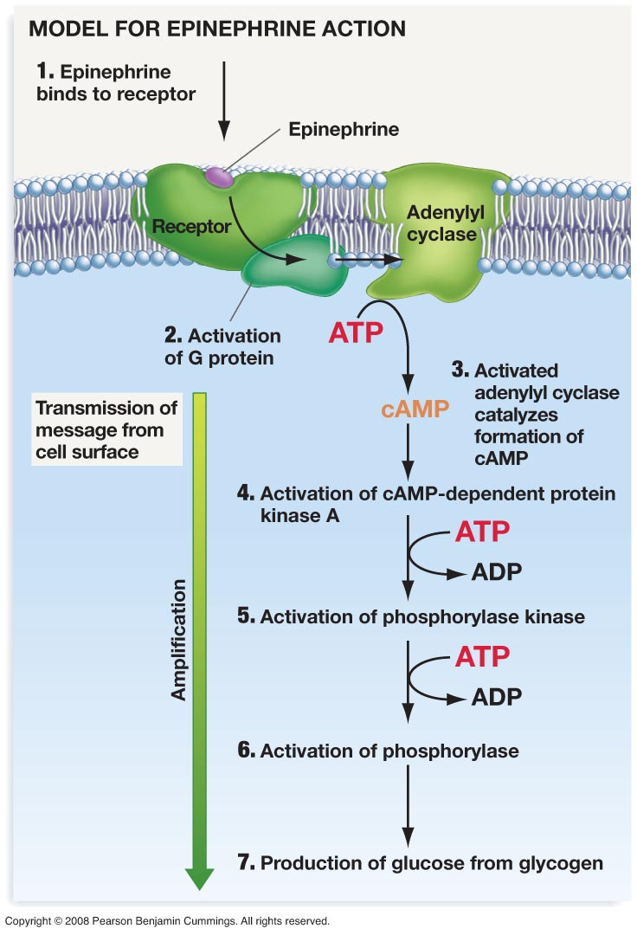
Epinephrine triggers a signal transduction cascade

Slide 23
To remember
-Depending on the characteristics of the characteristics of the signal transduction system hormones can have very different effects on different tissues/cells.
-Epinephrine (adrenaline) is a fight or flight hormone: it blocks digestive function, stimulates blood flow to muscles, mobilizes “fuels”.
-Whereas inuslin is an anabolic (synthesis) hormone, glucagon is a catabolic hormone (stimulates breakdown, production of glucose).
-The receptors of water soluble hormones (insulin, glucagn, epinephrine) are in the membrane of target cells.
-Water soluble hormones act by eliciting the amplification of a signal (G-protein->cAMP->protein kinases->phosphorylation (activation) of metabolic enzymes).

Slide 24
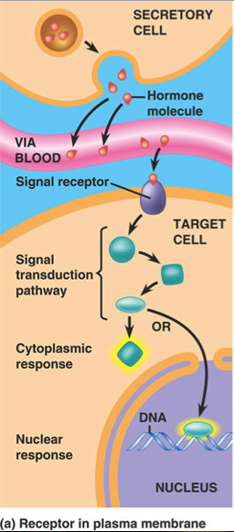
2) Sometimes (not always) water soluble hormones send a signal to the nucleus to start a nuclear (or genomic) response.

Slide 25
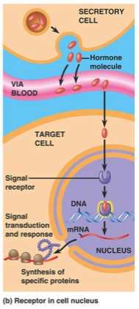
Not all hormones are water soluble. Some are lipid soluble.
The receptors of lipid soluble hormones act within the nucleus of cells in target organs. They have genomic effects. Their action is to stimulate the synthesis of new proteins. The genomic effects of lipid/fat soluble hormones tend to be more slow and more long-lasting than those of water soluble hormones.
All the steroids (androgens and estrogen, and the hormones of the adrenal cortex, the corticosteroids) are examples of lipid soluble hormones.

Slide 26
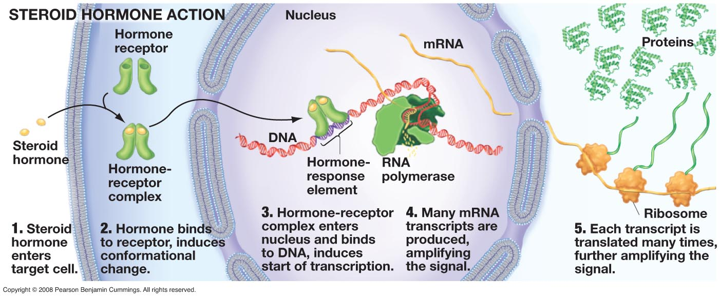
Steroid hormones bind to receptors inside of cells and change gene expression

Slide 27
A *simplistic summary of the differences between water soluble and lipid soluble hormones.
Type water soluble lipid soluble
____________________________________________
Receptors membrane nucleus
Mode of action metabolic cascade genomic (protein synthesis)
Time course fast/transient slow/persistent
Examples insulin, glucagon androgens, estrogen
epinephrine steroids
____________________________________________
REMEMBER THIS
* There are lots of exceptions

Slide 28
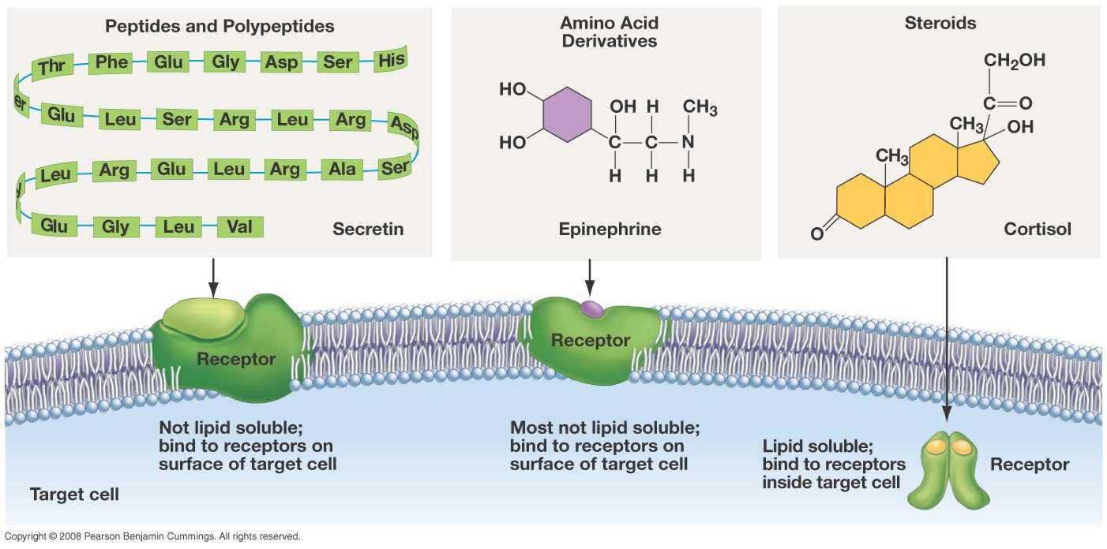
Most animal hormones belong to one of three chemical families: peptides/polypeptides, amino acid derivatives, and sterols. The first two “families” are water soluble, the third is lipid soluble.

Slide 29
Clicker Question
Both epinephrine and cortisol are involved in the response to stress. How do these two molecules differ?
Cortisol is an amino acid derivative, epinephrine is a steroid
Cortisol binds to receptors on the plasma membrane; epinephrine binds to receptors in the interior of cells
Epinephrine mediates the short term response to stress, cortisol mediates the long term responses.
Cortisol is a water soluble membrane; epinephrine is lipid soluble.

Slide 30

How do animals regulate urine concentration

Slide 31
Mammals become diuretic when blood levels of the hormone ADH are ________and the permeability of the epithelial membrane of the collecting duct is _____________
Low, Low
High, Low
High, High
Low, High

Slide 32
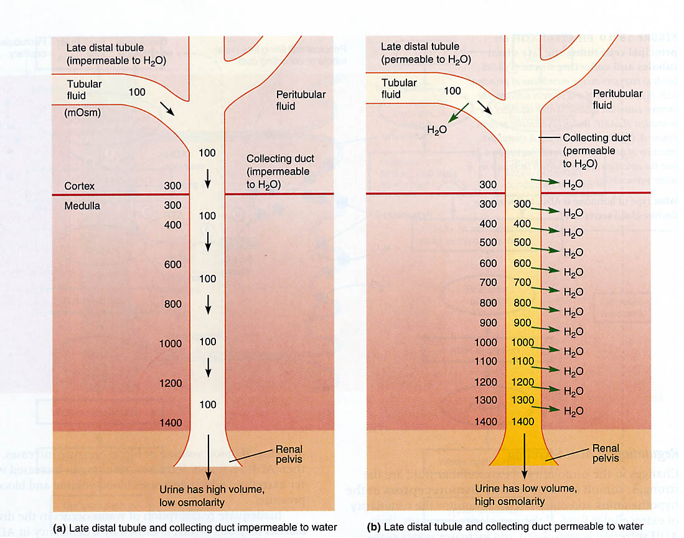
How do we make dilute urine?
We make concentrated urine by having a collecting duct that is permeable to water
We make dilute urine by having a collecting duct that is impermeable to water
How is the water permeability of the collecting duct modulated?
diluting
concentrating
.

Slide 33
Message
-Urine is concentrated when the epithelium of the collecting duct is very permeable to water. We call the production of concentrated urine anti-diuresis.
-Urine is diluted when the epithelium of the collecting duct is impermeable to water. We call the production of dilute urine, diuresis.
How is the water permeability of the collecting duct modulated?

Slide 34
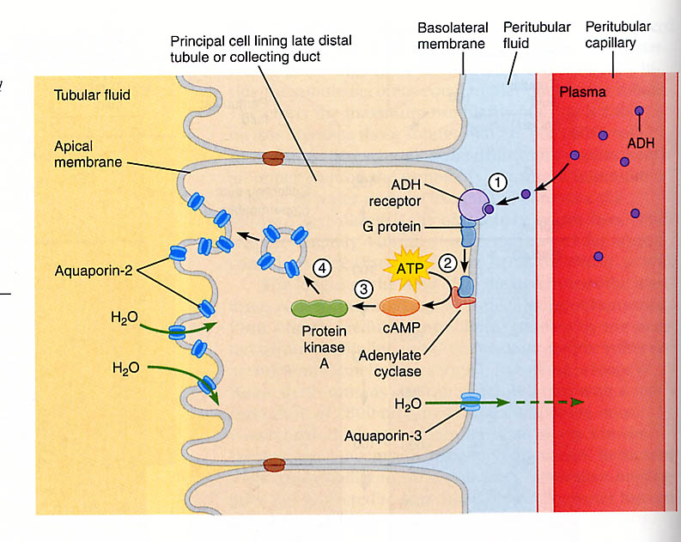
The water permeability of the collecting duct is modulated by ANTI-diuretic hormone (ADH)
The water permeability of the collecting duct is modulated by ADH (antidiuretic hormone) through a G-protein mediated signalling pathway. The outcome of ADH stimulation is the recruitment of aquaporin 2 into the apical membrane. Recall that aquaporins are water channels.
Aquaporin 2 is recruitable into the apical membrane.
Aquaporin 3 is constitutive and found in the basolateral membrane.
How is the secretion of ADH regulated?

Slide 36
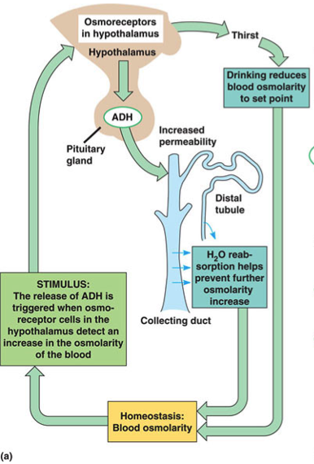
The sensor for dehydration is in the hypothalamus. There are “osmoreceptors” in this structure that sense the osmolarity of blood. If the osmolarity of blood goes above a set point value, the pituitary gland (actually a structure within it called the neurohypophysis) secretes ADH (anti-diuretic hormone also called vasopressin). ADH increases the water permeability of the kidney’s collecting duct. The kidney recovers water and makes more concentrated urine.

Slide 37
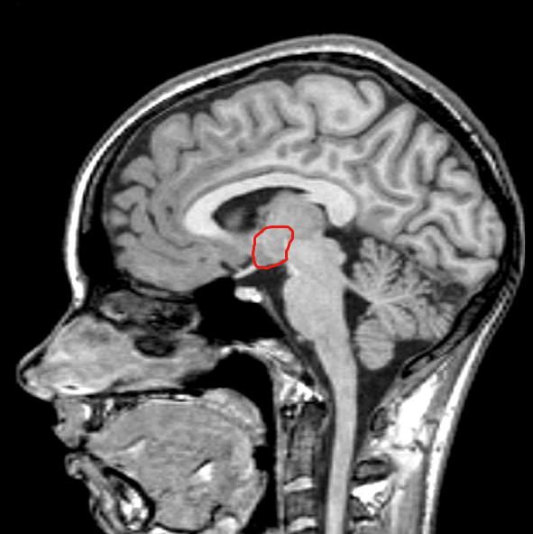
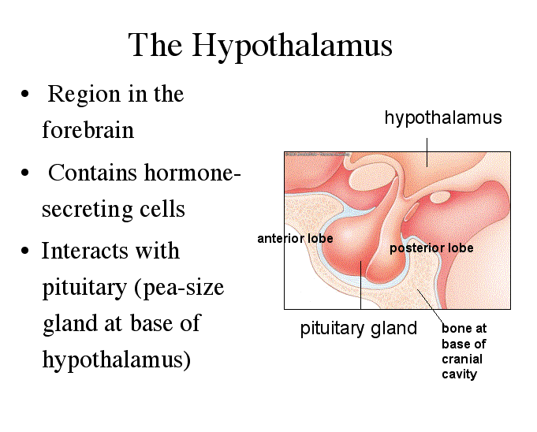
The neurohypophysis is the functional unit made of the posterior pituitary and parts of the hypothalamus.

Slide 38
To remember
-The center that controls urine concentration is in the hypothalamus.
-Osmoreceptors detect hydration/dehydration in the hypothalamus stimulate the posterior pituitary to secrete ADH.
-ADH stimulates the insertion of aquaporins to the apical membrane of cells in the epithelium of the colecting duct.

Slide 39
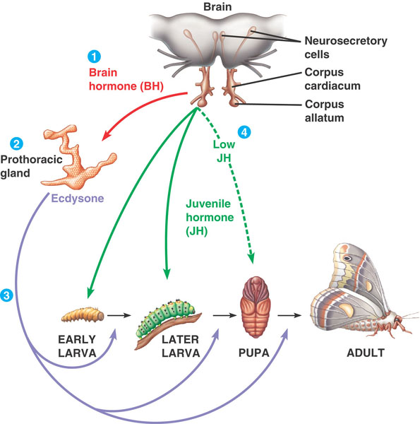
Hormones play a central role in development (an example on insects). This example is a terrible oversimplification!
Neurosecretory cells in the brain produce BH* which…
stimulates the production (in pulses) of ecdysone by the prothoracic gland.
The result of the action of ecdysone depend on the “levels” of juvenile hormone (neotenin). If levels are high, molts result in (bigger) larvae. If they are low, they result in a pupa.
Ecdysone stimulates molting by acting on the epidermis.
*BH is really called prothoracicotropic hormone (PTTH)

Slide 40
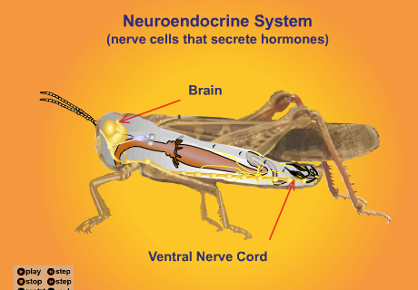
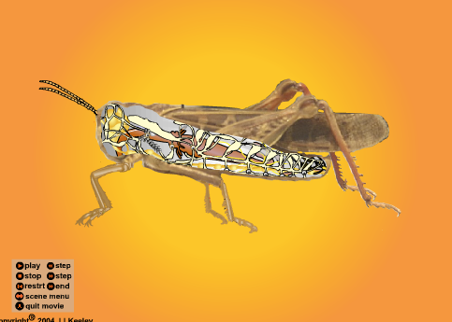
Corpora cardiaca
Prothoracic gland
From
http://entochem.tamu.edu/insect_structure-function/
Check it out for some fantastic animations
tracheae

Slide 41

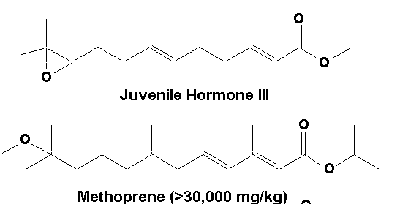
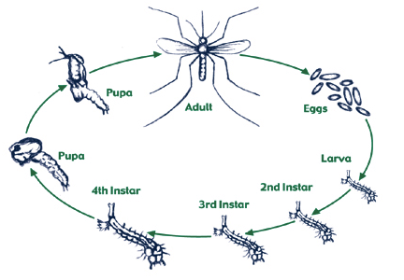
Synthetic forms of juvenile hormone are used as insecticides. They disrupt the development of mosquitoes and fleas…
A problem is….

Slide 42
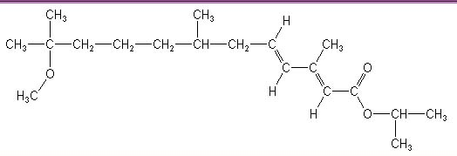
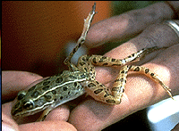
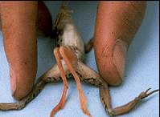
methoprene
…in the lab (and maybe in nature) methoprene causes malformation in frogs.
One more example of endocrine disruption….

Slide 43
-Molting in insects is stimulated (indirectly) by a neurohormone called Brain Hormone (BH).
-BH stimulates ecdysone production by the prothoracic gland.
-In the presence of juvenile hormone ecdysone elicits a molt.
-In the absence of juvenile hormone, ecdysone elicits pupation.

Slide 44
Hormones play a central role in development (an example on insects). This example is a terrible oversimplification!
Neurosecretory cells in the brain produce BH* which…
stimulates the production (in pulses) of ecdysone by the prothoracic gland.
The result of the action of ecdysone depend on the “levels” of juvenile hormone. If levels are high, molts result in (bigger) larvae. If they are low, they result in a pupa.
Ecdysone stimulates molting by acting on the epidermis.
*BH is really called prothoracicotropic hormone (PTTH)

Slide 45
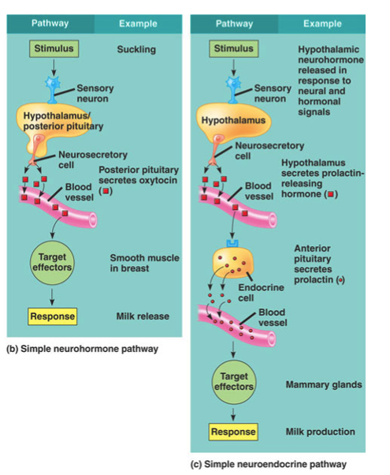
BH (or better PTTH is an example of a neurohormone. Neurohormones are chemical messengers secreted by neurons rather than by glands.
Neurohormones can act directly on target tissues (this is called a simple neurohormone pathway) or they can act by stimulating a gland to produce a hormone (this is called a simple neuroendocrine pathway).

Slide 46
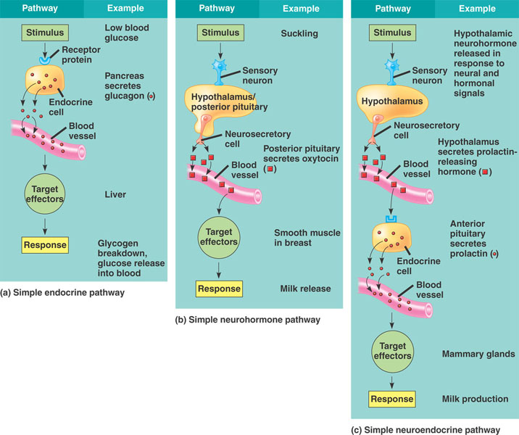

Slide 47
To Remember
In simple endocrine systems the sequence is:
Stimulus->gland->hormone->target tissue
2) In simple neurohormone pathway
Stimulus->nervous system->neurohormone->target tissue
3) In simple neuroendocrine pathway
Stimulus->nervous system-> neurohormone->gland->hormone-target tissue

Slide 48
Review Hormones
1) What are the “ingredients” of a simple endocrine system?
2) Where are insulin and glucagons secreted? Answering “the pancreas” is not sufficient.
3) What are the stimuli for the secretion of these hormones?
4) How come epinephrine has such different effects on its different target tissues?
5) Why do we call insulin anabolic and glucagon catabolic hormones?

Slide 49
6) List the steps in the G-protein mediated signaling cascade depicted in slide 18. Explain how this process amplifies the signal of a hormone.
7) What are the differences between hormones that have membrane receptors and those that have nuclear receptors.
8) What are the three families of hormones depending on their chemical origin.
8) Create a feedback diagram that illustrates how urine concentration is regulated. The ingredients should be the hypothalamus, ADH, and the cells of the epithelium of the collecting duct.
10) Juvenile hormone can be used to control insect pests. Why?
11) Use simple diagrams to differentiate between a simple endocrine pathway, a simple neurohormone, and a simple neuroendocrine pathway.

Slide 50
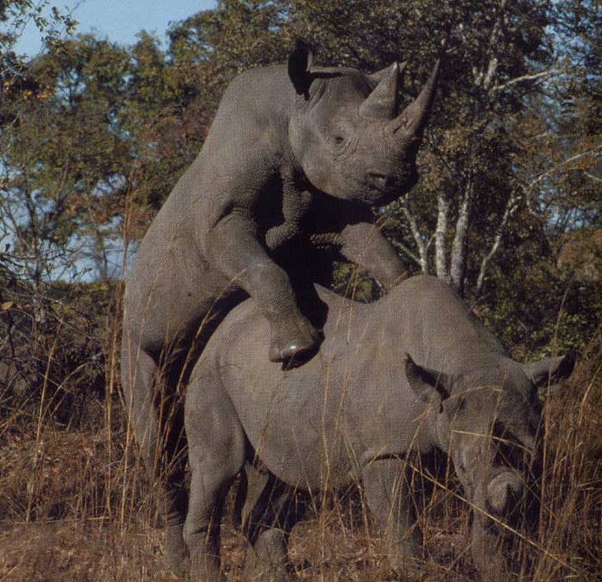
Next we talk about sex!!
Please read all of chapter 48

