Slide 1
Population Ecology: The interesting consequences of reproduction and death
(Chapter 52)
-What are populations and how we measure their density?
-Population growth: Exponential and logistic growth.
-Age structure and life history strategies.
-Human demography and population growth.

Slide 2
Population ecology is the study of populations. It studies how organisms are distributed in space and time.
Translation
Population ecologists study how the numbers of organisms change in time, how they are distributed in space, and what are the factors (biotic and abiotic) that produce these changes.

Slide 3
A bit of jargon:
What is a population? A group of individuals of the same species living in a general area (e.g. The elk population in the Snowy Range Mountains, the population of Cambarus sp. Crayfish living in the drainage of the Little Laramie River). Sometimes the boundaries of the area are well defined (an island), sometimes they are arbitrary (game management area).
Two Important terms
Population Density: The number of individuals per unit area (elk/sq. km, fish/ha,..,etc).
Population dispersion: The pattern of spacing among individuals within the boundaries of the population.

Slide 4
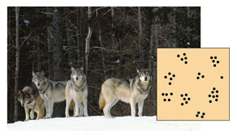
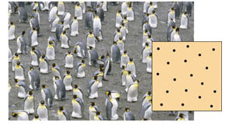
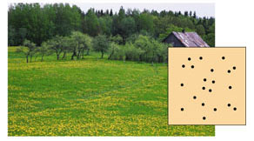
Patterns of dispersion:
Clumped (individuals aggregate in patches). For many animals, living in groups increases the effectiveness of hunting, spreads the work of protecting and caring for young, and helps exclude other individuals from their territory.
Uniform (individuals are evenly distributed). Birds nesting on small islands, such as these king penguins on South Georgia Island in the South Atlantic Ocean, often exhibit uniform spacing, maintained by aggressive interactions between neighbors.
Random (the position of each individual is independent of that of others). Dandelions grow from windblown seeds that land at random and later germinate.

Slide 5
To Remember
-Populations are groups of individuals of the same species living in a defined space.
-Population ecology is the discipline that studies the factors that determine changes in abundance of individuals in space and time.
-Individuals can be distributed in space in 3 possible ways: clumped (“aggregated”), uniformly, and randomly.

Slide 6
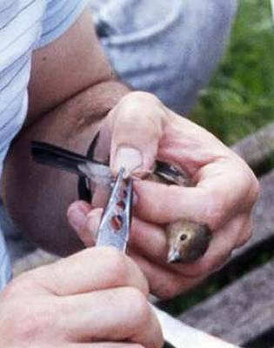
How many? A very simplistic introduction to capture recapture methods.
The concentration principle
-One can use the dilution principle to estimate volumes:
C=A/V, then V=A/C
As we will see the same principle can be used to measure how big a population is (N=population size).

Slide 7
Catch a number M of animals, mark them and release them
Recapture a number K and find out how many are marked in this group (lets call this number R).
The “concentration” of marked individuals (C) equals R/K.
Recall that Volume=Amount/Concentration
4) Estimate N as
N = M/(R/K)=MK/R
Note that N = M/(R/K) is equivalent to V=A/C

Slide 8
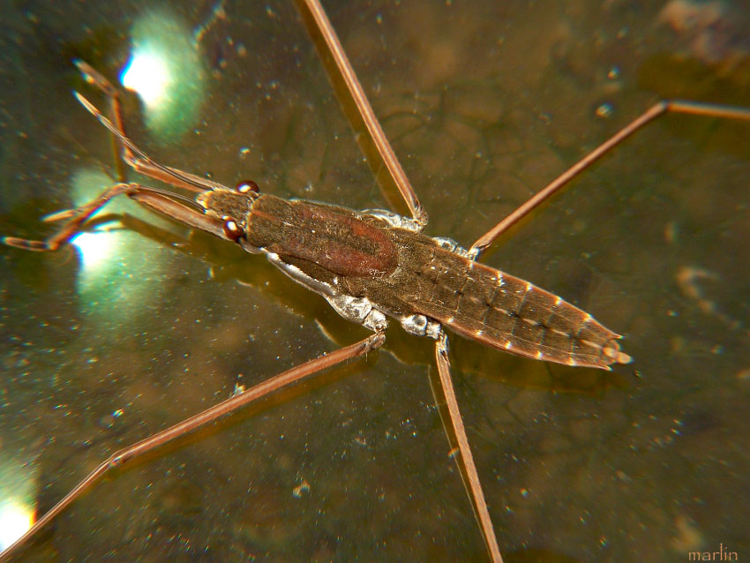
Example:
You catch and mark 350 water striders in a pond, you let them go and the next day you go again and catch 500. You find that 70 are marked. How many water striders are in the pond?
M=animals marked
K=how many of the recaptured are marked
R=number recaptured
Thus, N =
3400
3500
500
1000
2500
N = M/(R/K)=MK/R
350/(50/500)=350/0.1=3500 individuals

Slide 9
What assumptions do we make to use the simple model of capture-recapture?
Closed population that is in equilibrium (no immigration or emigration)
2) We capture a random sample of individuals (the beasties that we catch are not more nor less likely to be caught than other individuals).
3) Capture probability does not influence recapture probability.

Slide 10
TO REMEMBER
-We can use the dilution method (modified as capture-recapture) to estimate population size.
N = M/(R/K)=MK/R
M= marked, K = captured, R=recaptured
Note that N = M/(R/K) is equivalent to V=A/C

Slide 11
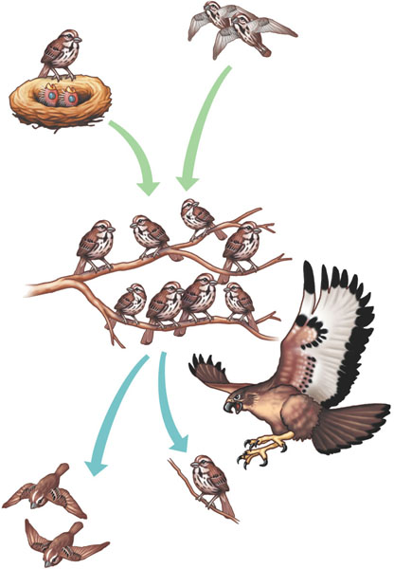
What are the factors that determine population density:
Births and immigration add individuals to a population.
INPUTS
births
immigration
OUTPUTS
deaths
emigration
Births
Immigration
PopuIation
size
The size (or density) of a population is a dynamic (i.e. changing) variable that depends on the dynamic interplay of inputs into the population and outputs out of the population.
Emigration
Deaths
Deaths and emigration remove individuals from a population.

Slide 12
Often, it is very useful to recognize that animals are not all of the same age but are divided into age classes.
Population ecologists use either numerical categories (age in years, 1, 2, 3, 4,…,etc), or for animals that cannot be aged easily (birds, some mammals, many invertebrates) discrete categories (egg, larvae/juvenile, adult).
The study of the age-specific mortality and survival of organisms is called demography. Demography is very useful for ecologists and also to actuarians (that calculate your insurance rates).

Slide 13
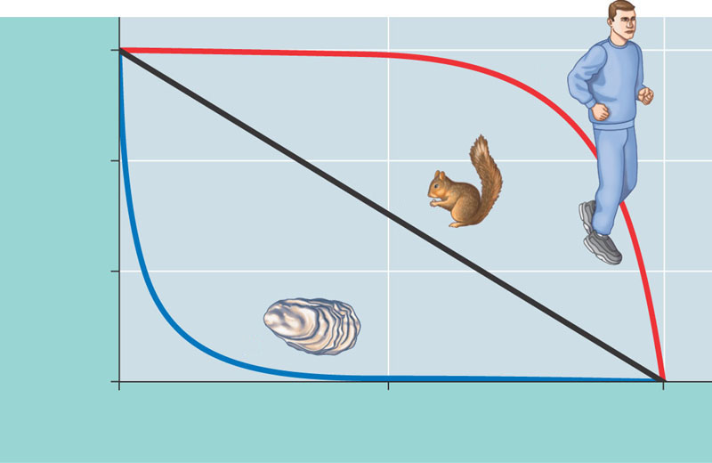
One of the (many) ways used by population ecologists to describe age-specific demographic characteristics is by the use of survivorship curves.
Note the semi-logarithmic axis.
1,000
These follow how many individuals in a cohort of 1000 survive to a given age (here represented as % of maximal life span).
Survivorship curves come in many forms. Here we describe only 3 forms.
I
100
Number of survivors (log scale)
II
10
III
1
0
50
100
Percentage of maximum life span

Slide 14
1,000
I
100
Number of survivors (log scale)
II
10
III
1
0
50
100
Percentage of maximum life span
Type I survivorship curves are characterized by mortality concentrated in senescing (ageing) older stages.
In Type II survivorship curves mortality is independent of age (the curve is linear in semilogarithmic axes).
In Type III survivorship curves mortality is concentrated in young individuals.

Slide 15
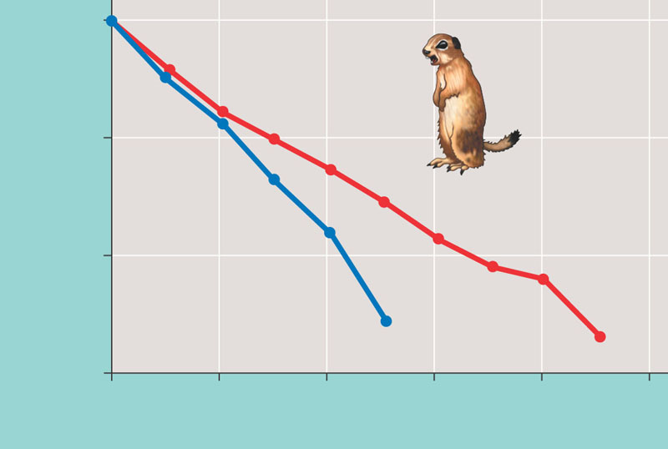
1000
100
Number of survivors (log scale)
Females
10
Males
1
0
2
4
6
8
10
Age (years)
Belding’s ground squirrels have Type____ survivorship curves. Survivorship is __________ in females than males
A) I, higher
B) II, higher
C) III, higher
D) II, lower
Mortality is relatively independent of age (but in this case, it is sex-dependent. It is higher for males than for females).

Slide 16
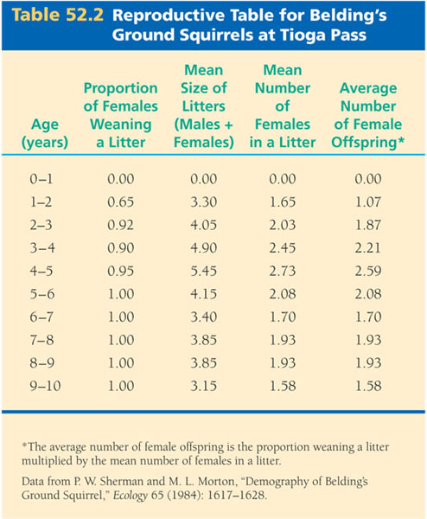
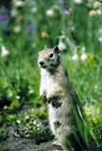
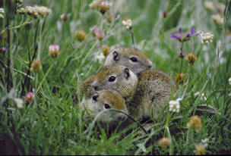
Of course, reproduction is also age-dependent:

Slide 17
We can combine data on survivorship curves with data on age-specific fecundity to predict how a population will grow. We will not do it. Instead, I will describe the simplest possible model of population growth.
Suppose that a population grows according to the following rule
N_{t+1} = N_{t +} N_{t} (b - d) = N_{t}(R)
^{Where}
Nt+1 = population size at time t+1 (time is measured in years)
^{Nt = population size at time t}
b=per capita birth rate (births/individual per year)
d=per capita death rate (deaths/individual per year).
^{R= 1+ b-d}
Imagine that you start at time 0 with N₀ individuals then
Time 0 1 2 3 n Individuals N₀ (R) N₀ (R) N₁ = (R)(R) N₀ = ( R)²N₀ (R)³N₀ (R)^{n}N₀

Slide 18
N_{t+1} = Nt + N_{t}(b - d) = (1+ (b-d))N_{t}
Lets define R = (1+ (b-d))
Thus, N_{n} = (R)^{n}N₀
If R > 1, that is if b > d If R < 1, that is if b < d
then the population grows then the population declines

Slide 19
Homework: Assume that R = 1.2 (population grows by 20% each year) and 0.8 (the population declines by 20% each year) , and N₀ is 10. Fill the following table and plot N_{t} against time:
Time | N_{t} (R=1.2) | N_{t} (R=0.8)
0 | 10 | 10
1
2
4
6
8
10
12
14
18
20
Recall that
N_{n} = (R)^{n}N₀

Slide 20
TO REMEMBER
-The simplest model of population growth assumes that
-individuals have the same chance of dying from time t to time t+1 (prob of death = d)
-individuals on average have a reproductive rate equal to b
-Thus N_{t+1} = N_{t}(1+b-d) =RN_{t}
This implies that N_{n} = R^{n}N₀
If R > 1 populations grows, if R < 1 it decreases.

Slide 21
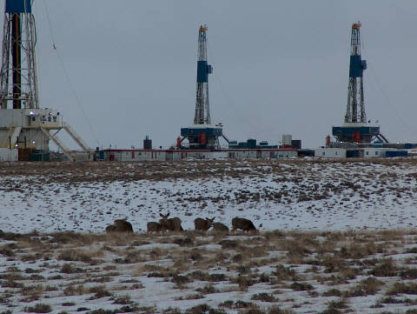
The R value of the deer population that winters in the Pinedale Anticline area is ≈ 0.7. If the initial population in 2011 is 3000 deer, the population in 2015 will be
approximately (Hint, N₀ = 3000).
2100
3300
1029
720
504

Slide 22
I have been using the discrete for of an exponential growth equation. Your book uses the continuous form:
∆N/∆t =dN/dt
This differential equation has the solution:
N(t) =N₀e^{rt}
If you do not know, or cannot remember calculus close your eyes, the equation will go away!

Slide 23
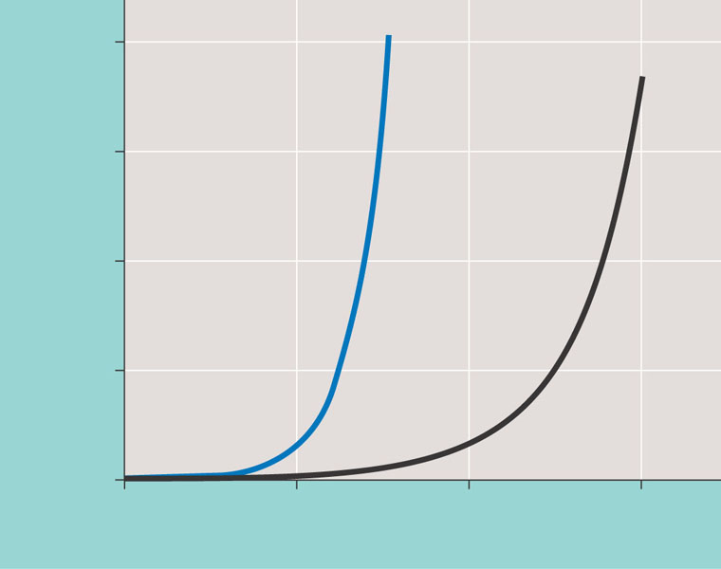
The exponential equation tells you that if a population has constant per-capita birth and death rates, and birth rates exceed death rates then the population will grow very, very rapidly.
2,000
dN
=
1.0N
dt
1,500
dN
=
dt
0.5N
Population size (N)
1,000
500
0
0
5
10
15
Number of generations
years

Slide 24
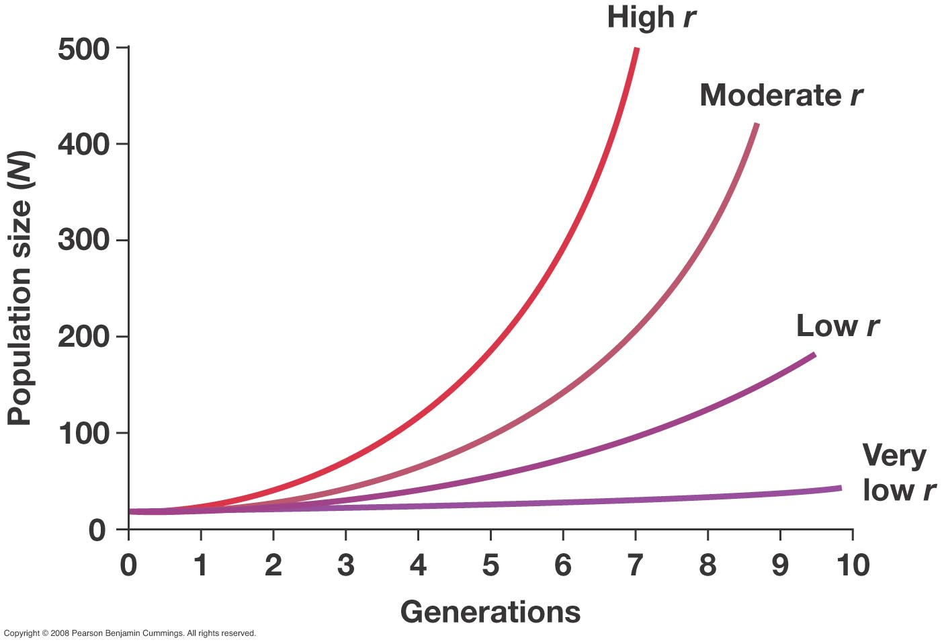

Slide 25
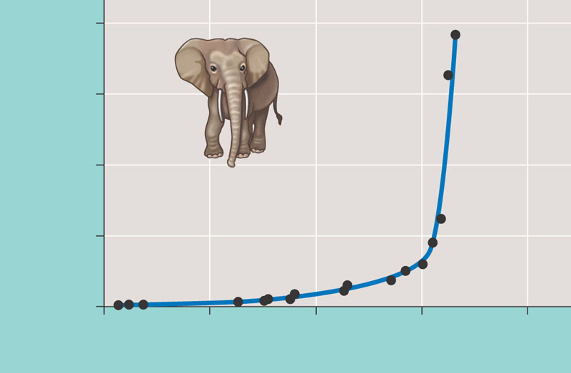
8,000
6,000
Elephant population
4,000
2,000
0
1900
1920
1940
1960
1980
Year
Populations that are re-bounding after harvest (sometimes they do…) or that are invading new unoccupied spaces (islands) grow exponentially. The figure is for Elephants in Kruger National Park, South Africa.

Slide 26
To remember about exponential growth.
Populations grow exponentially if:
-per-capita birth rates and death rates remain relatively constant
-birth rate exceeds death rate
(if r=0 the population is steady, if r < 0 the population is declining mortality > birth rate)
Exponentially growing populations grow very rapidly indeed…They grow in a compound interest-like fashion. The parameter that goberns the rate of growth is called r
r = instantaneous per capita birth-death rate.
Exponential growth cannot be sustained for long as animals would consume the resources that sustain them.

Slide 27
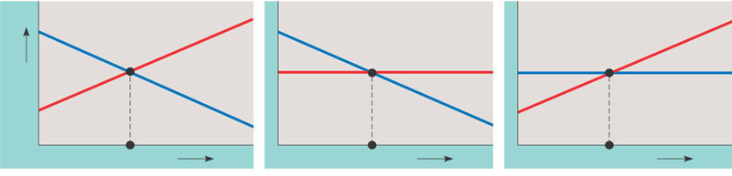
In some populations per-capita birth rate is not constant, it decreases with population size/density. Sometimes per-capita death rate increases with density
These “density-dependent” processes, put the breaks on exponential growth. They sometimes lead to an equilibrium called K or the carrying capacity.
Density-dependent death rate
Density-dependent death rate
Density-independent death rate
Density-independent birth rate
Birth or death rate per capita
Density-dependent birth rate
Equilibrium density
Population density
Density dependence in birth or death rates is sometimes (not always) the consequence of intra-specific competition for resources.
K = carrying capacity
birth rate = death rate

Slide 28
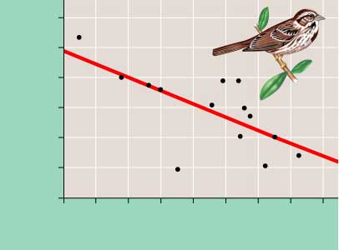
Example of density dependence. In a population of Song sparrows (Melospiza melodia) clutch size (the number of eggs laid per female) decreases with population density. As you would expect territoriality can have density-dependent demographic effects.
4.0
Equilibrium density
3.8
Population density
3.6
3.4
Average clutch size
3.2
3.0
2.8
0
0
10
20
30
40
50
60
70
80
Density of females

Slide 29
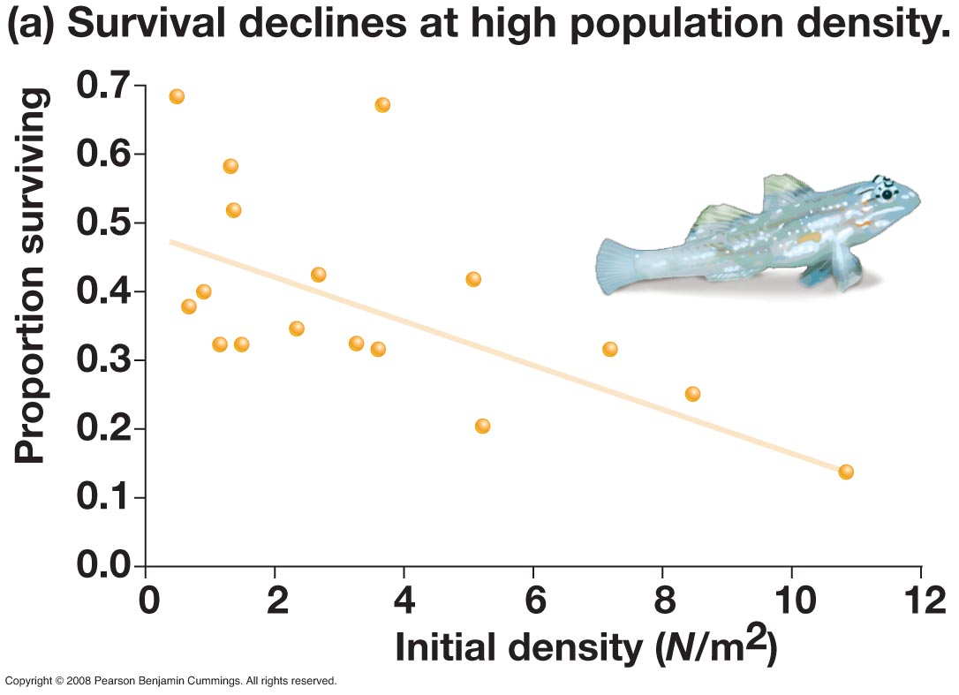

Slide 30
To Remember
-Often birth and mortality rates are density dependent.
-Birth rate decreases with population density
-Death rate (mortality) increases with population density
What is the consequence of density-dependence??

Slide 31
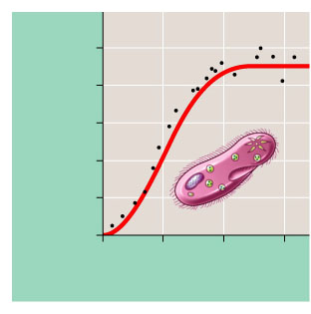
1,000
K
800
600
Number of Paramecium/ml
400
200
0
0
5
10
15
Time (days)
Density dependence sometimes leads to an S-shaped population growth curve. This form of growth is called “sigmoidal” (like an S) or logistic.
The equilibrium value that populations reach is called the carrying capacity and is denoted by K

Slide 32
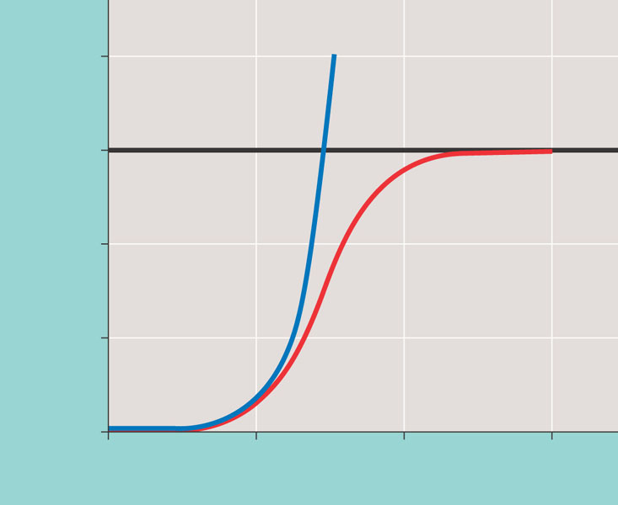
2,000
Exponential growth
1,500
K = 1,500
Logistic growth
Population size (N)
1,000
500
0
0
5
10
15
Number of generations
In exponential growth populations grow without check (b-d> 0). In logistic (or sigmoidal) growth the populations grow to a carrying capacity (K) as a result of density -dependent processes.

Slide 33
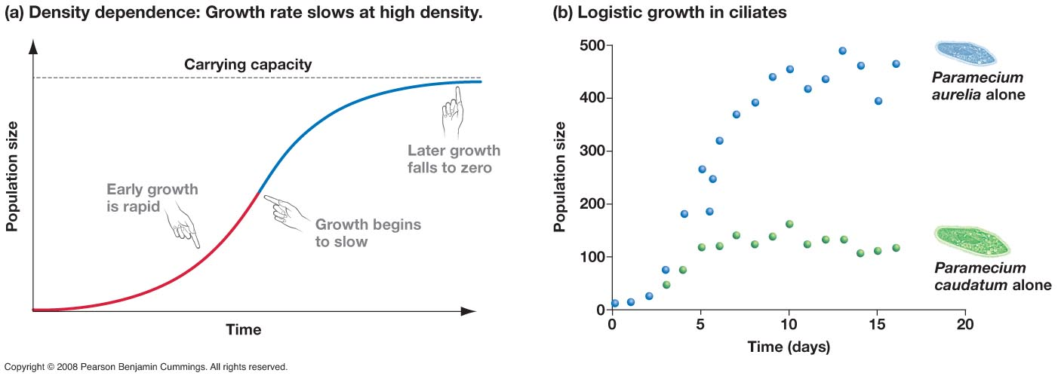

Slide 34
TO REMEMBER
If there are “density dependent” processes and either
birth rate decreases with population size or death rate increases with population size, then populations grow in a sigmoidal fashion and reach and equilibrium in which birth rates balance death rates.
The population size at this equilibrium is called K = carrying capacity.

Slide 35
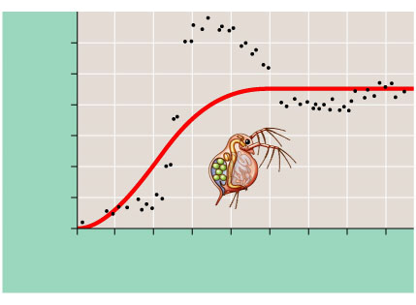
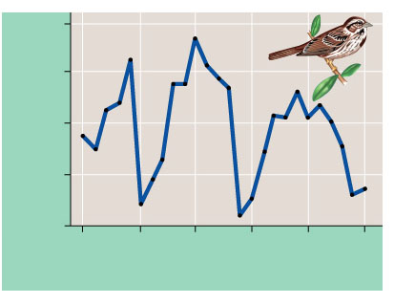
Logistic growth rarely takes place in nature in its perfect (ideal form)
80
180
150
60
120
40
90
Number of females
Number of Daphnia/50 ml
60
20
30
0
0
0
20
40
60
80
100
120
140
160
1975
1980
1985
1990
1995
2000
Time (days)
Time (years)
A song sparrow population in its natural habitat. The population of female song sparrows nesting on Mandarte Island, British Columbia, is periodically reduced by severe winter weather, and population growth is not well described by the logistic model.
A Daphnia population in the lab. The growth of a population of Daphnia in a small laboratory culture (black dots) does not correspond well to the logistic model (red curve). This population overshoots the carrying capacity of its artificial environment and then settles down to an approximately stable population size.

Slide 36
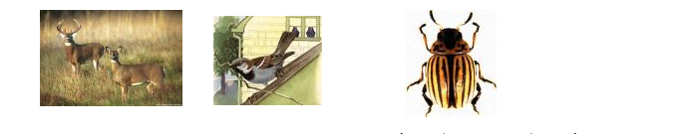
r-selected populations
Some populations have high reproductive rates and live short lives. They often have very high rates of population increase and live far away from equilibrium. Variable environments that favor individuals that are good at reproducing but poor at competing are believed to favor this “strategy”.
Population ecologists call these populations r-selected.
“Weedy” species such as white-tailed deer, house-sparrows, house mice, and many insect pests are examples of r-selected populations.
Colorado potato beetle

Slide 37
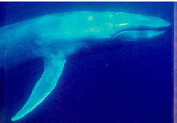
K-selected populations
On the other hand some populations that live close to equilibrium. In these populations selection favors competitive ability over reproductive output.
Population ecologists call these populations K-selected.
Examples are many large predators (mountain lions, lynx), some whales, large beetles.
Blue whale (Balaenoptera musculus)

Slide 38
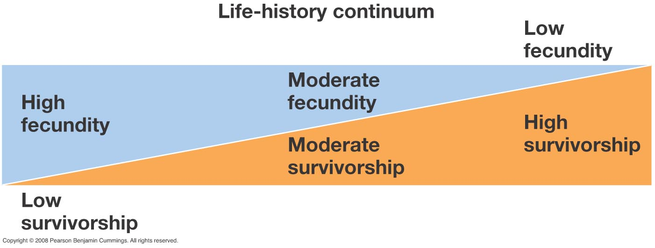
R-selected ----------------------------→ K-selected

Slide 39
MY OWN OPINION
You will hear ecologists still using the terms r- and K-selection. I think that these terms are a gross oversimplification that makes a cartoon of the complexities of life histories in animals.
‘
But I am an opinionated ecologist….

Slide 40
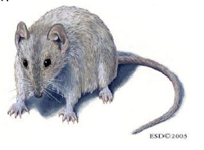
This does not mean that there is no variation in life histories.
One extreme:
Antechinus stuartii (brown antechinus, not a mouse but a marsupial) One of the more striking and unusual things about Antechinus is that all males die shortly after mating in their eleventh or twelfth month of life. This phenomenon occurs at the same time each year in any given population. Increased physiological stress results from aggression and competition between males for females, and heightened activity during breeding season.
Increased stress levels apparently cause suppression of the immune system after which the animals die from parasites of the blood and intestine, and from liver infections. In the wild, many females die after rearing their first litter, although some do survive a second year.
They literally “reproduce” themselves to death…….

Slide 41
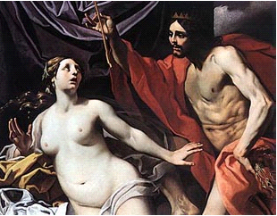
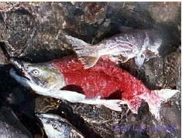
Ecologists call animals that reproduce once and die:
Semelparous
The name comes from the mortal Semele who died after having a child with Zeus. The child is Dionysius (my very favorite Greek god!). The word Parous (Gr. Means to reproduce).
Examples of semelparous animals are:
Pacific Salmon, some squid and octopi (all?), and mayflies
Luca Da Reggio (ca. 1640)

Slide 42

Summary:
Zeus falls for Semele as she bathes.
Zeus seduces Semele in the guise of an eagle and makes her pregnant
Hera, Zeus’ wife finds out
Convinces Semele to see Zeus
Semele sees Zeus, gives birth to Dyonisius and dies
Zeus and Semele by G. Moreau

Slide 43
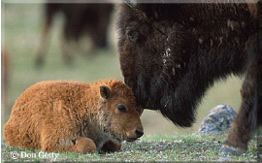
Animals (organisms) that reproduce repeatedly throughout their lives are called
Iteroparous
The word iter (gr.) means to pass by or repeat.
You know of many examples of iteroparous animals. Cows, humans, many insects, many bird species,…etc.
Of course semelparity and iteroparity are extremes in a continuum.

Slide 44
TO REMEMBER
Animals can be
Semelparous (reproduce once and die, salmon, octopi, Antechinus)
Or
Iteroparous (reproduce repeatedly, humans, many others)

Slide 45
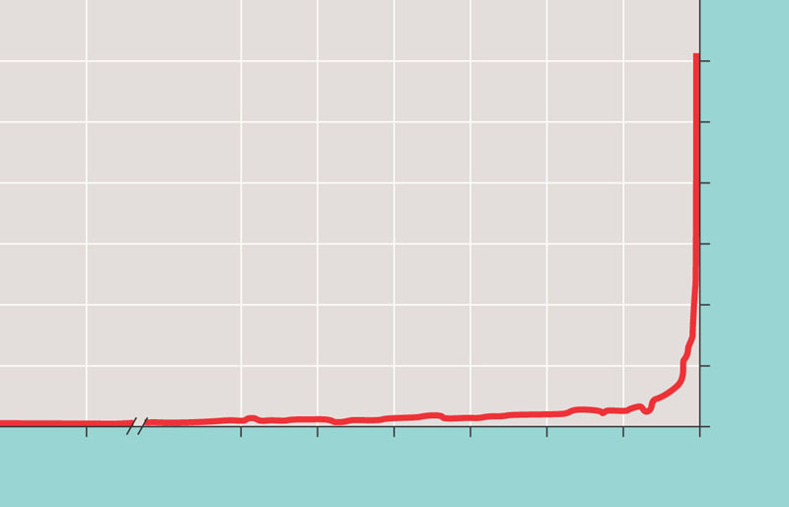
Human population growth
6
5
4
Human population (billions)
3
2
The Plague
1
0
8000
B.C.
4000
B.C.
3000
B.C.
2000
B.C.
1000
B.C.
0
1000
A.D.
2000
A.D.
The human population increased relatively slowly until ≈ 1650. Then it took off exponentially…It is still going!

Slide 46
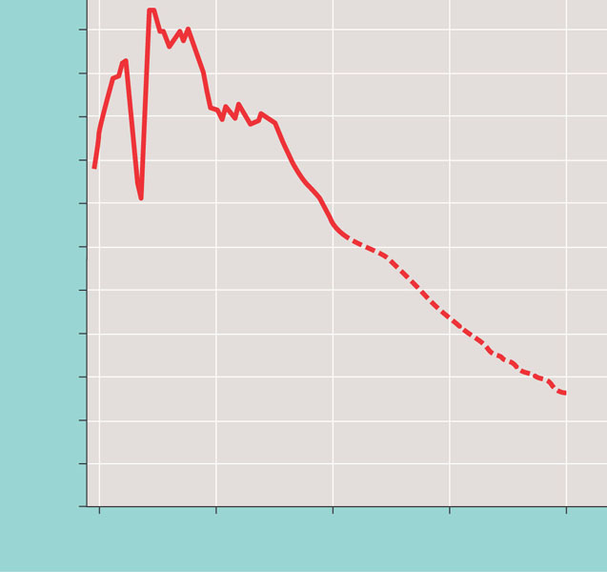
Although the global population is still growing, there seems to be a slow decline in the rate of growth. This means that the population will keep growing, albeit at a slower rate. If we follow the trend, then the population will stabilize by ≈ 2080 (if we survive so long…).
2.2
2
1.8
1.6
2003
1.4
Percent increase
1.2
1
0.8
0.6
0.4
0.2
0
1950
1975
2000
2025
2050
2100
Year

Slide 47
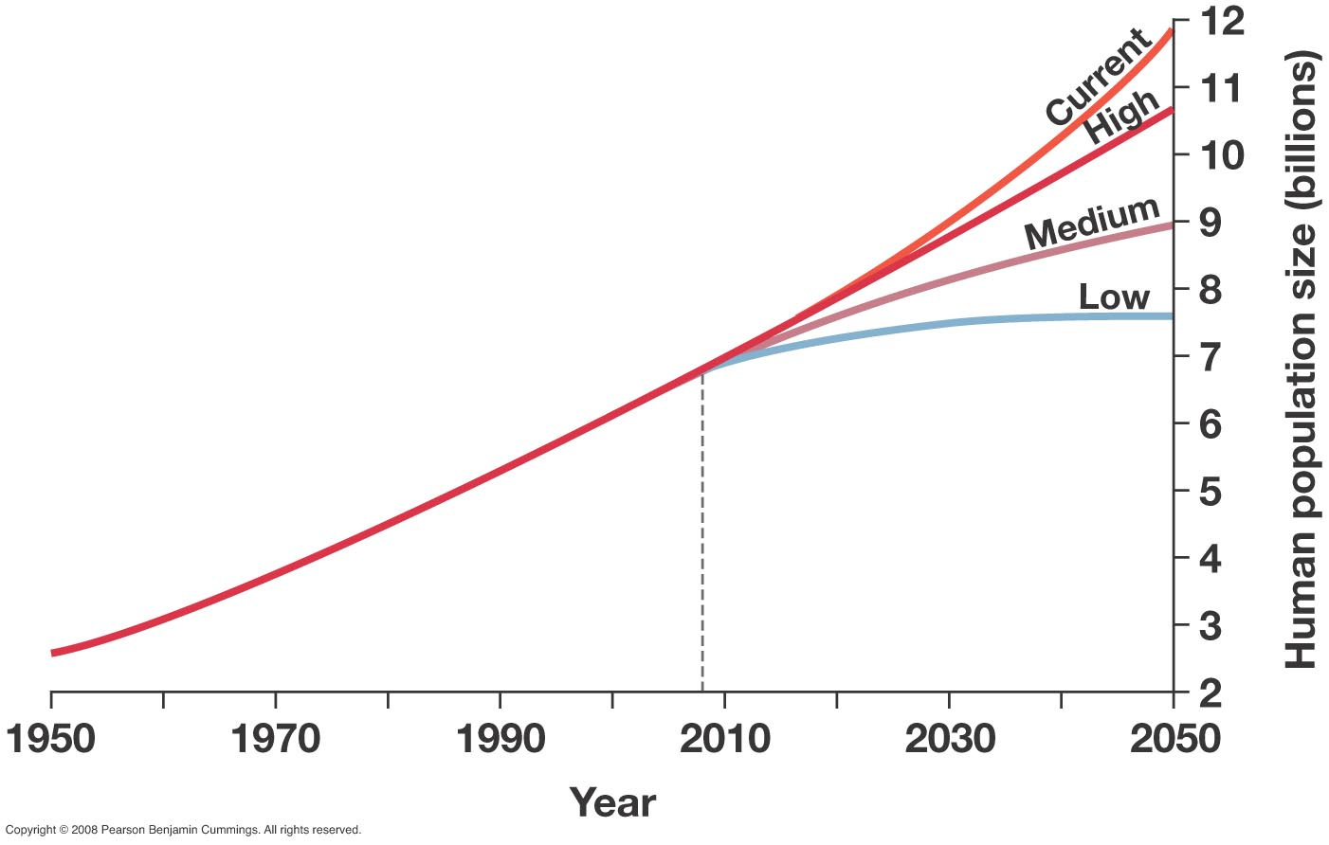
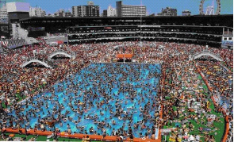
In the worse case scenario, the population will double. In the best, very optimistic, case, the population will stabilize by 2050 with an increase of ≈ 30%.
Swimming pool in Tokio

Slide 48
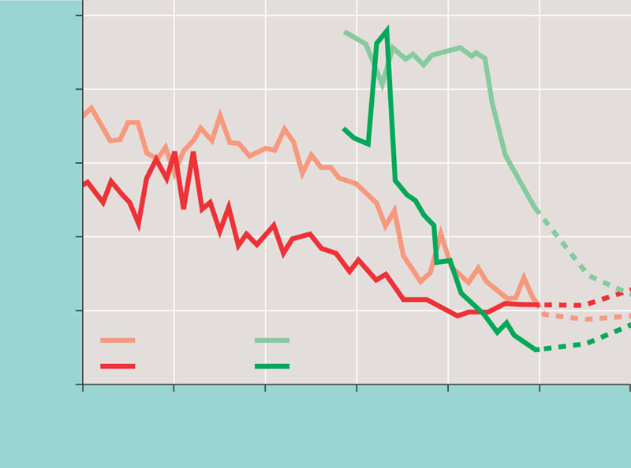
Not all populations in the world are growing at the same rate. Note that we can have zero population growth under two scenarios:
Zero population growth = High birth rates – High death rates
Zero population growth = Low birth rates – Low death rates
Some human populations move from the first state to the second one, which is characteristic of “development”.
50
40
30
Birth or death rate per 1,000 people
This phenomenon is called the
DEMOGRAPHIC
TRANSITION
20
10
Sweden
Mexico
Birth rate
Birth rate
Death rate
Death rate
0
1750
1800
1850
1900
1950
2000
2050
Year

Slide 49
To Remember
Many countries undergo a demographic transition as they develop. This transition has 3 phases:
High birth and high mortality (r = 0)
High birth but low mortality (r > 0)
Low birth and low mortality

Slide 50
http://www.youtube.com/watch?v=BPt8ElTQMIg&feature=related
In humans wealth and health (demography) are correlated.

Slide 51
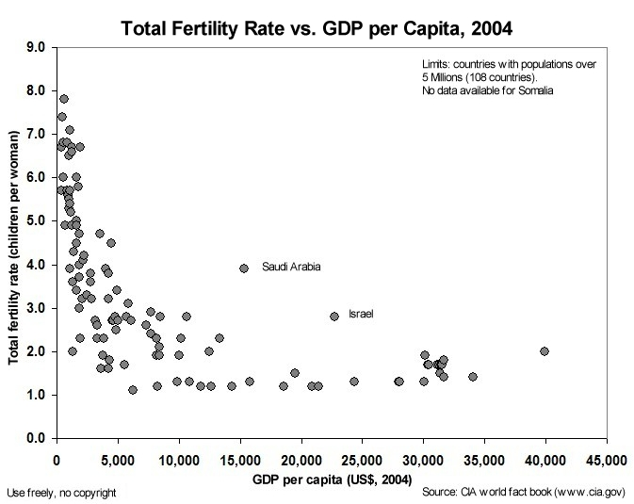
The demographic transition is often an economic transition

Slide 52
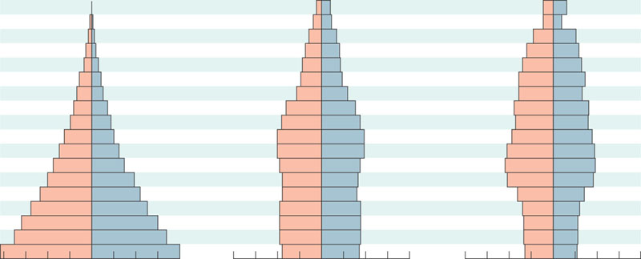
A relatively good predictor of a human (or animal) population growth rate is the age structure (or age pyramid).
Rapid growth Afghanistan
Slow growth United States
Decrease Italy
Male
Female
Age
Male
Female
Age
Male
Female
85+
85+
80–84
80–84
75–79
75–79
70–74
70–74
65–69
65–69
60–64
60–64
55–59
55–59
50–54
50–54
45–49
45–49
40–44
40–44
35–39
35–39
30–34
30–34
25–29
25–29
20–24
20–24
15–19
15–19
10–14
10–14
5–9
5–9
0–4
0–4
8
6
4
2
0
2
4
6
8
8
6
4
2
0
2
4
6
8
8
6
4
2
0
2
4
6
8
Percent of population
Percent of population
Percent of population
2.6% per year
0.6% per year
-0.1% per year

Slide 53
Why?
Rapid growth Afghanistan
Slow growth United States
Decrease Italy
Male
Female
Age
Male
Female
Age
Male
Female
85+
85+
80–84
80–84
75–79
75–79
70–74
70–74
65–69
65–69
60–64
60–64
55–59
55–59
50–54
50–54
45–49
45–49
40–44
40–44
35–39
35–39
30–34
30–34
25–29
Reproductive
25–29
20–24
20–24
15–19
15–19
10–14
10–14
5–9
Soon to be reproductive
5–9
0–4
0–4
8
6
4
2
0
2
4
6
8
8
6
4
2
0
2
4
6
8
8
6
4
2
0
2
4
6
8
Percent of population
Percent of population
Percent of population

Slide 54
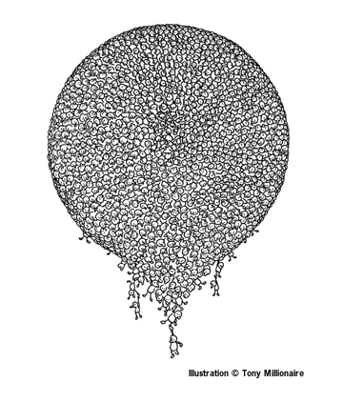
Projected Population Growth in the United States
2000 275,306,000
2010 299,862,000
2020 324,927,000
2030 351,070,000
2040 377,350,000
2050 403,687,000
2060 432,011,000
2070 463,639,000
2080 497,830,000
2090 533,605,000
2100 570,954,000
US Census Bureau -January 13, 2000The highest projection has 553 million people in 2050 and 1.2 BILLION in 2100
THINK ABOUT IT!

Slide 55
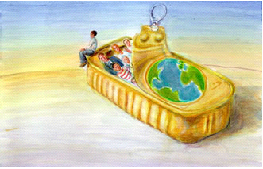
Is there a human carrying capacity? Is there a humane carrying capacity?
What kind of world do we want to live in?

Slide 56
Study questions
Define the following terms: population, population density, population dispersion.
Explain with examples the meaning of the terms clumped, uniform, and random as they refer to the spatial distribution of individuals in a population.
What are the inputs and outputs of individuals into a population.
What is demography?
Explain the differences between type I, II, and III survivorship curves.
A population grows exponentially at about 2% per year (R=1.02). Assume that the population starts with 15 individuals. How many individuals will it have after 10 years? After 20 years? How long will it take for the population to double?
What are the conditions that lead to exponential population growth?
Explain the term negative density dependence.
Explain logistic (or sigmoidal) population growth using a graph. Label K.
Define carrying capacity (K)
Explain the meaning of the terms r and K selection and describe the situations that may favor each strategy. Provide examples.
Describe the life history of Antechinus stuartii
What does the term semelparous mean? Give two examples of semelparous animals.
What does the term iteroparous mean?
Explain the meaning of the expression “demographic transition”.
From a comparative examination of the age structure of two countries, you should be able to say which one has the higher population growth.

