Slide 1
Nervous Systems
(Chapter 45)
Today’s lecture
-What are nervous systems for
-A diversity of nervous system organizations
-Information processing
-A review of neuron structure
-Resting Potential
-Action potentials
-Synapses and neurotransmitters
-The vertebrate nervous system
-Peripheral
-Central

Slide 2
Nervous systems are the structures that animals use to
-Sense the world around them (in the form of stimuli)
And
-React rapidly to these stimuli.
Nervous systems complement endocrine systems (which in general act more slowly). Whereas endocrine systems depend on chemicals to convey a message, nervous systems use electrical signals.
All animals but sponges have nervous systems. However not all nervous systems are designed in the same way.

Slide 3
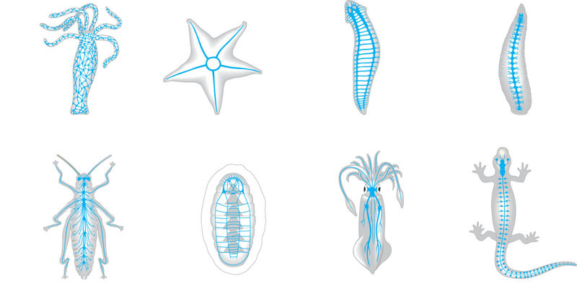
Eyespot
Brain
Brain
Radial
nerve
Nerve
cord
Ventral
nerve
cord
Nerve
ring
Transverse
nerve
Nerve net
Segmental
ganglion
(a) Hydra (cnidarian)
(b) Sea star (echinoderm)
(c) Planarian (flatworm)
(d) Leech (annelid)
Brain
Brain
Ganglia
Ventral
nerve
cord
Anterior
nerve ring
Brain
Spinal
cord
(dorsal
nerve
cord)
Sensory
ganglion
Longitudinal
nerve cords
Ganglia
Segmental
ganglia
(e) Insect (arthropod)
(f) Chiton (mollusc)
(g) Squid (mollusc)
(h) Salamander (chordate)
Cnidarians contain diffuse nerve nets (nerves are fiber-like bundles of neurons). Animals with distinct cephalization (annelids, arthropods, vertebrates) have a central nervous system (CNS) which consists of one brain and one (sometimes 2) longitudinal nerve chord(s). The nerves that connect the CNS with the rest of the body comprise the peripheral nervous system (PNS).

Slide 4
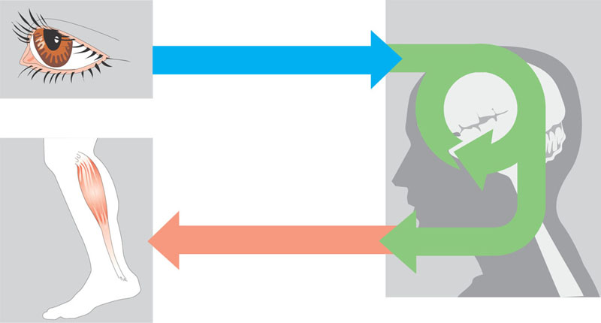
Nervous systems can be characterized as information processing structures. In general, the PNS (peripheral nervous system) does two things:
1) It senses inputs (it has sensory neurons)
And
2) It relays inputs to muscles or glands (motor neurons)
The CNS (central nervous system) integrates sensory inputs and produces motor outputs.
Afferent
Sensory input
Sensor
Integration
Motor output
Efferent
Effector
Peripheral nervous
system (PNS)
Central nervous
system (CNS)

Slide 5
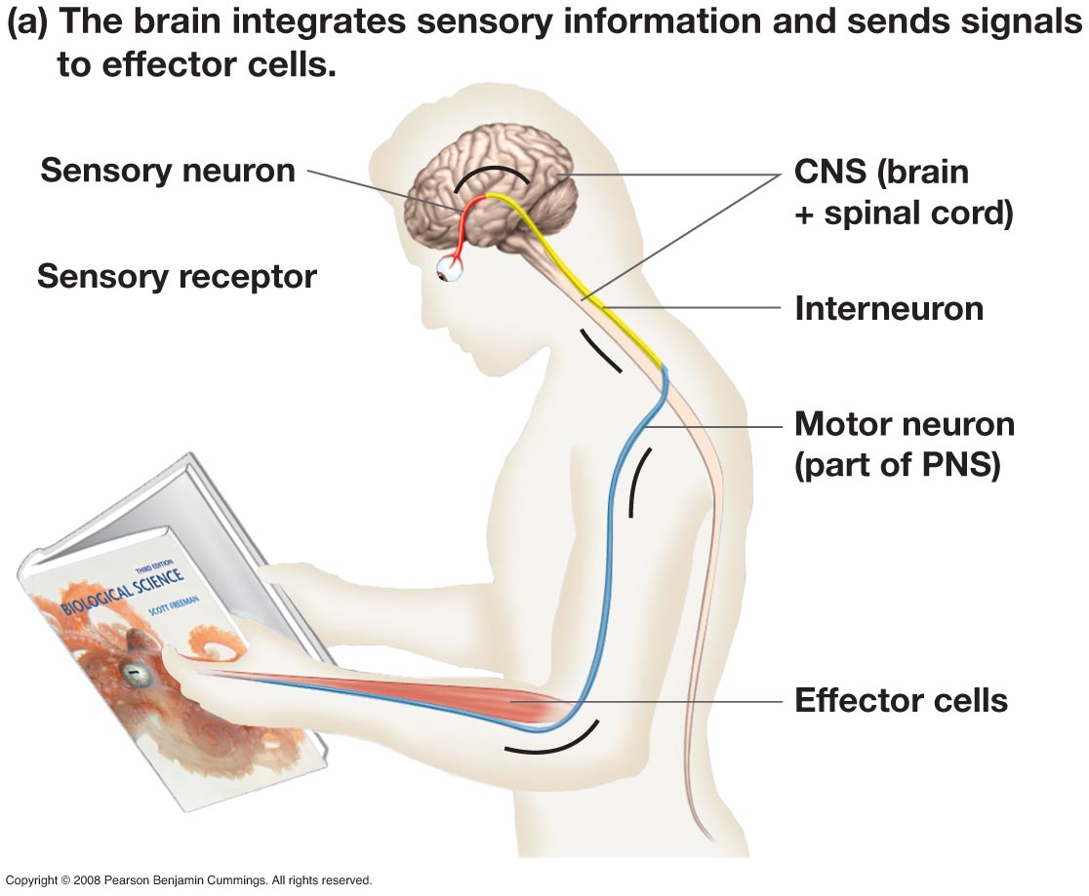

Slide 6
TO REMEMBER
-Animals use nervous systems to sense the world around them (in the form of stimuli) and to react rapidly to these stimuli.
-Cnidarians have diffuse nervous systems, most other animals have cephalization (a CNS, brain and nerve chords) and a PNS.
The CNS (central nervous system) integrates sensory inputs and produces motor outputs. The PNS (peripheral nervous system) senses inputs (it has sensory neurons)
And it relays inputs to muscles or glands (motor neurons).

Slide 7
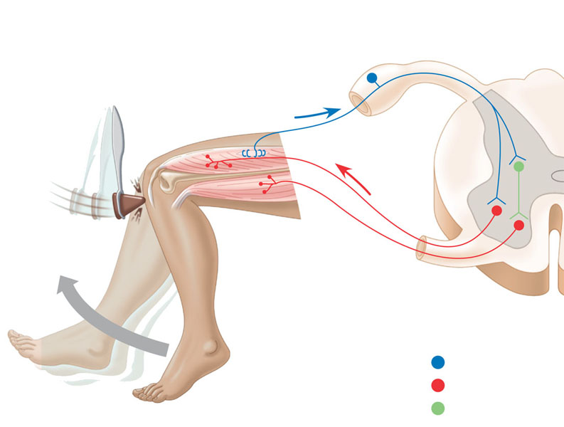
The simplest form of response to a stimulus is called a reflex. The knee-jerk reflex is a great example.
3
2
Sensory neurons
convey the information
to the spinal cord.
4
Sensors detect
a sudden stretch in
the quadriceps.
The sensory neurons communicate with
motor neurons that supply the quadriceps. The
motor neurons convey signals to the quadriceps,
causing it to contract and jerking the lower leg forward.
Cell body of
sensory neuron
in dorsal
root ganglion
Gray matter
5
Sensory neurons
from the quadriceps
also communicate
with interneurons
in the spinal cord.
Quadriceps
muscle
White
matter
Hamstring
muscle
6
The interneurons
inhibit motor neurons
that supply the
hamstring (flexor)
muscle. This inhibition
prevents the hamstring
from contracting,
which would resist
the action of
the quadriceps.
Spinal cord
(cross section)
Sensory neuron
Motor neuron
1
The reflex is
initiated by tapping
the tendon connected
to the quadriceps
(extensor) muscle.
Interneuron

Slide 8
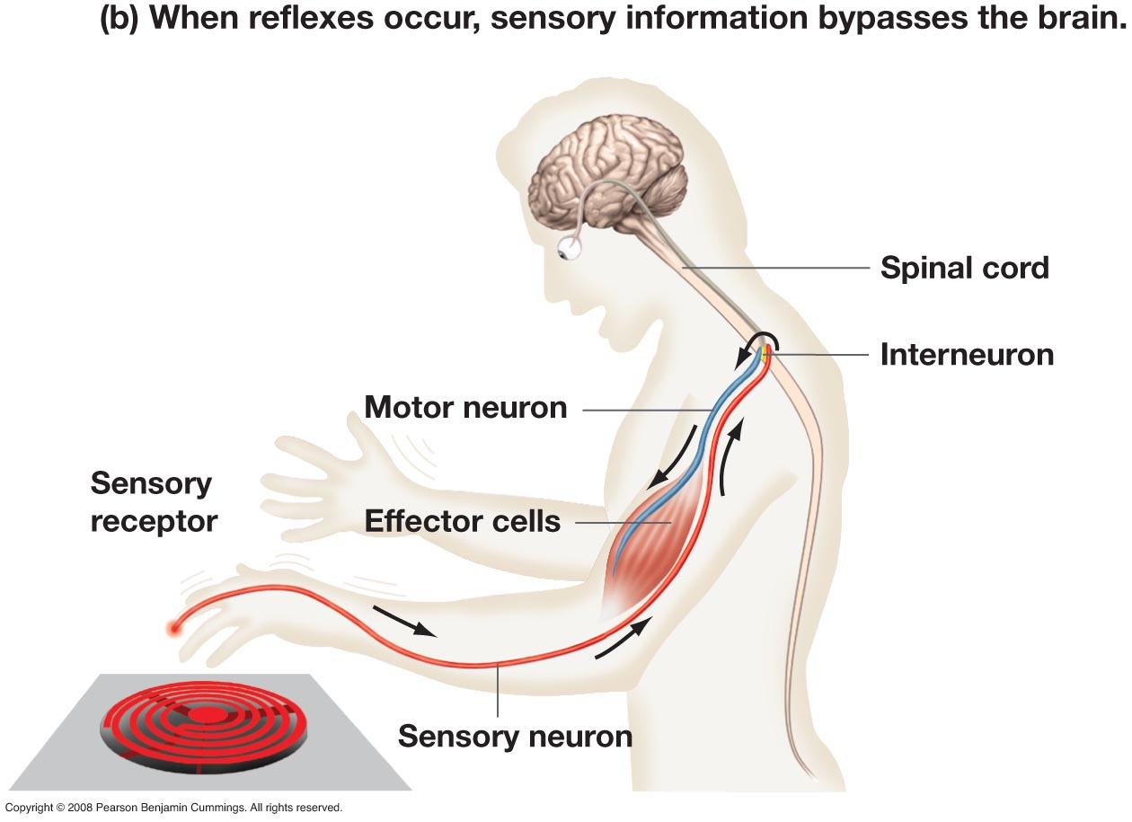

Slide 9
TO REMEMBER
-The simplest form of a neural response is a reflex.
-A reflex has the following elements: 1) stimulus, 2) sensory neurons, 3) motor neurons which interact with an effector muscle (or muscle system), 4) interneurons, which act on motor neurons to inhibit the antagonist/opposite muscle (system).

Slide 10
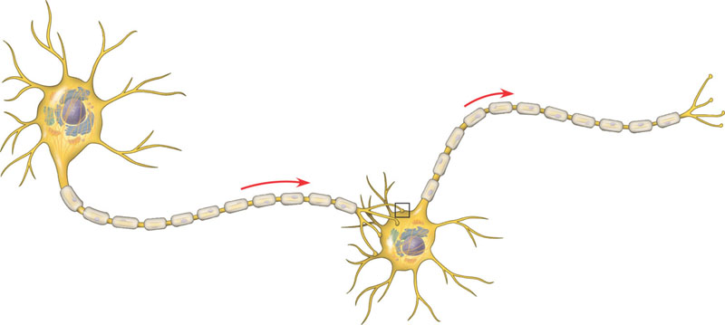
Dendrites
Cell body
Nucleus
Synapse
Signal
direction
Axon
Axon hillock
Presynaptic cell
Postsynaptic cell
Myelin sheath
Synaptic
terminals
The nervous system is made of neurons. Neurons have a) cell bodies, b) dendrites (receive signals), c) axons (transmit signals), d) axon hillock (where the message transmitted is initiated). Near its end the axon divides into several branches, each of which ends in a synaptic terminal. The site of communication between a transmitting cell (a presynaptic neuron) and a receiving one (a postsynaptic cell) is called the synapse.

Slide 11
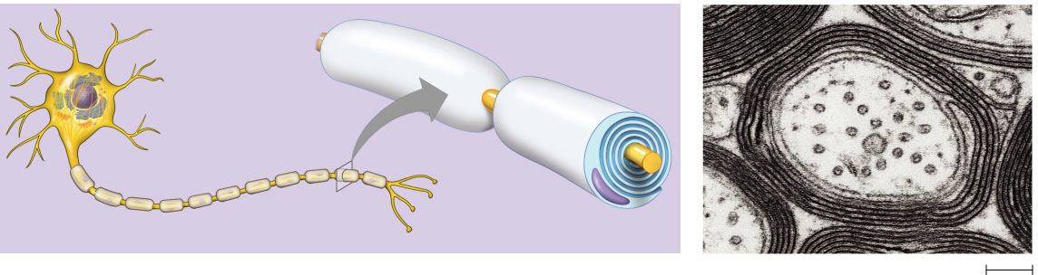
Node of Ranvier
Layers of myelin
Axon
Schwann
cell
Schwann
cell
Nodes of
Ranvier
Nucleus of
Schwann cell
Axon
Myelin sheath
0.1 µm
In vertebrates, axons are surrounded by concentric membrane bands called myelin sheaths made by Schwann Cells (PNS) and Oligodendrocytes (CNS). The material of the sheaths is called myelin (phospholipid) and acts as an insulator ( a bit like insulation tape). The bare spots between myelin sheaths are called nodes of Ranvier.
Only vertebrates have myelinated neurons. Myelination permits faster relay of an action potential.

Slide 12
TO REMEMBER
-The nervous system is made of neurons.
Neurons have a) cell bodies, b) dendrites (receive signals), c) axons (transmit signals), d) axon hillock (where the message transmitted is initiated). Axons divide into several branches, each of which ends in a synaptic terminal. The site of communication between a transmitting cell (a presynaptic neuron) and a receiving one (a postsynaptic cell) is called the synapse.
Axons are surrounded by myelin sheaths made by Schwann Cells (PNS) and Oligodendrocytes (CNS) made of myelin (phospholipid) which acts as an insulator ( a bit like insulation tape). The bare spots between myelin sheaths are called nodes of Ranvier.

Slide 13
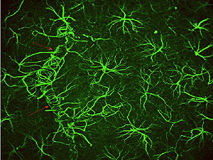
Glial (glia means glue) cells provide structural support. There are several types of glial cells:
Astrocytes (structural support and regulation of extracellular concentration of ions and neurotransmitters CNS).
Oligodendrocytes (insulation of axons CNS)
And
Schwan cells (insulation of axons
PNS)
Astrocytes

Slide 14
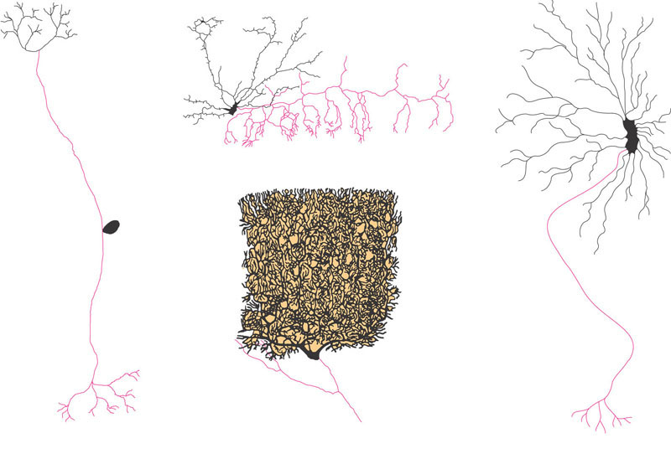
Dendrites
Axon
Cell
body
(a) Sensory neuron
(b) Interneurons
(c) Motor neuron
Neurons differ quite a bit in morphology depending on their function.

Slide 15
TO REMEMBER
-The central nervous system also has glial cells which provide structural support.
-In the CNS the types of glial cells are: astrocytes and oligodendrocytes. In the PNS the glial cells are the Schwan cells.
-Neurons differ in morphology depending on their function. Please remember the morphology of sensory neurons, interneurons, and motor neurons.

Slide 16
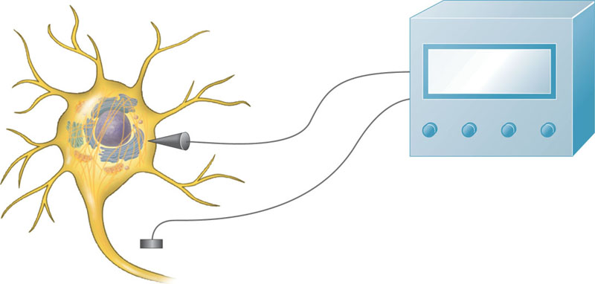
Neurons communicate with each other by “electrical” impulses. To understand them, we first need to understand the term “resting potential”.
Microelectrode
–70 mV
Voltage
recorder
Reference
electrode
Most cells including nerve cells are negatively charged (the interior of the cell adjacent to the membrane is more negatively charged than the outside).
Why?

Slide 17
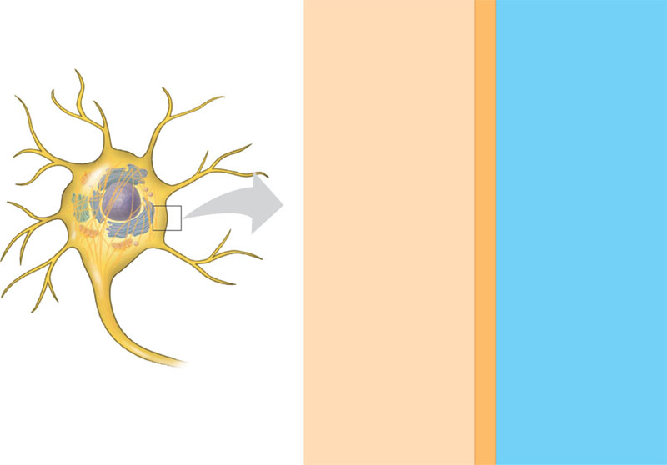
CYTOSOL
EXTRACELLULAR
FLUID
[Na⁺]
15 mM
–
+
[Na⁺]
150 mM
[K⁺]
150 mM
–
+
[K⁺]
5 mM
–
+
[Cl–]
10 mM
[Cl–]
120 mM
–
+
[A–]
100 mM
–
+
Plasma
membrane
Neurons are more negatively charged because there are large gradients in ion concentrations. Why? Partially as a result of the action of the Na+/K+ pump (remember?).

Slide 18
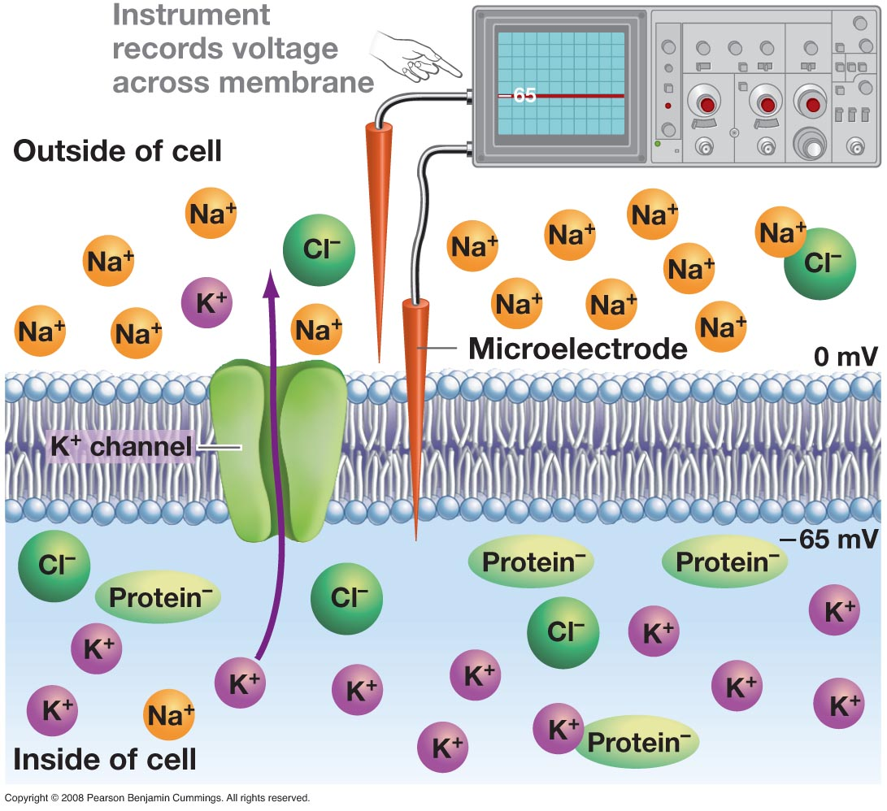

Slide 19
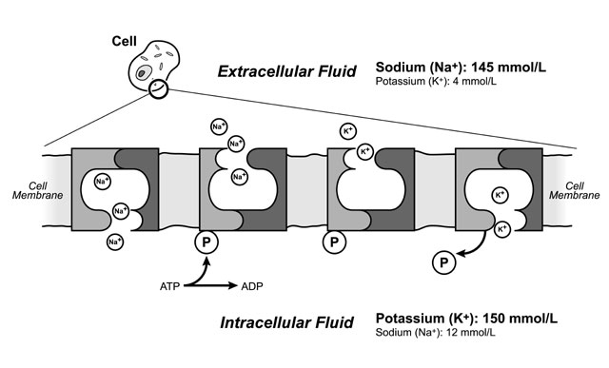
The NA+/K+ pump uses energy to take Na+ (3 out) out and bring K+ (2 in) into the cell.

Slide 20
CYTOSOL
EXTRACELLULAR
FLUID
[Na⁺]
15 mM
–
+
[Na⁺]
150 mM
[K⁺]
150 mM
–
+
[K⁺]
5 mM
–
+
[Cl–]
10 mM
[Cl–]
120 mM
–
+
[A–]
100 mM
–
+
Plasma
membrane
THINGS TO REMEMBER
-The resting potential of cells is negative (-80 to -60 mV). Cells are hyperpolarized.
-The concentration of potassium (K+) is much higher (by 30 times) inside of the cell (≈150 mM) than outside of the cell (5 mM).
-The concentration of sodium is much lower (by 10 times) inside of the cell (15 mM) than outside of the cell (≈ 150 mM).

Slide 21
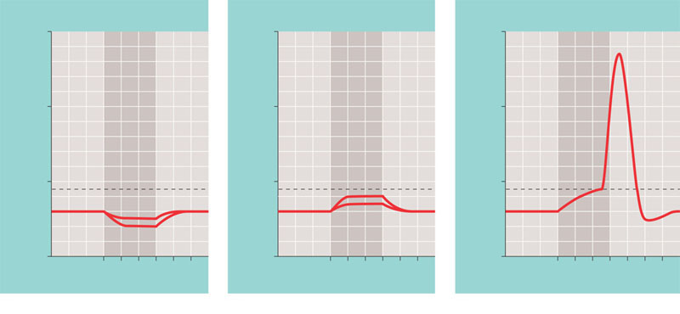
Neurons transmit a signal by changing the charge of their membranes. This is called an Action Potential.
Stimuli
Stimuli
Stronger depolarizing stimulus
+50
+50
+50
Action
potential
0
0
0
Membrane potential (mV)
Membrane potential (mV)
Membrane potential (mV)
–50
Threshold
–50
Threshold
–50
Threshold
Resting
potential
Resting
potential
Depolarizations
Resting
potential
Hyperpolarizations
–100
–100
–100
0 1 2 3 4 5 6
0 1 2 3 4 5
0 1 2 3 4 5
Time (msec)
Time (msec)
Time (msec)
(a) Graded hyperpolarizations
produced by two stimuli that
increase membrane permeability
to K⁺. The larger stimulus produces
a larger hyperpolarization.
(b) Graded depolarizations produced
by two stimuli that increase
membrane permeability to Na+.
The larger stimulus produces a
larger depolarization.
(c) Action potential triggered by a
depolarization that reaches the
threshold.
If you stimulate a cell by changing its charge from negative (hyperpolarized) to positive (depolarized) and if the stimulus is strong enough to reach a threshold then the cell shows a spike of depolarization.
Action potentials are all or nothing.

Slide 22
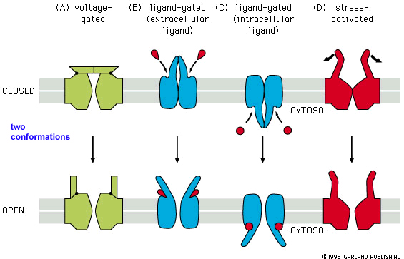
To understand how this happens, we need to introduce the idea of gated channels.

Slide 23
REMEMBER
Gated ion channels are proteins that allow ions to move in and out of cells in response to a stimulus.
They can be
-Stretch-gated ion channels (they respond to mechanical stimuli)
-Ligand-gated ion channels (they respond to the presence of a chemical called the ligand)
And
-Voltage-gated channels (found in neurons, they respond to changes in the membrane potential of a cell).

Slide 24
Neurons transmit a signal by changing the charge of their membranes. This is called an Action Potential.
Stimuli
Stimuli
Stronger depolarizing stimulus
+50
+50
+50
Action
potential
0
0
0
Membrane potential (mV)
Membrane potential (mV)
Membrane potential (mV)
–50
Threshold
–50
Threshold
–50
Threshold
Resting
potential
Resting
potential
Depolarizations
Resting
potential
Hyperpolarizations
–100
–100
–100
0 1 2 3 4 5 6
0 1 2 3 4 5
0 1 2 3 4 5
Time (msec)
Time (msec)
Time (msec)
(a) Graded hyperpolarizations
produced by two stimuli that
increase membrane permeability
to K⁺. The larger stimulus produces
a larger hyperpolarization.
(b) Graded depolarizations produced
by two stimuli that increase
membrane permeability to Na+.
The larger stimulus produces a
larger depolarization.
(c) Action potential triggered by a
depolarization that reaches the
threshold.
If you stimulate a cell by changing its charge from negative (hyperpolarized) to positive (depolarized) and if the stimulus is strong enough to reach a threshold then the cell shows a spike of depolarization.

Slide 25
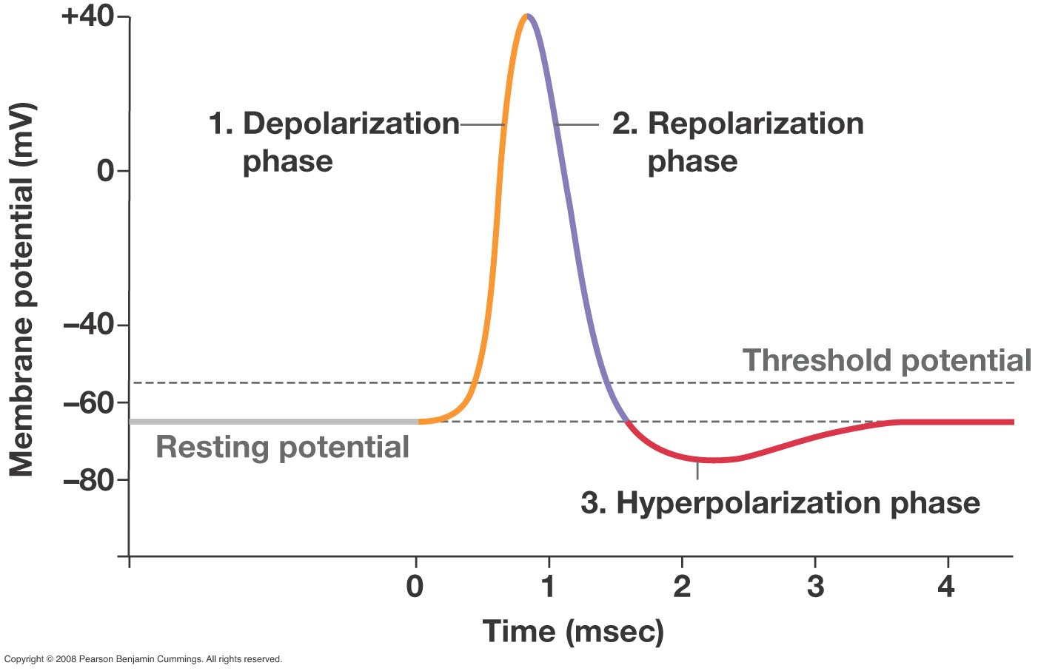
The anatomy of an action potential

Slide 26
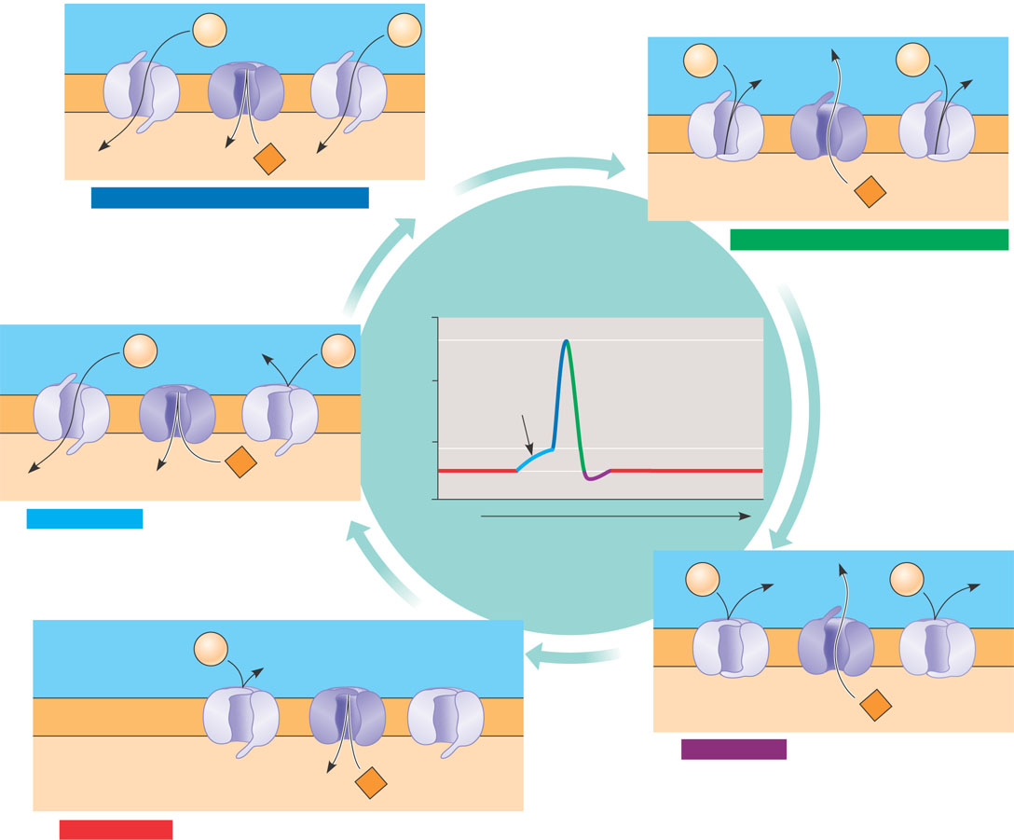
Na⁺
Na⁺
– –
– –
– –
– –
Na⁺
Na⁺
+ +
+ +
+ +
+ +
+ +
+ +
+ +
+ +
K⁺
– –
– –
– –
– –
3
Rising phase of the action potential
K⁺
Depolarization opens more of the activation gates for Na+. The membrane potential becomes more +
(cell depolarizes).
4
Falling phase of the action potential
The inactivation gates of Na⁺ close, the K⁺ voltage-gated channels open. The cell hyperpolarizes.
+50
Action
potential
Na⁺
Na⁺
+ +
+ +
+ +
+ +
0
3
Membrane potential
(mV)
2
4
Threshold
– –
– –
– –
– –
–50
Threshold
K⁺
1
5
1
–100
Resting potential
2
Depolarization
Time
A stimulus opens the activation of Na+ if a threshold is reached it triggers and action potential
Na⁺
Na⁺
+ +
+ +
+ +
+ +
Extracellular fluid
Potassium
channel
Activation
gates
Na⁺
+ + + + + + + +
+ +
+ +
+ +
– –
– –
– –
– –
Plasma membrane
K⁺
– – – – – – – –
– –
– –
– –
5
Undershoot
Cytosol
Sodium
channel
K⁺
Inactivation
gate
1
Resting state
The activation gates on the Na+ and K+ voltage-gated channels are closed

Slide 27
Na⁺
Na⁺
– –
– –
– –
– –
Na⁺
Na⁺
+ +
+ +
+ +
+ +
+ +
+ +
+ +
+ +
K⁺
– –
– –
– –
– –
3
Rising phase of the action potential
K⁺
Depolarization opens more of the activation gates for Na+. The membrane potential becomes more +
4
Falling phase of the action potential
The inactivation gates of Na+ close, the K+ voltage-gated channels open. The cell hyperpolarizes.
+50
Action
potential
Na⁺
Na⁺
+ +
+ +
+ +
+ +
0
3
Membrane potential
(mV)
2
4
Threshold
– –
– –
– –
– –
–50
Threshold
K⁺
1
5
1
–100
Resting potential
2
Depolarization
Time
A stimulus opens the activation gates of some Na+ channels. If a threshold is reached it triggers an action potential
Na⁺
Na⁺
+ +
+ +
+ +
+ +
Extracellular fluid
Potassium
channel
Activation
gates
Na⁺
+ + + + + + + +
+ +
+ +
+ +
– –
– –
– –
– –
Plasma membrane
K⁺
– – – – – – – –
– –
– –
– –
5
Undershoot
Cytosol
Sodium
channel
K⁺
Inactivation
gate
1
Resting state
The activation gates on the Na+ and K+ voltage-gated channels are closed

Slide 28
To remember:
The Na+ voltage-gated channels have two gates: an activation gate and a deactivation gate.
The K+ channels only have one gate.
Please read and understand figure 48.13!!!

Slide 29
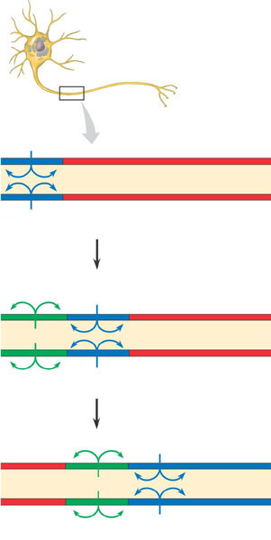
How are action potentials conducted along an axon…
Axon
1
An action potential is generated
as Na⁺ flows inward across the
membrane at one location.
Action
potential
–
–
+
+
+
+
+
+
+
+
–
–
–
–
–
–
Na⁺
–
–
–
–
–
–
+
+
–
–
+
+
+
+
+
+
The depolarization of the action
potential spreads to the neighboring
region of the membrane, re-initiating
the action potential there. To the left
of this region, the membrane is
repolarizing as K⁺ flows outward.
2
Action
potential
K⁺
+
+
–
–
+
+
+
+
–
–
+
+
–
–
–
–
–
–
Na⁺
–
–
–
–
+
+
+
+
–
–
+
+
+
+
K⁺
The depolarization-repolarization process is
repeated in the next region of the
membrane. In this way, local currents
of ions across the plasma membrane
cause the action potential to be propagated
along the length of the axon.
3
Action
potential
K⁺
+
+
+
+
–
–
–
–
–
–
–
–
+
+
+
+
–
–
–
–
Na⁺
+
+
+
+
+
+
+
+
–
–
–
–
K⁺

Slide 30
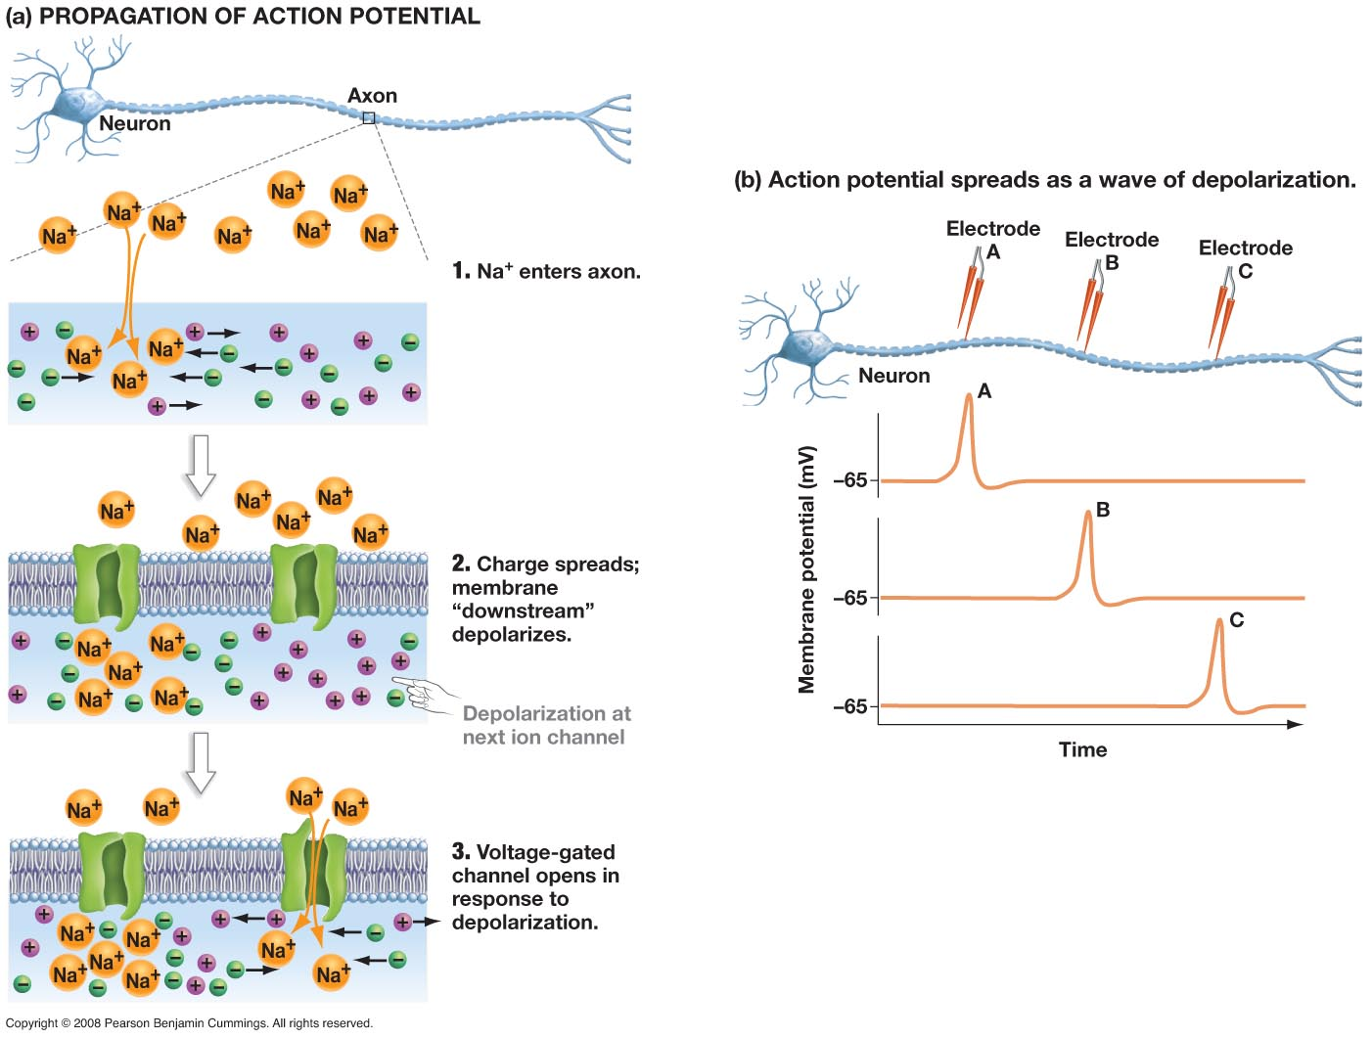

Slide 31
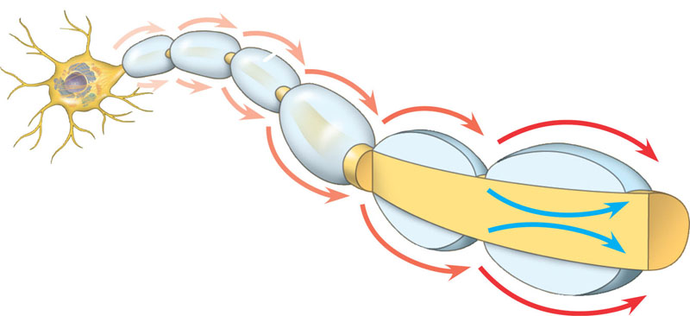
Schwann cell
Depolarized region
(node of Ranvier)
Myelin
sheath
–
–
–
–
+
+ +
–
–
Cell body
+
+
+
+ +
–
Axon
–
–
+
+ +
–
–
–
In myelinated axons the ion current during an action potential at one node of Ranvier spreads along the interior of the axon to the next node (see the blue arrows) triggering an action potential there. The gated Na+ and K+ channels are only at the nodes. Thus the action potential “jumps” from one node of Ranvier to the other. This form of conduction is called “saltatory conduction”. Saltatory conduction greatly increases the speed at which a signal is conducted along an axon.

Slide 32
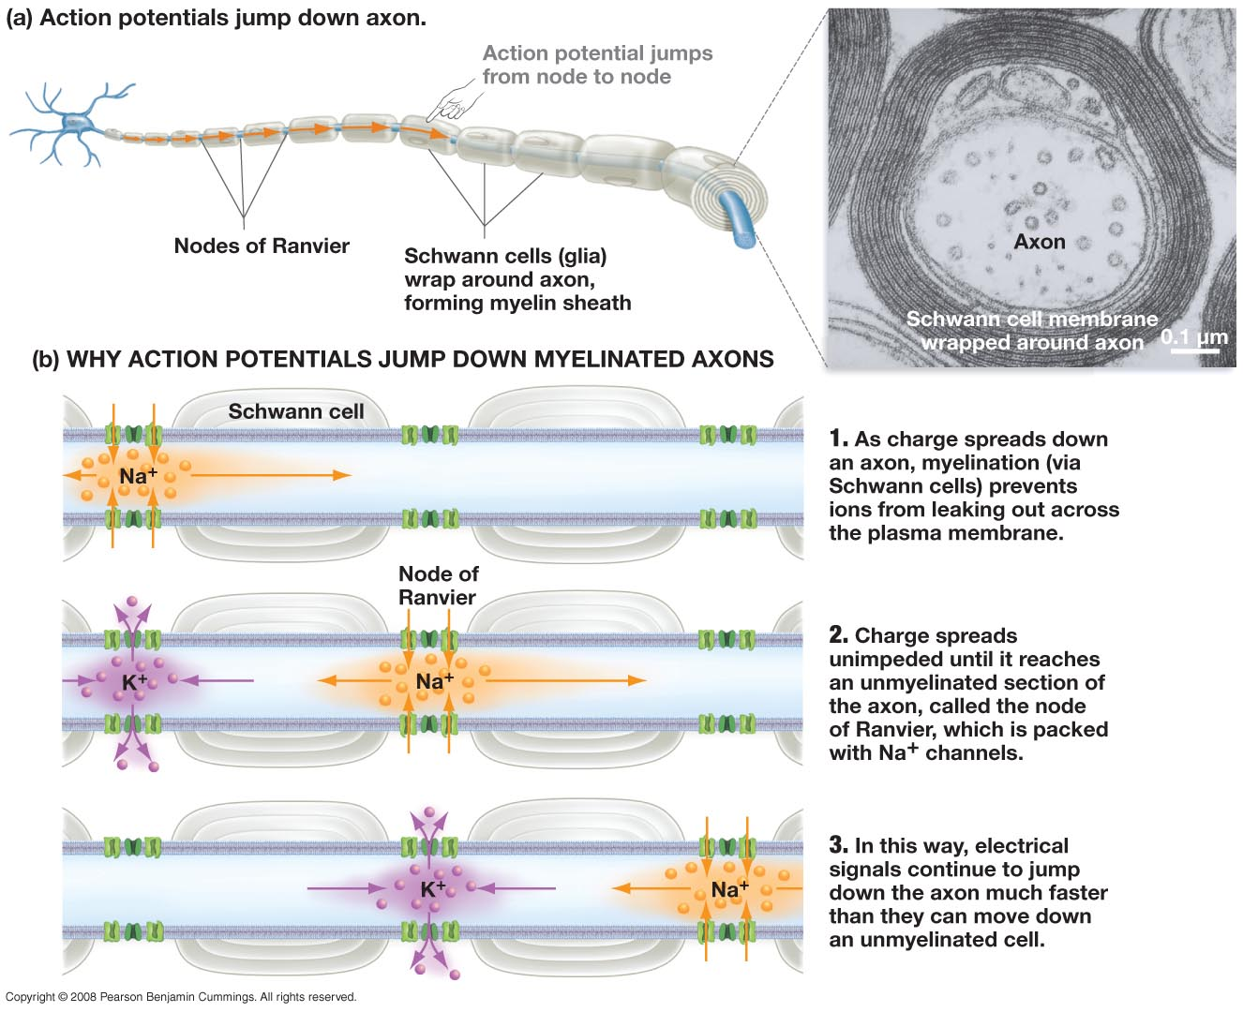

Slide 33
How do neurons communicate with other neurons and with other cells at synapses?
Dendrites
Cell body
Nucleus
Synapse
Signal
direction
Axon
Axon hillock
Presynaptic cell
Postsynaptic cell
Myelin sheath
Synaptic
terminals

Slide 34
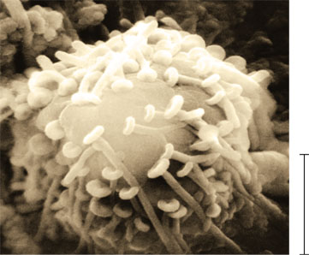
Postsynaptic
neuron
Synaptic
terminal
of presynaptic
neurons
5 µm

Slide 35
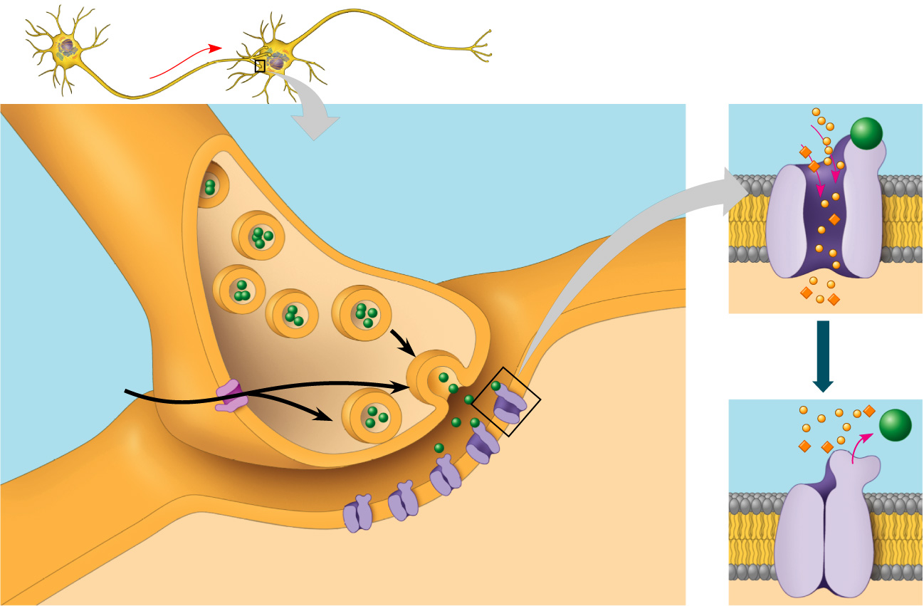
Presynaptic
cell
Postsynaptic cell
Synaptic vesicles
containing
neurotransmitter
5
Na⁺
Neuro-
transmitter
K⁺
Presynaptic
membrane
Postsynaptic
membrane
Ligand-
gated
ion channel
Voltage-gated
Ca²⁺ channel
1
Ca²⁺
2
4
Postsynaptic
membrane
6
Synaptic cleft
3
Ligand-gated
ion channels
1) When an AP depolarizes the membrane at the synaptic terminal it 2) opens voltage-gated Ca++ channels, 3) the Ca++ that gets in causes vesicles full of neuro-transmitter to empty (4). The neurotransmitter binds to ligand-gated ion channels. The result is a post-synaptic potential (PSP). PSPs are, unlike action potentials, graded. Sometimes PSPs generate a new AP, but not always.

Slide 36
There is a multitude of neurotransmitters:
Acetylcholine (excites skeletal muscle among other things)
Biogenic Amines (norepinephrine, dopamine, serotonin)
Amino acids (GABBA, glycine, glutamate, aspartate)
Neuropeptides (substance P, some endorphines).
Gases (NO, nitric oxide not to be confused with nitrous oxide).
Neurotransmitters are broken up so that the stimulus is not persistent (acetylcholinase breaks up acetylcholine).

Slide 37
Presynaptic
cell
Postsynaptic cell
Synaptic vesicles
containing
neurotransmitter
5
Na⁺
Neuro-
transmitter
K⁺
Presynaptic
membrane
Postsynaptic
membrane
Ligand-
gated
ion channel
Voltage-gated
Ca²⁺ channel
1
Ca²⁺
2
4
Postsynaptic
membrane
6
Synaptic cleft
3
Ligand-gated
ion channels
1) When an AP depolarizes the membrane at the synaptic terminal it 2) opens voltage-gated Ca++ channels, 3) the Ca++ that gets in causes vesicles full of neuro-transmitter to empty (4). The neurotransmitter binds to ligand-gated ion channels. The result is a post-synaptic potential (PSP). PSPs are, unlike action potentials, graded. Sometimes PSPs generate a new AP, but not always.

Slide 38
To Remember
When an AP depolarizes the membrane at the synaptic terminal it 2) opens voltage-gated Ca++ channels, 3) the Ca++ that gets in causes vesicles full of neuro-transmitter to empty (4). The neurotransmitter binds to ligand-gated ion channels. The result is a post-synaptic potential (PSP). PSPs are, unlike action potentials, graded. Sometimes PSPs generate a new AP, but not always.

Slide 39
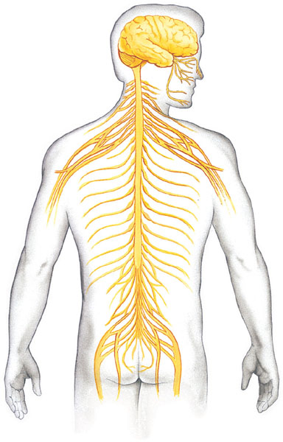
As we discussed before, in many animals (including vertebrates), the nervous system can be divided into the central nervous system (CNS) and the peripheral nervous system (PNS).
Central nervous
system (CNS)
Peripheral nervous
system (PNS)
The CNS has two parts. 1) The brain, which is enclosed within the cranium, and 2) The spinal chord enclosed within the foramen of vertebrae.
The PNS has cranial nerves that originate in the brain and end in organs of the head and upper body and spinal nerves that originate in the spinal chord and extend to parts of the body below the head.
Brain
Cranial
nerves
Spinal cord
Ganglia
outside
CNS
Spinal
nerves

Slide 40
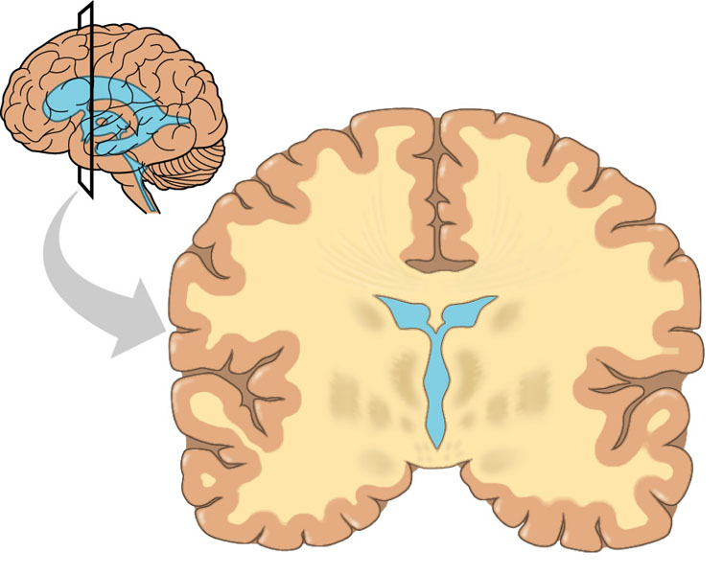
Gray matter
White
matter
Ventricles
In a cross section of the CNS you can see white matter (white from myelin in axons) and gray matter (mainly dendrites, unmyelinated axons, and neuron cell bodies). The spaces within the CNS (central canal and ventricles) are filled with cerebrospinal fluid (CF), formed from filtered blood. The CF has two functions: cushioning and circulation of wastes, nutrients, hormones, and neurohormones.

Slide 41
TO REMEMBER
-The central nervous system (CNS) has two parts: The brain (enclosed in the cranium) and the spinal chord (enclosed within the foramen of vertebrae).
-The peripheral nervous system (PNS) has cranial nerves (start in brain, end up in head and upper body), and spinal nerves (start in spinal chord).
-A cross section of the CNS reveals gray matter (mainly dendrites, unmyelinated axons, and neuron cell bodies), white matter (white from myelin in axons).
-The spaces within the CNS (central canal and ventricles) are filled with cerebrospinal fluid (CF), formed from filtered blood.
-CF has two functions: cushioning and circulation of wastes, nutrients, hormones, and neurohormones.

Slide 42
Central nervous
system (CNS)
Peripheral nervous
system (PNS)
The spinal nerves of the PNS contain both sensory (afferent) and motor (efferent) neurons.
The PNS can be divided into two functional components:
Brain
Cranial
nerves
Spinal cord
Ganglia
outside
CNS
Spinal
nerves
1)The somatic nervous system (carries signals to and from skeletal muscles in response to external stimuli). It is both voluntary and mediated by reflexes.
2) The autonomic nervous system regulates the internal environment by controlling smooth and cardiac muscles and the organs of the digestive, cardiovascular, excretory, and endocrine systems.
By and large the autonomic nervous system is involuntary.

Slide 43
REMEMBER!!!!
1)The somatic nervous system (carries signals to and from skeletal muscles in response to external stimuli). It is both voluntary and mediated by reflexes. Deals with movement.
2) The autonomic nervous system regulates the internal environment by controlling smooth and cardiac muscles and the organs of the digestive, cardiovascular, excretory, and endocrine systems. Deals with internal homeostasis.

Slide 44
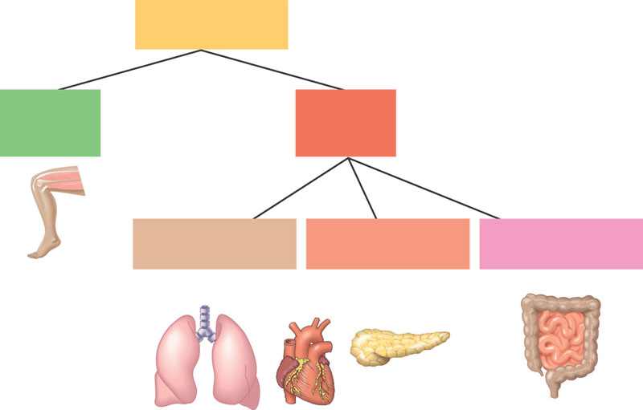
The autonomic nervous system has three divisions
Peripheral
nervous system
Somatic
nervous
system
Autonomic
nervous
system
Sympathetic
division
Parasympathetic
division
Enteric
division
1) the sympathetic (corresponds to arousal/energy generation fight or flight situations. It makes the heart go faster the liver produce glucose, slows digestion,…,etc.).
3) The enteric division innervates the gut, pancreas, and gallbladder. It “talks” with the enteric nervous system.
2) The parasympathetic generally causes the opposite calming/self-maintenance functions (the rest and digest situation?).

Slide 45
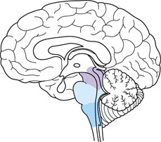
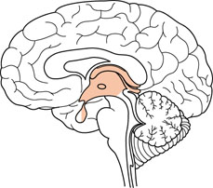
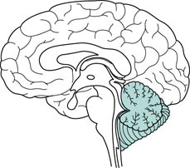
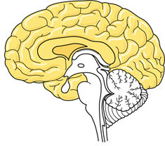
Very broadly speaking the brain can be divided into 4 parts:
The brainstem
(hindbrain)
The diencephalon
The cerebellum
The cerebrum

Slide 46
The brainstem (lower brain) controls breathing, heart and blood vessel activity, swallowing, vomiting, digestion.

Slide 47
The cerebellum is important in coordination, error-checking during motor, perceptual, and cognitive function. Hand-eye coordination is mediated by the cerebellum.

Slide 48
thalamus
pineal gland
The dienecephalon contains the thalamus, epithalamus (including the pineal gland) and hypothalamus. Both the thalamus and hypothalamus are important integrating systems. The thalamus is main input center for sensory information. The hypothalamus is involved in:
-hunger and thirst.
-thermoregulation
-produces many important hormones
-mediates sexual behavior.
hypothalamus
pituitary

Slide 49
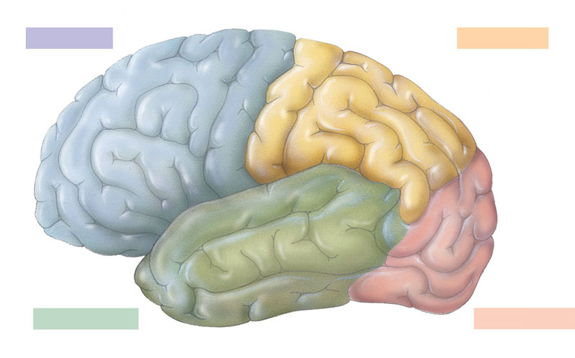
The cerebrum is divided into hemispheres (left and right) and does all sort of things. The human cerebral cortex controls voluntary movement and cognitive functions.
Frontal lobe
Parietal lobe
Motor cortex
Somatosensory
association
area
Frontal
association
area
Somatosensory cortex
Speech
Taste
Speech
Reading
Hearing
Visual
association
area
Smell
Auditory
association
area
Vision
Temporal lobe
Occipital lobe

Slide 50
Sorry for the very superficial treatment! You will get more information when you take physiology!!!
Next…Sensory Systems. Please read chapter 46

Slide 51
Biol 2022, Lecture 21
Study questions
1) How do glial cells differ from neurons?
2) What are the 3 parts of a neuron? What are the functions of the axon and dendrites?
3) What types of cells are excitable?
4) How does the resting membrane potential of a neuron come about? Be able to discuss the role of ion concentrations (Na+, K+, A-, Cl-), and selective permeability of the plasma membrane.
5) How does active transport maintain the resting membrane potential? What is the resting membrane potential in millivolts?
6) What is an action potential? What is its’ function?
7) During an action potential, what happens during depolarization? Repolarization?
8) How are action potentials conducted:
a. Along unmylenated axons?
b. Along mylenated axons?
9) How does an action potential “move” from cell to cell when there are spaces between cells called synapses?
10) What are the components of the central nervous system (CNS)?
11) Be able to identify the fore, mid, and hindbrain in a figure. Name one structure and and its’ function for each part of the brain.
12) How do the sensory and motor systems differ?
13) In the motor system, how do somatic and autonomic nerves differ?
14) In autonomic nerves, how do the sympathetic and parasympathetic nerves differ? Be able to give examples of each type.

