Slide 1
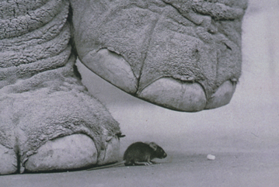
The importance of body size
(p. 811-813)

Slide 2
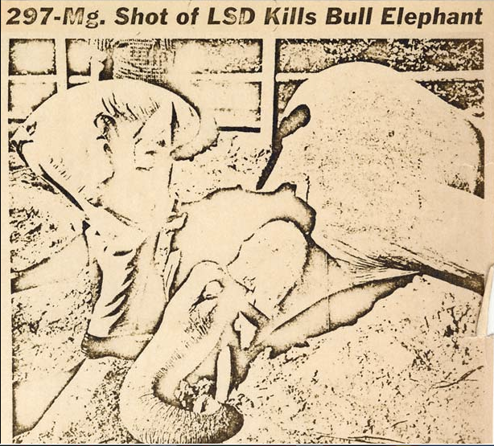
The sad history of an elephant and LSD
In 1962 a group of “researchers” (led by a psychiatrist called Jolly West) injected a poor elephant (named Tusko) with 297 mg of LSD. They wanted to know if LSD induced musth in elephants. After being darted with an LSD-containing syringe, the elephant
“…trumpeted, collapsed, fell heavily into its right side, defecated, and died.”
Why did the “researchers” use 297 mg?

Slide 3
A previous study found that a dose of 0.1 mg was safe for 2.6 kg cats, but was sufficient to produce a psychotic effect. Poor old Tusko weighed 7722 kg, and hence Jolly and his collaborators decided to “scale-up” the dose by 2970 times.
0.1 (mg/cat)X(7722/2.6) = 0.1x2970=297
How big Tusko was relative to the cat….
Is this a good way to estimate a potential dose?

Slide 4
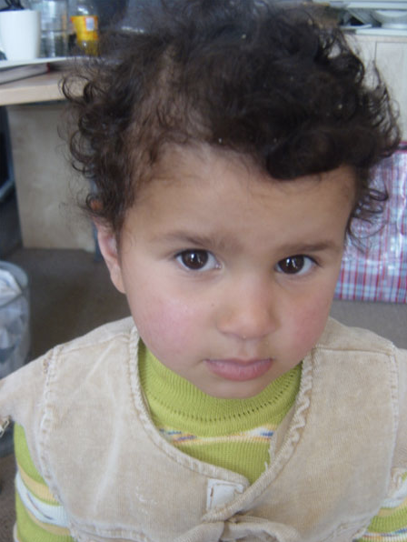
If a 3 year old child weighs 20 kg should we give her about one third (I.e. 20/70=0.28) of the dose of a medicine that we give a 70 kg adult?

Slide 5
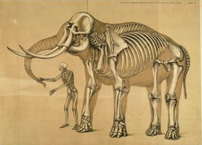
Back to Tusko…
Infamous Dr. West could have designed
a dose based on the following criteria:
Body weight 297 mg
Metabolic rate 80 mg
Brain size (elephant/cat) 0.4 mg
I hope to have convinced you that “scaling-up” a physiological process (and hence a dose) is not trivial. Body mass is the main determinant of the magnitude of most physiological processes (such as metabolic rate), but these processes often do NOT vary in direct proportion with body mass.

Slide 6
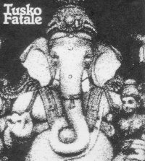


Slide 7
Why is body mass important:
Because animals vary a lot in mass
And
2) Because the magnitude of many biological/physiological processes depends on body mass.

Slide 8
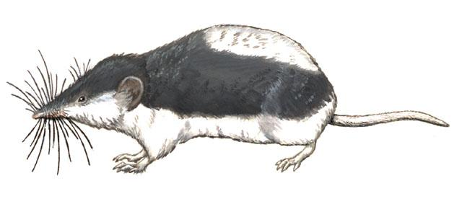

A male African elephant (Loxodonta africana) weighs 11,000 kg, whereas a piebald shrew (Diplomosedon pulchellum) weighs 11 g.
These animals differ in body mass by
3 orders of magnitude
A factor of 1000
6 orders of magnitude
A factor of 10,000
A factor of 6,000

Slide 9
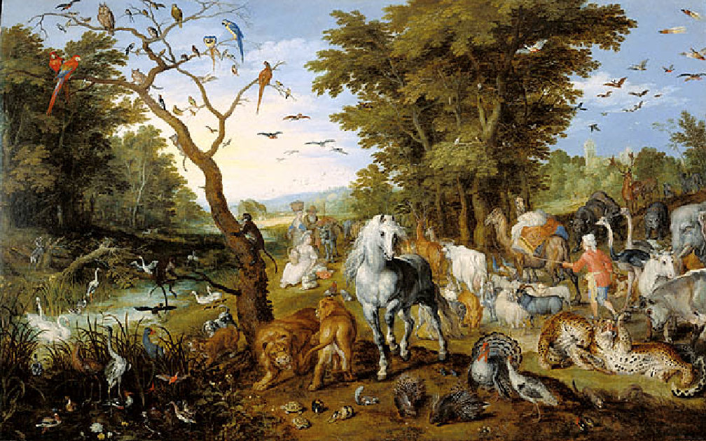
From bacteria (≈ 10⁻¹³ g) to whales (10⁸ g), organisms vary in body mass by more than 21 orders of magnitude;
That is by a factor of
1, 000, 000, 000, 000, 000, 000, 000.
Noah’s Ark
By
Jan Brueghel

Slide 10
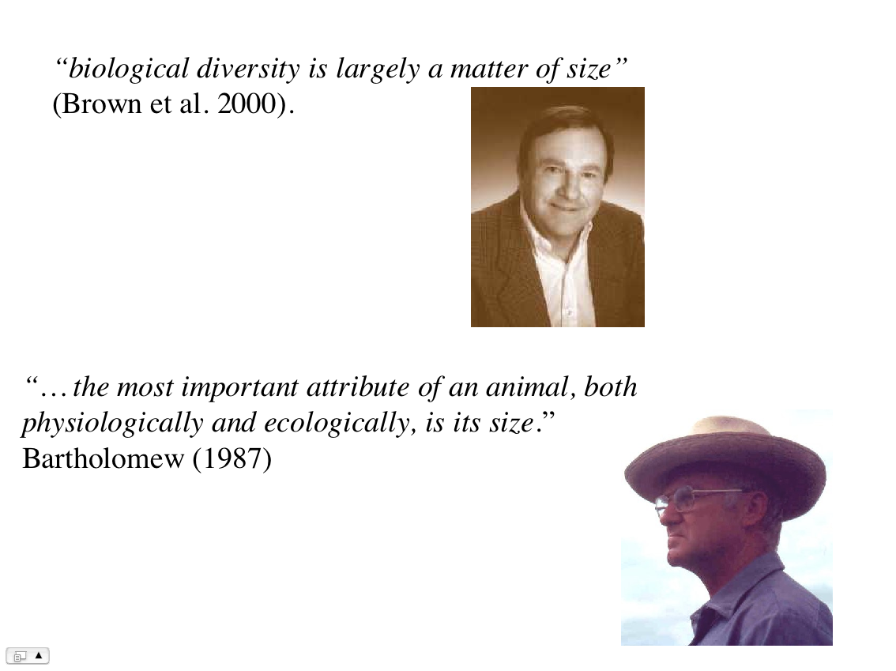

Slide 11
The Importance of Body Mass
-The principle of geometric similarity
-Surface to volume(mass) relationships
-How do animals maximize exchange areas?
-Metabolic Rate and body mass

Slide 12
Overall message for this lecture
Body mass matters for biology because:
It determines the surface/volume ratio of an organism.
And
2) It determines its metabolic rate (how much energy the animal uses (many things stem from this…).

Slide 13
BROAD PRINCIPLE
Body size matters!
-We can tell a lot (a lot!!) about an animal’s biology, from its size.

Slide 14
Understanding the biological importance of body mass requires that we spend a bit of time discussing simple mathematics.

Slide 15
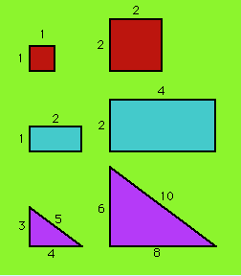
BROAD PRINCIPLE
The principle of geometric similarity
2/2=1/1
4/2 =2/1
10/6=5/3
If two objects have the same shape, they are said to be “geometrically similar”. The ratio of two linear dimensions will be the same for two geometrically similar objects.

Slide 16
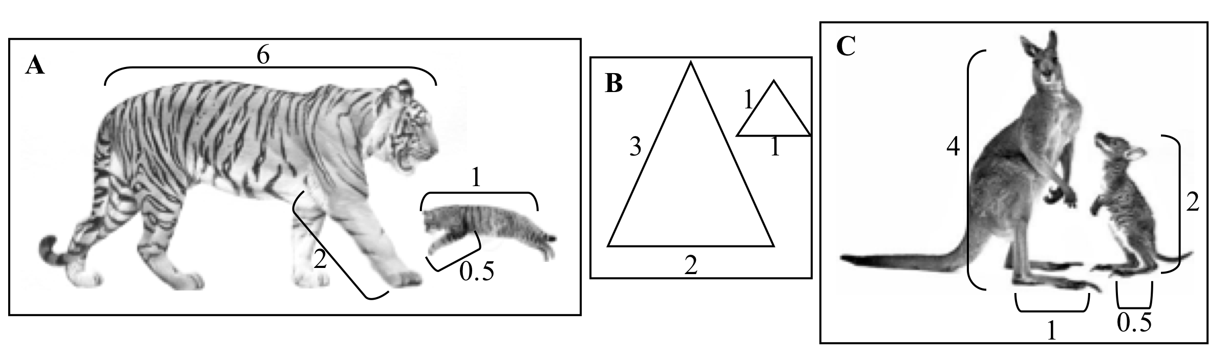
Which of the following pairs exhibit geometric similarity based on the measurements provided?
a) A
b) B
c) C
d) None of the above
e) A and C

Slide 17
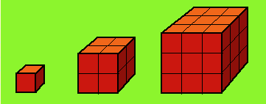
Geometrically similar objects have nice properties:
Linear dimension L 2L 3L
Area 6L² 6(2L)² 6(3L)²
Volume L³ (2L)³ (3L)³
You can either count squares (or boxes) or use the formulae for: Surface area = 6(length)², and
Volume = (length)³.
BROAD PRINCIPLE

Slide 18
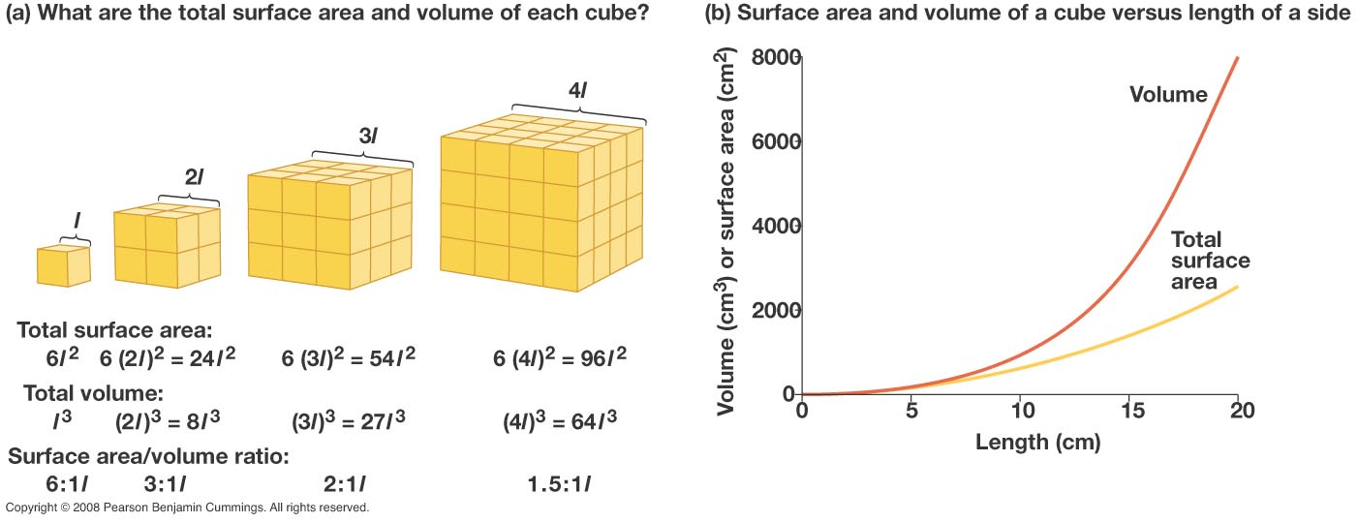

Slide 19
BROAD PRINCIPLE
Areas increase with the square (L²) of linear dimensions
Whereas
Volumes* (and hence masses) increase with the cube (L³) of linear dimensions
What assumption am I making in this statement?

Slide 20
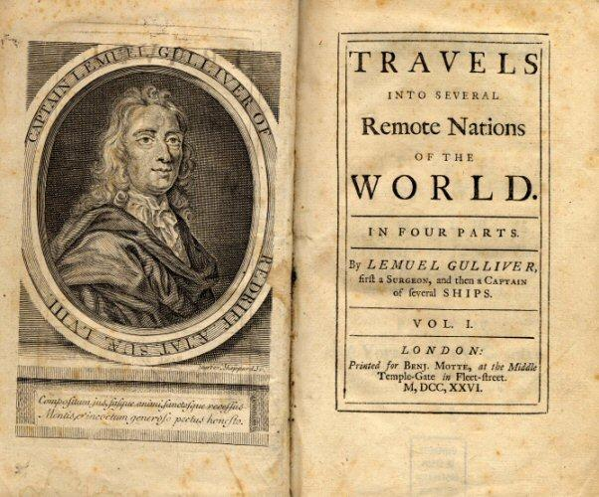
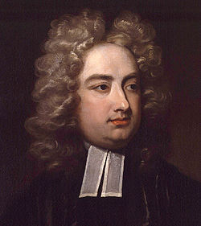
The first (mis-) application of the geometric similarity principle to metabolic allometry
Jonathan Swift (1726)
Notes:
The first application of the principle of geometric similarity to metabolic allometry

Slide 21
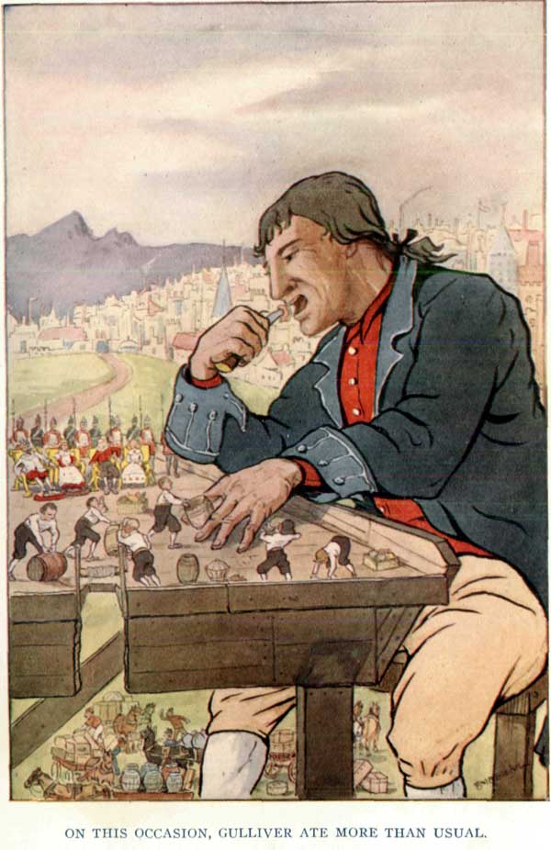
“…the emperor stipulates to allow me a quantity of meat and drink sufficient for the support of 1724 Lilliputians. Some time after, asking a friend at court how they came to fix on that determinate number, he told me that his majesty's mathematicians, having taken the height of my body by the help of a quadrant, and finding it to exceed theirs in the proportion of twelve to one, they concluded from the similarity of their bodies, that mine must contain at least 1724 of theirs, and consequently would require as much food as was necessary to support that number of Lilliputians.
What is wrong with
the calculations?
12³ = 1724

Slide 22
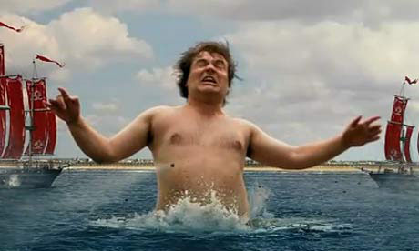
The amount of energy that an animal uses is NOT proportional to body mass
NO
Rate of energy use
YES
Body mass
Notes:
Jack Black

Slide 23
To Remember
-In geometrically similar objects the ratio of two linear dimensions is equal and independent of the size of the objects.
In geometrically similar objects
Area is proportional to L²
Mass and volume are proportional to L³
L = length (or a linear dimension)

Slide 24
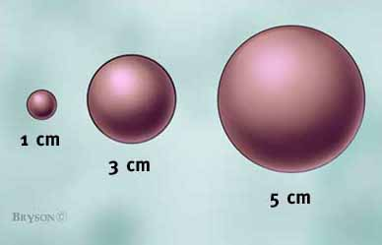
A
9A
25A
V
27A
125A

Slide 25
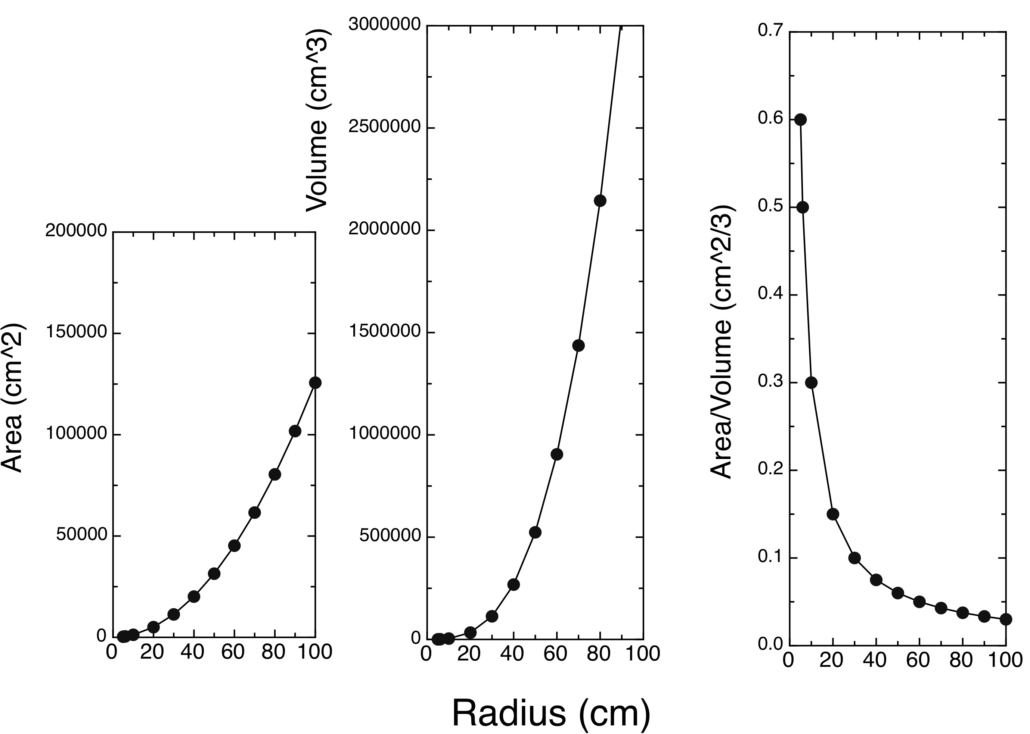
V=(4/3) πr³
A/V=3π/r
A=4πr²

Slide 26
Message:
In geometrically similar objects (and in animals!!), surface to volume ratios decrease with size

Slide 27
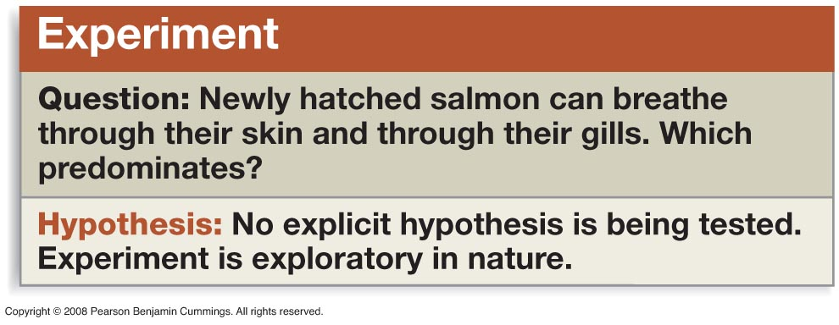
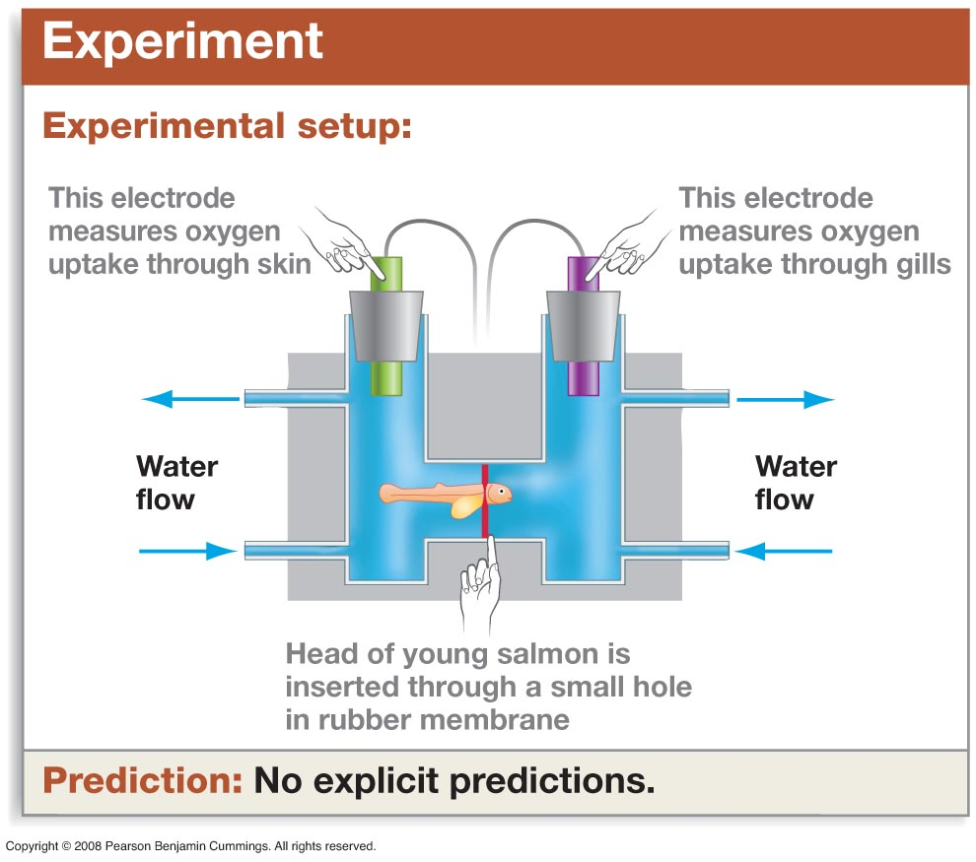
Is this true?

Slide 28
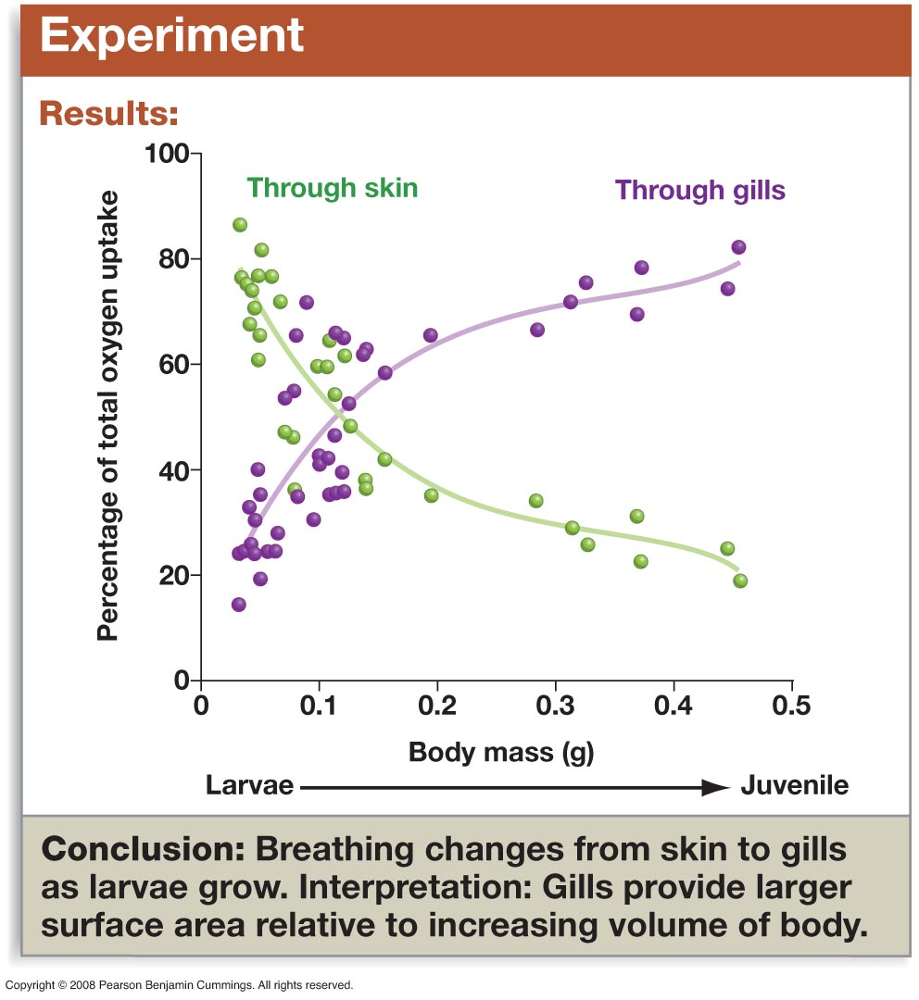

Slide 29
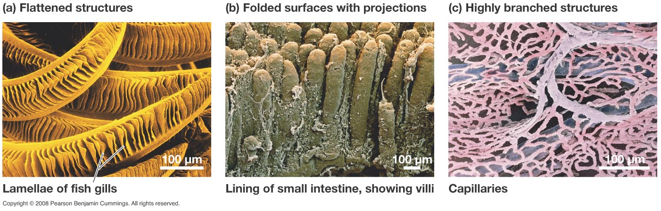
BROAD PRINCIPLE
Because surface/volume ratios decrease with an organism's size, exchange surfaces (epithelia) tend to increase their areas of contyact by folding, flattening, and branching.

Slide 30
To go a little deeper, we need to do a bit of math

Slide 31
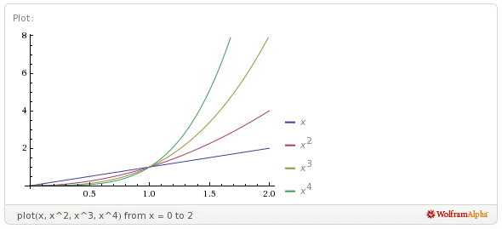
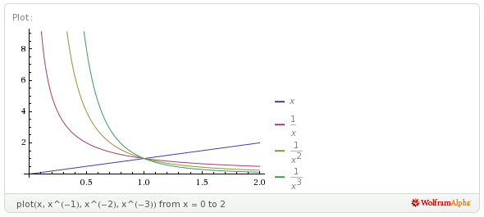
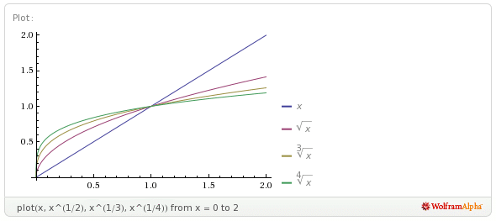
Power Functions
Y =ax^{b}

Slide 32
(x ª)(x^{b}) = x^{a+b}
1/xª = x^{-a} xª/x^{b} =x^{a-b}
(xª)^{b}= x^{ab} x⁰ = 1
Remember:
Area ∝Length²
Volume ∝Length³
Things to remember from math 101
Print the box
YOU NEED TO KNOW HOW TO USE EXPONENTS

Slide 33
10X⁷ and 10X⁵
a) 10X⁷/10X⁵ = X¹²
b) 10X⁷/10X⁵ = X²
c) 10X⁷/10X⁵ = 100X²
d) 10X⁷/10X⁵ = 1
e) 10X⁷/10X⁵ = 100X¹²
10X⁷/10X⁵ = X⁷/X⁵ = X⁷⁻⁵ = X²

Slide 34
(X³/X⁴)²
a) (X³/X⁴)² = X⁻²
b) (X³/X⁴)² = X²
c) (X³/X⁴)² = X³
d) (X³/X⁴)² = X⁻¹
e) (X³/X⁴)² = X⁻³
(X³/X⁴)² = (X³⁻⁴)² = (X⁻¹)² = X⁽⁻¹⁾⁽²⁾ = X⁻²

Slide 35
From geometric similarity we know that:
surface ∝ (length)²
volume ∝ (length)³
This means that
surface ∝ (volume)?
(volume)^{1/3} ∝ length
therefore ....
surface ∝((volume)^{1/3})² =(volume)^{2/3}

Slide 36
BROAD PRINCIPLE
Really important relationship
Area ∝ (Volume)^{2/3}
In geometrically similar objects, surface area is proportional to volume (or mass) raised to the 2/3 power.

Slide 37
In mammals, surface area (SA in cm²) increases with body mass (M_{b}, in grams) as:
SA =12.3M_{b} ^{0.65}
Therefore SA/Mb depends on body mass as?
Hint
xª/x^{b} =x^{a-b}
a) SA/Mb = 12.3M_{b}^{0.35}
b) SA/Mb = 12.3M_{b}^{-0.35}
c) SA/Mb = 12.3M_{b}^{1.5}
d) SA/Mb = 12.3M_{b}^{1.5}
SA/Mb = 12.3M_{b}^{0.65}/Mb = 12.3M_{b}^{0.65-1} =12.3M_{b}^{-0.35}.
What are the units of SA/M_{b}?
cm²/g

Slide 38
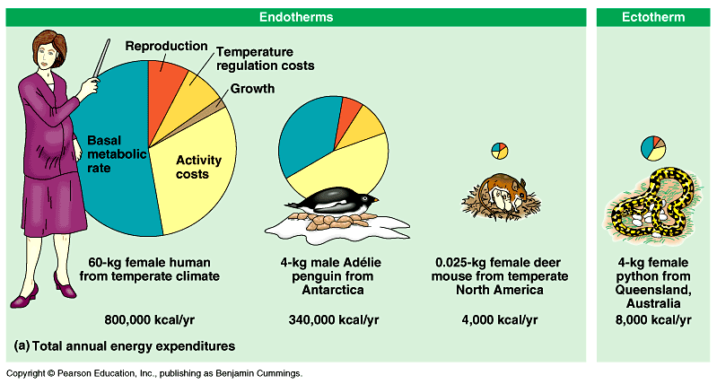
Why is it that per unit body mass, the mouse spends ≈ 12 times more energy than the woman?
Woman | Penguin | Mouse | Python
13,333 kCal/Kg | 85,000 | 160,000 | 2000
The SA/Mb of a 60 g mouse is 12.3(60^{-0.35})=2.9.
The SA/Mb of a 60 kg woman is 12.3(6000 ^{-0.35})=0.58
The mouse has a SA/Mb ratio ≈ 5 times higher!

Slide 39
BROAD PRINCIPLE
Really important relationship
Really important relationship
Area ∝ (Volume)^{2/3}
In geometrically similar objects, surface area is proportional to volume (or mass) raised to the 2/3 power.
Really important consequence
Area/Volume ∝ (Volume)^{-1/3}

Slide 40
Why does this matter?
A large number of physiological process (heat loss, evaporation, water absorption in aquatic animals,…,etc.) depend on surface area.

Slide 41
TO REMEMBER
-Surface/Volume ratios decrease with body mass
-In geometrically similar objects
Surface area is proportional to Mass^{2/3}
Therefore
Surface/Mass is proportional to Mass^{-1/3}

Slide 42
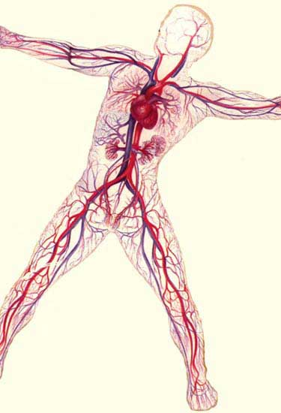
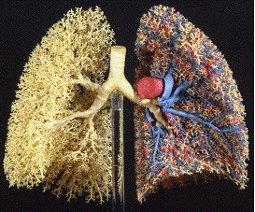
Remember
Surface/volume (or surface/mass) ratios in geometrically (or close to) similar objects decrease as mass^{-1/3}.
Which is why we have circulatory (and respiratory) systems!

Slide 43
What do you think is the relationship between metabolic rate (MR) and body mass (W)?
Hint: recall that a large number of physiological process (heat loss, evaporation, water absorption in aquatic animals,…,etc.) depend on surface area...What is the relationship between surface area and mass ≈ volume?
MR ∝ surface area
MR ∝ (M)^{2/3}

Slide 44
BROAD PRINCIPLE
MR ∝ surface area
MR ∝ (M)^{2/3}
The idea that metabolic rate (the rate at which animals use energy) is proportional to body mass^{2/3} is called
the surface area rule
The surface area rule hypothesizes that in endotherms the rate of heat loss per unit area of skin is constant.

Slide 45
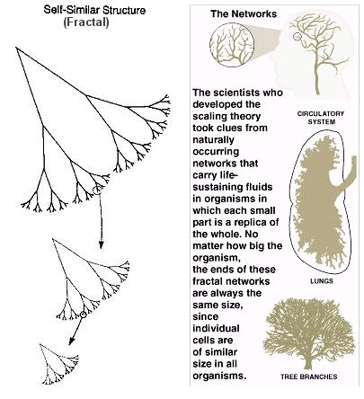
BROAD PRINCIPLE
In reality what we find is that
MR ∝ (M)^{b}
where 2/3 < b < 1
The average value of
b = ¾
Who knows why?

Slide 46
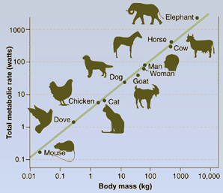
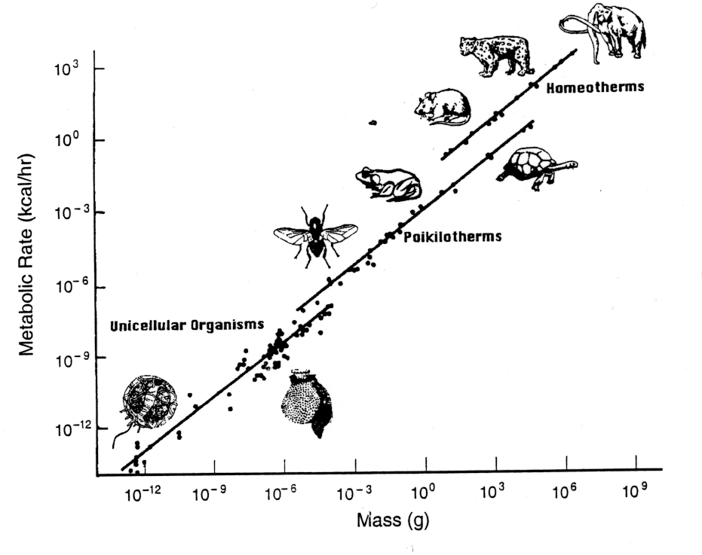
The relationship between metabolic rate and body mass is remarkably robust and works across a large number of animals.
Why does it matter…
It is important because a great number of biologically important features of an organism depend on metabolic rate..

Slide 47
What are the implications of the dependence of metabolic rate on (body mass)^{3/4}?
We can define "mass specific" metabolic rate as
(metabolic rate)/(body mass)
Because metabolic rate ∝ (body mass)^{3/4}
then
(metabolic rate)/(body mass) ∝ (body mass) ^{3/4}/(body mass)
mass specific metabolic rate ∝ (body mass)^{-1/4}
This means that per unit mass small animals use more energy than large ones.

Slide 48
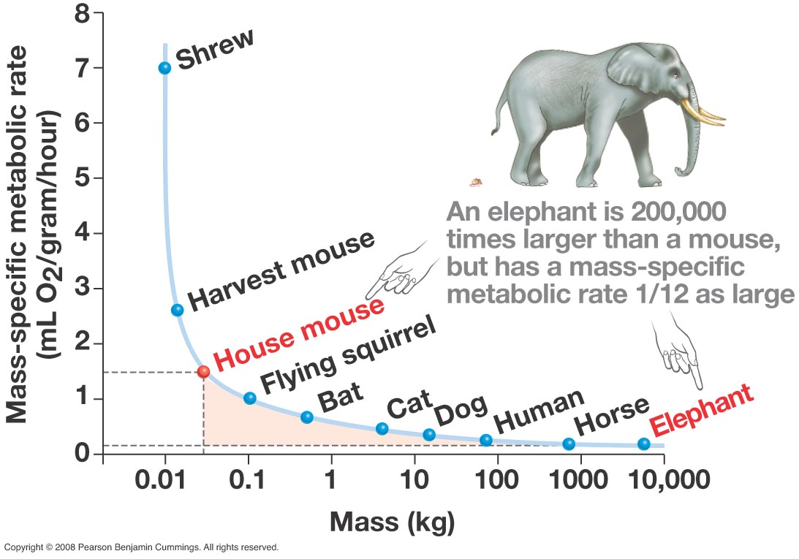

Slide 49
BROAD PRINCIPLE
The amount of energy used by animals per unit mass decreases with body size....
Per gram, a shrew uses a lot more energy than an elephant!

Slide 50
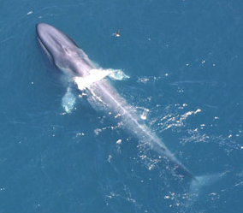
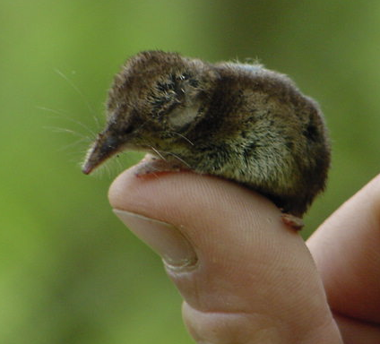
The relationships between body mass and the features of organisms are important because:
They summarize a lot of biological information in a very compact form (y=ax^{b}).
They allow us to make predictions (educated guesses) about an organism’s feature if all we know is its body mass.
They allow making inferences about other traits.
blue whale
masked shrew

Slide 51
In mammals, the rate of population growth under optimal condition depends on (body mass)^{-1/4}. This observation implies that the rate of population growth rate of elephants (4,600 kg) is ________ than that of horses (500 kg).
a) lower
b) equal
c) higher
500^{-0.25}/4600^{-0.25} = 1.74
horses have population growth rates that are ≈ 74% higher than those of elephants.

Slide 52
Review questions
1) Explain the principle of geometric similarity.
2) The length of a 30 cm tall baby’s arm is 10 cm. When the same child grows in 3 years to be 100 cm tall, her arm is 42 cm. Is the child geometrically similar to the baby?
3) The surface of the skin of birds (SA, in cm²) is related to the bird’s body mass (M_{b} in grams) by the equation SA=10.0M_{b}^{0.67}.
    a) Is the value of the exponent in this equation what you would expect from geometric similarity?
b) Compare the SA/M_{b} ratios of a 3.5 g hummingbird with that of a 3.5 kg domestic goose.
SEE FOLLOWING PAGES!

Slide 53
4) The relationship between the breathing rate (in breaths per minute) in birds and body mass (Mb in kg) is given by the equation
breaths/minute = 17.2M_{b}^{-0.31}
Compare the breathing rate of the following species:
Species | Mass (in g)
Anas Hummingbird | 4.0
Yellow-rumped Warbler | 13
American Robin | 75
Meganser | 330
Canada Goose | 2000
6) Explain why body mass is of such importance for the study of an animal’s biology.

Slide 54
PLEASE DO THE EXERCISES!!!

Slide 55
(x ª)(x^{b}) = x^{a+b}
1/xª = x^{-a} xª/x^{b} =x^{a-b}
(xª)^{b}= x^{ab} x⁰ = 1
Remember:
Area ∝ Length²
Volume ∝Length³
Things to remember from math 101
Print the box
Therefore:
Length ∝ (Area)^{1/2}
Length ∝ (Volume)^{1/3}
Area ∝ (Volume)^{2/3}
Volume ∝Length³
Area ∝ ((Volume)^{1/3})²
Area ∝ ((Volume)^{2x(1/3)}
Area ∝ (Volume)^{2/3}

Slide 56
Really important relationship
Area ∝ (Volume)^{2/3}
In geometrically similar objects, surface area is proportional to volume (or mass) raised to the 2/3 power.

