Slide 1
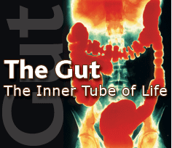
Nutrition and digestion
Please read chapter 43 in your text from one end to the other

Slide 2
Nutrition
-Carbohydrates, proteins, and lipids
-Essential nutrients
amino acids
fatty acids
minerals
vitamins
-The enough but not too much principle

Slide 3
Most animals are heterotrophs (or chemoheterotrophs if you are either pedantic or taking BIO 2022).
They obtain their nutrients mostly from organic sources: from plants, from other animals, or from microbes and fungi.
“I am food, I am food. I am the eater of food,..”
The Upanishads (ancient Hindu text)
What do animals get from these resources?

Slide 4
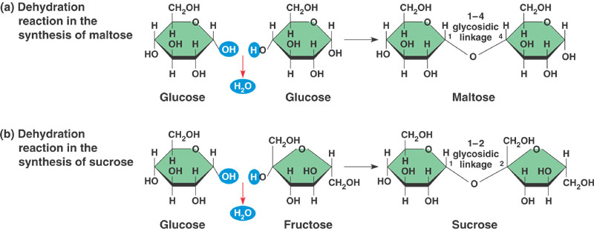
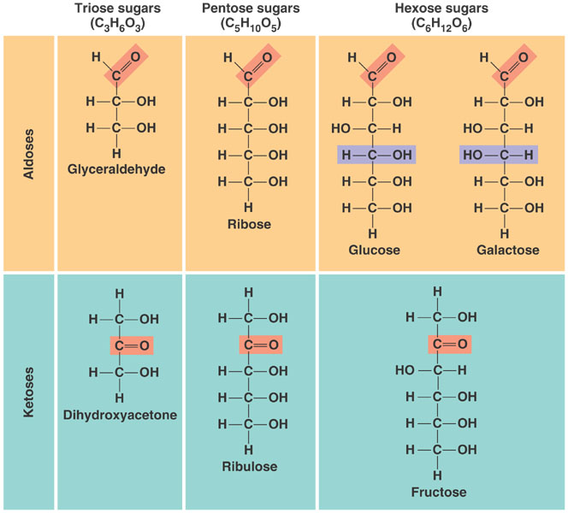
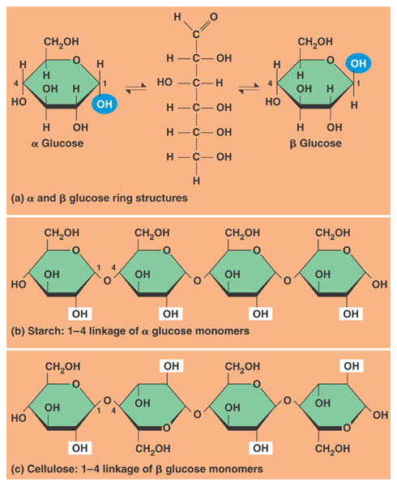
Carbohydrates can be divided into monosaccharides (the most important nutritional hexoses are glucose, fructose, and galactose); disaccharides (sucrose, maltose, and lactose); and
polysaccharides (starch and glycogen). Starch is the primary energy storage molecule in plants. Glycogen is the most important polysaccharide in animals.

Slide 5
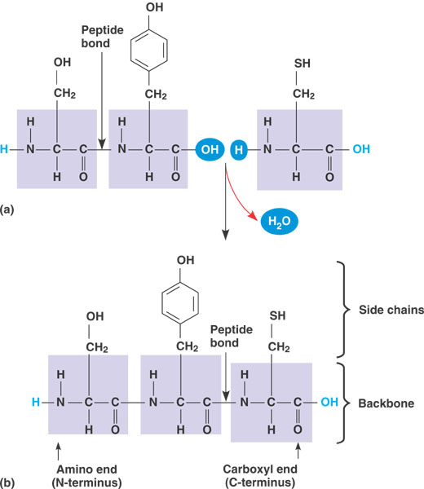
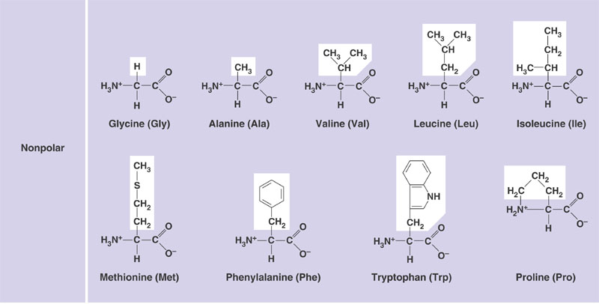
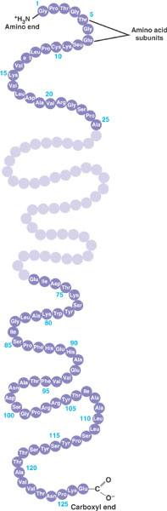
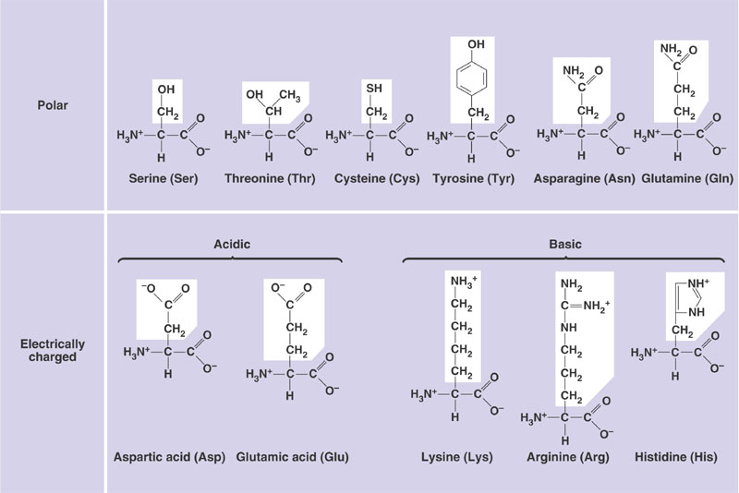
Proteins are polymers of 20 amino acids joined by peptide bonds.
The tertiary and quaternary structure of proteins determines their function.

Slide 6
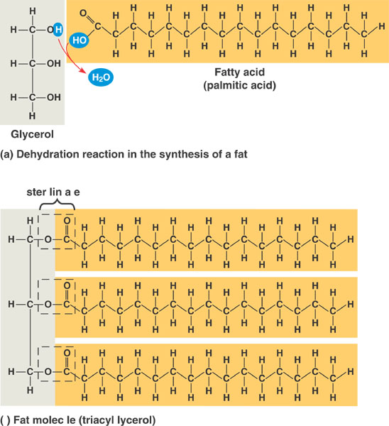
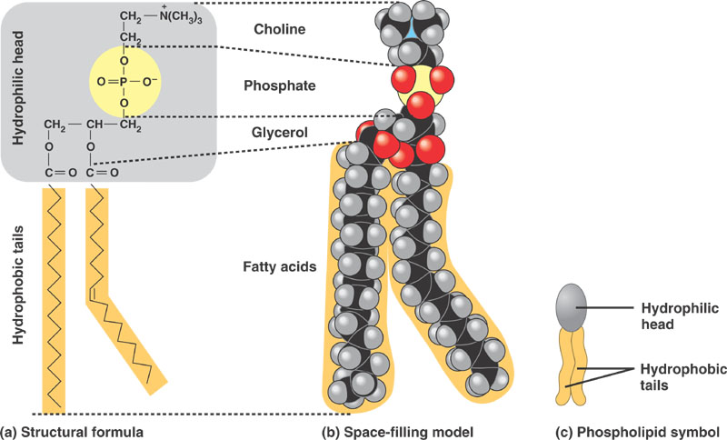
To remember about lipids
-Triacylglycerides are esters of glycerol and fatty acids.
-They are good sources of energy and the energy storage of choice in animals (why? Two reasons?).
-Important components of biological membranes (Why?)

Slide 7
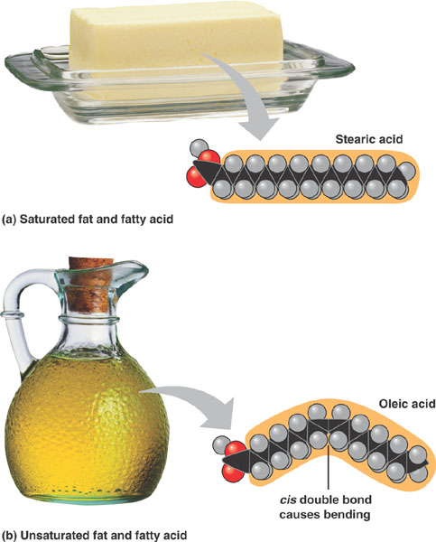
Long
And saturated FAs have high melting points (lards)
Short
and unsaturated FAs have low melting points (oils)
18 Carbons
Fatty acids without double bonds are called saturated. Those with double bonds are called unsaturated. Melting point is lower in unsaturated FAs and in short- than in long-chained fatty acids.

Slide 8
TO REMEMBER
-The most important dietary monosaccharides (hexoses) are glucose, fructose, and galactose.
-The most important dietary disaccharides are sucrose (G-F), maltose (G-G), and galactose (lactose-glucose).
-Starch (plants) and glycogen (animals) are important dietary polysaccharides.
-Proteins are polymers of 20 amino acids joined by peptide bonds.
-Lipids (fatty acids, phospholipids, cholesterol, triacylglycerides) are non-polar molecules. Triacylglycerides are made of fatty acids and glycerol. Many lipids are amphipathic
-Fatty acids without double bonds are called saturated. Those with double bonds are called unsaturated. Melting point is lower in unsaturated than in saturated FAs and in short- than in long-chained fatty acids.

Slide 9
If this flash tour through the major classes of nutrients left you dizzy you must read chapters 3-6 of your textbook (This is material covered ad-nauseaum in BIO 1010)

Slide 10
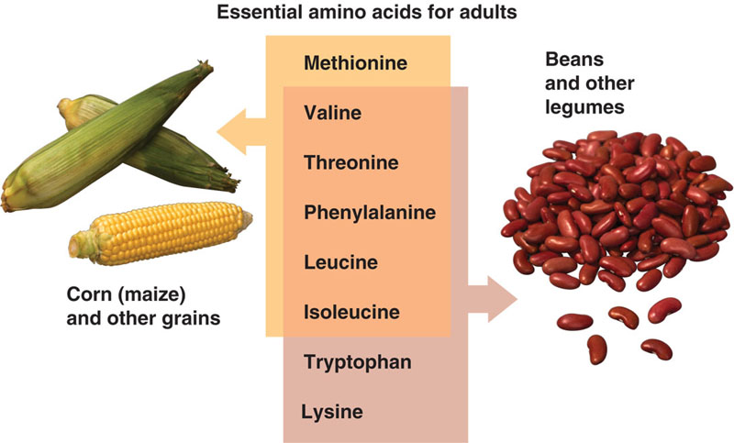
Some nutrients are indispensable (essential)
Indispensable means that the animals cannot synthesize them in sufficient amounts and hence it must obtain them in food. A nutrient can be indispensable because the animal lacks the metabolic pathway to make it, or because it has limited ability to make enough of the nutrient.
BROAD PRINCIPLE
There are 8 indispensable amino acids but a few others are
“conditionally indispensable” (arginine is indispensable in cats and can be indispensable during wound/burn healing).

Slide 11
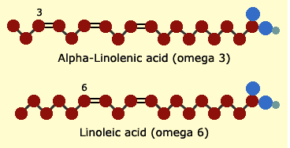
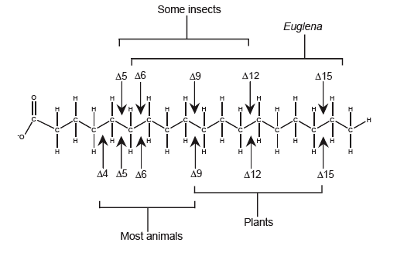
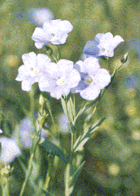
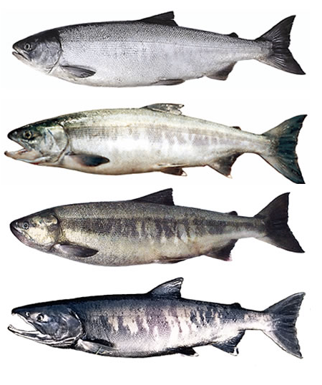
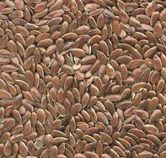
There are two essential fatty acids. They are essential because animals do not have the ability to place a double bond beyond carbon 9 of the fatty acid (counting from the carboxyl end)
Linseed from flax
Desaturases

Slide 12
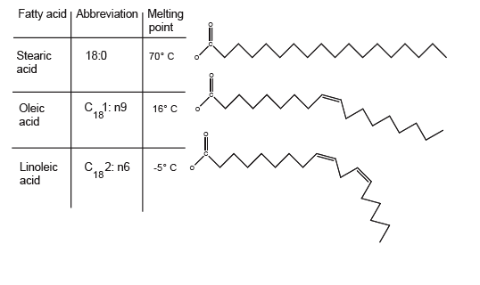
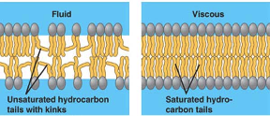
Essential fatty acids are important because they are
precursors of important signaling molecules (such as prostaglandins)
and
b) because they maintain the fluidity of biological membranes.

Slide 13
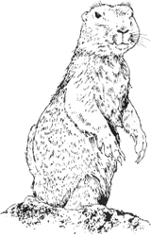

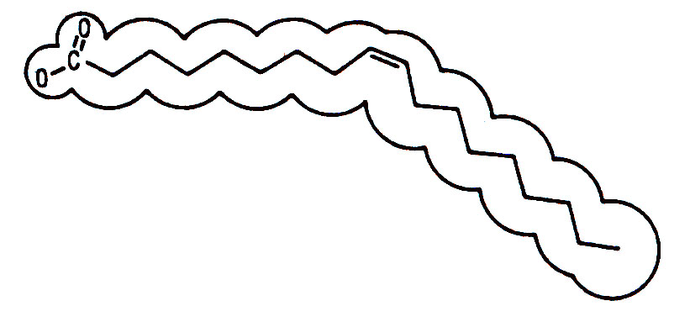
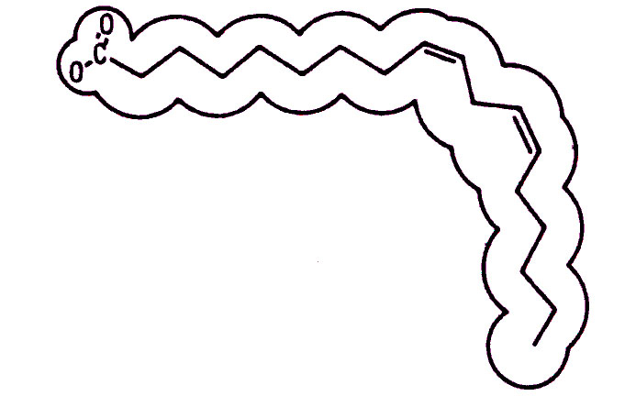
Fatty Acid | Abbreviation | Melting point
Stearic Acid | 18:0 | 70° C
Oleic Acid | C₁₈:1 n9 | 16° C
Linoleic Acid | C₁₈:2 n6 | -5° C
Stories about reindeer legs, lizards, and hibernators…

Slide 14
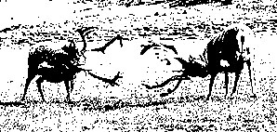
Svalbard reindeer (Pond et al. (1993)
More double
bonds
Fewer double
bonds
Subcutaneous deposits
Hind leg bones

Slide 15
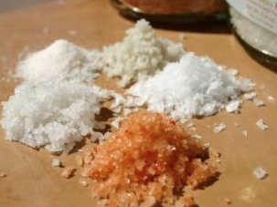
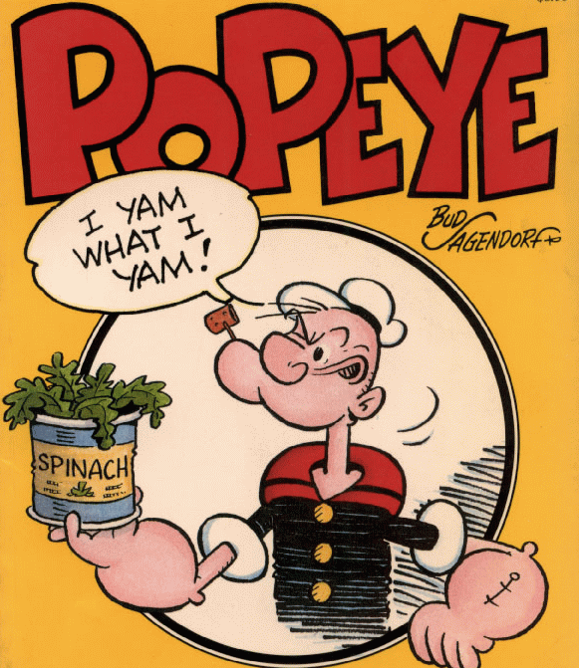
Minerals
Inorganic nutrients usually required in small amounts
Mineral Source Function
Calcium dairy, legumes, some vegetables skeleton, signaling
Phosphorous dairy, meat, some grains skeleton, nucleic acids
Sulfur animal protein component of some *amino acids
Chlorine table salt acid-base balance, gastric juice
Sodium table salt nerve function, many others
Iron meat, some vegetables hemoglobin, enzyme co-factor
Iodine sea food, iodized salt component of thyroid hormones
(many others: Fluorine, Zinc, Copper, Manganese, Cobalt Selenium, Chromium, Molybdenum…)
*methionine and cysteine

Slide 16
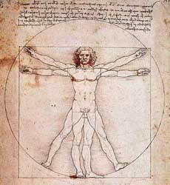
A human’s chemical formula
Element Hydrogen Oxygen Carbon Nitrogen Other
% 61.8 25.4 9.4 1.4 1.0
99%

Slide 17
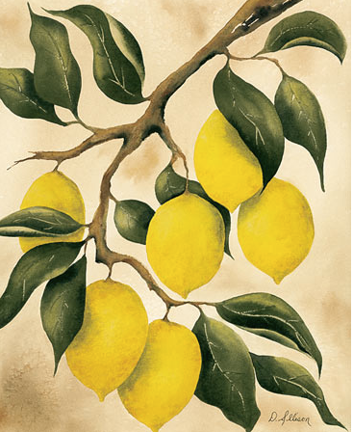
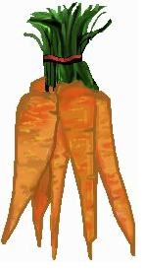
BROAD PRINCIPLE
Vitamins
Organic molecules required in small amounts. Vitamins have very diverse functions….
Water soluble Source Function
Vitamin C fruits (citrus), vegetables collagen synthesis, immunity
Niacin nuts, meat, grains component of NAD+ and NADP+
Lipid soluble
Vitamin A Green and orange vegetables visual pigments, antioxidant
Vitamin D Dairy, egg yolk, fish absorption and use of Ca and P
Excess of water soluble vitamins is excreted in urine (moderate overdoses are more or less harmless). Excess of lipid soluble vitamins is stored in fat and therefore overdoses may result in toxic effects.

Slide 18
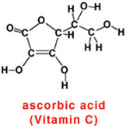
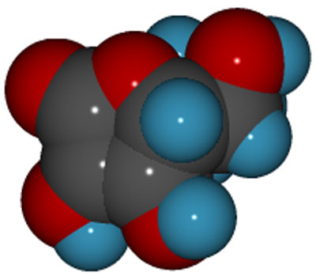
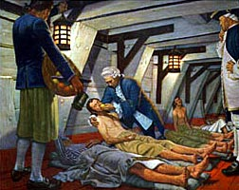
Functions: antioxidant, synthesis of collagen, synthesis of carnitine (aids fatty acid entry into mitochondria, biosynthesis of norepinephrine,..,etc.).
Symptoms of avitaminosis: Scurvy. In this condition the structure of collagen is defective and people end up with spongy gums, bleeding from mucous membranes, liver spots in legs.
Sources: fresh fruit (citrus, rose hips), liver.

Slide 19

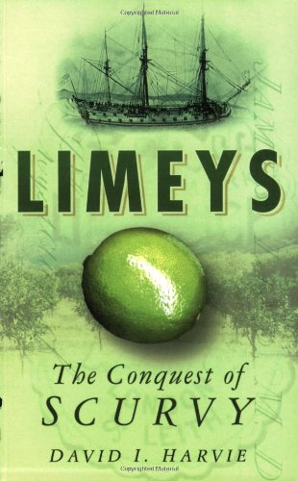
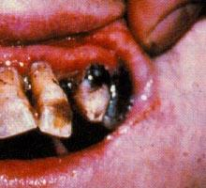

Slide 20
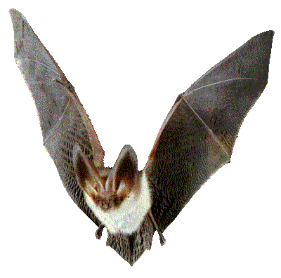
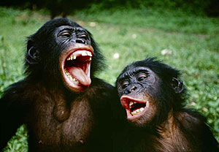

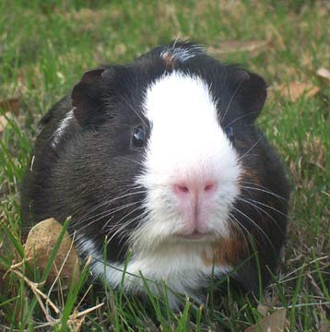
Phylogenetic Distribution of Vitamin C Synthesis
Cannot synthesize Vit. C
Bats
Can synthesize vitamin C
Anthropoid Primates
All (most other mammals)
Guinea Pig

Slide 21
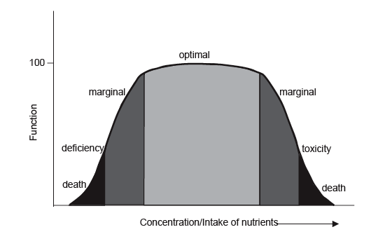
BROAD PRINCIPLE
The effect of many minerals and vitamins is dependent on intake. There is an optimal intake level. Eating to little or too much can have negative effects… The “enough but not too much” principle applies to much of biology.

Slide 22
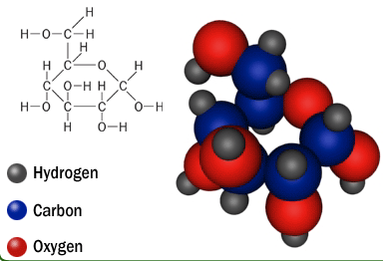
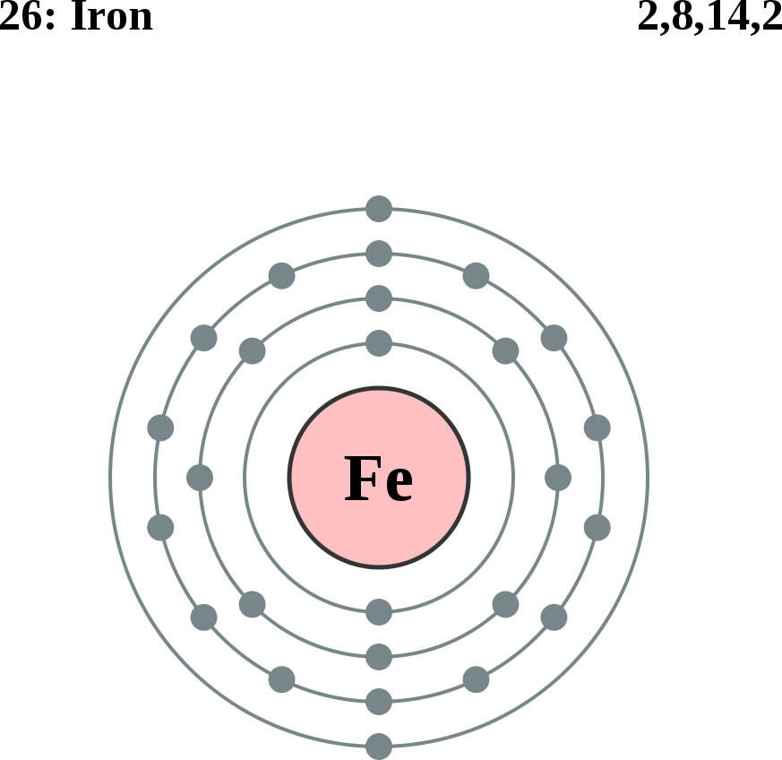
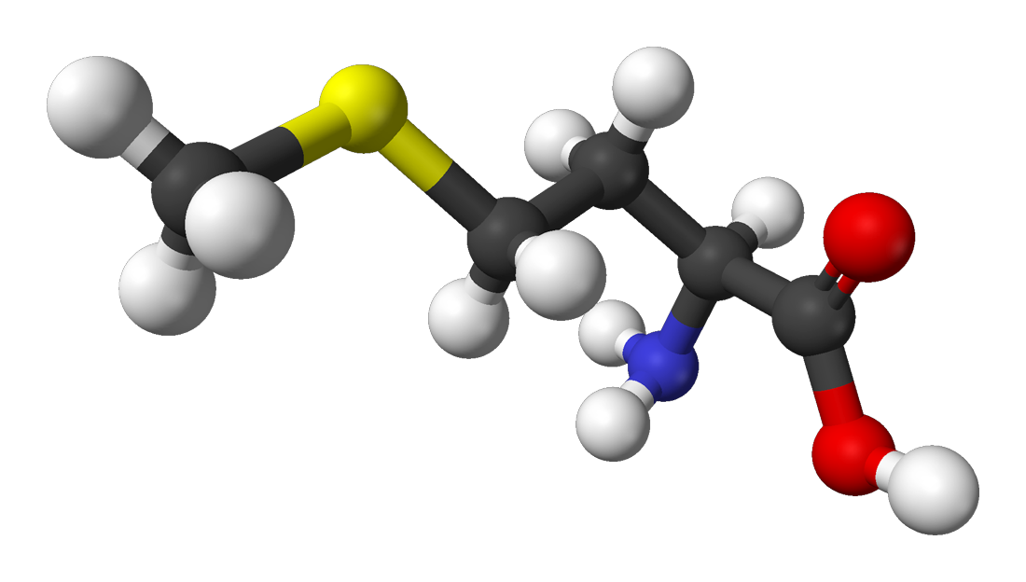
Which one of these nutrients is NOT essential for humans
E
A
B
D
Iron
C
L-methionine

Slide 23
Things to Remember
-An indispensable (essential) nutrient is a nutrient than an animal cannot synthesize by itself.
-There are 8 indispensable amino acids.
-There are 2 indispensable fatty acids (linoleic and linolenic)
-Essential fatty acids are important because they are precursors of signaling molecules and because they increase the fluidity of membranes.
-Animals require a bunch of minerals (please recall the function of iron, sodium, and sulfur).
-Vitamins are organic molecules required in small amounts.
-Water soluble vitamins (VC and Niacin) are excreted in urine. Lipid solubles are stored in fat and over-ingestion can be toxic.
-The effect of many minerals and vitamins follows the “enough but not too much” principle.

Slide 24
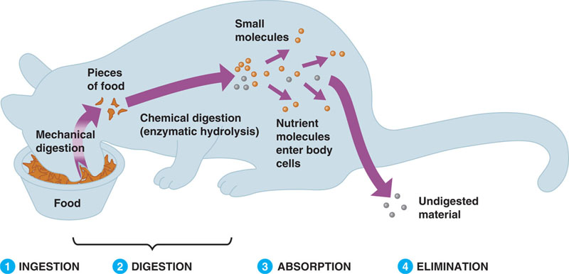
How do guts work

Slide 25
Digestive Physiology
-The concept of assimilation
-A variety of gut designs
-The human gut and its glands
-An overview of nutrient assimilation
-Lactose intolerance
-Glucose transport

Slide 26
How do animals assimilate nutrients
Assimilation = Digestion + Absorption
to digest is to break up a large molecule into smaller ones.
Assimilation (most often takes place in the gastrointestinal tract). There are exceptions… Arachnids inject digestive enzymes into their prey.

Slide 27
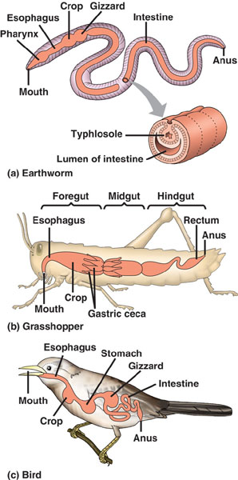
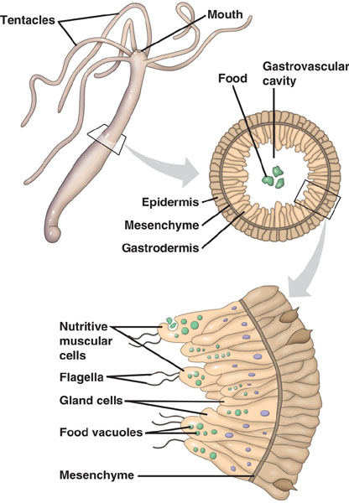
Guts!

Slide 28
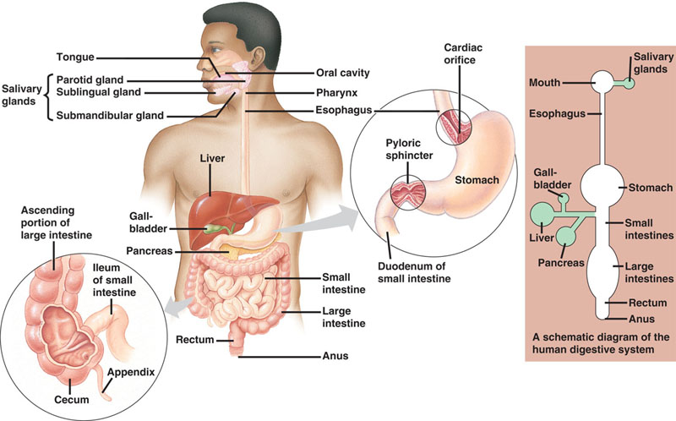
The digestive system in many (but not all) animals is a saculated tube into which many glands empty their contents.

Slide 29
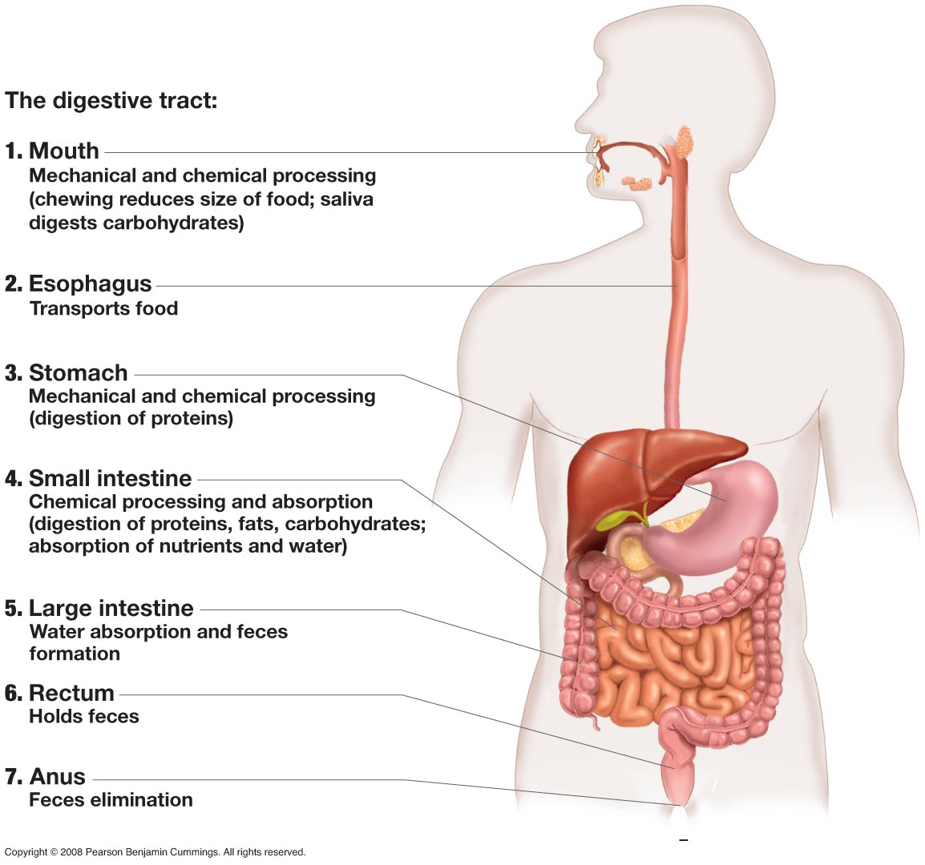

Slide 30
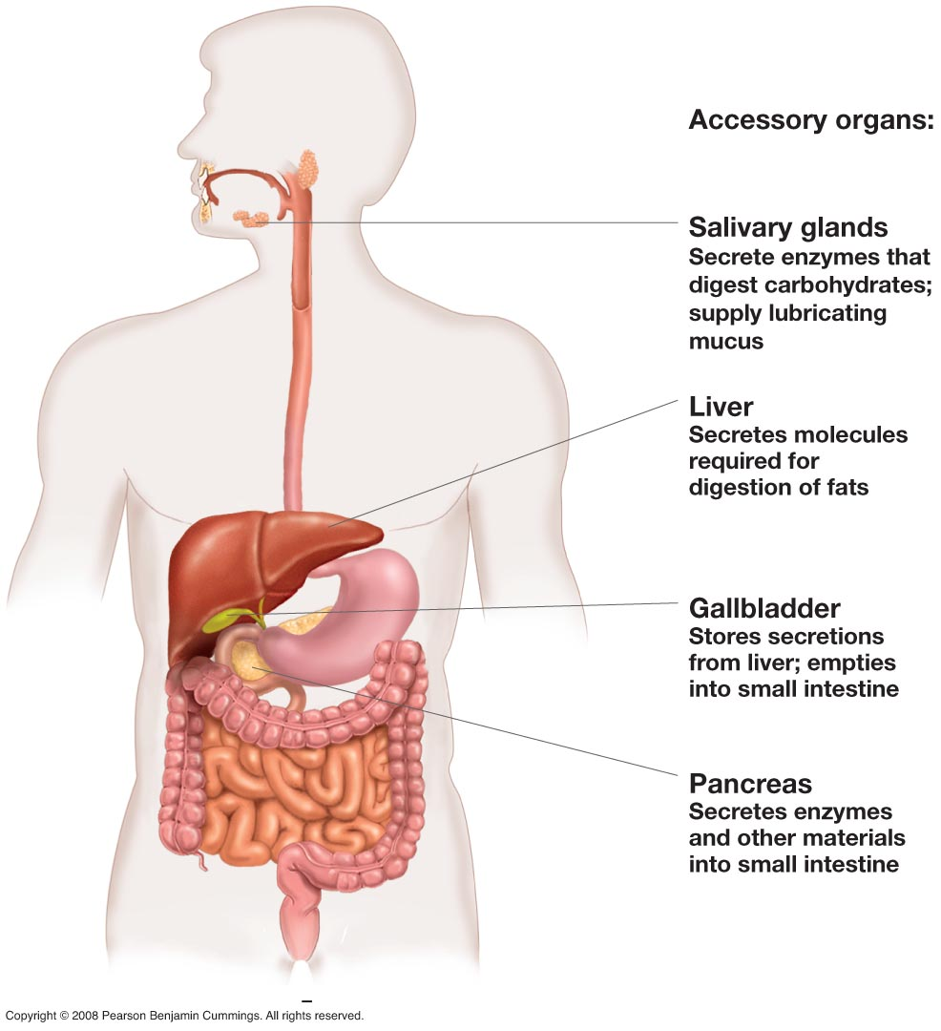

Slide 31
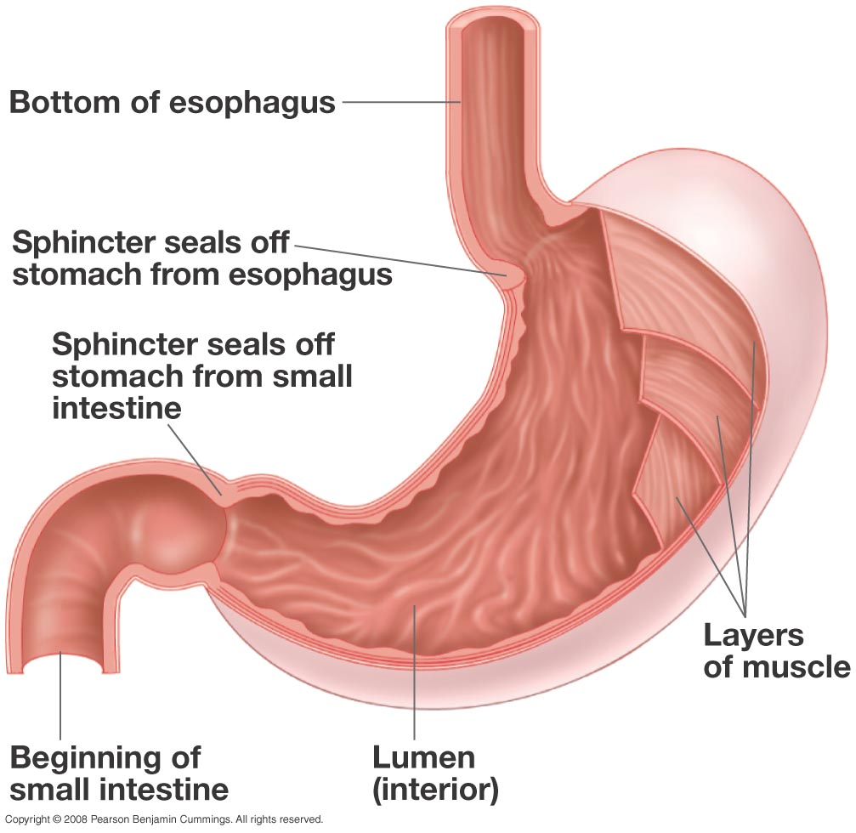

Slide 32
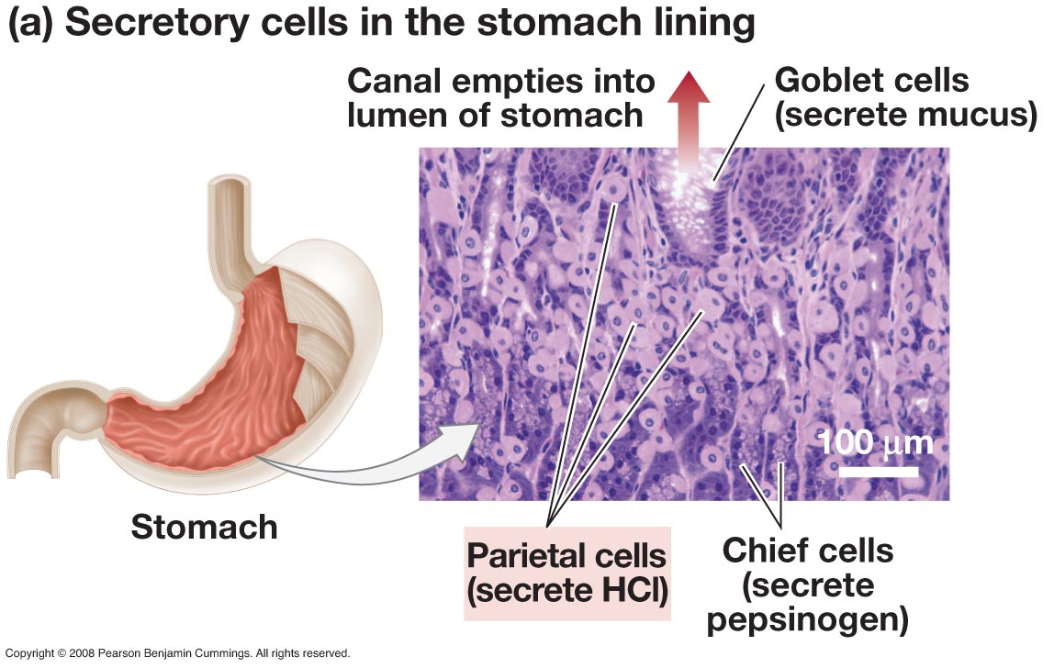
The HCl helps in the hydrolysis of protein.
Pepsinogen is the precursor of pepsin

Slide 33
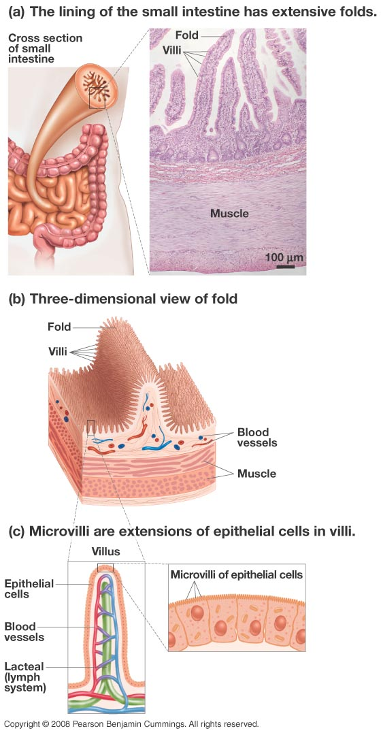
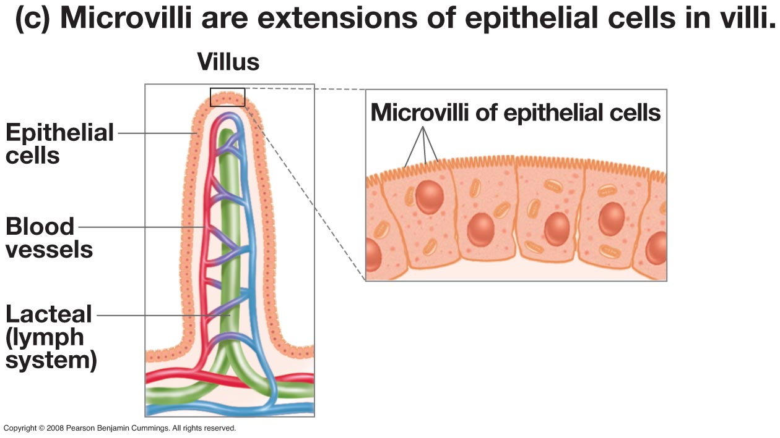

Slide 34



Nominal area ≈3.3 m²
Addition of folds of Kerkring ≈ 10 m²
Addition of villi to
Folds of Kerkring ≈100 m²
Addition of microvilli to
villi ≈2,000 m²
Absorptive surfaces maximize their area by successive levels of folding.

Slide 35


The cells of the intestine are called enterocytes
Gr. Enteron = gut
Cytos = cell

Slide 36
To Remember
The digestive process consists of four steps: ingestion, digestion, absorption, and elimination (defecation).
Nutrient assimilation consists of 2 steps: digestion and absorption
The GI tract is a saculated tube with many glands.
The digestive and absorptive surfaces of the GI tract often increase their surface area by multiple levels of folding.
Intestinal epithelial cells are called enterocytes

Slide 37
Why would a person with a weak esophageal sphincter complain of “heartburn”?
The sphincter is inhibiting the passage of food into the stomach from the esophagus, causing the esophagus to swell.
The sphincter is not allowing the passage of bile salts from the esophagus to the small intestine.
The sphincter is allowing regurgitation of stomach acids into the relatively unprotected esophagus.
All of the above answers apply.
Notes:
Answer: C

Slide 38
Why is it that the small intestine has so much more surface area than other major digestive organs?
Its huge surface area allows production of sufficient hydrochloric acid for digestion.
Because the small intestine is involved in mixing and breaking up food mechanically.
The extra surface area allows the small intestine to secrete enough enzymes for digestion.
Its huge surface area makes highly efficient absorption of nutrients into the bloodstream possible.
Notes:
Answer: D

Slide 39
The process of assimilation can be divided into several steps:
Luminal (extracellular) digestion ---> membrane digestion
Often, enzymatic digestion has two steps.

Slide 40
This aplies to all types of nutrients EXCEPT lipids
The assimilation process
luminal
enzymatic
digestion
membrane
enzymatic
digestion
physical
processing
uptake/transport
BROAD PRINCIPLE

Slide 41

Figure 43-6
Slide 5
Location in
digestive
tract
Carbohydrates
Lipids
Proteins
1. Mouth
Salivary amylase
Lingual lipase
2. Esophagus
Pepsin
3. Stomach
Polypeptides
4. Small intestine
Pancreatic
α-amylase
Bile salts
and pancreatic
lipase
Trypsin
Chymotrypsin
Elastase
Carboxypeptidase
Lumen
of small
intestine
Monosaccharides
(simple sugars)
Disaccharides
Trisaccharides
Monoglycerides
Fatty acids
Short peptides
Amino acids
DIFFUSION
Cell membrane of epithelial cell
FACILITATED
DIFFUSION AND
COTRANSPORT
Monoglycerides
Fatty acids
FACILITATED
DIFFUSION AND
COTRANSPORT
Epithelium of
small intestine
Triglycerides
Monosaccharides
Amino acids
Chylomicrons (protein-
coated globules)
FACILITATED
DIFFUSION AND
COTRANSPORT
FACILITATED
DIFFUSION
EXOCYTOSIS
To bloodstream
To lymph vessels,
then bloodstream
To bloodstream

Slide 42

Figure 43-6
Slide 1
Location in
digestive
tract
Carbohydrates
Lipids
Proteins
1. Mouth
Salivary amylase
Lingual lipase

Slide 43

Figure 43-6
Slide 2
Location in
digestive
tract
Carbohydrates
Lipids
Proteins
1. Mouth
Salivary amylase
Lingual lipase
2. Esophagus
Pepsin
3. Stomach
Polypeptides

Slide 44

Figure 43-6
Slide 3
Location in
digestive
tract
Carbohydrates
Lipids
Proteins
1. Mouth
Salivary amylase
Lingual lipase
2. Esophagus
Pepsin
3. Stomach
Polypeptides
4. Small intestine
Pancreatic
α-amylase
Bile salts
and pancreatic
lipase
Trypsin
Chymotrypsin
Elastase
Carboxypeptidase
Lumen
of small
intestine
Monosaccharides
(simple sugars)
Disaccharides
Trisaccharides
Monoglycerides
Fatty acids
Short peptides
Amino acids

Slide 45

Figure 43-6
Slide 4
Location in
digestive
tract
Carbohydrates
Lipids
Proteins
1. Mouth
Salivary amylase
Lingual lipase
2. Esophagus
Pepsin
3. Stomach
Polypeptides
4. Small intestine
Pancreatic
α-amylase
Bile salts
and pancreatic
lipase
Trypsin
Chymotrypsin
Elastase
Carboxypeptidase
Lumen
of small
intestine
Monosaccharides
(simple sugars)
Disaccharides
Trisaccharides
Monoglycerides
Fatty acids
Short peptides
Amino acids
DIFFUSION
Cell membrane of epithelial cell
FACILITATED
DIFFUSION AND
COTRANSPORT
Monoglycerides
Fatty acids
FACILITATED
DIFFUSION AND
COTRANSPORT
Epithelium of
small intestine
Triglycerides
Monosaccharides
Amino acids
Chylomicrons (protein-
coated globules)

Slide 46
Figure 43-6
Slide 5
Location in
digestive
tract
Carbohydrates
Lipids
Proteins
1. Mouth
Salivary amylase
Lingual lipase
2. Esophagus
Pepsin
3. Stomach
Polypeptides
4. Small intestine
Pancreatic
α-amylase
Bile salts
and pancreatic
lipase
Trypsin
Chymotrypsin
Elastase
Carboxypeptidase
Lumen
of small
intestine
Monosaccharides
(simple sugars)
Disaccharides
Trisaccharides
Monoglycerides
Fatty acids
Short peptides
Amino acids
DIFFUSION
Cell membrane of epithelial cell
FACILITATED
DIFFUSION AND
COTRANSPORT
Monoglycerides
Fatty acids
FACILITATED
DIFFUSION AND
COTRANSPORT
Epithelium of
small intestine
Triglycerides
Monosaccharides
Amino acids
Chylomicrons (protein-
coated globules)
FACILITATED
DIFFUSION AND
COTRANSPORT
FACILITATED
DIFFUSION
EXOCYTOSIS
To bloodstream
To lymph vessels,
then bloodstream
To bloodstream

Slide 47

Error!!!!
Di- and Trisaccharides are NOT taken up by the intestinal cells. They are first broken up by membrane-bound enzymes into monosaccharides.

Slide 48


Sucrose
Glucose + Fructose
SUCRASE

Slide 49
luminal
enzymatic
digestion
membrane
enzymatic
digestion
physical
processing
uptake/transport
many transport proteins attached to the brush-border of intestinal cells
enzymes secreted by
salivary glands
(amylase,
lipase)
stomach (pepsin)
pancreas
(amylase,
trypsin,
lipase)
enzymes attached to the brush-border of intestinal cells
(lactase, sucrase)
BROAD PRINCIPLE

Slide 50
To Remember
1) For many nutrients, the process of assimilation consists of four steps: physical processing, luminal digestion, membrane digestion, and uptake/transport.
2) The glands that secrete the enzymes that act in the lumen of the gastrointestinal tract are: the salivary gland, the stomach, and the pancreas.
3) Disaccharides must be hydrolyzed (broken down) into monosaccharides

Slide 51
The evolution of lactose tolerance in
Homo sapiens (sapiens?)
-We are mammals.
-Mammals are hairy, warm blooded (endothermic
homeotherms), viviparous vertebrates, that feed
their young on milk.
-Milk is a heterogeneous solution (its composition
varies from species to species) that contains proteins,
Lipids, carbohydrates, electrolytes, and vitamins.

Slide 52

the
“invention”
of milk
Mammals are the only vertebrates that secrete “true” milk
(pigeons, emperor penguins, and flamingos secrete “crop milk”)

Slide 53

Lactose
-Lactose is the primary carbohydrate
in mammalian milk (a few marsupials
secrete oligosaccharides of galactose).
-Lactose is a disaccharide made of galactose
and glucose joined by a 1-4 β bond.
-Lactose is very rare in nature except in milk.
Glucose + Galactose
SGLT1
Lactase

Slide 54



Most adult
mammals are lactose
intolerant.
Babies, of course, are not!
The loss of intestinal lactase activity follows a fixed ontogenetic program (it is independent of diet)
(data for rats)

Slide 55


Two exceptions:
Many pinnipeds (sea lions and seals) lack intestinal lactase activity (why?).
Their milk lacks lactose!
2) Certain human ethnic groups (N. European caucasians, pastoral groups of north and central Africa) retain lactase activity as adults (less than 10% of humanity).
BROAD PRINCIPLE

Slide 56


Slide 57

-lactose intolerance is a genetically determined trait
-It has simple Mendelian genetics (tolerance is dominant,
intolerance is recessive).
-Lactose intolerance is the ancestral condition in humans
-Lactose tolerance evolved twice in humans, how come?
in both cases as a result of “coevolution” with domestic ungulates (cows, goats, and camels).

Slide 58
Hypotheses to explain the evolution of lactose tolerance
Pastoralism (nutritional advantage, sensu stricto. Low latitudes)
Calcium absorption (high latitudes)
  The low availability of sunlight, and hence low synthesis of Vit. D is the the selective agent
  Milk has high Calcium content
  Calcium and lactose enhance each other’s absorption (mechanism unclear).
Lactose Tolerance may have its bio-cultural origins in the practice of relying on milk to supplement mother’s milk

Slide 59



Slide 60
In summary:
Lactose intolerance is an example of a genetic polymorphism in humans. It is an example of relatively recent (less than 10,000 years) evolutionary change in human populations. Lactose tolerance evolved in response to an association with ruminants (cows, goats, and sheep). It is also an example of convergent evolution in humans.
It is one of many examples of clinically significant ethnic variation in physiological traits. Other examples are cystic fibrosis, sickle cell anemia, and adult onset (type II) diabetes.

Slide 61


Evolution matters!
Understanding how evolution works has profound consequences for human health and well-being
1859
1809-1882

Slide 62
To Remember
Milk is a unique mammalian trait.
The main carbohydrate in milk is the disaccharide lactose (glucose-galactose).
Lactose is hydrolyzed by the membrane-bound intestinal enzyme lactase.
Most mammal babies have lactase, but most adults do not.
Exceptions are some pinnipeds (never have lactase) and a small fraction of Homo sapiens individuals (≈ 10%) who have it as adults.
Lactose intolerance is the ancestral and most frequent trait in humans, but tolerance has evolved in humans twice in pastoralist societies.

Slide 63

A brief review of material from LIFE 1010
BROAD PRINCIPLE

Slide 64
A brief review of material from LIFE 1010
Simple difussion
(does not saturate, it always takes place down a concentration gradient... it is "downhill")
Facilitated diffusion
(always mediated by transport proteins. These can be channels (does not saturate) or transporters (saturate), it always takes place down a concentration gradient... it is "downhill").
Active transport
(always mediated by transport proteins, can be "uphill" (against a concentration gradient), it always requires energy, can be primary or secondary)
BROAD PRINCIPLE

Slide 65

How are glucose and galactose transported

Slide 66
Which of the following mechanisms of membrane transport DOES NOT participate in the uptake of glucose by enterocytes?
A) Active transport
B) Facilitated diffusion
C) Simple diffusion
D) Co-Transport

Slide 67

The chemical ouabain, blocks the flow of K⁺ into cells and therefore stops the action of the Na+/K+ ATPase pump. Ouabain
A) has no effect on the intestinal transport of glucose
B) stops the intestinal transport of glucose
C) increases the intestinal transport of glucose

Slide 68
Fermentative Digestion
(not in your book in any detail)
-The concept of fiber (why the anisomeric carbon in glucose matters)
-Nutritional symbioses
-The fermentation process
-Foregut and hindgut fermenters
-Foregut fermentation: the multichambered stomach (rumination and merycism)
-Hindgut fermentation and its consequences.
Isomeric: made of the same components in the same proportions.
bradley@uwyo.edu

Slide 69

Cellulose and starch differ in the form of the bond that joins the glucose residues. Cellulose is the most abundant molecule on earth.

Slide 70



Why you can eat, but cannot assimilate grass: a case against vegetarianism in the high plains.
cellulose
Vs
β glycosidic bonds
All vertebrates have α-amylase, but no known vertebrates have cellulases (many mollusks and insects do have cellulases). Then how do cows manage to assimilate a large fraction of the cellulose that they ingest?
Cellulose is (with hemicellulose, lignin, and pectin) what animal nutritionists call “fiber”. Chemical (plant cell walls) and nutritional (“refractory”) definitions of “fiber”.
α glycosidic bonds

Slide 71


Many herbivores maintain “nutritional symbioses” with:
Anaerobic
Bacteria
Ciliated Protozoans
Fungi
These have cellulases!
Symbiosis = living together

Slide 72

the host gets
volatile fatty acids (waste products of bacterial metabolism) + bacterial bodies
cellulose
+
source of nitrogen
BROAD PRINCIPLE
bacterial bodies are yummy (rich in protein, essentials, vitamins, ..., etc.)

Slide 73



A few cool factoids....
Human Microbiome ≈ 100 trillion cells
Human cells ≈ 10 trillion cells

Slide 74
General message: Fermenting herbivores (and humans!!) participate in a nutritional/digestive mutually beneficial symbiosis with anaerobic microorganisms. The herbivore provides the microbes with a relatively homeostatic environment and with nutrients. The microbes assimilate materials (such as cellulose and hemicellulose) that cannot be digested by the herbivore and produce metabolites (volatile fatty acids) that can be used by the herbivore. The herbivore also assimilates a fraction of all microbes and hence receive the benefits of a more or less balanced diet (vitamins, essential amino acids and fatty acids).

Slide 75
To Remember
The cell walls of plant cells contain the polysaccharide cellulose.
Vertebrates do not have cellulases and few animals are efficient at breaking down cellulose.
Thus, animals have established a partnership with symbiotic fermentative microbes (bacteria, protoctists, and fungi) that can break cellulose.
The microbes get a nice environment and plenty of food, the animal gets the microbes’ energy-rich waste products (plus some microbe flesh served on the side).

Slide 76


There are two types of mammalian fermenting herbivores.
-Fore-gut (pre-gastric) fermenters
-Hind-gut (post-gastric) fermenters
The difference between them is in the placement of the fermentation vat/chamber in the GIT. The fermentation chamber houses the fermentative microorganisms.
Colobus guereza
Phascolarctos cinereus
+ horses, rabbits, voles, geese, grouse, iguanas,..,etc.
BROAD PRINCIPLE

Slide 77


In foregut fermenters the fermentation chamber is located in an oral position (before) relative to the small intestine.
Cecum
In hindgut fermenters the fermentation chamber is located in an aboral (after) position relative to the small intestine.
This anatomical difference has profound physiological and ecological consequences.
Colon
Hindgut=Cecum+Colon

Slide 78

Cows are foregut fermenters

Slide 79

Horses are hindgut fermenters

Slide 80



Fig. 8.17
What about humans?
total
Gg
Pp
Hp
Pt
Hl
Ss
Hs
^{Are humans herbivores?}
Large intestine

Slide 81


Foregut Fermenters
Birds ( hoatzin, only one species)
Marsupials (kangaroos and wallabies*)
Edentates (three toad sloth)
Primates (colobus and langur monkeys)
Artyodactils (hippopotamus, camels+, sheep+, goats+, deer+, cows+)
Cetaceans (baleen whales, why???? Chitin=shrimp shells)
Minke whale
Balaenoptera acutorostrata
^{Baleen whales feed on krill}

Slide 82


^{cellulose}
^{N-acetyl-β-D-glucosamine}
^{Chitin (chitobiose)}

Slide 83



Slide 84
In foregut fermenters, the products of fermentation contribute with a very large fraction of an animal’s energy budget. But there is variation
Grazers Browsers (concentrate feeders)
Wallaby 42% Duiker 18-40%
Wildebeest 67% Mule deer 23-45%
Cattle 63-90%
Sheep 53-80%

Slide 85

Form and function of the multichambered fermentative stomach
Reticulorumen pH≈ 7 (!!)
fermentation and absorption of VFAs
Abomasum, 1 < pH < 3
Acid digestion of bacterial protein
Omasum
pH≈ 7 (!!)
absorption of VFAs
Filter/pump
One example of a large diversity
esophagous
Ventricular (esophageal) grove
Shunts materials (milk!) directly from the esophagous to the omasum.
Llama (cows are more complicated!)

Slide 86

Houses microbes, absorbs products of fermentation
Means “book” (folds), particle retention.
Absorbs products of fermentations, H₂0, some particle retention
Acid digestion, secretes lisozyme

Slide 87
To Remember
Vertebrates can be divided into fore- and hind-gut fermenters depending on where in the gut is the fermentative chamber that houses microbes.
Remember some examples of each type of fermenter.
Some whales are fore-gut fermenters and ferment the chitin in crustaceans.
In many foregut-fermenters, the foregut is divided into a reticulorumen (fermentation and absorption, pH 7), an omasum (pH 7), and an abomasum (acidic stomach, digests bacteria).

Slide 88
On what you can and cannot eat….
And the LORD spake unto Moses and to Aaron, saying unto them,What should we eat?
11:2: Speak unto the children of Israel, saying, These are the beasts which ye shall eat among all the beasts that are on the earth….
11:3 Whatsoever parteth the hoof, and is clovenfooted, and cheweth the cud, among the beasts, that shall ye eat.

Slide 89




Which ones could the ancient Hebrews eat?
D
A
C
B

Slide 90


11:3 Whatsoever parteth the hoof, and is clovenfooted, and cheweth the cud, among the beasts, that shall ye eat
⁺
^{Not cloven hoofed}
^{Chews the cud}
^{= No good (to eat…)}

Slide 91

Nitrogen metabolism in fermenters
Foregut fermenters are efficient in their use of protein.
-They can use bacterial protein with high biological value and they recycle nitrogen.
Nitrogen recycling
The deamination of amino acids yields ammonia which is transformed into urea in the liver and kidney. A fraction of all urea is excreted in urine, a fraction is delivered directly to the rumen, and a fraction is delivered to the rumen through saliva. Urea is transformed into ammonia by bacterial ureases and used to synthesize protein by bacteria. The cow, then, can assimilate these microorganisms.

Slide 92

Many mammals (and birds and reptiles) show hindgut fermentation. The reliance on fermentation as an energy source varies significantly (why??).
Herbivores Omnivores
Rabbit 30-40% Pig 9-23%
Wombat 30% Human 6-9%
Howler Monkeys 31% Rat 5%
Horses 30%
Beaver 10%
Porcupine 10%
Hindgut fermentation takes place in either the large intestine or the caecum (or in both).

Slide 93

Hindgut fermenters also show nitrogen recycling.
However, because there is no abomasum after the large intestine, hindgut fermenters can lose the nutrients produced by bacteria to feces….

Slide 94

To solve this problem many hindgut fermenters eat their own feces. Many hindgut fermenters use
Coprophagy=feces ingestion
(hamsters, koalas, rats, guinea pigs, lemurs…among others)
and
Cecotrophy =ingestion of cecotrophs (fecal pellets produced by the cecum)
(rabbits, ground squirrels, beavers)
The contents of the cecum are enriched in bacteria, water, and solubles as a result of a process called “colonic separation”.
The fibrous undigested large particles are shunted to the colon. Water, small particles, and soluble materials are transported into the cecum. The contents of the cecum are voided regularly and consumed.

Slide 95


The Bible as a source of hypothesis…
11:6 And the hare because he cheweth the cud, but divideth not the (cloven?) hoof; he is unclean unto you.
cheweth the cud?
Nope. Eateth its poop!
(doeth not cheweth it)
divideth not the (cloven?) hoof? √

Slide 96

Cecotrophs are rich in bacteria and nutrients
Cecotrophs Feces
Protein 18.6% > 7.0%
Phosphorous 1.54% > 0.98
Bacteria 142 > 31
(10¹⁰/g)
VFAs 180 > 45
(mMol/Kg)
Fiber 17.8 < 29.6%
Data for rabbits Yummy!

Slide 97
To Remember
Fore-gut fermenters can recycle nitrogen. They can use waste nitrogen (urea) to “feed” bacteria, and then assimilate the high quality protein in the bacteria.
Hind-gut fermenters also have nitrogen recycling, but to be able to assimilate the nitrogen “recycled” into high quality protein by their bacteria, they either eat their own feces (coprophagy) or by producing specialized nutritious feces from the cecae called cecotrophs (ceotrophy).

Slide 98
Differences between fore- and hindgut fermenters
Foregut
Direct availability of microbial protein and nutrients (essential FAs, vitamins)
Detoxification
Rumination allows particle reduction
Limited availability of dietary glucose
Hindgut
No direct availability of microbial protein and nutrients (essential FAs, vitamins). Reliance on coprophagy and cecotrophy in some species.
Availability of dietary glucose

Slide 99


Many birds are hindgut fermenters (e.g. grouse, domestic fowl). Among birds only the hoatzin has foregut fermentation.
pH, morphological equivalent
Crop ___ _________
Gizzard ___ __________
Proventriculus ___ _________
A bird that takes the 2 Fs of life earnestly!
We are done digesting!

Slide 100

Important message: do not swallow anything bigger than yourself!
Please start reading chapter 42

Slide 101
Review Questions
1) What are the two most important dietary monosaccharides? How many carbons do they have?
2) What are the hexose components of sucrose, maltose, and lactose?
3) Starch is the primary storage carbohydrate in _________________, whereas glycogen is the prmary storage carbohydrate in ___________________.
4) In proteins, amino acids are joined by a ___________________ bond that links a __________ with a __________ group.
5) A triacylglycerol is an esther of three fatty acids and _______________
6) Stearic acid is a saturated fatty acid with a hydrocarbon chain of 18 carbons. Palmitoleic acid is an unsaturated fatty acid (it has one double bond) with a hydrocarbon chain of 16 carbons. Which one of these fatty acids has a higher melting point?
7) Define what is meant by an indispensable nutrient. Is glucose an indispensable nutrient?
8) Explain why you can ingest enormous doses of vitamin C but a large dose of vitamin A would be toxic.
9) What is the apical membrane of enterocytes called?
10) Describe in a diagram the steps involved in the assimilation of starch and sucrose.
11) How is lactose assimilated?
12) Does a baby iguana express lactase in its intestinal cells? Does a calf? Does a sparrow?

Slide 102
13) The pH of the lumen of the intestine is a) acidic, b) alkaline, or c) neutral.
14) What do you think is the pH optimum of the pancreatic enzyme trypsin?
15) What is the chemical difference between cellulose and starch? What are its biological consequences?
16) Horses are pre- or postgastric fermenters? What are the other terms for pre- and post-gastric fermenter?
17) Why are some whales pre-gastric fermenters?
18) What are the functions and pH of the reticulorumen and abomasums in ruminants?
19) Where are bacteria assimilated in fore-gut fermenters?
20) What on earth is a cecotroph?
21) Please fill up the answers in slide 96 of lectures 5 and 6.

