Slide 1
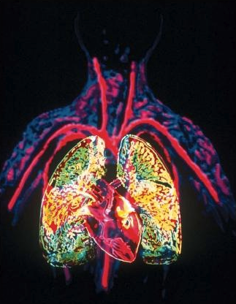
Circulation and Gas Exchange
(chapter 44)

Slide 2
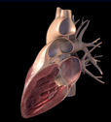
Circulation

Slide 3
Circulatory Systems
-Why we (multicellular animals) need them?
-Gastrovascular cavities
-Fick’s Law of diffusion
-Open and closed circulatory systems and their components (hearts and vessels)
-The diversity of circulatory systems in vertebrates
-Two-chambered fish hearts and their parts
-Three chambered hearts in amphibians and reptiles
-The four-chambered heart of birds and mammals.
-The cardiac cycle
-Cardiac output
-Arteries and veins
-Blood pressure and velocity
-Blood and its constituents (cells and plasma)
-Hematocrit

Slide 4
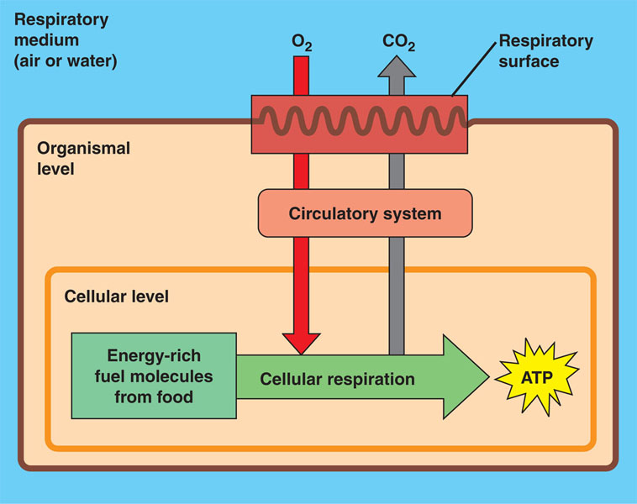
Organisms exchange energy and materials with the environment. They use circulatory systems to deliver energy, nutrients, and gases to and from the sites of exchange to cells.

Slide 5
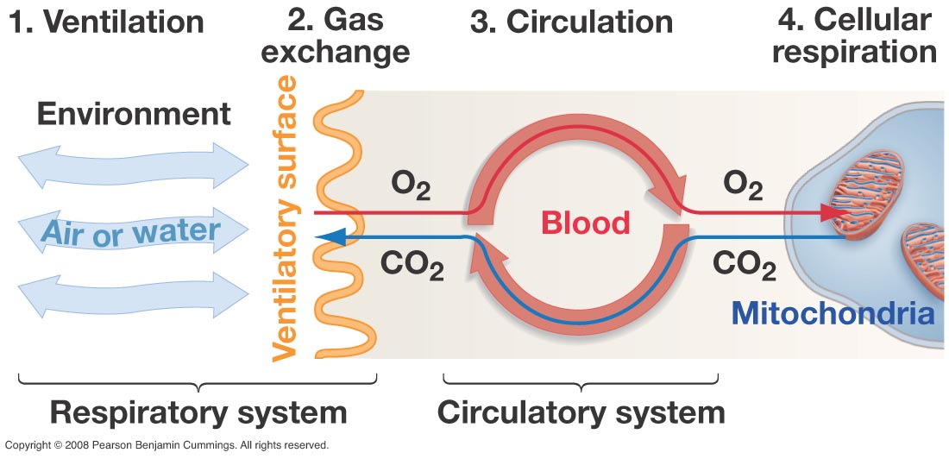
Digestion Uptake Circulation Respiration/Synthesis
BROAD PRINCIPLE

Slide 6
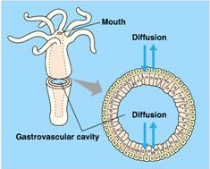
There are a variety of circulatory system designs
Some animals use the same space as a gastrointestinal tract and a circulatory system. This space is called a gastrovascular cavity (gastros means stomach…)

Slide 7
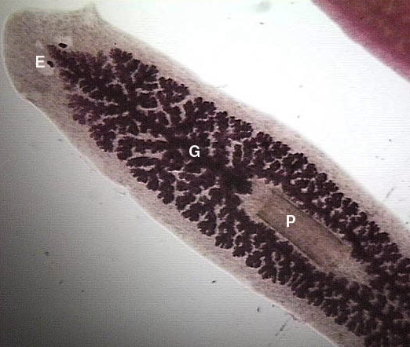
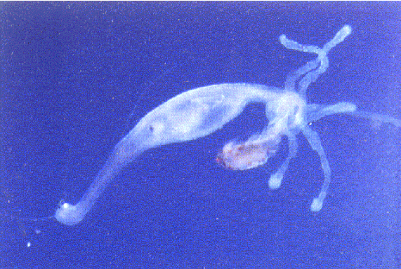
Two examples of animals with gastrovascular cavities are cnidarians and some (not all) platyhelminthes (flat worms).
Cnidarians, such as this hydra also have a gastrovascular cavity.
Turbellarians have a branched gastrovascular cavity

Slide 8
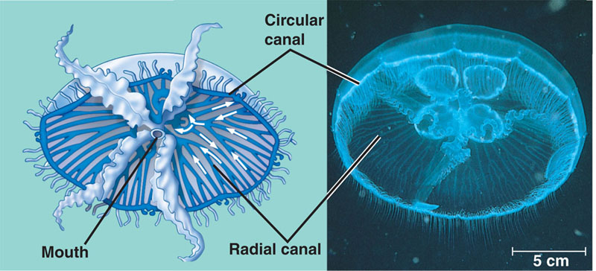
Gastrovascular cavities can be complex…
In this Aurelia (a cnidarian jellyfish), the mouth leads to a cavity that branches and radiates to and from a circulary canal.

Slide 9
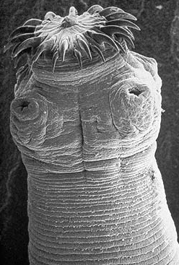
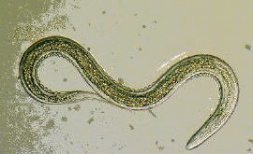
Many parasitic animals (nematodes and cestods) do not have circulatory systems.
How can they get away with this?

Slide 10
Many animals lack circulatory systems because
A) They have high metabolic rates
B) They are anaerobic
C) They are small and/or flat and hence the diffusional distances are small.
D) They live in air with high oxygen concentration.

Slide 11
Animals can get away with having a gastrovascular cavity or without a circulatory system only if the distances that energy and materials have to travel are small.

Slide 12
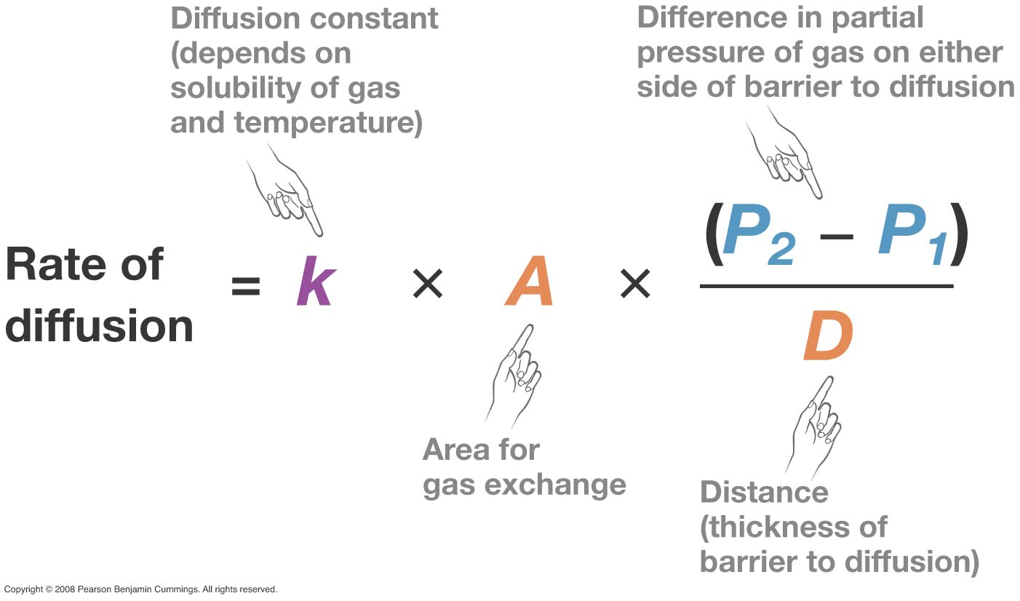
Fick's Law of Diffusion

Slide 13
General Biological Principle
The rate at which organisms move materials across membranes is governed by Fick's Law:
Rate (of diffusion) increases with
a) Surface area of exchange (A)
b) diffusion gradient (P₂-P₁)
and decreases with
c) thickness of barrier to diffusion (D)
BROAD PRINCIPLE HERE

Slide 14
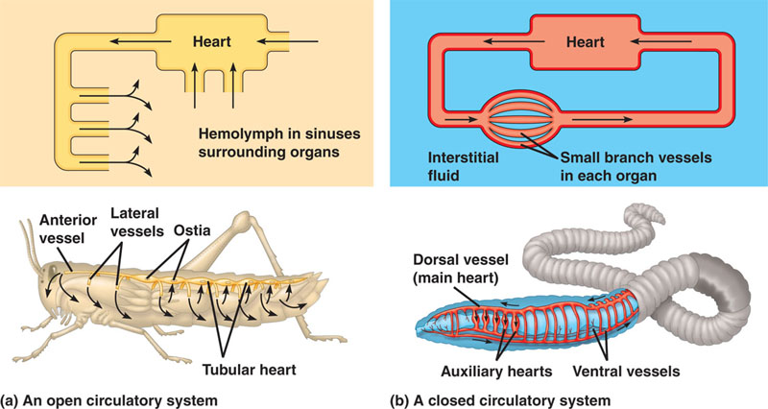
Animals with many cell layers have circulatory systems that follow two designs:
CLOSED
OPEN
The fluid in open circulatory systems is called hemolymph
The fluid in closed circulatory systems is called blood

Slide 15
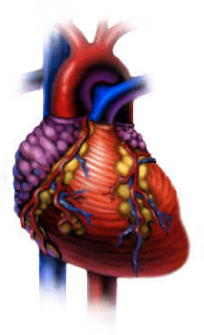
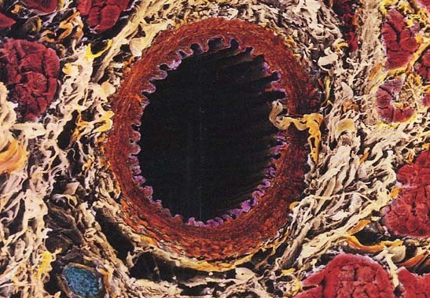
All circulatory systems have three ingredients:
A fluid to move around (blood or hemolymph)
A set of tubes (or vessels)
One or more muscular pumps (hearts)
Circulatory systems are often called cardiovascular systems
From (Gr) Kardia = heart
and (L) Vasculum = vessel

Slide 16
To Remember
-Multicellular animals use circulatory systems to deliver energy and nutrients to and from the sites of exchange to cells.
-Some invertebrates (flatworms and cnidarians) have gastrovascular cavities (a gut that doubles as a circulatory system).
-Many parasites do not have circulatory systems.
-True circulatory systems come in two designs (open with hemolymph, as in artropods) and closed (with blood, as in vertebrates).
-Circulatory systems have three ingredients: A fluid to move around (blood or hemolymph), a set of tubes (or vessels, one or more muscular pumps (hearts)

Slide 17
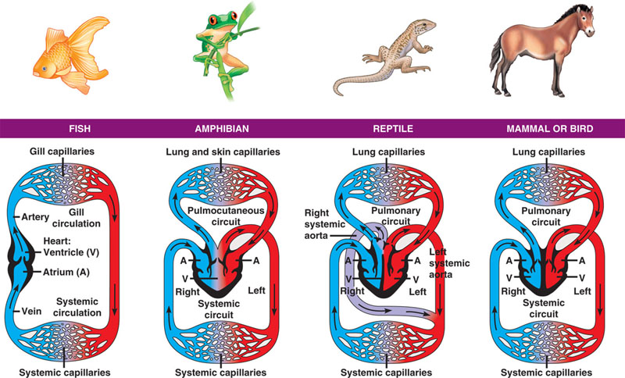
Vertebrates show 4 designs in their circulatory systems

Slide 18
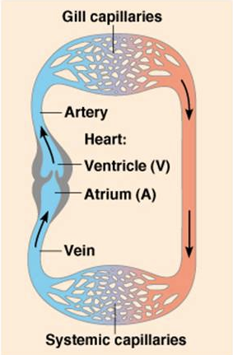
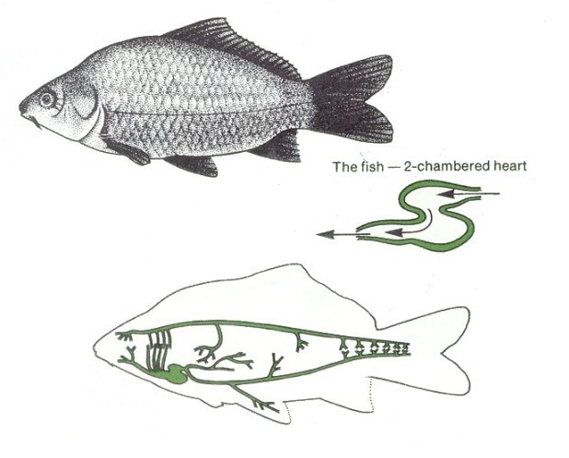
Fishes have a two-chambered heart. In fish, blood flows along a single pathway (or circuit)
oxygenated
blood
de-oxygenated
blood

Slide 19
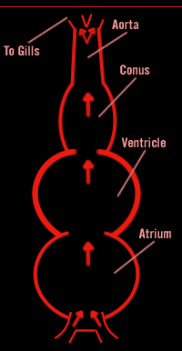
Fish hearts are simple but have all the main elements of a vertebrate heart. They have
A thin-walled atrium, which receives blood from veins into the heart (veins deliver blood to the heart).
A more muscular ventricle that pumps blood to a conus (a stretchy compartment).
The heart delivers blood to the gills by two aortic arteries (arteries are vessels that deliver blood out of the heart).

Slide 20
Atrium (plural atria) receive blood (from veins)
Ventricles pump blood away from the heart (through arteries).
Veins are vessels that deliver blood to the heart.
Arteries deliver blood from the heart to other organs/tissues.
BROAD PRINCIPLE

Slide 21
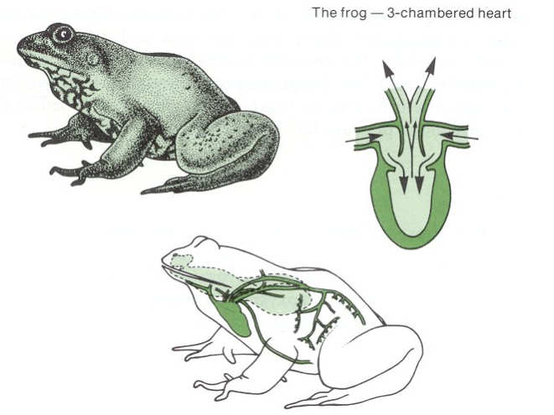
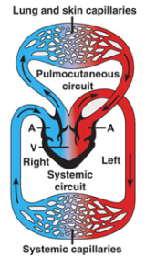
cutaneous
pulmo
+ gills
Amphibians have a heart with 3 chambers, and two blood flow circuits: a pulmocutaneous one, that goes from the heart to the sites of gas exchange, the skin, lungs, and gills, and a systemic one, that goes into internal organs and tissues. Note that there is some mixing of oxygen-rich and oxygen-poor blood in the single ventricle.

Slide 22
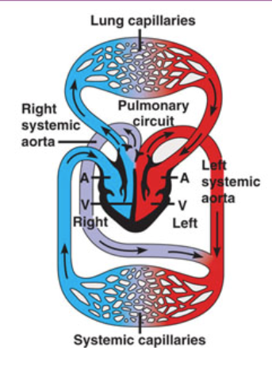
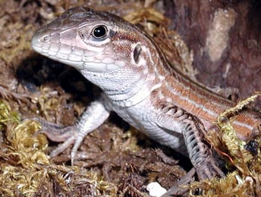
Most reptiles have a three-chambered heart and two circuits of blood (a pulmonary and a systemic one), but a
septum
that partially divides the ventricle and helps to reduce the mixing of oxygenated and de-oxygenated blood.

Slide 23
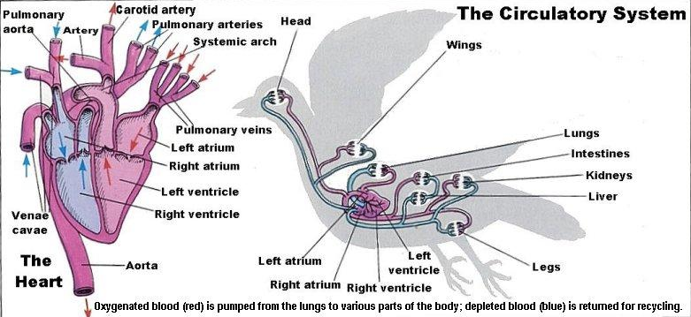
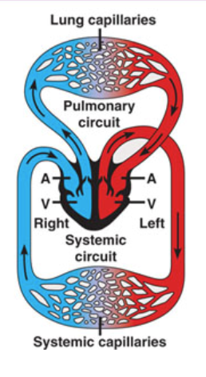
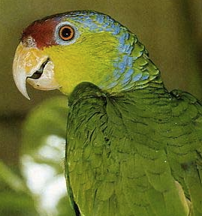
Mammals and birds have a four-chambered heart that separates oxygen-rich and oxygen-poor blood. Most likely, the four-chambered heart evolved independently in birds and mammals and its evolution was correlated with the evolution of endothermy.

Slide 24
THE PRESSURE EXCERTED BY THE MAMMALIAN HEART IS HIGHEST AT THE
RIGHT ATRIUM
LEFT VENTRICLE
RIGHT VENTRICLE
LEFT ATRIUM

Slide 25
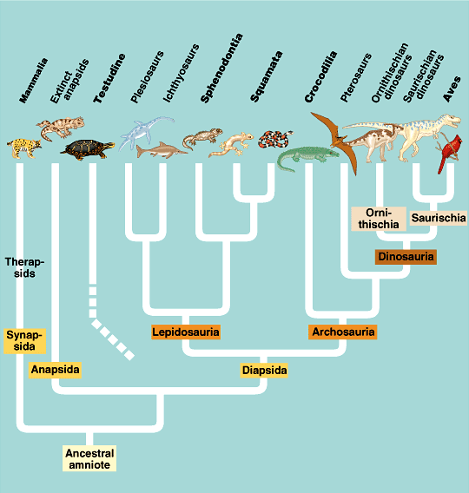
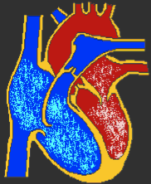
?
?
?
?
4-chambered hearts have evolved at least twice among vertebrates
?
?

Slide 26
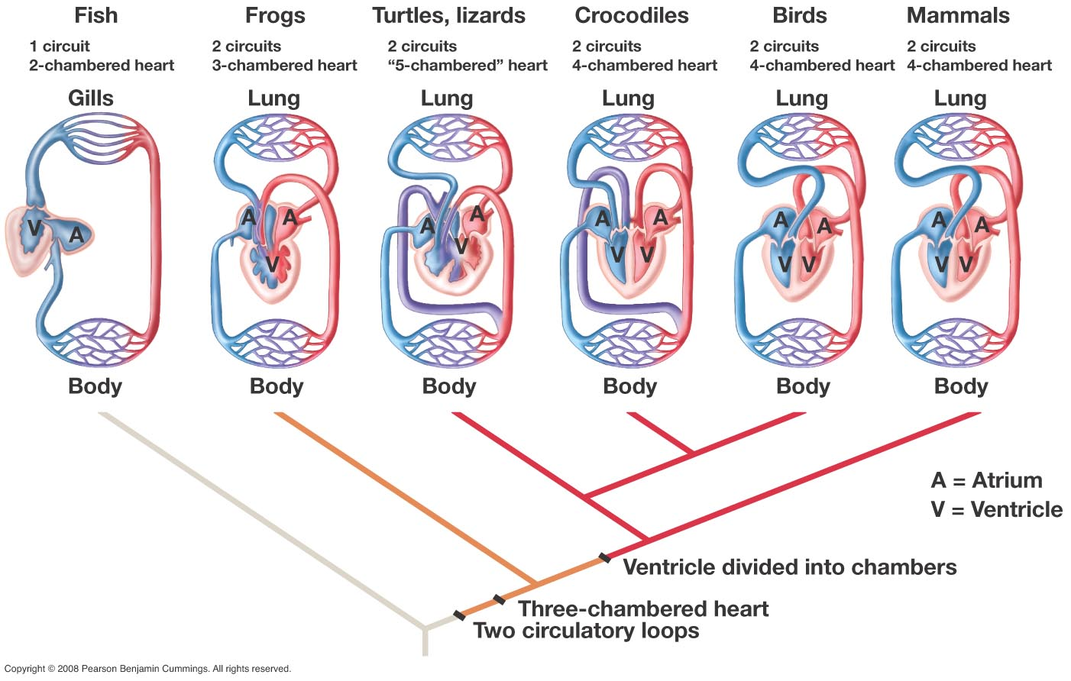

Slide 27
To Remember
Fish have a single pathway circulatory system with a two-chambered heart (sketch it).
Other vertebrates have two-pathway circulatory systems. One circuit flows into gas exchange surfaces where blood is oxygenated and another flows into tissues.
In amphibians and reptiles, the heart has 3 chambers (a ventricle and 2 atria). In these animals there is a little bit of mixing of oxygenated and de-oxygenated blood.
Four-chambered hearts have evolved independently at least twice in vertebrates maybe in concert/correlation with endothermy. We find them in crocs, birds, and mammals. In animals with a four chamber heart, the systemic and the pulmonary circulations are separate and in series.

Slide 28
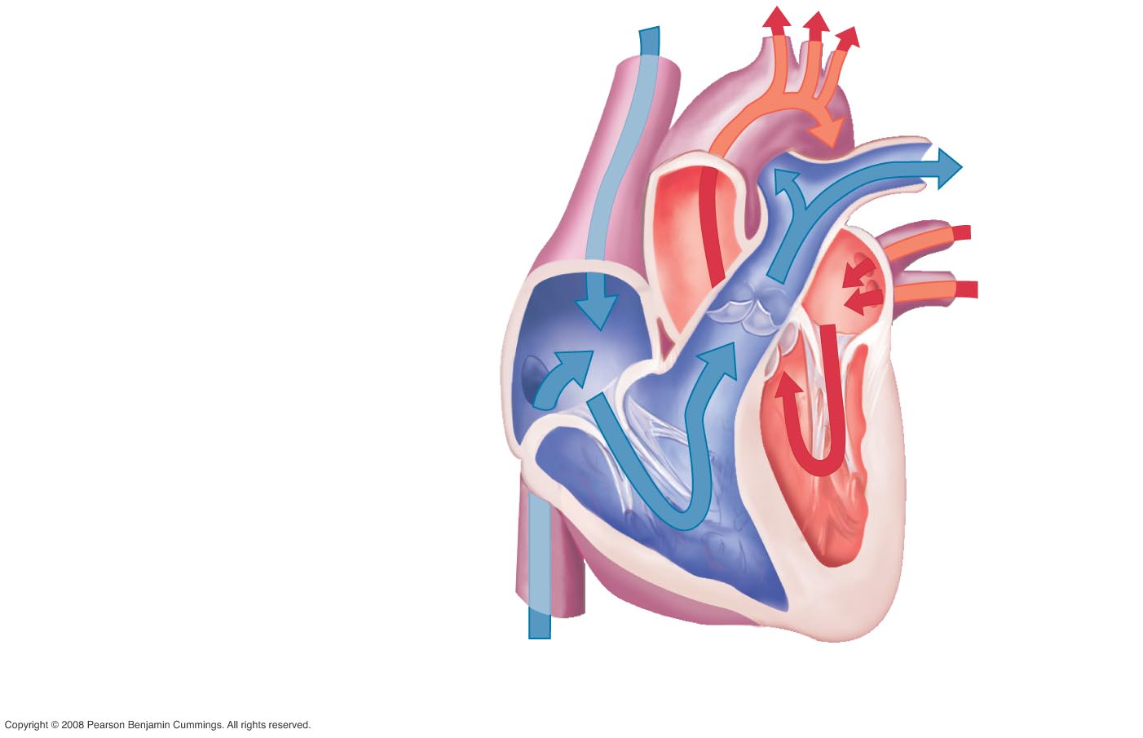
A and B = ?
Where does blood come from through A and B?
C = ?
D = ?
E = ?
Where does blood go
through E?
Vena Cava
A
E
Tissues
Right atrium
C
Right ventricle
Pulmonary artery
D
B
The right heart

Slide 29
A = ?
Where does blood come from through A ?
B = ?
C = ?
D = ?
Where does blood go
through D?
Pulmonary vein
D
Lungs
A
Left atrium
B
Left ventricle
Aorta
C
Tissues
The left heart

Slide 30
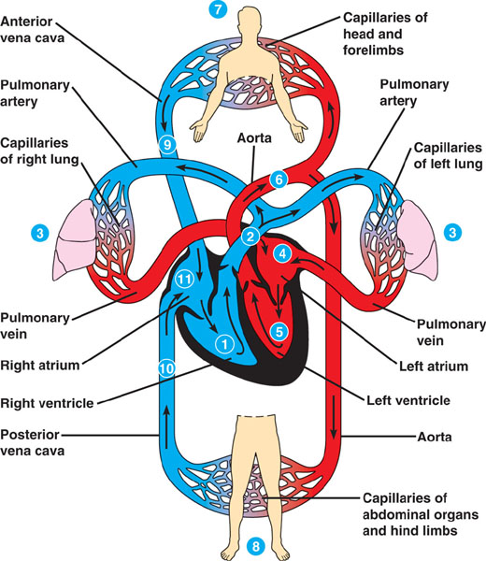
The right ventricle (1) pumps deoxygenated blood via the pulmonary arteries (2). As blood flows through the respiratory capillary beds (3) in the lungs, it takes up oxygen and releases carbon dioxide. O₂-rich blood returns from the lungs through the pulmonary vein to the left atrium of the heart (4). O₂-rich blood flows into the left ventricle (5), which pumps it through the aorta (6) which conveys it to the arteries through the body. One branch irrigates the capillaries of the head and arms (7), the other the abdominal organs and legs (8). Blood returns to the right atrium by the anterior (9) and posterior (10) vena cavae.

Slide 32
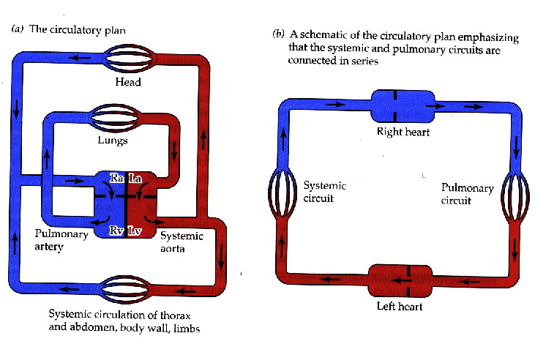
The pulmonary and systemic circuits are connected in series.
BROAD PRINCIPLE

Slide 33
Messages:
The “right” heart services the pulmonary circuit. It receives and pumps out de-oxygenated blood.
The “left” heart services the systemic circulation. It receives oxygenated blood from the pulmonary circulation and delivers oxygenated blood to tissues.
Remember that arteries are vessels that take blood OUT of the heart and veins take it INTO the heart.
BROAD PRINCIPLE

Slide 34
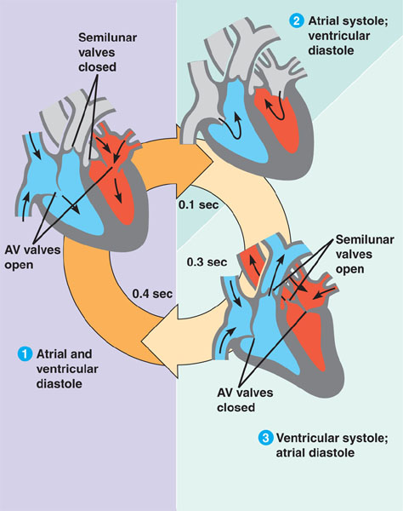
The cardiac cycle can be divided into three phases:
1) During a relaxation phase (the atria and ventricles are in diastole) and receive blood from veins. 2) A brief period of atrial systole sends blood from the atria into the ventricles. 3) In the next phase the ventricles are in systole (ventricular systole) and expel blood into the large arteries. The AV (atrioventricular valves) are closed and prevent blood from back-flowing into atria.
Diastole means “to expand”. Systole means “to contract” (Greek)

Slide 36
Cardiac Output = Heart RateXStroke Volume
mL/minute = beats/minute X mL/beat
In humans at rest, heart rate equals 70 beats/min and stroke volume is about 75 mL/beat. Therefore cardiac output equals:
Cardiac Output = 70X75=5,250 mL/min = 5.25 L/min
Beats/min
mL/beat
How much blood the heart pumps per unit time
BROAD PRINCIPLE

Slide 37
In mammals heart rate depends on body mass as
Heart Rate (beats/min) = 250(body mass)^{-0.25}
Cardiac output also depends on body mass as
Cardiac Output (ml/min) = 150(body mass)^{0.75}
These two relationships imply that stroke volume:
A) Increases with (body mass)¹
B) Decreases with (body mass)⁻¹
C) Is independent of body mass (i.e. SV is proportional to (body mass)⁰
D) Increases with (body mass)^{0.75}
Cardiac Output = Heart RateXStroke Volume
therefore SV = CO/HR = (150(body mass)^{0.75})/(250(body mass)^{-0.25}) = 0.6(body mass)¹

Slide 38
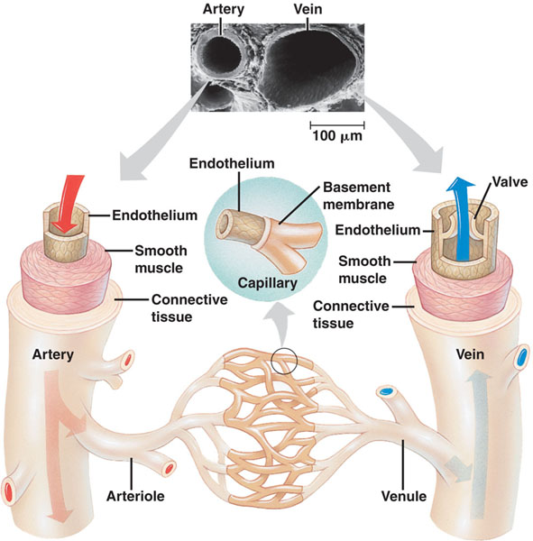
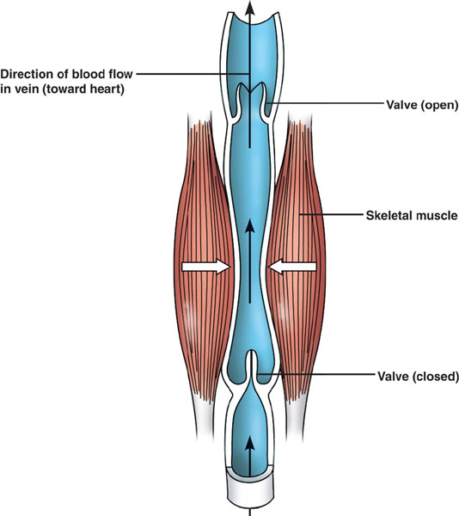
In vertebrates, blood vessels (arteries and veins) are built of the same tissues. On the outside there is a layer of connective tissue that allows the vessel to stretch and recoil. A middle layer contains smooth muscle and
more elastic fibers.
The lumen of vessels, including the tiny capillaries is a single layer of fattened cells called the endothelium that provides a smooth surface (so that blood flows smoothly). Capillaries lack the outer two layers (Why?). Veins convey blood back to the heart as a result of muscle action. Large veins have one-way valves that prevent back-flow.

Slide 41
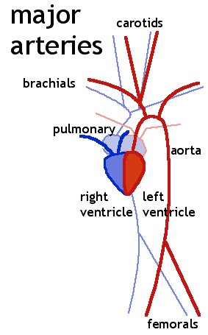
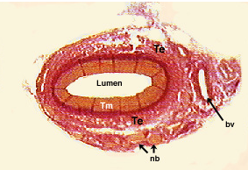
Arteries:
-Carry blood from the ventricles to the body or lungs.
-Are thick-walled and muscular.
-Contain blood at high pressure
arms
legs

Slide 42
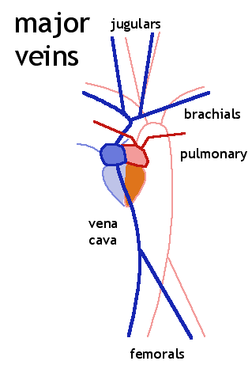
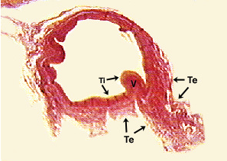
Veins
-Carry blood from the body or lungs back to atria.
-Are thinner-walled and flaccid when empty.
-Are under low-pressure and contain valves to prevent backflow.

Slide 43
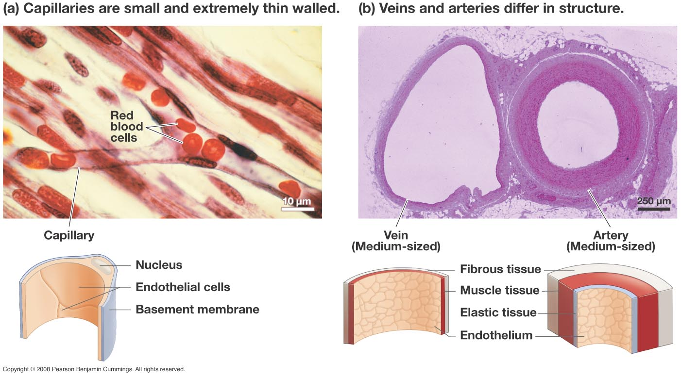
BROAD PRINCIPLE

Slide 44
To Remember
Diastole means “to expand”. Systole means “to contract” (Greek).
Cardiac Output = Heart RateXStroke Volume (please add units!)
Arteries and veins have a) layer of connective tissue, b) a layer of smooth muscle, c) an endothelium.
Capillaries just have endothelium.
5) Arteries carry blood from the ventricles to the body or lungs, are thick-walled and muscular, contain blood at high pressure
6) Veins carry blood from the body or lungs back to atria, are thinner-walled and flaccid when empty, are under low-pressure and contain valves to prevent backflow.

Slide 45
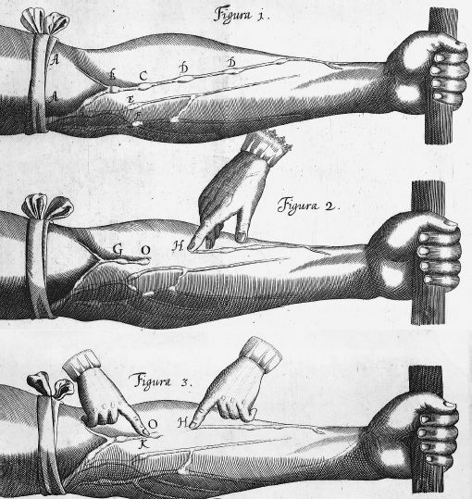
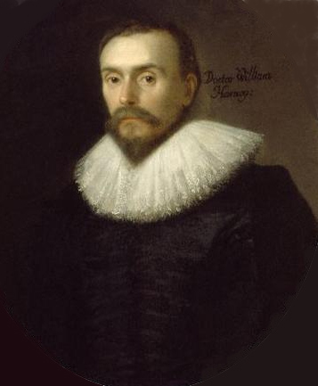
WHO DISCOVERED ALL THIS?
WILLIAM HARVEY (1578-1657)

Slide 46
Arteries are deeper
What are the bumps?
You cannot push venous blood down the arm (why??)
If you push it up the arm, it flows freely

Slide 47
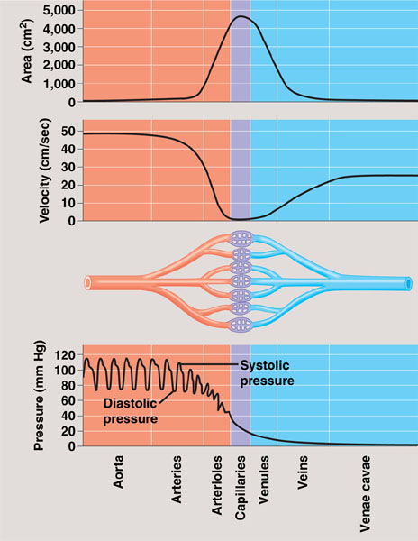
Fluids, such as blood, exert hydrostatic pressure. This is the pressure that drives fluids through a pipe. Remember that fluids flow always from areas of high pressure to areas of low pressure. Blood pressure is much greater in arteries than in veins and it is highest in arteries when the heart is in ventricular systole than when it is in diastole. But even during diastole there is significant blood pressure in arteries and blood continues to flow.

Slide 48
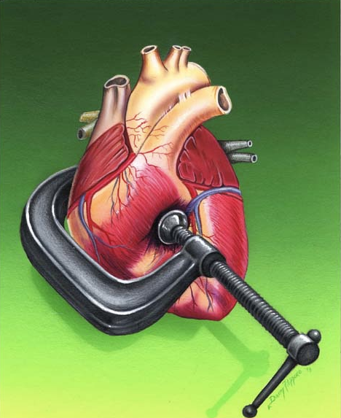
In healthy humans at rest
Systolic blood pressure ≈ 120 mm Hg (mercury)
Diastolic blood pressure is less than 80 mm Hg
(but lower is better…).
Blood pressures above 130/80 should probably be considered a risk factor for hypertension (increased risk of strokes, heart attacks, heart failure, chronic kidney failure). Not good!

Slide 49
To Remember
-Blood flows from areas of high hydrostatic pressure to areas of low hydrostatic pressure.
-Blood pressure in the aorta oscillates from being high during systole (≈ 120 mm Hg) to low during diastole (≈ 80 mm Hg).
-Blood pressure is much higher in arteries than in veins.
-High blood pressure is a risk factor for increased cardiovascular diseases.
BROAD PRINCIPLE

Slide 50
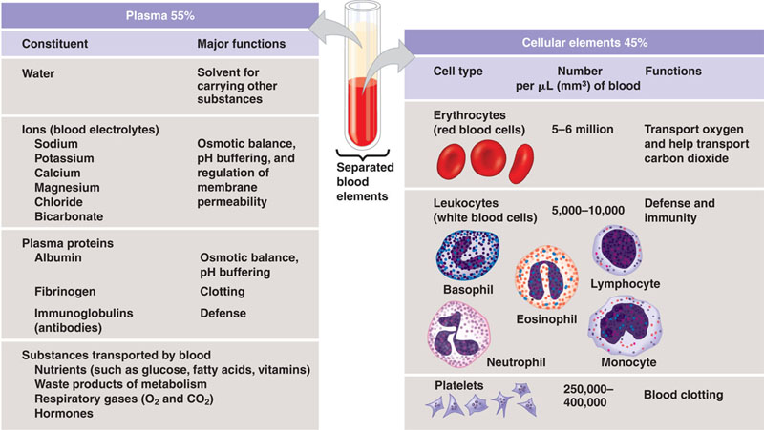
Blood is a connective tissue with cells suspended in plasma.
90%

Slide 53
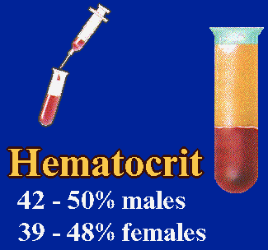
Hematocrit
Spin in
centrifuge
Hematocrit = 100x(cell volume/total volume)

Slide 54
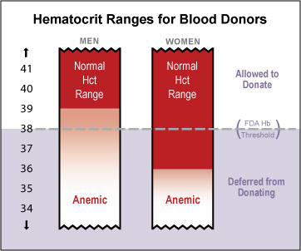
Hematocrit can be used to measure the concentration of red blood cells and therefore to diagnose anemia (anemia means low content of hemoglobin in blood).
BROAD PRINCIPLE

Slide 55
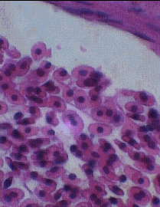
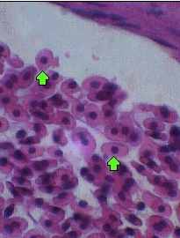
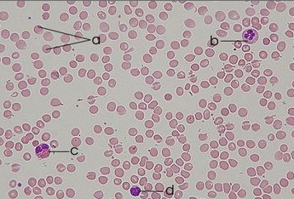
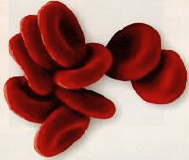
The red-blood cells of mammals lack a nucleus (indeed they lack all organelles)
mammal
fish
bird
Why??
Maybe because without a nucleus they can carry more hemoglobin. What is the tradeoff?

Slide 56
Red blood cells lack mitochondria. This means that they rely on _______________ to fuel their metabolism
Aerobic respiration
Lipid catabolism
Glycolysis
Anaerobic respiration
C and D

Slide 57
To Remember
-Blood is a connective tissue with cells suspended in plasma.
-Blood contains water, electrolytes, plasma proteins (albumin, fibrinogen, and immunoglobulins), nutrients, waste products, and gases (O₂ and CO₂)
-It also has cells (red blood cells, several types of white blood cells, and platelets which aid in coagulation).
-Hematocrit is the ratio of the volume of cells to total volume (plasma + cells).
-A low hematocrit is evidence of anemia.
-The erythrocytes of mammals have no nuclei (and no organelles), those of all other vertebrates are nucleated.

Slide 58
Review Questions
1) What type of circulatory systems do planarias and hydras have?
2) What types of circulatory systems do insects have?
3) What are the three fundamental components of a circulatory system.
4) Sketch the circulatory system of a fish, a reptile, and a bird.
5) Sketch the heart of a fish, a frog, and a human.
6) The pulmonary artery delivers blood from the __________ ____________ of the heart into the _____________
7) The pulmonary vein delivers blood from the _______________ into the _____________ _______________ of the _______________
Be ready for a bunch of questions of this type about the aorta and vena cava.
8) Define diastole and systole.
9) A shrew (Sorex araneus, 7.6 g) has a heart rate equal to 690 beats per min. The cardiac output of this shrew is 8.36 mL/min. What is this shrews stroke volume? Express your results in microliters.
10) the most external (outside) layer of a blood vessel is made primarily of ___________ ____________.

Slide 59
11) The layer in contact with blood is called _________________.
12) In a table list the differences between veins and arteries.
13) In the aorta ______________ blood pressure is lower than _________________ blood pressure.
14) A patient returning from tropical Africa has the following volumes of blood cells and plasma in a 50 microliter blood sample: Blood cells 17.5 µl, plasma 32.5 µl. Is this patient anemic? What is her hematocrit?

Slide 60

Gas exchange
The gills of a bluefin tuna

Slide 61
Gas Exchange
-Gases in the atmosphere
-Dalton’s Law of partial pressures
-Atmospheric pressure
-Relative Humidity
-Henry’s Law
-Fick’s Law of diffusion (once again)
-Gills and countercurrent exchanges
-Insect tracheae
-Positive and negative pressure ventilation
-Mammalian lungs
-Bird lungs
-How much oxygen can you carry in blood and why you have hemoglobin.
-Hemoglobin
-CO₂ transport
-Sickle cell anemia

Slide 62

BROAD PRINCIPLE
The composition of the atmosphere
Fractional composition of dry air
(F_{x,} %)
Nitrogen 78.09
Oxygen 20.95
Carbon Dioxide 0.037 (and increasing…)
Other (Argon, Helium,..) 0.93
Water 0 (it is dry air!)
The main determinant of variation in the composition of atmospheric air is water content (more later).

Slide 63

Carbon dioxide concentration has increased 30% during the past 200 years. Burning of fossil fuels and deforestation are the main causes.

Slide 64

TO REMEMBER
The composition of the atmosphere
Fractional composition of dry air
(F_{x,} %)
Nitrogen 78.09
Oxygen 20.95
Carbon Dioxide 0.037 (and increasing…)
Other (Argon, Helium,..) 0.93
Water 0 (it is dry air!)
The main determinant of variation in the composition of atmospheric air is water content (more later).

Slide 66
The total pressure exerted by a mixture of gases equals:
P_{tot} = ∑P_{x}=PN₂+PO₂+…etc.
Where P equals the partial pressure of gas x
(This is called Dalton’s law of partial pressures).

Slide 67
TO REMEMBER
Dalton’s law of partial pressures
The total pressure exerted by a mixture of gases equals:
P_{tot} = ∑P_{x}=PN₂+PO₂+…etc.
Where P equals the partial pressure of gas x
Therefore the partial pressure of an atmospheric gas is given by
P_{x}=(F_{x}/100)P_{atm}
For example in dry air and at sea level
PO₂ = (20.94/100)x760 =159.14 mm Hg.

Slide 68



Of barometers and mm of mercury
1 Atm = 760 mm Hg = 760 Torr=101.325 kPa
The barometer was invented by Evengelista Torricelli in 1644

Slide 69


Slide 70

The weight of the atmosphere at any point is called the atmospheric (or barometric) pressure. It is measured in a variety of units, but we will use mm Hg (mm of mercury).
760 mmHg = 1 atm= 101.3X10³ Pascals
Atmospheric pressure decreases with altitude.

Slide 71
To calculate the partial pressure of the gas, you multiply the fractional concentration of the gas by the total pressure of the mixture.
P_{x} = (F_{x}/100)xP_{tot}
For example, the partial pressure of oxygen in dry air at sea level is:
PO₂ = O.21 x 760 (mm Hg) = 159.6 mm Hg.
DO NOT MEMORIZE ANY NUMBERS. IF NEEDED, I WILL GIVE THEM TO YOU!
Fx = 21%, P_{tot} =P_{atm} =760 mm Hg

Slide 72

Breathing both oxygen and nitrogen at high partial pressures can cause negative effects (nitrogen narcosis and oxygen poisoning). Therefore, deep sea divers often use mixtures of gases that are more suitable for deep dives. One of these mixtures is called Trimix, it is suitable to dive at ≈ 100 m. It includes oxygen (10%), nitrogen (20%), and helium (70%). The pressure on a diver’s lungs at 100 m is ≈ 8,000 mm Hg.
The partial pressure of nitrogen inhaled by this diver is:
800 mm Hg
1600 mm Hg
5,600 mm Hg
1,000 mm Hg

Slide 73

The partial pressure of carbon dioxide in dry air at sea level is
A) 0.2812 mm Hg
B) 28.12 mm Hg
C) 281.2 mm Hg
D) 592.8 mm Hg
FCO₂ = 0.037

Slide 74

BROAD PRINCIPLE

Slide 75

The atmospheric pressure in Laramie (WY) is 74% that of sea level. This means that the partial pressure of oxygen in dry air in Laramie is:
A) 118.1 mm Hg
B) 562.4 mm Hg
C) 159.6 mm Hg
D) 0.1554 mm Hg

Slide 76
The atmospheric pressure in Laramie (WY) is 74% that of sea level. This means that the partial pressure of oxygen in dry air in Laramie is:
A) 118.1 mm Hg
B) 562.4 mm Hg
C) 159.6 mm Hg
D) 0.1554 mm Hg
0.21x760x0.74=118.1 mm Hg

Slide 77

The single most important determinant of variation in air composition is water vapor.
When air and water come in contact some molecules of water go into the gas phase.

Slide 78
The partial pressure caused by water vapor at saturation increases exponentially with temperature.

Slide 79
The single most important determinant of variation in air composition is water vapor.
When air and water come in contact some molecules of water go into the gas phase.
P*H₂0
pH₂0
pH₂0=vapor pressure = the partial pressure of water vapor in air.
In air above an open water container, the air saturates with water vapor and a dynamic equilibrium is reached with a given partial pressure for these molecules. This equilibrium depends on ambient temperature.
r.h. = 30/55.1=0.54 (54%)
Sometimes air is not saturated with water vapor.
Relative humidity = r.h.
= pH₂0/ p*H₂0 =actual vapor pressure/saturating vapor pressure

Slide 80
Vapor pressure deficit

Slide 81

To remember
1) pH₂0 =vapor pressure = the partial pressure of water vapor in air.
2) Relative humidity = r.h.
= pH₂0/ p*H₂0 =actual vapor pressure/saturating vapor pressure
3) Saturating vapor pressure increases rapidly with temperature
BROAD PRINCIPLE
Why does dew form?

Slide 82


Contrails and breath condensation

Slide 83
The saturating vapor pressure at 10°C is 10 mm Hg. If the measured vapor pressure is 3 mm Hg, then relative humidity is
A) 10%
B) 30%
C) 50%
D) 60%
3/10 = 0.3, 30%
…and the vapor pressure deficit is…
90%
70%
50%
60%
100-30% = 70%

Slide 84
To Remember
Dry air contains 78% N₂, 21% O₂, and 0.04% CO₂
Physiologists measure pressure in mm Hg
At sea level atmospheric pressure ≈ 760 mm Hg
Atmospheric pressure decreases with altitude
Gases follow Dalton’s law (P_{tot} = PN₂+PO₂+PCO₂+…
You can calculate the partial pressure of a gas x as
P_{x} = (F_{x}/100)XP_{tot}
The saturated partial pressure of water (vapor pressure) increases with temperature.
Relative humidity equals
(actual vapor pressure/saturated vapor pressure)X100

Slide 85



Slide 86

Gases in solution
The amount of gas that dissolves in a given volume of water (at equilibrium) depends on
The solubility of the gas
P_{x}, its partial pressure
Temperature
Other non-gas solutes.
Henry’s Law
[x] = α_{x}P_{x} (ml/100 ml)
The solubility of a gas is measured by its solubility coefficient (α_{x}). α_{x} depends on temperature, α_{x} = f(temperature, other solutes)
α_{x} = ml of gas dissolved in 100 ml of water (vol %) per mm Hg
α_{x} decreases with temperature (gases behave differently from solid solutes!). α_{x} decreases with solutes.

Slide 87
In words Henry’s law tells you that the volume of gas in solution increases with pressure ([x]=α_{x}P_{x})

Slide 88
To remember
1) Henry’s law [x] =α_{x}P_{X}(ml/100 ml)
Partial pressure
Concentration of gas (ml/100 ml)
Solubility coefficient
α_{x} = f(temperature, other solutes)
ml/(100 ml x mm Hg)
This is important because it allows us to express the concentration of a gas in either mm of Hg or in ml/100 ml
BROAD PRINCIPLE

Slide 89
The solubility of a gas
DECREASES WITH TEMPERATURES
DECREASES WITH THE CONCENTRATIO OF OTHER SOLUTES.

Slide 90



The chemistry, physics, and biolology of beer.
Heat: what happens?
Add salt: what happens?

Slide 91
At 36° C the solubility coefficient of oxygen is 0.003 ml/ (100 mlxmm Hg). The partial pressure of oxygen at sea level is approximately 160 mm Hg. How many mL of O₂ are in 100 mL of water?
Henry’s law [x] = α_{x}P_{x} (ml/100 ml)
A) 48 ml of O₂/100 mL
B) 0.048 ml of O₂/100 mL
C) 3 ml of O₂/100 mL
D) 0.48 of O₂/100 mL

Slide 92
At 36° C the solubility coefficient of oxygen is 0.003 ml/ (100 mlxmm Hg). The partial pressure of oxygen at sea level is approximately 160 mm Hg. How many mL of O₂ are in 100 mL of water?
Henry’s law [x] = α_{x}P_{x} (ml/100 ml)
A) 48 ml of O₂/100 mL
B) 0.048 ml of O₂/100 mL
C) 3 ml of O₂/100 mL
D) 0.48 of O₂/100 mL
0.003x160 = 0.48 mL of O₂/100 mL

Slide 93


Oxygen and Carbon dioxide differ in solubility
at 37 °C
ml/ (100 mlxmm Hg)
α_{O2} 0.003
α_{CO2} 0.063
[x] = α_{x}P_{x,} Henry’s Law
[0₂]=100X0.003=0.3 ml/100 ml
[C0₂]=100X0.063=6.3 ml/100 ml
CO₂ is ≈ 20 times more soluble in water than O₂ (REMEMBER THIS).
BROAD PRINCIPLE

Slide 94
To Remember
The amount of gas dissolved in water satisfies Henry’s Law:
mL of gas/100 mL = solubility coefficientXpartial pressure
2) Solubility of gases decreases with temperature
3) Solubility of gases decreases with the concentration of other solutes (NaCl)
4) CO₂ is ≈ 20 times more soluble in water than O2.

Slide 95
How much OXYGEN is in 1 L of air and 1 L of water?
0.21X1 L = 0.21 L = 210 ml/L
in water at sea level
0.03 ml/LXmm HgX760x0.21 = 4.8 ml/L
Air has a MUCH higher oxygen content AND is a lot
less dense
BROAD PRINCIPLE

Slide 96
Gas exchange surfaces: gills, tracheae, and lungs

Slide 97

The partial pressure of oxygen in a deep sea diver’s lungs is 750 mm Hg. At sea level, the partial pressure of oxygen is only about 100 mmm Hg. The solubility coefficient of oxygen equals 0.03 ml/(mm HgxL), this means that each liter of the blood of the diver will have _________ ml of oxygen under water, but only __________ ml of oxygen when the diver is on land.
22.5 and 3 (ml of oxygen) /L mm Hg
3 and 22.5 (ml of oxygen) /L mm Hg
0.225 and 0.3 (ml of oxygen) /L mm Hg
0.3 and 0.25 (ml of oxygen) /L mm Hg
2.25 and 0.3 (ml of oxygen) /L mm Hg

Slide 98
Fick's Law of Diffusion
BROAD PRINCIPLE

Slide 99
All gas exchange structures must be designed so that:
1) A is maximized (large surface area)
2) (P₂-P₁) is maximized (the gradient in gas concentration
between medium and "blood)
3) D is minimized (the distance between medium and blood)

Slide 100
General Biological Principle
The rate at which organisms move materials across membranes is governed by Fick's Law:
Rate (of diffusion) increases with
a) Surface area of exchange (A)
b) diffusion gradient (P₂-P₁)
and decreases with
c) thickness of barrier to diffusion (D)

Slide 101

Gills are…..
out-foldings of the body surface suspended in flowing water. The process of “ventilation” refers to the ways in which animals move water around gills.
BROAD PRINCIPLE
Most (not all) animals that live in water use gills for respiration

Slide 102

In sea stars and other echinoderms the gills are simple tubular projections of the skin.
Polychaetes (marine annelids) have paired flattened appendages that serve as both gills and legs/paddles.
The gills of a scallop are long, flattened plates that project from the main body inside of the shell. They are covered with cilia which circulate water.
Crustaceans have long, feathery gills surrounded by the exoskeleton. Specialized body appendages drive water over the gill surfaces.

Slide 103

Fish pump water continuously through their mouth and over the gill arches, using coordinated movements of the jaws and operculum. Each gill has two rows of gill filaments composed of flattened plates called lamellae.
Blood flows though the capillaries of the lamellae against the direction of water flow. Water and blood flow in opposite directions in a countercurrent exchange pattern. This arrangement increases the efficiency with which gills take-up oxygen from water.

Slide 105


Slide 106

The respiratory system of insects consists of
Branched internal tubes that deliver air directly to body cells. Rings of chitin reinforce these tubes. Trachea become enlarged in air sacs near organs that need a lot of oxygen. Air enters the tracheae through openings called spiracles and passes into smaller tubes called tracheoles. The tracheoles are closed and have fluid at their tips to facilitate gas exchange.
Tracheal systems reach all of an insect’s body

Slide 107

But many aquatic insects have gills…..(why?)
Potamanthus pluteus (the nymph of a mayfly)

Slide 108



Land snails (pulmonates) have lungs…. (marine mollusks have gills)
So do spiders
Apple snail (Pomacea bridgesii)
A lung is restricted to one location and animals must move air in and out of it. Lungs are usually surrounded by a dense bed of capillaries just under the gas exchange epithelium

Slide 109
Animals that "breath" water use gills whereas animals that breath air have lungs because
A) The oxygen content of air is higher in air than water
B) Water is a lot more dense than air
C) Moving water in and out of lungs would be too expensive
D) All of the above

Slide 110
Two Important Principles That Drive Ventilation
1) Fluids (including gases) always move from areas of high to areas of low pressure.
2) Pressure is reciprocally related to volume (remember
P=nRT/V)
BROAD PRINCIPLE

Slide 111
For animals with lungs there are two mechanisms of ventilation (ventilation = moving air in and out of lungs):
Positive pressure
Negative pressure

Slide 112


Amphibians (adult and not all adults), reptiles, birds, and mammals have lungs.
Compliance is low because of low levels of surfactant
Frogs use positive pressure ventilation…
Positive ventilation is often used in clinical practice.

Slide 113

Reptiles, birds, and mammals use negative pressure ventilation.
Remember that when volume increases, pressure drops! In humans, the volume of the lung expands when the diaphragm contracts. The expansion and contraction of the thoracic cavity during exercise is aided by the action of intercostal (rib-cage) muscles.

Slide 114

BROAD PRINCIPLE

Slide 115


Slide 116
To Remember
Animals use skin, gills, trachea and lungs to exchange gases. All these structures are very heavily vascularized.
Gills are outfoldings of the body surface.
Fish gills rely on a countercurrent exchanger.
Terrestrial insects use tracheal systems aquatic insects use gills.
Lungs are vascularized infoldings of the body surface.
Lungs can be ventilated by positive pressure in amphibians.
Reptiles, birds, and mammals, use negative pressure ventilation.

Slide 117


Slide 118


The respiratory system has two major functional components:
The airways (“conducting zone”, from trachea to bronchioles).
The gas exchange surfaces (“respiratory zone”, respiratory bronchioles and alveoli)

Slide 119


The epithelial surfaces of the airways are lined by ciliated cells and goblet cells which secrete mucus. Particulate matter that is entrapped in this mucus is delivered to the pharynx and then swallowed (Oh my!). The epithelium also secretes a water fluid that lubricates the space between cells and mucus.
In cystic fibrosis the mucus becomes dry and thick.

Slide 120

Ciliated
cells
Goblet
cells

Slide 121


Slide 122

Emphysema….
A brief preachy (and precautionary) note

Slide 123



The term lung emphysema means “excess air in the lungs”. It is a complex obstructive and destructive lung disease that is in most cases the consequence of long term smoking. It results from:
Chronic infection (smoke and tar irritate bronchi and bronchioles)
Excess mucus and inflamatory edema cause chronic obstruction.
Obstruction entraps air in alveloli
Emphysema has many physiological consequences:
Reduced diffusing capacity
Reduced number of lung capillaries
Increased vascular resistance.

Slide 124


And emphysema may be the least of your troubles….
Cancer

Slide 125
To Remember
In mammals The respiratory system has two major functional component: 1) The airways (“conducting zone”, from trachea to bronchioles); 2)The gas exchange surfaces (“respiratory zone”, respiratory bronchioles and alveoli).
The epithelial surfaces of the airways are lined by ciliated cells and goblet cells which secrete mucus.
3) Alveoli, the main elements of the respiratory zone, are richly supplied with blood by a capillary bed.
4) DON’T SMOKE!

Slide 126

Birds have a lung with a different, much more efficient, design. Contraction and expansion of air sacs ventilates the lungs. During inhalation the air sacs expand. The posterior air sacs fill with fresh air (blue) from the outside. The anterior air sacs fill with stale (grey) air from the lungs. During exhalation the air sacs deflate and the fresh air moves from the posterior air sacs into the lungs and that in the anterior air sacs out of the system through the trachea. Two cycles of inhalation and exhalation are required for air to pass all the way through the bird. Gas exchange takes place in lung structures called parabronchi.

Slide 127


Slide 128


Slide 129
To Remember
In mammals The respiratory system has two major functional component: 1) The airways (“conducting zone”, from trachea to bronchioles); 2)The gas exchange surfaces (“respiratory zone”, respiratory bronchioles and alveoli).
The epithelial surfaces of the airways are lined by ciliated cells and goblet cells which secrete mucus.
3) Alveoli, the main elements of the respiratory zone, are richly supplied with blood by a capillary bed.
4) In mammals and reptiles the respiratory system moves air in and out in each breath.
5) In birds, air stays in the respiratory system for 2 breath cycles. The through-flow respiratory system of birds in very, very efficient.

Slide 130

Gases always move across partial pressure gradients (from high to low pressure). PO₂ in alveoli (at sea level) is ≈ 104 mm Hg. The PO₂ in de-oxygenated blood is ≈ 40 mm Hg.
Remember Henry’s law?
Henry’s law [x] = α_{x}P_{x} (ml/L)

Slide 131
HOW MUCH OXYGEN CAN BLOOD CARRY?
Remember Henry’s law?
Henry’s law [x] = α_{x}P_{x} (ml/L)

Slide 132

FOR EMPHASIS
[O2] = αO₂xPO₂ = 0.003X100=0.3 ml/100 ml=3 ml/L
αO₂
(ml/(LXmm Hg) UNITS!
PO₂
(mm Hg)
Not very much!!!
Human oxygenated arterial blood has approximately 213 ml of O₂ per liter!
How do we increase the oxygen carrying capacity of blood??

Slide 133
The amount of oxygen that can be carried in blood in simple solution is very small. It is not sufficient to fuel metabolism!!
How do we increase the oxygen carrying capacity of blood??
BROAD PRINCIPLE

Slide 134


Most of the O₂ in blood is bound to hemoglobin
Hemoglobin has long been a star among proteins. Its 3-dimensional structure was determined by Max Perutz (Cambridge University) in the late 50s. Normal hemoglobin is composed of four subunits linked together (each subunit is shown in a different color in the ribbon model). Each subunit contains a single heme-ring like structure with an iron atom that binds one oxygen atom.
Max Ferdinand Perutz (1914-2002)
Mountaineer, Chemist
He won the Nobel Prize for his Hb work in 1962.

Slide 135


Hemoglobin is transported within erythrocytes (Red Blood Cell). RBCs have no nucleus in mammals but are nucleated in all other vertebrates.
Hence the concentration of hemoglobin in blood [Hb] is proportional to hematocrit.
Hematocrit is the fraction of blood’s volume that is comprised of cells
H = 100(cells/(cells+plasma))

Slide 136
Whole blood
Spin in a centrifuge
Plasma = P
Cells = C
Hematocrit =100X C/(P+C)
Low hematocrit is called ANEMIA

Slide 137
A patient returns from Equatorial Africa. You obtain a 50 µl of blood, you spin it in a centrifuge, and you find that plasma represents 35 µl. From this you conclude that the patient
A) Is healthy
B) Has too much hemoglobin
C) Is anemic

Slide 138
Hematocrit can be used to measure the concentration of red blood cells and therefore to diagnose anemia (anemia means low content of hemoglobin in blood).
100(15/50)=30%
BROAD PRINCIPLE

Slide 139


In fetal
Hb there are 2 ϒ chains instead of the β chains of adults
a=α
b=β
BROAD PRINCIPLE
Hb is a tetramer. It has 4 polypeptide chains (2 alpha and 2 beta). Each chain has a heme group. Because Hb has a distinct color, it is called a respiratory pigment.

Slide 140

Each molecule of hemoglobin can bind 4 oxygens.
Each gram of Hb can bind 1.4 ml of oxygen. Each liter of human blood has 150 g of Hb. Therefore each liter of human blood can hold:
1.4 (ml/gram)x150 g/liter = 210 ml of O2/liter of blood.

Slide 141

Oxygen in blood is in 2 forms: 1) in simple solution, 2) bound to hemoglobin (most O₂ in blood is bound to hemoglobin!)

Slide 142



Other respiratory pigments
Pigment Metal Taxa
_________________________________________
Hemocyanin Copper some arthropods
(colorless ->blue) and mollusks
Hemerythrin Iron brachiopods
Chlorocruonin Iron Annelids
(green-> red)

Slide 143

Where does the term “blue blood” come from?
Hemocyanin
Hemoglobin

Slide 144


How come there are Antarctic fish (fam: Nothotenioidea, rockcods) with no respiratory pigments?
Treamtus loennbergii
Tremathomus bernacchii
Cold water
Low metabolism

Slide 145
Oxygen in blood is in 2 forms: 1) in simple solution, 2) bound to hemoglobin (most O₂ in blood is bound to hemoglobin!)

Slide 146
To Remember
Only a very small amount of oxygen in blood is in simple solution.
Most is bound to hemoglobin.
The hemoglobin molecule has two alpha and two beta chains. Oxygen binds to the heme (iron-containing) group contained in each of these chains.
Animals use a variety of other respiratory pigments.

Slide 147

Oxyhemoglobin
(Hb4O₂), red blood
Oxygen-Hb dissociation
or
Oxygen-Hb equilibrium
curve
Deoxyhemoglobin
(Hb), bluish blood
BROAD PRINCIPLE
The amount of blood that is carried by hemoglobin depends on oxygen’s partial pressure. The relationship between how saturated Hb is with oxygen and PO₂ is sigmoidal.

Slide 148


Slide 149
But, the O₂-Hb dissociation curve is not static….

Slide 150

Low pH (more acid), higher temperature, and increased CO₂ concentration shift the curve to the right. This shift facilitates the unloading of O₂ to tissues.
BROAD PRINCIPLE

Slide 151
Do these shifts make physiological sense??.

Slide 152
To Remember
How saturated hemoglobin is with oxygen depends on partial pressure. The relationship between % saturation and PO₂ is sigmoidal.
Low pH, shifts the hemoglobin dissociation curve to the right and facilitates O₂ unloading to tissues.
Higher CO2 concentrations in blood also shift the Hb-O₂ dissociation curve to the right and also facilitates O₂ unloading to tissues.

Slide 153


From this graph you can infer that
A) At the same altitude vicuñas have lower oxygen in their blood than other mammals.
B) At the same altitude vicuñas have the same oxygen in their blood than other mammals.
C) At the same altitude vicuñas have more oxygen in their blood than other mammals.

Slide 154


A or B
A
B

Slide 155
A nice video
http://www.youtube.com/watch?v=WXOBJEXxNEo

Slide 156

CO₂ reacts with water to form first carbonic acid, which then dissociates into bicarbonate and H⁺:
Both CO₂ and H⁺ bind to hemoglobin and reduce its affinity for oxygen.
(catalyzed by carbonic anhydrase)
CO₂+H₂O <--> H₂CO₃ <--> HCO₃⁻ + H⁺
CO₂ is transported:
As CO₂ in plasma (7%)
2) as HCO3⁻ in plasma (70%, increased CO₂ content drive pH DOWN).
3) Bound to hemoglobin (HbCO₂ =carbamino, 23%)
Of course the %s are approximate!
Increased concentration of CO₂ (produced by tissues during exercise) makes blood slightly more acidic.

Slide 157
CO₂ is transported in blood primarily as bicarbonate (70% in plasma), bound to hemoglobin (23% in RBC), and in simple solution (7% in plasma).

Slide 158

The whole process is reversed in the capillaries of the lung, and CO₂ is expelled. Note that as the concentration of CO₂ decreases, the affinity of Hb for oxygen increases and hence blood can increase its capacity to pick up oxygen.

Slide 159
To Remember
CO₂ is transported in blood primarily as bicarbonate (70% in plasma), bound to hemoglobin (23% in RBC), and in simple solution (7% in plasma).

Slide 160

Malaria is a widespread vector-borne infectious disease caused by a sporozoan (ampicomplexan) parasite (Plasmodium sp). It afflicts 400 million people each year and causes between 1-5 million deaths every year.
How can we treat it?

Slide 161


Slide 162




THE SICKLE CELL CURE
Normal hemoglobin (Hb) has 2 alpha and 2 beta chains that form a 4 chain tetramer
What if valine is substituted in a single position for glutamic acid in both beta chains? Normal hemoglobin is called A hemoglobin. The hemoglobin with the valine substitution is called S hemoglobin.
This confers resistance to Malaria!

Slide 163



Why do erythrocytes become sickle-shaped?
When Hb is deoxygenated the beta chain binds with other beta chains in a polymer. Hb polymers distort red blood cells into sickle shapes leading to the death of parasites!!!
one Hb molecule
a dimer

Slide 164

The genetics of sickle cell anemia.
Sickle cell anemia is coded by simple Mendelian genetics. The “defective” Hb is coded by a “recessive allele” (S) and the normal Hb is coded by a “dominant” allele.
THE CATCH
The method works only for heterozygous individuals
Genotype Expression
SS Sickle Cell, often lethal
AS and AA Normal but AS is protected against malaria
It is a catch because some individuals will be protected but a large fraction of their children will either a) suffer from malaria, or b) die of a nasty condition.

Slide 165


In areas with malaria
The homozygous condition causes serious circulatory problems. The heterozygous condition kills the parasites which are…
Apicomplexan
Plasmodium falsiparum

Slide 166
If both parents are heterozygous for the sickle cell trait, what is the probability that one of their children will be heterozygous as well?
A) ¼
B) ½
C) 1
D) 3/4

Slide 167
1/2
1/4
1/4
 | Sickle (S) | Normal (N)
Sickle (S) | SS | SN
Normal (N) | SN | NN

Slide 168
Why do erythrocytes become sickle-shaped?
When Hb is deoxygenated the beta chain binds with other beta chains in a polymer. Hb polymers distort red blood cells into sickle shapes leading to vaso-occlusion (sluggish marrow circulation can lead to osteomyleitis (bone infection), infarction)
one Hb molecule
a dimer

Slide 169
DO YOU THINK THAT OUR “INTELLIGENTLY DESIGNED”
GENETIC THERAPY FOR MALARIA IS ETHICAL AND HUMANE?
Yes
No
WOULD A HUMAN SYSTEM DESIGNED IN THIS WAY BE MORALLY ACCEPTABLE?
Yes
No

Slide 170

The geography of sickle cell anemia
Why is the S allele so common in some regions?
The heterozygous (AS) condition protects against malaria (“heterozygous advantage”).

Slide 171


Once again, evolutionary theory provides the clues to understand human disease…..
Evolution is not an ideological/theological debate of no consequence. It is at the foundation of modern biology (including medicine).

Slide 172
To remember
Sickle cell anemia is a “molecular disease” that results from a single amino acid substitution in the beta chains of hemoglobin.
It is inherited by simple Mendelian segregation with two alleles: a dominant (“normal”, A allele) and a recessive one (Anemia, S allele).
The heterozygous (AS) is protected against malaria, the dominant homozygous is normal but susceptible to malaria, the recessive homozygous (SS) is often lethal.
The frequency of S is very high in areas with high incidence of malaria as a result of natural selection.

Slide 173
Review questions in the web site

