Slide 1

Acid-Base Balance
Perhaps the most important homeostatic process…

Slide 2
Schedule
Intro
Why the pH value of body fluids must be “defended”
Defining pH
Logarithms (see appendix)
Acidosis and alkalosis
Biological Buffers and the Henderson-Hasselbalch equation
Physiological mechanisms (the lung and kidney)
Tutorial

Slide 3
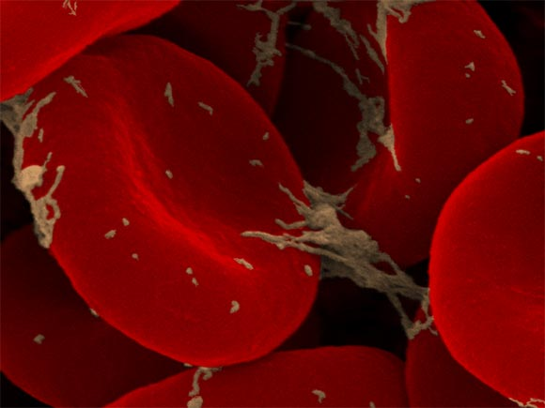
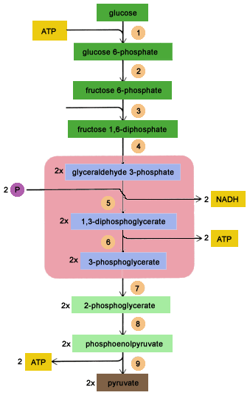
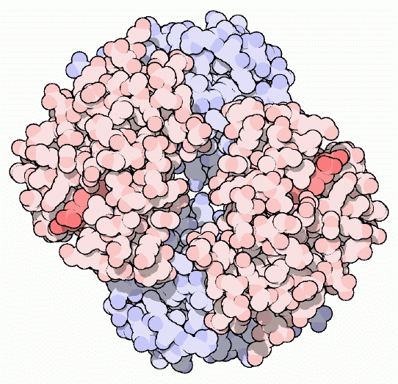
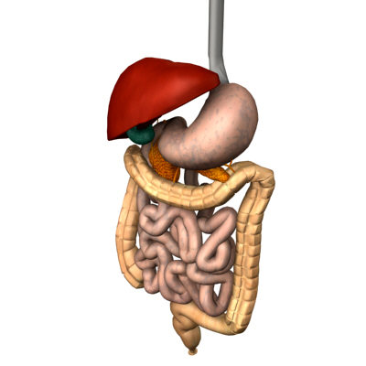
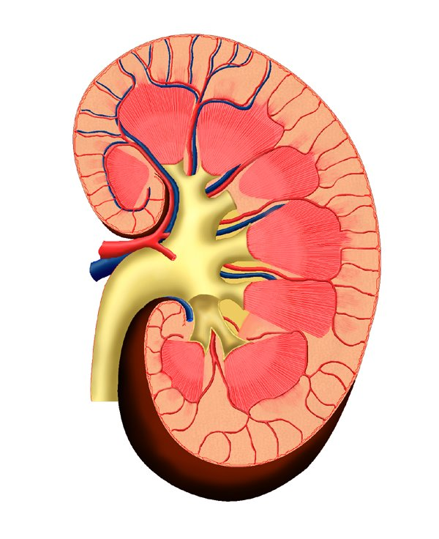
Factors that influence the pH of body fluids
Control mechanisms
Processes that generate energy (metabolism)
Respiration (blood gases)
[H⁺] in body fluids
Circulation (Hb as a buffer)
Renal processes (conservation and excretion of H⁺ and bicarbonate)
Intake, digestion, and fecal losses (GI tract)

Slide 4
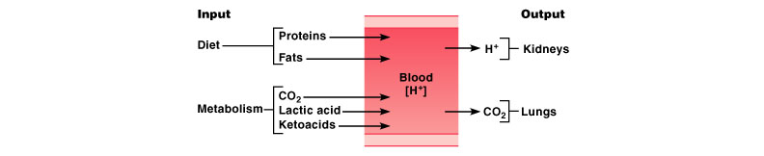

Slide 5
A few important numbers
Keeping the concentration of H⁺ in body fluids within a narrow range is fundamental.
The range is narrow (i.e. 7.36 -7.44). If pH falls outside of this range, enzyme activity is affected, the polar state of ionic molecules is changed, and membrane function (i.e. the Na⁺/K⁺ ATPAse pump) is impacted.
pH < 7 (extreme acidosis) and pH > 7.8 (extreme alkalosis) are fatal. These values refer to pH in blood!

Slide 6
Things that one needs to know to be able to understand acid base balance
Acids/bases
Buffers (we will deal with them in class)
pH (we will deal with it in class)
Logarithms
-Rules of logarithms
-How to solve equations involving logarithms
(I WILL NOT DEAL WITH LOGS IN CLASS! BUT ALL THE NECESSARY INFORMATION IS IN YOUR NOTES)

Slide 7
pH from a physiologists perspective (for your own use)
A few definitions
An acid is a substance that produces H⁺ in aqueous solution
( HCl(aq) ------------> H⁺(aq) + Cl⁻(aq) )
A base is a substance that produces OH⁻ in aqueous solution
( NaOH(aq)-----------> Na⁺(aq) + OH⁻ )
HCl and NaOH are a strong acid and base, respectively

Slide 8
pH is a measure of the acidity of an aqueous solution
[H₃O⁺] (or [H⁺]) can vary from 1 M to 10⁻¹⁴ M. In the range in which physiologists work, it is around 10⁻⁷ (i.e. 0.0000001). It is really awkward to work with such small numbers. To make life easier people use logarithms
pH = -Log([H⁺])
pH = Log (1/[H⁺])
DO NOT COMMIT THE FOLLOWING MISTAKE
pH ≠ 1/Log([H⁺])
NOTE NEGATIVE SIGN

Slide 9
To Remember
The normal pH range in plasma is really narrow: between 7.36 and 7.44
The concentration of H⁺ ions in really pure water is 10⁻⁷ M (the pH of pure water is 7 and we call it neutral!)
pH =-Log[H+] =Log(1/[H+])
NOT MUCH TO REMEMBER. BUT REMEMBER IT.

Slide 10
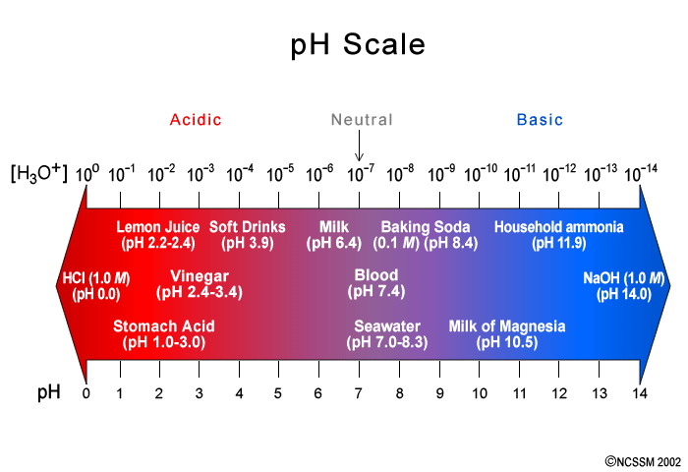

Slide 11
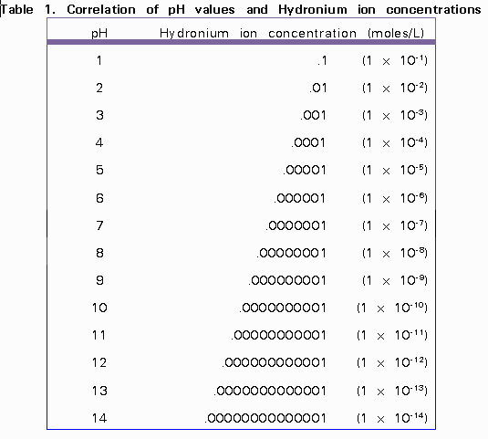

Slide 12
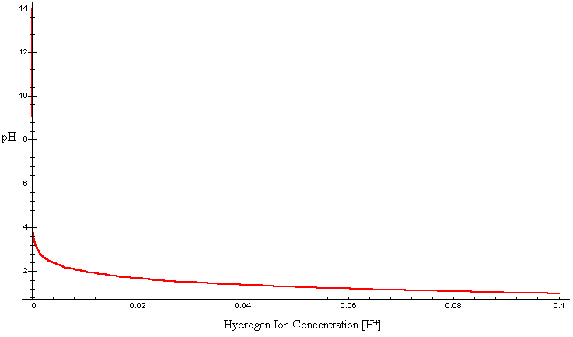
pH = -Log([H⁺])
pH = Log (1/[H⁺])

Slide 13
To Remember
pH =-Log([H⁺]) = Log(1/[H⁺])
pH = 7 is neutral
pH > 7 is basic, pH < 7 is acidic

Slide 14
Why do we need to understand all this darn chemistry?
Because acidosis lurks….
The pH of body fluids is constantly under challenges because:
CO₂ produced by catabolism generates H⁺
Carbonic Anhydrase
CO₂ + H₂0 ---> H₂CO₃ ---> H⁺ + HCO₃⁻
2) When NADH and FADH are reduced (as in the Krebs cycle), there is a net production of H⁺
REMEMBER THIS REACTION!
It takes place in RBCs

Slide 15
Other H⁺ producing processes
3) Catabolism of proteins produces some sulfuric (methionine/Cysteine) and phosphoric acid.
4) Catabolism of fatty acids and ketones produces H⁺.
In all, these 4 sources produce the equivalent of ≈ 15 L of HCl per day. Without some mechanism to buffer/excrete all this acid, the pH of blood would drop from 7.4 to 4.4 in 24 h.

Slide 16
Alkalosis also lurks (but not as frequently) due to…
Vomiting (you lose H⁺ from stomach contents)
Excess exhalation of CO₂ (as when you hyperventilate).

Slide 17
To Remember
Many metabolic processes produce acidity.
Important example is the production of carbonic acid from water and carbon dioxide (KNOW THE REACTION!!!)
Alkalosis results from vomiting (WHY?) and from excess exhalation of CO₂.

Slide 18
How do we control pH in body fluids within narrow ranges
Buffers
Physiological Processes

Slide 19
Three lines of defense:
  Buffering of hydrogen ions (first line, instantaneous)
  Respiratory compensation (second line, takes minutes)
  Renal compensation (3rd line, takes hours to days regulates the excretion of H⁺ and HCO₃⁻ in urine and regulates the synthesis of HCO₃⁻ in tubules)

Slide 20
Physiological buffering systems
In this course we will consider 3 buffering systems:
carbonic acid:bicarbonate
Hemoglobin
Phosphate (HPO₄⁻)
HCO₃⁻ and Hb function in ECF, whereas the HPO₄⁻ system works inside of cells.

Slide 21
How do buffers work?
A buffer is a weak acid (and its conjugate base) that can resist changes in pH by neutralizing either added acid or added base. In the bicarbonate case, the acid is H₂CO₃ and its conjugate base is HCO₃⁻
We have already talked about bicarbonate (HCO₃⁻) as an important biological buffer
CO₂ + H₂0 < --- > H₂CO₃ < --- > H⁺ + HCO₃⁻
Lots of acid
CO₂ + H₂0 < --- H₂CO₃ < --- H⁺ + HCO₃⁻
Lots of base (not much acid)
CO₂ + H₂0 --- > H₂CO₃ --- > H⁺ + HCO₃⁻

Slide 22
H₂CO₃ is the acid and HCO₃⁻ is the conjugate base in the bicarbonate buffer system
CO₂ + H₂0 < --- > H₂CO₃ < --- > H⁺ + HCO₃⁻
conjugate acid
conjugate base

Slide 23
The Henderson Haselbach Equation and, more importantly, how to use it.
Where pKa is the pH at which [Conjugate base] = [acid] and therefore:
Log ([conjugate base]/[acid]) = Log (1) = ?
0

Slide 24
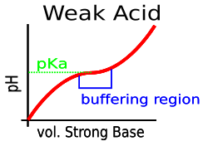
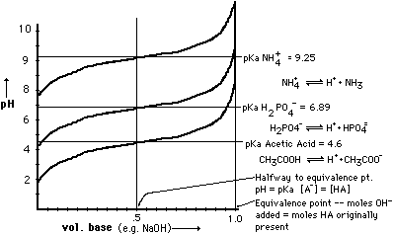
A buffer works best around its pK_{a}
Remember that the pKa is the pH at which
[Conjugate base] = [acid]

Slide 25
Buffers in body fluids (1): The bicarbonate system

Slide 26
To Remember
A buffer is a weak acid (and its conjugate base) that can resist changes in pH by neutralizing either added acid or added base.
In the bicarbonate case, the acid is H₂CO₃ and its conjugate base is HCO₃⁻
Henderson-Haselbach equation
pKa is the pH at which [conj. Base] =[acid]

Slide 27
Because in body fluids H₂CO₃ <---- > CO₂ + H₂O, we estimate
[H₂CO₃] = αP_{arterial}CO₂ (α is CO2’s solubility coeff.)
[H₂CO₃] = 0.03 (mmol/Lxmm Hg)xP_{a}CO₂ (mm Hg) (by Henry’s Law!!).
We can write:
Please note the units of concentration, which in this case are mmol/L.

Slide 28
What do you need to know to estimate the pH of blood?
pKa =6.1
[HCO₃⁻]
PCO₂
aCO2 = 0.03 mmol/(Lxmm Hg)

Slide 29
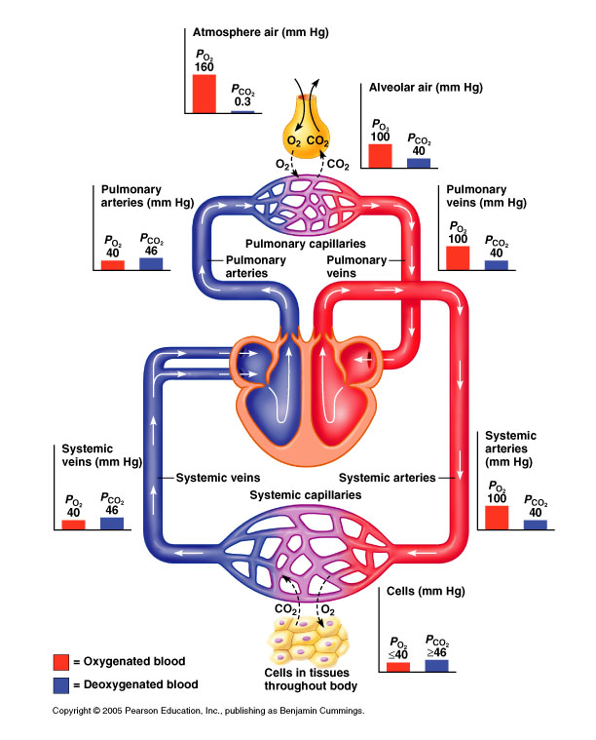
Lets use it
pKa (HCO₃⁻:H₂CO₃) = 6.1
P_{a}CO₂ ≈ 40 mm Hg
[HCO₃⁻] = 24 mmol/L
α=0.03 mmol/(Lxmm Hg)
Log(20) =1.3

Slide 30

Lessons
The bicarbonate buffer system is far from perfect (its pK_{a} = 6.1 is far from 7.4)
The 20:1 ratio between [HCO₃⁻] and [CO₂] must be maintained (how?)
If [CO₂] goes up
ventilation goes up, the lungs excrete it
If [HCO₃⁻] goes down, then the kidneys reabsorb and synthesize bicarbonate

Slide 31
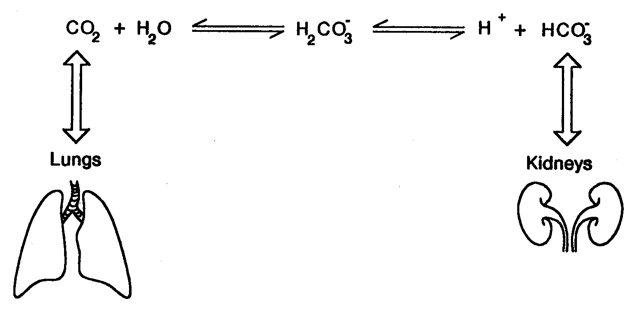
The importance of bicarbonate
The bicarbonate system (including the kidney and lung!) controls ≈ 65% of all H⁺ produced.

Slide 32
To Remember
At physiological pH (≈ 7.4), [HCO₃⁻]/[aP_{a}CO₂] ≈ 20/1
This ratio MUST be maintained, so if CO2 goes up, then we hyperventilate. If bicarbonate goes down the kidney synthesizes it and reabsorbs it.
The bicarbonate system (including lung+ kidneys controls ≈ 65% of all H⁺ produced)

Slide 33
Hemoglobin as a buffer
In theory all amino acids in proteins could work as buffers (they have COOH:COO⁻, NH₂:NH⁺ groups). However they do not…
pKa (COOH:COO-) ≈ 2 (at physiological pH the carboxylic acid is fully dissociated!
pKa(NH₂:NH⁺ ) ≈ 9
In what form are these two weak acids in our proteins?
COO⁻ + H+ < --- > COOH
Not a lot of acid (pH >>>> pKa)
NH⁺ < --- > NH₂
Lots of acid (pH of blood <<< pKa)

Slide 34
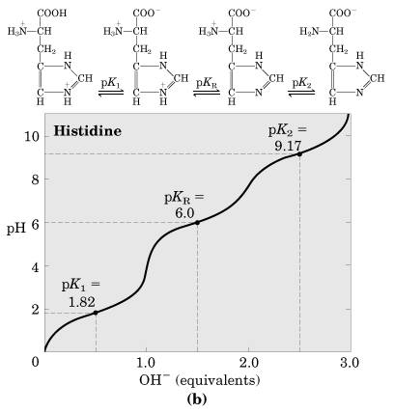
Hemoglobin is a pretty good buffer because (1):
It has a lot of histidine (144 histidines/474 total aas, 30%). Histidine has an imidazole ring (PK_{a} ≈ 6.0).

Slide 35
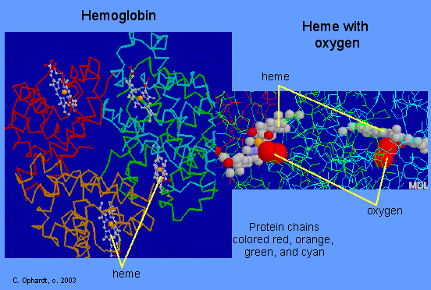
Hemoglobin (Hb) as a buffer
The abundance of histidine in Hb makes both hemoglobin (HHb:HHb, pKa = 7.85) and oxyhemoglobin (HHbO₂:HbO₂, pKa = 6.6) act as great buffers around pH =7.4.
In addition Hb is in high concentration in blood (150 g/L).
  Hemoglobin accounts
  for the remaining 35% of the buffering “needs” of extracellular fluids.

Slide 36
Phosphate an intracellular buffer
This buffer has the following conjugated pair:
(H₂PO4⁻:HPO4⁻⁻)
(monobasic phosphate:dibasic phosphate)
The intracellular concentration is 60 mmol/L
pKa ≈ 6.8

Slide 37
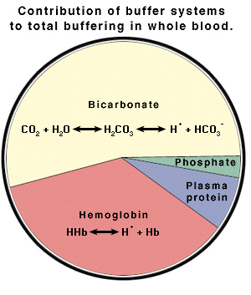
To remember and in summary

Slide 38
To Remember
Hemoglobin (both oxy and deoxy) is a good buffer.
It is a good buffer because its histidines have pKa-s in the right range and because there is a lot of Hb.
Hb accounts for ≈ 35% of the buffering needs of extracellular fluids.
Phosphate is the primary intracellular fluid.
The relative contributions of the buffering systems are:
bicarbonate (64%) > Hemoglobin (35%) > phosphate and
other

Slide 39
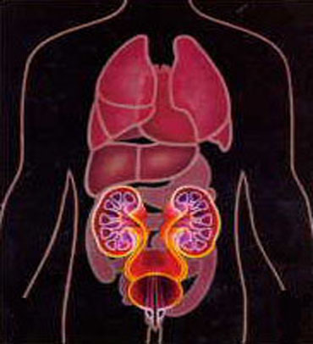
Physiological mechanisms
Two organ systems participate in the regulation of acid base balance:
The lungs (respiratory system)
The kidney

Slide 40
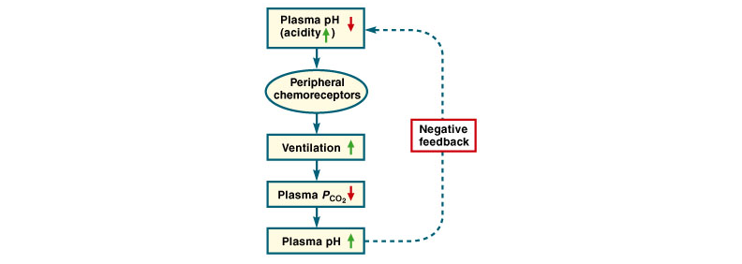
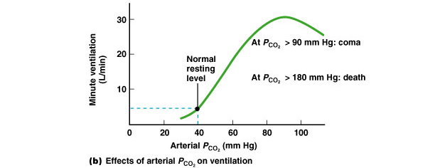
The lungs
-[H⁺] is reduced when V_{A} (alveolar ventilation) is increased because as PCO₂ goes down the reaction
CO₂ + H₂O < ---- > H⁺ + HCO₃⁻
favors the production of CO₂.
(if PCO₂ ⬆ (i.e. pH⬇) then V_{A}⬆ and vice versa)
-When V_{A} is decreased, PCO₂ goes up and the reaction
CO₂ + H₂O < ---- > H⁺ + HCO₃⁻
favors the production of H⁺.
(if PCO₂ ⬇ (i.e. pH⬆) then V_{A}⬇ and vice versa)

Slide 41
If PCO₂ goes UP (consequently pH goes down), ventilation increases and blows off the CO2 (pH returns to normal)
If PCO₂ goes down (pH goes up, acidity decreases), ventilation decreases, CO₂ is retained, and pH returns to normal.

Slide 42
Physiological mechanisms
Two organ systems participate in the regulation of acid base balance:
The lungs (respiratory system)
The kidney

Slide 43
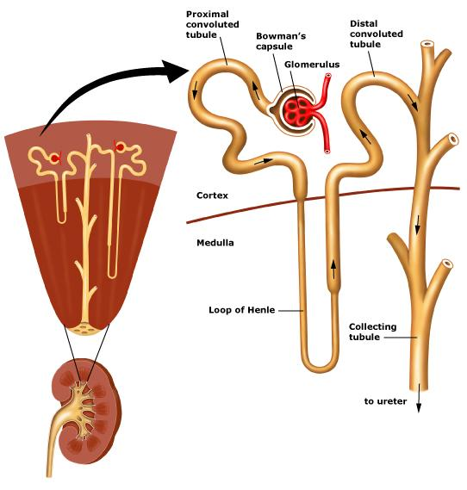

Slide 44
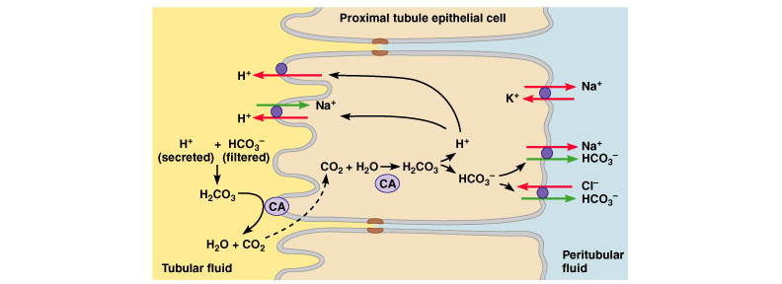
The kidneys…
Have two main functions: they (a) maintain the concentration of HCO₃⁻ and (b) regenerate HCO₃⁻from CO₂ when CO₂ is in excess in blood.
(a) The proximal convoluted tubule reabsorbs 4000 mmol of filtered HCO₃⁻ per day(≈ 116 g/d, i.e. 4 moleX29 g/mol). Note the importance of CA (Carbonic Anhydrase).

Slide 45
1) Kidney reabsobs bicarbonate

Slide 46
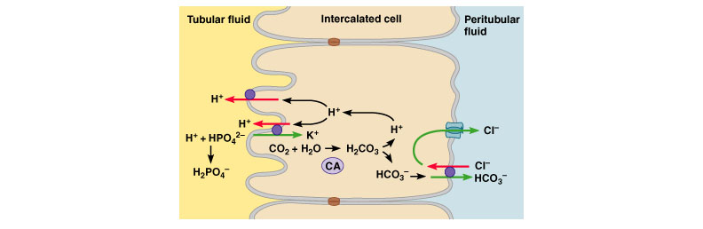
The kidneys…
Have two main functions: they (a) maintain the concentration of HCO₃⁻ and (b) regenerate HCO₃⁻ from CO₂ when CO₂ is in excess in blood.
(b) When CO₂ in blood is high (lung insufficiency), intercalated cells in distal tubule and collecting duct regenerate HCO₃⁻ from CO₂ in blood.
In the distal tubules and collecting duct H⁺ ions are buffered by phosphates (filtered NaPO₄, the Na is reabsorbed).

Slide 47
The kidney regenerates bicarbonate from CO₂

Slide 48
To Remember
Both the lungs and the kidneys are fundamental participants in acid-base balance.
The lungs participate by regulating the level of PCO₂ as a consequence of adjustments in ventilation.
The kidneys maintain the concentration of HCO₃⁻ in blood by reabsorbing it in the proximal convoluted tubule.
The kidneys also regenerate HCO₃⁻ when CO₂ in blood is high.

Slide 49
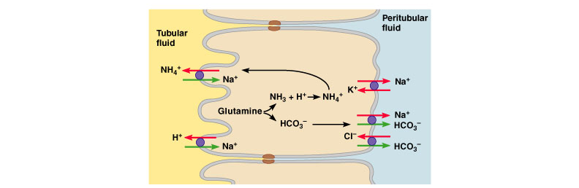
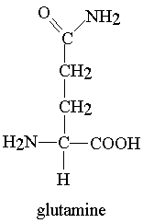
  -Regulation of hydrogen ion secretion, bicarbonate reabsorption, and bicarbonate synthesis by kidneys is usually sufficient. However, in severe acidosis, glutamine metabolism produces new bicarbonate and H⁺ ions are secreted in the form of ammonium (NH₄). Because the pKa of NH₄ ≈ 9.2. it does not dissociate. Urine smells like ammonia because i) NH₄ dissociates into ammonia, and ii) bacterial ureases release NH₃.

Slide 50
To Remember
Both the lungs and the kidneys are fundamental participants in acid-base balance.
The lungs participate by regulating the level of PCO₂ as a consequence of adjustments in ventilation.
The kidneys maintain the concentration of HCO₃⁻ in blood by reabsorbing it in the proximal convoluted tubule.
The kidneys also regenerate HCO₃⁻ when CO₂ in blood is high.
In severe acidosis, the kidney also synthesizes HCO₃⁻ from glutamine. In this process H⁺ ions are also excreted bound to ammonia (NH₄)

Slide 51
A few factoids about urine’s pH
Urine pH is diet-dependent. Carnivores produce more acidic urine than vegetarians.
Typical pH urine values range from 4.6 to 8.0, but on a mixed diet the pH is ≈ 6.0.
pH values can be diagnostic for a variety of conditions
High urine pH
-Kidney failure
-Kidney tubular acidosis (failure of kidneys to excrete H⁺)
-Urinary tract infection
-Vomiting
Low urine pH
-Chronic obstructive diseases (emphysema)
-Diabetic ketoacidosis
-Diarrhea

Slide 52
Acid-Base Disturbances
Two types
-acidosis (blood pH < 7.35)
-alkalosis (blood pH > 7.45)
Each type has two types of causes
-respiratory
-metabolic

Slide 53
Acidosis
Respiratory
  Inadequate ventilation leads to accumulation of CO₂ (obstructive airway disease, broken ribs, paralysis of the diaphragm). The compensation is metabolic and relies on regeneration of HCO₃⁻ to maintain the HCO₃⁻:CO₂ ratio of 20:1.
Metabolic
Adding acid (ketoacidosis in diabetes, generation of H⁺ during the synthesis of lactate (lactacidosis), renal failure (kidney fails to excrete H⁺), removal of HCO₃⁻ in diarrhea (GIT contents have lots of it)). The compensation is respiratory and is the result of increased ventilation and excretion of CO₂. Diabetics can have high V_{A}.

Slide 54
Alkalosis
Respiratory
  Excessive ventilation leads to deletion of CO₂ (anxiety, high body temperature, and VERY high altitude when PO2⬇ sufficiently to stimulate ventilation). The compensation is metabolic and relies on neither reabsorbing nor regenerating of HCO₃⁻ in the kidneys to maintain the HCO₃⁻:CO₂ ratio of 20:1.
Metabolic
Removing acid (vomiting), adding HCO₃⁻ (by eating it). The compensation is respiratory and is the result of decreased ventilation and retention of CO₂.

Slide 55
How do we diagnose the type of acid-base disorder?
We rely on the HCO₃⁻:CO₂ buffer system.
 | Arterial pH | Primary Change | Secondary (compensatory) change
Respiratory Acidosis | < 7.4 | PCO₂ > 40 mm Hg | HCO₃⁻ > 24 mmol/L
Respiratory Alkalosis | > 7.4 | PCO₂ < 40 | HCO₃⁻ < 24
Metabolic Acidosis | < 7.4 | HCO₃⁻ < 24 | PCO₂ < 40
Metabolic Alkalosis | > 7.4 | HCO₃⁻ > 24 | PCO₂ > 40

Slide 56

 | Arterial pH | Primary Change | Secondary (compensatory) change
Respiratory Acidosis | < 7.4 | PCO₂ > 40 mm Hg | HCO₃⁻ > 24 mmol/L (kidney retains bicarb)
Respiratory Alkalosis | > 7.4 | PCO₂ < 40 | HCO₃⁻ < 24 Kidney gets rid of bicarb
Metabolic Acidosis | < 7.4 | HCO₃⁻ < 24 | PCO₂ < 40 Lung gets rid of CO₂ (hyperventilation)
Metabolic Alkalosis | > 7.4 | HCO₃⁻ > 24 | PCO₂ > 40 Lung retains CO2 (hypoventilation)

Slide 57
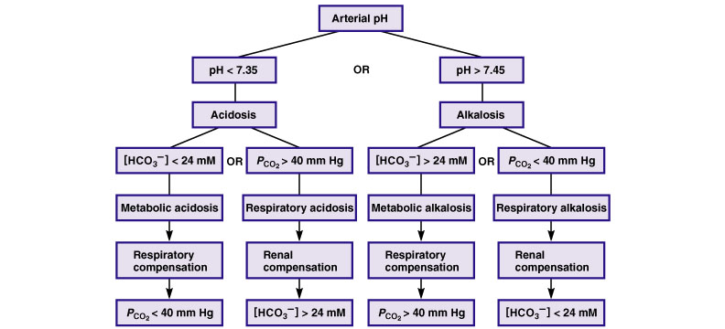
In summary

Slide 58
Tutorial
Which one of the following statements about acid-base balance is INCORRECT
pH is a measure of the H+ ion concentration of a fluid
The Henderson-Hasselbalch equation is
pH = pKa + Log([H⁺]/[HCO₃⁻])
c) pKa is the pH at which a buffer pair exists as 50% acid and 50% base
d) A base is defined as a substance that accepts a H⁺ ion from a solution
e) An acid is defined as a substance that donates a H⁺ ion from a solution

Slide 59
2. A metabolic acidosis is characterized by an increase in which one of the following?
PaCO₂
Urinary H⁺ concentration
Plasma pH
Plasma HCO₃⁻ concentration
pKa for the bicarbonate buffer system

Slide 60
DATA ANALYSIS
 | A | B | C | D | E
pH |  | 7.5 | 7.1 | 7.2 | 7.5
[HCO₃⁻] mmol/L | 25 | 6 |  | 12 | 38
PaCO₂ (mm Hg) | 40 |  | 80 | 31 | 50
Complete the table using the H-H equation
HH, pH =6.1 + Log([HCO3-]/[0.03xPaCO₂])

Slide 61
 | A | B | C | D | E
pH |  | 7.5 | 7.1 | 7.2 | 7.5
[HCO₃⁻] mmol/L | 25 | 6 |  | 12 | 38
PaCO₂ (mm Hg) | 40 |  | 80 | 31 | 50
7.4
pH(A)= 6.1 +Log(25/40x0.03)
=6.1 +log(20.8) = 6.1 +1.3=7.4
Why is PaCO₂ multiplied by 0.03 mmol/(Lxmm Hg)?
At normal pH what is the ratio of [HCO₃⁻]/[CO₂]

Slide 62
 | A | B | C | D | E
pH | 7.4 | 7.5 | 7.1 | 7.2 | 7.5
[HCO₃⁻] mmol/L | 25 | 6 |  | 12 | 38
PaCO₂ (mm Hg) | 40 |  | 80 | 31 | 50
8.0
PaCO₂(B)=?
pH = pKa + Log([HCO3-]/PaCO₂x0.03)
Thus, PaCO₂ =[HCO₃⁻]/(0.03x10^(pH-pKa)), pH-pKa =7.5-6.1
PaCO₂ =6/(0.03x10^1.4) =6/0.75=8.0

Slide 63
 | A | B | C | D | E
pH | 7.4 | 7.5 | 7.1 | 7.2 | 7.5
[HCO₃⁻] mmol/L | 25 | 6 |  | 12 | 38
PaCO₂ (mm Hg) | 40 | 8.0 | 80 | 31 | 50
24
[HCO₃⁻] (B)=?
pH = pKa + Log([HCO3-]/PaCO₂x0.03)
Thus, [HCO₃⁻]=(PaCO₂x0.03x10^(pH-pKa))
[HCO₃⁻]=(80x0.03x10^(7.1-6.1))=80X0.3=24

Slide 64
 | A | B | C | D | E
pH | 7.4 | 7.5 | 7.1 | 7.2 | 7.5
[HCO₃⁻] mmol/L | 25 | 6 | 24 | 12 | 38
PaCO₂ (mm Hg) | 40 | 8.0 | 80 | 31 | 50
1) Who has metabolic acidosis (i.e. uncontrolled diabetes)?
D, compensated with hyperventilation (lower than normal P_{a}CO₂)
Who has respiratory alkalosis (i.e. high elevation climber)?
B (low P_{a}CO₂), compensated with higher excretion of bicarbonate (lower than normal [HCO₃⁻])

Slide 65
 | A | B | C | D | E
pH | 7.4 | 7.5 | 7.1 | 7.2 | 7.5
[HCO₃⁻] mmol/L | 25 | 6 | 24 | 12 | 38
PaCO₂ (mm Hg) | 40 | 8.0 | 80 | 31 | 50
Who has metabolic alkalosis (due to e.g. vomiting)?
E, compensated with hypoventilation (higher than normal P_{a}CO₂)
Who has respiratory acidosis (person poisoned by curare)?
C (high PCO₂), compensated with retention of bicarbonate (high bicarb)

Slide 66
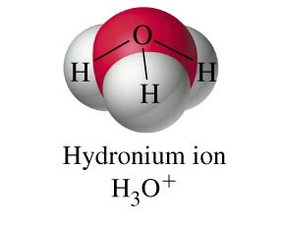
For those that want more pH…..In reality…
We talk about [H⁺] in aqueous solution, but…..
HCl(aq) + H₂O(liq)------> Cl⁻(aq) + H₃O⁺(aq)
We will use [H⁺] as shorthand for H₃O⁺

Slide 67
Pure water contains a small number of hydronium ions (H₃O⁺) and hydroxide ions (OH⁻) which arise from the equilibrium:
H₂O + H₂O------> H₃O⁺ + OH⁻
The equilibrium constant K_{w} of this equilibrium is
K_{w} = ([H₃O⁺][OH⁻]) = 10⁻¹⁴ M² (really, really low in pure water, [H₂O]≈ 1 M)
Because
[H₃O⁺] = [OH⁻]
[H₃O⁺]² = 10⁻¹⁴ M²
(I just substituted [H₃O⁺] for [OH⁻] in [H₃O⁺][OH⁻] = 10⁻¹⁴ M² )
Therefore [H₃O⁺] = (10⁻¹⁴ M²)^{1/2} = 10⁻⁷ M (recall that √x = x^{1/2})
THIS MEANS THAT THE CONCENTRATION OF HYDROGEN IONS (H⁺) IN PURE WATER IS
[H⁺] = [H₃O⁺] = (10⁻¹⁴ M²)^{1/2} = 10⁻⁷ M

Slide 68
LOGARITHMS
A logarithm of a number x is the number that we must raise the “base” a so that
a^{log}a^{(x)} =x
The base a can be any number, but it is usually 2, e, or 10.
To make your life easier, I will always (almost) use logarithms in base 10 (Log₁₀). Therefore:
Log(10) =1, 10^{Log(x)} =x, Log(10^{x}) = x

Slide 69
a^{log(x)} =x
10^{Log(x)}=x
Log(x) and ax are “inverse functions”
Log₁₀
Logarithmic scale
If Log(x)= 1 2 3 4 5 6….
x= 10 100 1000 10⁴ 10⁵ 10⁶
10¹
10²
10³
Increasing a logarithmic scale by 1 unit, implies increasing the corresponding arithmetic scale by a factor of 10 (an order of magnitude).

Slide 70
If Log(x)= -2 -1 0 1 2 3 4 5 6….
x= 10⁻² 10⁻¹ 1 10 100 10³ 10⁴ 10⁵ 10⁶
0.01 0.1
If Log(x) < 0, then x < 1
The log of negative numbers or of 0 is undefined.

Slide 71
PLEASE REMEMBER!!!!
Logarithms
Definition: a logarithm of a number x is the number that we must raise the “base” a so that
a^{log}a^{(x)} =x
The rules
Log (xy) =Log x + Log y
Logx^{y} = yLog x
Log (x/y) = Log x - Log y
Log (1) = 0
(x ª)(x^{b}) = x^{a+b}
1/xª = x^{-a}
xª/x^{b} =x^{a-b}
(xª)^{b}= x^{ab}
x⁰ = 1

Slide 72
Changing logarithm bases
Log₁₀(x) = 0.43Ln(x), Ln(x) = Log_{e}(x)
WHY???
We know that
10ª = x
means that a = Log(x),
we also know that
Ln(a^{x}) = xLn(a)
Take natural logs (Ln) to both sides of 10ª = x
Ln(10ª) = Ln(x)
aLn(10) = Ln(x)
But a = Log(x)
Therefore
Log(x)Ln(10) = Ln(x)
But Ln(10) = 2.303
Therefore
Log(x) = Ln(x)/Ln(10) = 0.43Ln(x)

Slide 73
Examples
Recall that [H+] = 10⁻⁷ in pure water
Therefore
pH = -Log (10⁻⁷⁾=Log(1/10⁻⁷)=Log(10⁷) =7
For homework show that if [H⁺]=[H₃O⁺]=5X10⁻¹⁰
then pH = 9.3 (Hint: Log(5)=0.7)
YOU MUST BE ABLE TO USE Logs AND TO CALCULATE pH!!

Slide 74
Another homework question
Show that a pH range of 7.36 to 7.44 corresponds to a range in [H+] of between ≈ 36 to 44 to nmol/liter (n means nano = 10⁻⁹).
Milli = m, 10⁻³
Micro = µ, 10⁻⁶
Nano = n, 10⁻⁹
Pico = p, 10⁻¹²
Femto = f, 10⁻¹⁵
pH =-Log([H⁺]),
Hint: use
If a=Log(x) -> x=10^{Log(a)}
(x ª)(x^{b}) = x^{a+b}
[H⁺] =10^{-pH}
If pH=7.36
[H⁺]=10^{-7.36} M
[H⁺]=10^{-7.36} mole/L x 10⁹ nmol/mole
[H⁺]=10^{9-7.36} M = 10^{1.64} =43.7 nmol/L

Slide 75
To Remember
(IF YOU DON’T PRINT THIS)
Log (xy) =Log x + Log y
Logx^{y} = yLog x
Log (x/y) = Log x - Log y
Log (1) = 0
(x ª)(x^{b}) = x^{a+b}
1/xª = x^{-a}
xª/x^{b} =x^{a-b}
(xª)^{b}= x^{ab}
x⁰ = 1
Log(1) =0, Log(10) =1, Log(100) =2, Log(1000)=3, …etc.

Slide 76
pH is a measure of the acidity of an aqueous solution
[H₃O⁺] (or [H⁺]) can vary from 1 M to 10⁻¹⁴ M. In the range in which physiologists work, it is around 10⁻⁷ (i.e. 0.0000001). It is really awkward to work with such small numbers. To make life easier people use logarithms
pH = -Log([H⁺])
pH = Log (1/[H⁺])
DO NOT COMMIT THE FOLLOWING MISTAKE
pH ≠ 1/Log([H⁺])
NOTE NEGATIVE SIGN
Start here

