Slide 1
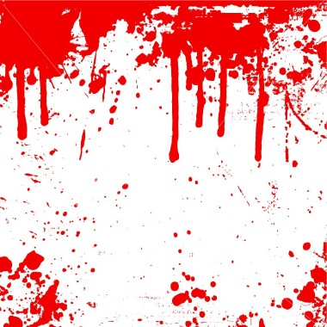
Blood
(chapter 15 of your textbook)

Slide 2
Topics
What is blood for?
How much blood?
Hematocrit and anemia
The constituents of plasma
Red Blood Cells
White Blood cells and the defensive role of blood (optional)
Clotting cascades

Slide 3
Please Download and Read Learning Objectives (STUDY GUIDE) for this Section

Slide 4

What is blood for?
Blood is a vehicle (the circulatory system is the system of roads)
Blood provides defense

Slide 5

What is blood for?
1) Blood is a vehicle that we use to transport:
-Nutrients from GI tract to tissues (some in solution, such as glucose, others together with proteins, lipids are transported as lipoproteins).
-Oxygen from lungs to tissues and CO₂ from tissues to lungs.
-Hormones from glands to target organs/tissues/cells.
-Waste materials (urea) from tissues to kidney

Slide 6
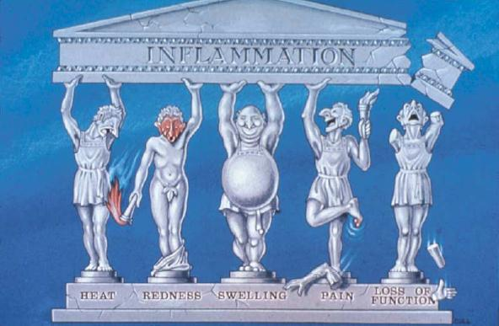
What is blood for?
2) Defense against infection through immunity and inflammation

Slide 7
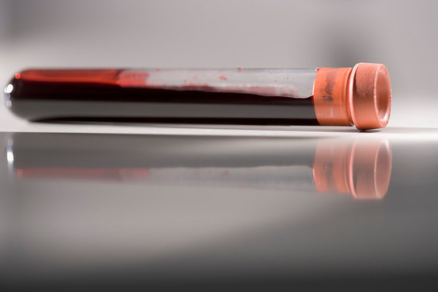
Why should you (as a health professional) care about blood?
Blood is easy to sample
Blood’s characteristics* are found in narrow ranges. Values outside of these ranges can be used to diagnose a variety of conditions.
*hematocrit, concentration of electrolytes, concentration of enzymes, cholesterol, HDL/LDL/TAG, sugar, drugs, …, etc.

Slide 8
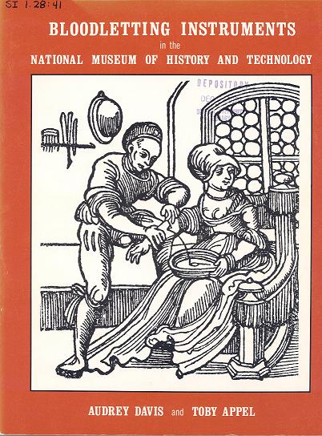
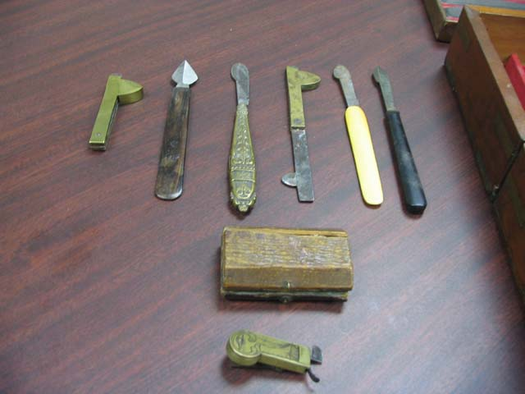

Slide 9
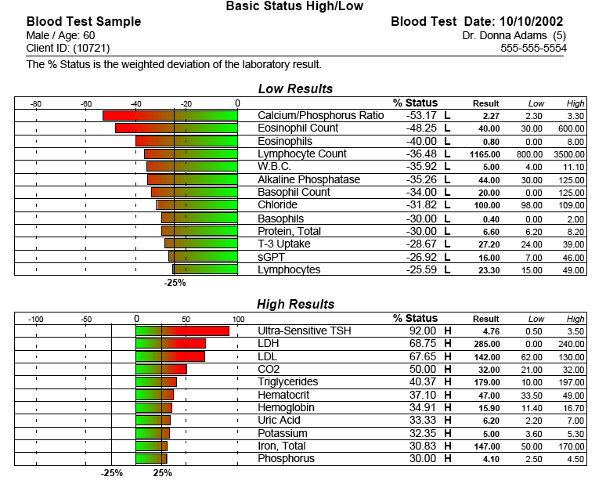

Slide 10
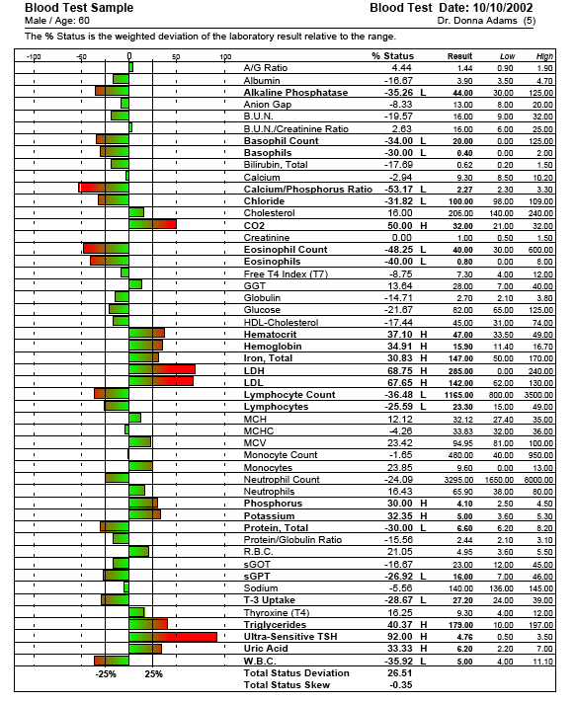

Slide 11
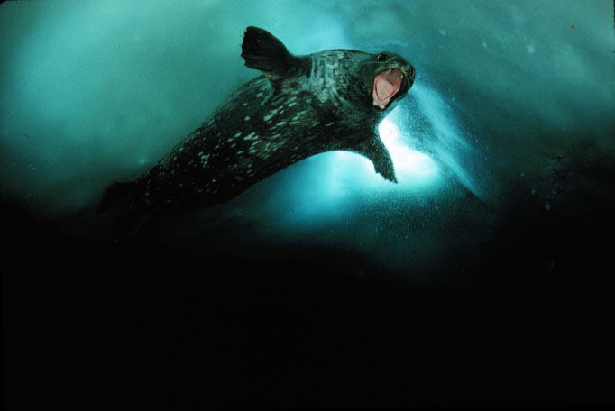
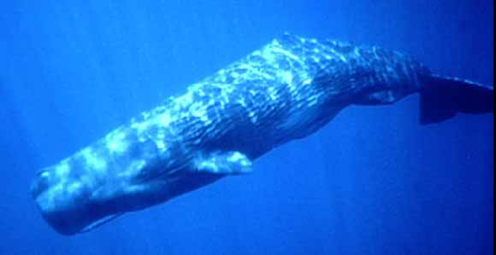
How much blood?
About 8% of a normal human being’s body mass is blood (Please remember this number). Therefore, there are about 80 ml of blood per Kg of mass (some textbooks use the value 70 ml/kg). This value is for people with ideal body mass.
Deep diving mammals have a lot more blood per body mass than non-diving mammals (and shallow diving mammals like sea lions).
Weddel seal (210 ml/kg)
Sperm whale (200 ml/kg)

Slide 12
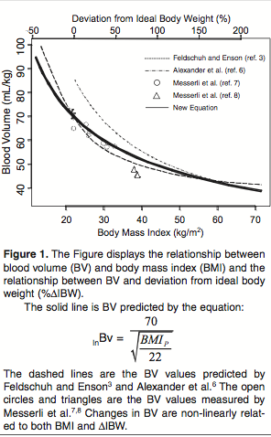
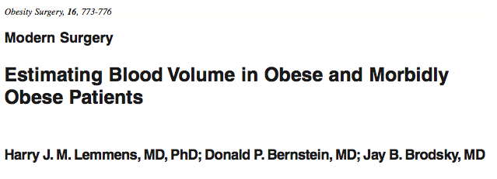
The % of body mass represented by blood decreases with degree of obesity!

Slide 13
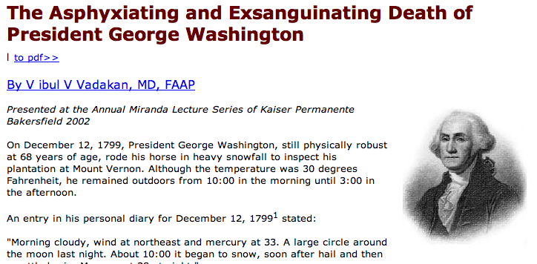
He got pneumonia….

Slide 14
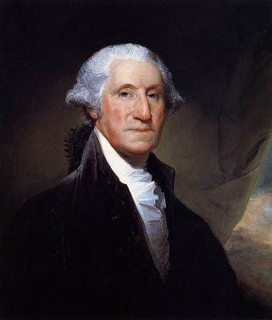
George Washington weighed ≈ 99 kg (≈ 218 lb, he was 6’2” tall)
He had 0.08x99 =7.9 L
They removed 2.7 L (≈ 85 ounces)
They removed (2.7/7.9)x100 =34% of his blood.
Class I hemorrhage ≈ 15%
Class II 15-30%
Class III 30-40%
Class IV > 40% (death often)

Slide 15
To Remember
Blood transports nutrients from GIT to tissues, gases to and from tissues to gas exchange surfaces, hormones from glands to target cells, and waste materials from tissues to the kidney.
Blood plays a tremendously important role in protection against pathogens and injury.
Blood is fundamentally important to diagnose diseases.
≈ 8% of a human’s body (80 ml/kg) is blood (i.e. the mass of blood ≈ 0.08xbody mass)

Slide 16
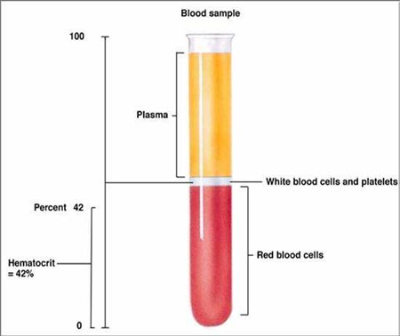
The gross anatomy of blood
Blood can be separated into its cellular and fluid (plasma) components.
In humans hematocrit ranges from 37-54%. It is slightly higher in males.
Serum is plasma that has had clotting factors (such as fibrinogen) removed. Plasma is more viscous than water (it splatters less!).
Hematocrit = 100X(Cells/(Cells+Plasma))

Slide 17
A 65 kg person has a hematocrit equal to 45%, what is this person’s approximate plasma volume?

Slide 18
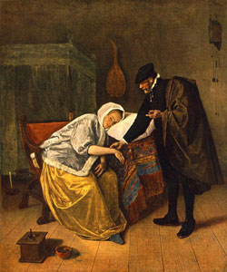
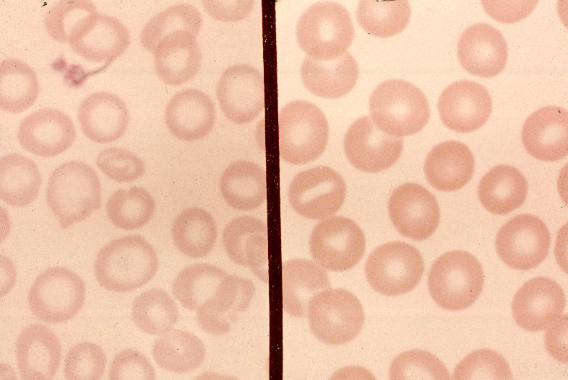
Anemia
(from Gr. Anaimia = without blood)
Types of causes: hemorrhagic, renal, aplastic, hemolytic, and nutritional.
Healthy
Fe deficient
Jan Steen
(The doctor and his patient, 1665)

Slide 19
Types of anemia
1) Nutritional
-Iron deficiency
-Folic acid deficiency (needed for synthesis of thymine IT is unknown why thymine has antianemic properties)
-Pernicious anemia (deficiency in vitamin B₁₂, damage to stomach)
  2) Aplastic
  -Autoimmune damage to bone marrow
  3) Renal
  -Decreased production of erythropoyetin (EPO) due to kidney damage.
  4) Hemorrhagic
  -Blood loss
  5) Hemolytic (Hemolysis means rupture of RBCs)
  -Sickle cell anemia
  -Thalassemia (Mediterranean anemia)

Slide 20
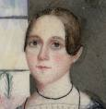
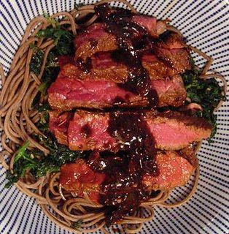
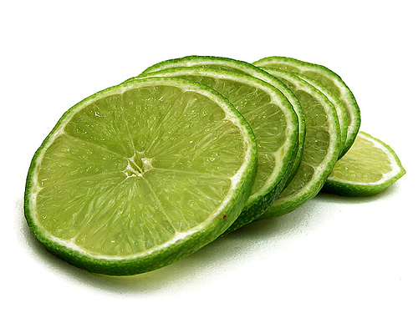
Symptoms
Weakness
Headaches
Dizziness
Concave/brittle nails
Much worse symptoms for the severe cases
Paleness
Food that has Iron
Red meat, liver, iron-fortified cereals, green vegetables (broccoli, spinach). Vitamin C enhances the absorption of iron by a) preventing the formation of insoluble iron compounds, and 2) reducing ferric iron (Fe⁺⁺⁺, 3 loose electrons) to ferrous (Fe⁺⁺) iron which seems to be required for absorption.
Sesame marinated steak
with spinach and lime

Slide 21
To Remember
Blood has two components: fluid and cells (a simplification, but…)
Hematocrit = 100x(cells/(cells+plasma))
Serum is plasma minus clotting factors.
Anemia is a condition diagnosed by low hematocrit.
Anemias can be classified as nutritional, aplastic, renal, hemorrhagic and hemolytic (please know examples of each).

Slide 22
The constituents of plasma
Each Liter of plasma contains ≈ 920 ml of water and 90 mg of solids (solutes). Plasma is more viscous than water.
90 g of solutes
INORGANIC
(electrolytes)
10 g/L
Na^{+,} K⁺, HCO₃⁻, Cl⁻,…etc)
ORGANIC
80 g/L
COLLOIDS
(proteins and lipoproteins)
75 g/L
CRYSTALLOIDS
(metabolites)
5 g/L
glucose, urea, creatinine, ketones
NON-ENZYMES
70 g/L
albumin, globulin, some hormones
LDL/HDL/VLDL
ENZYMES
5 g/L
INACTIVE
Leaking from intracellular tissues (ALT, AST, LDH)
ACTIVE
clotting factors
renin
complement system

Slide 23
Enzymes found in plasma and often used in diagnostics
Amylase (inflammation of pancreas)
Lipase (inflammation of pancreas)
Alkaline Phosphatase (AP, Paget’s disease [inflamation of bone])
Transaminases (ALT, AST, liver damage, hepatitis,Tylenol overdose)
ALT = alanine aminotransferase
AST = aspartate aminotransferase

Slide 24
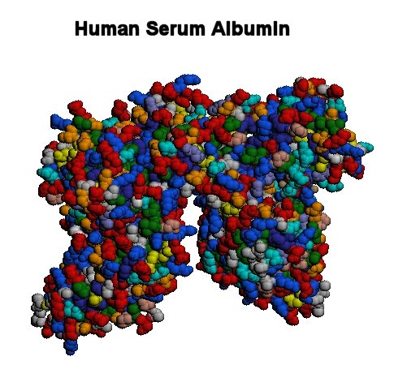
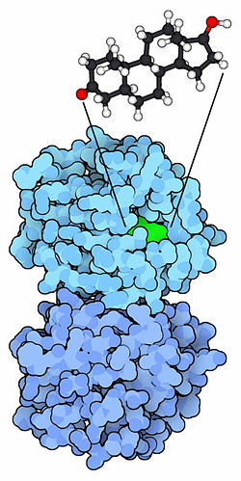
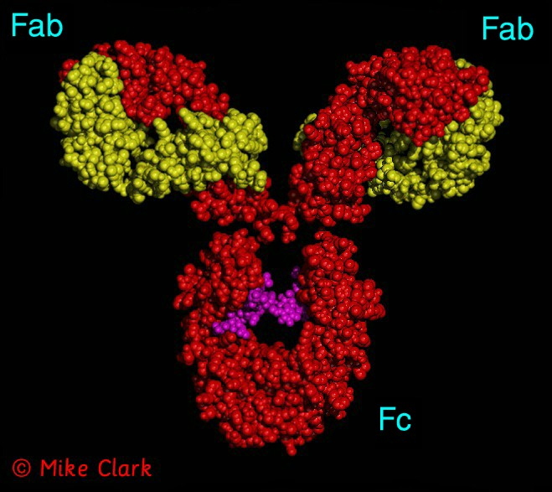
Some important plasma proteins
Albumin (≈ 40 g/L, made in liver, MW ≈ 70,000 because it is big it cannot cross capillary walls, generates colloidal pressure)
Globulins (≈30 g/L, aid in the transport of some hormones including thyroid hormones, include the lipoproteins)
Immunoglobulins (manufactured by white blood cells and are antibodies against antigens).

Slide 25
To Remember
Each liter of blood contains 920 ml of H₂O and 90 mg of solids.
You do not need to remember the amounts of each of the solid components, but please remember the meaning of the following words as they pertain to blood (inorganic (electrolytes), organic (crystalloids, colloids (non-enzymes), enzymes(active, inactive)))
Inactive enzymes such as amylase, AP,ALP, and AST are often used for diagnostic purposes)
Albumin (big) and the globulins are important determinants of colloidal pressure).

Slide 26
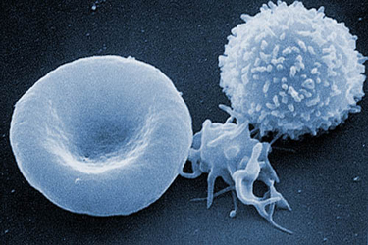
The cells in blood
Three Types
White Blood Cells
(Leucocytes)
Red Blood Cells
(RBC, Erythrocytes)
Platelets
(Thrombocytes)
Platelets (Thrombocytes)

Slide 27
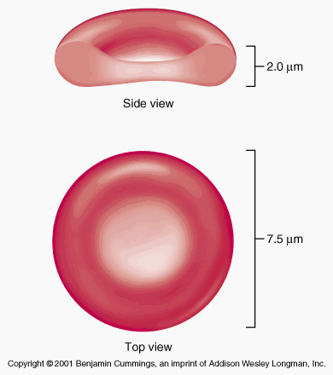
Erythrocites
Form and Function
-RBCs are O₂ carriers. They are full of hemoglobin (much more on HB later on).
-In humans ≈ 5X10⁹ (5 billion)/mL.
-Large surface area (combined area ≈ 3000 m²!)
-Lack nuclei and mitochondria.
-Uncommonly flexible to squeeze through narrow capillaries and to crenate in hypertonic solutions.
How do RBCs produce energy?
Anaerobically using glycolysis

Slide 28
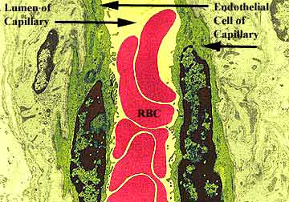
A few more factoids
Erythrocytes are about 25% larger than the size of a capillary (6-8 µm in diameter, they are among the smallest of your cells).
They circulate for between 100-120 days before they die in the spleen.
Approximatly ¼ of your cells are erythrocytes.

Slide 29
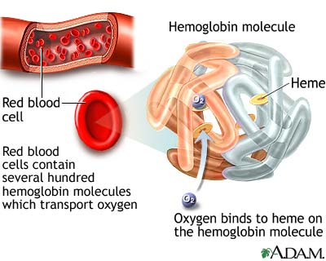
A bit on their physiology (more later)
-The amount of O₂ that can be carried in solution is very limited (≈ 3 ml O₂/L). Our blood carries ≈ 200 ml O₂/L.
-Each mole of Hb can bind 4 moles of O₂ (Hb has four subunits)
-Each subunit contains a Fe-containing Heme group.
-Each gram of Hb can carry ≈ 1.3 ml O₂.
-A healthy human has
≈ 160 g Hb/L
How much O₂ is carried bound to Hb?
{1.3 (ml O₂/g of Hb)}X{160 (g of Hb/L)} = 208 ml O₂/L

Slide 30
Please take all our numbers with a grain of salt. Humans are variable!
Normal hemoglobin values are:
* Adult: (males): 13.5 - 17 g/dl
* (Females): 12 - 15 g/dl
* Pregnancy: 11 - 12 g/dl
Newborn: 14-24 g/dl 77% of this value is fetal hemoglobin, which drops to approximately 23% of the total at 4 months of age
* Children: 11-16 g/dl

Slide 31
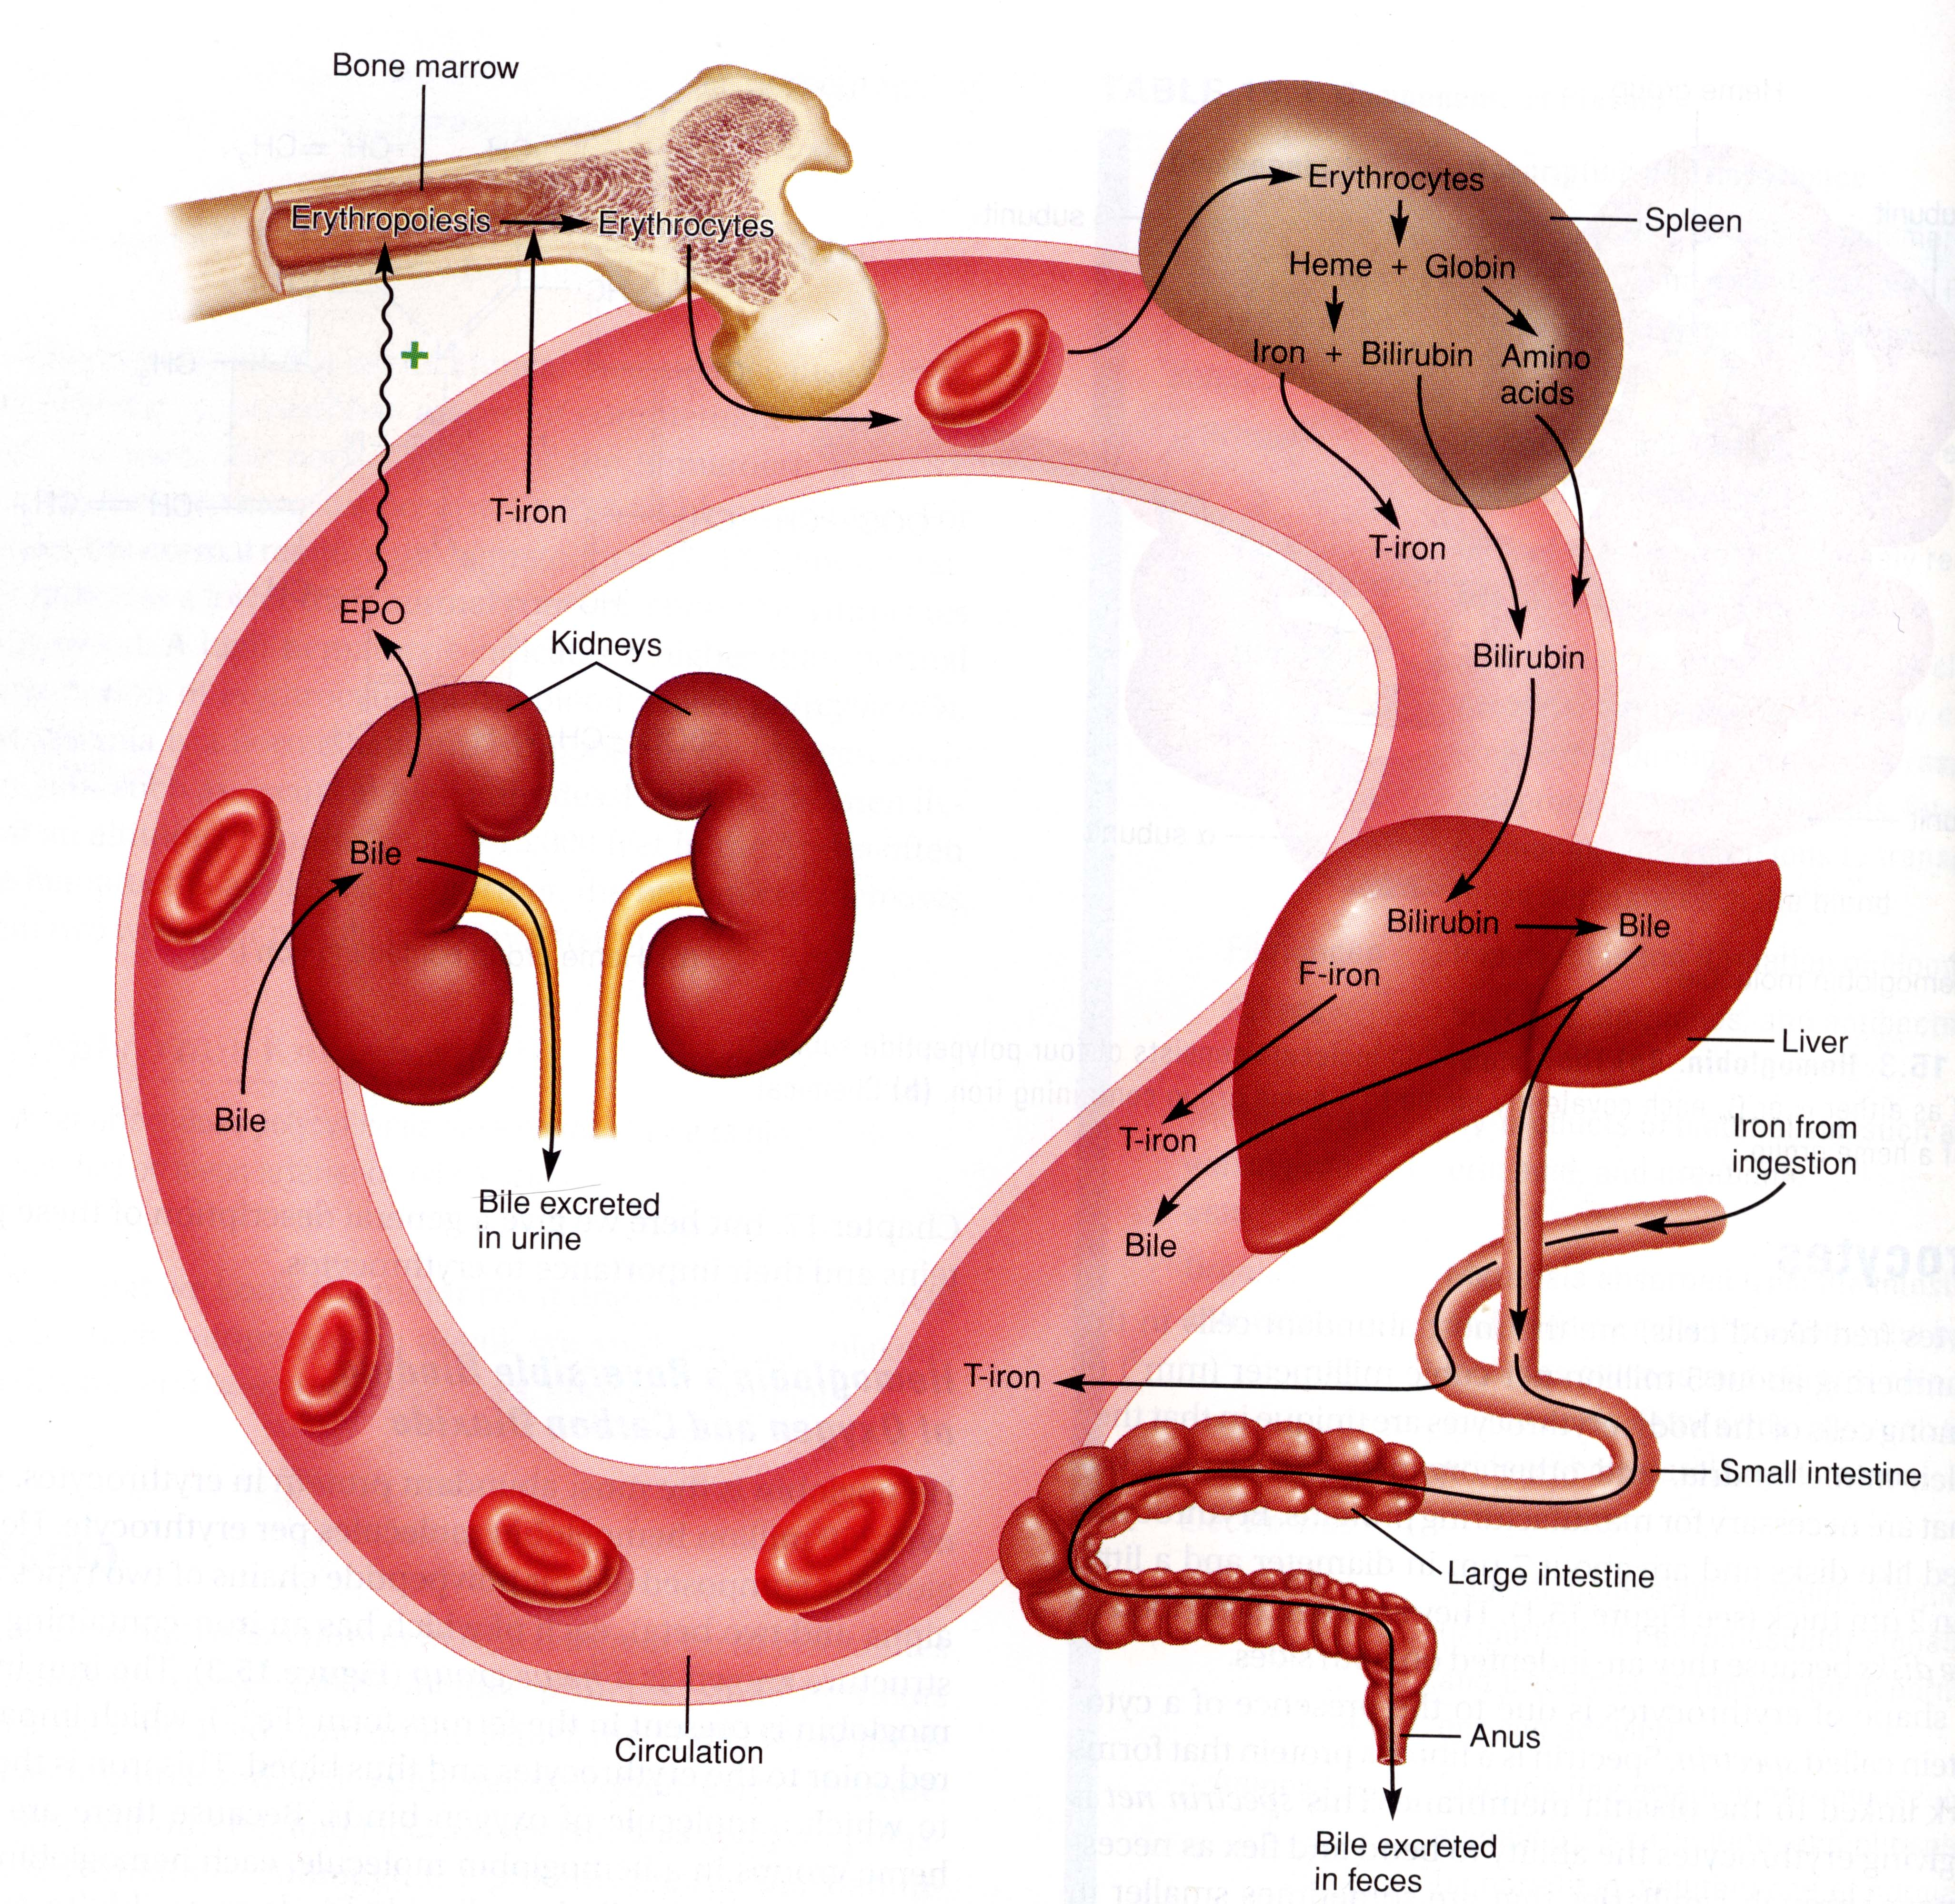
-RBCs are produced in bone marrow in the process called erythropoyesis (2-3 million RBCs are produced per minute!).
-Erythropoyesis is stimulated by the renal hormone erythropoyetin (EPO) which is secreted in response to low circulating O₂ levels.
-The average life span of a RBC is about 120 days.
-RBC are degraded in the spleen (the RBC graveyard, also degraded in liver and bone marrow).
-The catabolism (degradation) of Hb produces bilirubin (a component of bile).

Slide 32
To Remember
RBCs are little packets of hemoglobin without organelles, about 5 billion/mL, use glycolysis (no mitochondria).
Very little O₂ can be carried in blood in simple solution (≈ 3 ml/L). Blood carries (when saturated) ≈ 200 ml/L.
Each mole of Hb can carry 4 moles of oxygen.
The [Hb] varies among individuals in more or less predictable patterns (males>females>pregnant females)
RBCs are produced by erythropoyesis in bone marrow
Erythropoyesis is stimulated by EPO (erithopoyetin) which is secreted by kidney in response to low oxygen levels)
The average lifespan of a RBC is ≈ 120 days
RBCs are degraded in the spleen.
The catabolism of Hb produces bilirubin

Slide 33
This diagram has three themes:
1) Iron
2) EPO
3) Bilirubin

Slide 34
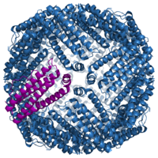
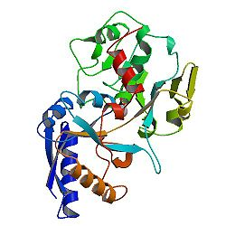
-Free iron is toxic and hence is stored complexed in the huge protein (450 kDa) ferritin in the liver (1 ferritin molecule can bind 4500 Fe³⁺ ions).
-Iron is transported in blood complexed with the protein transferrin.
Iron. A most important mineral!

Slide 35
To Remember about iron
-It is really reactive (you don’t want it floating around…)
- It is absorbed in the intestine and transported in blood bound to transferrin
-It is stored in liver bound to ferritin (a humongous protein).

Slide 36
EPO
Lets talk about EPO (why has it been in the media??)

Slide 37
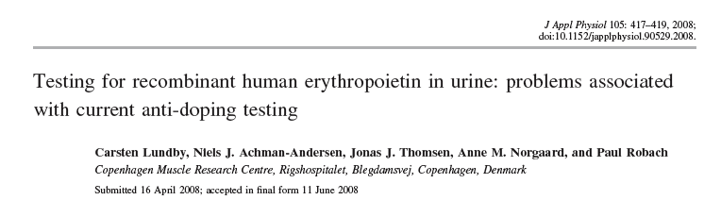

Summary:
-rHuEPO greatly increased O₂ carrying capacity and performance in cyclists.
-Available tests are not very good (1 lab found 16/18 positives, the other 0/18).
-Hence, performance is increased at little risk of detection (oh my!).

Slide 38
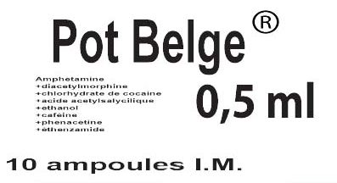
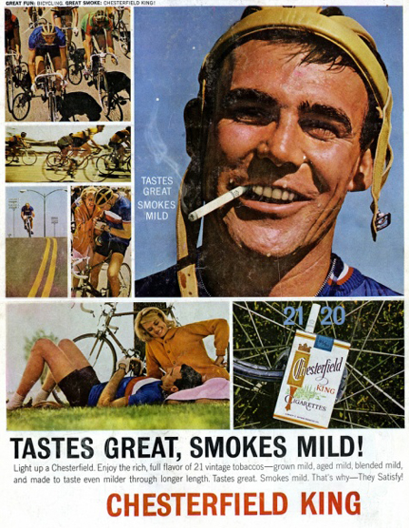
Doping is Cyclism
"You need never go off-course chasing the peloton in a big race - just follow the trail of empty syringes and dope wrappers."
Jock Andrews (1960)
Anabolic Steroids (cortisone and Testosterone, stanozolol, tetrahydrogestrinone), Blood Doping, Cannabinoids, Diuretics, Narcotics, Painkilleerrs, Sedatives, Stimulants (Pot Belge), Beta2-adrenergic agonists,Clenbuterol,Ephedrine, EPO
Human Growth Hormone, Methylhexanamine
SARMs (selective androgen receptor modulators)
Pot Belge = a mixture of cocaine, caffeine, amphetamines (developedin Belgium)

Slide 39
To Remember about EPO
-It is secreted by the kidneys
- It is secreted in response to relative hypoxia
-It acts by stimulating hemotopoyesis in bone marrow
-There is recombinant EPO in the market (for good and evil….)

Slide 40
Lets talk about bilirubin

Slide 41
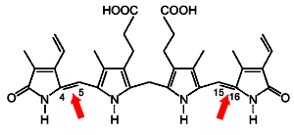
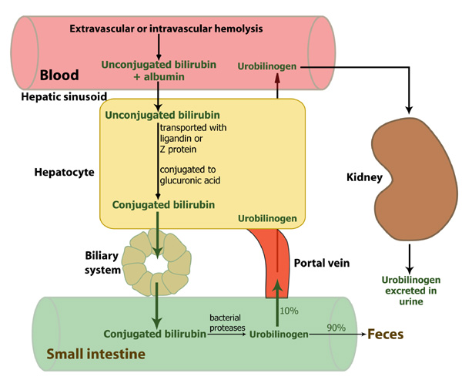
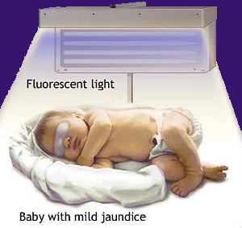
Jaundice
-Prehepatic (excess hemolysis overwhelms ability of liver to take it up, Unconjugated ⬆, malaria).
-Hepatic (most common. Caused by liver damage (cirrhosis) both uptake and excretion are compromised, un- and conjugated ⬆)
-Post-hepatic (Caused by bile duct obstruction (gallstones, parasites) conjugated ⬆)
Hyperbilirubinemia of the new born

Slide 42
To Remember
Jaundice is a condition diagnosed by increased levels of bilirubin in circulation (people look yellowish)
Jaundice can be prehepatic (unconjugated bilirubin is increased), hepatic (both un- and conjugated bilirubin are increased), or post-hepatic (conjugated goes up).

Slide 43
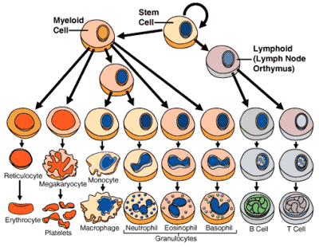

Slide 44
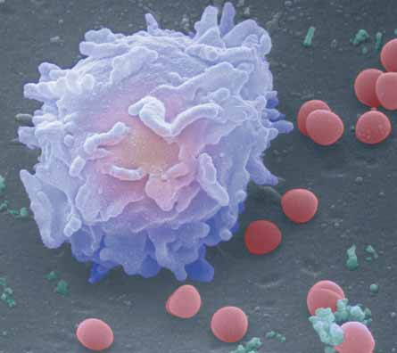
White blood cells
(we will skip WBCs and immunity, not because it is unimportant but because we do not have time. I prepared a bunch of slides for those of you interested. They are at the end of the lecture notes).
-Are part of the protective mechanisms that we use against harmful organisms and substances.
-They are an integral part of the immune system.
-There are ≈ 4-11 million WBC/ml of blood.
-Most are generated by bone marrow from stem cells. The reminder are generated by replication (they have nuclei!!) at the time of an infection in lymph tissue, spleen, or the site of infection.

Slide 45
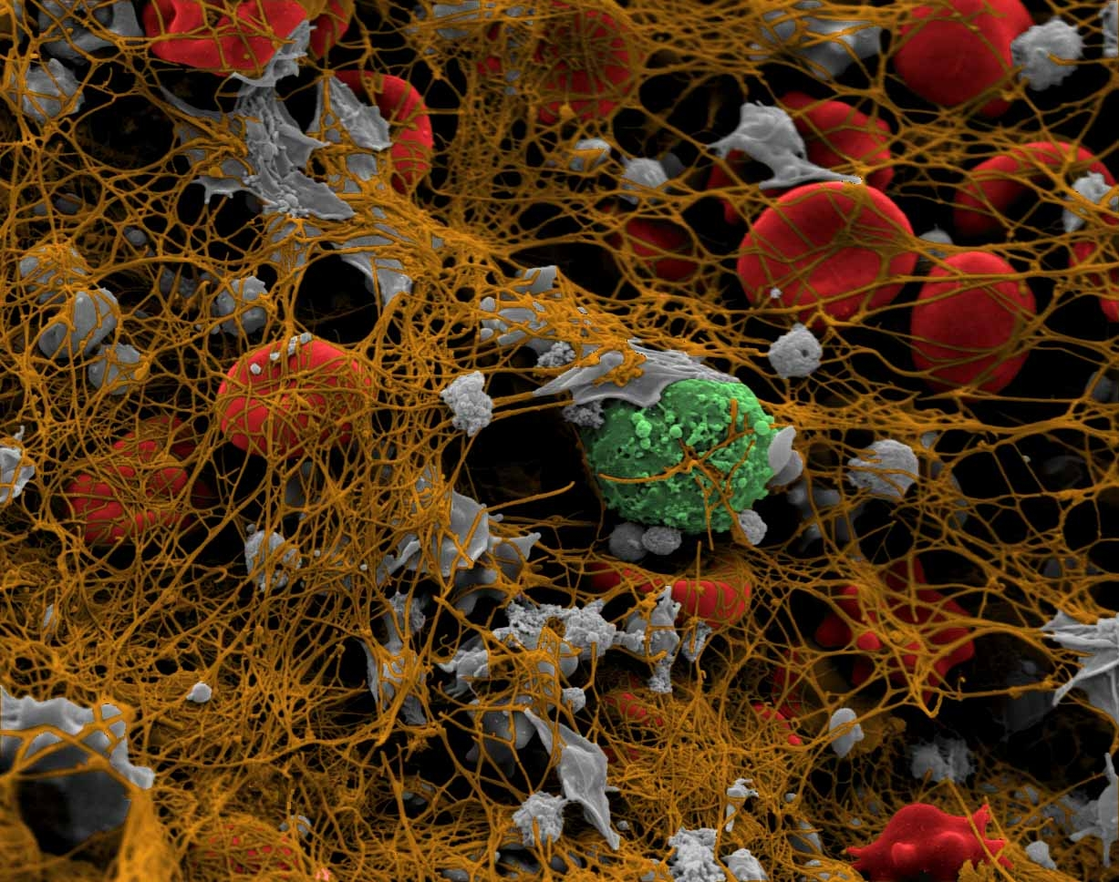
COAGULATION AND CLOTTING

Slide 46
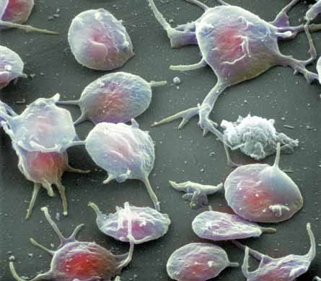
Platelets (also called thrombocytes)

Slide 47
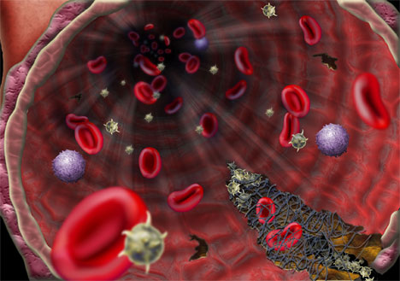
The coagulation cascade
(what happens in a wound…)
Hemostasis (means to stop bleeding) has three phases: vascular spasm, formation of a platelet plug and blood coagulation.

Slide 48
Hemostasis
(the big picture)
-Damage exposes the subendothelium. The vessel spasms to prevent blood loss.
-Subendothelium exposure elicits the aggregation of platelets/thrombocytes
-Clot formation requires the formation of a fibrin mesh (this requires that fibrinogen is activated)
-Then the clot must be dissolved

Slide 49
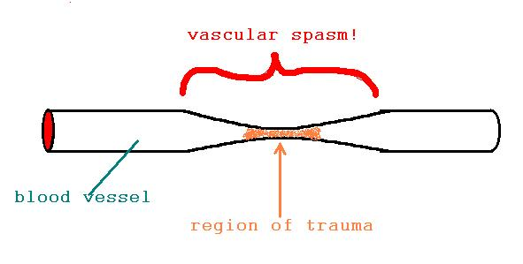
vascular spasm

Slide 50
Formation of a platelet plug
Blood Vessel Damage
Exposure of Subendothelium
vWf Binds to Collagen Fibers
Platelets Bind to vWf
Platelet Adhesion
Sticky
Secretions

Slide 51
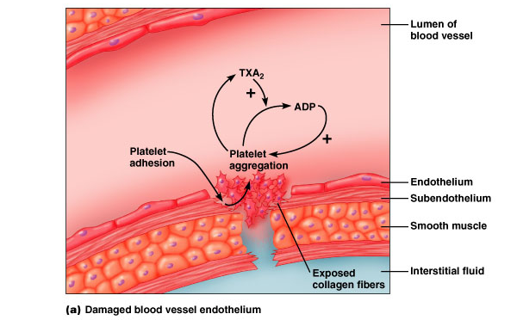
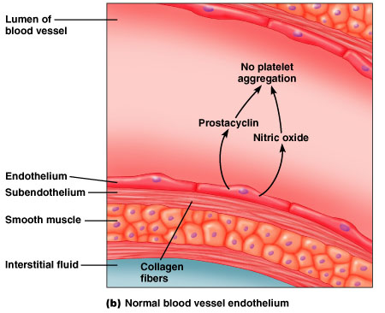
Platelets secrete serotonin, epinephrine (adrenaline), and chemicals for blood coagulation (vWF, von Wilebrand factor and TXA₂, Thromboxane A₂) that stimulate platelet aggregation and contribute to vasoconstriction.
Chemicals that prevent platelet aggregation: Prostacyclin (PGI₂) and nitric oxide (NO)
Platelet Aggregation

Slide 52
TO REMEMBER
Hemostasis has three phases: vascular spasm, formation of a platelet plug, and blood coagulation.
In non-damaged endothelium, the secretion of nitric oxide and prostacyclin prevents platelet aggregation.
In a damaged endothelium the subendothelium promotes the secretion of a variety of factors (vWf) that elicit aggregation of platelets into a plug. The aggregating platelets secrete these and other factors that contribute to the formation of a plug.

Slide 53
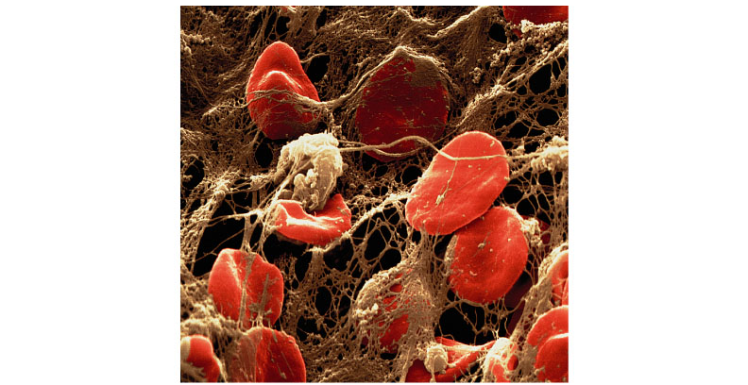
Formation of a blood clot
Fibrinogen
Fibrin (loose)
Fibrin (mesh)
(Fibrin clot = blood clot)

Slide 54
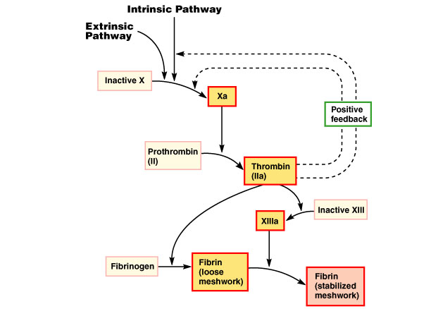
Activation of fibrinogen

Slide 55
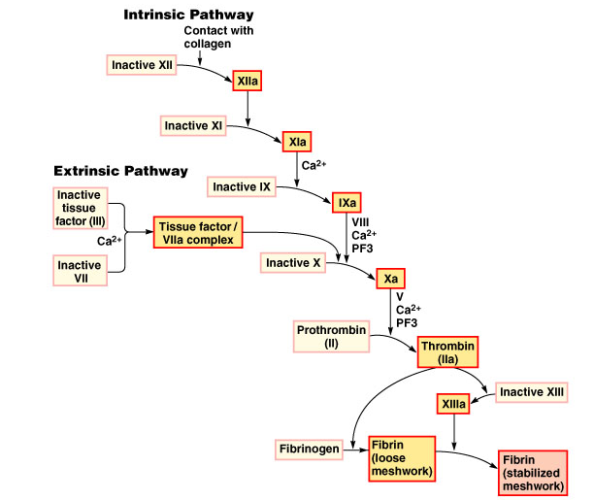
Activation of fibrinogen
Vitamin K is necessary in several steps of the intrinsic pathway
Intrinsic Pathway
everything in plasma
trigger = collagen
Extrinsic Pathway
requires Factor III
from damaged
tissue

Slide 56
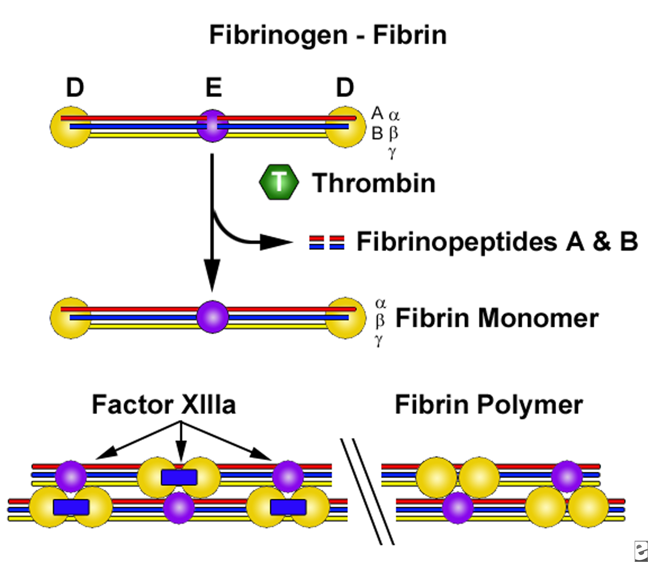

Slide 57
  Clotting (Coagulating) factors (are very many, > 20) produced by liver
    Secreted into blood in inactive form
    Activated during cascade
  Plasma without clotting factors = serum
  Hemophilia = genetic disorder, deficiency in clotting factor, usually Factor VIII

Slide 58
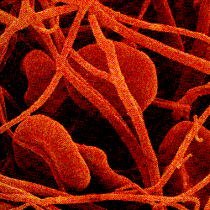

Then the clot dissolves
Plasminogen
Plasmin
Dissolves Clot
plasminogen activators (activated by fibrin)
Plasmin is a protease

Slide 59
To Remember
Blood coagulates around the platelet plug as a result of the activation of fibrinogen into the mesh form of fibrin.
Fibrinogen is activated by two complementary pathways: the intrinsic factor, which is activated by exposed collagen, and the extrinsic factor which is stimulated by a factor (Factor III) that is produced by damaged tissue. There is a variety of clotting factors (you DO NOT HAVE TO REMEMBER THEM). YOU MUST REMEMBER THAT PLASMA WITHOUT THEM IS CALLED SERUM..
Hemophilia is a genetic defect that leads to the deficiency of one of these clotting factors.
The clot dissolves by the action of the protease plasmin.

Slide 60
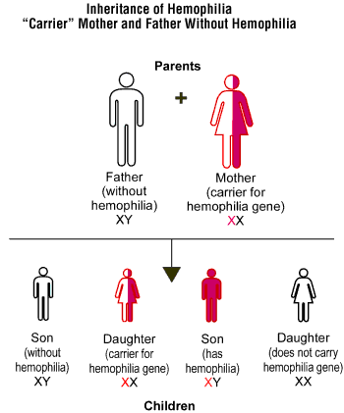
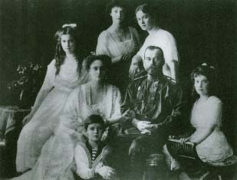
Clotting Disorders
  Hemophilia
    Genetic disorder caused by deficiency of gene
    for specific coagulation factor (Factor VIII)
  Von Willebrand’s disease
    Reduced levels of vWf
    Decreases platelet plug formation
  Vitamin K deficiencies
    Decreased synthesis of clotting factors

Slide 61


Many types of anticoagulants
Aspirin (at low doses inhibits Throboxane A2, at higher doses inhibits production of prostacyclin)
Draculin (inhibits the activation of Factor X), Hirudin (inhibits Thrombin).
Hirundo medicinalis (their saliva also has anesthetic and a vasodilator!)
Desmodus rotundus

Slide 62






Slide 63



Thrombosis
Formation of a clot in a blood vessel.
Deep vein and coronary (arterial) thromboses.
If clot dislodges and travels through bloodstream you have a thromboembolism.
The blocking of an artery causes hypoxia (75% obstruction) or anoxia (90% obstruction) and hence cell death.
Deep vein thrombosis

Slide 64
To Remember
Three types of clotting disorders: Hemophilia (why is it more common in males than females?), von Willebrand’s disease, and vitamin K deficiencies.
Animals that feed on blood (vampire bats and leeches) can produce anticoagulants.
The word thrombosis means the formation of a clot in a blood vessel (two types deep vein and coronary).
Thromboembolisms can cause serious problems or be fatal if they clog coronary arteries, or lung arteries.

Slide 65

NEXT RESPIRATION
(please read chapter 16)

Slide 66
White blood cells
.
-Are part of the protective mechanisms that we use against harmful organisms and substances.
-They are an integral part of the immune system.
-There are ≈ 4-11 million WBC/ml of blood.
-Most are generated by bone marrow from stem cells. The reminder are generated by replication (they have nuclei!!) at the time of an infection in lymph tissue, spleen, or the site of infection.

Slide 67

White blood cells (leukocytes)
Agranulocytes
< 1% stain blue, in respiratory tract, GIT, and skin. Coated with Immunoglobulin E (IgE). When they detect an antigen, they release histamine which starts an inflammatory response.
50-80%, stain red and blue, they are phagocytes (“eaters”) and engulf and digest microbes, damaged cells, and foreign particles. Recall Donal’s movie? During infections their numbers increase (good diagnostic tool). They activate “the complement”. Short-lived.
1-4%, they aggregate around invaders too large to be phagocytosed and release hydrolytic enzymes, stain red. Cause itching (NEWS, they “vomit” their mitochondrial DNA and trap bacteria).

Slide 68


Neutrophils: The Kamikaze cells
Neutrophils have very short life spans (a few days, and just a few hours at a site of infection).
Why?

Slide 69

Phagocytosis (by neutrophils)

Slide 70


The respiratory burst
Sometimes neutrophils use antibacterial substances (lysozyme, lactorferrins, defensins, proteases). Sometimes they use the respiratory (or oxidative) burst.
Hydrogen peroxide (reactive oxygen species)
Hypochlorous acid (chlorine bleach)

Slide 71


Not in Exam!

Slide 72
72 h
5-10 times larger than monos
2-8% of leukocytes in circulation, after a few hours of circulating in blood they migrate to tissues, grow and turn into “big eaters”. Secrete interleukins which mediate an inflammatory response. They phagosytose dead tissue and microbes. Found in abundance in spleen and lymph nodes. Macrophages “present” foreign antigens to lymphocytes.

Slide 73

Macrophage gobbling up a spirochete

Slide 74
20-40% of all leukocytes and about 99% of all cells in interstitial fluid. Produced by bone marrow in the fetus and mature either in thymus (T lymphocytes) or the liver (B lymphocytes). Responsible for immunity, cellular immunity, antibody production… Super important. Their function would take us many (many) lectures.

Slide 75
To Remember
White blood cells are part of the immune system and have a protective function. Most are produced by hematopoyesis in bone-marrow, some can reproduce
Leucocytes can be divided in
phagocytes and lymphocytes
phagocytes in turn divide into granulocytes and agranulocytes
Granulocytes can be divided (depending on the color of their “grains” after different stains”) into basophils (blue), neutrophils (red and blue), eosinophils (red). Please remember the functions of these things.
Agranulocytes can be divided into monocytes that “grow up” to become macrophages which eat dead tissue and microbes.
Lymphocytes (T mature in thymus and B in liver) are responsible for a variety of immune functions.

Slide 76

A very fast and very superficial intro to innate immunology

Slide 77
Innate Immunity
Phagocytic cells (neutrophils+macrophages)
The complement system (antimicrobial proteins).
Inflamatory response
Natural killer cells

Slide 78



The complement system

Slide 79

Chemical signals by macrophages and mast cells at site of injury increase vasodilation and permeability of capillaries
Fluid, antimicrobial proteins, and clotting elements move to site. Clotting begins.
Chemokines released by various cells attract more phagocytic cells from blood
Neutrophils and macrophages phagocyose pathogens and cell debris, and the tissue heals.
Local Inflammation (a VERY simplistic view)

Slide 80


Natural Killer Cells (NKC)
..are a form of lymphocyte that contains granules (vesicles) full of proteases (called granzymes). They often kill virus-infected cells.

Slide 81
To Remember
Immune responses can be divided into two components innate and acquired (we will only deal with innate in this course).
The innate immunity system depends on phagocytic cells (neutrophils and macrophages, the complement system, the inflammatory response, and natural killer cells).
The complement system is a complex cascade of events triggered by a microbial infection. The cascade leads to the formation of pores in the bacterial cell wall and membrane that lead to the cell’s lysis.
After a superficial injury the response is often local inflammation. Please remember the 4 stages in a local inflammation.
Natural killer cells are a type of lymphocytes responsible for (trying) to kill virus-infected cells and bacteria.

Slide 82
To learn about acquired immunity, you will have to wait until you take immunology!

