Slide 1
Digestion
Morphology/function of the gastrointestinal tract
Dietary carbohydrates
Assimilation of carbohydrates
Assimilation of lactose
Dietary protein
Assimilation of dietary protein and the function on the pancreas
Dietary lipid
8) Assimilation of lipid
9) Regulation of GIT motility and secretion

Slide 2
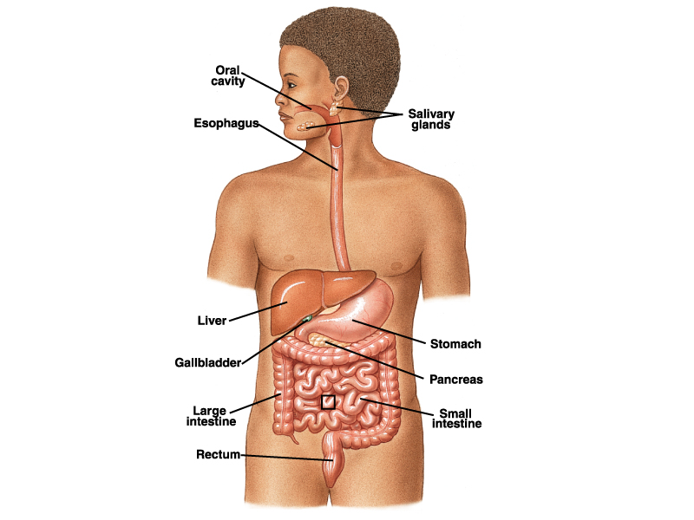
The gut ≈ Gastro-intestinal tract (digestive organs and glands)

Slide 3
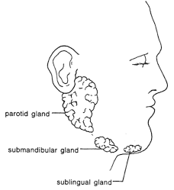
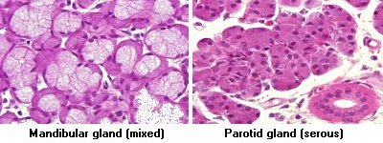
Functions of saliva
Lubrication and solubilization of food
Digestion (salivary amylase)
Secretion of HCO₃⁻
Endocrine functions (IGF, many others)
“watery”
“mucusy”
IGF= Insulin-Like Growth Factor

Slide 4
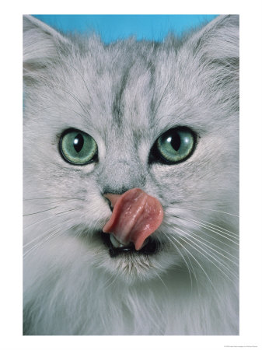
Trivia
The saliva of cats does not contain amylase.
A small fraction of all humans secretes saliva without amylase.
The number of salivary amylase gene copies varies among ethnic groups: it is higher in agricultural
societies (7-14 copies) than among
hunter gatherers (3 to 8 copies)!

Slide 5
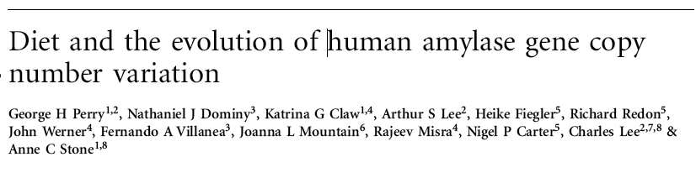
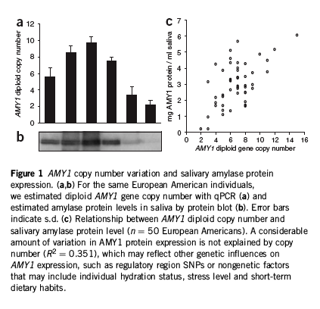
Nature Genetics
More copies of the salivary amylase gene translate in higher rates of starch hydrolysis

Slide 6
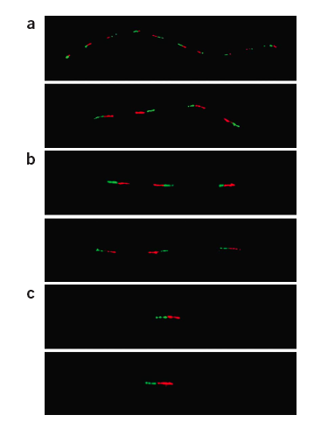
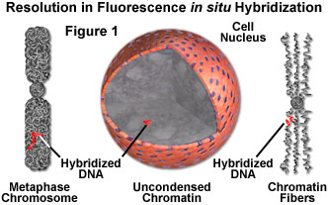
You can use FISH (Fluorescence in situ hybridization) to “see” the number of copies of a gene.
Japanese (14 copies)
Mbenga Pigmy (6 copies)
Chimpanzee (2 copies)
≈

Slide 7
The esophagus is a muscular tube.
Its function is to conduct food from the pharynx to the stomach (and back, in ruminants). It consists both of skeletal muscle (in the upper part) and smooth muscle (in the lower part).

Slide 8
Function of the stomach
Acid peptic digestion of proteins (secretion of HCl and pepsinogen)
Absorption of a few substances (alcohol, and acetylsalycilic acid)

Slide 9
Lower esophageal sphincter (note the reinforcement by diaphragm)
1 < pH < 3
The rest of the
gut’s contents
have near to
neutral pH

Slide 11
Function of the small
intestine
Peristaltic mixing and regulated delivery to the large intestine.
Luminal and membrane digestion (carbohydrates, protein, lipids, nucleic acids)
Absorption of the products of digestion
Endocrine regulatory function

Slide 12
Assimilation = digestion+ absorption
(breakdown) + (uptake)
complex macromolecule (starch, protein)
Simpler macromolecule
(small peptides, di- and tri-saccharides)
Small molecules
(sugars, amino acids, di- and tri-peptides)
luminal digestion
(pancreatic enzymes)
membrane digestion
(disaccharidases, peptidases)
transport
(many transporters and
mechanisms )

Slide 13
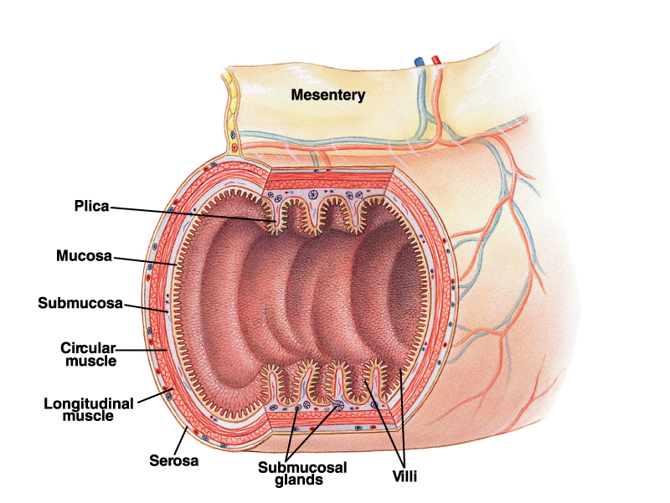
folds of
Kerkring

Slide 14
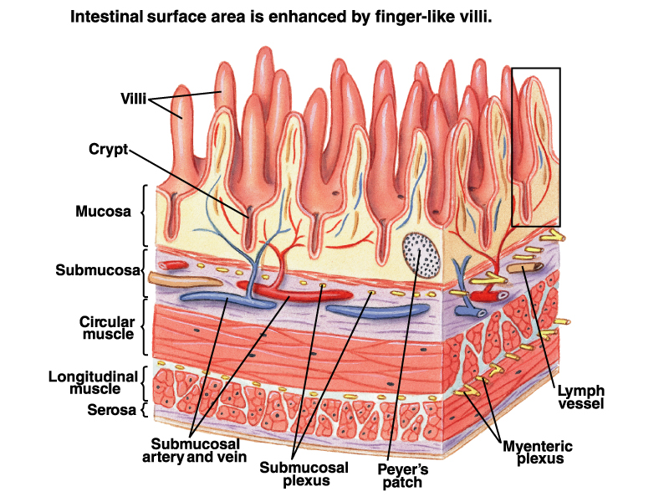

Slide 15
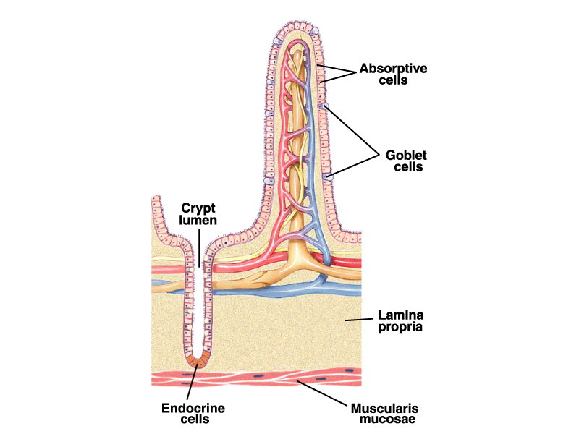
Singular = villus
Plural =villi
older cells
Lacteal
(lymphatic system)
young cells

Slide 16
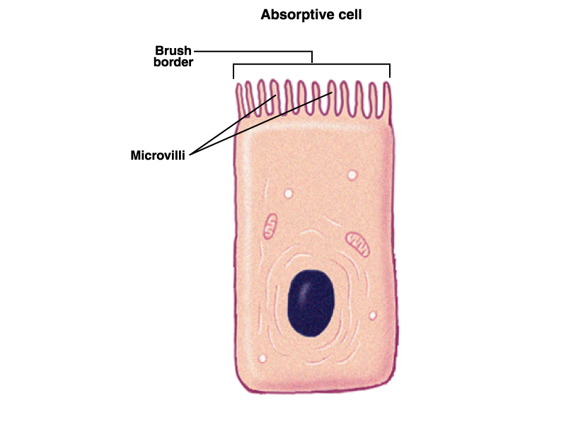
Apical
membrane
Glycocalyx
Basolateral
membrane
Enterocyte (enteron = gut, cytos=cell)

Slide 17
Nominal area ≈3.3 m²
Addition of folds of Kerkring ≈ 10 m²
Addition of villi to
Folds of Kerkring ≈100 m²
Addition of microvilli to
villi ≈2,000 m²

Slide 18
Glands…

Slide 19
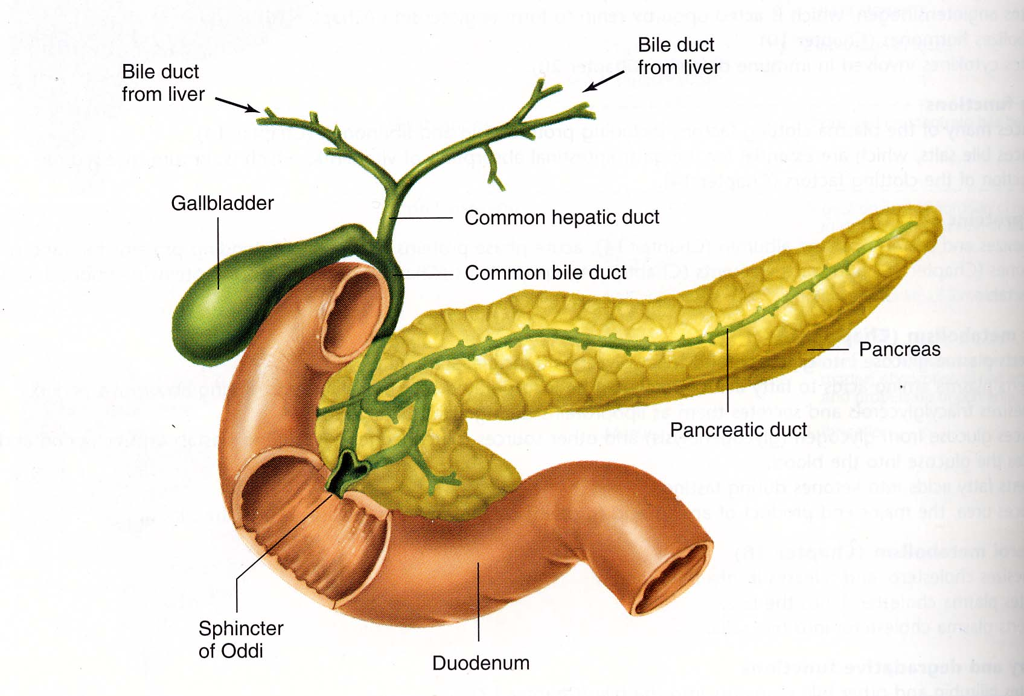
The pancreas is an
“endocrine” and
“exocrine” gland.
Endocrine means that
It secretes hormones (insulin and glucagon)
Exocrine means that it secretes digestive
enzymes and
buffering pancreatic
“juice” (HCO₃⁻ and Cl- among other things).
The gall bladder stores bile secreted by the liver.

Slide 20
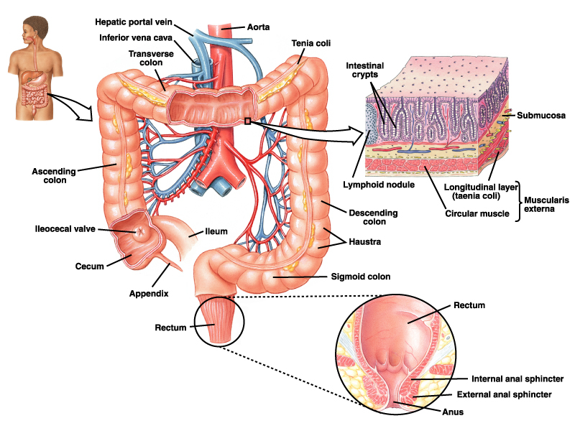
The large intestine

Slide 21
Function of the large intestine
Mixing
Fermentative digestion of fiber (in herbivores, but also in humans)
Absorption of water, ions (Na+, Cl-, vitamins produced by bacteria)
Feces formation

Slide 22
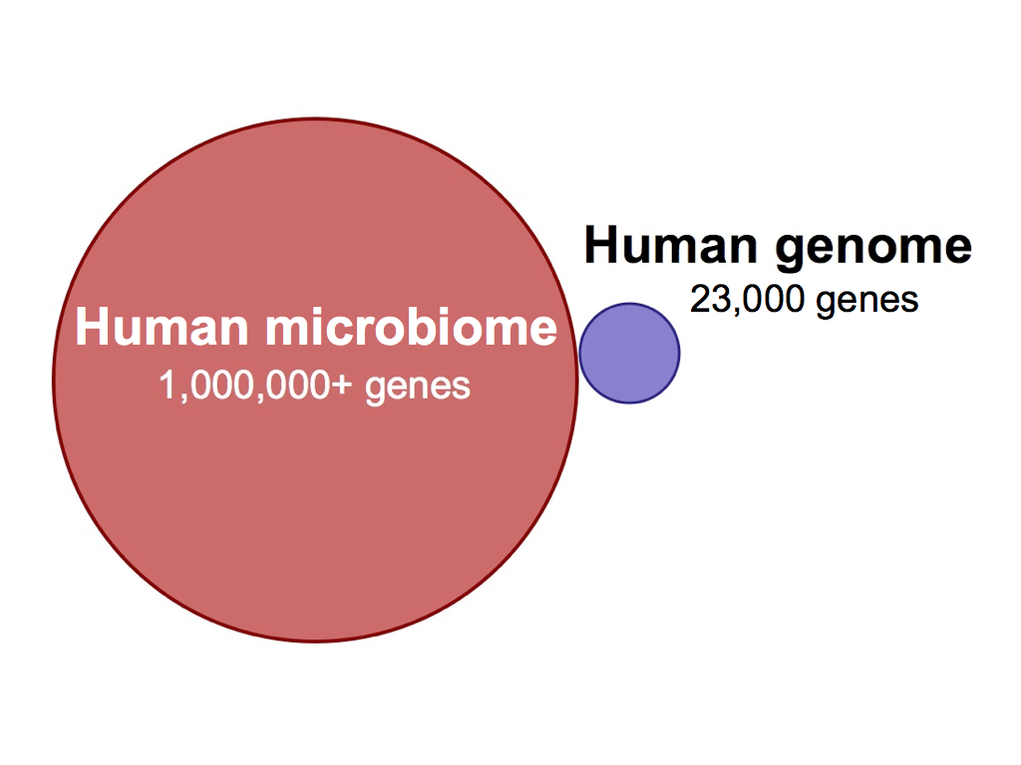
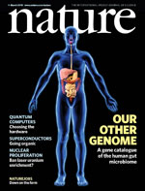
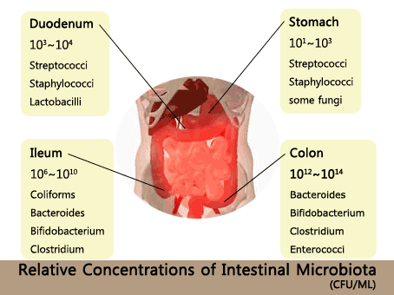
A few cool factoids....
Human Microbiome ≈ 100 trillion cells
Human cells ≈ 10 trillion cells

Slide 23
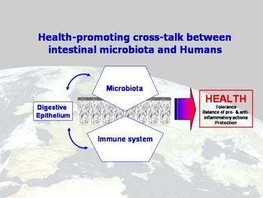
There are about 10X more bacterial cells in the large intestine than “human” cells, and these have ≈ 100X more genes (combined).
What is the importance of the intestinal microbiome?
Digestive/Nutritional (biotin, vitamin K, a bunch of essential nutrients)
Immunological (stimulated development of immune system, repression of pathogenic microbes)

Slide 24
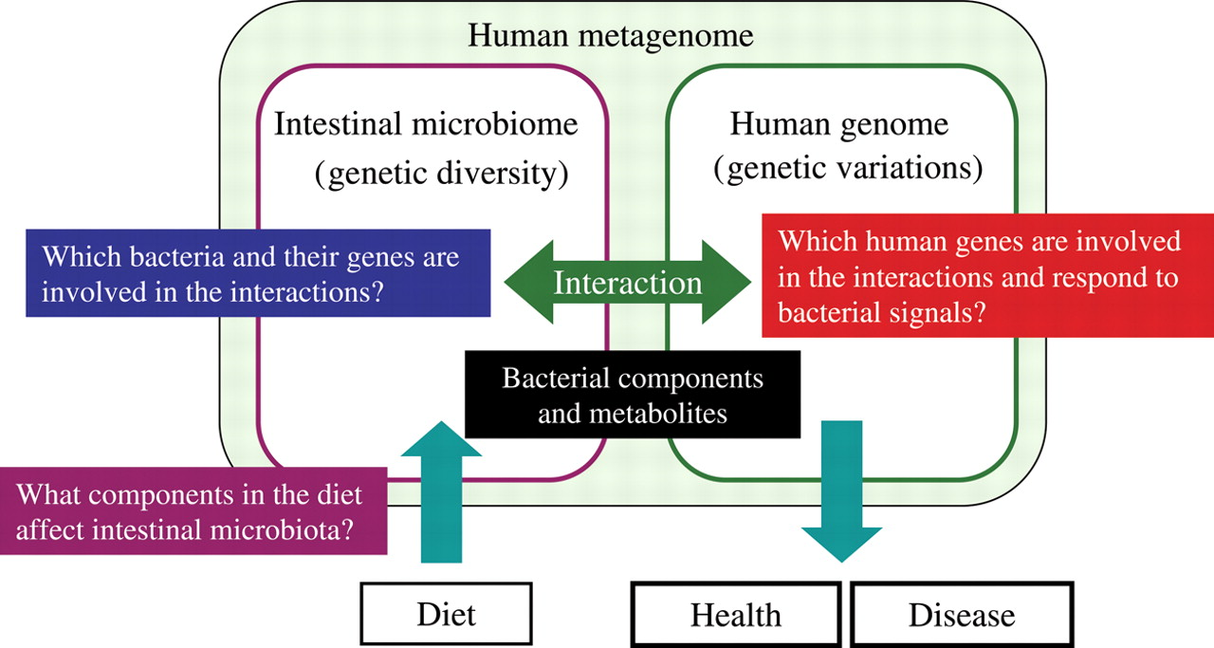

Slide 25
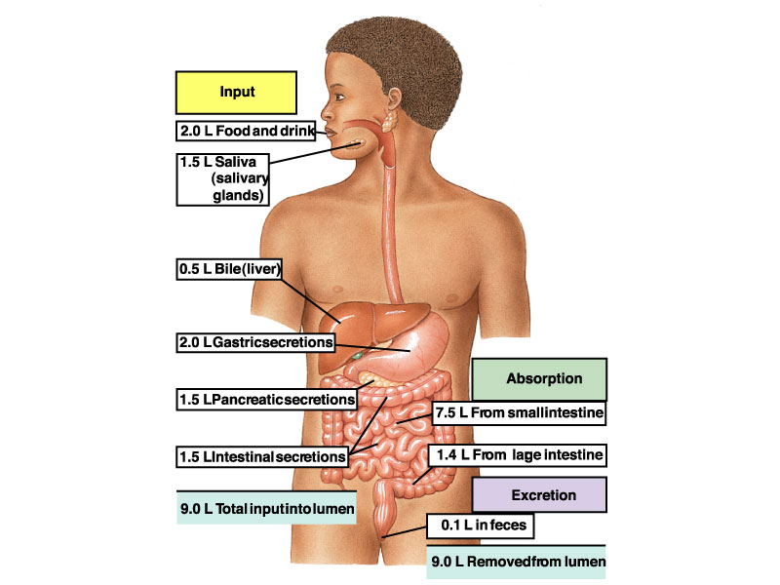

Slide 26
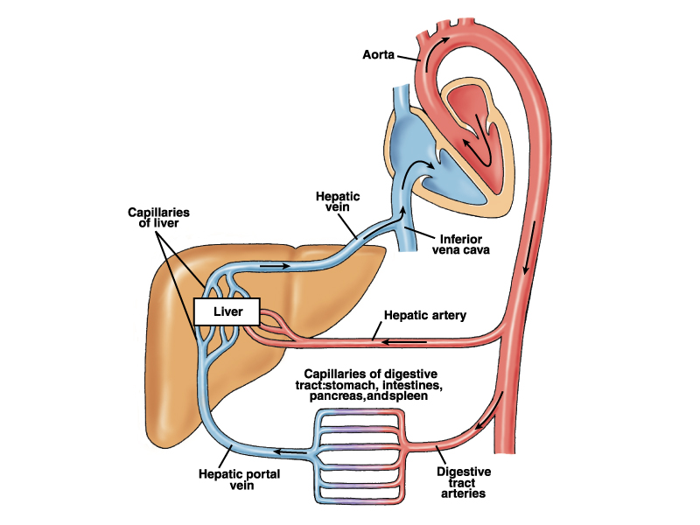
The circulation of the GIT

Slide 27
To Remember
Saliva is a lubricant, it contains many enzymes (amylase), some hormones (IGF), and many other things!
The stomach has low pH (1 < pH < 3) and begins protein digestion.
The small intestine is where most digestion and absorption of nutrients takes place (intestinal pH ≈ neutral)
Assimilation = digestion + absorption
Digestion can be luminal or membrane.
The intestinal epithelium is folded, and then folded again (folds of Kerkring, villi, microvilli).
Intestinal cells are called enterocytes and have an apical membrane full of microvilli (called the brush-border membrane) and a basolateral membrane.
Pancreas is both an endocrine (insulin and glucagon) and an exocrine organ (bicarbonate and digestive enzymes)
Gall bladder stores bile.
The large intestine is where fermentative digestion takes place, also absorbs water, and it is where feces formation occurs.

Slide 28
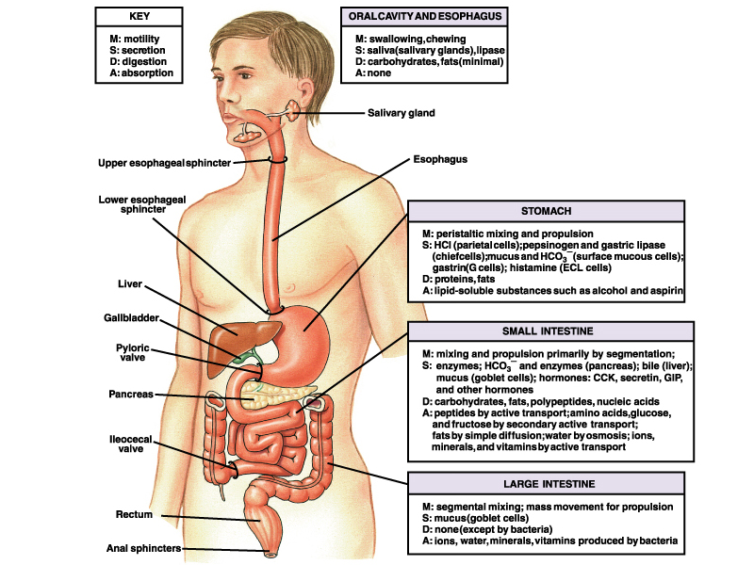
In summary….

Slide 29
Dietary carbohydrates
-Starches/polysaccharides (starch, amylopectin, and glycogen)
-Disaccharides (sucrose, maltose, and lactose)
-Monosaccharides (glucose, fructose, and
galactose)
Also dietary fibers (cellulose, pectins,…,etc.).

Slide 30
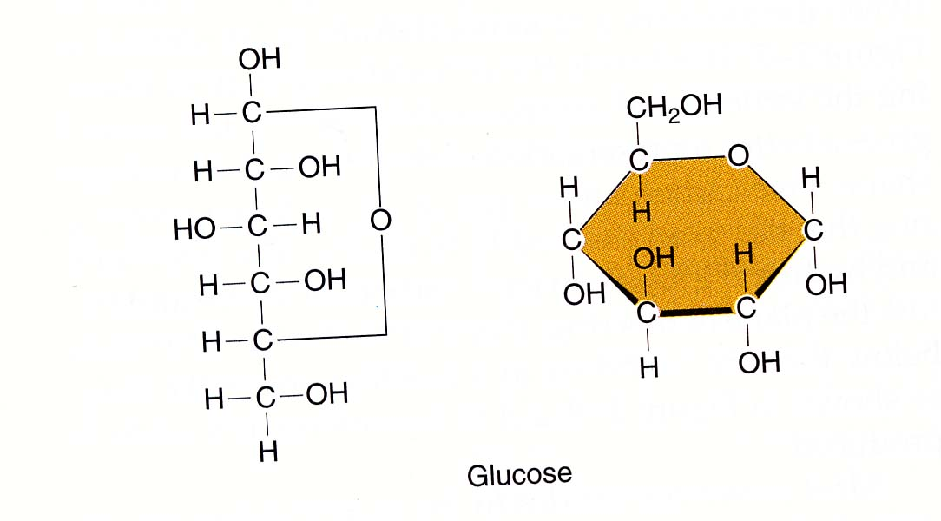
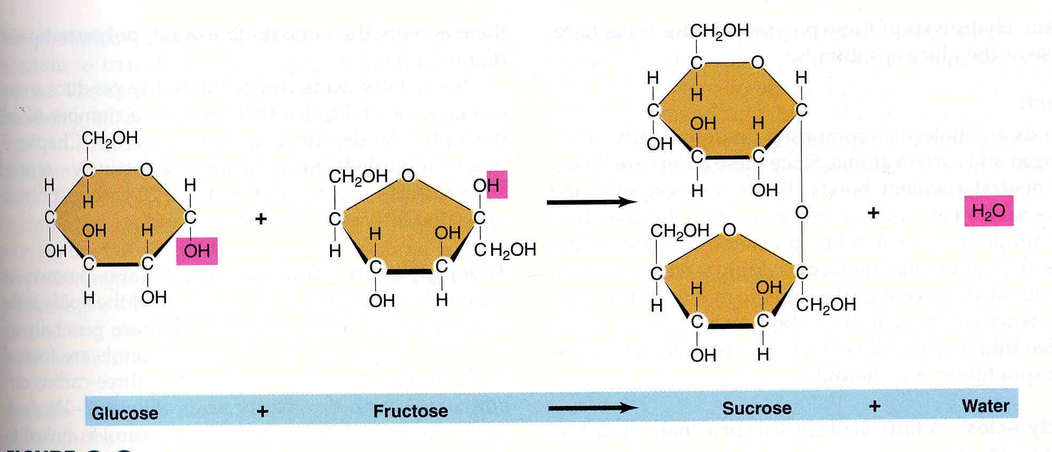
Carbon 6
Carbon 1 is an “anisomeric” carbon
Glucose
Fructose (fruit sugar)
Galactose
Monosaccharides (hexoses)
Sucrose is disaccharide that has recently become common in human diets.

Slide 31
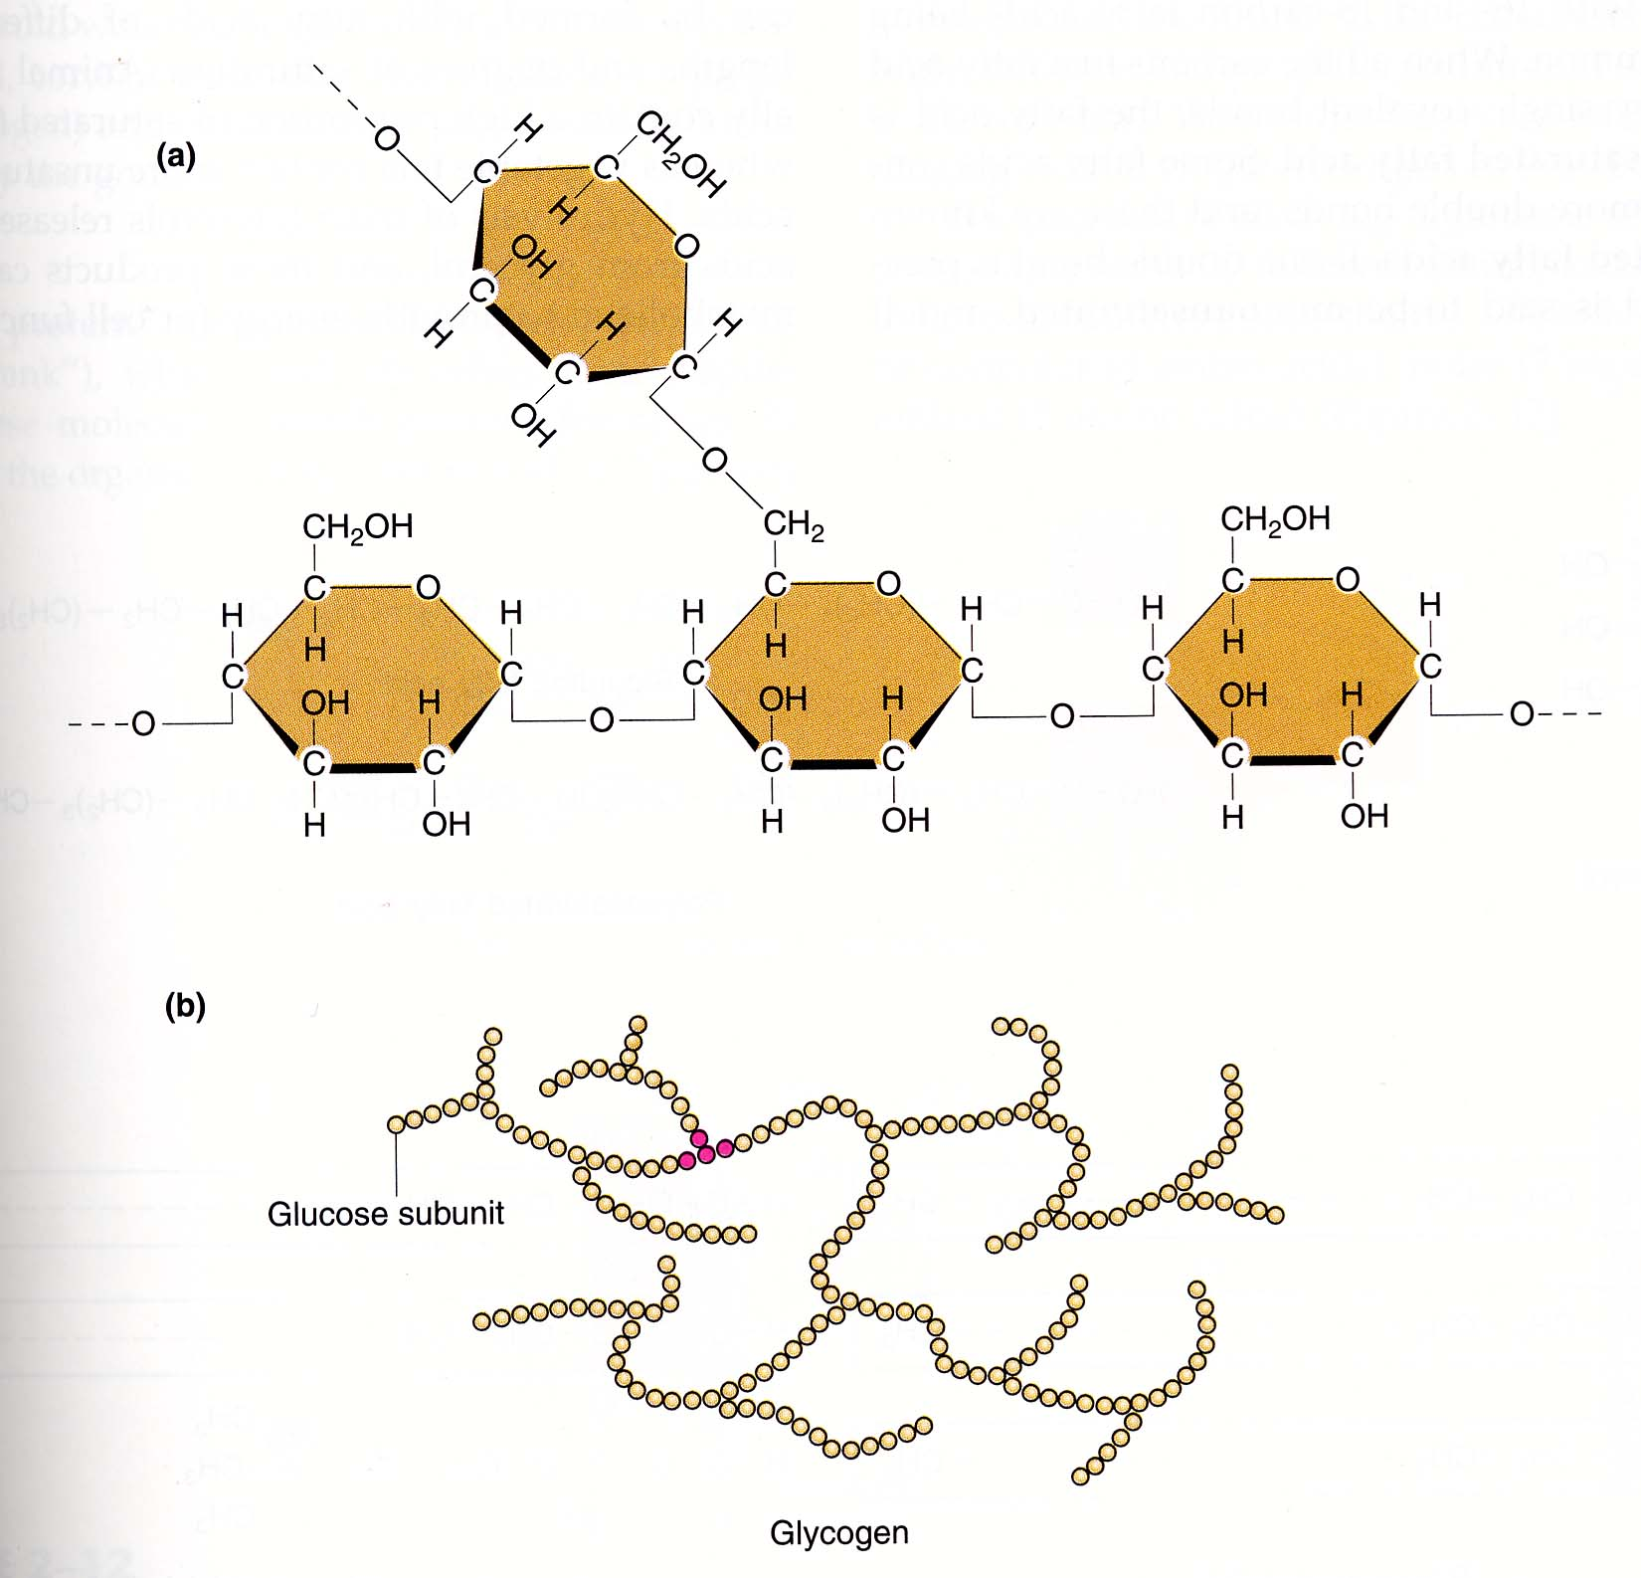
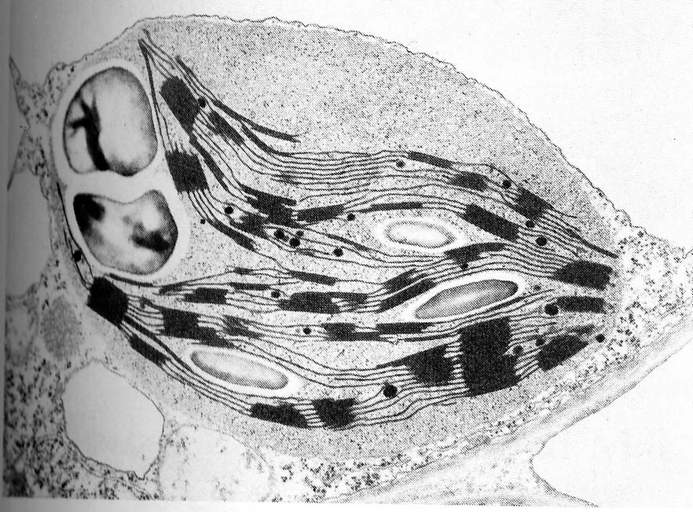
α(1-6) glycosidic bond
α(1-4) glycosidic bond
Starch granule in wheat
Starch and amylopectin
are plant storage
carbohydrates
Glycogen is an animal
storage carbohydrate
starch amylopectin glycogen
(linear)------------------------->(branched)
1:6/1:4 1/150 1/30 1/10
Polysaccharides

Slide 32
An overview of carbohydrate assimilation
Starch
maltose, isomaltose, and α-dextrins
fructose+galactose+ glucose
luminal digestion by
pancreatic and salivary
amylases
lumen
Sucrose + lactose
disaccharidases
transporters
BBM
enterocyte’s interior

Slide 33
Luminal digestion by pancreatic and salivary
amylases
Amylase (“ase” = enzyme, amylose=starch)
Amylase is secreted by both salivary glands and pancreas
It is an “endoenzyme” (it breaks internal α(1:4) bonds)
It has a neutral pH optimum (7-7.5).

Slide 34
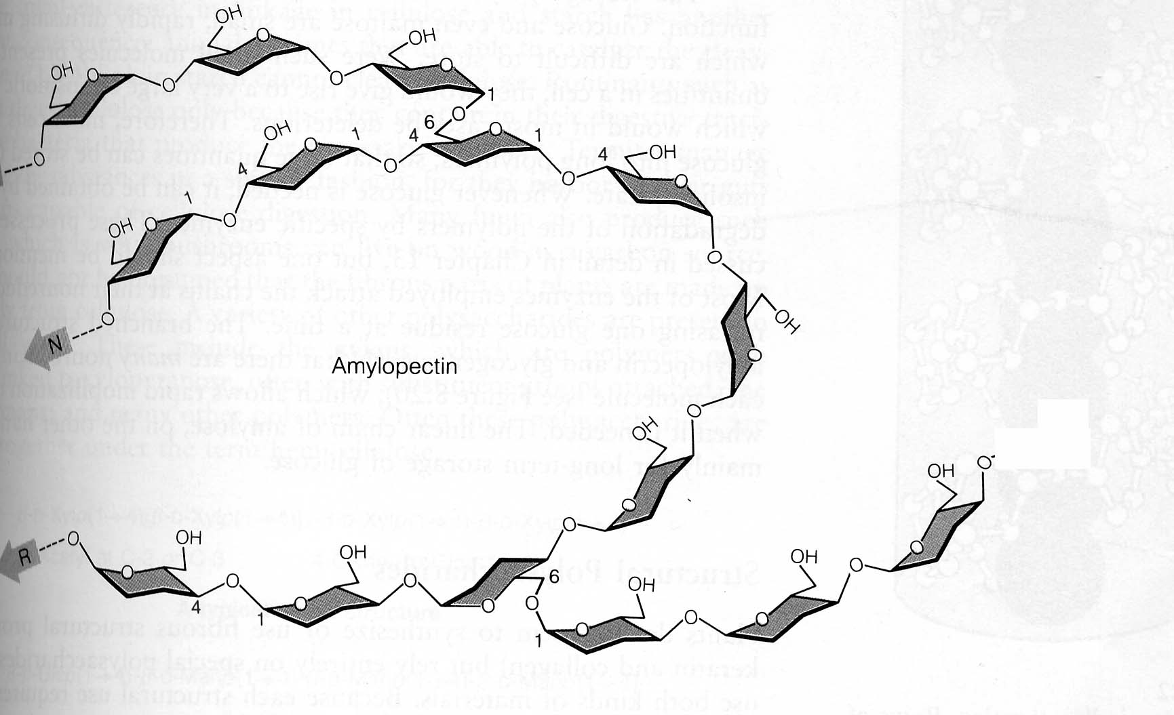
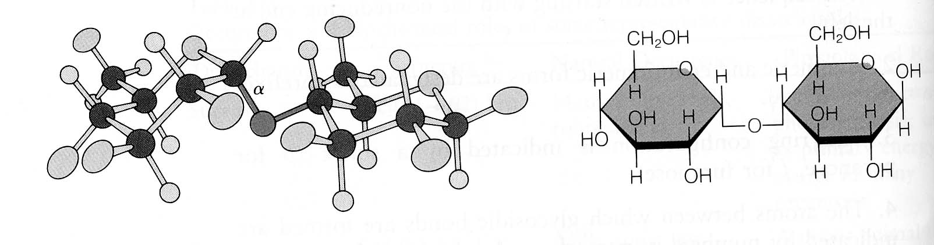
?
No
?
Yes
Yes
Yes
H
No
G
amylopectin + amylase --> maltose (G-G)
isomaltose -----------------> G
maltotriose (G-G-G)
1-6 bond

Slide 35
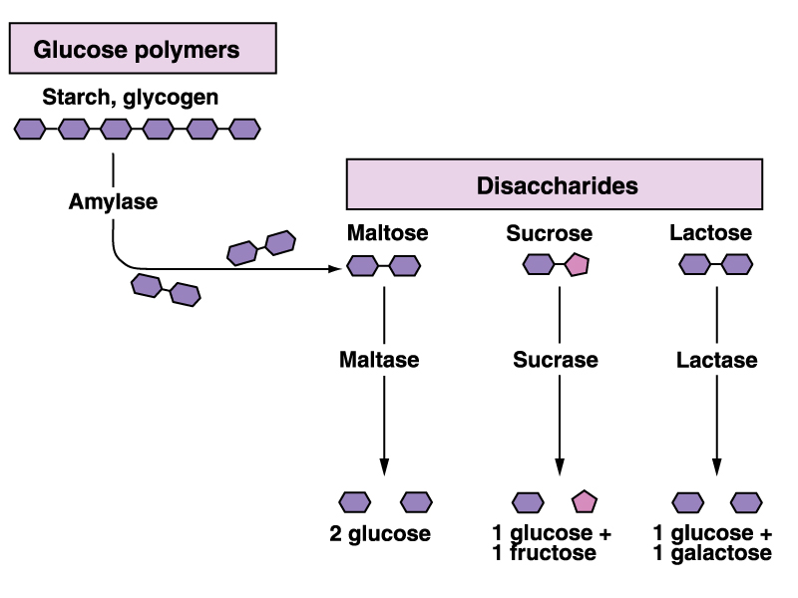
Carbohydrate digestion
luminal digestion
membrane digestion
by membrane-bound
enzymes.
maltase and lactase
are specific enzymes
(have a narrow range
of substrates)
Sucrase-isomaltase
Has broad specificity
(it hydrolyzes
sucrose, maltose,
and isomaltose)
Sucrase and maltase are α-glucosidases
Lactase is a α-galactosidase

Slide 36
Assimilation!
An overview of carbohydrate digestion
Starch
maltose, isomaltose, and α-dextrins
fructose+galactose+ glucose
luminal digestion by
pancreatic and salivary
amylases
lumen
Sucrose + lactose
disaccharidases
transporters
BBM
enterocyte’s interior

Slide 37
glucose
2Na⁺
Lumen Side
Brush Border (apical) Membrane
SGLT1
Na⁺/K⁺
pump
K⁺
glucose
Na⁺
Glucose transport
ATP
GLUT 2
Basolateral Membrane
Blood Side
Glucose Transport is an example of secondary active transport

Slide 38
Glucose transport into and out of
enterocytes
Glucose is transported across the brush border membrane by secondary active transport (it is co-transported with Na⁺). Glucose is transported against a concentration gradient but
sodium is transported downhill a concentration gradient
2) The glucose/Na+ symporter is called SGLT1 (“sodium glucose transporter 1”). SGLT1 also transports galactose.
3) Glucose is transported out of enterocytes by a
facilitative uniporter (GLUT2, “glucose transporter 2”).

Slide 39
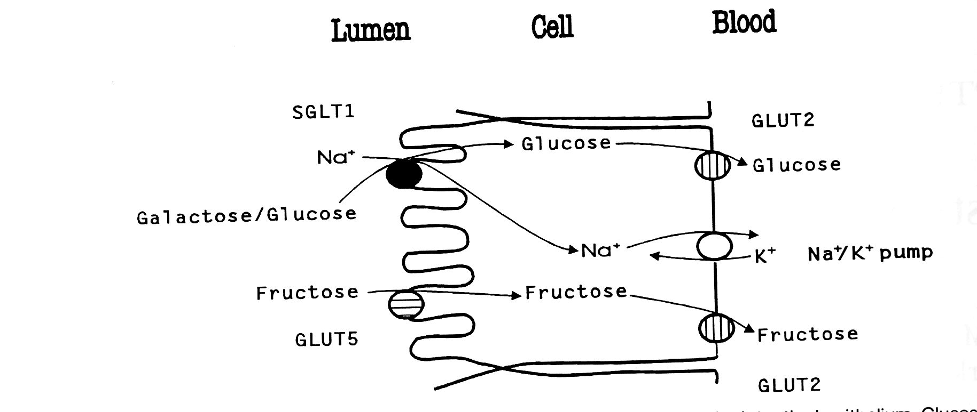
What about
Fructose?
Fructose is transported by a facilitated (“facilitative”)
saturable uniporter called GLUT5 into enterocytes.
(why GLUT? Because it is “homologous” with other GLUTs)
Glucose and fructose share GLUT2 as a transporter
out of enterocytes.
Is fructose transport “concentrative” (uphill)? Glucose?
No

Slide 40
An overview of carbohydrate Assimilation
Starch
maltose, isomaltose, and α-dextrins
fructose+galactose+ glucose
luminal digestion by
pancreatic and salivary
amylases
lumen
sucrose  +  lactose
disaccharidases
transporters
BBM
enterocyte’s interior

Slide 41
To Remember
The digestion of complex carbohydrates (starch, amylopectin, and glycogen) starts with amylase (salivary and pancreatic).
Amylase is an endoenzyme
The important dietary disaccharides sucrose (glucose-fructose) and lactose (galactose-glucose) are hydrolyzed by sucrase and lactase, respectively.
Amylase hydrolysis is luminal, sucrase and lactase are membrane-bound.
Glucose is co-transported by secondary active transport with sodium by SGLT1.
The transport of fructose is non-concentrative (GLUT5)

Slide 42
The evolution of lactose tolerance in
Homo sapiens (sapiens?)
-We are mammals.
-Mammals are hairy, warm blooded (endothermic
homeotherms), viviparous vertebrates, that feed
their young on milk.
-Milk is a heterogeneous solution (its composition
varies from species to species) that contains proteins,
Lipids, carbohydrates, electrolytes, and vitamins.

Slide 43
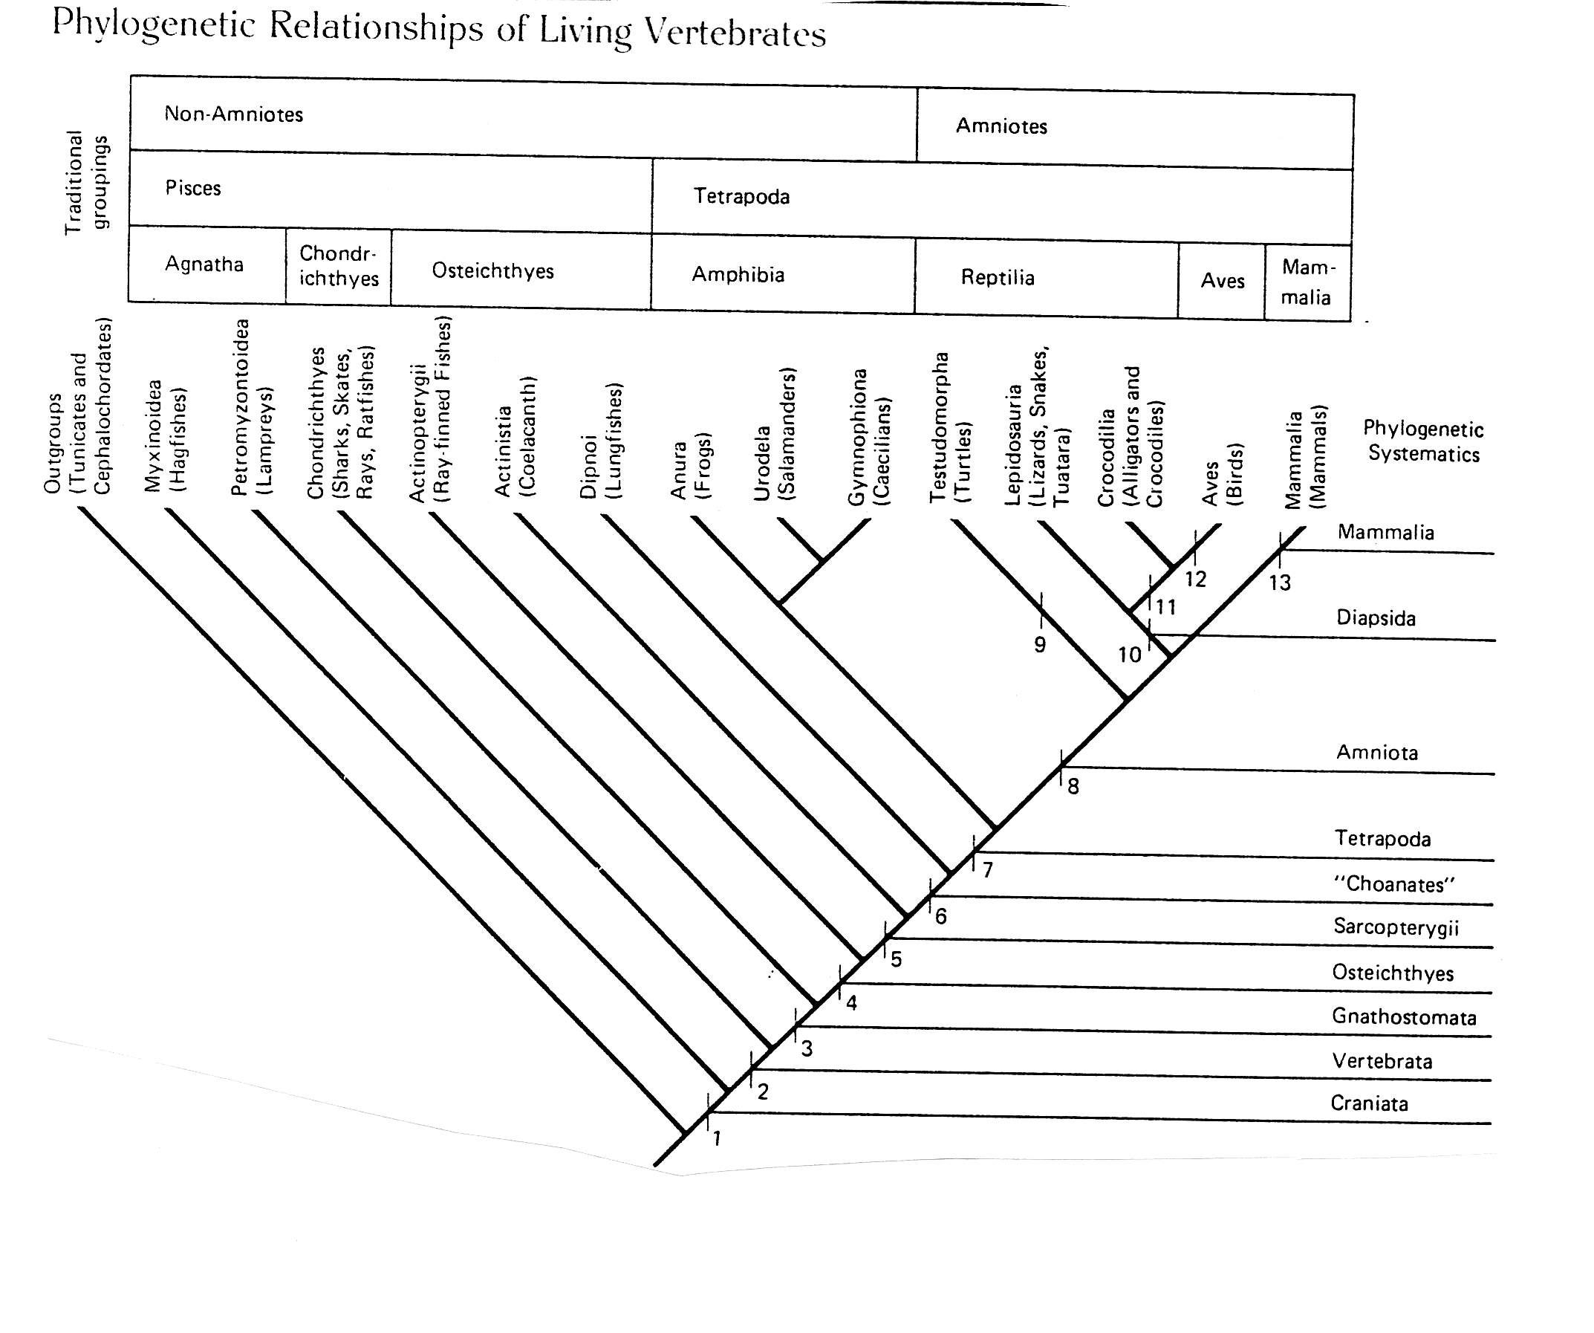
the
“invention”
of milk
Mammals are the only vertebrates that secrete “true” milk
(pigeons, emperor penguins, and flamingos secrete “crop milk”)

Slide 44
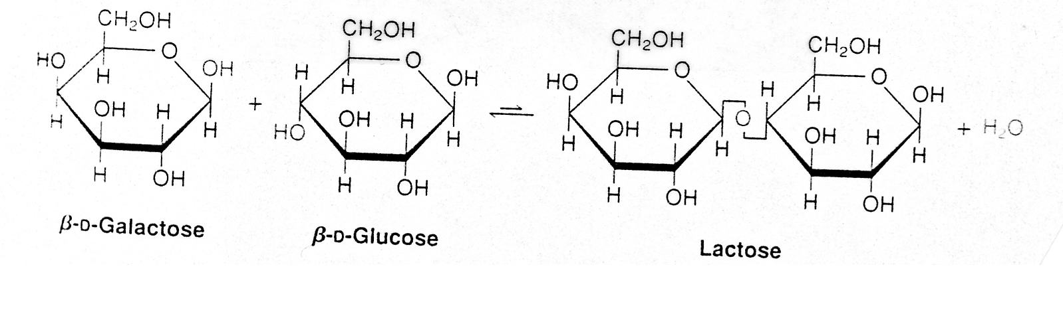
Lactose
-Lactose is the primary carbohydrate
in mammalian milk (a few marsupials
secrete oligosaccharides of galactose).
-Lactose is a disaccharide made of galactose
and glucose joined by a 1-4 β bond.
-Lactose is very rare in nature except in milk.
Glucose + Galactose
SGLT1
Lactase

Slide 45
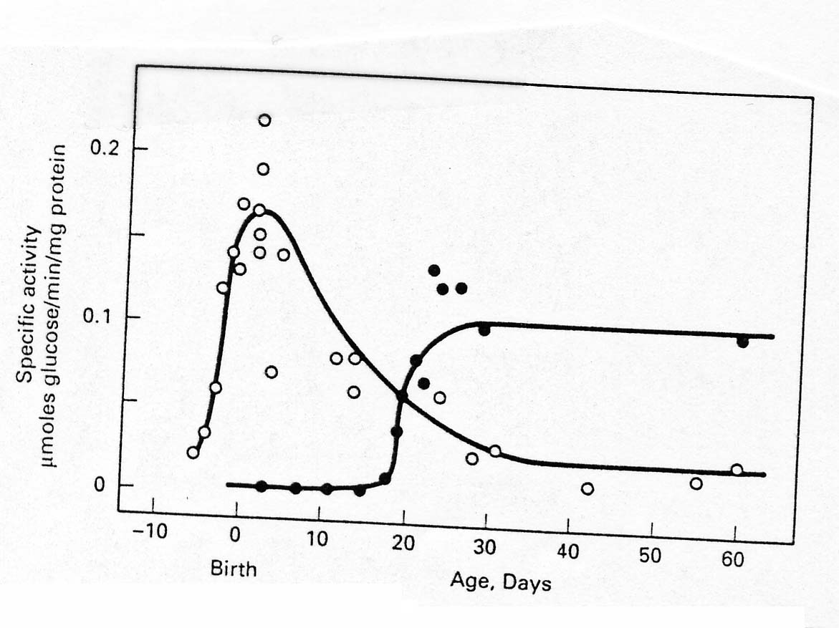
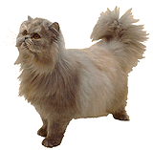
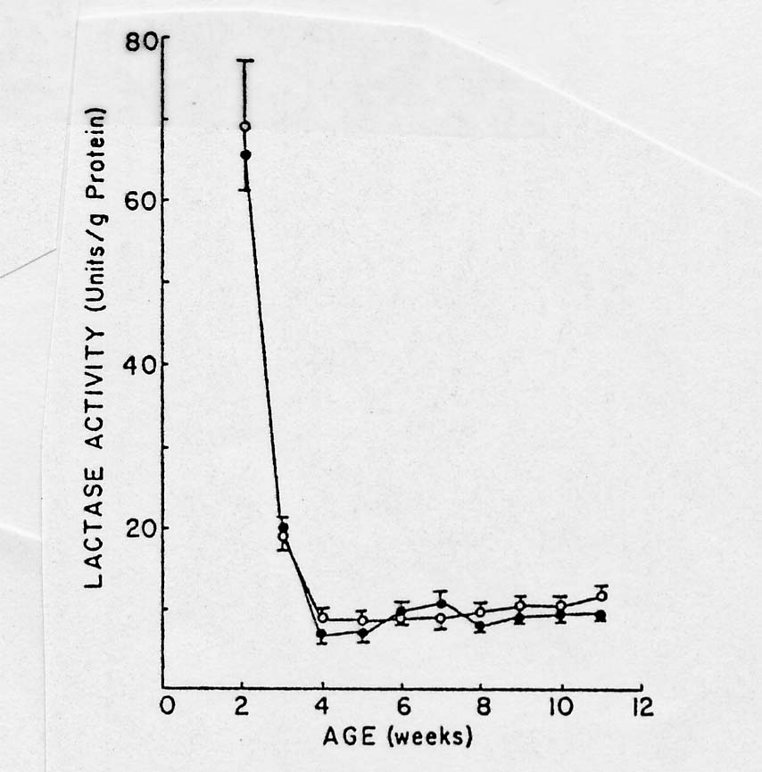
Most adult
mammals are lactose
intolerant.
Babies, of course, are not!
The loss of intestinal lactase activity follows a fixed ontogenetic program (it is independent of diet)
(data for rats)

Slide 46
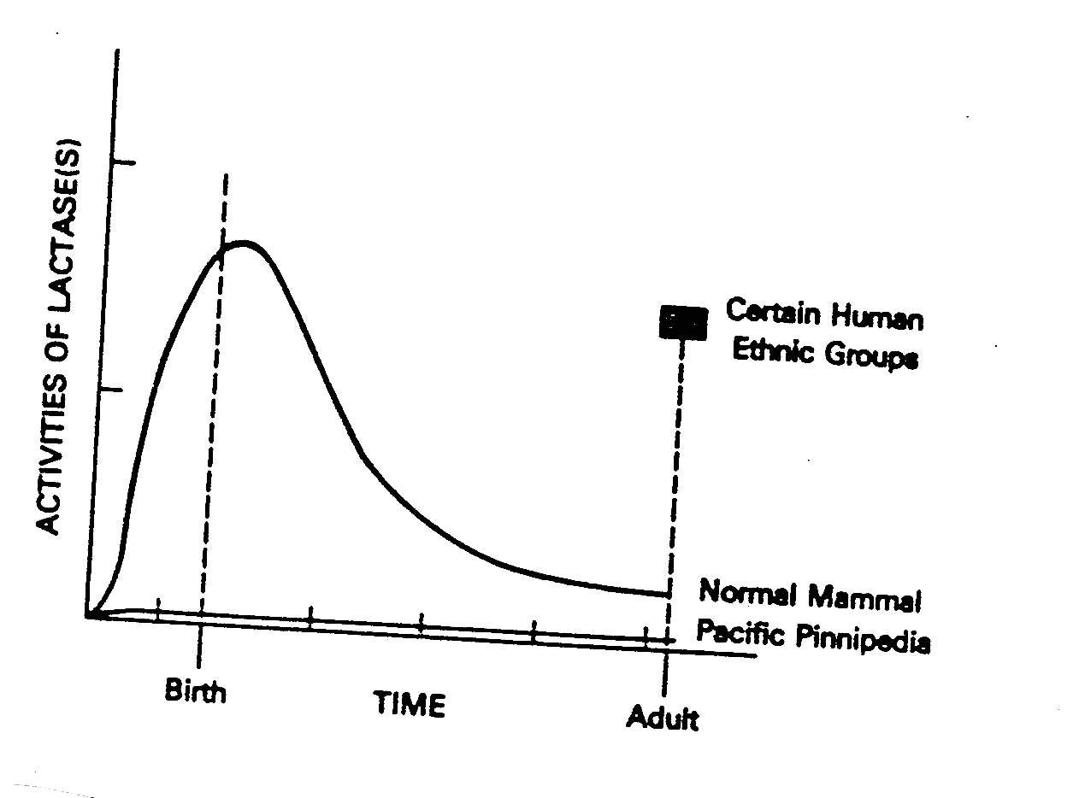
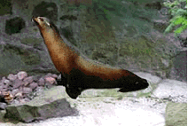
Two exceptions:
Many pinnipeds (sea lions and seals) lack intestinal lactase activity (why?).
Their milk lacks lactose!
2) Certain human ethnic groups (N. European caucasians, pastoral groups of north and central Africa) retain lactase activity as adults (less than 10% of humanity).

Slide 47
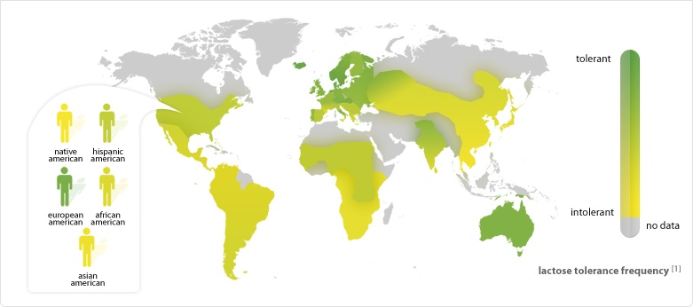
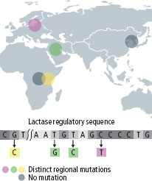
-lactose intolerance is a genetically determined trait
-It has simple Mendelian genetics (tolerance is dominant,
intolerance is recessive).
-Lactose intolerance is the ancestral condition in humans
-Lactose tolerance evolved three times in humans, how come?
GOT MILK?
in both cases as a result of “coevolution” with domestic ungulates (cows, goats, and camels).

Slide 48
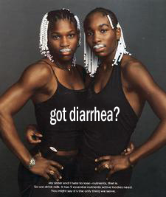

Slide 49
Hypotheses to explain the evolution of lactose tolerance
Pastoralism (nutritional advantage, sensu stricto. Low latitudes)
Calcium absorption (high latitudes)
  The low availability of sunlight, and hence low synthesis of Vit. D is the the selective agent
  Milk has high Calcium content
  Calcium and lactose enhance each other’s absorption (mechanism unclear).
Lactose Tolerance may have its bio-cultural origins in the practice of relying on milk to supplement mother’s milk

Slide 50
Diagnosing lactose intolerance
Two tests: blood glucose and hydrogen in breath
Blood Glucose Level (mg/dL)
Blood glucose protocol.
Measure BGL in fasted subject
subject ingests lactose solution (5mg/kg)
Measure BGL sequentially or after 30 minutes
120
A
80
B
A = ?
B=?
A=tolerant
B=intolerant
Time (min)

Slide 51
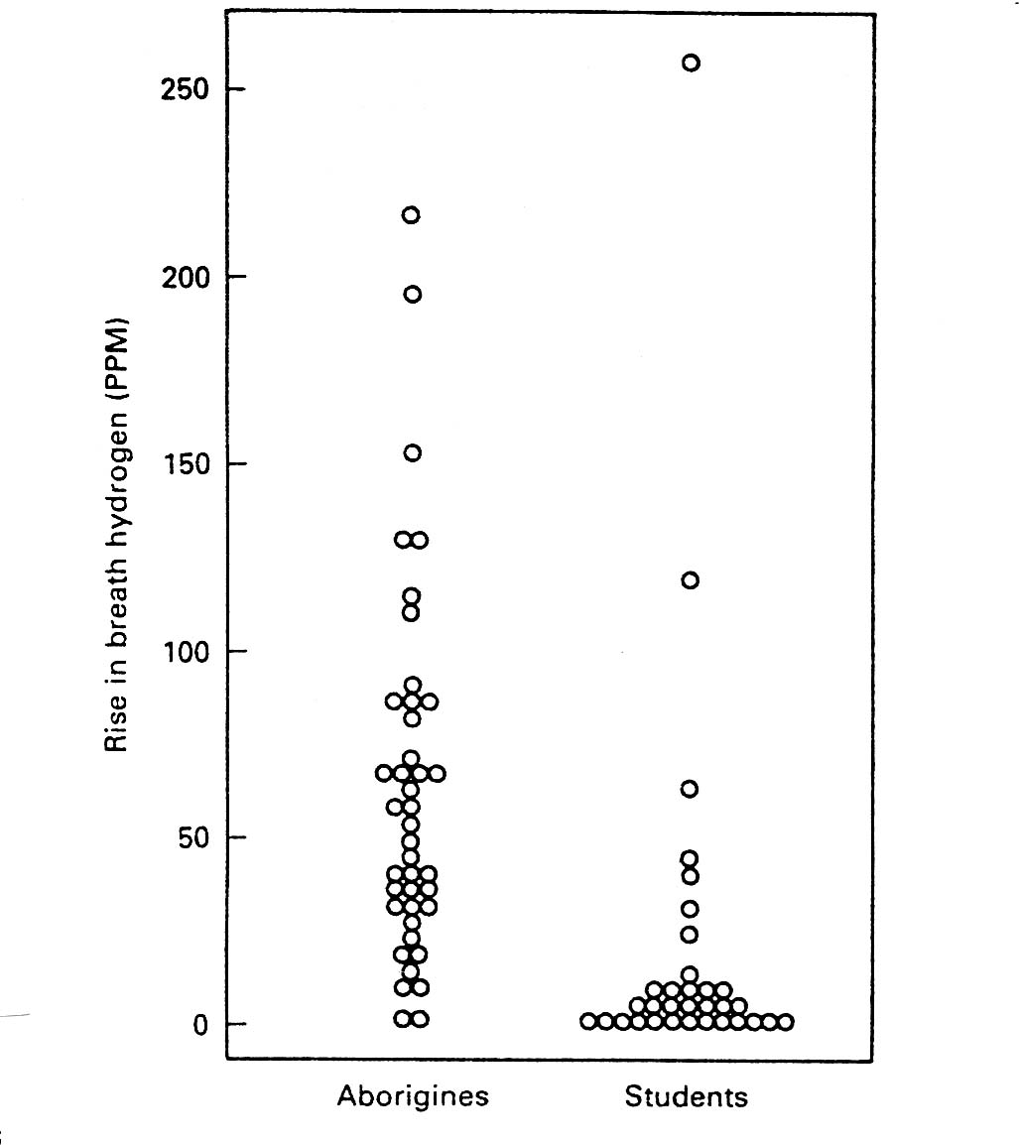
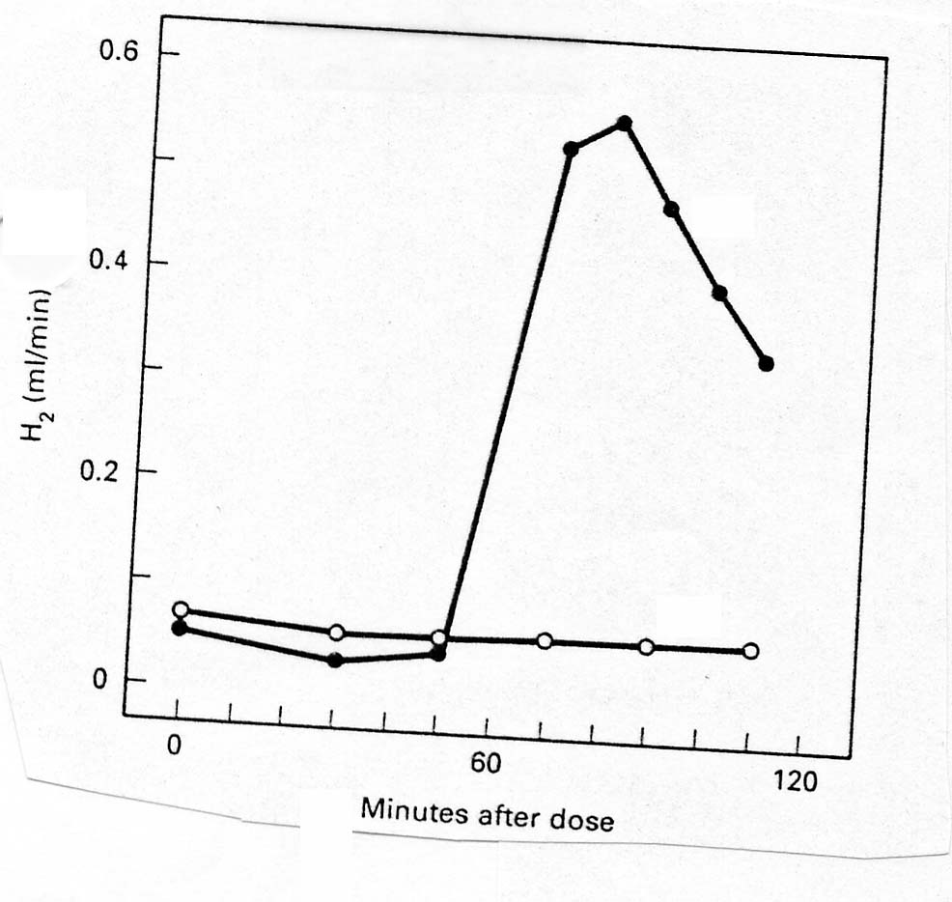
Hydrogen in breath protocol.
Measure hydrogen exhaled by fasted subject
subject ingests lactose solution (5mg/kg)
Measure hydrogen exhaled sequentially
A
B
A=?
B=?
A = intolerant
B=tolerant

Slide 52
In summary:
Lactose intolerance is an example of a genetic polymorphism in humans. It is an example of relatively recent (less than 10,000 years) evolutionary change in human populations. Lactose tolerance evolved in response to an association with ruminants (cows, goats, and sheep).
It is one of many examples of clinically significant ethnic variation in physiological traits. Other examples are cystic fibrosis, sickle cell anemia, and adult onset (type II) diabetes.

Slide 53
To Remember
Most ADULT mammals are lactose intolerant because of an ontogenetic loss of intestinal lactase during weaning.
Most ADULT humans are lactose intolerant.
Lactose tolerance is a genetically dominant trait found in pastoral societies in Africa and Northern Europe.
Lactose intolerance can be diagnosed by measuring blood glucose levels (BGL) or hydrogen (H₂) in breath after a dose of lactose.
In tolerant patients BGL ⬆ and H₂ in breath does not change after lactose ingestion.

Slide 54
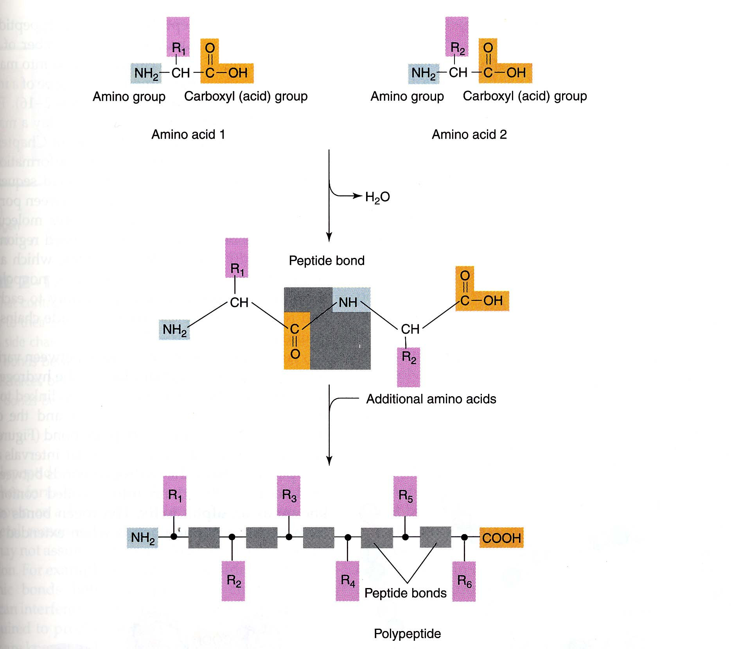
Proteins are chains of amino acids joined by peptide bonds.
A peptide bond joins the -OH of the carboxyl group with the NH₂ of the amino group.
Depending on the number of amino acids, a peptide can be a di-, tri, tetra-, oligo- or polypeptide.

Slide 55
Amino acids
20 amino acids
Aliphatic with hydroxyl aromatic basic acidic
or sulfur
containing
chains
Glycine Serine *Phenylalanine *Histidine Aspartic acid
Alanine Cysteine Tyrosine *Lysine Glutamic acid
*Valine *Threonine *Tryptophan Arginine Asparagine
*Leucine *Methionine Glutamine
*Isoleucine
Cyclic DO NOT MEMORIZE! (YOU WILL HAVE TO IN
BIOCHEM, SORRY….). Know only the stuff in red.
Proline
9 amino acids are essential (indispensable) for mammals *

Slide 56
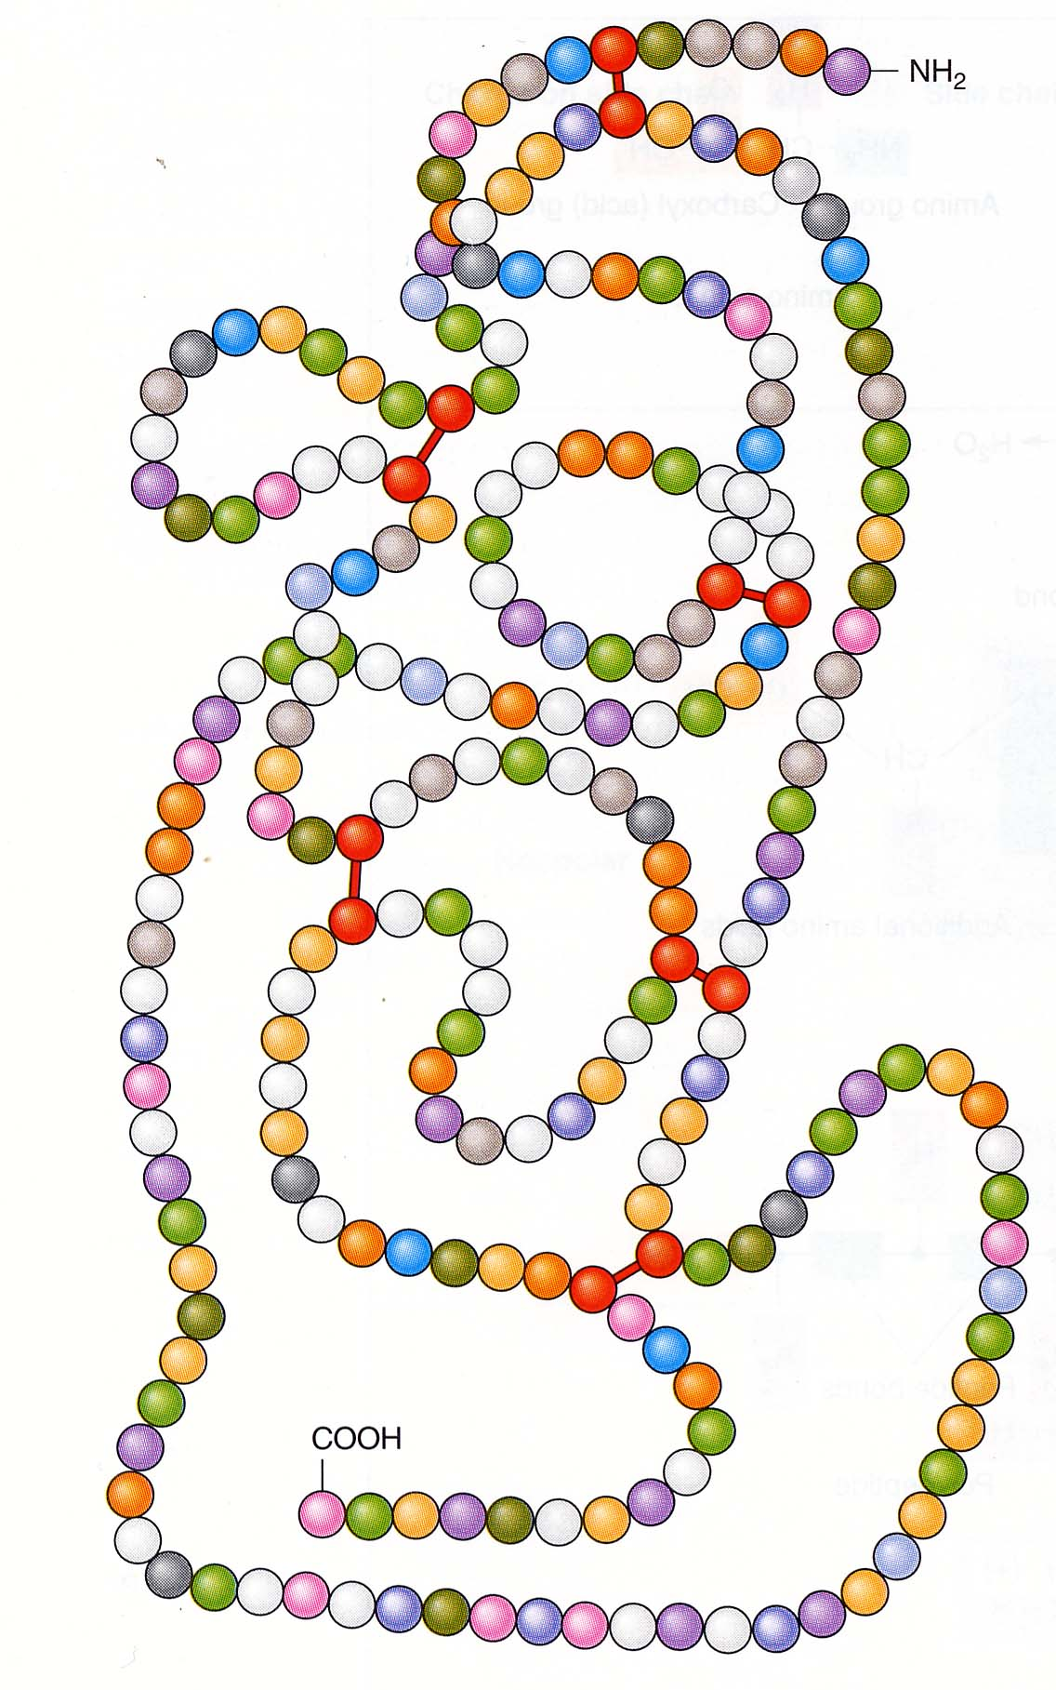
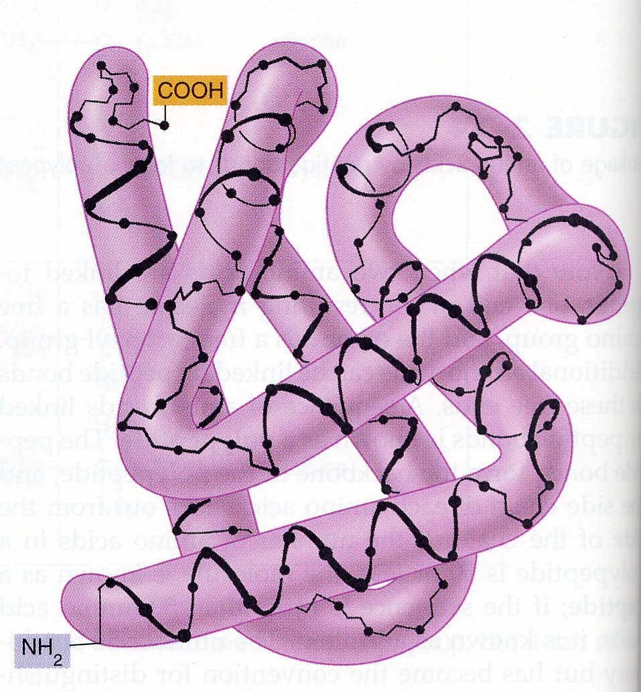
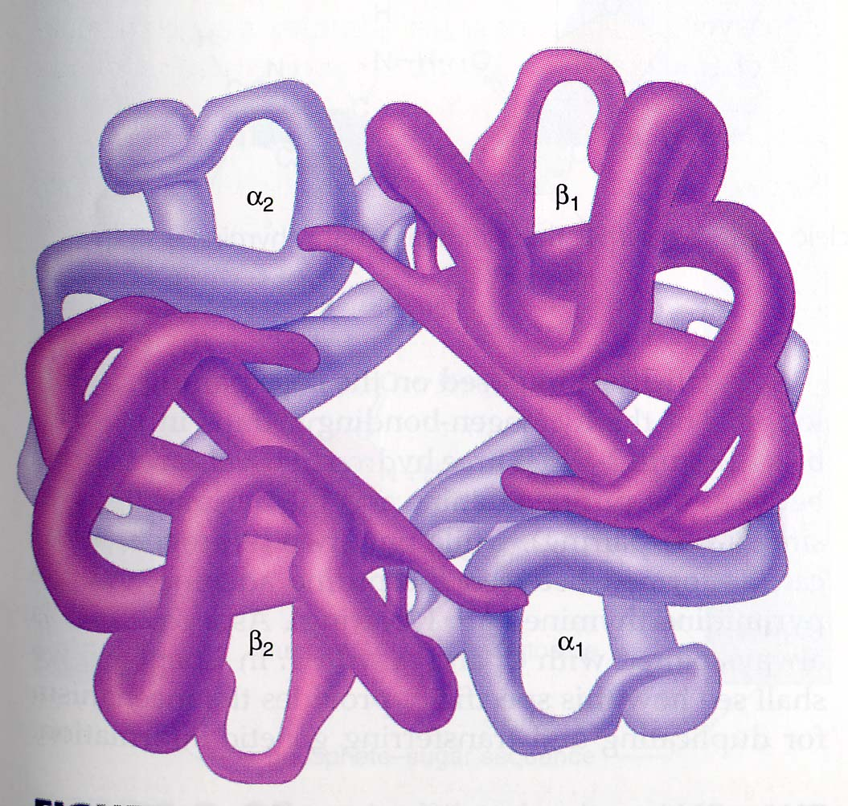
Proteins have primary structures (the linear ordered array of amino acids in a polypeptide chain.
The “conformation” (3-D) structure of a protein is determined by
-hydrogen bonds (polar)
-Weak van der Waals forces (non-polar)
-Covalent bonds (disulfide bonds between cysteines)
Many proteins have a “quaternary” structure. They are made of 2 or more interacting polypeptide chains (SGLT1 is a tetramer, hemoglobin is a tetramer)

Slide 57
An overview of protein assimilation
Protein
Smaller oligopeptides
Di- and tripeptides + amino acids
acid pepsic
digestion
Stomach
lumen
digestion by
pancreatic
peptidases (proteases)
Small Intestine
di- and tri-peptide
transporters
oligopeptidases
Many amino acid
Transporters
enterocyte

Slide 58
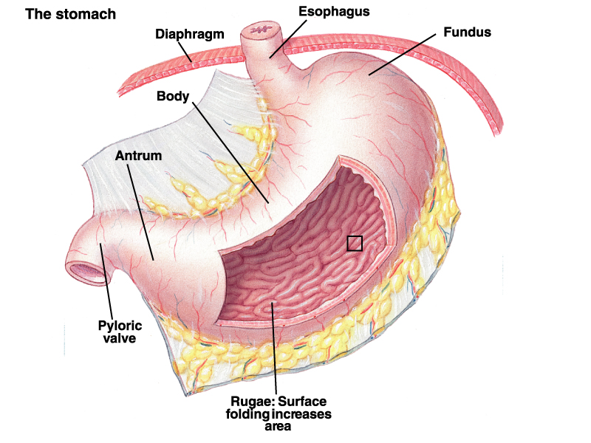
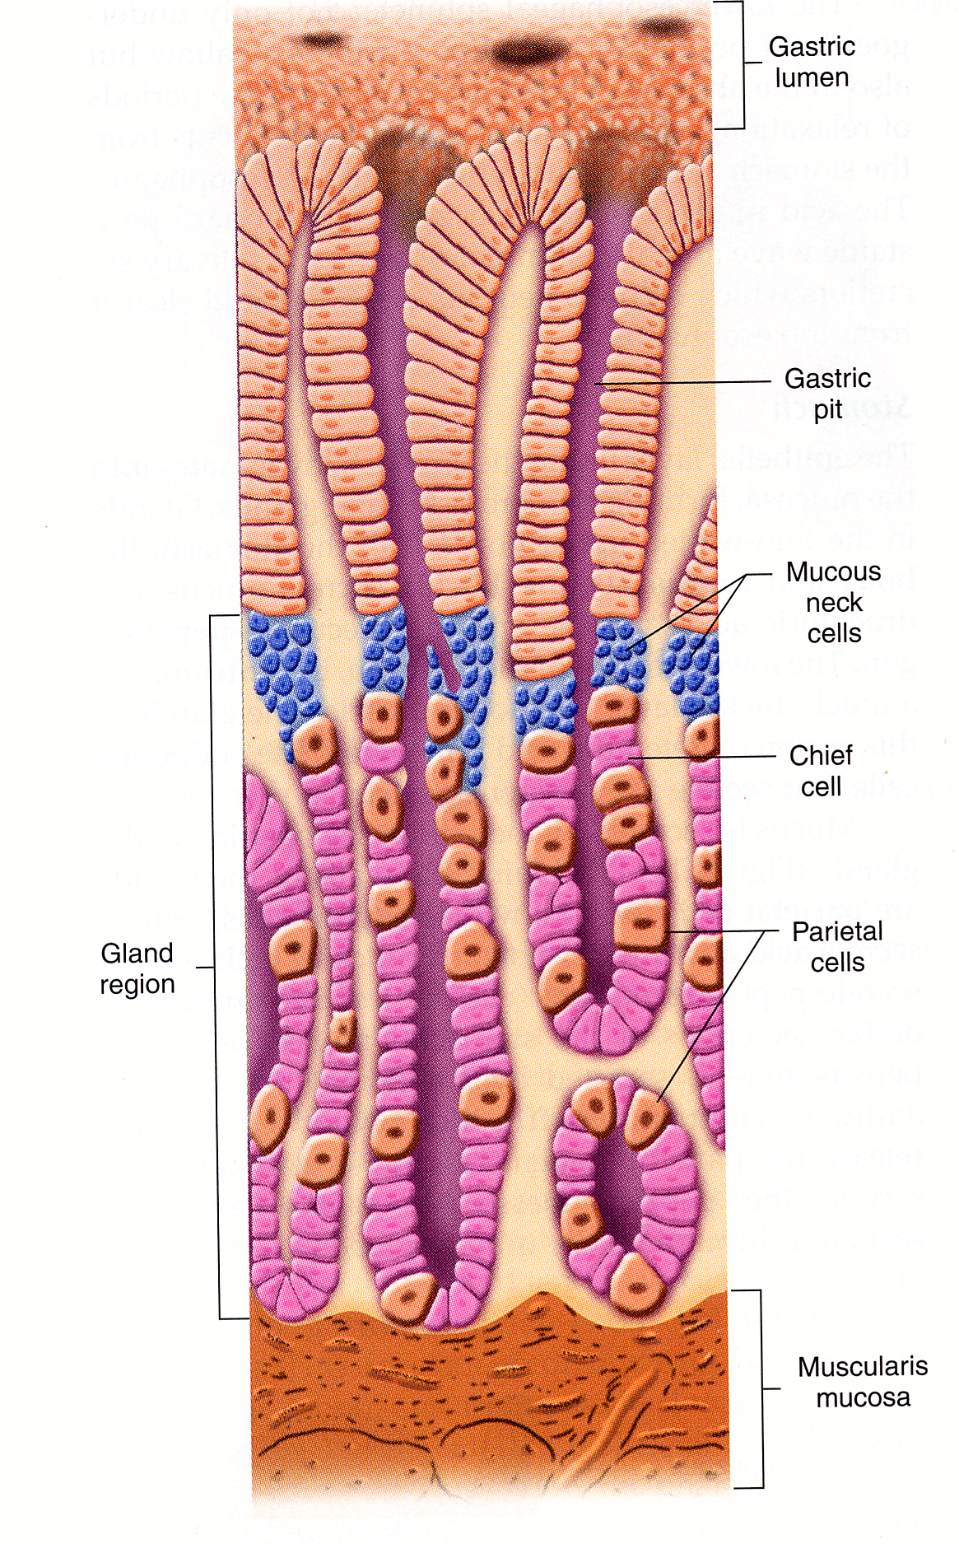
mucus
Intrinsic factor protects vitamin B-12 (Cobalamin) from digestion
pepsinogen
HCl and
intrinsic
factor
Because Vitamin B12 is essential in the synthesis of Hb, damage to the stomach can lead to anemia. START

Slide 59
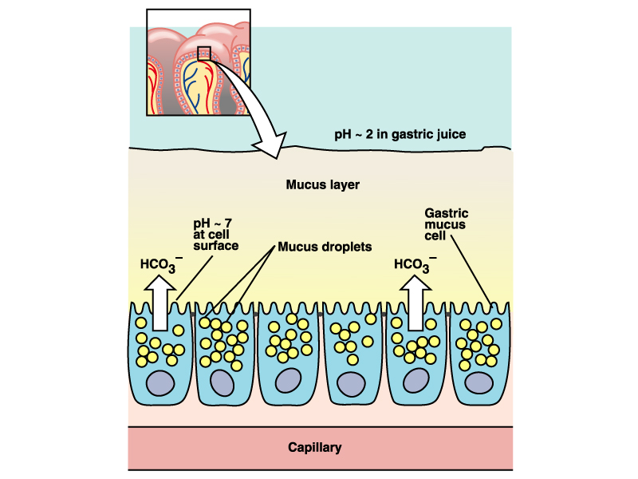
Mucus protects the lining of the stomach from self digestion.

Slide 60
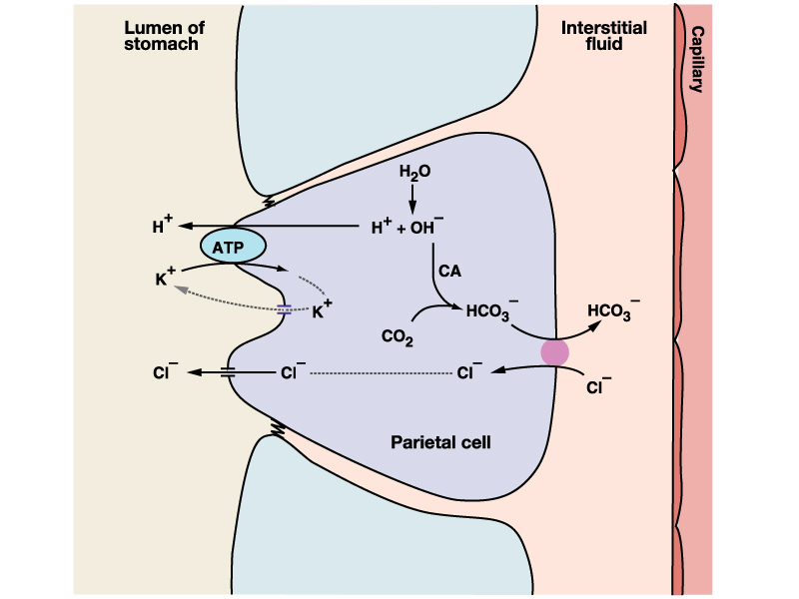
How is HCL secreted by parietal cells
Hypothesis!!!!
CA=carbonic anhydrase
H₂0+CO₂+CA<--->H₂CO₃ <----->H⁺ + HCO₃⁻

Slide 61
Pepsinogen
(inactive
secreted by parietal cells)
Pepsin
(active)
+
Protein
HCl
Protein fragments
-Pepsin is secreted as an inactive
zymogen (zymogen= protease precursor) by chief cells.
-Pepsinogen is activated by HCl and by pepsin (autocatalysis)
-HCl aids protein digestion because it denatures proteins

Slide 62


Slide 63
An overview of protein assimilation
Protein
Smaller oligopeptides
Di- and tripeptides + amino acids
acid pepsic
digestion
Stomach
lumen
digestion by
pancreatic
peptidases (proteases)
Small Intestine
di- and tri-peptide
transporters
oligopeptidases
Many amino acid
Transporters
enterocyte

Slide 64

“enterokinase”
(membrane bound)

Slide 65
-Many pancreatic enzymes are secreted as
Zymogens.
-They are activated by trypsin.
-Trypsin is activated by membrane-bound enterokinase
(kinase≈activator)
and
-Trypsin is activated by autocatalysis.

Slide 66


Slide 67

Amino acid and peptide transport
receptor mediated
endocytosis
(maybe some dietary peptides such as gluten. We know little!!)

Slide 68
Amino acid and peptide transport
Both amino acids and small peptides (2-6 residues) are transported.
The di- and tripeptide transporter is a secondary active H⁺ symporter (this is trivia!!!).
There are many amino acid transporters (all saturable, some secondary active, some facilitated)
Some proteins are transported intact through a transcellular pathway (endocytosis?)

Slide 69



Endocytosis is an important venue of protein transport for newborns.
Why? What is colostrum?
Colostrum is the first milk produced during and at the end of pregnancy. It contains growth factors and immunoglobulins.
Colostrum (from cows) is marketed as a miracle supplement that “increases circulating levels of growth factors”.
Does this claim make sense?

Slide 70
mucus
pepsinogen
HCl and
intrinsic
factor

Slide 71
How is the pH of the small intestine buffered?

Slide 72

Regulation of pH in the small intestine
intestinal
endocrine
cells

Slide 73
To Remember
Epithelial cells in the stomach secrete mucus, pepsinogen, HCl and intrinsic factor.
Pepsinogen is activated by HCl and pepsin into the peptidase pepsin.
Protein digestion continues in the small intestine as a result of the action of pancreatic proteases (secreted as inactive “zymogens” and activated by other peptidases (remember the names enteropeptidase, and trypsin). Membrane-bound peptidases contribute to “finish off” peptide digestion and amino acids and small peptides are transported into enterocytes.
New-born babies absorb intact, non-hydrolyzed, proteins (immunoglogulins growth factors) by endocytosis.
The pH of the intestine is buffered by the secretion of bicarbonate by the pancreas (stimulated by the intestinal hormone secretin).

Slide 74
Lipid Assimilation

Slide 75

The most abundant dietary lipids are triacylglycerides (triglycerides, TAGs). TAGs are esthers of glycerol and fatty acids.
(what are MAGs and DAGs?)
The physical properties of TAGs are similar to those of their fatty acid constituents:
-Their melting point increases with hydrocarbon chain length.
-Their melting point decreases with degree of unsaturation.

Slide 76

Facts about fats
-Triacylglycerides are the main energy storage molecules in animals (why? Energy dense and can be stored “neat’).
-If their melting point is high, we call them lards (many animal fats have high melting points) if it is low we call them oils (many plant lipids). Degree of unsaturation, rather than chain length is key..
-There are two essential (indispensable) fatty acids: linoleic and linolenic acid .
Unsaturated fatty acids are
Synthesized from saturated precursors as a result of the action of enzymes called “desaturases”.
Linoleic acid

Slide 77

Lipid assimilation: an overview

Slide 78

FIG. 21.17
The first step in the assimilation of lipids is the emulsification of fat globules by the action of phospholipids and bile salts.
An emulsion is a more homogeneous suspension of small lipid droplets called emulsion droplets

Slide 79

The emulsification of fats requires 1) mechanical disruption (the contractions of the stomach and small intestine) and 2) an emulsifying agent that prevents droplets from aggregating again.
Steroid
The emulsifying agents are bile salts (cholesterol+ an amino acid) and phosholipids. These two substances are “amphipathic” (Gr. amphi=on both sides, both, pathic = way).
Amino acid
(taurine, glycine)

Slide 80
Composition of bile
Organic Inorganic
Bile salts Cations (Na⁺, K⁺, Ca⁺⁺)
Phospholipids Anions (Cl⁻, HCO₃⁻)
(lecithins)
Cholesterol
Bile pigments
(bilirubin)
In well balanced mixtures (gallstones!! CaCO3+cholesterol)

Slide 81

Emulsion droplets are made of TAGs with a coating of bile salts and phospholipids.
TAGs are broken down by lipase/colipase (secreted by pancreas) into MAGs and FFAs
MAGs= monoacylglycerides
FFAs=free fatty acids
The result is micelles (lipid particles).

Slide 82


Slide 83

Summary
and reminder

Slide 84

-MAGs and FFAs diffuse into the enterocyte (they are lipid soluble!)
-Inside of the cell (in the ER and Golgi apparatus) MAGs and FFAs are reconstituted into TAGs and assembled into “chylomicrons”.
-Chylomicrons are lipoproteins: particles made of TAGs (80-90%), phospholipids (8-9%), cholesterol (2%), and apoporotein (2%). Very similar to VLDLs (Very Low Density Lipoproteins)
-Chylomicrons are then transported out of the cell by exocytosis and deposited in lacteals (small vessels of the lymphatic system).

Slide 85

What happens with bile salts?
They are recycled.
They are actively transported in the ileum (last segment of the SI), they circulate through the hepatic portal vein into the liver, where they are then secreted back into the gall bladder.
About 95% of al bile salts are recycled and 5% are synthesized in the liver
FIG. 20.19

Slide 87
To Remember
You must be able to recognize the chemical structure of FAs, UFAs, and TAGs.
Step 1. Emulsification of lipids into emulsion droplets by phospholipids and bile salts (all amphipatic)
Structure of bile salts (cholesterol with an amino acid)
Formation of micelles (hydrolysis by lipase/colipase)
Diffusion into enterocytes, synthesis of chylomicrons, and exocytosis into lacteals.
The lipoprotein nature of chylomicrons.
Bile salts are recycled in the ileum.

Slide 88
Regulation Of Gut Motility and Secretion
Neural regulation
  The enteric nervous system
  Short and long reflexes
  Hormonal regulation
  Control of swallowing Control of gastric function
  Control of intestinal motility

Slide 89


Slide 90

The GIT is unique because it has its own “small brain” (its own semi-independent nervous system). This system is called the “Enteric Nervous System” (ENS).
The enteric nervous system has two interacting components: the myenteric (deals with motility) and the submucous (deals with secretion) nervous systems.
The ENS has as many neurons as the spinal chord

Slide 92
-The control mechanisms of the GIT regulate conditions in the lumen.
Reflex
Stimuli --------------------------------------------> Response
Hormones
Stimuli Receptors
Distension of the wall Mechanoreceptors
Chyme osmolarity Osmoreceptors
Chyme acidity Chemoreceptors
Chyme nutrient concentration Chemoreceptors
Responses: secretion of various substances and changes in motility.
Definition: Chyme is the semidigested material inside of the GIT

Slide 93
To Remember
-The GIT has its own semi-independent nervous system called the “Enteric Nervous System” (ENS).
-The enteric nervous system has two interacting components: the myenteric (deals with motility) and the submucous (deals with secretion) nervous systems.
-The stimuli that influence GIT motility and secretion are both mechanical (distension) and chemical (acidity, osmolarity, nutrients) and are detected by mechano- and chemoreceptors, respectively.
-

Slide 94



William Beaumont
1785-1853
Alexis St. Martin
(trapper)

Slide 95

Nerve fibers from both the sympathetic and parasympathetic branches of the autonomic nervous system enter the GIT and connect with neurons from the ENS. Thus, some of the GITs functions are mediated by the CNS. We call this form of regulation a “long reflex”.
The ENS can mediate reflex behavior in the absence of communication with the CNS (the colon of Guinea pigs will “defecate” plastic pellets even when excised from the animal!). These reflexes that do not involve the CNS are called “short reflexes”.
Many of the GIT’s functions are mediated by BOTH short and long reflexes.

Slide 97


Slide 98

http://www.catamountresearch.com/products/gimm-preclin.htm

Slide 99


Slide 100

Swallowing Reflex
-Bolus of food stimulates mechanoreceptors in the pharynx.
- These receptors send afferent impulses to the swallowing center (located in the medulla oblongata in the brainstem).
3) This center elicits swallowing by efferent fibers to the muscles in the pharynx
4) Impulses from the swallowing center inhibit respiration, and close the glottis (preventing food from entering the trachea).
5) The upper esophageal sphincter relaxes, and a peristaltic wave (partially mediated by short reflexes) moves food to the stomach. The lower esophageal sphincter relaxes , and the stomach relaxes and increases in volume (from 50 to 1500 ml) even before food reaches it (this is called receptive relaxation).

Slide 102
GIT function is also mediated by a variety of hormones secreted by endocrine cells scattered throughout the epithelium of the intestine and stomach. The 4 most important (ooops, I caught myself!) (substitute “best studied” for most important..) hormones are peptides.
Gastrin, CCK, Secretin, GIP

Slide 103
Hormone | site of secretion | stimulus | effect/target cell
Gastrin | stomach | amino acids peptides, parasymp. | stimulates acid secretion and gastric motility (*)
CCK(cholecystokinin) | small intestine | amino acids, peptides, FAs | Inhibits gastric motility (*), stimulates gall bladder, relaxes the sphincter of Odi
secretin | Small intestine | acidity | Stimulates bicarbonate secretion in pancreas
GIP (glucose-dependent insulinotropic peptide) | Small intestine | glucose | Stimulates insulin secretion in pancreas

Slide 104

The control of gastric HCL secretion during a meal illustrates the multiple systems that regulate gastric function.
In the cephalic phase (before food enters the stomach), sight, smell, and taste of food elicit direct parasympathetic stimulation of parietal cells (ACh is involved) and secretion of gastrin. These stimuli lead to HCL secretion.
When food enters the stomach (the gastric phase), it distends the stomach, and the nutrients in it (peptides) elicit both long and short reflexes as well as secretion of gastrin.
3) When food exits the stomach into the intestine, intestinal pH drops, osmolarity and nutrient concentration in the intestinal lumen increase. These stimuli lead to the secretion of CCK and secretin and to long and short reflexes that inhibit HCL secretion (this phase is called the “intestinal phase”). CCK and gastrin have opposite effects and hence are called antagonists.

Slide 105


In the intestine there are two types of movements: peristalsis and segmentation.
Peristaltic movements propel food directionally (“aborally”= mouth to anus, or “orally” = backwards, if the animal is regurgitating food).
Segmentation leads to mixing of digesta (“Chyme” = partially digested digested food in the lumen of the stomach and small intestine).

Slide 106
The large intestine

Slide 107

The ascending and descending colon shows a pattern of motility (similar to segmentation) called haustration. Haustration is very slow (2/hour). Haustra are permanent folds.
About 3-4 times a day, the colon shows mass movements (slow peristaltic waves in which the contracted section remains contracted longer). These mass movements propel the luminal contents aborally towards the rectum.
Defecation. The defecation reflex is triggered by distension of the rectum resulting from mass movements. In animals that are toilet-trained, defecation may be postponed by voluntary contraction of the anal sphincter (a good thing…if we did not have it we’d be wearing diapers).

Slide 108
To Remember
The GIT is unique because it has “its own” more or less independent nervous system, the ENS (myenteric and submucosal).
The stimuli that elicit GIT responses are distension of the wall, osmolarity, acidity,and nutrient concentration. The response is mediated either by hormones or by reflexes.
The ENS is not completely independent. It has both short/local reflexes and long reflexes mediated by the CNS. In addition its function is modulated by sensory inputs coded in the CNS.
GIT function is mediated by a bunch of hormones (recall the site of secretion, stimuli, and target cell/effect of gastrin, cck, and secretin).
Peristalsis and segmentation.

Slide 109

KIDNEYS!!!

