Slide 1



The agenda
The Respiratory System
(chapter 16)
2) Digestion: the gut and its adjacent organs and glands.
(Chapter 20)
3) Water and ion balance: The kidney
(Chapters 18 and 19)

Slide 2
Gas Exchange and Respiration
-The respiratory system
-airways and sites of gas exchange.
-Lung mechanics and ventilation
-Ventilation and pressure within the lung.
-Inspiration and expiration.
-Lung compliance and its determinants.
-The spirometer and the capacities of the lung
-Gas exchange I
-Gases in solution
-Alveolar gas exchange
-Gas exchange II: respiratory pigments
-Hemoglobin and O₂ transport
-CO₂ transport and acid-base balance
-The control of respiration
Please
Read!

Slide 3
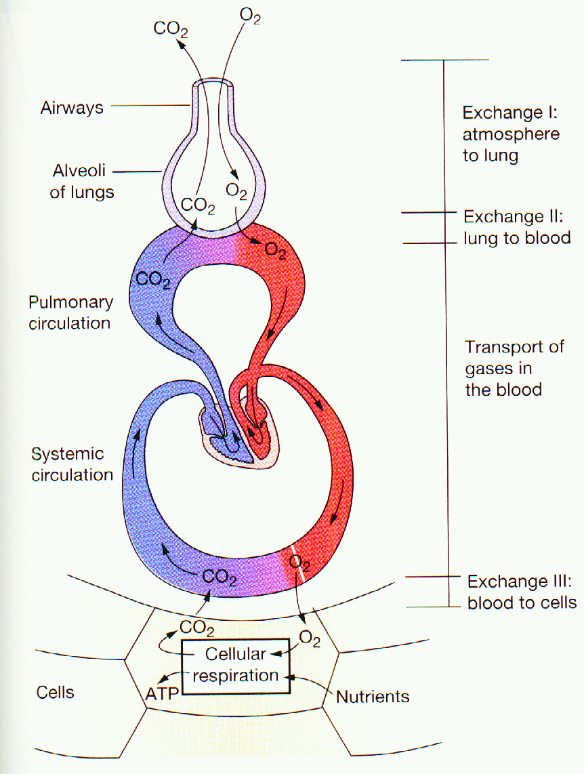
What are the functions of the respiratory system?
-Primary: Acquire O₂ and dispose of CO₂
-Secondary: -Protect from inhaled pathogens and irritants
-Vocalization
The function of the respiratory system is very closely tied to that of the circulatory system.
Deoxygenated blood from the right heart/ventricle enters the RS through the pulmonary artery. Oxygenated blood from the lung enters the heart through the pulmonary vein into the left atrium (this is the only case in which an artery delivers deoxygenated blood and a vein delivers oxygenated blood)

Slide 4
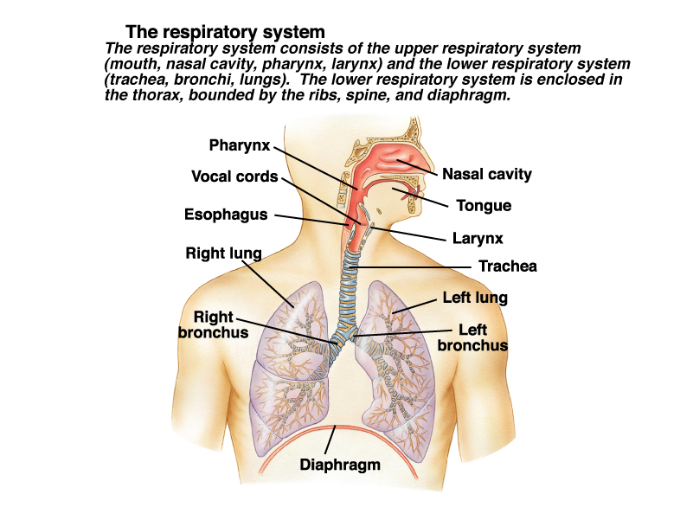

Slide 5
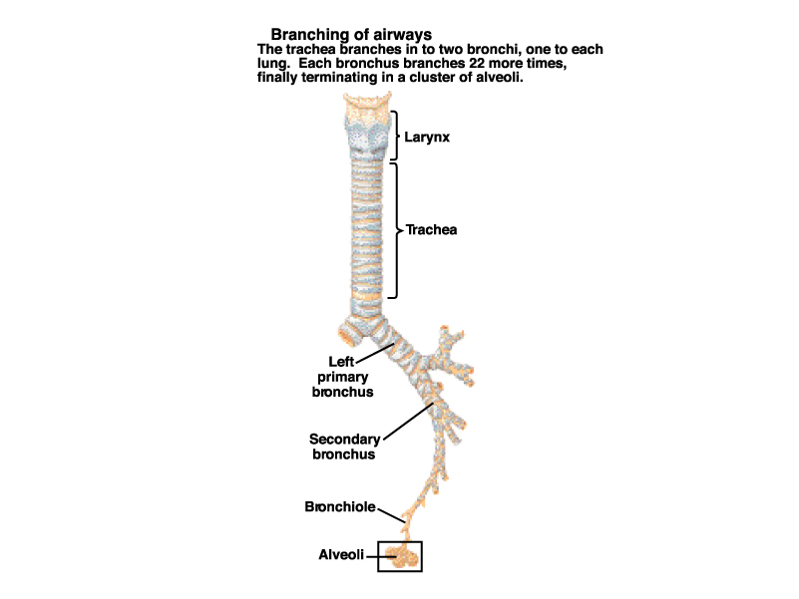
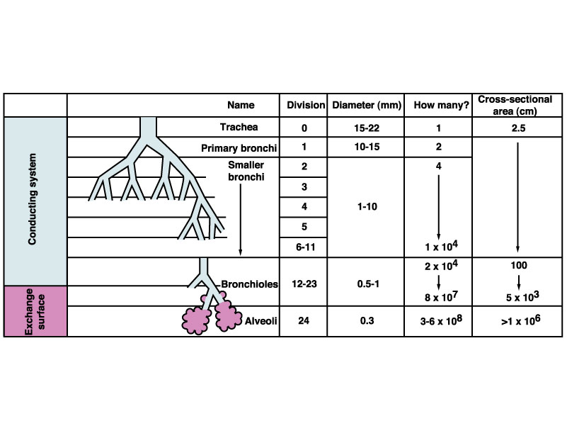
The respiratory system has two major functional components:
The airways (“conducting zone”, from trachea to bronchioles).
The gas exchange surfaces (“respiratory zone”, respiratory bronchioles and alveoli)

Slide 6
Something wrong with this diagram???

Slide 7
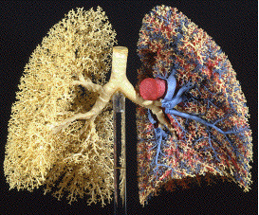
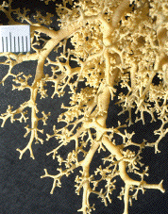

Slide 8
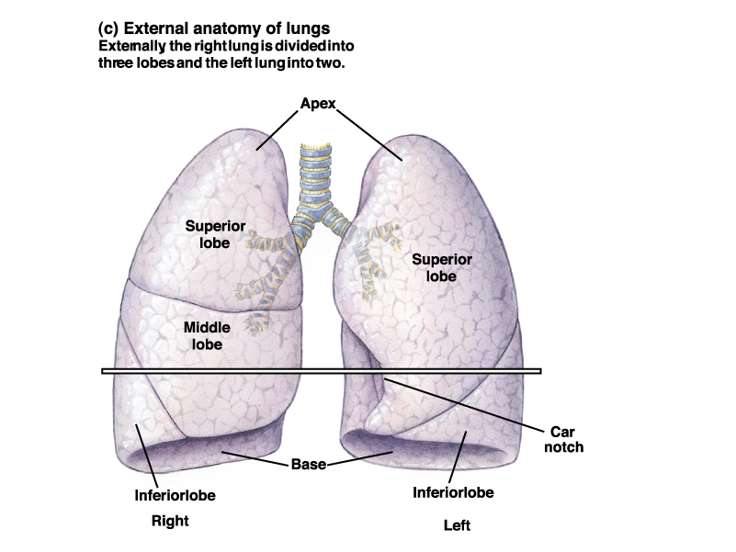
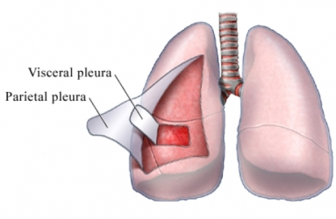
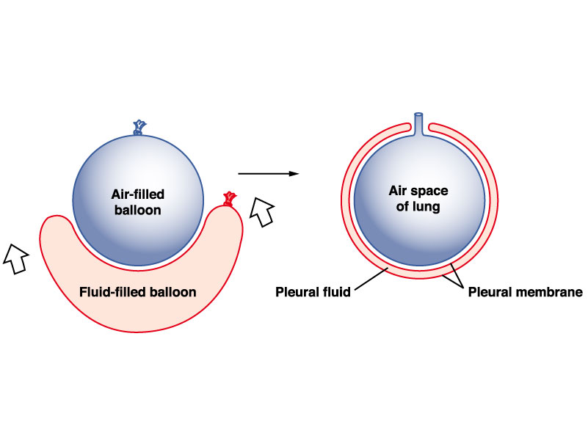
The pleura is a double membrane that envelops the lungs. The space within the pleura is filled with intrapleural fluid and plays a very important role.

Slide 9
To Remember
The respiratory system is where we acquire O₂ and dispose of CO₂. It protects us from inhaled pathogens and irritants and aids in vocalization.
The RS is very closely linked with the circulatory system. It receives deoxygenated blood from the pulmonary artery and delivers oxygenated blood through the pulmonary vein.
The RS has two major functional components: the conducting zone (trachea to bronchioles) and the respirator zone (respiratory bronchioles and alveoli).
The “respiratory tree” is surrounded by a double membrane called the pleura.

Slide 10
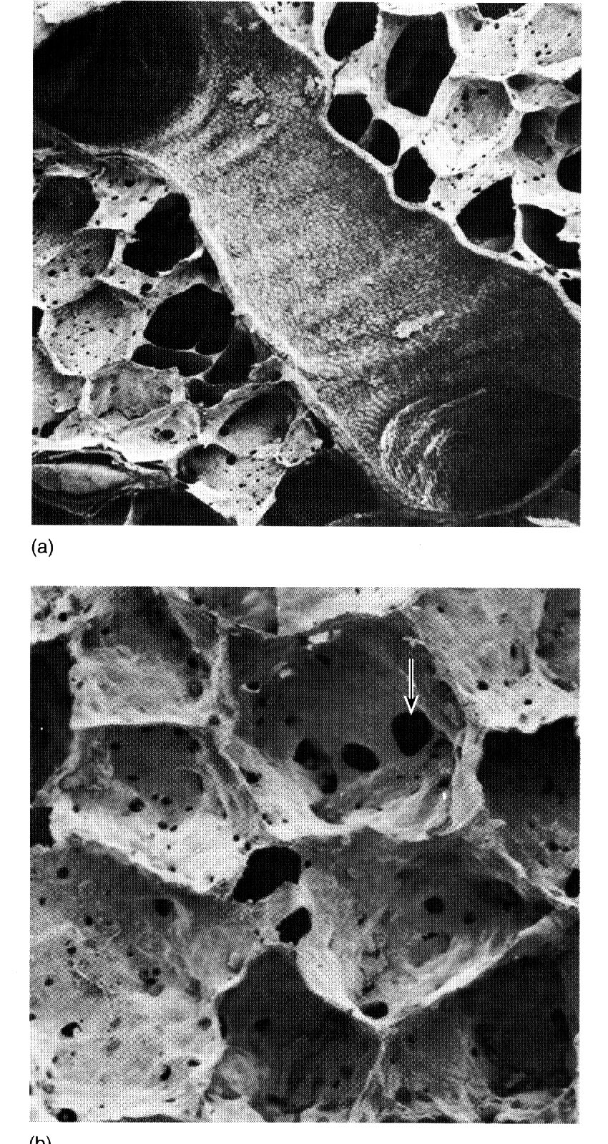
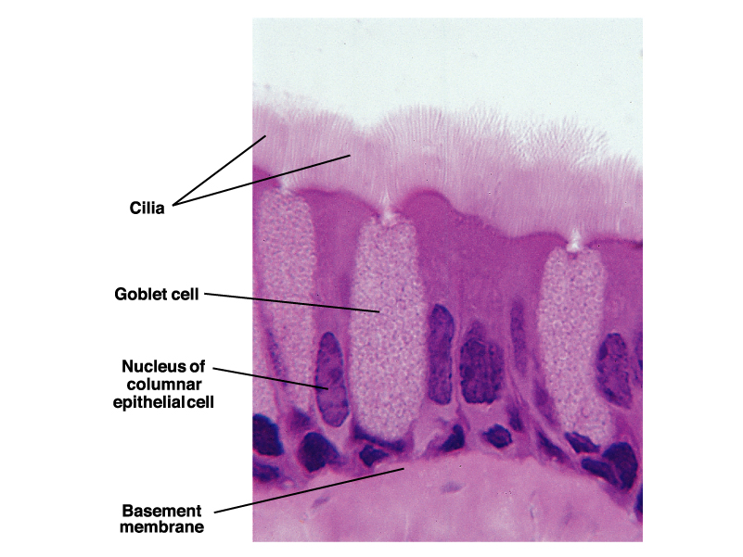
The epithelial surfaces of the airways are lined by ciliated cells and goblet cells which secrete mucus. Particulate matter that is entrapped in this mucus is delivered to the pharynx and then swallowed (Oh my!). The epithelium also secretes a watery fluid that lubricates the space between cells and mucus.
In cystic fibrosis (which inhibits Cl⁻ movement and hence water flow) the mucus becomes dry and thick.

Slide 11
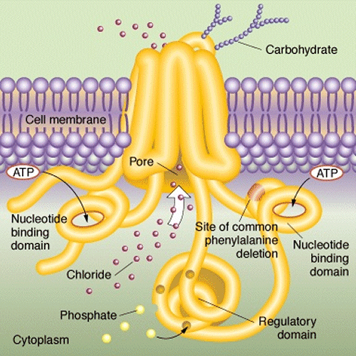
Clinical Application
Why does cystic fibrosis cause respiratory problems….
The Cystic Fibrosis Transmembrane Regulator (CFTR) is an ion channel that regulates the movement of Cl- and hence water across cell membranes.
No Cl- (and hence Na+) flux out of cells implies no water flux and hence a think, dry, and sticky mucus that does not flow (infections!)
Cystic fibrosis is caused by several possible mutations in the CFTR gene (the most common is AF508)

Slide 12
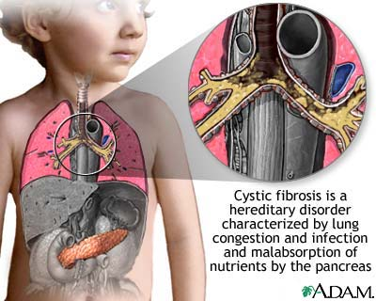
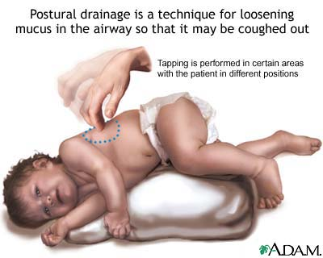

Slide 13
Unanswered Questions
Why is Cystic Fibrosis so common?
Why does it incidence vary with ethnicity?
Ethnic Origin | Incidence of the gene | Frequency at birth
European | 1 in 25 | 1 in 4,000
Hispanics | 1 in 46
African | 1 in 65 | 1 in 15,000
Asian | 1 in 90 | 1 in 32,000

Slide 14
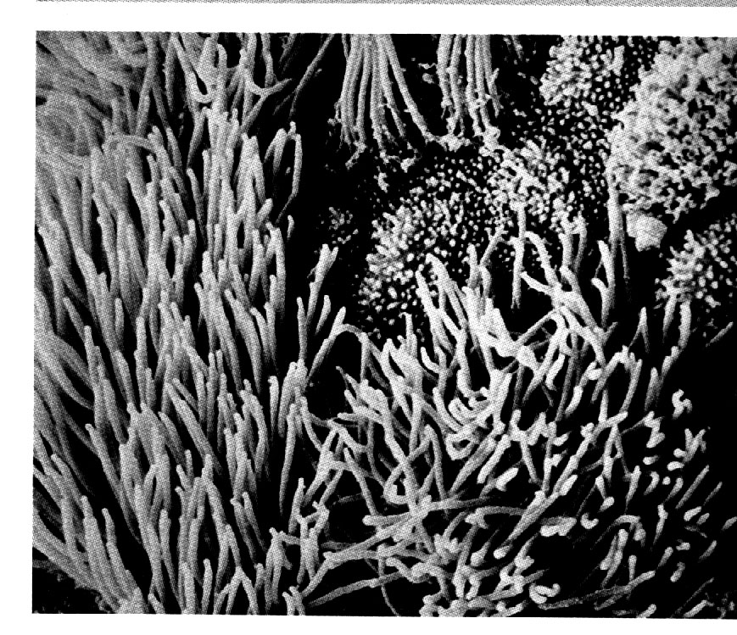
Ciliated
cells
Goblet
cells

Slide 15
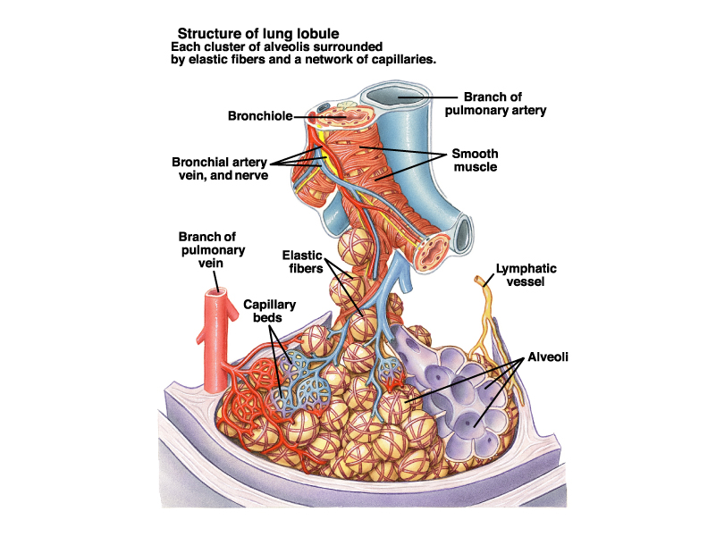
The lung is well irrigated by capillary beds that “follow” the branching of the conducting zone. Alveoli, the main elements of the respiratory zone, are richly supplied with blood by a capillary bed (alveoli are connected by pores) .

Slide 16
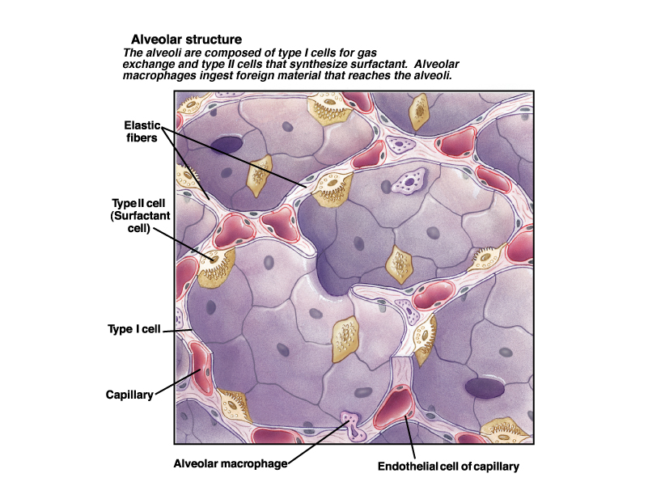
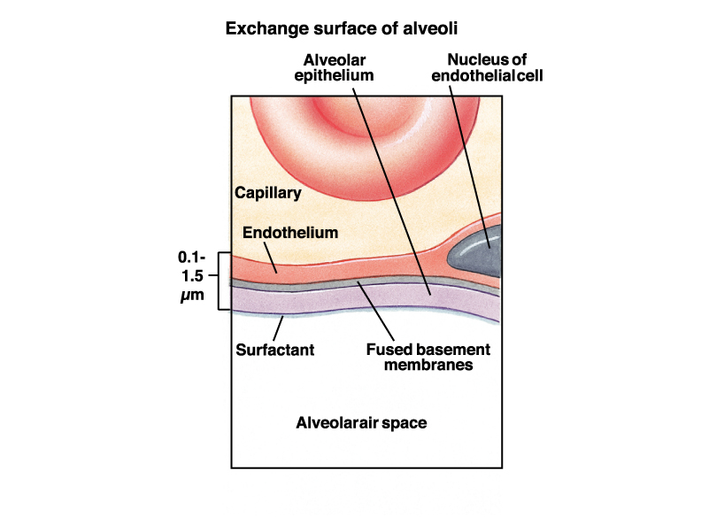
Alveoli are tiny sacs. The air-facing surface is lined by a one cell thick epithelium made of two types of cells: flat type I cells and fat type II cells.
Type I cells are, well…thin. That is their function (to minimize diffusion distances).
Type II cells are fat and secrete surfactant. The surfactant plays a crucial role in keeping the compliance of the lungs high (more later).

Slide 17
To Remember
The epithelial surfaces of the airways or conducting zone (trachea to bronchioles) are lined by ciliated and goblet cells. The latter produce mucus, the former move it to the pharynx.
The elements of the respiratory zone (respirator bronchioles and alveoli) are lined by type I (thin) and type II (surfactant producing) cells.

Slide 18
The mechanics of ventilation:
How we move air into and out of the respiratory zone through the conducting “pipes”.

Slide 19
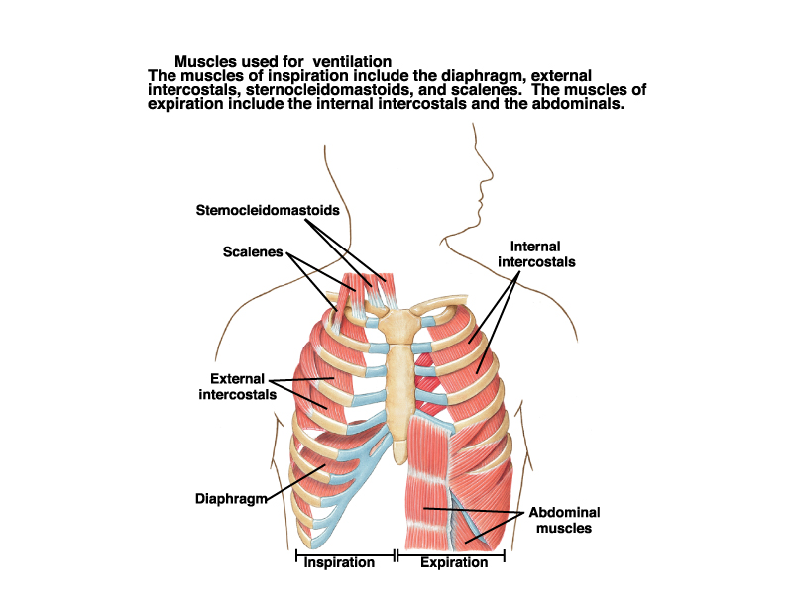
Drop the rib cage (and decrease the volume of the thorax)
Lift the rib cage (and increase the volume of the thorax)

Slide 20
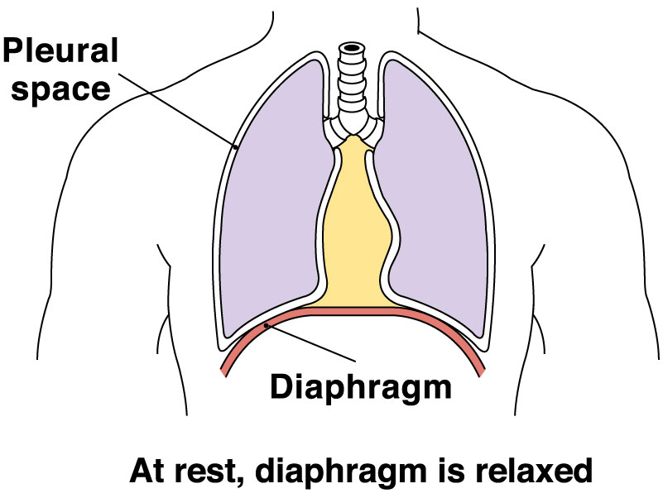
Ventilation is the exchange of air between alveoli and the atmosphere. Air, of course, obeys the laws of gases (or Boyle’s Law):
PV=nRT, or P =nRT/V (i.e. pressure in INVERSELY related to volume).
If volume expands, pressure drops. Gases (like other fluids) move from areas of high pressure to areas of low pressure (∆P is a pressure differential).
During inspiration and expiration, the volume of the lungs changes driving air in and out of the lungs as a result of differences in pressure between the lungs and the atmosphere.
∆P = P_{alv}-P_{atm}

Slide 21
Equations to Remember and understand…..
P=nRT/V
(Boyle’s Law)
∆P = P_{alv}-P_{atm}
(pressure differential between the alveoli and the atmosphere)

Slide 22
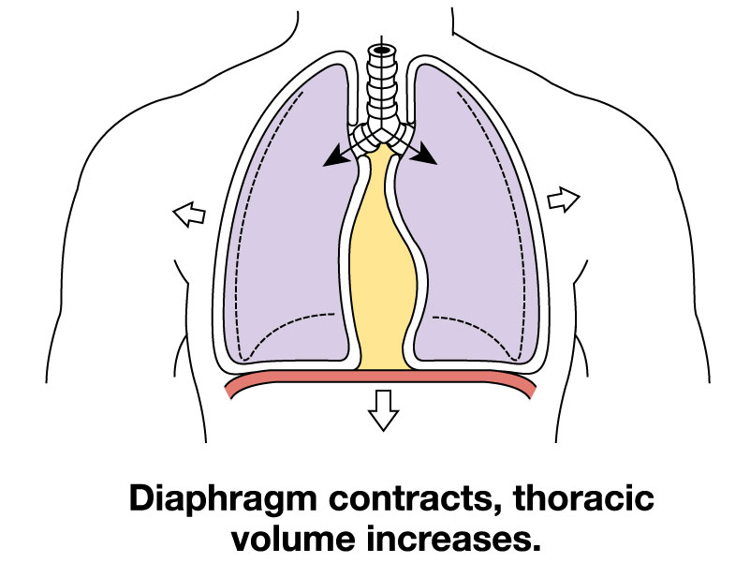
Flow into the lungs = F = ∆P/R
(the famous mantra ∆P=FxR)
∆P=P_{alv} - P_{atm}.
P_{atm}=atmospheric pressure
P_{alv} =alveolar pressure
R = resistance of the pipes.
∆P_{inspiration} < 0, air moves into the lungs (P_{alv} is sub-atmospheric, P_{alv} < P_{atm})
∆P_{expiration} > 0, air moves out of the lungs (P_{alv} is supra-atmospheric, P_{alv} > P_{atm})
INSPIRATION AT REST

Slide 23
P_{atm} = 760 mm Hg
At rest, ventilation is primarily a consequence of the contraction and relaxation of the diaphragm.
P_{alv} = 759
P_{alv} = 759 mm Hg
-
P_{atm} = 760 mm Hg
_______________
∆P = -1 mm Hg
Flow into the lungs = F = ∆P/R
∆P=P_{alv}-P_{atm}.
∆P_{inspiration} < 0, air moves into the lungs (P_{alv} is sub-atmospheric)

Slide 24
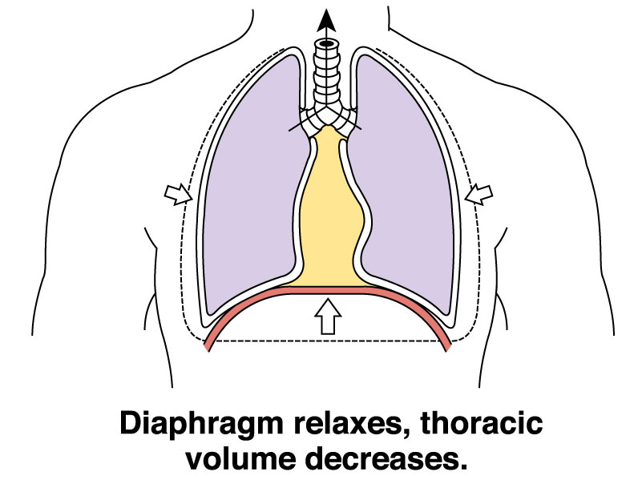
P_{alv} = 761 mm Hg
-
P_{atm} = 760 mm Hg
_______________
∆P = +1 mm Hg
Flow into/out of the lungs = F = ∆P/R
∆P=P_{alv}-P_{atm}.
∆P_{expiration} > 0, air moves out of the lungs (P_{alv} is supra-atmospheric)

Slide 25
Equations to Remember and understand…..
P=nRT/V (Boyle’s Law)
∆P = P_{alv}-P_{atm} (pressure differential between the alveoli and the atmosphere)
Flow into the lungs = F = ∆P/R

Slide 26
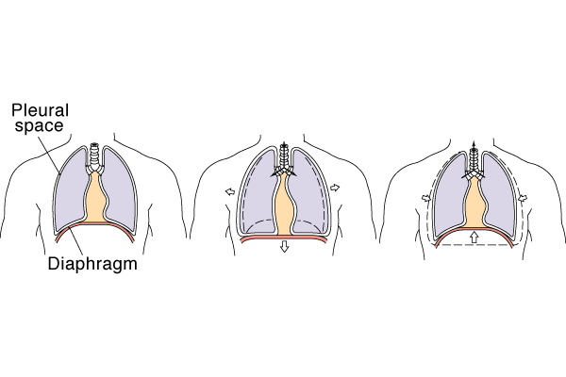
Inspiration (active)
Expiration (passive)
Diaphragm contracts (descends), intrapulmonary pressure decreases, air moves in passively
Recoil

Slide 27
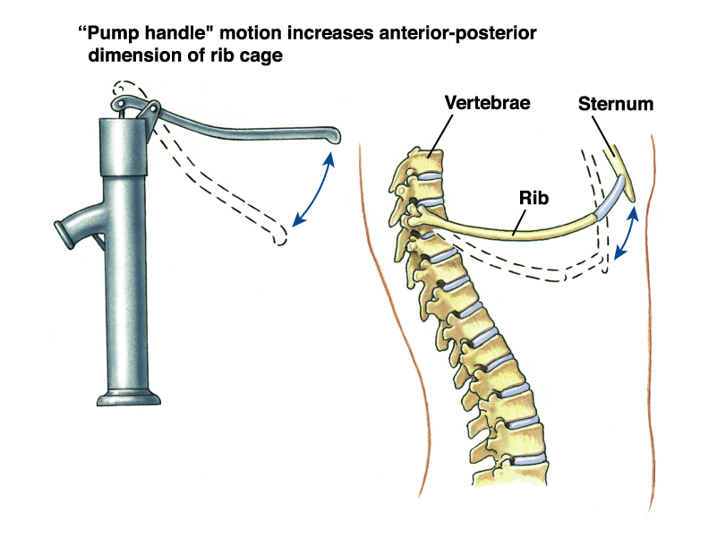
During activity, ventilation increases as a result of the action of intercostal muscles. During inspiration, the external intercostals contract and lift the ribs and increase the volume of the thorax (and hence the lungs).
During expiration, the internal intercostals (and abdominal muscles) contract and pull the ribs down, reducing thoracic (and hence lung volume) volume.

Slide 28
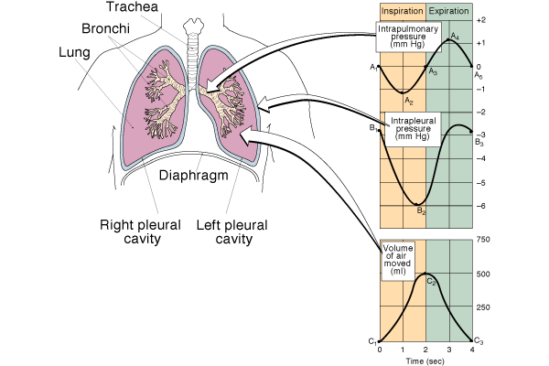
∆P=P_{alv}-P_{atm}
P_{alv}-P_{intrapleural}
Note that intrapleural ∆P is ALWAYS sub-atmospheric (what if it wasn’t?)
The degree of lung expansion is dependent (roughly proportional) on the change in transpulmonary pressure = ∆(P_{alv}-P_{intrapleural}).
P_{alv}
P_{intrapleural}
lung
Thoracic

Slide 29
When in this diagram does the diaphragm contract/relax?

Slide 30
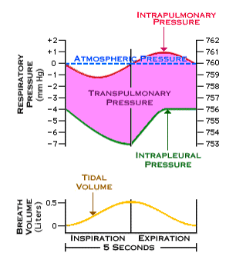
During inspiration
transpulmonary pressure
increases
During expiration
transpulmonary pressure
decreases

Slide 31
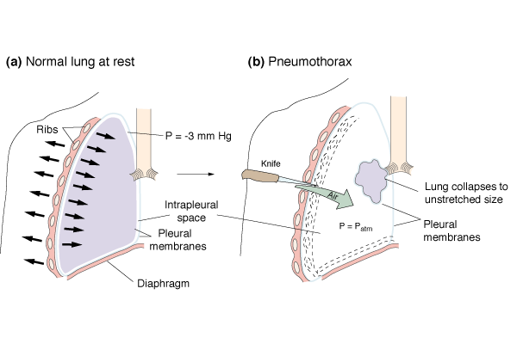
Intrapleural pressure is ALWAYS sub-atmospheric
Pneumothorax is the collapse of the lung due to entry of air into the chest/thoracic cavity. Shown is pneumothorax due to a penetrating wound (there are other types: spontaneous in Marfan syndrome, emphysema)

Slide 32

http://www.youtube.com/watch?v=6WZ-yqEoEBg

Slide 33
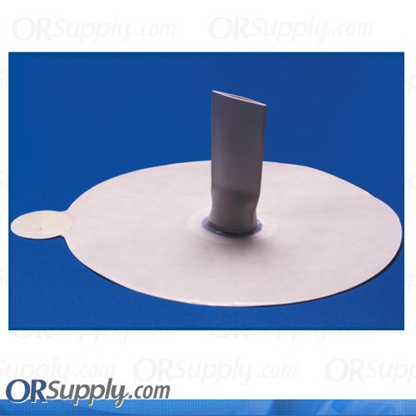
Asherman Chest Seal for pneumothorax and open chest injuries

Slide 34
MESSAGES
-Flow into the lungs = F = ∆P/R, where ∆P=P_{alv}-P_{atm} and R = resistance.
-∆P < 0 (subatmospheric) during inspiration and ∆P > 0 (supra-atmospheric) during expiration.
-At rest the diaphragm does most of the work but during activity a variety of muscles (e.g. the intercostals) help.
-∆P_{intrapleural} is always sub-atmospheric. Remember the meaning of the term pneumothorax (the purpose of the video!!!).
∆P_{intrapleural} = P_{intrapleural}-P_{atm}

Slide 35
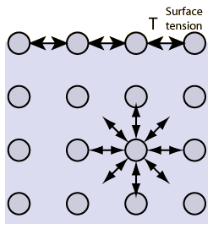

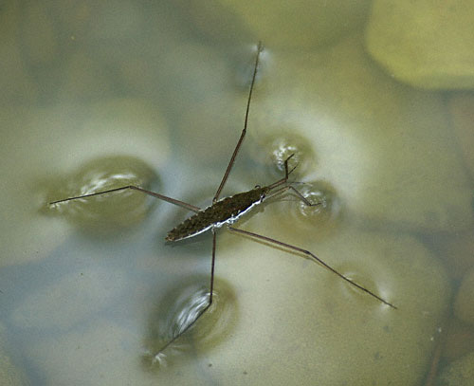
SURFACE TENSION
The cohesive forces between molecules down into a liquid are shared with all neighboring atoms. Those on the surface have no neighboring atoms above, and exhibit stronger attractive forces upon their nearest neighbors on the surface. This enhancement of the intermolecular attractive forces at the surface is called surface tension

Slide 36
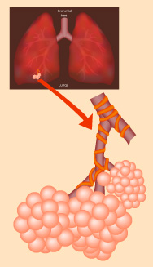
The resistance that the lung offers to changes in volume with changes in transpulmonary pressure depends on the elastic properties of the lung’s structures and also to surface tension of the fluid that bathes the surface of alveoli.
Which is more important….???
If a lung expands more easily as transpulmonary pressure increases we call it more “compliant”

Slide 37
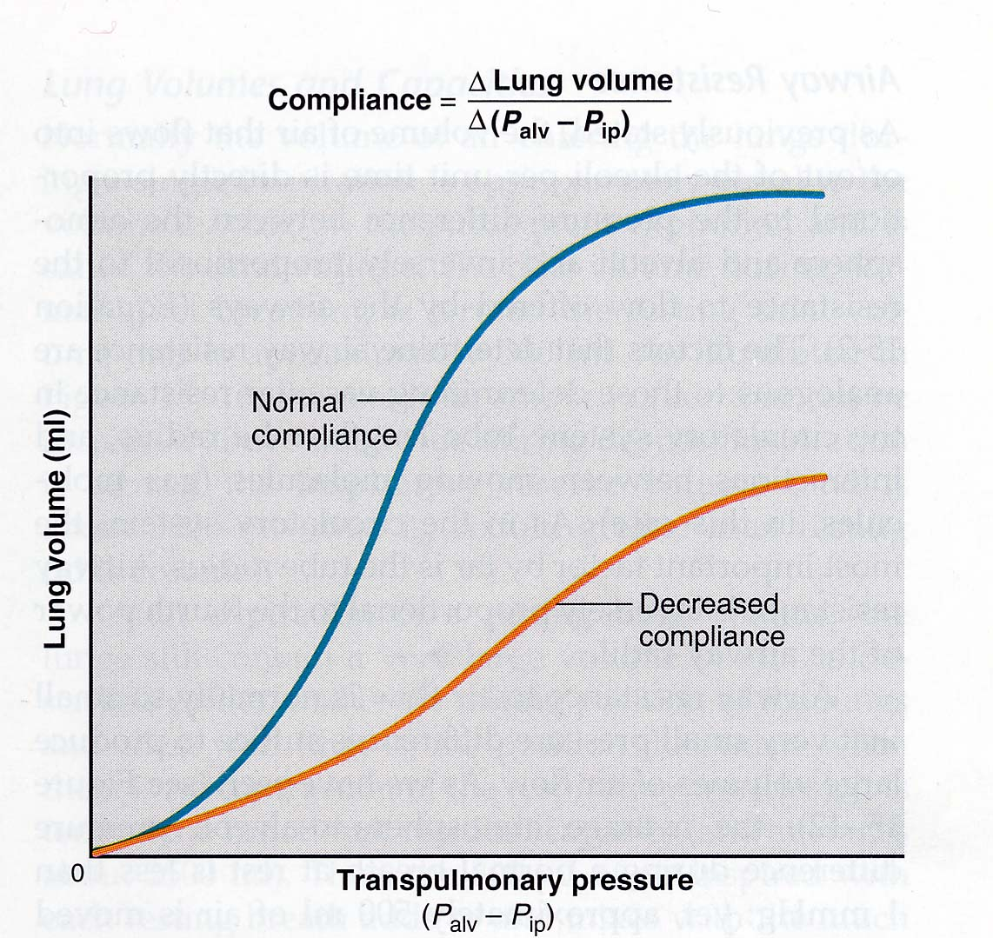
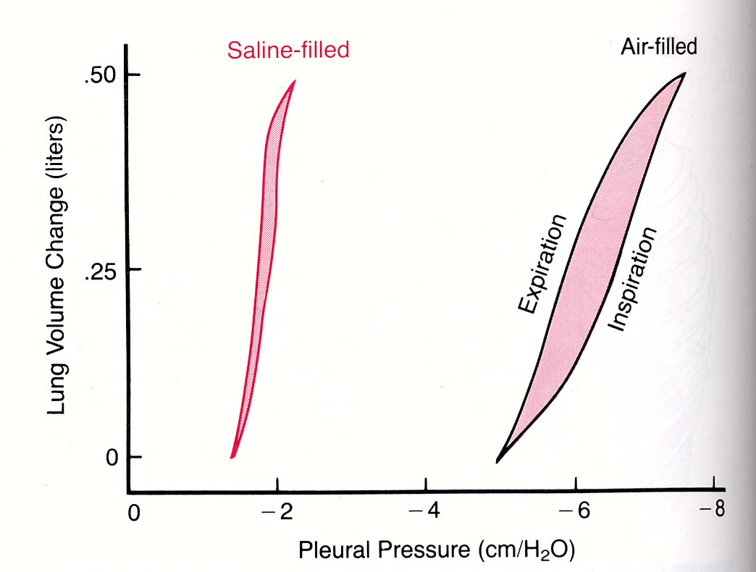
Compliance Diagrams
The compliance of the lung is determined by
Elastic forces of the lung’s tissues (collagen and elastic tissue)
The elastic force caused by surface tension of the fluid that lines the inside walls of the lung.
Which is more important?
When we eliminate surface tension by filling a lung with saline solution, compliance increases 3-fold. Surface tension is the most important determinant of compliance.

Slide 38
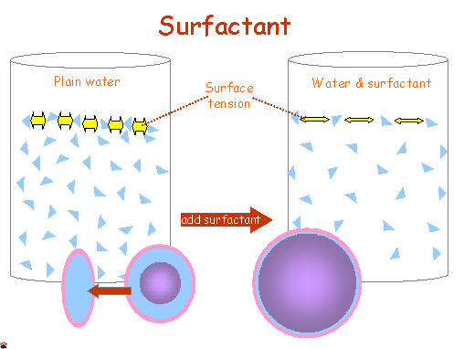
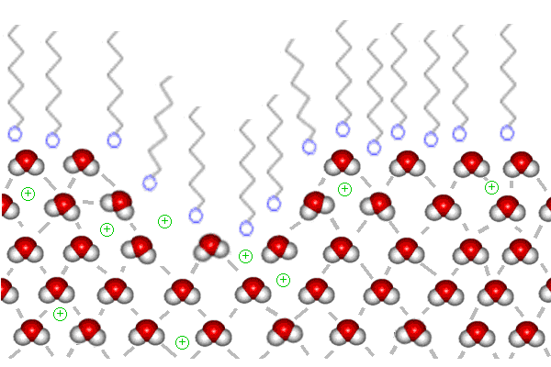
Which is why the surfactant produced by type II cells is so important
The surfactant secreted by these cells increases the compliance of the lungs and….
It also prevents alveoli from collapsing
Not surprisingly the surfactant is mostly (but not only) an amphipathic phospholipid
What does amphipatic mean? Examples?

Slide 39
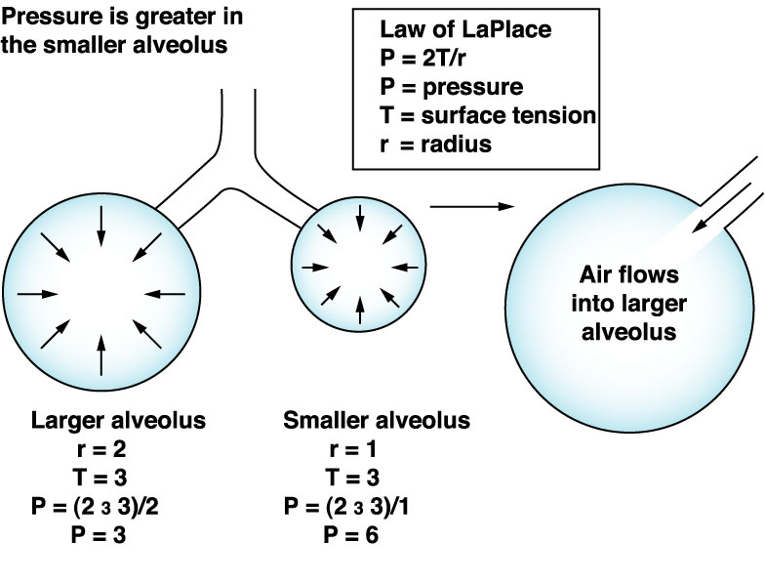
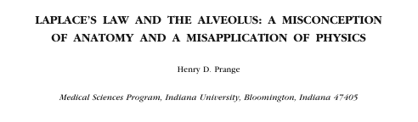
X
X
Why is surface tension so important? If r is small, P is big!!! SEE PAGE 467 of your book

Slide 40
Without a mechanism to reduce surface tension, the alveoli would collapse (NOPE, they would not collapse, but the small airways would reduce their diameter, compliance would be reduced, and resistance would increases… See Prange 2003) .
Surface tension of the lung’s fluids is reduced by the effect of the surfactant secreted by type II cells:
A surfactant (or surface active substance) is a solute that greatly reduces the surface tension of a solution.
Surfactant in the lung contains:
Phospholipid (dipalmitoyl lecithin, apoproteins, and Ca⁺⁺). The phospholipids and apoproteins are very amphipatic.
It starts being secreted after months 6-7 during gestation (respiratory distress syndrome of the new born)
The secretory activity of type II cells depends on lung expansion.

Slide 41
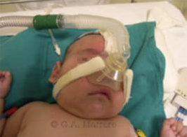
Infant respiratory distress syndrome (IRDS, also called "Respiratory distress syndrome of newborn”), is caused in premature infants by developmental insufficiency of surfactant production and structural immaturity in the lungs. It can also result from a genetic problem with the production of surfactant associated proteins. IRDS affects about 1% of newborn infants and is the leading cause of death in preterm infants. The incidence decreases with advancing gestational age, from about 50% in babies born at 26-28 weeks (≈ 6.5-7 mo), to about 25% at 30-31 weeks (7.5-8 mo). The syndrome is more frequent in infants of diabetic mothers and in the second born of premature twins. Often treated with cow surfactant (Survanta®) and positive-pressure ventilation

Slide 42
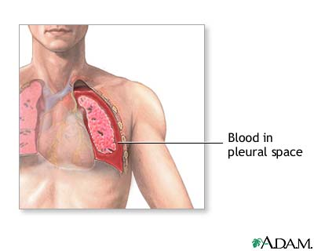
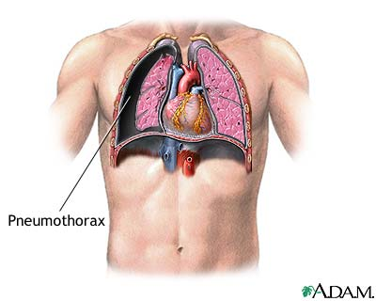
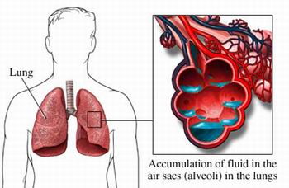
Hemothorax (trauma)
Pneumothorax (trauma or spontaneous)
Pulmonary Edema (Cardiac Insufficiency, pulmonary vein)

Slide 43
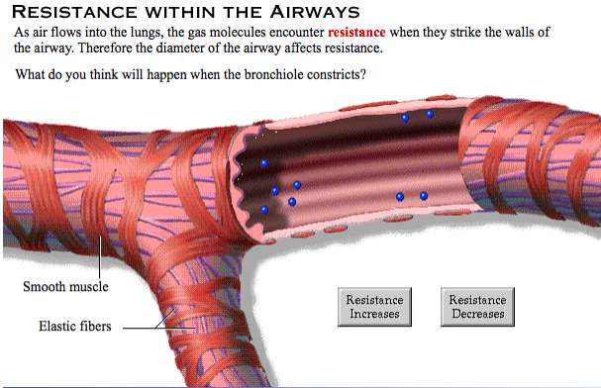
F =∆P/R

Slide 44

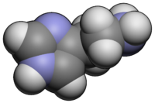
F =∆P/R
Histamine

Slide 45
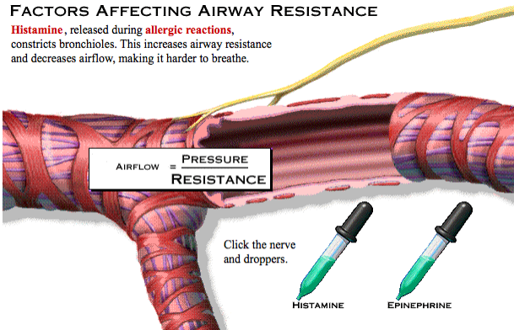

Slide 46
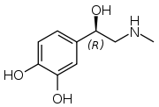
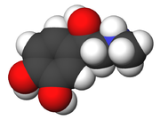
F =∆P/R
Epinephrine

Slide 47
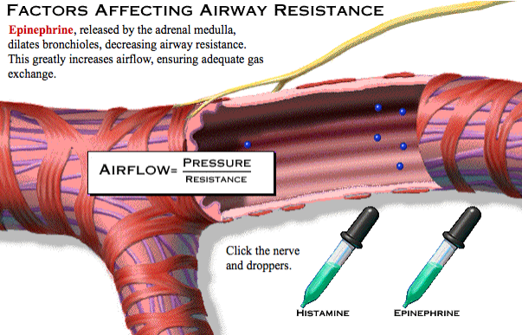

Slide 48
To Remember
The term pulmonary compliance refers to how easily the lung expands in response to a change in transpulmonary pressure.
Compliance is determined by 1) surface tension of the lung (most importantly) and 2) the elastic forces of the lung’s tissues.
The surfactant secreted by type II cells reduces the surface tension of the lung’s fluids and increases its compliance.
By “adjusting” the concentration of surfactant in adjacent alveoli of different sizes surfactant prevents the collapse of smaller alveoli. (NOPE….)
Infant respiratory distress syndrome (IRDS), also called "Respiratory distress syndrome of newborn”), is caused in premature infants by developmental insufficiency of surfactant production and structural immaturity in the lungs.

Slide 49
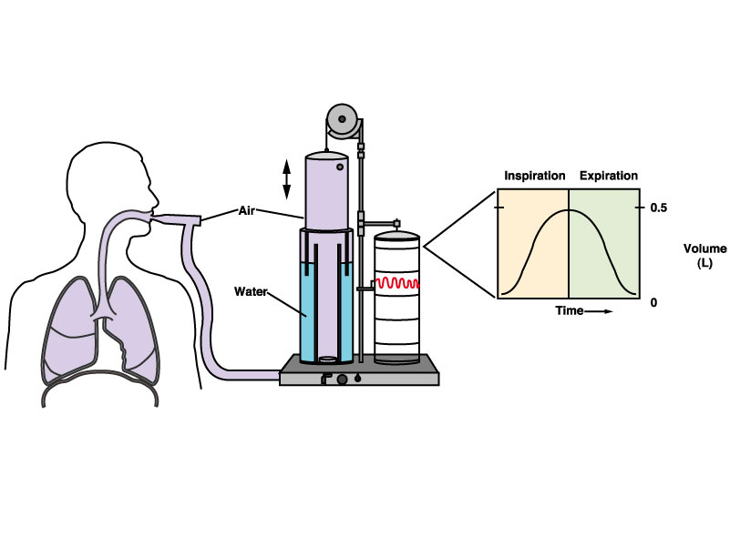
Lung capacity and the spirometer

Slide 50
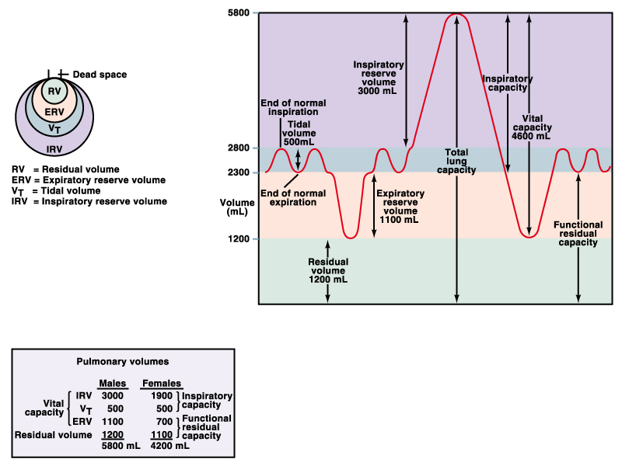
Time
Vital Capacity =
tidal volume+
inspiratory reserve volume+ expiratory reserve volume
Average tidal volume ≈ 500 mL
(PLEASE REMEMBER!)

Slide 51
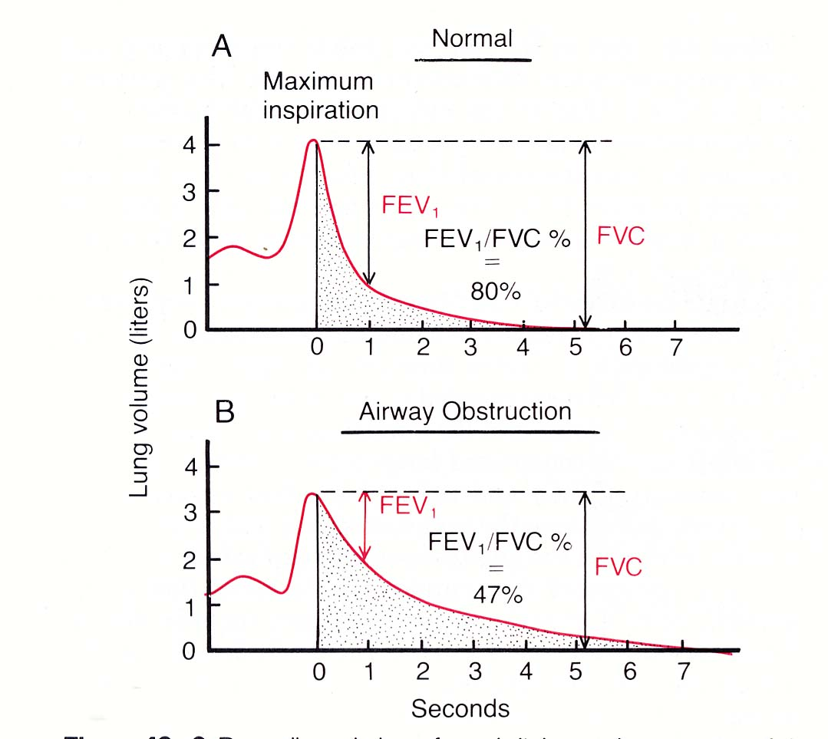
A useful clinical pulmonary test that relies on a spirometer is called the forced vital expiratory capacity test. If asked to exhale forcefully, a person with healthy lung function exhales about 80% of the total vital capacity in 1 second.
(FEV₁/FVC)x100=80%
FVC = forced vital capacity
FEV₁ = forced exhaled volume
after 1 second
If (FEV₁/FVC)x100 < 80% then the patient likely suffers from an obstructive lung disease. In obstructive lung diseases (asthma), the airways are obstructed.
In restrictive lung diseases (some emphysemas) (FEV₁/FVC)x100 ≈ 80% but FVC is low.

Slide 52
Equations to Remember and understand…..
-P=nRT/V (Boyle’s Law)
-∆P = P_{alv}-P_{atm} (pressure differential between the alveoli and the atmosphere)
-Flow into the lungs = F = ∆P/R
-Vital Capacity =
tidal volume+
inspiratory reserve volume+ expiratory reserve volume
Forced expiratory vital capacity test, (FEV₁/FVC)x100 ≥ 80%

Slide 53

Obstructive respiratory diseases:
Bronchial tubes are narrowed leading to increased resistance to air flow.
-Asthma (hyper-responsive airways)
-Cystic fibrosis (thick mucus)
-Scarring due to tuberculosis
Restrictive respiratory diseases (also known as interstitial lung diseases are characterized by reduced total lung capacity (TLC), vital capacity, or resting lung volume):
-Infant respiratory distress syndrome
-Asbestosis
-Acute respiratory distress syndrome (inflammation of lung parenchyma)

Slide 54
To Remember
Vital Capacity = tidal volume+ inspiratory reserve volume+ expiratory reserve volume
If 100X(FEV₁/FVC) < 80% obstructive lung condition.
Obstructive respiratory diseases (asthma, scarring due to tuberculosis, cystic fibrosis, emphysema)
Restrictive (IRDS, asbestosis,…., emphysema)

Slide 55

LETS TALK ABOUT SMOKING…

Slide 56






The “acute” (short term) effect of smoking is a reduction in cilia movements. The chronic (long term) effect is the destruction of ciliated cells and their replacement by squamosal, basement (potentially cancerous), cells. The chronic effect of smoking is reversible if caught early.
Effect of smoking on the “airways”
Non-smoker
Beginning smoker
“Advanced” smoker

Slide 57



The term lung emphysema means “excess air in the lungs”. It is a complex obstructive and restrictive lung disease that is in most cases the consequence of long term smoking. It results from:
Chronic infection (smoke and tar irritate bronchi and bronchioles)
Excess mucus and inflamatory edema cause chronic obstruction.
Obstruction entraps air in alveloli
Emphysema has many physiological consequences:
Reduced diffusing capacity
Reduced number of lung capillaries
Increased vascular resistance.
Effect of smoking on the respiratory zone

Slide 58


Slide 59


Slide 60
Emphysema
-Increased compliance
-Reduced FEV1/FVC (increased obstruction)
-Reduced VC (due to reduced TV)
-Increased Residual Volume

Slide 61


Slide 62


And emphysema may be the least of your troubles….
Cancer

Slide 63

1946

Slide 64


Slide 65
To Remember
Vital Capacity = tidal volume+ inspiratory reserve volume+ expiratory reserve volume
If 100X(FEV₁/FVC) < 80% obstructive lung condition.
Obstructive respiratory diseases (asthma, scarring due to tuberculosis, cystic fibrosis, emphysema)
Restrictive (IRDS, asbestosis,…., emphysema)

Slide 66

The amount of “fresh” air that gets down to the alveoli is called alveolar ventilation. It is hugely influenced by rate and depth of breathing
Alveolar ventilation = RR (TV – DSV) ≈ 12(500-150)=4200 mL/min
  RR = respiration rate (breaths/min) ≈ 12
  TV = tidal volume (mL) ≈ 500
  DSV = dead space volume (mL), ≈ 150
Minute ventilation = RRxTV
MV ≈ 12x500 =6000 mL/min

Slide 67
Minute ventilation = RRxTV
Minute ventilation is the rate at which air is moved in and out of the lungs.
Its units are breaths/min X ml/breath = ml/min, “normal” (mean) RR values equal 12 breaths/min, and TV ≈ 500 ml/breath.Thus, MV =6 L/min.
Alveolar ventilation = RR (TV – DSV) ≈ 12(500-150)=4200 mL/min
Where DSV = dead space volume. Alveolar ventilation measures the rate at which fresh air enters in contact with respiratory surfaces (alveoli and respiratory bronchioles)

Slide 68
Equations to Remember and understand…..
-P=nRT/V (Boyle’s Law)
-∆P = P_{alv}-P_{atm} (pressure differential between the alveoli and the atmosphere)
-Flow into the lungs = F = ∆P/R
-Vital Capacity =
tidal volume+
inspiratory reserve volume+ expiratory reserve volume
-Forced expiratory vital capacity test, (FEV₁/FVC)x100 < 80%
-Minute ventilation = RRxTV
-Alveolar Ventilation=RRx(TV-DSV)
PLEASE PUT UNITS IN ALL THESE EQUATIONS!

Slide 69
To Remember
Elements of a spirometer’s trace: Tidal volume, inspiratory reserve volume, expiratory reserve volume, vital capacity, total lung capacity, residual capacity.
Vital capacity = tidal volume+ inspiratory reserve volume+expiratory reserve voume.
If (FEV1/FVC)x100 < 80%, then obstructive lung disease
(FEV1/FVC)x100 ≥ 80%, but FVC is low, restrictive lung disease.
Alveolar ventilation = Respiratory ratex(tidal volume-dead space), RR ≈ 12 breaths/min
Minute ventilation = RRxTV

Slide 70
-The respiratory system
-airways and sites of gas exchange.
-Lung mechanics and ventilation
-Ventilation and pressure within the lung.
-Inspiration and expiration.
-Lung compliance and its determinants.
-The spirometer and the capacities of the lung
-Gas exchange I
-Gases in solution
-Alveolar gas exchange
-Gas exchange II: respiratory pigments
-Hemoglobin and O₂ transport
-CO₂ transport and acid-base balance.
-The control of respiration

Slide 71
The composition of the atmosphere
Fractional composition of dry air
(F_{x,} %)
Nitrogen 78.09
Oxygen 20.95
Carbon Dioxide 0.037 (and increasing…)
Other (Argon, Helium,..) 0.93
Water 0 (it is dry air!)
The main determinant of variation in the composition of atmospheric air is water content (more later).

Slide 72

Carbon dioxide concentration has increased 30% during the past 200 years. Burning of fossil fuels and deforestation are the main causes. The value will double the pre-industrial values by 2075 with a 1-3°C increase in global temperature (increased ocean levels, changes in precipitation patterns,…,etc.)

Slide 73

Remember that the tobacco industry denied the link with cancer?
Who was one of the guys that led the campaign ….
Steve Milloy (worked until 2005 for Phillip Morris and now is a paid advocate for EXXOnMobil and Chevron to lead the climate change denial campaign)…At least they believe in recycling.

Slide 74
The composition of the atmosphere
Fractional composition of dry air
(F_{x,} %)
Nitrogen 78.09
Oxygen 20.95
Carbon Dioxide 0.037 (and increasing…)
Other (Argon, Helium,..) 0.93
Water 0 (it is dry air!)
The main determinant of variation in the composition of atmospheric air is water content (more later).

Slide 75

The total pressure exerted by a mixture of gases equals:
P_{tot} = ∑P_{x}=PN₂+PO₂+…etc.
Where P equals the partial pressure of gas x
(This is called Dalton’s law of partial pressures).
The weight of the atmosphere at any point is called the atmospheric (or barometric) pressure. It is measured in a variety of units, but we will use mm Hg (mm of mercury).
760 mmHg = 1 atm= 101.3X10³ Pascals
Atmospheric pressure decreases with altitude.

Slide 76
TO REMEMBER
Dalton’s law of partial pressures
The total pressure exerted by a mixture of gases equals:
P_{tot} = ∑P_{x}=PN₂+PO₂+…etc.
Where P equals the partial pressure of gas x
Therefore the partial pressure of an atmospheric gas is given by
P_{x}=(F_{x}/100)P_{atm}
For example in dry air and at sea level
PO₂ = (20.94/100)x760 =159.14 mm Hg.
Calculate PN₂, and PCO₂ at sea level (very challenging homework…).

Slide 77
Equations to Remember and understand…..
-P=nRT/V (Boyle’s Law)
-∆P = P_{alv}-P_{atm} (pressure differential between the alveoli and the atmosphere)
-Flow into the lungs = F = ∆P/R
-Vital Capacity =
tidal volume+
inspiratory reserve volume+ expiratory reserve volume
-Forced expiratory vital capacity test, (FEV₁/FVC)x100 < 80%
-Minute ventilation = RRxTV
-Alveolar Ventilation=RRx(TV-DSV)
-Dalton’s Law of partial pressures: P_{tot} = ∑P_{x}=PN₂+PO₂+…etc.
P_{tot} = ∑P_{x}=PN₂+PO₂+PH₂O…etc.
-How to estimate partial pressures: P_{x}=(F_{x}/100)P_{atm}

Slide 78
The single most important determinant of variation in air composition is water vapor.
When air and water come in contact some molecules of water go into the gas (vapor) phase.
P*H₂0
pH₂0
pH₂0=vapor pressure = the partial pressure of water vapor in air.
In air above an open water container, the air saturates with water vapor and a dynamic equilibrium is reached with a given partial pressure for these molecules. This equilibrium depends on ambient temperature.
r.h. = 30/55.1=0.54 (54%)
Sometimes air is not saturated with water vapor.
Relative humidity = r.h.
= pH₂0/ p*H₂0 =actual vapor pressure/saturating vapor pressure

Slide 79

To remember
1) pH₂0 =vapor pressure = the partial pressure of water vapor in air.
2) Relative humidity = r.h.
= pH₂0/ p*H₂0 =actual vapor pressure/saturating vapor pressure
3) Saturating vapor pressure increases rapidly with temperature.
Why does dew form?

Slide 80
Equations to Remember and understand…..
-P=nRT/V (Boyle’s Law)
-∆P = P_{alv}-P_{atm} (pressure differential between the alveoli and the atmosphere)
-Flow into the lungs = F = ∆P/R
-Vital Capacity =
tidal volume+
inspiratory reserve volume+ expiratory reserve volume
-Forced expiratory vital capacity test, (FEV₁/FVC)x100 < 80%
-Minute ventilation = RRxTV
-Alveolar Ventilation=RRx(TV-DSV)
-Dalton’s Law of partial pressures: P_{tot} = ∑P_{x}=PN₂+PO₂+…etc.
P_{tot} = ∑P_{x}=PN₂+PO₂+PH₂O…etc.
-How to estimate partial pressures: P_{x}=(F_{x}/100)P_{atm}
-rh ={(measured pH2O)/(saturating pH2O)}x100
-

Slide 81

Gases in solution
The amount of gas that dissolves in a given volume of water (at equilibrium) depends on
The solubility of the gas
P_{x}, its partial pressure
Temperature
Other non-gas solutes.
Henry’s Law
[x] = α_{x}P_{x} (ml/100 ml)
The solubility of a gas is measured by its solubility coefficient (α_{x}). α_{x} depends on temperature, α_{x} = f(temperature, other solutes)
α_{x} = ml of gas dissolved in 100 ml of water (vol %) per mm Hg
α_{x} decreases with temperature (gases behave differently from solid solutes!). α_{x} decreases with solutes.

Slide 82



The chemistry, physics, and biolology of beer.
Heat: what happens?
Add salt: what happens?

Slide 83
To remember
1) Henry’s law [x] = α_{x}P_{x} (ml/100 ml)
Partial pressure (mmm Hg)
Concentration of gas (ml/100 ml)
Solubility coefficient
α_{x} = f(temperature, other solutes)
Units are
(ml/100 mlxmm Hg)
This is important because it allows us to express the concentration of a gas in either mm of Hg or in ml/100 ml

Slide 84
Equations to Remember and understand…..
-P=nRT/V (Boyle’s Law)
-∆P = P_{alv}-P_{atm} (pressure differential between the alveoli and the atmosphere)
-Flow into the lungs = F = ∆P/R
-Vital Capacity =
tidal volume+
inspiratory reserve volume+ expiratory reserve volume
-Forced expiratory vital capacity test, (FEV₁/FVC)x100 < 80%
-Minute ventilation = RRxTV
-Alveolar Ventilation=RRx(TV-DSV)
-Dalton’s Law of partial pressures: P_{tot} = ∑P_{x}=PN₂+PO₂+…etc.
-How to estimate partial pressures: P_{x}=(F_{x}/100)P_{atm}
-Relative humidity = r.h. = pH₂0/ p*H₂0
-Henry’s law [x] = α_{x}P_{x} (ml/100 ml)
11 Questions in the exam!

Slide 85


Oxygen and Carbon dioxide differ in solubility
at 37 °C
vol %/mm Hg
α_{O2} 0.003
α_{CO2} 0.063
[x] = α_{x}P_{x,} Henry’s Law
[0₂]=100X0.003=0.3 ml/100 ml
[C0₂]=100X0.063=6.3 ml/100 ml
CO₂ is ≈ 20 times more soluble in water than O₂ (REMEMBER THIS).

Slide 86
To Remember
FO₂ ≈ 21%, FCO₂ ≈ 0.04%
Dalton’s Law of partial pressures: P_{tot} = ∑P_{x}=PN₂+PO₂+…etc.
P_{x}=(F_{x}/100)P_{atm}
rh= pH₂0/ p*H₂0 =actual vapor pressure/saturating vapor pressure
Henry’s law [x] = α_{x}P_{x} (ml/100 ml)
α_{x}, the solubility of gas x depends on the properties of a gas, temperature (⬇) and the concentration of other solutes (⬇).
CO₂ is ≈ 20 times more soluble than O₂ in water.

Slide 87

HOMEWORK
Under normal (at rest) conditions
pO₂ (arterial) ≈ 100 mm Hg and
pCO₂ (arterial) ≈ 40 mm
How much O₂ and CO₂ in solution?

Slide 88

How come
pO₂(alv) ≈ 100 mmHg
rather than
0.209x760=159 mm Hg?
Hint:
pH₂O(37°C)=47 mm Hg.
In the lungs:
  Venous blood: PO₂ = 40, PCO₂ = 45 mmHg
  Alveolar space: PO₂ = 100, PCO₂ = 40 mmHg
In the periphery:
  Arterial blood: PO₂ = 100, PCO₂ = 40 mmHg
  Inside cells: = PO₂ = 40, PCO₂ = 45 mmHg
Approximate values!

Slide 89
VO₂=Q([O₂]_{art}-[O₂]_{vein}]
Note that you can calculate Q (cardiac output. If you know
VO₂=rate of oxygen consumption (ml/min)
And
The oxygen concentration in arteries and veins: [O2]_{art} and [O₂]_{vein} in ml/L
Q =VO₂/([O₂]_{art} - [O₂]_{vein} )
VO₂=250 ml/min, [O2]_{art} = 200 ml/L, and [O₂]_{vein} = 150 ml/L
Q = 250/(200-150)= 5 L/min

Slide 90
VO₂=Q([O₂]_{art}-[O₂]_{vein}]
Messages
[O₂]arterial ≈ 200 ml/L
[O₂]venous ≈ 150 ml/L
Q=cardiac output ≈ 5 L/min
VO2 ≈ 250 ml of O₂/min
(50/200)x100=25% OUR O₂ EXTRACTION EFFICIENCY

Slide 91
The maximal amount of O₂ that can be carried in blood in simple solution equals:
[O2] = αO₂PO₂ = 0.003X100=0.3 ml/100 ml=3 ml/L
Units of αO_{2 are} ml O₂/(100 mlXmm Hg)
Those of PO_{2 are} mm Hg
Blood flow equals 5 L/min
Assuming that you can extract all oxygen from blood (which is not the case!), then
5 L/min X 3 ml/L = 15 ml/min
But metabolic rate at rest is ≈ 250 ml/min
MESSAGE: The amount of oxygen that can be carried in simple solution in blood is not sufficient to satisfy metabolic requirements!

Slide 92
To remember
The maximal amount of O₂ that can be carried in blood in simple solution is ≈ 3 ml/L
This amount is not sufficient to satisfy the demands of metabolism (supply = 5 L/minX3 ml/min=15 ml/min, demand ≈ 250 ml/min).
How can we increase the O₂ carrying capacity of blood?

Slide 93



By increasing its oxygen carrying capacity …
Perfluorcarbon solutions (oxygen is 20 times more soluble in PFCs than in water!)

Slide 94

FOR EMPHASIS
[O2] = αO₂PO₂ = 100X0.003=0.3 ml/100 ml=3 ml/L
How do we increase the oxygen carrying capacity of blood??

Slide 95


Most of the O₂ in blood is transported bound to hemoglobin (Hb)…
Hemoglobin has long been a star among proteins. Its 3-dimensional structure was determined by Max Perutz (Cambridge University) in the late 50s. Normal hemoglobin is composed of four subunits linked together (each subunit is shown in a different color in the ribbon model). Each subunit contains a single heme ring-like structure with an iron atom that binds one oxygen atom.
Max Ferdinand Perutz (1914-2002)
Mountaineer, Chemist
He won the Nobel Prize for his Hb work in 1962.

Slide 96


Hemoglobin is transported within erythrocytes (Red Blood Cell). RBCs have no nucleus in mammals but are nucleated in all other vertebrates.
Hence the concentration of hemoglobin in blood [Hb] is proportional to hematocrit.
Hematocrit is the fraction of blood’s volume that is comprised of cells
H = 100x[cells/(cells+plasma)]

Slide 97
Whole blood
Spin in a centrifuge
Plasma = P
Cells = C
Hematocrit =100X C/(P+C)
Men ≈ 42%
Women≈38
Varies some…
???

Slide 98


In fetal
Hb there are 2 γ chains instead of the β chains of adults
Two alpha and two beta chains.

Slide 99

O₂ in blood
[O₂]_{blood} = [O₂]_{solution} + [O₂]_{bound to hemoglobin,} [O₂] _{solution} = αO₂PO₂
[O₂]_{bound to hemoglobin} = k[Hb]SO₂(PO₂),
k = hemoglobin’s carrying (binding) capacity = 1.4 ml O₂/g
[Hb] = hemoglobin concentration = 150 g/L
SO₂(PO₂) = hemoglobin’s fractional saturation, 0 < SO₂(PO₂) < 1

Slide 100
REMEMBER
[O₂]_{bound to hemoglobin} = k[Hb]SO₂(PO₂),
k = hemoglobin’s carrying (binding) capacity = 1.4 ml O₂/g
[Hb] = hemoglobin concentration ≈ 150 g/L (this value varies somewhat)
SO₂(PO₂) = hemoglobin’s fractional saturation,
0 < SO₂(PO₂) < 1
SO₂(PO₂) means saturation AS A FUNCTION of PO₂ (hence the parenthesis)!

Slide 101
To Remember
VO₂=Q([O₂]_{art}-[O₂]_{vein}]
Hb has two alpha and two beta chains, each of which binds one O₂ molecule. Fetal Hb has two gamma chains instead of the beta chains.
[O₂]_{blood} = [O₂]_{solution} + [O₂]_{bound to hemoglobin}
[O₂]_{bound to hemoglobin} = k[Hb]SO₂(PO₂)

Slide 102
Messages
Oxygen is transported in blood
In simple solution
Bound to hemoglobin
The amount in simple solution is given by Henry’s Law:
[O₂]solution = αO₂(PO₂alv) ≈ 3 ml/L
The amount bound is the result of the product of
[hemoglobin concentration]X[Hb carrying capacity]X[Hb saturation]
Hb saturation (= SO₂(PO₂)) depends on PO₂.

Slide 103
Equations to Remember and understand…..
-P=nRT/V (Boyle’s Law)
-∆P = P_{alv}-P_{atm} (pressure differential between the alveoli and the atmosphere)
-Flow into the lungs = F = ∆P/R
-Vital Capacity =
tidal volume+
inspiratory reserve volume+ expiratory reserve volume
-Forced expiratory vital capacity test, (FEV₁/FVC)x100 < 80%
-Minute ventilation = RRxTV
-Alveolar Ventilation=RRx(TV-DSV)
-Dalton’s Law of partial pressures: P_{tot} = ∑P_{x}=PN₂+PO₂+…etc.
-How to estimate partial pressures: P_{x}=(F_{x}/100)P_{atm}
-Relative humidity = r.h. = pH₂0/ p*H₂0
-Henry’s law [x] = α_{x}P_{x} (ml/100 ml)
-VO₂=Q([O₂]_{art}-[O₂]_{vein}]
-[O₂]_{blood} = [O₂]_{solution} + [O₂]_{bound to hemoglobin}
₋- [O₂]bound to hemoglobin = k[Hb]SO₂(PO₂)
14 Questions in the exam!

Slide 104
A person suffers from anemic hypoxia if they have low Hemoglobin concentration.
We have discussed anemias when we talked about blood…. Nutritional, Renal, Aplastic, and Hemolytic!
Nutritional? Renal? Aplastic? Hemolytic?

Slide 105
O₂ in blood
[O₂]_{blood} = [O₂]_{solution} + [O₂]_{bound to hemoglobin,} [O₂] _{solution} = αO₂PO₂
[O₂]_{bound to hemoglobin} = k[Hb]SO₂(PO₂),
k = hemoglobin’s carrying (binding) capacity = 1.4 ml O₂/g
[Hb] = hemoglobin concentration = 150 g/L
SO₂(PO₂) = hemoglobin’s fractional saturation, 0 < SO₂(PO₂) < 1

Slide 106
REMEMBER
[O₂]_{bound to hemoglobin} = k[Hb]SO₂(PO₂),
k = hemoglobin’s carrying (binding) capacity = 1.4 ml O₂/g
[Hb] = hemoglobin concentration ≈ 150 g/L (this value varies somewhat)
SO₂(PO₂) = hemoglobin’s fractional saturation,
0 < SO₂(PO₂) < 1
SO₂(PO₂) means saturation AS A FUNCTION of PO₂ (hence the parenthesis)!

Slide 107




SICKLE CELL ANEMIA
Normal hemoglobin (Hb) has 2 alpha and 2 beta chains that form a 4 chain tetramer
In sickle cell anemia, valine is substituted in a single position for glutamic acid in both beta chains. It is probably (I am not certain, the first “molecular disease” discovered, named by Linus Pauling).
When Hb is deoxygenated the beta chain binds with other beta chains in a rod-like polymer. Hb polymers distort red blood cells into sickle shapes leding to vaso-occlusion (sluggish marrow circulation can lead to osteomyleitis (bone infection), infarction).
1901-1994 (scientist, peace activist, superb human being)

Slide 108



Why do erythrocytes become sickle-shaped?
When Hb is deoxygenated the beta chain binds with other beta chains in a polymer. Hb polymers distort red blood cells into sickle shapes leading to vaso-occlusion (sluggish marrow circulation can lead to osteomyelitis (bone infection), infarction)
one Hb molecule
a dimer

Slide 109
http://www.youtube.com/watch?v=9UpwV1tdxcs

Slide 110

How prevalent/frequent is sickle cell anemia?
Ethnic Group | Prevalence
Whole population | 1 in 1000 (0.1%) US
Hispanic | 1 in 1400 (0.07%) US
African American | 1 in 500 (0.2%) US
Uganda | 20 in 1000 (2%)

Slide 111

The genetics of sickle cell anemia.
Sickle cell anemia is coded by simple Mendelian genetics. The defective Hb is coded by a “recessive allele” (S) and the normal Hb is coded by a “dominant” allele.
Genotype Expression
SS Sickle Cell, often lethal
AS and AA Normal
Why is the S allele so common in some regions?
The heterozygous (AS) condition protects against malaria (“heterozygous advantage”).

Slide 112


Another application: hystotoxic hypoxia
(carbon monoxide poisoning)
Hb bound to CO is called carboxyhemoglobin and is bright red.

Slide 113

CO from illuminating gas (H₂ + small MW hydrocarbons produced from coal).
Symptoms of CO poisoning appear in many of Poe’s stories (e.g. Tell Tale Heart, Fall of the House of Usher…,etc.)
"The wild sickness and the terrible darkness have left me, and I hear no longer that mad, rushing, horrible sound, like the 'voice of many waters.' Yet my senses are bewildered Charmion, with the keenness of their perception of the new. ... The first sense of pain lay in a rigorous constriction of the breast and lungs, and an insufferable dryness of the skin. ... We gasped in the rapid modification of the air. The red blood bounded tumultuously through its strict channels. A furious delirium possessed all men ..."
1839
The Conversation of Eiros and Charmion

Slide 114
At saturation
SO₂(PO₂) = 1
[O₂]_{bound to hemoglobin} = k[Hb]x1 =1.4 (g/L)x150 (ml/g) = 210 ml/L
What is the functional relationship between SO₂ and PO₂??

Slide 115

Oxyhemoglobin
(Hb4O₂), red blood
Oxygen-Hb dissociation
or
Oxygen-Hb equilibrium
curve
Deoxyhemoglobin
(Hb), bluish blood
SO₂ is a sigmoidal (s-shaped) function of PO₂.The reason why it is s-shaped rather than M&M (co-exponential) is that the affinity of Hb for oxygen changes with hemoglobin’s oxygen content:
Affinity: Hb < Hb0₂ < Hb2O₂ < Hb3O₂ (O₂ binding is “cooperative”)

Slide 116


Slide 117


Myoglobin (Mb)
Binds oxygen in muscle (red in color)
Works like Hb, but has only one subunit
  Binding of oxygen is not cooperative

Slide 118
Note that alveolar PO₂ can drop from 100 to 70 mmHg without the HbO₂ saturation dropping below 90%
  Therefore, mountain climbing is possible
  Patients with HbO₂ ≥ 90% usually don’t get additional O₂
Note that venous blood (40 mmHg) is normally about 75% saturated with O₂ but
  Small changes in PO₂ between 20-50 mmHg will result in LARGE changes in HbO₂ saturation

Slide 119
MESSAGES
-The Hb-O₂ dissociation curve is sigmoidal.
-Hb saturates with oxygen when PO₂ > 90 mm Hg.

Slide 120
Recall that barometric pressure drops with altitude. So does PO₂ (alvelolar)
This is a big deal above 3000 m (≈ 9800 ft)

Slide 121
Town Sn Fco Laramie Lahsa Mt Everest
Altitude (ft) 0 7,500 15,000 30,000
meters (2,286) (4,572) (9,144)
Bar. Pressure 760 575 450 226
PO₂(air) 160 120 88 47
PO(alv) 105 73 48 24
SO₂ (%) ≈ 100 93 80 < 40

Slide 122

Lack of oxygen due to low environmental PO₂ is called hypoxic hypoxia

Slide 123


How do high altitude dwellers cope? An example for the Andes
altitude (ft)
0 15,000
Hematocrit(%) 40-45 60-65
[Hb] (g/100 ml) 150 220
Blood Volume 5 6-7
(L)
PO₂ (arterial) 100 48
mmHg
ml O₂/L (arterial) 200 (100%) 215 (80%)
PO₂ (venous) 40 30
mmHg
ml O₂/L (venous) 160 170

Slide 124
To Remember
Adaptations to high altitude living: to compensate for low alveolar PO₂ ethnic groups show a variety of physiological changes (Andean populations, for example have higher blood volumes and higher Hb content).

Slide 125





Humans have colonized high elevations in 3 different instances: in each the adaptations are slightly different
Andean Altiplano (high Hb content)
Ethiopian Highlands (high NO production, high BR)
Tibetan Plateau (normal to low Hb content, other features: high ventilation increased HVR)
Gurage
Tibetan
Aymara
Quechua
Amrah

Slide 126
Note that alveolar PO₂ can drop from 100 to 70 mmHg without the HbO₂ saturation dropping below 90%
  Therefore, mountain climbing is possible
  Patients with HbO₂ ≥ 90% usually don’t get additional O₂
Note that venous blood (40 mmHg) is normally about 75% saturated with O₂ but
  Small changes in PO₂ between 20-50 mmHg will result in LARGE changes in HbO₂ saturation

Slide 127
The form of this curve is not fixed….

Slide 128
Physiological conditions can move the curve toward the right or the left, changing the amount of O₂ that Hb gives up (or takes) at the same PO₂
Factors that influence the affinity of hemoglobin for oxygen
pH
PCO₂
And
Temperature

Slide 129

Decreased pH (more acidic blood) leads to a shift to the right. Increased acidity facilitates the unloading of oxygen. INCREASED pH facilitates the uploading of oxygen by Hb.

Slide 130

Increased PCO₂ leads to a shift to the right in the oxygen dissociation curve. Increased PCO₂ also facilitates the unloading of oxygen to tissues
(The carbamino effect).

Slide 131

Increased temperature also leads to a shift to the right in the oxygen dissociation curve (also facilitates O₂ unloading!).

Slide 132
Factors that facilitate the unloading of oxygen into tissues by reducing hemoglobin’s affinity for oxygen.
Increased acidity (Bohr effect)
Increased pCO₂ (Carbamino effect)
Increased temperature
All these factors shift the HbO₂ dissociation curve to the right.

Slide 133

Recall that DPG is generated during glycolysis.
Increased 2, 3-DPG (diphosphoglycerate, produced by RBC under relative anoxia) also leads to a shift to the right in the oxygen dissociation curve (also facilitates O₂ unloading!).

Slide 134


Slide 135



Slide 136
TO REMEMBER!
Shifts to the RIGHT
(decreased affinity and facilitate O₂ unloading!!!)
Increased temperature
Increased PCO₂
Decreased pH
Increased 2,3-DPG
  Made by RBC under hypoxic condition
Questions? Do these shifts make physiological sense? (yes!)
What are the mechanisms?

Slide 137

As CO₂ in plasma (7%)
2) as HCO₃⁻ in plasma (70%). HCO₃⁻ is synthesized by carbonic anhydrase and exchanged by Cl⁻
3) As carbamino hemoglobin (HbCO₂, 23%)
Of course the %s are approximate!
Depending on RQ, metabolism generates 190-250 ml CO₂/min
How is CO₂ transported in blood?
[HCO₃⁻]_{plasma}+[CO₂]_{plasma}+[HbCO₂]=total blood CO₂.
70% 7% 23% = 100%

Slide 138
MESSAGE
CO₂ is transported in blood
As CO₂ dissolved in plasma (7%)
2) as HCO₃⁻ in plasma (70%). HCO₃⁻ is synthesized by carbonic anhydrase within RBC and exchanged by Cl⁻ .
3) As carbamino hemoglobin (HbCO₂, 23%)

Slide 139

The reaction
CO₂+H₂0 + Carbonic Anhydrase g HCO₃⁻ + H⁺ + CA
Would lower the RBC’s pH (and it does), but the H⁺ are buffered by hemoglobin. This buffering effect explains why venous blood is only slightly more acidic (pH=7.36) than arterial blood (pH=7.4).
However, if the person hypoventilates or has a lung disease that prevents the disposal of CO₂, then respiratory acidosis can develop.
This explains the pH effect

Slide 140
Decreased pH leads to a shift to the right. Increased acidity facilitates the unloading of oxygen

Slide 141
The shifts to the right in the oxygen dissociation curve resulting from [CO₂] and [H⁺] are the consequence of the binding of these molecules with the globin molecule of Hb and changing its conformation (reducing its affinity for O₂). Thus, the pH and carbamino effects are a form of allosteric modulation.
Because tissues with high metabolism have [CO₂], [H⁺] and temperature, this modulation facilitates the unloading of O₂ to tissues that need it.

Slide 142


Fetal hemoglobin has a higher affinity for oxygen than adult Hb (because it is less responsive to 2-3-DPG).

Slide 143

start

Slide 144

THE NEURAL CONTROL AND REGULATION
OF BREATHING

Slide 145


Neural generation of rythmic respiration is poorly understood. Breathing depends on
cyclical stimulation of the diaphragm (and intercostal muscles). Cyclical respiration is controlled by inspiratory and expiratory neurons in the ventral respiratory group and dorsal respiratory group. These may stimulate motor neurons in the cervical chord. Thus, the central pattern generator for respiration is located in the medulla (but the pons may also be involved…).
A good area of research.

Slide 147
MESSAGES
-The respiratory center that controls rhythmic breathing is located in the medulla of the brain stem (and in the pons).
-This center contains a “central pattern generator” (cpg) that generates a regular, repeating pattern of neural activity. It is unknown whether there is input from the pons.
How is the frequency and intensity of breathing controlled?

Slide 148

Oxygen (arterial PO₂) has an effect.
Control of respiration I (the effect of arterial PO₂)
Above ≈ 60 mm Hg, arterial PO₂ has only a small effect on minute ventilation.
Below PO₂ ≈ 60 mm Hg, the effect is more dramatic.
Hint
Why??

Slide 149



Changes in PO₂ are detected by peripheral chemoreceptors located in the neck at the bifurcation of the carotid arteries (carotid bodies) and in the arch of the aorta (aortic bodies).
Their input is relayed to the brainstem.

Slide 150
MESSAGES
Arterial PO₂ contributes to the regulation of ventilation.
Above ≈ 60 mm Hg, the system is relatively insensitive to variation in PO₂. Below 60 mm Hg, the system is much more sensitive. A drop in arterial PO₂ below ≈ 60 mm Hg leads to greatly increased ventilation (both RR and TV).
The chemoreceptors that monitor arterial PO₂ are located in both the carotid arteries and in the aorta (peripheral).

Slide 151



In contrast, minute ventilation is very sensitive to changes in PCO₂. Both peripheral and central chemoreceptors (in the medulla oblongata of the brainstem) detect changes in PCO₂ and rely their inputs to the respiratory control centers of the medulla.
The effect of CO₂ is indirect. The chemoreceptors are stimulated by changes in [H⁺]. Because H⁺ cannot cross the blood brain barrier, the central chemoreceptors detect changes in H⁺ resulting from the conversion of CO₂ into carbonic acid in cerebrospinal fluid.

Slide 152
MESSAGES
-Minute ventilation is very sensitive to changes in PCO₂.
-PCO₂ is monitored both in the periphery (by H+ chemoreceptors) and in the CNS.
-The peripheral chemoreceptors are located in the carotid (in humans, in other animals they are in the aorta as well).
-They relay their message to the medulla of the brain stem.
-The central chemoreceptors are in the medulla oblongata of the brain stem.

Slide 154

Clinical Example:
Shallow water blackout (latent hypoxia).
Diver hyperventilates to blow-off CO₂. O₂ levels drop as the diver uses oxygen, but the low levels of CO₂ (hypocapnia) do not stimulate voluntary breathing. The diver can drown (but it is painless…).
Lesson: Do not dive alone.

Slide 155




Slide 156

In summary…..
A drop in alveolar PCO₂ due to hypoventilation leads to lowered arterial pH. The increased H+ are detected both in the carotid and in the brainstem leading to increased ventilation.

Slide 157


Even in the absence of changes in PCO₂, changes in H⁺ can elicit respiratory responses. A decrease in blood pH resulting from the metabolic production of acids (metabolic acidosis, lactic acid, ketones) leads to hyperventilation and hence to decreased PCO₂.

Slide 158


Slide 159
To Remember

