Slide 1
Kidneys: Regulation of water and inorganic ion homeostasis (Chapters 18 & 19)
Part 1
  Anatomy and Functions of the Kidney
  Glomerular Filtration
  Reabsorption
  Secretion
  Excretion
Part 2
The Concept of Balance
Water Balance
Sodium Balance
Potassium Balance
Calcium Balance
Interactions Between Fluid and Electrolyte Regulation
Acid-Base Balance

Slide 2
Why do we need kidneys?
1. To regulate extracellular fluid volume (& maintain
Blood Pressure)
2. To regulate osmolarity
3. To maintain ion balance ( Na⁺, K⁺ & Ca²⁺)
4. To regulate pH (acid-base balance)
5.To excrete waste: byproducts of metabolism (urea!) and
foreign substances.
6. To produce hormones (synthesize erythropoietin,
release renin, use renal enzymes to convert Vit D3
into a hormone that regulates Ca²⁺ balance)
7. Participate in gluconeogenesis during periods of
starvation
Notes:
Incredibly efficient – need to lose 75% of kidney function before homeostasis is affected.

Slide 3
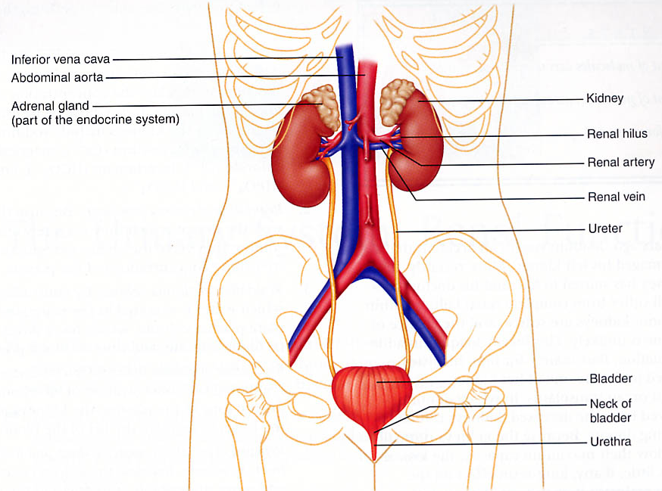
Urinary System
The Kidneys
  Kidneys - form urine
  Ureters - transport urine from kidneys to bladder
  Bladder - store urine
  Urethra - excrete urine from bladder to outside of body

Slide 4
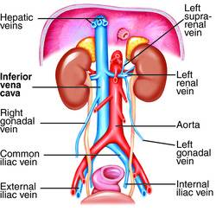

Slide 5
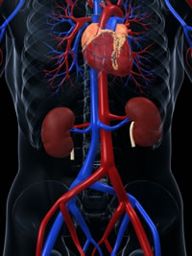
Remember……
Oxygenated blood is delivered to kidneys via renal
arteries. Deoxygenated blood leaves the kidneys via renal
veins.
-The kidneys receive 20% of cardiac output at rest, and utilize 16% of all ATP.
Kidneys are extremely efficient
Must lose almost 75% of
kidney function before homeostatic
functions will be affected.

Slide 6
TO REMEMBER
-The kidney contributes to regulate the volume of extracellular fluid, to maintain blood pressure, to regulate the osmolarity of body fluids, to maintain electrolyte balance, to regulate pH, to excrete waste, to produce hormones (EPO and renin), and to participate in gluconeogenesis (minor role relative to liver).
-Oxygenated blood enters the kidney via the renal artery. Deoxygenated blood leaves through the renal vein. A lot of blood (20% of total output at rest) enters the kidney.

Slide 7
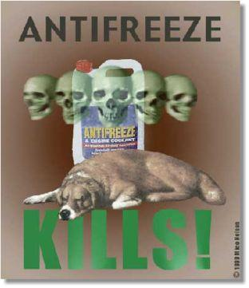
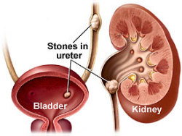
Kidney Stones
Ethylene glycol
-oxalic acid
-calcium oxalate
A case in April 2005, Kate Knight of England, carried out a plan to poison and kill her husband Lee Knight, after learning she would she would gain over $200,000 from his employers after his death. It is believed her motive for carrying out such an act was to pay off thousands of pounds' worth of debts. Mr Knight had his food contaminated by antifreeze and subsequently came close to death. Mr Knight remained in a coma for 16 weeks and eventually managed to pull through. Despite this, he was left with brain damage, kidney failure, blindness, and deafness. Ms Knight was found guilty of attempted murder and jailed for 30 yrs in Feb 2008.

Slide 8
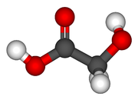
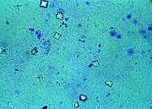
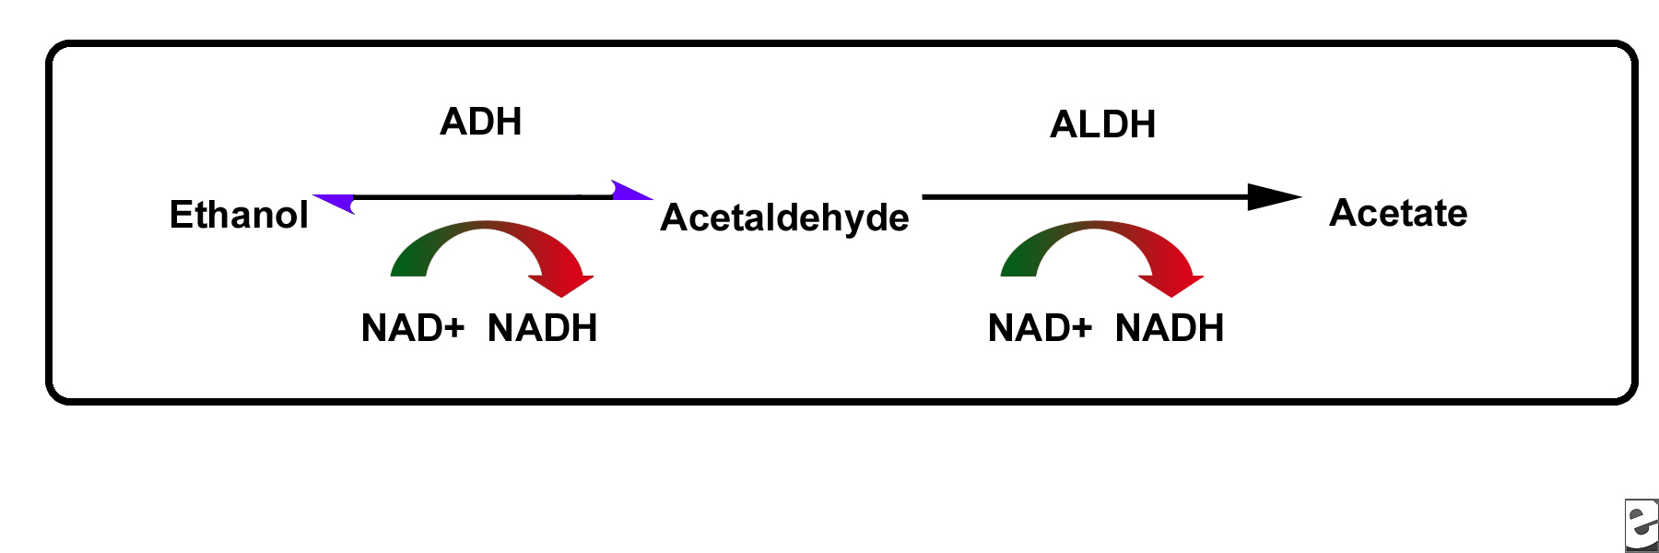
alcohol dehydrogenase
ethylene glycol --> glycoaldehyde-->glycolyc acid-->oxalic acid
Alcohol dehydrogenase is the same enzyme that catabolizes ethanol
calcium oxalate crystals
(precipitate in kidneys and damage cells)

Slide 9
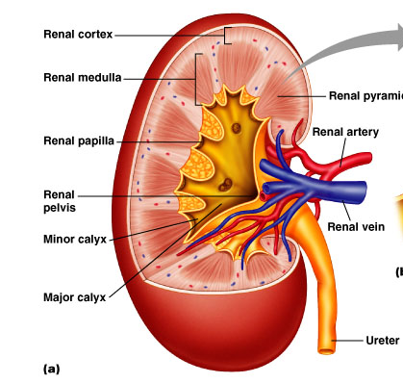

Slide 10
Medulla is divided into
conical sections called
renal pyramids
The word “calyx” means cup
At tips of the pyramids (papillae),
tubules called collecting ducts drain into common
passages called minor calyces; these converge to form
larger passages – major calyces- which then drain into
the renal pelvis – initial portion of the ureter
Notes:
Take a cross section of the kidney and see that there is an outer layer – the cortex and an inner layer the medulla. The layers are formed by
the organized arrangement of microscopic tubules called nephrons. 80% of the nephrons are contained within the cortex but some dip down into the medulla – called juxtamedullary nephrons. 1 million in each kidney. Nephrons conatin vascular elements (blood vessels) and tubular elements.

Slide 11
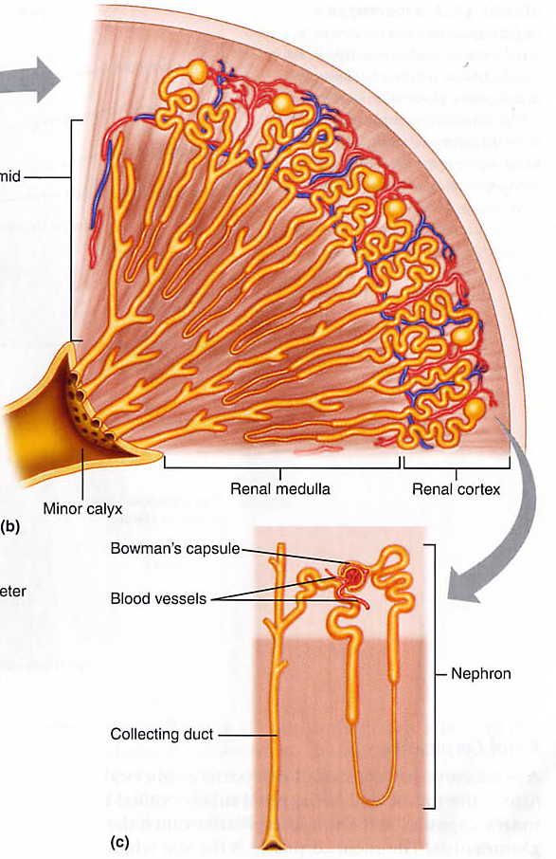
Within renal pyramids are
more than 1 million nephrons –
functional unit of the kidney
Two parts to a nephron:
a renal corpuscle, that filters
the blood and a renal tubule in
which the filtrate travels and
becomes modified in the formation
of urine.
Renal corpuscles are made of
Bowman’s capsule and a group of
capillaries called the glomerulus

Slide 12
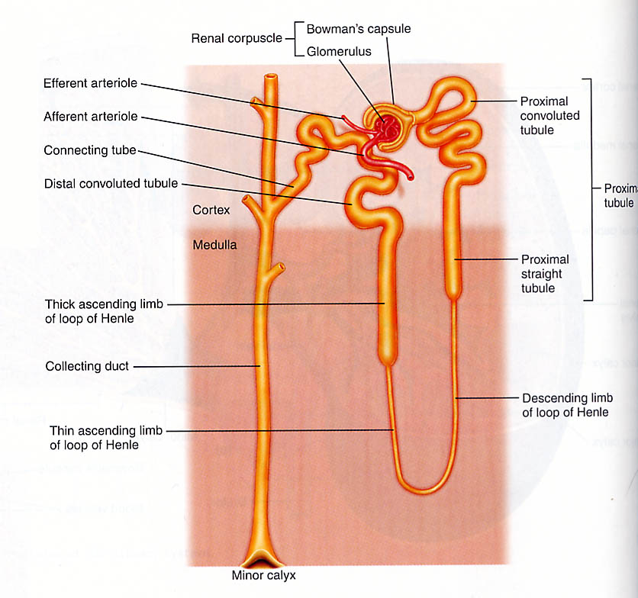

Slide 13
Remember…Blood is delivered
to kidney via renal artery,
which branches into afferent
arterioles
As blood flows into the
glomerular capillaries,
protein-free plasma filters
across the walls of the
glomerulus into Bowman’s
Capsule
This process is called
Glomerular filtration
The remaining blood leaves the glomerulus via the efferent
arteriole.
Afferent and efferent arterioles have smooth muscle and
so their diameters can be regulated via the sympathetic
nervous system

Slide 14
Renal Tubule
Glomerular filtrate flows from
Bowman’s capsule into the
proximal convoluted tubule, and
then into the proximal
straight tubule (together called
proximal tubule)
This empties into the
loop of Henle:
descending limb;
ascending limb;
thick ascending limb.
Further empties into distal convoluted tubule, then the
connecting tube and finally into the collecting duct

Slide 15
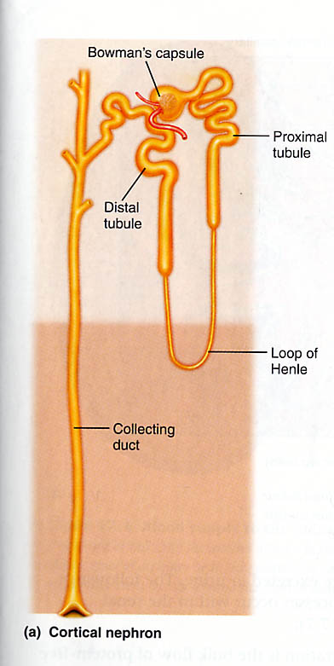
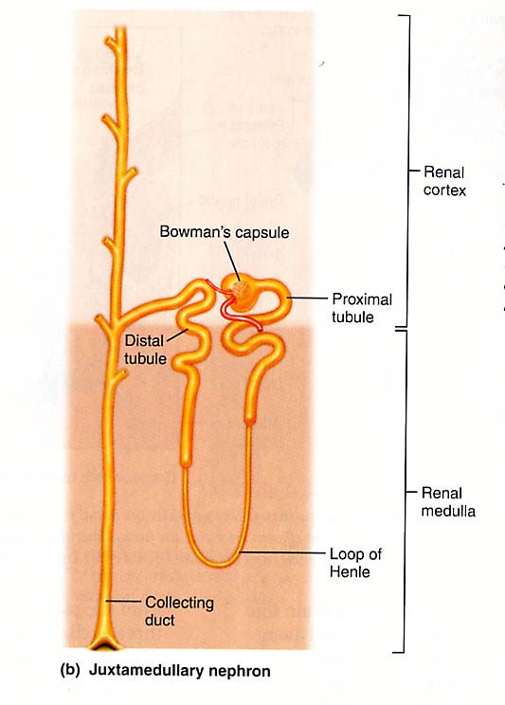
Two types of nephrons
Juxtamedullary long loops of Henle and a well developed juxtaglomerular apparatus
Cortical (70-80%) short
loops of Henle
Both participate in filtration, but juxtaglomerular nephrons also function to maintain an osmotic gradient in the medulla - crucial to produce concentrated urine and hence to conserve water.

Slide 16
To Remember
-Do not drink antifreeze (and don’t let your pet drink it)!
-You should be able to identify the following structures from a diagram: Cortex, medulla, papilla, ureter.
-You should be able to identify the following structures from a diagram: Bowman’s capsule, glomerulus, proximal tubule, loop of Henle, distal tubule, collecting duct.
-There are two ”extreme” types of nephrons: Juxtamedullary (with long loops of Henle) and Cortical (short-looped). The former contribute to create and maintain a cortico-medullary osmotic gradient.

Slide 17
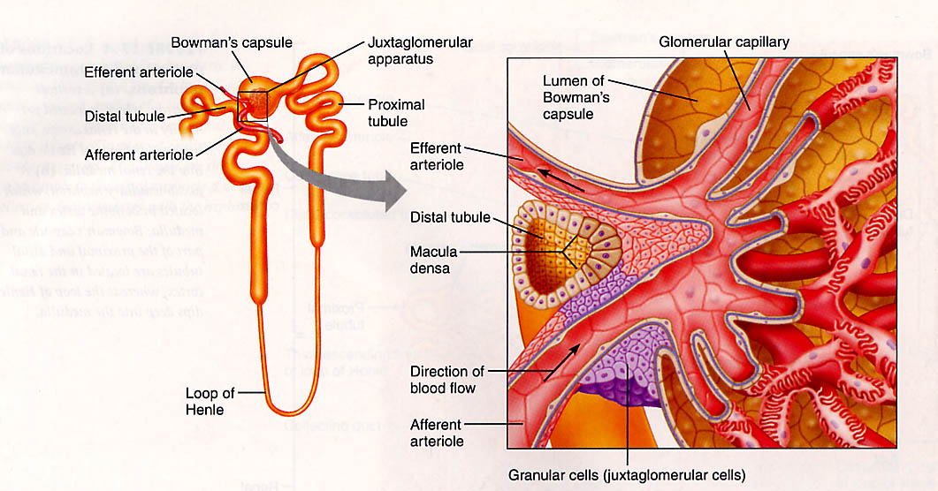
Juxtaglomerular Apparatus (JGA)
Located where the initial part of the distal tubule passes through the fork between the afferent and efferent arterioles.
Consists of cells of both the arterioles and the tubules.
Secretory cells in the JGA secrete renin.
Macula densa cells release prostaglandins

Slide 18
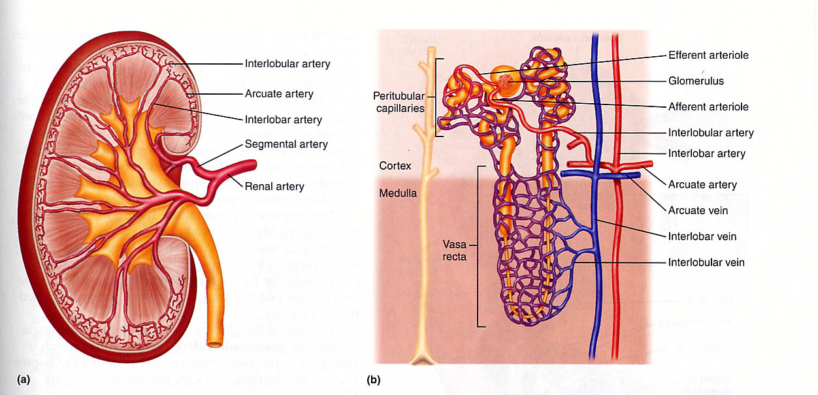
Kidney Blood Supply
Renal arteries supply blood to the kidneys and branch into smaller arteries. The efferent arterioles lead into two different types of capillary beds: the peritubular capillaries around renal tubules & the vasa recta around loops of Henle.
These two types of capillaries play different roles in formation
of urine

Slide 19
Structures to remember
-Elements of a nephron (corpuscule (glomerulus, Bowman’s capsule), proximal tubule, loop of Henle, distal tubule, collecting duct)
-Afferent and efferent arterioles
-Peritubular capillaries
-Vasa recta
-Juxtaglomerular apparatus (has an endocrine, regulatory function)
-Macula densa (“dense spot”, cells from the distal tubule)

Slide 20
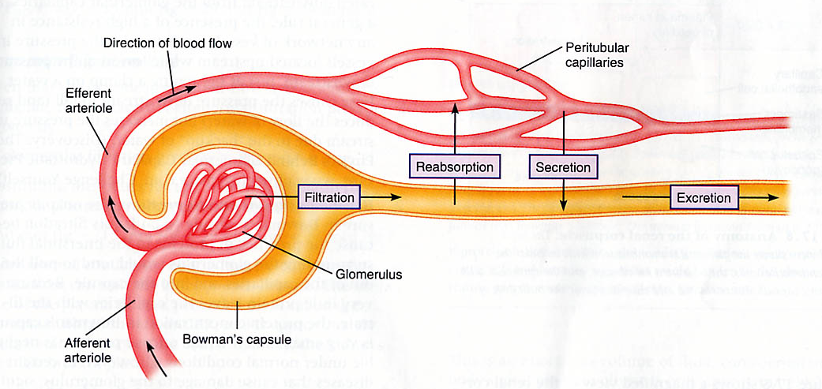
A brief and simplistic overview of what nephrons do :
Amount Filtered – Amount Reabsorbed + Amount Secreted = Amount Excreted
Important Definitions
Filtration: movement of fluid/solutes across capillary walls
Reabsorption: transport of substance back into the blood
Secretion: transport or movement of a substance across the
plasma membrane into the tubules
Excretion: Elimination from the body

Slide 21
Nephrons (kidneys!) filter (F), reabsorb (R), and secrete(S)
Excretion = E = F-R+S

Slide 22
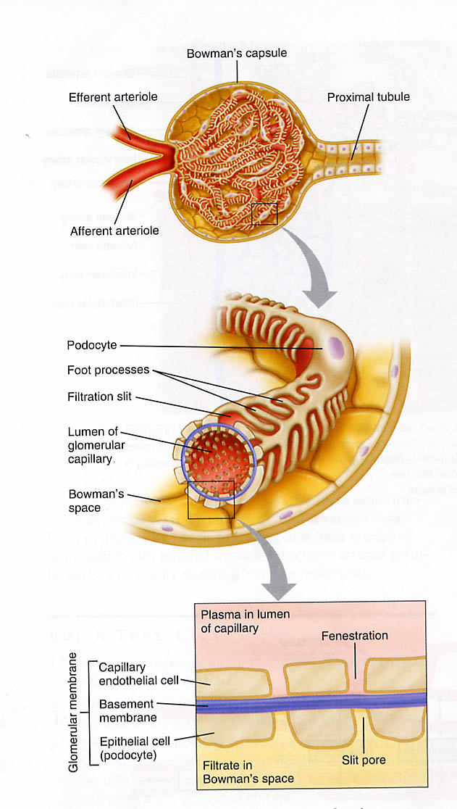
Glomerular Filtration
Glomerular capillaries
(smooth muscle cells that surround the arterioles in glomeruli are called mesangial cells)
Filtrate
Filtration is driven by Starling’s Forces
(hydrostatic and osmotic pressure
gradients) that exist across the walls
of the glomerular capillaries

Slide 23
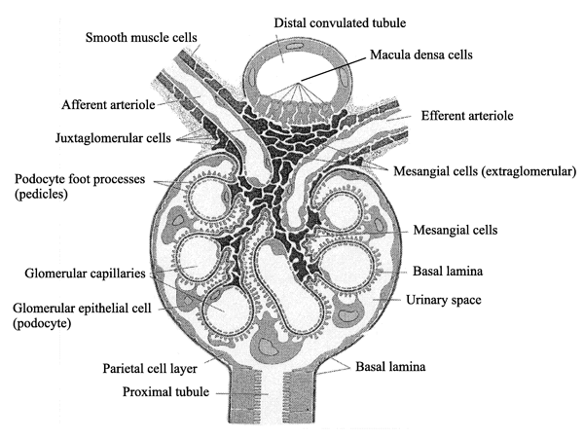

Slide 24
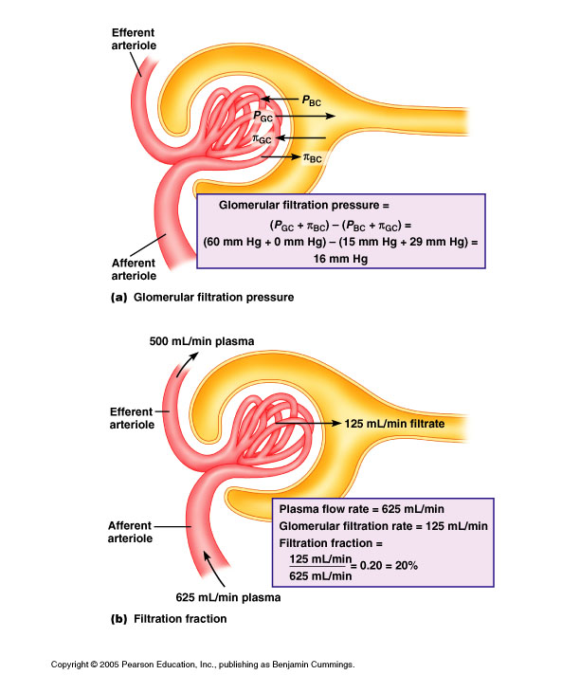

Slide 25
Glomerular Filtration Pressure
4 Starling Forces involved:
1. Glomerular Capillary Hydrostatic
Pressure (P_{GC}) favors filtration. It
is equal to the blood pressure in the
glomerular capillaries : 60mmHg
2. Bowman’s Capsule Oncotic Pressure ( π_{BC}) favors filtration
(remember…oncotic pressure is the osmotic force exerted by
the presence of proteins). Protein concentration in Bowman’s
capsule is very small, hence oncotic pressure (normally) is
negligible.
So, net pressure favoring filtration at the renal corpuscle is:
P_{GC} + π_{BC} = 60mmHg + 0mmHg = 60mmHg

Slide 26
3. Bowman’s Capsule Hydrostatic Pressure
(P_{BC}) opposes filtration and is
normally about 15mmHg
4. Glomerular Oncotic Pressure
(π_{GC}) opposes filtration because
plasma proteins tends to draw
filtrate back into the glomerulus.
This pressure is around 29mmHg
Hence, the net pressure opposing filtration under normal
conditions is P_{BC} + π_{GC} = 15mmHg + 29mmHg = 44 mmHg
Overall Glomerular filtration pressure = (
P_{GC} + π_{BC}) –(P_{BC}+π_{GC})
=(60mmHg+0mmHg)-(15mmHg+29mmHg) = 16mmHg

Slide 27
To Remember
-Nephrons filtrate, reabsorb, secrete, and excrete.
-Filtration is driven by the opposite effects of hydrostatic (favors) and osmotic (opposes) pressures.
-You must consider 4 pressures: Glomerular Capillary Pressure (P_{GC} ≈ 60 mm Hg, favors), Bowman’s Capsule Oncotic Pressure (π_{BC} ≈ 0, favors), Bowman’s capsule Hydrostatic Pressure (P_{BC} ≈ 15 mm Hg, opposes), Glomerular Oncotic Pressure (π_{GC} ≈ 29 mm Hg opposes).
(P_{GC} + π_{BC}) –(P_{BC}+π_{GC}) ≈ 16 mm Hg, which makes filtration possible

Slide 28
An important concept: glomerular filtration rate (GFR)
GFR is the volume of plasma filtered per unit time.
In humans, GFR is approximately 125 ml/min
i.e. The kidneys filter 180 liters/day!
Because a 60 kg human has ≈ 2.8 liters of plasma,
total plasma volume is filtered every 20-25 minutes
Filtration fraction (FF) is the fraction of renal plasma volume that is filtered (625 ml/min)
FF = GFR ÷ (renal plasma flow)
= (125 ml/min) ÷ (625 ml/min)
= 0.2 (i.e. 20%)

Slide 30
GFR ≈ 125 ml/minute
A good ballpark estimate

Slide 31
We might want to know how much of a particular solute is
filtered. (i.e. it is small enough to move across the glomerular
barriers without restriction)
We call this the Filtered load (FL)
FL = GFR x P_{x}, where P_{x} is the concentration of substance X in
plasma
E.g. normal plasma glucose concentration 1 mg/ml
Hence, FL = 125 ml/min x 1 mg/ml = 125 mg/min
FL would increase if either the GFR or the concentration of the solute increased.

Slide 32
Remember
-GFR is the amount of plasma filtered by all the nephrons in the kidney per unit time (≈ 125 ml/min, high!!!).
-Filtration fraction FF = GFR / Renal plasma flow
-Filtered load (FL) for a freely filtered substance
FL = GFR x concentration of substance in plasma
(amount of a substance filtered by the kidney per unit time)

Slide 33
Measuring GFR
GFR is an important indicator of renal function (both in clinical and research settings).
THE CONCEPT OF CLEARANCE
C_{x}P_{x} = U_{x} (dV/dt) NOTE UNITS!
C_{x} = volume of plasma cleared of substance X per unit time (“clearance of X”)
P_{x} = concentration of X in plasma
U_{x} = concentration of X in urine
(dV/dt) = rate of urine production
Clearance is the volume of plasma cleared of substance X per unit time
Clearance of x = (concentration of x in urine)x(rate of urine production)
(concentration of x in plasma)
Under what conditions is Cx =0?

Slide 34
C_{x}P_{x} = U_{x} (dV/dt)
Therefore
C_{x} =[U_{x}(dV/dt)]/P_{x}
Under what conditions is C_{x} = 0?

Slide 35
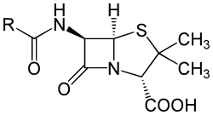
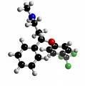
Renal clearance of penicillin ≈ 600 ml/min
Renal clearance of fluoxetine ≈ 30 ml/min
If Cx is high then the substance is secreted
If it is low, it is reabsorbed.
High/Low relative to what? GFR!!!!!!

Slide 36
HOW WE MEASURE GFR: GFR IS THE CLEARANCE OF A SUBSTANCE THAT IS ONLY FILTERED. IT IS NEITHER SECRETED NOR REABSORBED. INULIN IS A GOOD CANDIDATE
If substance X is freely filterable and it is not secreted or reabsorbed (inulin or to a lesser extent creatinine), then C_{x} = GFR
GFR = C_{inulin} = U_{inulin}(dV/dt) ÷ P_{inulin}
GFR ≈ C_{creatinine} = U_{creatinine}(dV/dt) ÷ P_{creatinine}
(overestimates GFR by 10-20% because some tubular secretion occurs)

Slide 37
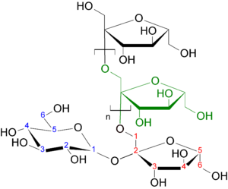
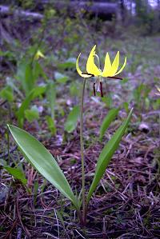
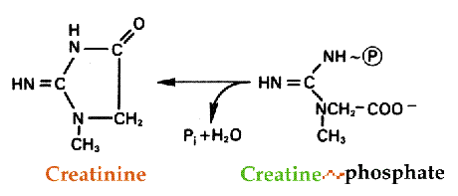
Inulin is an oligosaccharide of fructose (≈30 residues)
Creatinine is the byproduct of the catabolism of creatine (a phosphagen in muscle)

Slide 38
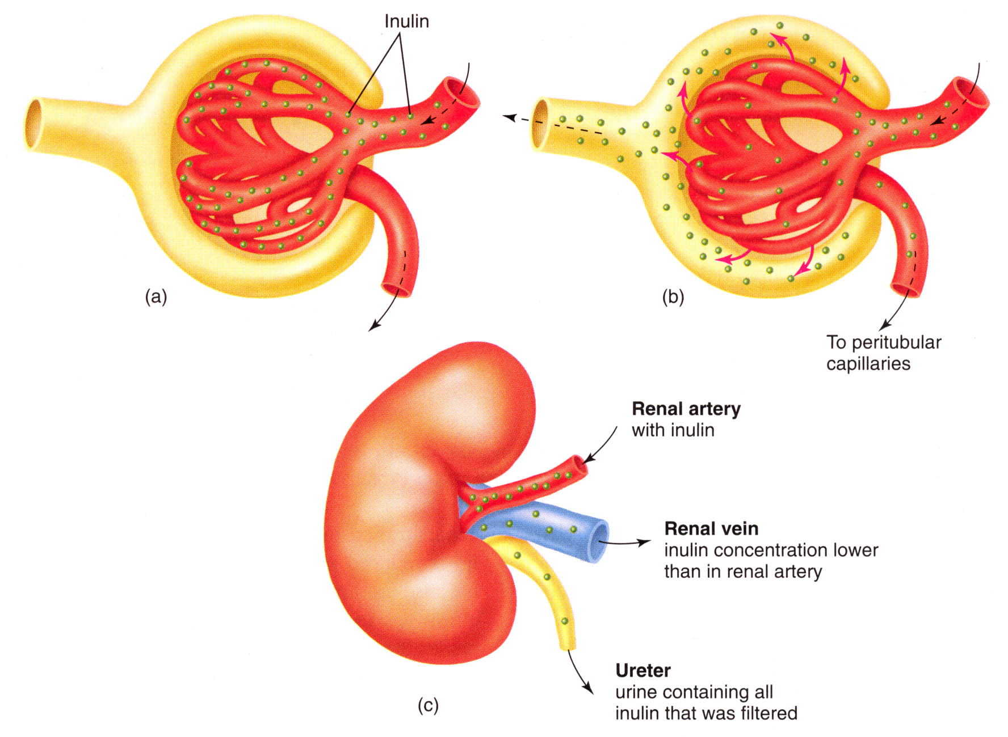
Inulin Clearance – an Accurate Estimation of GFR
We use the clearance of inulin to measure GFR because inulin is only filtered. It is neither secreted nor reabsorbed.

Slide 39
Summary
What is GFR?
-The rate at which the kidney filters plasma (mL/min)
-The clearance of inulin (the volume of plasma cleared of inulin in mL per minute)
How do we estimate it:
GFR = Clearance_{inulin} = U_{inulin}(dV/dt) ÷ P_{inulin}
= Concentration of inulin in urine x rate of urine production
Concentration of inulin in plasma

Slide 40
Example
GFR
= Concentration of inulin in urine x rate of urine production
Concentration of inulin in plasma
Concentration of inulin in urine=80 mg/ml
Rate of urine production=1.5 ml/min
Concentration of inulin in plasma =1 mg/ml
Thus
GFR =(1.5ml/min x 80mg/ml) / 1mg/ml
=120 ml/min

Slide 41
To Remember
Clearance of x = (concentration of x in urine)x(rate of urine production)
(concentration of x in plasma)
GFR
= Concentration of inulin in urine x rate of urine production
Concentration of inulin in plasma
MORE IMPORTANTLY, REMEMBER THE “WORD” DEFINITIONS OF Cx and GFR…

Slide 42
Clearance of substance x is the volume of plasma cleared by the kidney per unit time.
Glomerular Filtration Rate (GFR) is the volume of plasma filtered by the kidney per unit time.
WE MEASURE GFR AS THE CLEARANCE OF INULIN.

Slide 43
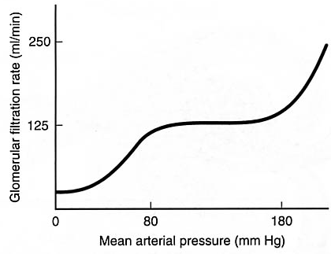
Blood Pressure and GFR
GFR is huge (180 L/day).
Hence, small changes in GFR can lead
to major effects (a 10% increase in
GFR translates into 18 L/day entering
the nephrons of each kidney).
No
change
How is GFR regulated in the face
of potential variation in MAP?
Three intrinsic mechanisms:
1. Myogenic regulation of afferent smooth muscle
2. Tubuloglomerular feedback changing the resistance of the afferent arteriole
3. Mesanglial cell contraction altering the permeability of the
filtration barrier

Slide 44
MAP ≈ ([2xdiastolic P]+[systolic P])/3
= diastolic P + 1/3 (systolic P –diastolic P)
No
change
hypotension
(< 70 mm Hg)
hypertension
( > 115 mm Hg)
≈ 140
GFR IS “DEFENDED” IN THE FACE OF VARIATION IN MAP

Slide 45
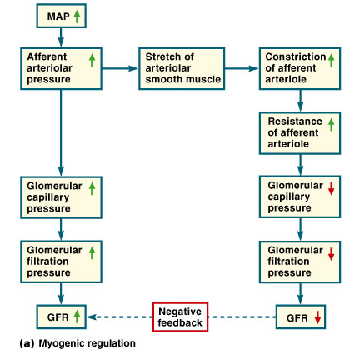
Blood Pressure and GFR

Slide 46
1. Myogenic regulation of afferent smooth muscle
An increase in MAP leads to increase "stretch" in the smooth muscle of the afferent arteriole. This results in vasoconstriction and hence in reduced hydrostatic pressure in the glomerulus. Hence keeping GFR constant.

Slide 47
Juxtaglomerular Apparatus (JGA)
Located where the initial part of the distal tubule passes through the fork between the afferent and efferent arterioles.
Consists of cells of both the arterioles and the tubules.
Secretory cells in the JGA secrete renin.
Macula densa cells release prostaglandins

Slide 48
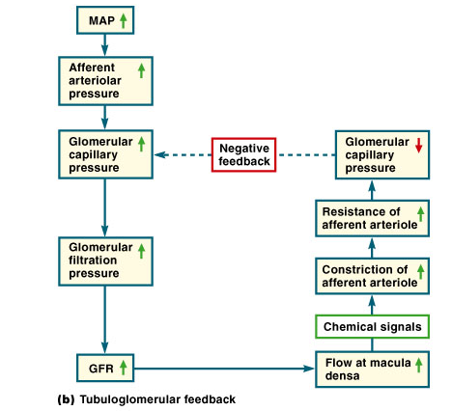
2. Think back to early slides of JGA…..
  Macula densa cells secrete paracrine in response to an increase in flow of fluid past them
  Smooth muscle of arteriole
  contract in response to this
  paracrine
3. Finally,glomerular capillaries
are surrounded by Mesangial cells
(modified smooth muscle cells)
If BP rises, GFR increases
and stretches Mesangial cells
causing them to contract, and
decreasing surface area
available for filtration

Slide 49
2. Tubuloglomerular feedback changing the resistance of the afferent arteriole.
When MAP increases, increased flow through the distal tubule stimulates the secretion of a paracrine signal that leads to the vasoconstriction of the afferent arteriole. This leads to the maintenance of constant GFR.

Slide 50
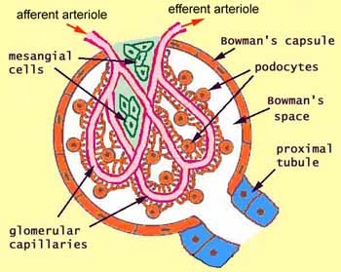
Glomerular Filtration
Glomerular capillaries
(the smooth muscle cells that surround endothelial cells in glomeruli are called mesangial cells)

Slide 51
3. Mesanglial cell contraction altering the permeability of the
filtration barrier
The mesanglial cells can decrease the size of the slit pores in response to the paracrine signal of the JGA (recall that this increases with MAP) and hence reduce permeability of the epithelium of the Bowman's capsule (GFR stays constant).
Remember, there are 3 intrinsic mechanisms:
myogenic
tubuloglomerular feedback
mesanglial cells

Slide 52
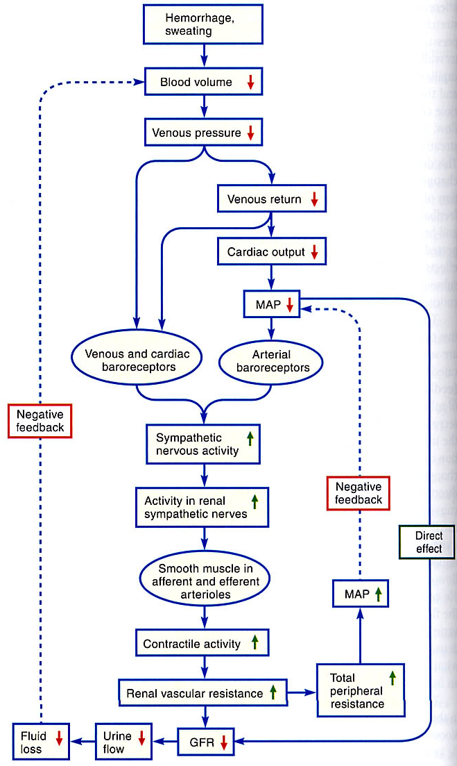
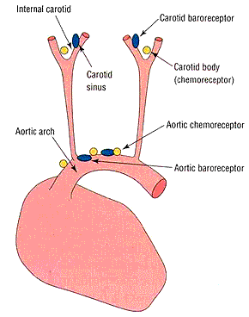
Extrinsic control of GFR in response to an acute drop in MAP (e.g. hemorrhage or dehydration).
Decreased MAP is detected by arterial baroreceptors (aortic arch +carotid sinuses). Signal relayed to the medulla oblongata in the brainstem, the signals are transmitted to the spinal chord, which increases sympathetic stimulation leading to vasoconstriction in afferent arterioles and increasing resistance. The consequence is decreased GFR and a reduction of urine flow and hence fluid loss.
Intrinsic

Slide 53
EXTRINIC
INTRINSIC
hypotension
(< 70 mm Hg)
hypertension
( > 115 mm Hg)
≈ 140
GFR IS “DEFENDED” IN THE FACE OF VARIATION IN MAP

Slide 54
To Remember
-GFR is maintained relatively constant in the face of broad variation in blood pressure.
-The mechanisms that control GFR are both intrinisc and extrinsic.
-The intrinsic mechanisms are: local vasoconstriction of afferent arterioles in response to stretching. Paracrine effects (mediated by the JGA) on afferent arterioles. Effects on mesaglial cells which reduce permeability of glomerulus. Intrinsic mechanisms help to maintain GFR constant when MAP goes up….
-The extrinsic effects are the result of drastic reductions in BP due to hemorrhage or dehydration. Lowered BP is detected by aortic and carotid baroreceptors, and a reflex mediated by the medulla leads to increased vasoconstriction of afferent arterioles and reduced GFR. Extrinsic mechanisms help to maintain GFR constant when MAP goes down….They reduce urine flow.

Slide 55
Excretion = Filtration + secretion -reabsorption
FL_{x}=(GFR)P_{x}
E_{x} = (dV/dt)U_{x}
GFR = C_{inulin}= [(dV/dt)U_{inulin}]/P_{inulin}
Please remember:
-GFR = clearance of inulin = rate at which plasma is filtered by the kidney (inulin is freely filtered but neither secreted nor reabsorbed).
-Cx=clearance of x = the volume of plasma “cleared” of substance x per unit time.

Slide 56
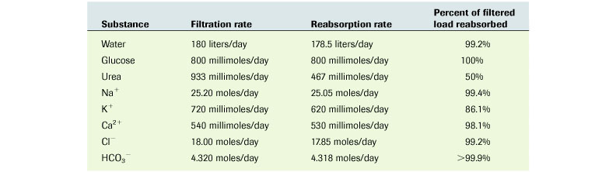
Reabsorption – movement of filtered solutes and water from
the lumen of the tubules back into the plasma.
Why do we need this?
If we didn’t have it, all filtered materials would be excreted.
For some substances, 100% of that filtered is reabsorbed.
For others, reabsorption is regulated to vary excretion rate.
For most solutes, reabsorption takes place in the proximal
and distal tubules.

Slide 57
For most solutes, reabsorption takes place in the proximal
and distal tubules.

Slide 58
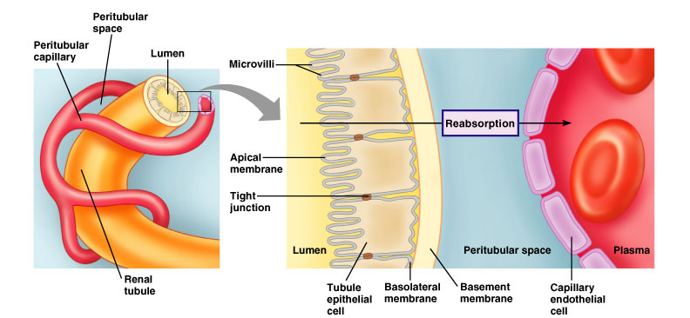
Barriers to Reabsorption….
The substance needs to cross the tubular epithelium and
the capillary epithelium
Three types of reabsorption:
passive & active reabsorption of solutes; reabsorption of water

Slide 59
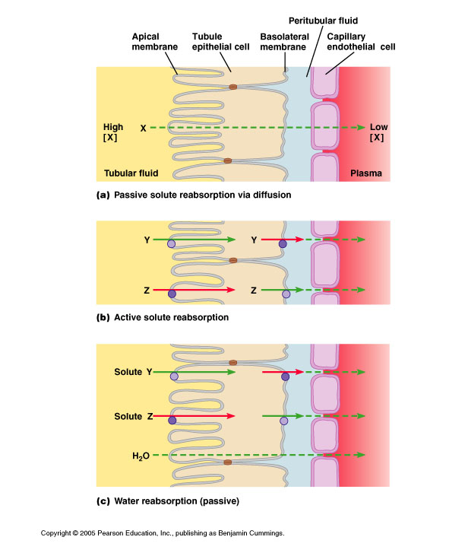
Passive reabsorption:
Solute X is higher in tubule
than in capillary. (Follows
reabsorption of water (urea))
Active transporters may be on
basolateral membrane (for “Y”)
or on apical membrane (for “Z”)
Transport of Y and Z into plasma
increases osmolarity and decreases
tubular osmolarity –hence
water moves down its concentration
gradient
Note: some membranes in renal
tubule are impermeable to water

Slide 60
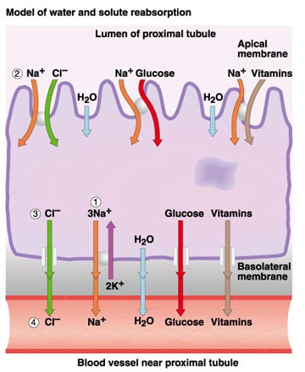
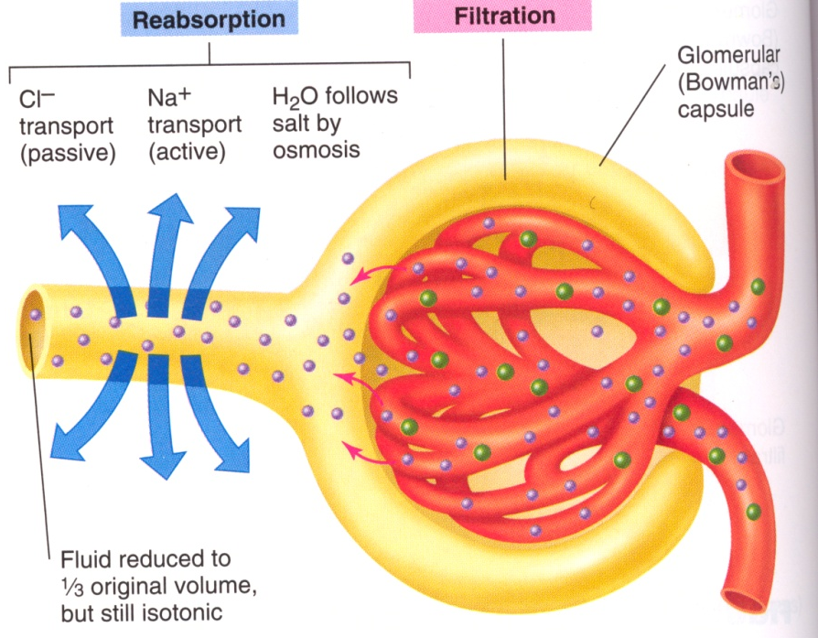
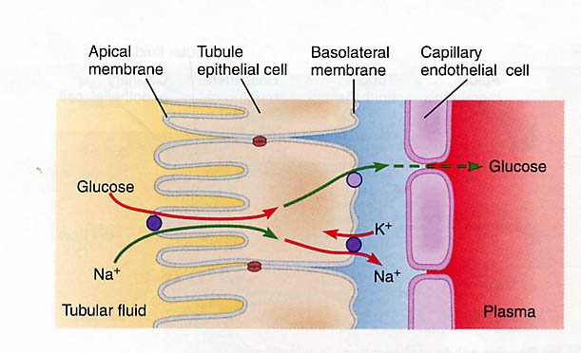
Reabsorption
Lots of symporter or antiporter systems use Na⁺.
Most of the transcellular NaCl is mediated by the proximal tubule apical membrane Na/H⁺ exchanger (antiporter). Important in acid-base balance
Glucose symporter (SGLT1!!!!!).

Slide 61
Reabsorption
In humans, kidneys reabsorb over 600g sodium/day and utilize 6% of energy at rest in this process. Kidney cells are rich sources of Na⁺/K⁺-ATPase; they contain up to 50 million pumps per cell.
70% of water + salt reabsorption occurs in Proximal Tubule
– not dependent on state of hydration. NOT REGULATED
ISO-OSMOTIC (no change in solute concentration in plasma or filtrate)

Slide 62
To Remember
-Many molecules (Na+, Cl-, water, glucose, amino acids) are reabsorbed by the kidney, by a variety of mechanisms (passive diffusion, active transport, passive movement of water down it s osmotic pressure gradient).
-≈ 70% of all salt and water reabsorption takes place in the proximal tubule.
-Many substances are completely reabsorbed (glucose amino acids), unless their transport mechanism becomes saturated.
MOST RENAL REABSORPTION (Especially of Na+, Water) TAKES PLACE IN THE PROXIMAL CONVOLUTED TUBULE

Slide 63
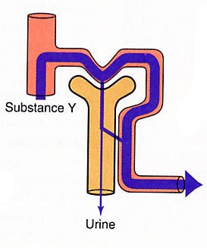
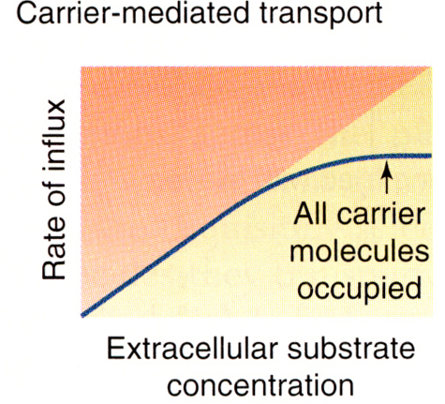
Reabsorption –
What happens when the capacity of the
kidney to reabsorb a substance is exceeded?
It gets excreted
Why does this happen?
Transporters become saturated
Then the system operates at
transport maximum.
The point at which the plasma
concentration of the solute
spills over into the urine is called
the renal threshold.

Slide 64
Then the system operates at
transport maximum. (UNITS ARE mg/min)
maximal transport
(Tmax)
Draw in board!
renal threshold
The point at which the plasma concentration of the solute spills over into the urine is called
the renal threshold. (UNITS ARE mg/ml)

Slide 65
Reabsorption –
Let’s think about glucose…..
Glucose is freely filtered from the glomerulus
and normally completely reabsorbed by active transport
in the proximal tubule
The transport maximum for
glucose reabsorption is
375mg/min and the normal
plasma concentration of
glucose is 80-100mg/dL (0.8-1 mg/ml)
Recall filtered load (FL) = GFR x P_{glucose}
FL = 125 ml/min x 1mg/mL = 125mg/min
which is well below the transport maximum
Hence all glucose is reabsorbed & none is excreted in the urine

Slide 66
Theoretically, the renal threshold for glucose can be calculated
If GFR x renal threshold = transport maximum
then, renal threshold = transport maximum /GFR
= 375mg/min/ 1.25dL/min = 300mg/dL
But the true renal threshold is 160-180mg/dL because not all glucose molecules are picked up by the transport carrier proteins

Slide 67
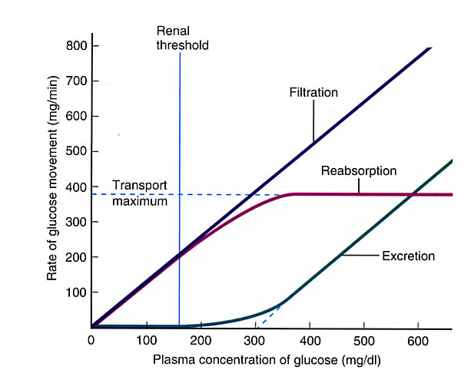
Reabsorption – putting the mellitus into diabetes
Recall filtered load (FL) = GFR x P_{glucose}
Excretion =FL-RL
RL=FL-EL
EL_{gluc}=U_{gluc}x(dV/dt)
T_{max} = maximal ability of the kidney to recover glucose

Slide 68
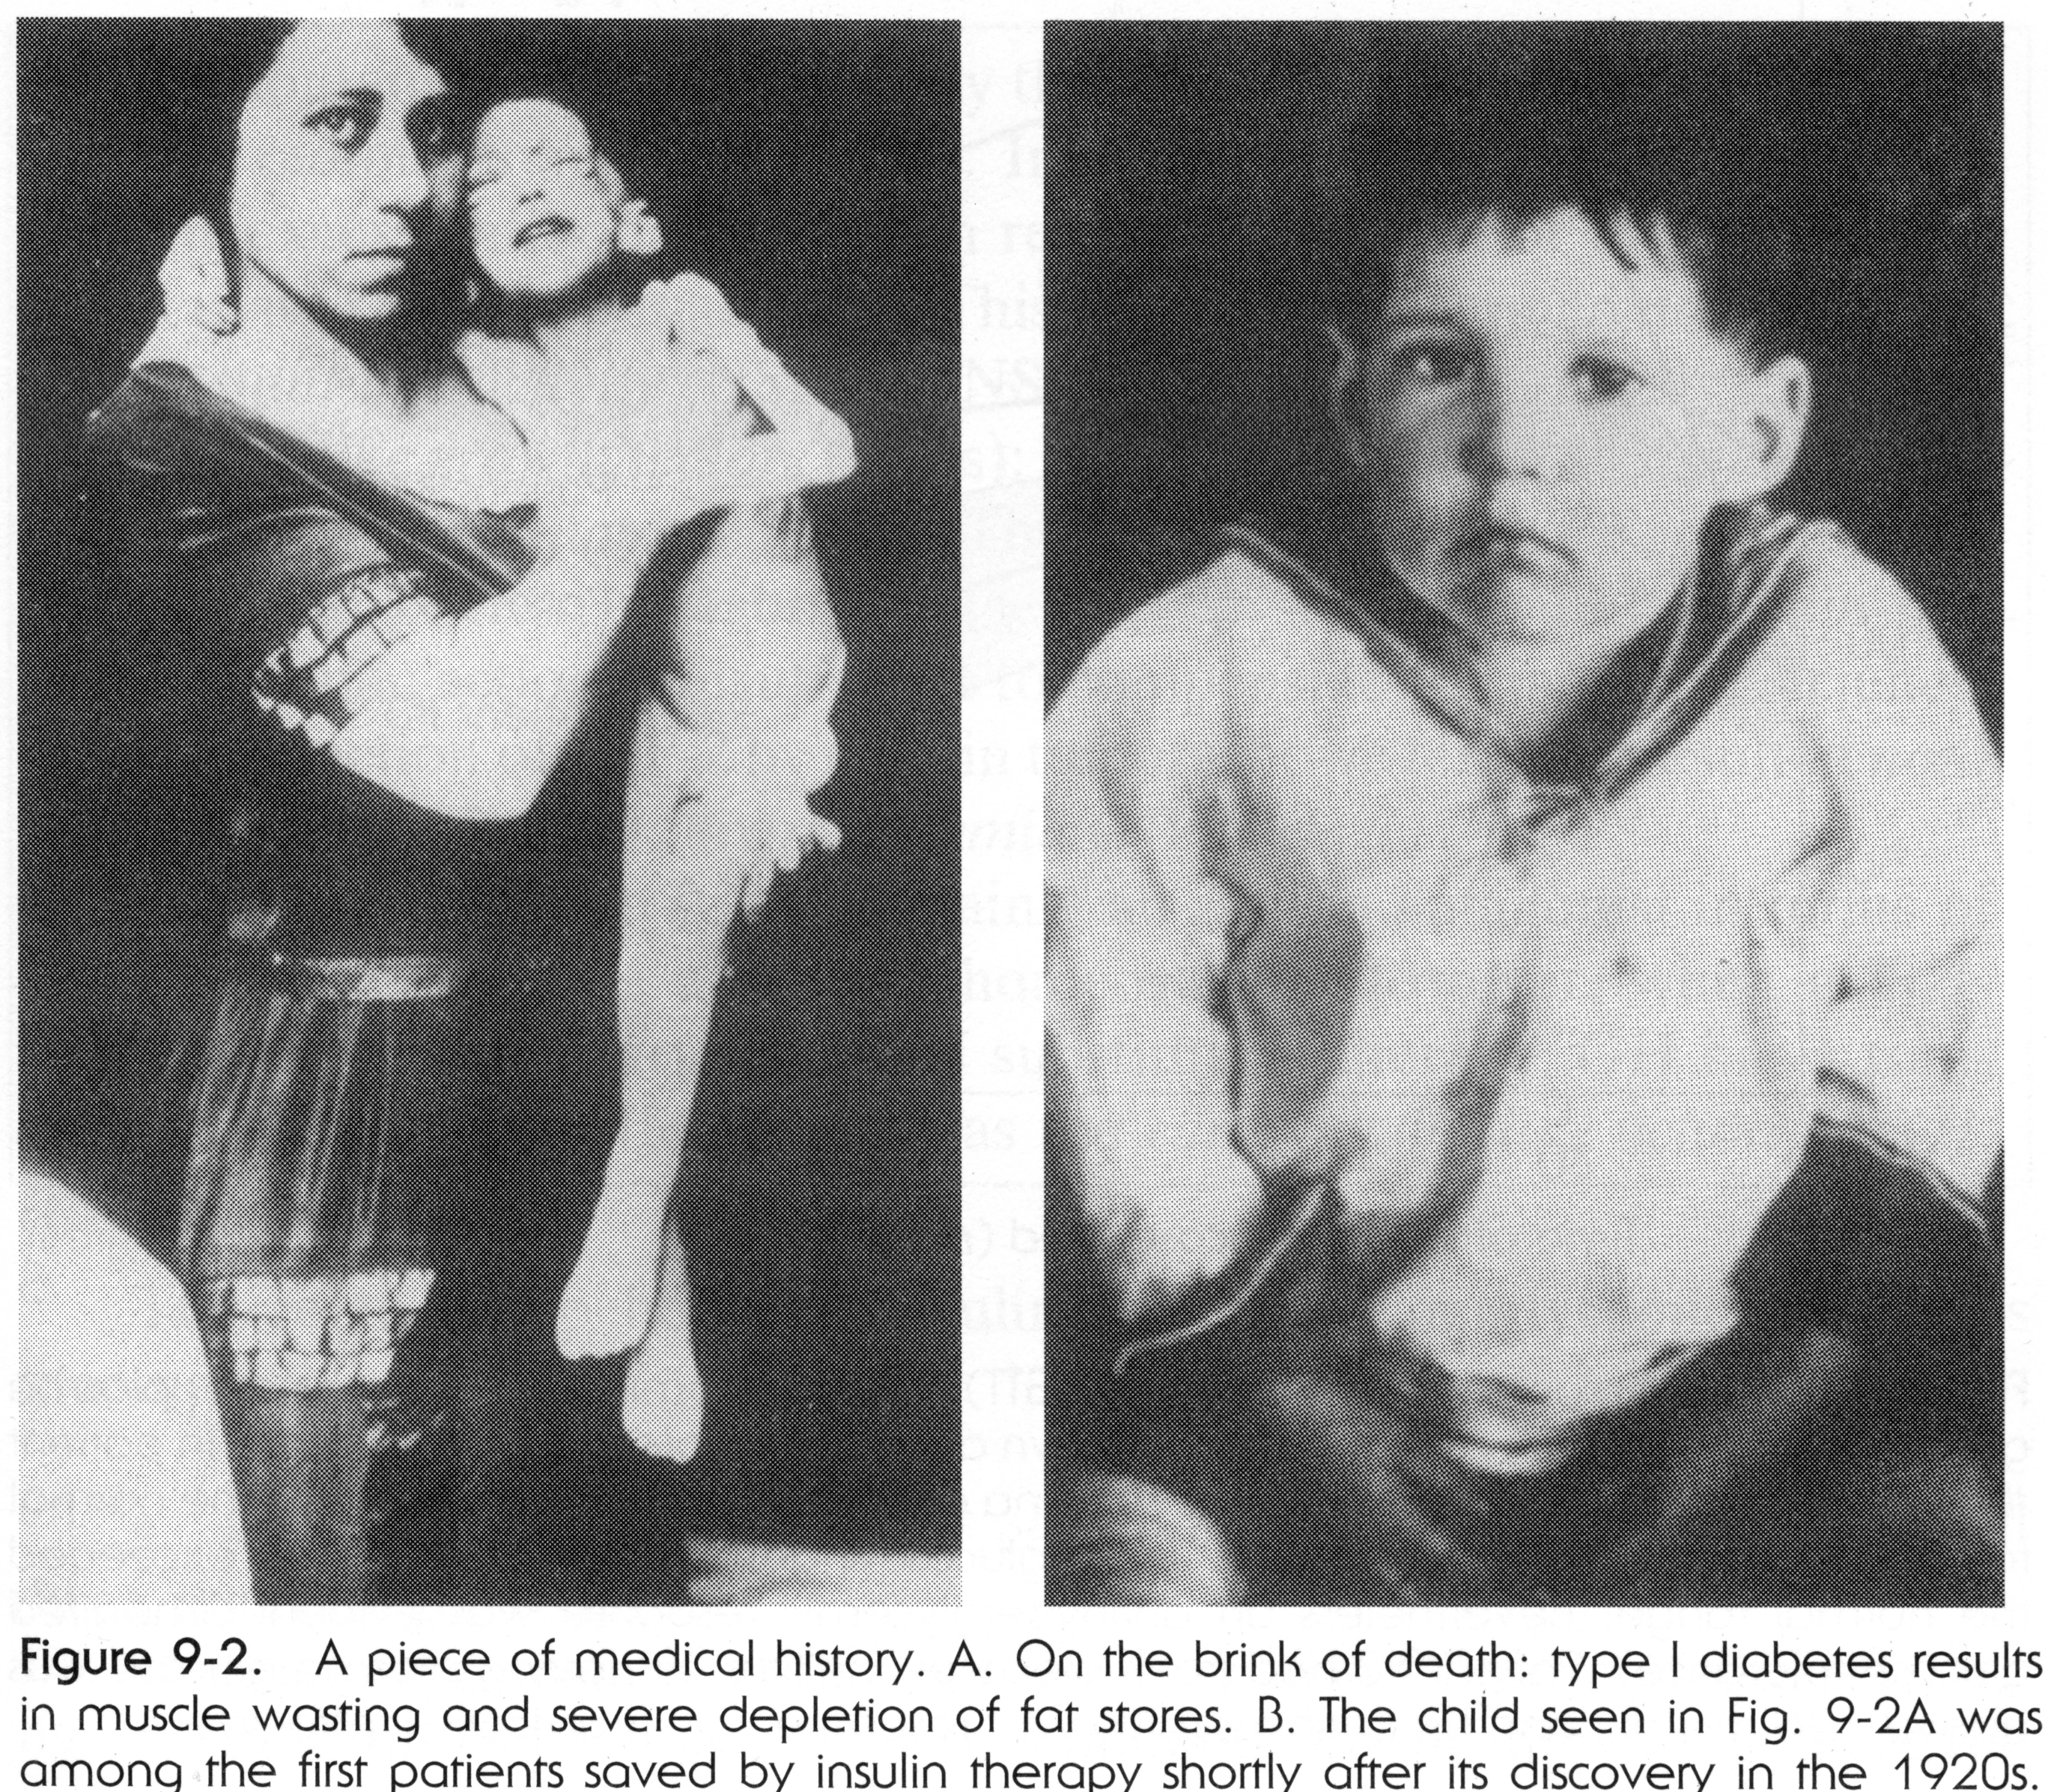
Diabetes Mellitus (“the sweet pissing evil”)
Caused by
Impaired Insulin secretion by the pancreas (Type I), or
2) Adipose and muscle cells do not respond to insulin stimulation (are insulin resistant as in some cases of Type II diabetes).
The subject is said to be diabetic and shows HYPERGLYCEMIA
and has GLYCOSURIA

Slide 69
For a remarkably well illustrated video on type I diabetes
please access this web site
http://www.wehi.edu.au/education/wehitv/insulin_production_and_type_1_diabetes/

Slide 70
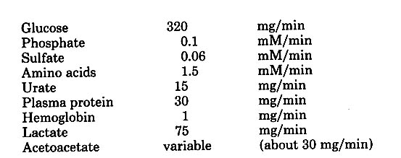
REMEMBER
When the substrate must be recovered, but is recovered by a saturable process, then the material starts to appear in urine when:
Filtered load (FL) = GFR x P_{x} > Tmax
Where T_{max} is the maximal capacity of the kidney to recover material X.
A typical example of material X is glucose.
Tubular reabsorption maxima (T_{max})

Slide 71
To Remember
-In diabetes mellitus
Filtered load (FL) = GFR x P_{x} > T_{max}

Slide 72
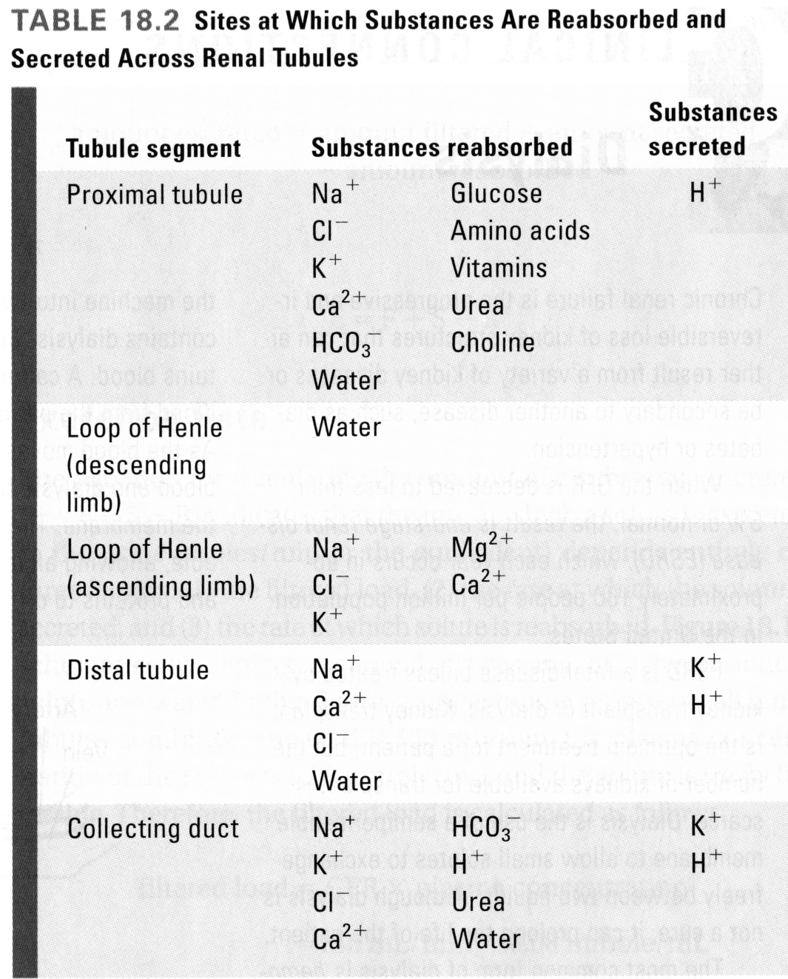
Secretion
Secretion follows the same basic processes as reabsorption and involves the same barriers, except that movement is in the opposite direction. This is different from neurotransmitter and hormone “secretion” and refers to the movement (passive or active transport) of molecules from the peritubular capillaries and vasa recta into the tubular filtrate.

Slide 73
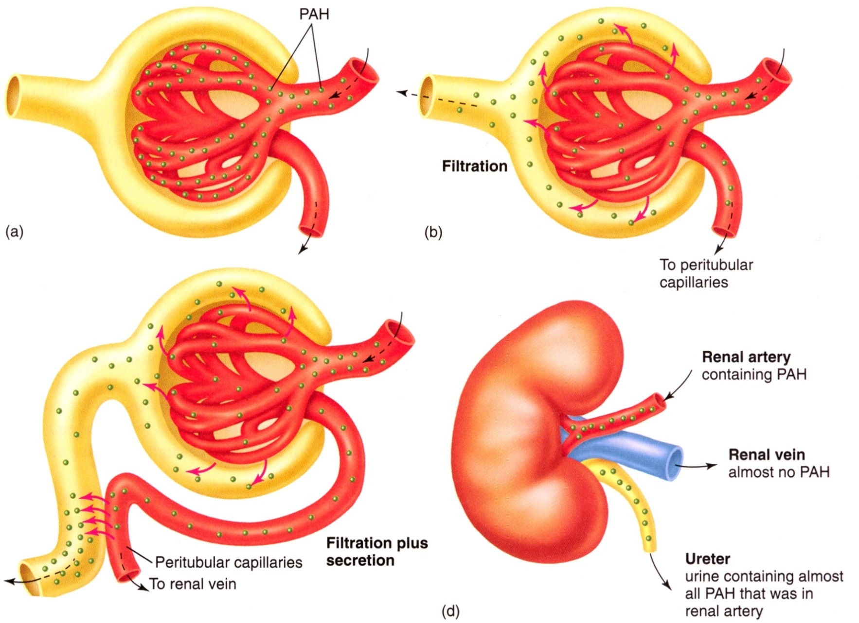
Secretion: para-aminohippuric acid (PAH)
PAH is first filtered at the glomerulus
And then normally completely secreted.
Thus, its clearance (the volume of plasma cleared of PAH)
can be used to measure renal plasma flow.

Slide 74
Plasma is completely “cleared” of PAH!

Slide 75
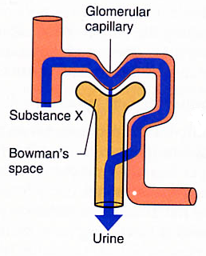
Estimating Plasma Renal Flow Rate using PAH
Clearance = [substance in urine] x [urine production rate]
_________________________________
[concentration of substance in plasma]
U_{PAH}= 18.33 mg/ml
P_{PAH}= 0.05 mg/ml
Urine production rate = 1.5 ml/min
PAH Clearance = (18.33mg/ml x 1.5ml/min) ÷ 0.05mg/ml
=27.5 ÷ 0.05
= 550 ml/min
= plasma renal flow rate

Slide 76
The clearance of PAH equals plasma renal flow
C_{PAH} = [(dV/dt)U_{PAH}]/P_{PAH}
Unless P_{PAH} is so high that you saturate the PAH transport/secretion system!!!

Slide 77
Kidneys: Regulation of water and inorganic ion homeostasis (Chapters 18 & 19)
- Anatomy of the kidney and its many functions
-The kidney as a selective filter:
Filtration,
Glomerular filtration rate
Reabsorption,
Sodium reabsorption
Secretion
- Excretion
- Establishing the Medullary Osmotic Gradient
How is urine concentrated and diluted
Hormonal regulation of kidney function
    Vasopressin
    Aldosterone

Slide 78
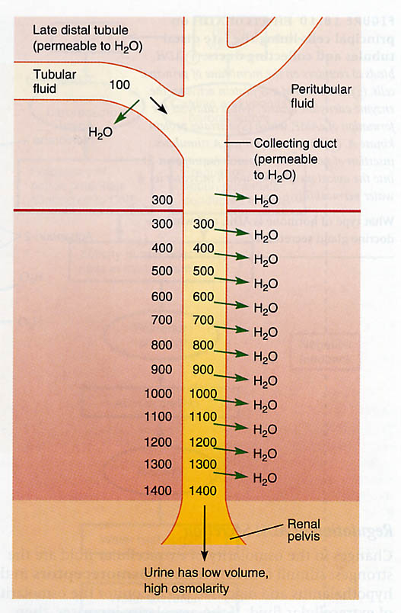
HOW DO MAMMALS CONCENTRATE URINE?
Urine is concentrated in the collecting duct.
Urine is concentrated when water flows out of the collecting duct as a result of a very large osmotic gradient from the kidney’s cortex to the medulla.
More questions!!!

Slide 79
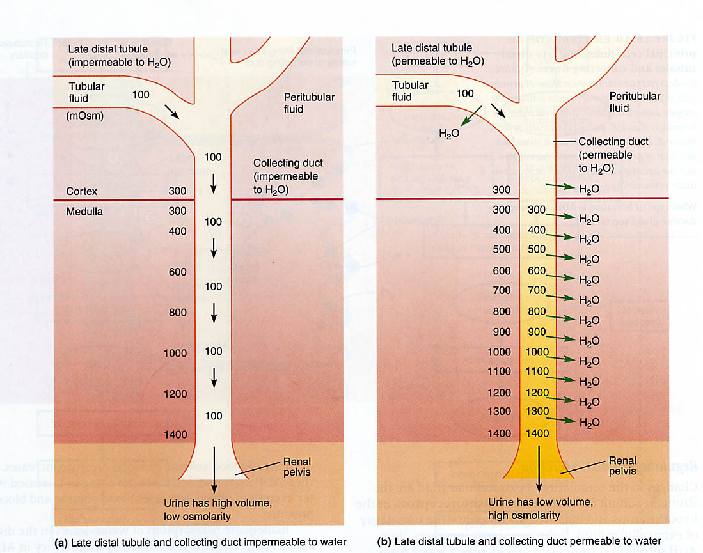
How do we make dilute urine?
We make concentrated urine by having a collecting duct that is permeable to water
We make dilute urine by having a collecting duct that is impermeable to water
How is the water permeability of the collecting duct modulated?
diluting
concentrating
.

Slide 80
Remember
There is a very large gradient in osmolarity between the cortex of the kidney (≈ 300 mOsm) to the medulla (≈ 1400 mOsm in humans).
If the epithelium of the collecting duct is PERMEABLE to water, then water flows from filtrate into the extracellular space of the kidney. The consequence is that urine becomes concentrated (it loses water). This is called antidiuresis.
If the epithelium of the collecting duct is IMPERMEABLE to water, then water does not flow from filtrate into the extracellular space of the kidney. Urine is dilute. This is called diuresis.

Slide 81
QUESTIONS
How can cells in the medulla survive in the face of very hyperosmotic interstitial fluid? How come cells don’t turn into shriveled raisins?
Medullary cells accumulate “compatible osmolytes”. Molecules which do not interact with the surface of a protein, and thereby can stabilize protein function. Cells are iso-osmotic with the interstitial fluid but instead of Na+, Cl-, and urea, they have a variety of osmolytes.
Examples
Some amino acids: glycine
Sugar alcohols: glycerol, sorbitol
Other: taurine, betaine, trimethylamine oxide (TMAO).

Slide 82
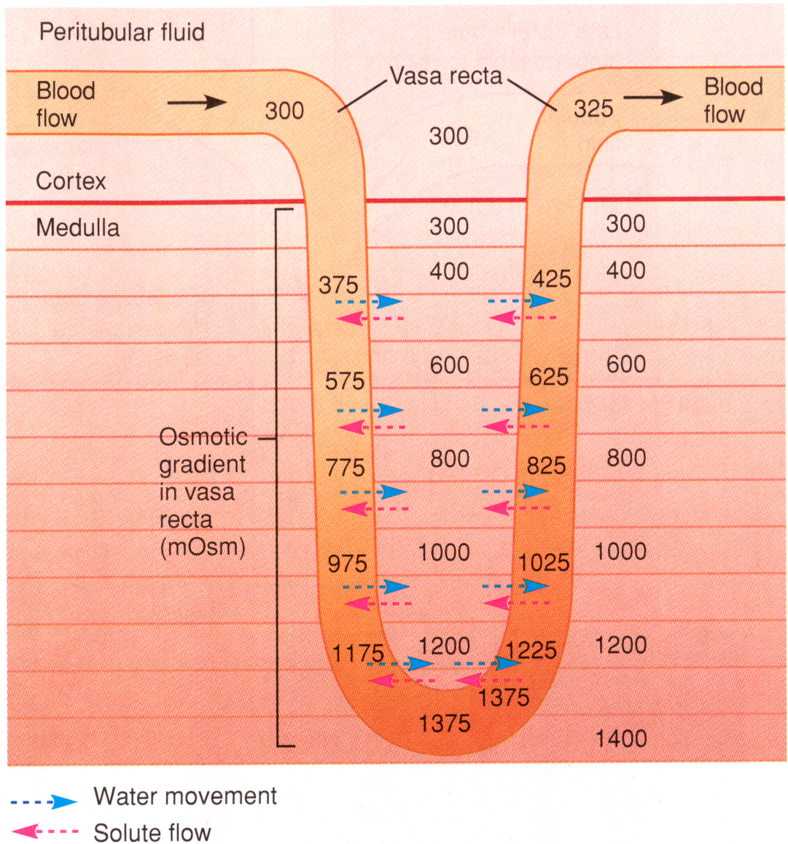
The Vasa Recta – provides nutrients to medulla without dissipating the gradient

Slide 83
How do red blood cells in the vasa recta survive?
They “crenate” (shrink…).

Slide 84
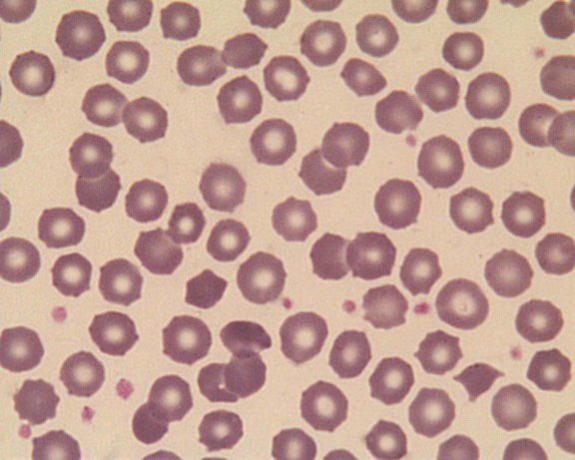
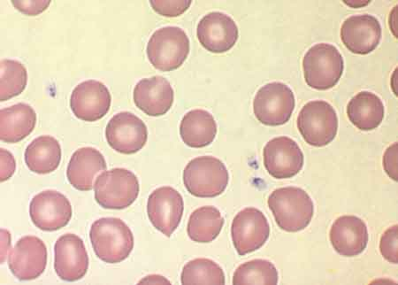
normal
Crenated

Slide 85
REMEMBER
-Urine is concentrated when the epithelium of the collecting duct is very permeable to water. The production of concentrated urine is termed anti-diuresis.
-Urine is diluted when the epithelium of the collecting duct is impermeable to water. The production of dilute urine - diuresis.
How is the water permeability of the collecting duct modulated?

Slide 86

The water permeability of the collecting duct is modulated by vasopressin (aka Anti-diuretic hormone (ADH))
The water permeability of the collecting duct is modulated by vasopressin through a G-protein mediated signaling pathway. The outcome of vasopressin stimulation is the recruitment of aquaporin 2 into the apical membrane. Recall that aquaporins are water channels.
Aquaporin 2 is recruitable into the apical membrane.
Aquaporin 3 is constitutive and found in the basolateral membrane.

Slide 88
REMEMBER
-If vasopressin (ADH) goes up, the permeability of the epithelium of the collecting duct increases leading to anti-diuresis (urine concentration).
-Vasopressin acts by stimulating the “recruitment” of aquaporin 2 (water channels) into the apical membrane of the cells of the lining of the collecting duct. The receptors for ADH are called V2 receptors.
-The action of vasopressin is mediated by an adenylate cyclase activating G-protein
How is the secretion of vasopressin regulated?

Slide 89

Vasopressin is secreted by posterior pituitary in response to:
Increased osmolarity of extracellular fluid (detected by osmoreceptors in the hypothalamus and the GIT)
Vasopressin is also secreted as a result of dehydration (sweating, hemorrhage, diarrhea) and leads to water conservation.

Slide 90
Vasopressin secreted by posterior pituitary in response to:
b) Decreased mean arterial pressure (arterial baroreceptors) and decreased blood volume (cardiac and venous baroreceptors)
STIMULI: HIGH OSMOLARITY, LOW MAP

Slide 91
Clinical Relevance:
Diabetes insipidus (DIABETES MEANS SYPHON (Gr.), INSIPIDUS MEANS WITHOUT TASTE)
Cranial (central or neurogenic): damageto pituitary or hypothalamus. Low production of ADH.
Nephrogenic: Mutation on AQP2 (≈ 10%), Mutation on ADH R2 ( V2, its receptor, 90%)
Dipsogenic: damage to the thirst mechanism in hypothalamus. You drink and drink….
Gestational: all pregnant women produce
vasopressinase (enzyme that breaks up ADH).
Some make too much…..
IN DIABETES INSIPIDUS THERE IS DIURESIS, BUT THERE IS NO GLUCOSE IN URINE!!!

Slide 92
Remember:
Stimuli for vasopressin (ADH): low MAP, low blood volume, high plasma osmolarity (dehydration). Messages detected BY and/or relayed to hypothalamus.
Where is it secreted: posterior pituitary.
What does it do: it helps to concentrate urine.
How does it do it: by increasing the water permeability of the collecting duct.
Molecular mechanism: recruitment of aquaporin 2 into apical membrane of collecting duct cells.
Diabetes insipidus: cranial (neurogenic), nephrogenic, dipsogenic, gestational.

Slide 93
HOW IS THE CORTEX-MEDULLA GRADIENT GENERATED: Countercurrent Multiplication (optional)
The loops of Henle of the juxtamedullary nephrons are responsible for establishing the concentration gradient in the renal medulla
Descending limb is freely permeable to H₂O, but NOT NaCl – so H₂O goes into ICF
Ascending Limb IMPERMEABLE to water
The ascending limb actively transports out NaCl

Slide 94

Countercurrent Multiplication

Slide 95

Countercurrent Multiplication–Na-K-2Cl transporter
Thick part of ascending limb of loop of Henle
Important: No water movement
Loop diuretics
NaCl & KCl are reabsorbed together in a secondary active, electroneutral manner
Na-K-2Cl cotransporter is driven by the electrochemical gradient for Na⁺ by Na/K ATPase in the peritubular membrane
Cl⁻ exits out of the cell at the basolateral surface via KCl symporter and Cl⁻ conductance channel

Slide 96


Slide 97
A reminder, how are concentrated and dilute urine produced.
DIURESIS AND ANTIDIURESIS

Slide 98


Slide 99


Slide 100
Clinical application:
WHY DOES GLYCOSURIA LEAD TO MALADAPTIVE DIURESIS?
PATIENTS WITH DIABETES MELITUS CONTINUE TO BE DIURETIC EVEN WHEN THEY ARE DEHYDRATED AND HAVE HIGH ADH/VASOPRESSIN LEVELS.
WHY?

Slide 101
The role of the kidney in Na⁺ balance.
Why is sodium balance important?
Na⁺ is the primary solute in extracellular fluid and the main determinant of its osmolarity.
Na⁺ is a main determinant of electrochemical gradients
Recall - an abnormal increase is called hypernatremia,
an abnormal decrease is called hyponatremia
How is normo-natremia maintained?

Slide 102

The role of aldosterone
Na⁺ is freely filtered at the glomerulus and undergoes tubular reabsorption, but it is not secreted. Regulation by reabsorption.
Sodium reabsorption mediated primarily by aldosterone (a mineralocorticoid secreted by the cortex zona granulosa ofadrenal))

Slide 103
Aldosterone binds to receptors in THE NUCLEUS OF late distal tubules and collecting ducts where it:
increases the number of Na⁺ and K⁺ channels in the apical membrane.
stimulates the synthesis of Na⁺/K⁺ -ATPase pumps

Slide 105
Remember
How does aldosterone increase Na⁺ reabsorption?
Aldosterone is a mineralocorticoid (secreted by cortex of adrenal) that binds to receptors in late distal tubules and collecting ducts where it:
increases the number of Na⁺ and K⁺ channels in the apical membrane.
stimulates the synthesis of Na⁺/K⁺ -ATPase pumps in the basolateral membrane (HAS A “GENOMIC” EFFECT)

Slide 106
Clinical Applications
Excess aldosterone leads to Na+ retention and K+ loss (Conn’s syndrome = primary aldosteronism sometimes caused by tumors in adrenal) will lead to excessive K+ loss and hypokalemia (also metabolic alkalosis)
Insufficient aldosterone leads to K+ retention and Na+ loss (Addison’s disease, chronic adrenal insufficiency) will lead to excessive K+ retention and hyperkalemia (also metabolic acidosis)

Slide 107
How is the secretion of aldosterone regulated?
(short answer by the renin/angiostensin system. Long answer: by a maddingly complicated mechanism!)
The liver secretes Angiotensinogen
Renin secreted by juxtaglomerular cells transforms angiostensinogen into angiotensin I
The enzyme “Angiotensin-converting enzyme” transforms angiotensin I into Angiotensin II
Angiotensin II acts on the adrenal cortex which then secretes aldosterone.

Slide 108

Low MAP (hemorrhage, surgery.. hypovolemia)
Increased K+
(acute, rare, decrease in Na+ levels)
STIMULI

Slide 109
Remember:
-Sodium reabsorption in collecting duct is stimulated by aldosterone.
-Aldosterone is secreted by the cortex of adrenal glands.
-Aldosterone secretion is stimulated by Angiostensin II
-The conversion of angiostensinogen into angiostensin II is catalyzed by renin and ACE (angiostensin converting enzyme).
-Some of the stimuli that lead to increased aldosterone secretion are hypovolemia (due to dehydration (of what type?), and in acute cases, hyponatremia) and hypotension.

Slide 110

The Renin-regulating pathway
A decrease in MAP leads to increased renin secretion (and hence to increased angiostensin I first and then II) by the cells of the juxtaglomerular apparatus.

Slide 111
-→ Angiostensin-> aldosterone

Slide 112
Brief Message
Aldosterone secretion is stimulated by low MAP (hypovolemia). Na+ reabsorption aids in the maintenance of normonatremia (normal Na+ levels), and normal blood volume. The primary mechanism in the increase in aldosterone secretion is increased renin secretion by cells in the juxtaglomerular apparatus.

Slide 113


Salt and hypertension….
The link and the mechanisms are still unclear….
For 90% of folks no correlation between salt intake and hypertension. For 5-10% of “salt retainers”, there is a correlation. How do you know if you are a retainer? You don’t… But…

Slide 114


Alcohol effects
Alcohol effects
The Myth: alcohol inhibits vasopressin secretion and may interferes with its receptors in kidney
-dehydrated (get pissed!).
-Alcohol is a diuretic, though. You dehydrate and then drink more.
Hyponatremia
aldosterone is inhibited, not only you are dehydrated, you have less sodium. The K⁺/Na⁺ balance in ECFs gets messed up (you become hyponatremic and hyperkalemic) which is why you vomit).
- You drink more

Slide 115

Alcohol after-effects
The Hangover
(or Veisalgia after Kveis, Norwegian for the unpleasant after-effects of debauchery)
Both ADH (VP) and aldosterone go up, you retain fluids (get all puffy) and hypernatremic. Electrolyte imbalances are responsible for muscle fatigue,loss of appetite.

Slide 116
Excretion – the following should assist with the Tutorial
Should be very evident that:
Amount excreted = (amount filtered + amount secreted) – amount reabsorbed
Excretion Rate = (Filtered Load + Secreted Load) – Reabsorption Load
Recall: Filtered Load = GFR x plasma concentration
Excreted Load = Urine concentration x Rate of urine production
(Load = Rate)
If the amount of solute excreted per minute is greater than the filtered load, then the solute is secreted
If the amount of solute excreted per minute is less than the filtered load, then the solute was reabsorbed
From a physiological point of view, can get both secretion & reabsorption. So… can only establish net secretion or net reabsorption.

Slide 117
If the amount of solute excreted per minute is greater than the filtered load, then the solute was secreted
If (U_{x})x(urine production rate) > GFRxP_{x} = FL
Then we have secretion…
If the amount of solute excreted per minute is less than the filtered load, then the solute was reabsorbed
If (U_{x})x(urine production rate) < GFRxP_{x} = FL
Then we have reabsorption
PLEASE, PLEASE REMEMBER AND UNDERSTAND….

Slide 118
 | Group II
Urine Flow Rate (mL/min) | 2
P_{inulin} (mg/mL) | 1
U_{inulin} (mg/mL) | 60
P_{PAH} (mg/mL) | 0.1
U_{PAH} (mg/mL) | 27.5
P_{glucose} (mg/mL) | 1.5
U_{glucose} (mg/mL) | 5
Hematocrit % | 42
GFR =C_{inulin} (ml/min) | C_{PAH} (ml/min)
120 | 550
C_{x} = (U_{x})x(dV/dt)/P_{x}
GFR =C_{inulin} = (60)x(2)/1 = 120 ml/min
C_{PAH} = (27.5)x(2)/0.1
= 55/0.1=550 ml/min
ALWAYS REPORT UNITS!

Slide 119
 | Group II
Urine Flow Rate (mL/min) | 2
P_{inulin} (mg/mL) | 1
U_{inulin} (mg/mL) | 60
P_{PAH} (mg/mL) | 0.1
U_{PAH} (mg/mL) | 27.5
P_{glucose} (mg/mL) | 1.5
U_{glucose} (mg/mL) | 5
Hematocrit % | 42
FL_{glucose} | 120x1.5=180 mg/min | GFRxP_{glucose}
EL_{glucose} | 2x5=10 mg/min | (dV/dT)xU_{glucose}
Reabsorption_{glucose} | 180-10=170 mg/min | FL_{glucose}-EL_{glucose}
FL_{PAH} | 120x0.1=12 mg/min | GFRxP_{PAH}
EL_{PAH} | 2x27.5 =55 mg/min | (dV/dT)xU_{PAH}
Secretion_{PAH} | 55-12 =43 mg/min | EL_{PAH}-FL_{PAH}
Principles applied:
Filtered Load = FL_{x} = GFRxP_{x}
Excreted Load= El_{x}=(dV/dT)xU_{x}
SL_{x} = Secreted Load
RL_{x} = Reabsorbed Load
El_{x}=(FL_{x}+SLx) – (RL_{x})
If SL_{x} = 0 (as for glucose), RL_{x}= FL_{x}-El_{x}
If RL_{x} =0 (as in PAH), SL_{x} =EL_{x}-FL_{x}

Slide 120
El_{x} = (FL_{x} + SL_{x}) -RL_{x}
(dV/dt)xU_{x}
GFRxP_{x}

Slide 121
Associate equations with each of these curves……
FL_{x}=GFRxP_{x}
El_{x}=U_{x}(dV/dt)
El_{x}=FL_{x}-RL_{x}
RL_{x}= FL_{x} -EL_{x}

