Slide 1
FSSE Core Survey Reports
File created on: 9/23/2022 11:39:13 AM
UW 2022 FSSE Snapshot

Slide 2
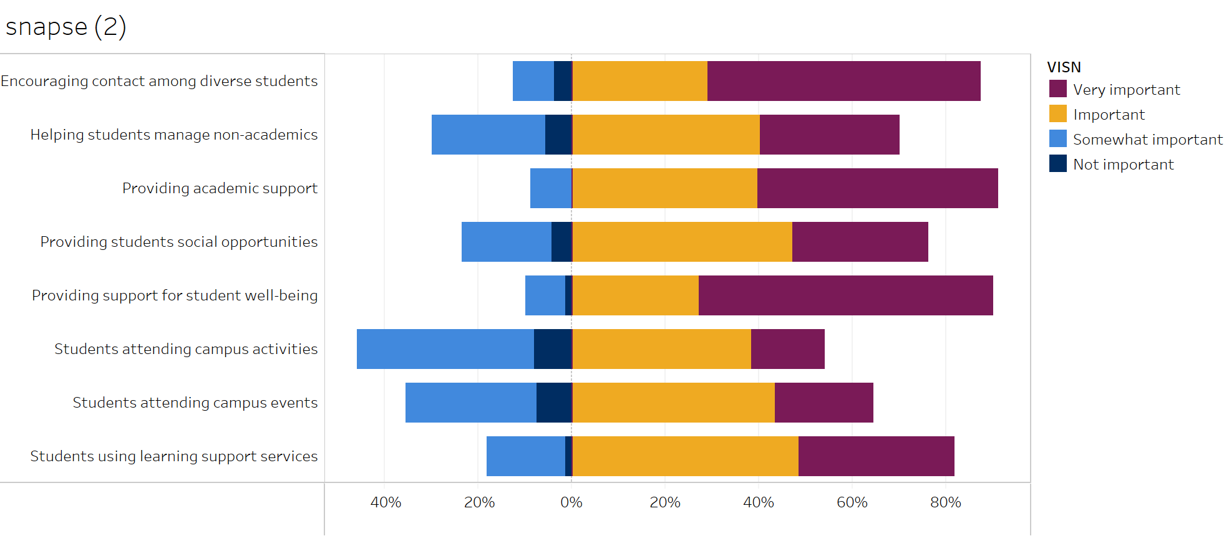
Supportive Environment
Faculty reported how important it was to them that your institution increase its emphasis on each of the following.

Slide 3
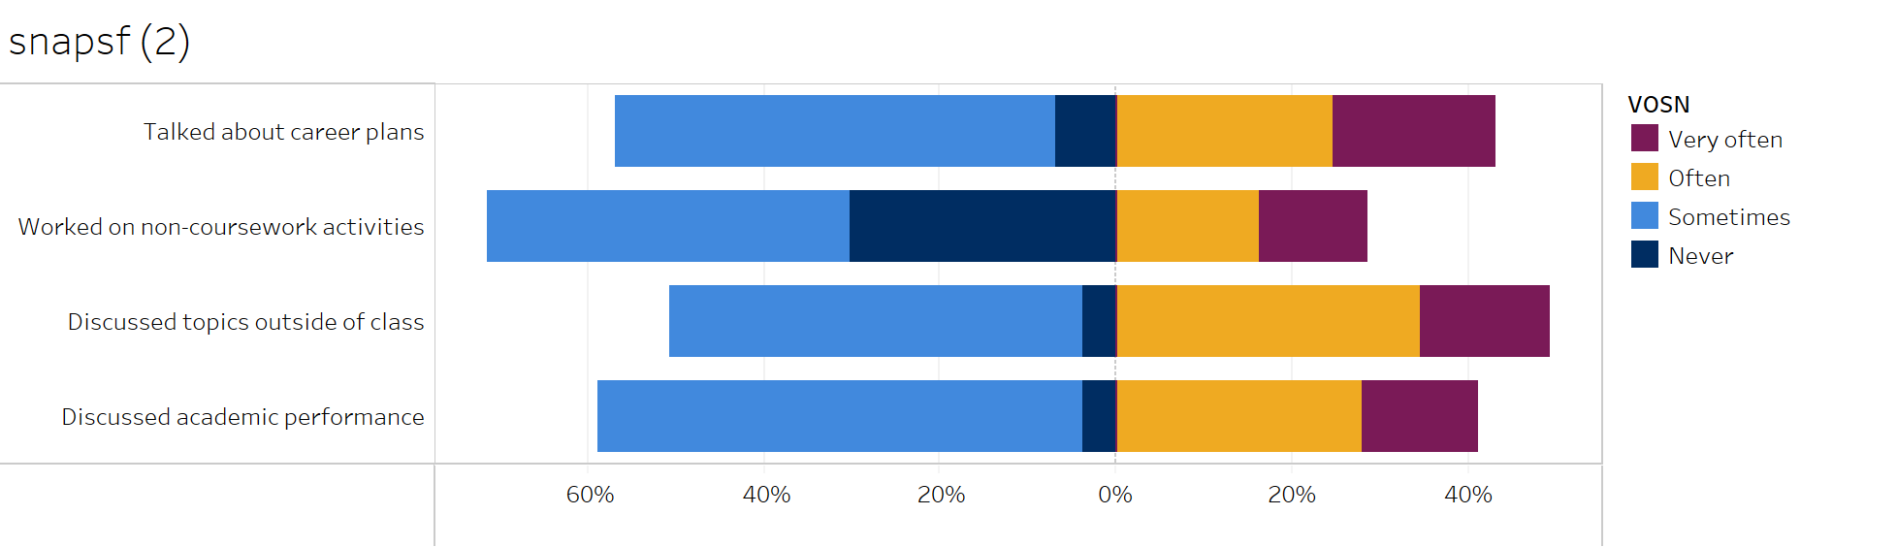
Student-Faculty Interaction
Faculty reported how often they had done each of the following with the undergraduate student they teach or advise.

Slide 4
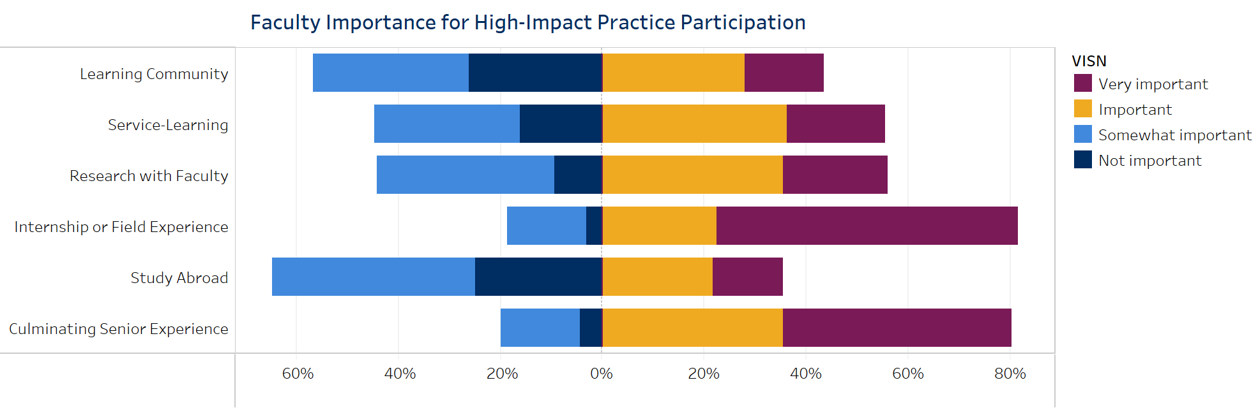
Due to their positive associations with student learning and retention, special undergraduate opportunities are designated ”high-impact.” The first figure at right displays how important faculty believe that it is for undergraduates at their institution to participate in select High-Impact Practices before they graduate.

Slide 5
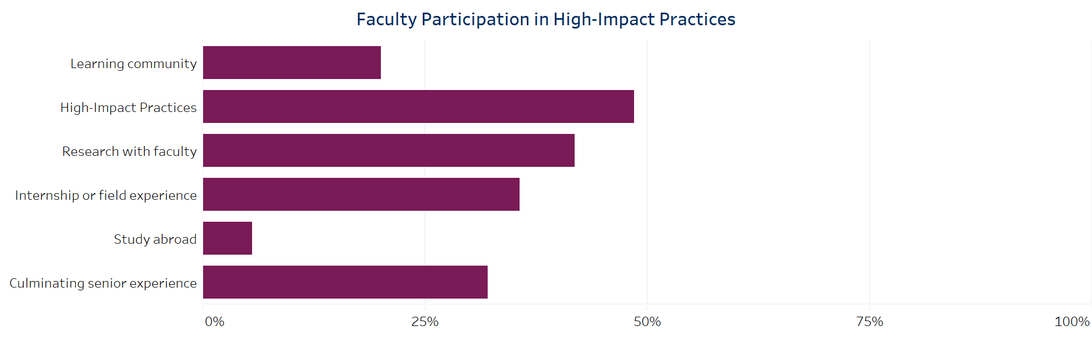
The second figure summarizes faculty participation in these selected High-Impact Practices in a typical week. For service-learning the percentage represents faculty responding that at least “some” of their courses include a service-learning component.

Slide 6
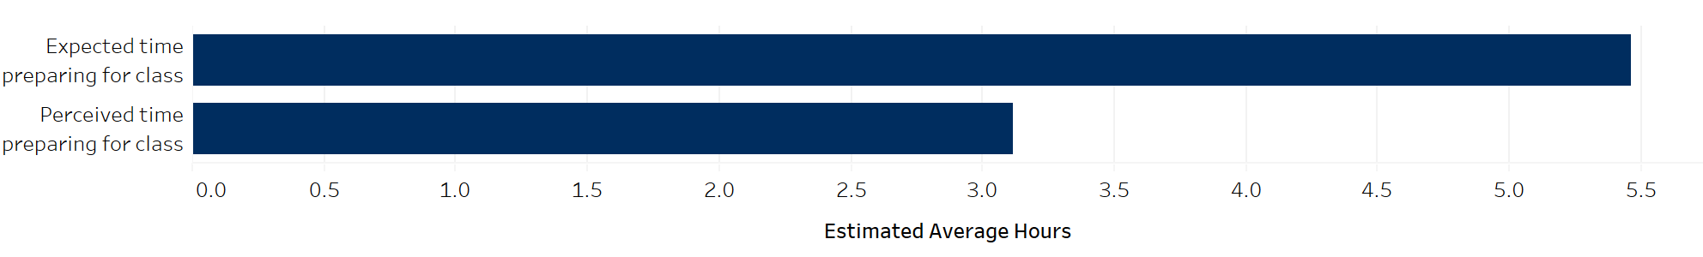
Time Spent Preparing for Class
These figures report the average weekly class preparation time faculty expected students to spend, and the average amount of time they perceived students actually spent, in the faculty’s selected course sections.

Slide 7
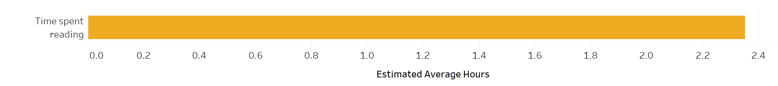
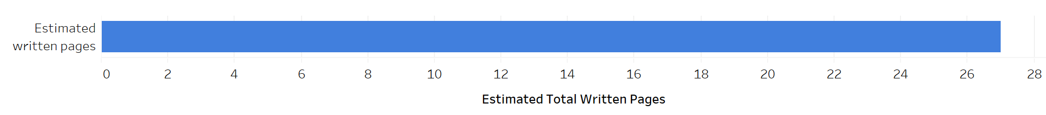
Reading and Writing
These figures summarize the number of hours faculty expected students to spend reading, and the average number of pages of assigned writing, for the faculty’s selected course sections.

Slide 8
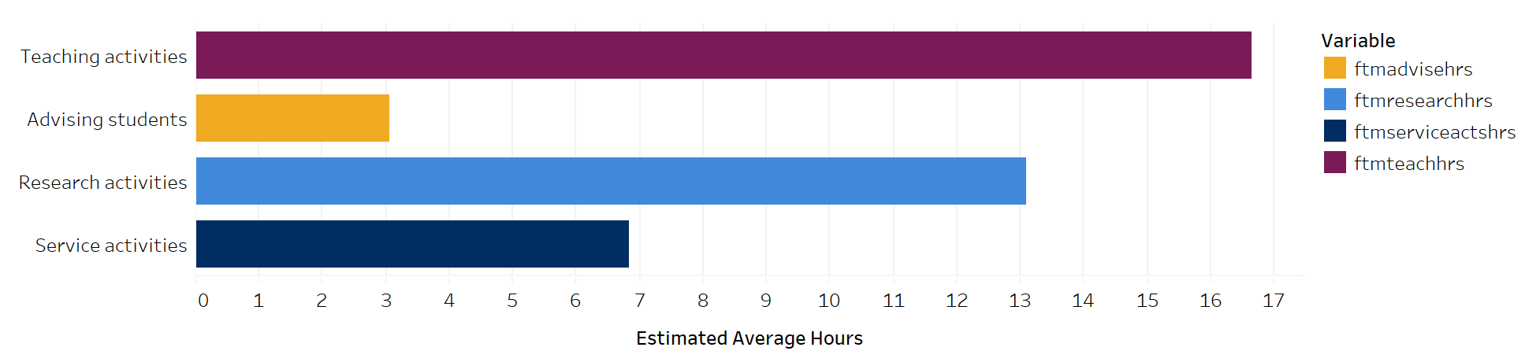
Time Allocation
This figure summarizes the number of hours that faculty spent in a typical seven-day week on teaching activities (preparing, teaching class sessions, grading, meeting with students outside of class, etc.); advising; research, creative, or scholarly activities; and service activities (committee work, administrative duties, etc.)

