Slide 1

Closing the Loop
Student Success Through Assessment
March 21, 2024
Dr. Jeffrey Means
Chair, Department of History

Slide 2


Surprising Truth About Assessment:
Assessment if useful for your department
Curriculum Development:
Student Achievement
Recruiting:
Student Perspective
Retention:
Student Satisfaction
Faculty Engagement:
Doing something that Matters

Slide 3


Undergraduate
Students shall be able to demonstrate critical thinking skills by analyzing, synthesizing, and evaluating historical information from multiple sources.
Students will develop the ability to distinguish between different culturally historical perspectives.
Students will produce well researched written work that engages with both primary sources and the secondary literature.
Students will develop an informed familiarity with multiple cultures.
Students will employ a full range of historical techniques and methods.
Students will develop an ability to convey verbally their historical knowledge.
Students will demonstrate their understanding of historical cause and effect along with their knowledge of the general chronology of human experience.
Students will develop an understanding of the concepts of historical theory and/or conceptual frameworks and be able to use these in their own studies.
Graduate
1. Demonstrate an understanding of the theories and methodologies of the discipline of History.
2. Demonstrate a critical understanding of the historiography of their field of specialization.
3. Demonstrate some understanding of comparative and/or thematic methods, approaches, and theories.
4. Conduct original research based on primary sources and construct an argument based on that research.
5. Write graduate-level expository prose and orally present their ideas at an advanced level.
Curriculum Development
Student Achievement: Match Your Learning Objectives to a Specific Class
Undergraduate: How to Measure Success
Assignments: Written, Group, Presentation
Graduate: How to Measure Success
Assignments, Feedback, Partnership

Slide 4

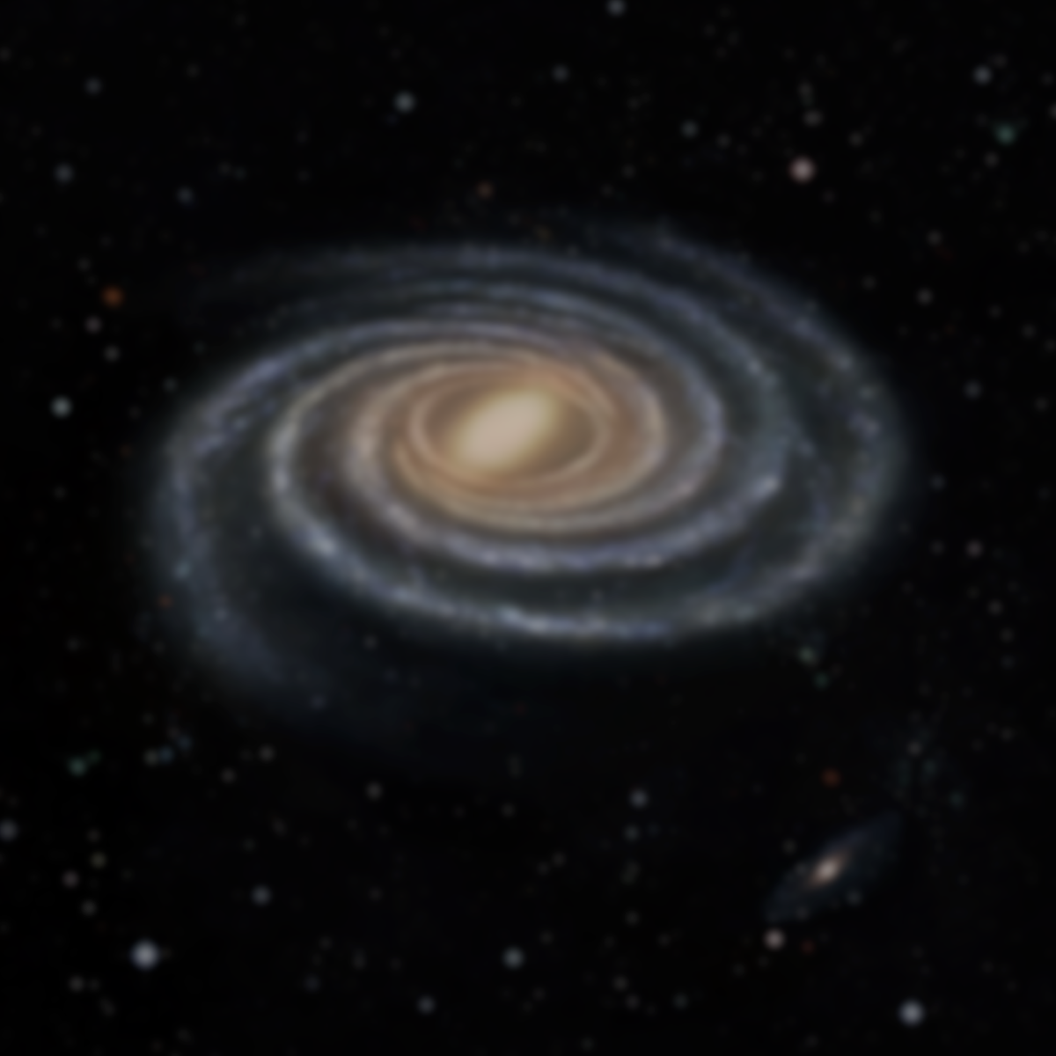
Recruiting
Student Perspective:
Great Education in History!
Built for Student Success
Universally Employable Skills
Outstanding Faculty
Engaged in Student Success
Success Draws Students to Other Resources
Research Funding, Financially Supported Study Abroad, Internships, Scholarships, Etc.

Slide 5


Retention
Student Satisfaction
Student Success is Key to Student Retention
Knowing How to Best to Foster Student Success is What
Assessment is All About
How do You Create a Departmental Framework for
Student Success?

Slide 6


Faculty Engagement
Convince Faculty That Assessment is Vital to Departmental Success
Discuss What Learning Objectives/Skills to Measure
Target Courses That Best Engage with LO’s/Skills
Discuss how Best to Measure Those Skills: Papers,
Exams, Oral Presentations
Analyze Skill Development Over the Semester
Discuss the Results as a Department and Create a
Plan to Address any Needed Changes to Departmental Curriculum
Questions?

