Slide 1

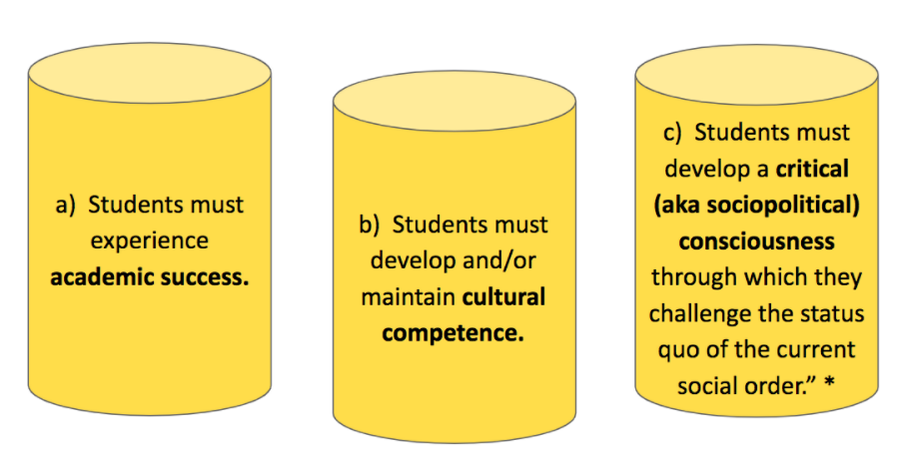
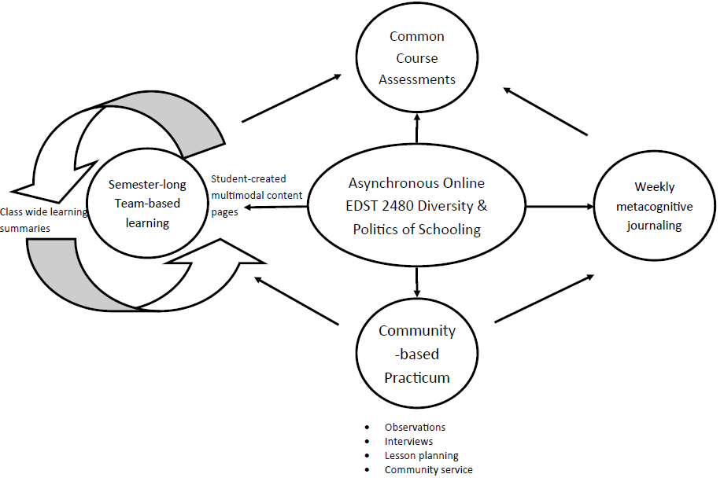
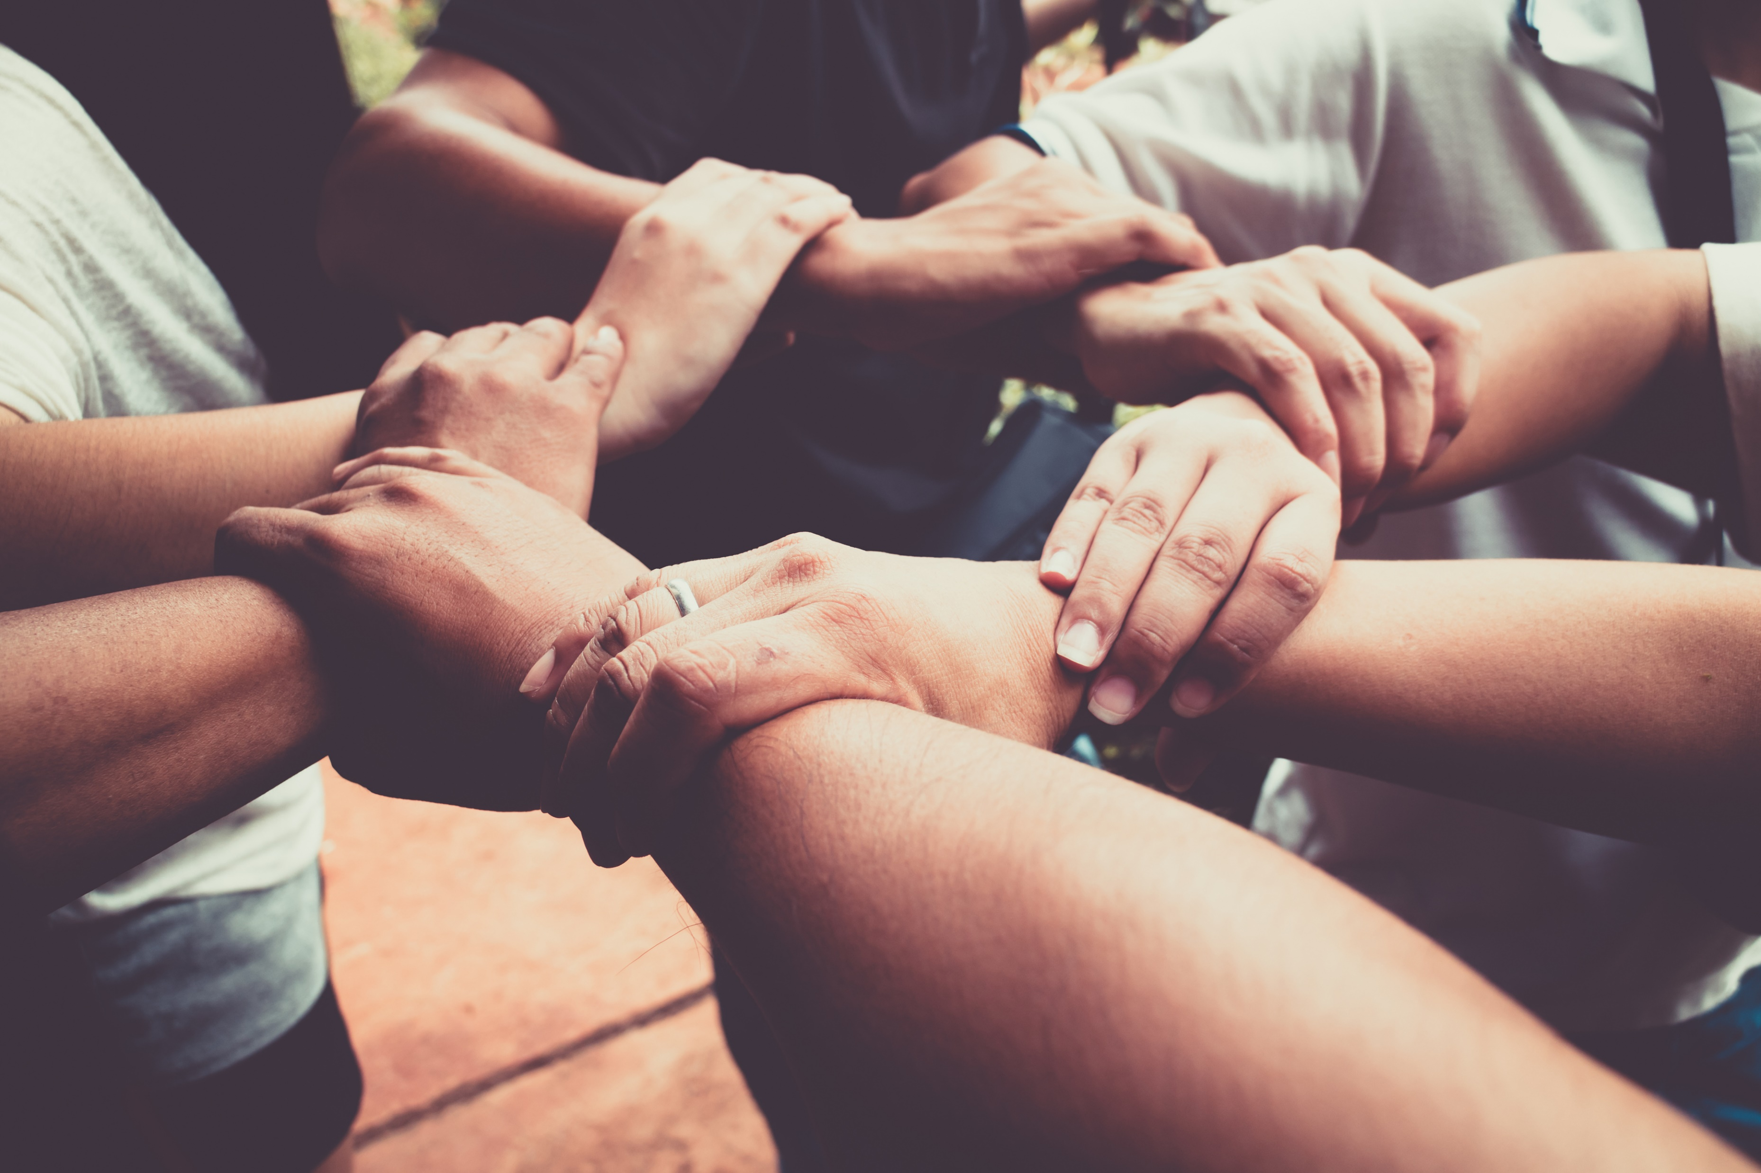
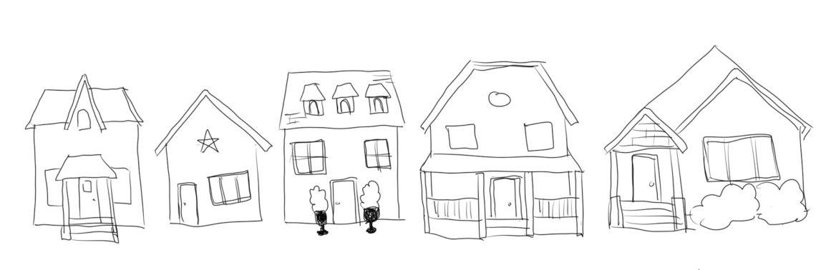
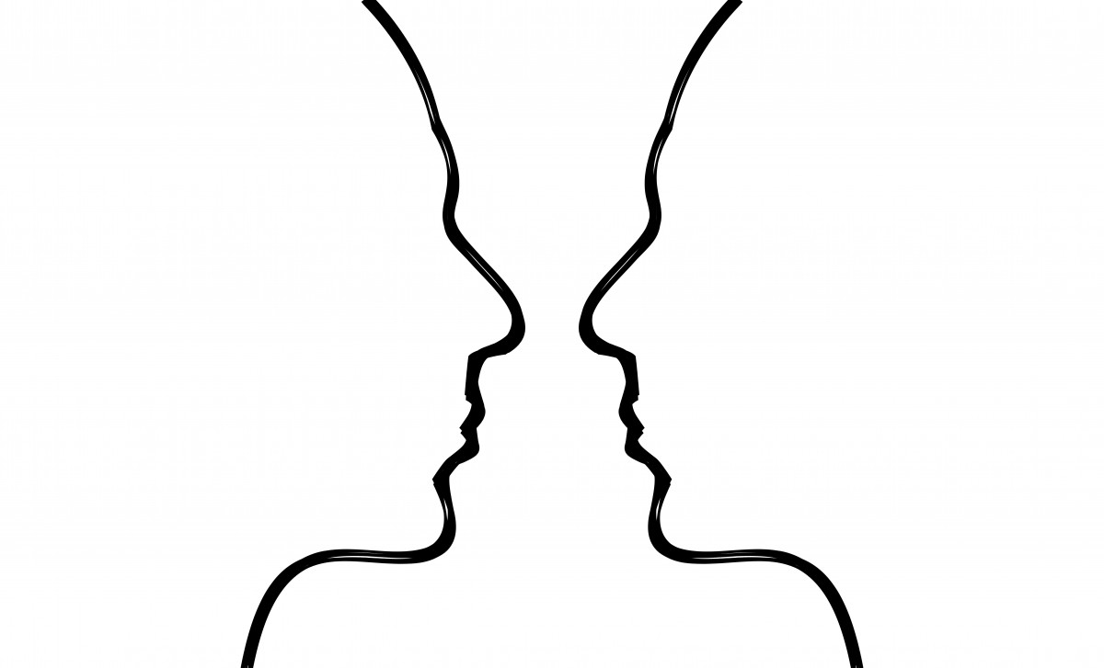
What is the source of my learning? Students’ Reflections on Preservice Teacher Diversity Education during the Pandemic
Ian Bitzes, Julia Bulick, and Rosemary McBride
Introduction
Becoming Culturally Relevant Teachers
Results: Creating Conscious Communities
The world needs:
Dr. Gloria Ladson Billings’ Three Pillars of Culturally Relevant Teaching (1994)
“I want to learn something and there's a person next to me and my phone in my hand, my first response is to ask the person before I asked the device, because yes, this could give me a guaranteed answer. Yeah, sure. But I can learn more from a person and their own perspective.”
Culturally Relevant Teachers
Formative Learning
Student Engagement
Emotionally Supportive Education
Global Thinkers
More Work to be Done to Create Sociopolitical Consciousness
How do we make critical conversations about race and diversity more open?
COVID-19 broke our ability to engage in communities outside our own.
Social media has made us fear commenting our beliefs and fear the critical because it is a form of criticizing.
We silence hard discussions because of fear and uncertainty about what to do about the other person’s response. No response is a response.
COVID-19 Adapted Learning Spring 2021
“I think of it like building worldwide citizens and worldwide students who have a broader view of things that happen outside of their hometown and outside of Wyoming.”
“We can’t make students aware of painful truths and just move on. We need to help turn their awareness into power.” – Khalilah Brann
Learning in Multimodal Team Discussions
Results: Internal & External Narratives
Next Steps: A Student & Teacher’s Perspective
 | Multimodal team discussions | Typical asynchronous discussions | Both
Pros | Build relationships in small group throughout semester | May take on multiple purposes Sourcing info Verifying content Engaging in debate | Learning from others
 | Reading student-created content and building empathy & understanding implicit biases
 |  |  | Embedded within the content in the modules
 |  | Complete thread of course learning around topic
 | Interdependent work product Student create team- assigned multimodal summaries of primary texts One student in 5 summarized group themes for the week and shared with the class
 |  |  | Build community in the class
 |  | Adds student voice
Cons | Success of the interdependent work product requires everyone in the group participating fully | Scope of posts can be too long to read | Missing authentic relationship with peers
 |  |  | Students need to choose critically engage in the discussion
 |  |  | Not a substitute for real conversation and relationships
Desire to form more authentic relationships
Not students or teachers, “we are all learners.” Flattening the hierarchy.
Adding more empathy in teaching builds better learning communities.
We are emerging from COVID-19 learning year with the hope to push the boundaries of education to better our future classrooms globally.
“It’s harder to be empathetic to things you don’t have a relationship to…”
“My learning is a product of my own narrative, but reading other’s perspective helps me build empathy?”

