Slide 1
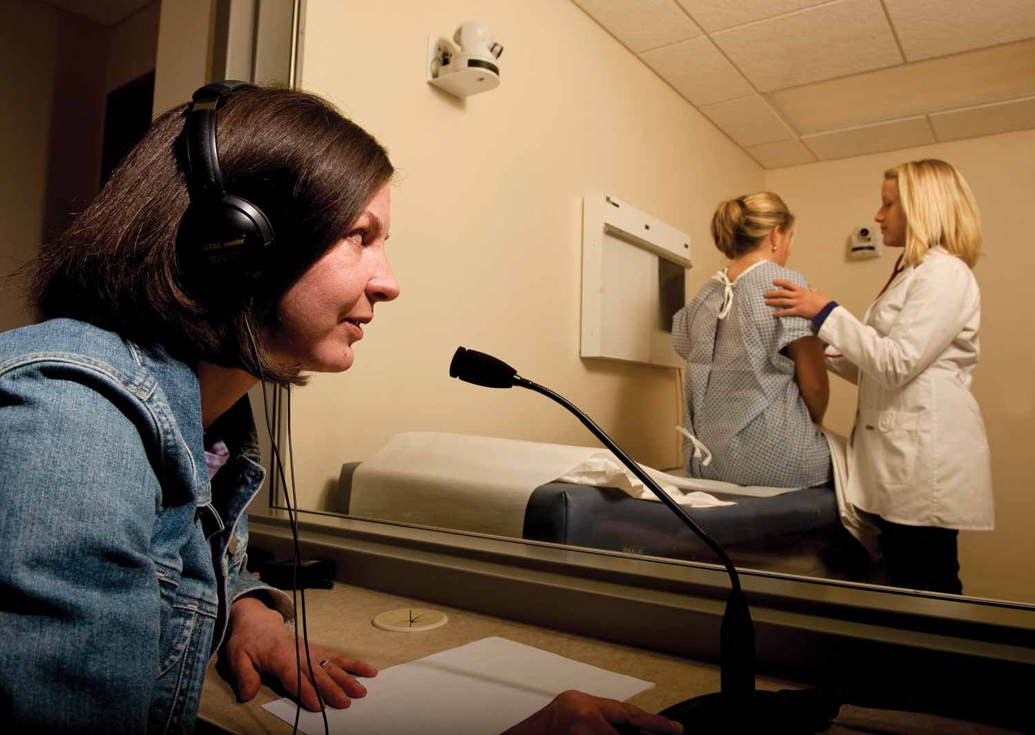


Fay W. Whitney School of Nursing
Assessment Success Story
Fay W. Whitney School of Nursing
Assessment Success Story

Slide 2
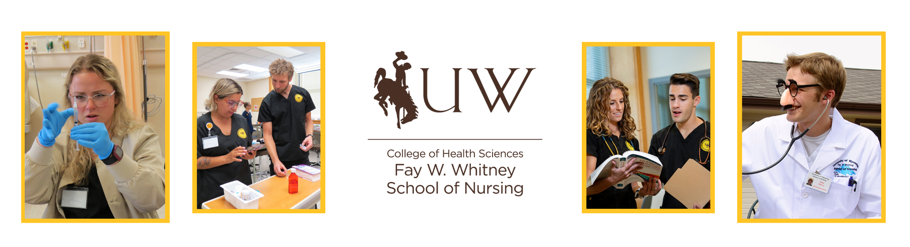



Our Journey
The Fay W. Whitney School of Nursing (FWWSON) BSN program has been nationally accredited since 1957. See our history here: Accreditation (uwyo.edu)

Slide 3


Three Nursing Undergrad Programs
Basic (Traditional)
BRAND (Accelerated)
BSN completion: ReNEW & RN-BSN
All have the same end of program outcomes

Slide 4

Stakeholders and Partners
Community partners – Hospitals, Clinics, Healthcare systems, Public Health, Schools
University – Higher Learning Commission
Wyoming Community Colleges
State Board of Nursing
Commission on Collegiate Nursing Education (CCNE)
Articulation

Slide 5
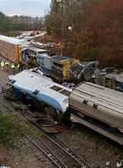
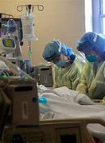

Covid Effects

Slide 6
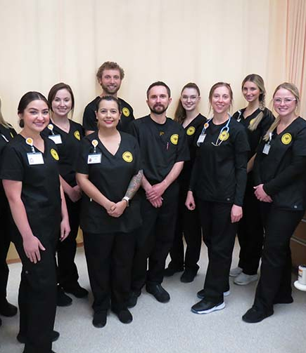
Moving Forward

Slide 7
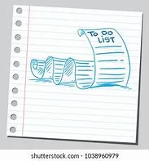
To Do:
New BSN essentials from AACN
5 year program evaluation due
5 year accreditation CIPR report due
University Assessment Initiative
Outdated curriculum maps and curriculum drift
Outdated end of program outcomes
Next GEN NCLEX

Slide 8






All of these have specific educational outcomes that need to be met
They provide guidance, but how we get there is up to us

Slide 9



Type of Curriculum
Concept Based aligned with ReNEW
Now need to fold in competency based: AACN

Slide 10

How will we do it?
Meet our team: Faculty and Staff (uwyo.edu)
Lead faculty
Each program had a lead faculty member assigned to facilitate that program’s map with primary faculty who taught in that program.
Committee work-Undergrad C&E, Clinical, Admissions, Testing

Slide 11
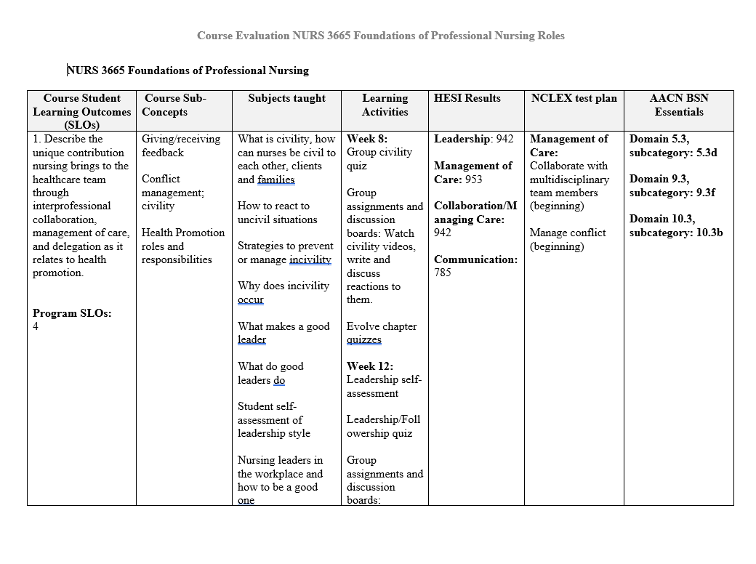
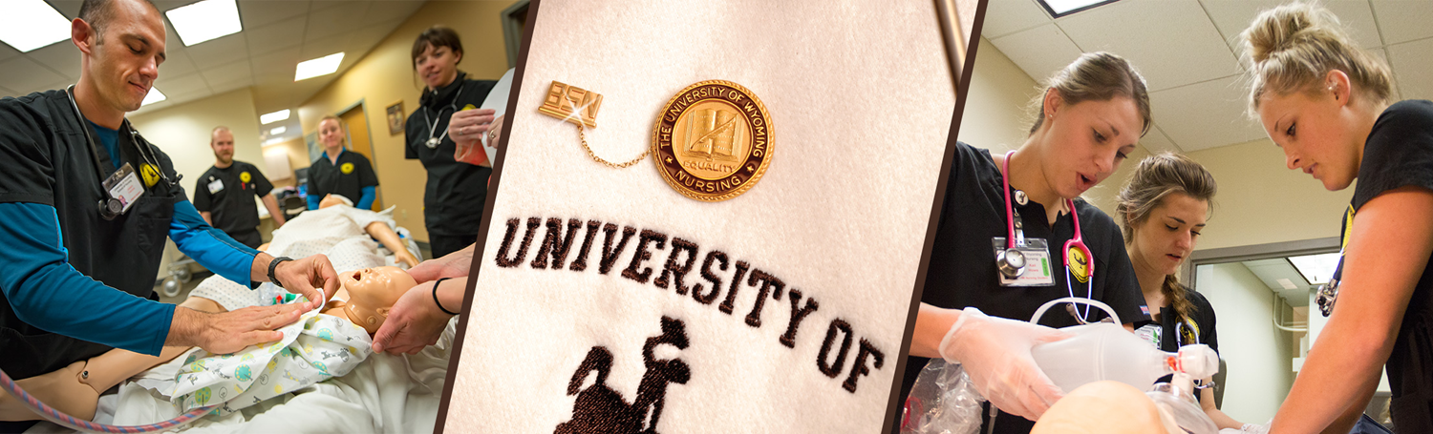
And so it began…

Slide 12
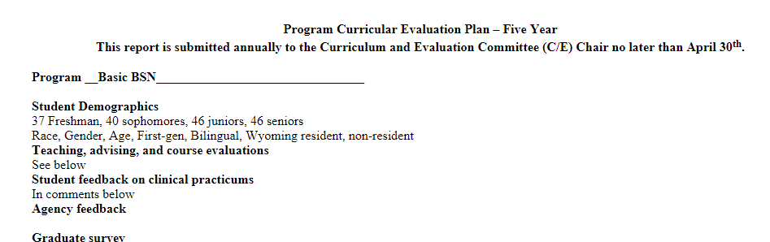
Program evaluations

Slide 13
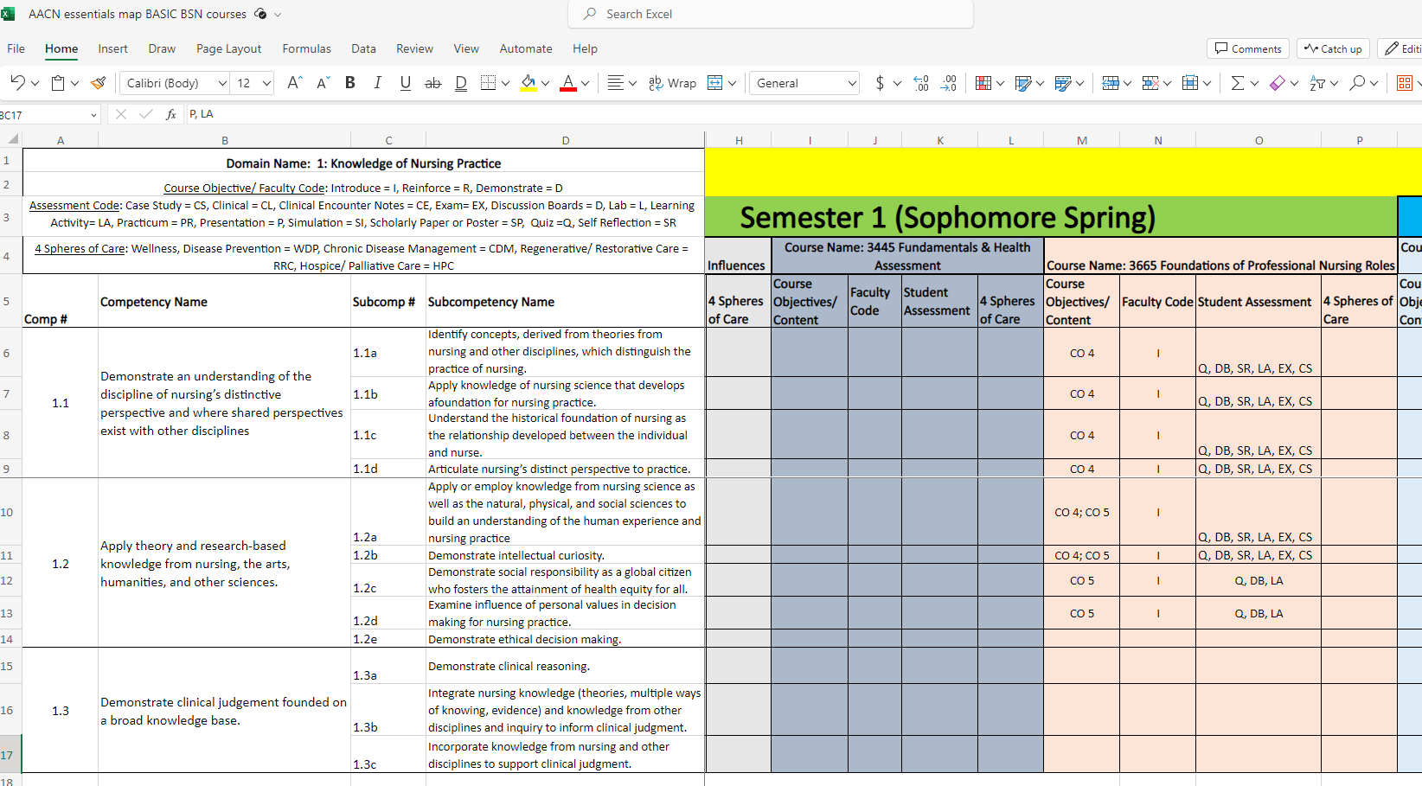
Essentials mapping

Slide 14
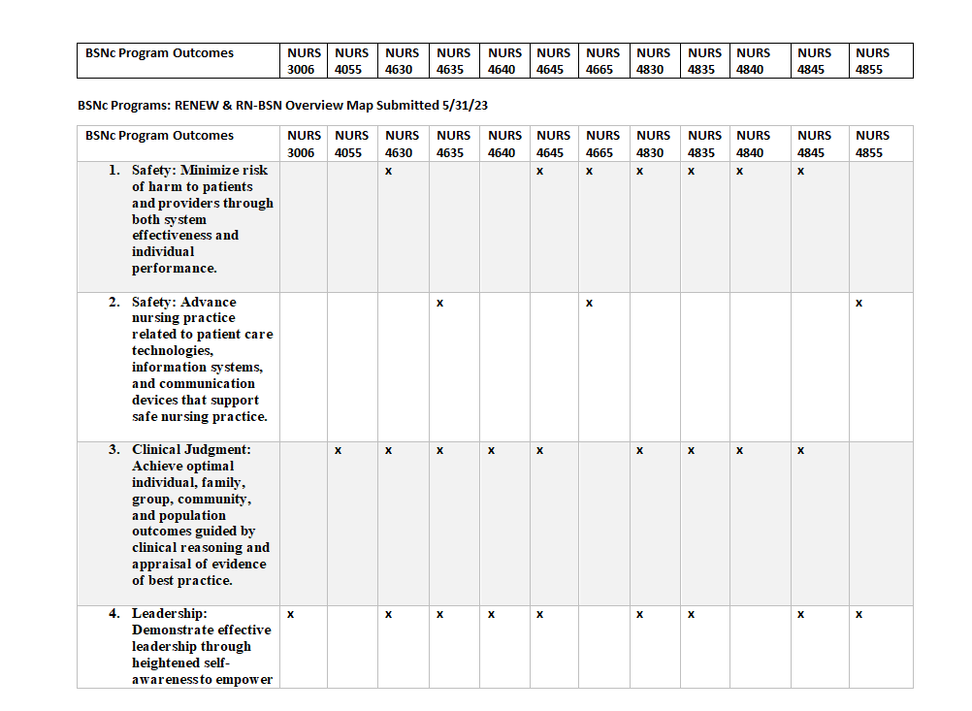
UW mapping

Slide 15
Previous BSN Outcomes

Slide 16

New Outcomes
Employ evidence-based information and communication technologies to deliver safe nursing care. (Domains 4, 5, & 8; CCC: Safety, Clinical Judgment, Patient centeredness)
Integrate knowledge from nursing and other disciplines to inform clinical judgement. (Domain 1 & 2; CCC: Clinical Judgement, Health Promotion, Patient Centeredness)
Generate evidence-based solutions to system level problems across multiple healthcare settings. (Domain 7; CCC: Leadership, Clinical Judgment, Safety)
Coordinate person-centered care for optimal health and wellness. (Domain 2; CCC: Patient centered care & Health Promotion)
Demonstrate professional behaviors that align with nursing standards and scope of practice. (Domain 9; CCC: Professionalism)
Implement effective partnerships, policy, and advocacy across diverse populations. (Domains 3 & 6; CCC: Leadership & Health Promotion)
Establish self-reflective behaviors to foster personal well-being, lifelong learning and leadership traits. (Domain 10; CCC: Leadership, Professionalism, and Health Promotion)

Slide 17
Now what?
Backward curricular design to address curricular gaps, refine course outcomes and overall curriculum to meet our new outcomes.
Focus on scaffolding and assessment.

Slide 18

Thank You!

Slide 19

UWYO.EDU

