Slide 1
Measuring Changes in Students’ Perception of Active Learning and Feelings of Inclusion
Original Lilly Conference on College Teaching
Kerry Sondgeroth, Michele Larson, Rachel Watson
University of Wyoming
2019

Slide 2
Students’ Perception of Active Learning
Coding Activity
  Form small groups
  Each group will receive a set of student responses to “code”, tape and a large white sheet of paper
  Your task is to group the responses based on the following:
  +/- Active Learning exposure
  Was active learning experience positive/negative/neutral
  Use tape and the white sheets provided to group your responses
  5. Take 1-2 minutes to discuss what the different colors of paper may represent
ACTIVE LEARNING EXPOSURE
YES
NO
NEGATIVE
POSITIVE
NEUTRAL

Slide 3
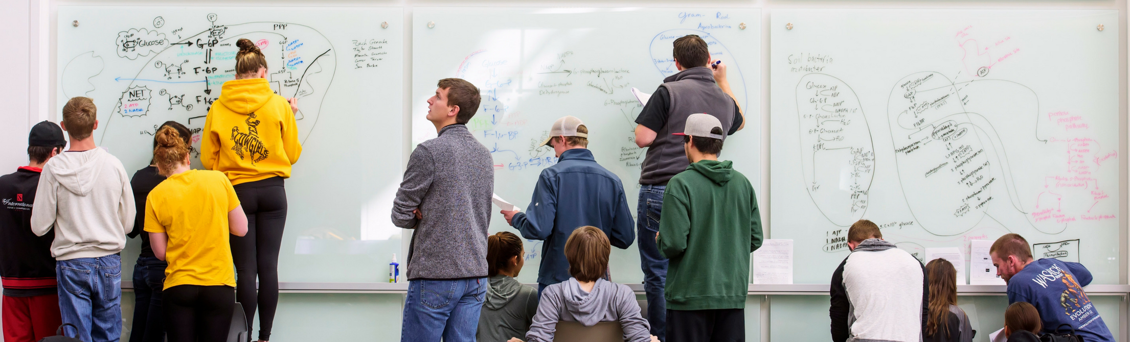
Active Learning Survey
Offered to faculty members who had participated in a year-long educational development program called the Learning Actively Mentoring Program (LAMP)
Developed in collaboration with trained faculty
Measured
  Students’ experience with active learning and how these experiences impacted their attitudes, feelings behaviors and sense of inclusion
  Demographics (open-ended)
Administered using a Google form

Slide 4
Coding Methods
Students were assigned a number so their anonymity was preserved
Response to a single question was coded by 3 faculty members
PRE-SEMESTER SURVEY QUESTION:
Tell us about your experience with active learning prior to this semester.
POST-SEMESTER SURVEY QUESTION:
What was your experience with active learning during this semester?

Slide 5
Results of Coding
6 Instructors participated in both the pre/post Active Learning Survey
Results from students with pre and/or post responses included
Pathogenic Microbiology 37
Life Science
12
Geography
57
Active Learning Survey
Aerospace Science
8
Food Science
3
Honors Colloquium
9

Slide 6
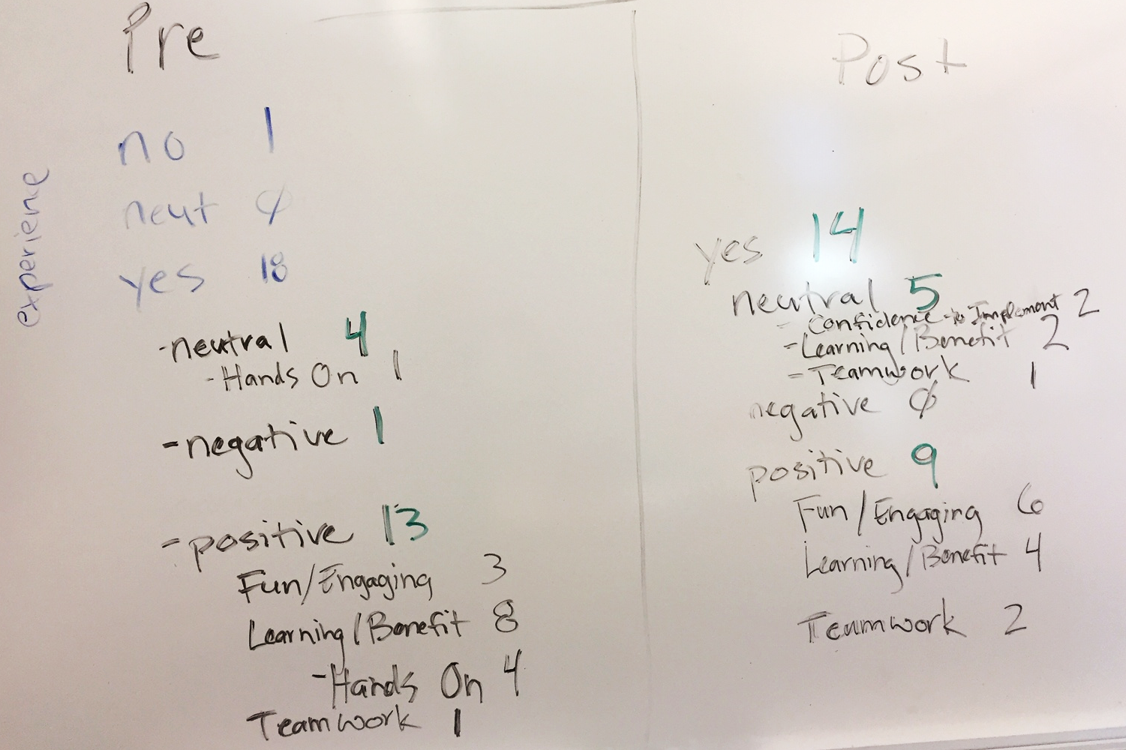
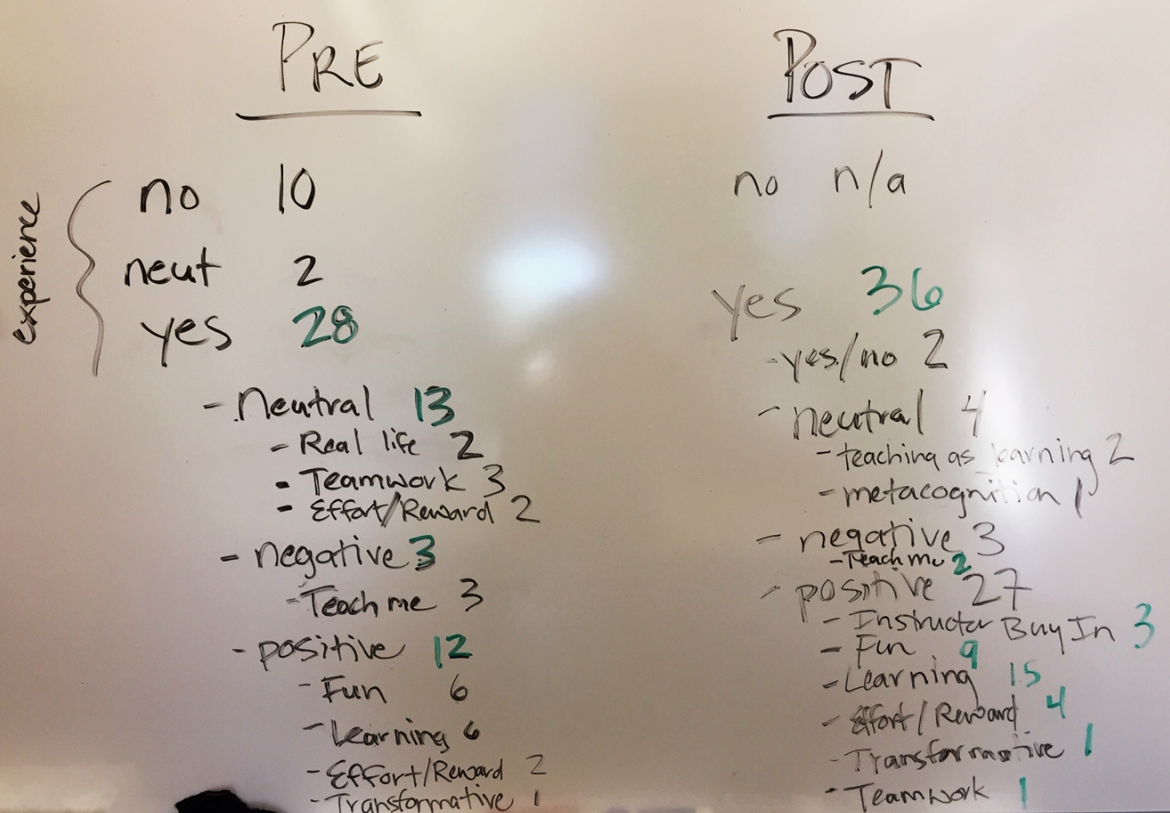
Examples of Raw Coding Data
LIFE SCIENCE FOR NON-MAJORS
PATHOGENIC MICROBIOLOGY

Slide 7
Results of Coding
45% increase in # of students
with positive feelings about active learning

Slide 8
Emerging Themes with Active Learning
TEAMWORK
ENGAGEMENT
METACOGNITION
**Data from 14 Likert-type scale questions of a single course, 37 students

Slide 9
Assessing Inclusivity

Slide 10
Likert-type Scale Questions for Inclusivity
Utilized the Active Learning Survey
Only included students with both pre and post survey responses
7 questions:
I can equally participate in a team
I can study with peers from my team
I am afraid to ask questions when my team works together
I can contribute to team discussions
My opinion has been valued in team discussions
I am treated with respect by my instructor
I am treated with respect by my group members
I enjoy activities when they involve learning in a group

Slide 11
Likert-type Scale Questions for Inclusivity
5 possible responses, maximum score of 40
Strongly agree → Agree → Neutral → Disagree → Strongly disagree
(5) (4) (3) (2) (1)
Total score converted to a percentage
I can equally participate in a team
I can study with peers from my team
*I am afraid to ask questions when my team works together
I can contribute to team discussions
My opinion has been valued in team discussions
I am treated with respect by my instructor
I am treated with respect by my group members
I enjoy activities when they involve learning in a group

Slide 12
Inclusivity Increased in
UW Active Learning Classrooms Over 1 Semester
OVER 4% INCREASE IN INCLUSIVITY

Slide 13
Is there more inclusivity of marginalized groups with active learning?

Slide 14
Demographic Data
Utilized the Active Learning Survey
Questions for
  Race/Ethnicity
  Biological Sex
  *Gender Identity
  Sexuality
  Disability (visible or invisible)
  Transfer student
Back to the Active Learning Activity: what the colored paper represents

Slide 15
Demographic Data
Utilized the Active Learning Survey
Questions regarding:
  Race/Ethnicity
  Biological Sex
  *Gender Identity
  Sexuality
  Disability (visible or invisible)
  Transfer student
Back to the Active Learning Activity……what the colored paper represents
MALE
PRE
MALE
POST
FEMALE
PRE
FEMALE
POST
MINORITY
PRE
MINORITY
POST
NON-HETERO
PRE
NON-HETERO
POST

Slide 16
Demographics and Inclusivity
OVER 6% INCREASE IN INCLUSIVITY
IN FEMALES
OVER 3% INCREASE IN INCLUSIVITY
REGARDLESS OF RACE

Slide 17
Demographics and Inclusivity
OVER 4% INCREASE IN INCLUSIVITY
REGARDLESS OF SEXUALITY
OVER 7% INCREASE IN INCLUSIVITY
REGARDLESS OF DISABILITY

Slide 18
Demographics and Inclusivity
NEARLY 6% INCREASE IN INCLUSIVITY
IF NON-TRANSFER STUDENT
NEARLY 2.5% DECREASE IN INCLUSIVITY
IF A TRANSFER STUDENT???

Slide 19
Summary
Over the course of 1 semester, using 6 courses across multiple disciplines:
  Approximately 100 students for both pre and post response to active learning exposure
    Over 45% increase in number of students with positive feelings toward active learning
  Approximately 120 students for both pre and post Likert-type scale questions
    4% overall increase in inclusivity based on answers to Likert-type scale questions
    6% increase if self-identified as female or a non-transfer student
The Active Learning Survey is available for you and your courses when you are ready!

Slide 20
Acknowledgements
Rachel Watson
SI² and LAMP fellowship program
Educator Learning Community “Leaving the Light On”
Funding
  UW Science Initiative

