Slide 1


Assessment with a Purpose
Katelyn A. Golladay, Ph.D.
Jamie a. Snyder Ph.D.

Slide 2
Importance of Assessment
Create: Define Student Learning Objectives
Plan: Establish a Plan
Measure: Collect Data
Analyze: Conclusions from findings
Apply: Identify and Implement Changes

Slide 3
Background
Department of Criminal Justice and Sociology
Merged into a single department in 2017
Operate as two separate programs
Separate SLOs and goals
Department and program level mission statements
A lot of overlapping students
Notes:
History/background of our department:
- Merged into a single department in 2017
- Work as two separate programs with separate SLOs and goals
- Will mainly be talking about the CJ side of the department through this presentation

Slide 4
Where we started…
How did we assess?
Pre- and Post-tests
Issues in policing
Criminal courts and processes
Correctional theory and practice
Results?
What did we assess?
Spreadsheets
Improvement over the course of the semester
16 questions that measure core criminal justice principals
Only measuring some SLOs
Notes:
What did our assessment look like?
- What did it tell us?
- How did we assess?
- What did we do with assessment results?

Slide 5
Assessment Culture
Initial faculty concerns:
  Extra workload
  Constant change at the university level
  Why is assessment important?
  Lack of input within their own classes and assessment assignments
  Will assessment require assignment changes and added workload in the classroom?
Discussion: What are some things people would say about assessment in your department?
Notes:
What are some things you think people would say about assessment in your department?
State things people have said about assessment in our department.
Initial faculty concerns:
Extra work load
Constant change at the university level
Why assessment is important?
Will they need to change assignments or added workload in the classroom?
Lack of input within their own classes in terms of assessment assignments

Slide 6
Goals of Assessment
General goals for assessment in our department:
  Measure what our students are learning
  What knowledge do we want our students to leave with?
  What skills will help our students be successful in their future careers?
  Are students leaving with the skills and knowledge we want them to have/think we are providing them?
  Ensuring alignment with mission, SLOs, and assessment
Discussion: What other goals are important in your department?
Notes:
General goals of our assessment process
Measure what our students are learning
Are students leaving with the skills and knowledge we want/think they are?
What skills will help our students be successful in their future careers?
What do we want our students to leave with?

Slide 7
Goals of Assessment
Eight core classes:
  Intro to Criminal Justice
  Criminal Law
  Criminology
  Research Methods
  Criminal Courts and Processes
  Correctional Theory and Practice
  Issues in Policing
  Ethics
New mission statement:
The Criminal Justice program is committed to providing its students with a comprehensive education, including historical and contemporary topics across the field of criminal justice. We strive to provide a high-quality education to students that will inspire them to become critical thinkers, effective communicators, and lifelong consumers of knowledge. Students will be exposed to diverse perspectives, research, and learning opportunities in criminal justice to prepare them for a variety of professions in the public, private, non-profit, research, service, and academic settings.
Notes:
Our curriculum and how the goals would fit in with our curriculum
What our program looks like
*** I added our new mission statement in here. I am not sure if it needs its own, but I thought it could fit here too

Slide 8
Student Learning Objectives - Old
Students will acquire an accurate knowledge base relating to crime in modern society to include the elements of major crime, the extent of crime, and its distribution in society.
Students will possess a broad historical and contemporary understanding of the institutions that make up our criminal justice system, the interconnectedness of these institutions, and the related issues of diversity and discrimination.
Students will develop an understanding of the major legal principles that serve as the foundation for criminal law and the processing of individuals through the justice system, as well as the difficult situations and ethical dilemmas they will face in the criminal justice field.
Students will understand and apply basic concepts and theoretical perspectives in criminology and criminal justice.
Students will possess the ability to access, comprehend, and critically examine research and policy relevant to the field of criminal justice and criminology, including understanding basic research methodology.
Discussion: What do you notice about these SLOs?
Notes:
Old vs. new objectives (possibly ask audience to evaluate/critique old SLOs)

Slide 9
Student Learning Objectives - New
Students will identify and describe major types of crime, the extent of crime, and its distribution in society.
Students will describe the broad historical and contemporary understanding of criminal justice systems, the interconnectedness of policing, courts, and corrections.
Students will recognize and apply major legal principles that serve as the foundation for civil and criminal law in the justice system.
Students will describe basic concepts and evaluate theoretical perspectives in criminology and criminal justice.
Students will demonstrate the ability to comprehend and critically assess research and policy relevant to the field of criminal justice and criminology.
Students will critically examine major ethical dilemmas facing the criminal justice field and the related issues of diversity and discrimination.

Slide 10
Curriculum & Assessment Mapping
Understand which SLOs are addressed in each of our core classes
  Level of mastery : introduced, developed, mastered
Are all our SLOs being covered in our core classes?
Does each core class fulfill at least one SLO?
What assignments are our faculty already assigning that can be used to assess the SLOs?
How are they grading these assessments?
  Rubrics, multiple choice exams, etc.
Where are there gaps?

Slide 11
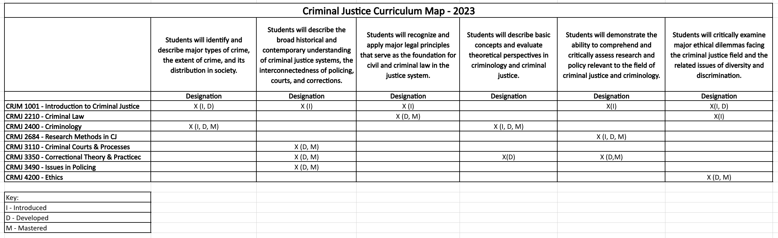

Slide 12
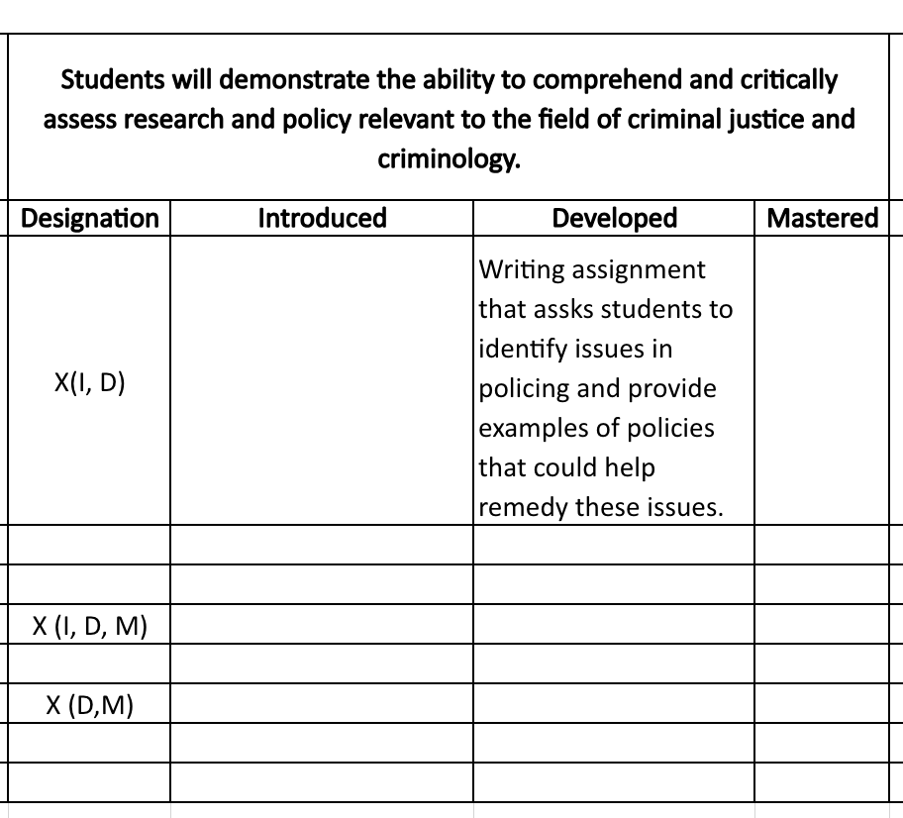
Assessment Map
Matching mastery levels for each course to assignments faculty are already using
Are these assignments appropriate for assessment?
Limiting extra workload for faculty and assessment coordinator
Reference for future timeline of assessment within our department
Notes:
Assessment map example

Slide 13
Assessment Culture
Skepticism to acceptance
Understanding of importance
Some lingering questions
What comes next?
Notes:
Post culture discussions

Slide 14
Challenges
Overall Assessment
Faculty
Resources
Where do we start?
What classes do we assess?
Balance between too little and too much assessment
Balancing input from. faculty
Faculty "buy-in"
Assessing core courses taught by adjuncts
Lack of resources
Faculty workload
Understanding assessment at the university level
Notes:
These are challenges we faced despite being a functional non-toxic department. These challenges may be even greater with a more “toxic” department. It is important to consider the culture/nature of your department when starting this process.
Where to start.
Balancing the input from faculty with the work of the assessment committee.
Getting buy in from faculty
Lack of resources (faculty work load)
Assessing core classes taught by adjuncts, can we force adjuncts to assess
How do we choose which classes to assess
Balancing between too little and too much assessment
Picking the right assessments for each course

Slide 15
Implementation
Pilot in Fall of 2023
Intro to Criminal Justice
Writing assignment
What we've been doing
Successes
Challenges
Limited extra workload on faculty
Use of rubrics
Consistency of evaluation
Do we evaluate “developed” and “mastery” classes?
Notes:
What have we been doing so far, what has worked, what hasn’t worked
Pilot study
Using grading rubrics
Getting started
Retaining information for SLOs assessed in freshman classes versus senior classes
Online vs in person classes

Slide 16
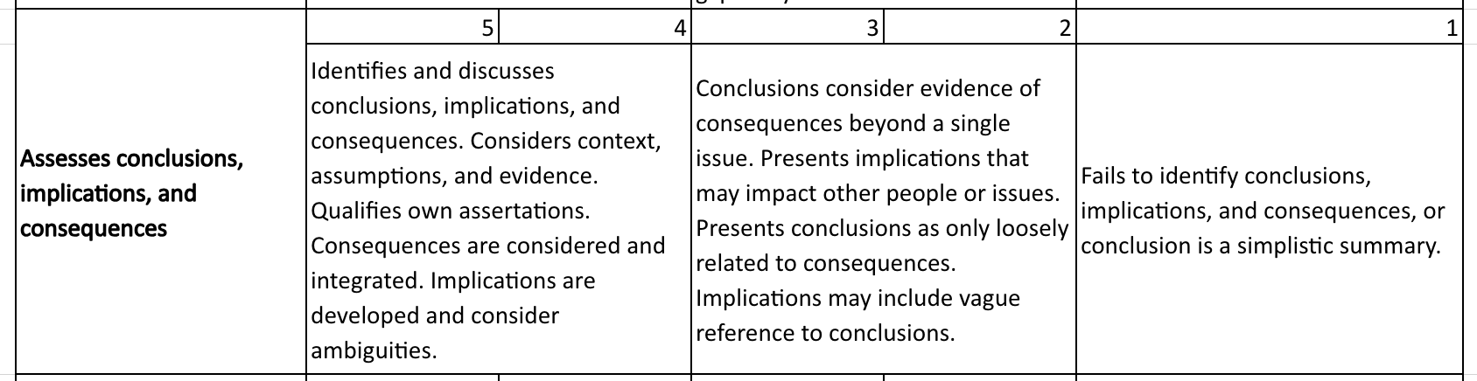
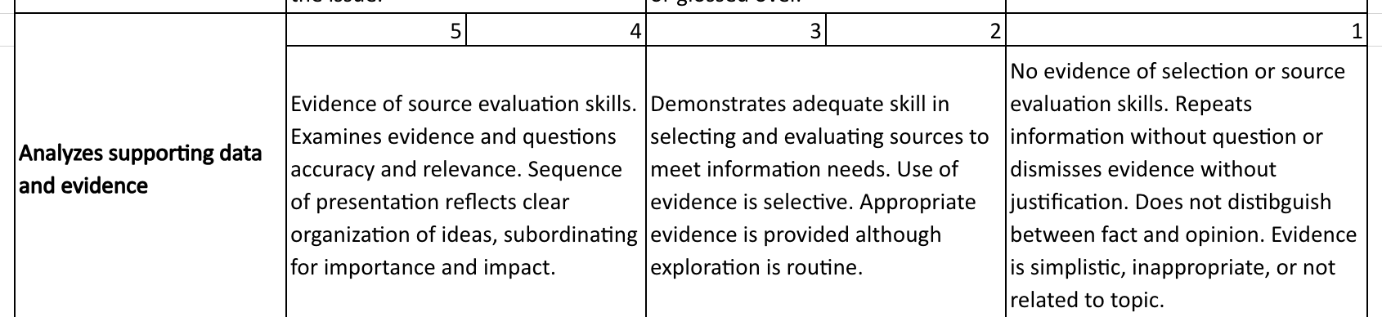
 |  | Percentage
Mastering | 62 | 62.6
Developing | 30 | 30.3
Emerging | 1 | 1.0
Not Present | 6 | 6.1
 |  | Percent
Mastering | 73 | 73.7
Developing | 20 | 20.2
Emerging | 1 | 1.0
Not Present | 5 | 5.1

Slide 17
Future Timeline
Develop a rotation for course assessment
Continue to assess what is working and what is not
Using data to inform change

Slide 18
Questions/Discussion

