Slide 1


Utilizing WyoCourses for Course-Level Assessment
UW Assessment Academy
Tawfik Elshehabi, PhD, PE
Friday, Dec. 7, 2023

Slide 2
Agenda
1- From Curriculum Mapping to Outcomes and Indicators
2- Backward Design of Teaching and Learning Activities
3- Wyocourses Assessment and Learning Mastery
2

Slide 3
Why Assessment?
Diversity, Equity, And Inclusion
Assessment
Teaching
Learning
Since all my students received an "A," learning outcomes have been met, is there a need for further assessment?

Slide 4
Definitions
Accreditation Board for Engineering and Technology [ABET]
Program Education Objectives: are broad statements that describe what graduates are expected to attain within a few years after graduation. Program educational objectives are based on the needs of the program’s constituencies.
Student Outcomes: describe what students are expected to know and be able to do by the time of graduation [summative assessment]. These relate to the knowledge, skills, and behaviors that students acquire as they progress through the program.
Assessment: one or more processes that identify, collect, and prepare data to evaluate the attainment of student outcomes. Effective assessment uses relevant direct, indirect, quantitative and qualitative measures as appropriate to the outcome being measured.
Evaluation: one or more processes for interpreting the data and evidence accumulated through assessment processes. Evaluation determines the extent to which student outcomes are being attained. Evaluation results in decisions and actions regarding program improvement.

Slide 5
General and Long-term
Institutional/College/Program Mission
ABET Student Outcomes (SOs)
Performance Indicators (PIs)
Course Learning Objectives (CLOs)
Module Learning Outcomes (MLOs)
Program Educational Objectives (PEOs)
Institution &
Program
Objectives & Outcomes Alignment
Curriculum
Course
Specific and Short-term
5

Slide 6
1- Energy Engineering
Program Curriculum Mapping

Slide 7

UW Assessment Academy
Discussion
Given 5 minutes, map student outcome (e) and its specific performance indicators (e1-e3) with the relevant course(s).

Slide 8
Program/Students Outcomes | 1. EE 200: Intro to Energy Engineering | 2. EE 220: Thermo-dynamics | 3. EE 240: Fluid Mechanics | 4. EE 300: Renewable Energy Systems | 5. EE 340: Non-Renewable Energy | 6. EE 360: Control Systems Lab | 7. EE 380: Energy Storage and Management | 8. EE 400: Environmental Engineering | 9. EE 420 Machine Learning in Energy | 10. EE 440: Engineering Ethics | 11. EE 460: Capstone Design
(a) An ability to apply knowledge of mathematics, science, and engineering
(b) An ability to design and conduct experiments, as well as to analyze and interpret data
(c) An ability to design a system, component, or process to meet desired needs
(d) An ability to function on multidisciplinary teams
(e) An understanding of professional and ethical responsibility e1. Identification of Ethical Dilemmas e2. Discussion of Professional Responsibilities e3. Recommendation for Ethical Action

Slide 9
Energy Engineering Courses
EE 200: Intro to Energy Engineering: Focuses on fundamental principles of energy, types of energy resources, and basic calculations, introducing engineering design, integrating societal, environmental, and ethical considerations.
EE 220: Thermodynamics: Covers the laws of thermodynamics, energy conversion, and systems analysis. Critical for understanding energy transformations.
EE 240: Fluid Mechanics: Covers the behavior of fluids under various conditions and their applications in energy systems. Enables design and experimentation.
EE 300: Renewable Energy Systems: Explores solar, wind, hydro, and other renewable energy systems, including design and implementation.
EE 340: Non-Renewable Energy Systems: Focuses on fossil fuels, nuclear energy, and other non-renewable sources, emphasizing sustainable practices.
EE 360: Control Systems Lab: Teaches principles of automatic control systems and their applications in energy engineering.
EE380: Energy Storage and Management: Centers on methods and technologies for storing energy and managing energy systems efficiently.
EE 400: Environmental Engineering: Examines the environmental impact of energy systems and offers strategies for mitigation, integrating societal, environmental, and ethical considerations..
EE 420: Machine Learning in Energy: Introduces machine learning algorithms for optimizing energy systems and automating processes.
EE 440: Engineering Ethics: Focuses on ethical considerations in engineering practice, including energy systems.
EE 460 Capstone Design: The culmination of the undergraduate student experience, creating a blueprint for innovation in engineering design, integrating societal, environmental, and ethical considerations.

Slide 10
2- Backward Design of Teaching and Learning Activities

Slide 11
1-Assessment Source
Given the mapped student outcomes/performance indicators, design a project, assignment, discussion, or survey
2-Assessment Method
Design a direct (rubric) or indirect (reflection) or both to accurately and specifically assess.
3- Teaching & Learning Activates
Instruct and engage students in the planned learning activities, publish the assignment, and collect evidence of student learning.
4- Assessment and Evaluation
Assess student attainment of outcomes and indicators. Set an action-trigger threshold, e.g., 80% meet and exceed expectations.
5- Continuous Improvement
Engage stakeholders to revise: curriculum mapping, assessment sources and methods, teaching and learning activities, threshold, course offerings, or prereqs, etc.
Backward Design
and Alignment
“Start with the end in mind”
11

Slide 12
Ethics: Teaching Learning Activities
Pre and post-module (knowledge) surveys and reflections
Reflection assignment on short and long-term benefits of applying the Daniels Fund Ethics Initiative (DFEI) principles
In-class individual reflection and group discussion (pair-share) on DFEI ethics principles
Professional Engineers guest speakers
Creating an ethical decision-making framework
Wyocourses discussion thread of real-world scenarios
Midterm research paper on engineering ethics
Wyocourses quizzes and assignments
Midterm and final exam questions
What else could we use for teaching, learning, and assessing ethics?
12

Slide 13
National Society of Professional Engineers
Code of Ethics for Engineers
Preamble: Engineers are expected to exhibit the highest standards of honesty and integrity. Engineering practice require honesty, impartiality, fairness, and equity, and must be dedicated to the protection of the public health, safety, and welfare.
  I. Fundamental Canons [6 Canons]
  II. Rules of Practice [5 Rules or Dos]
  III. Professional Obligations [9 Obligations with 19 subrules or Don’ts]
I. Fundamental Canons: Engineers, in the fulfillment of their professional duties, shall:
Hold paramount the safety, health, and welfare of the public.
Perform services only in areas of their competence.
Issue public statements only in an objective and truthful manner.
Act for each employer or client as faithful agents or trustees.
Avoid deceptive acts.
Conduct themselves honorably, responsibly, ethically, and lawfully so as to enhance the honor, reputation, and usefulness of the profession.
13

Slide 14
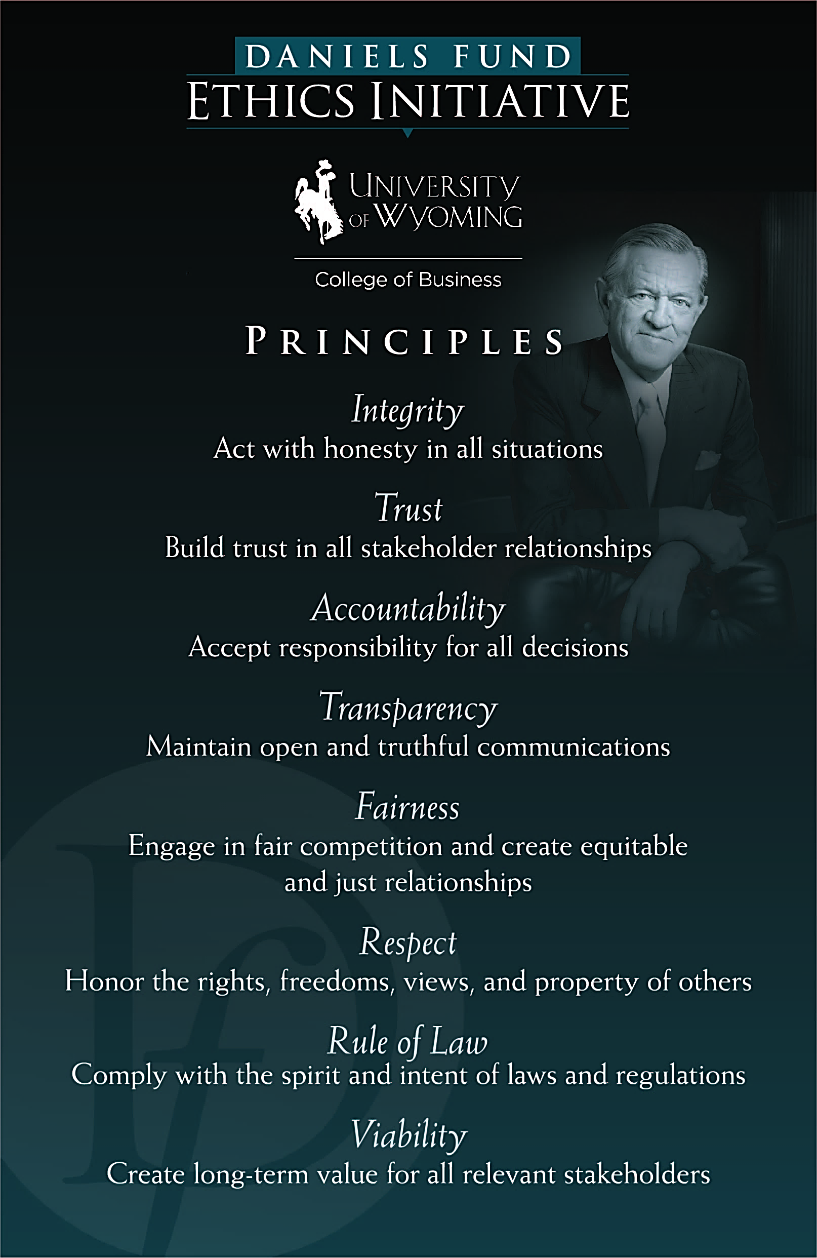
Daniels Fund honoring Bill Daniels' direction to make life better for the people and communities of Colorado, New Mexico, Utah, and Wyoming.
14

Slide 15
Energy Ethics Assignment
Objective: Evaluate students' understanding of professional and ethical responsibility by analyzing real-world engineering scenarios.
Energy Ethics Case Study Analysis Students will be presented with 3 case studies that depict ethical dilemmas in engineering practices. For each case study, the following performance indicators and competencies will be assessed:
  e1. Identification of Ethical Dilemmas (40 points)
  e2. Discussion of Professional Responsibilities (20 points)
  e3. Recommendation for Ethical Action (20 points)
  Quality of Writing and Discussion (20 points)
15

Slide 16
Grading/Assessment Rubric
Performance Indicators | Excellent (90%) | Good (80%) | Fair (70%) | Poor (<60%)
Identification of Ethical Dilemmas (40 points) | Identifies and articulates multiple ethical dilemmas in the case study, providing specific examples. | Identifies at least one ethical dilemma but may lack depth in articulation or example. | Makes an attempt to identify ethical dilemmas but struggles with articulation or relevance. | Fails to identify or incorrectly identifies ethical dilemmas in the case study.
Discussion of Professional Responsibilities (20 points) | Thoroughly discusses engineers' professional responsibilities in the context of the case study, including safety, confidentiality, and societal impact. | Discusses some aspects of professional responsibilities but lacks comprehensive understanding or context. | Limited discussion of professional responsibilities; may mention one aspect like safety but neglect others like confidentiality. | Does not discuss or incorrectly discusses professional responsibilities in the context of the case study.
Recommendation for Ethical Action (20 points) | Provides well-reasoned recommendation for ethical action, supported by ethical theories and professional guidelines. | Provides a recommendation for action but lacks strong theoretical or professional support. | Makes an attempt to recommend an action but lacks clarity, rationale, or alignment with ethical theories. | Fails to provide a recommendation or provides an unethical or poorly-supported recommendation.
Quality of Writing and Discussion (20 points) | Well-organized, clear, and cogent argumentation. Excellent use of citations and adheres to academic standards. | Generally good writing but may have minor errors or lack the depth of argumentation. Some citations may be missing or incorrectly formatted. | Writing is understandable but lacks clarity or strong argumentation. May have several errors or missing citations. | Poorly written with numerous errors, lacking coherent argumentation. Insufficient or incorrect use of citations.

Slide 17
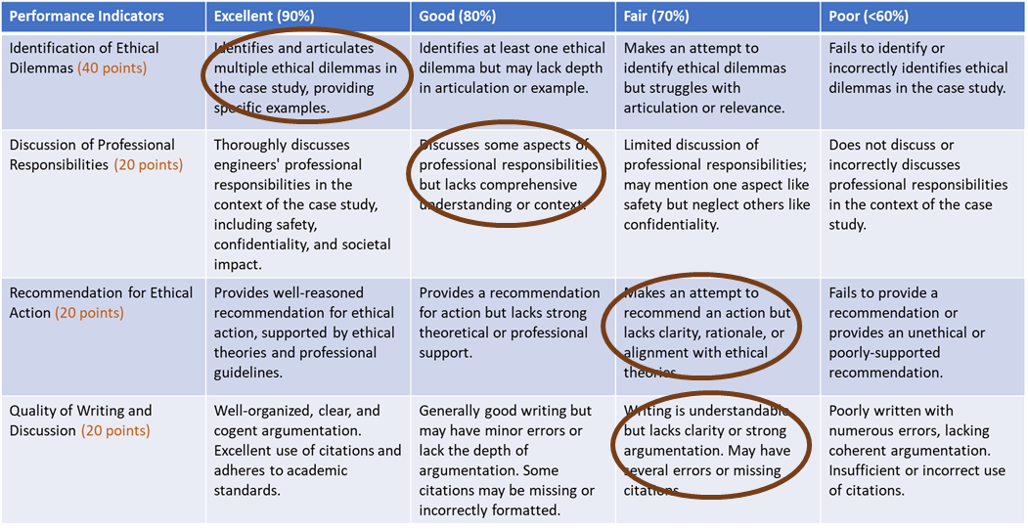
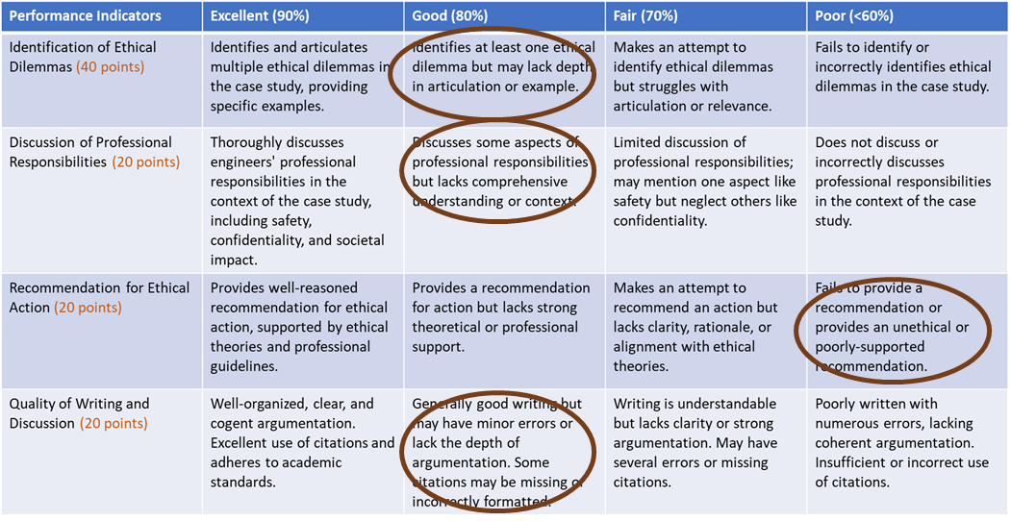
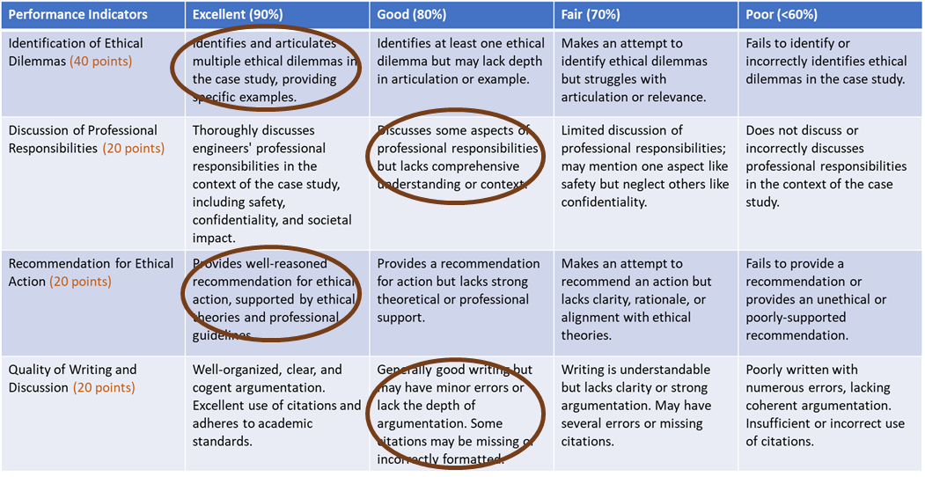
Spring 2022
Fall 2022
Spring 2023
Fall 2023
How do we keep track of all rubrics? We keep them for all courses and all students, right?
17

Slide 18
3- Wyocourses Assessment and Learning Mastery

Slide 19
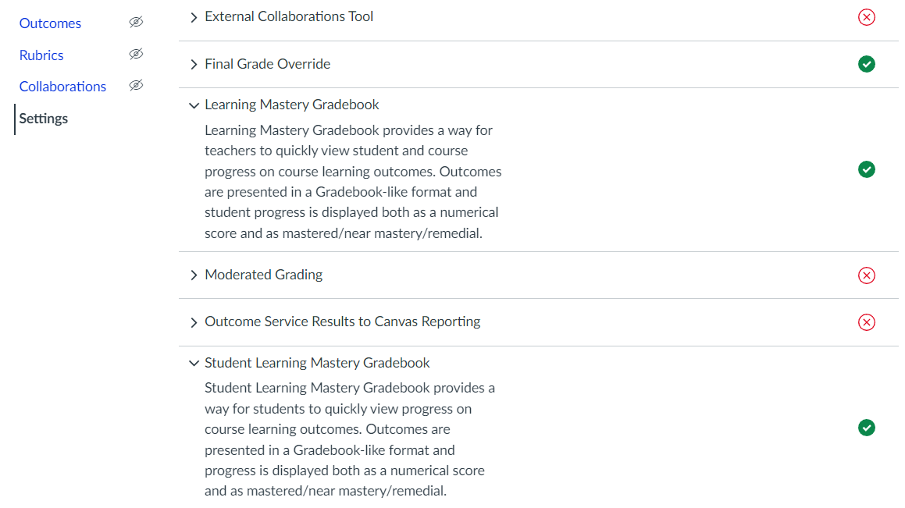



1- Enable Learning Mastery Gradebook
19

Slide 20
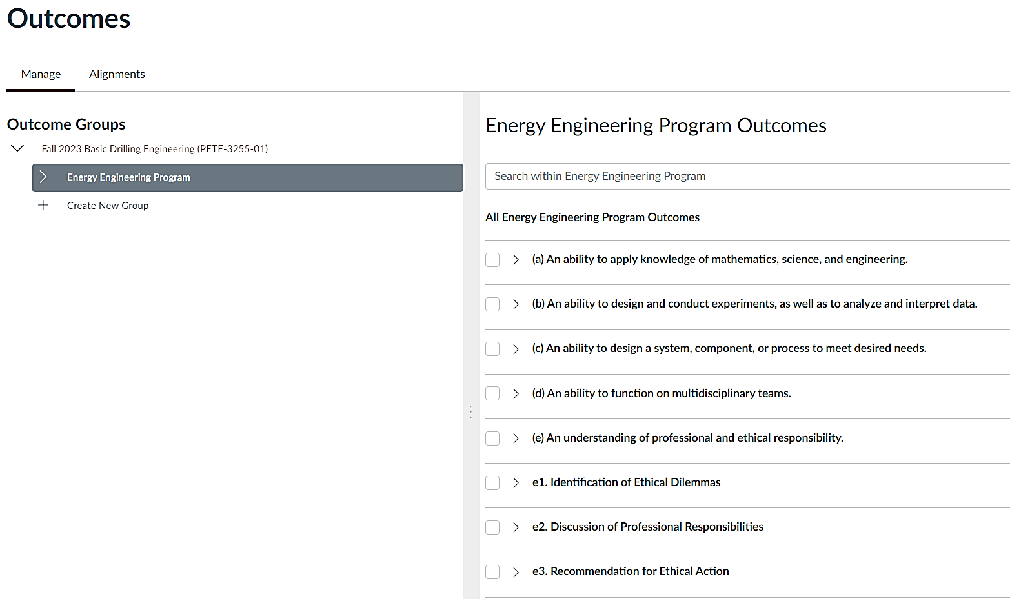
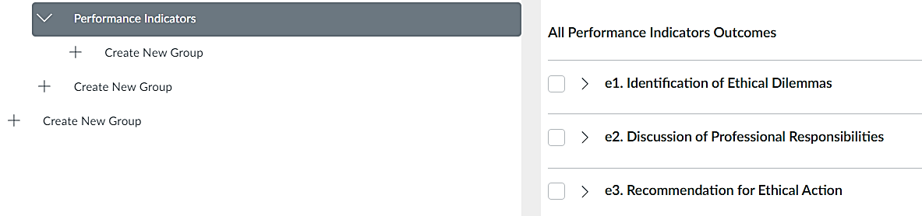
2- Write/Import Outcomes/Indicators
20

Slide 21
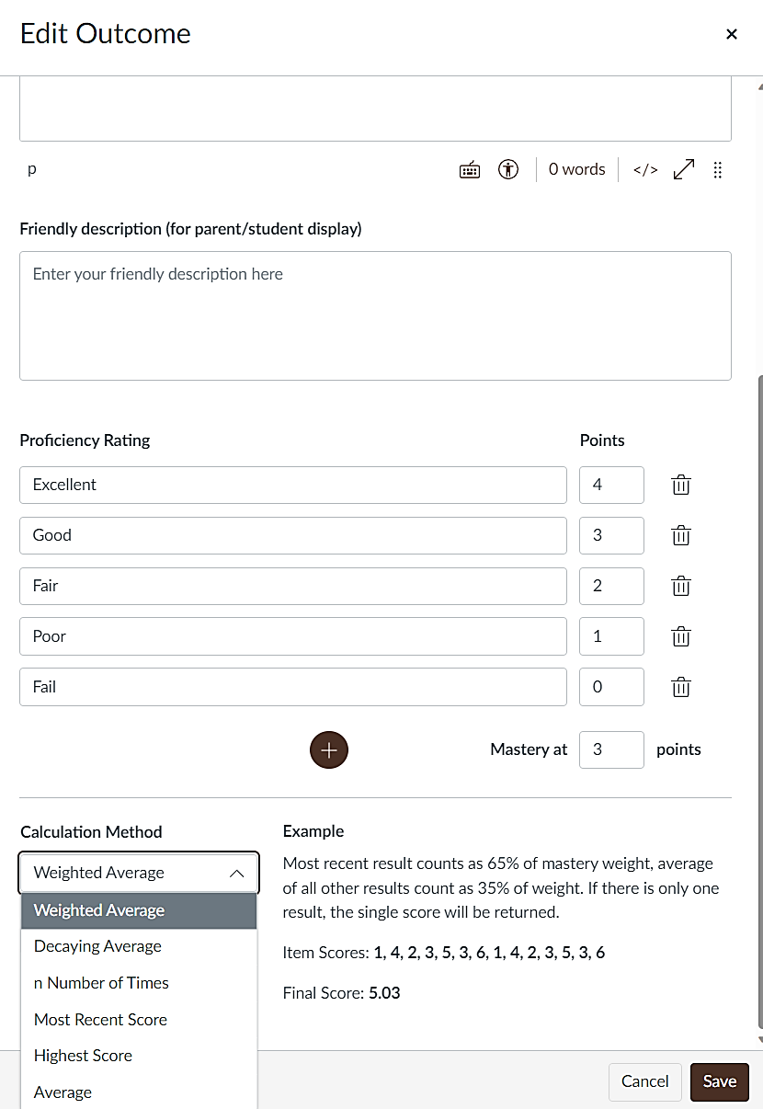
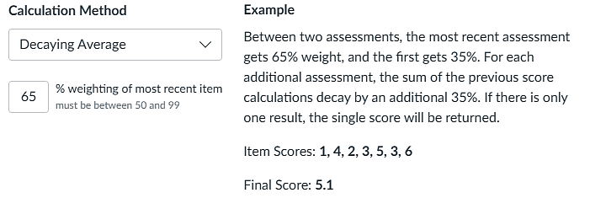
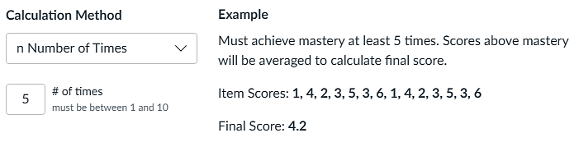
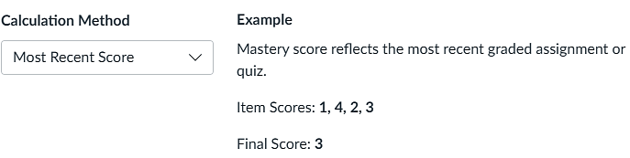
3- Edit Outcomes/Indicators
“Exceed expectations”
21

Slide 22
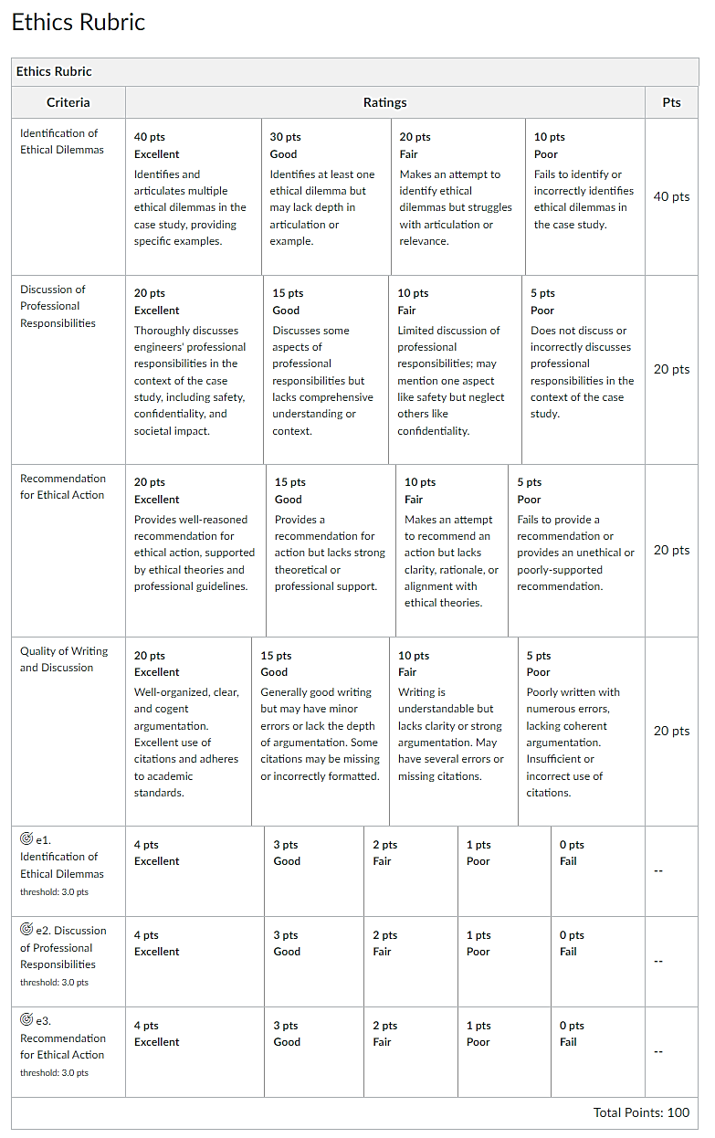
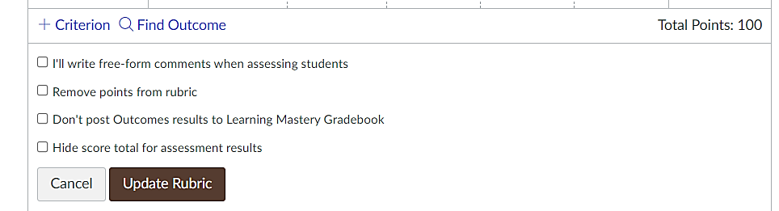
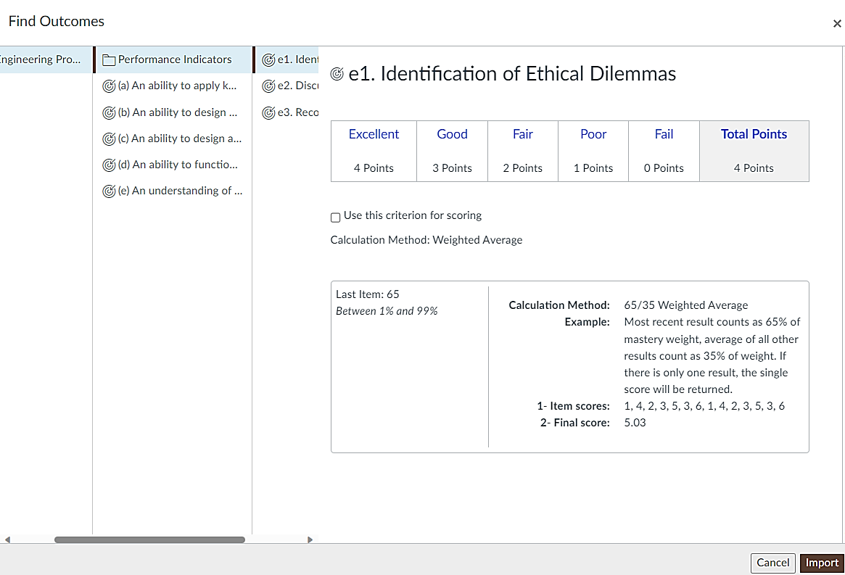

4- Create an Assignment and Add Rubric using Outcomes
“Grading, Assessment, or both”
Grading
Assessment
22

Slide 23
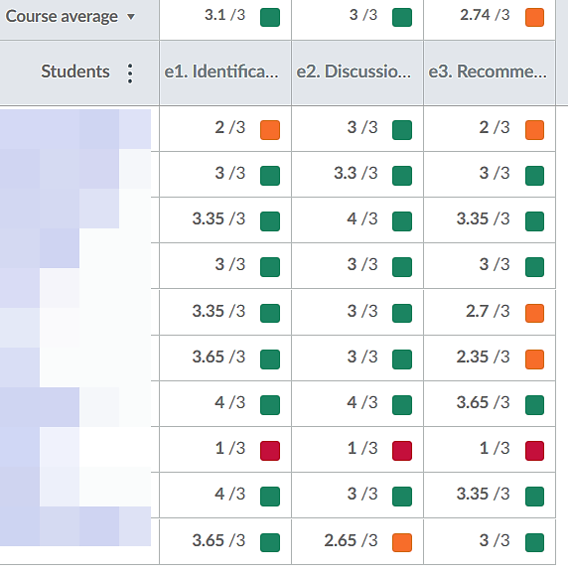
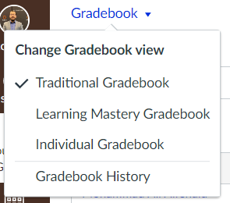
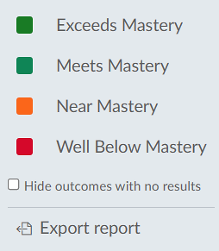
5- Learning Mastery Gradebook
23

Slide 24
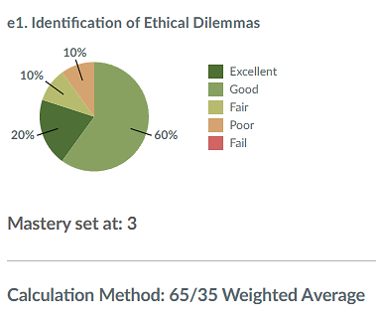
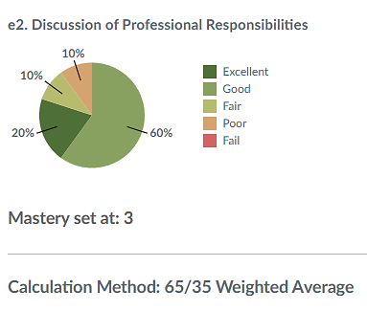
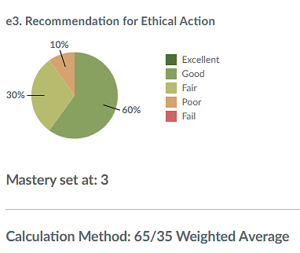
6- Assessment Results
24

Slide 25
Program/Students Outcomes | 1. EE 200: Intro to Energy Engineering | 2. EE 220: Thermo-dynamics | 3. EE 240: Fluid Mechanics | 4. EE 300: Renewable Energy Systems | 5. EE 340: Non-Renewable Energy | 6. EE 360: Control Systems Lab | 7. EE 380: Energy Storage and Management | 8. EE 400: Environmental Engineering | 9. EE 420 Machine Learning in Energy | 10. EE 440: Engineering Ethics | 11. EE 460: Capstone Design
(a) An ability to apply knowledge of mathematics, science, and engineering
(b) An ability to design and conduct experiments, as well as to analyze and interpret data
(c) An ability to design a system, component, or process to meet desired needs
(d) An ability to function on multidisciplinary teams
(e) An understanding of professional and ethical responsibility e1. Identification of Ethical Dilemmas e2. Discussion of Professional Responsibilities e3. Recommendation for Ethical Action |  |  |  |  |  |  |  |  |  | 80%* 80% 60%
Did we attain student outcome (e)? Do we need to take action?
80%* of students meet and exceed expectations

Slide 26
Summary
Map program/student outcomes and performance indicators with applicable courses, focusing assessments on upper-level classes.
With the outcomes in mind, utilize backward design for assignments, assessment methods, teaching pedagogy, and learning activities.
Evaluate the assessment results to continuously improve: curriculum mapping, assessment sources and methods, teaching and learning activities, threshold, course offerings, prereq, etc.
WyoCourses assessment tools are effective in tracking and measuring student learning outcomes across the program and over the years.
When we care, we share. Wyocourses communicates expected outcomes, grading rubrics, feedback, and learning mastery with students.

Slide 27
Thank You
UW Assessment Academy
“We Measure What We Value and
We Value What We Can Measure.”
“Let’s Measure Learning.”
Tawfik Elshehabi, PhD, PE
telsheha@uwyo.edu

