Slide 1
Career Building As A Collective
J
O
U
R
N
E
Y
Who will go with you on your journey?
Notes:
give them a bib on this, including pedagogies, or journals that we have edited

Slide 2
M y t h s
A career starts when I complete my PhD program
A career starts when I get a job
A career starts once I get tenure
Always Plan Your Career

Slide 3
Multiple meanings and pathways
THOUGHT PROBLEM 1
What educational processes are at the center of your journey to building a career?
My CAREER(s) have multiple roots and routes, what grounds yours?
As I share my roots, you will want to jot down yours for (re)thinking later.

Slide 4
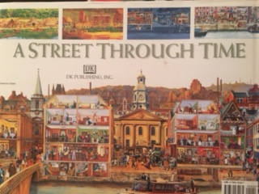
A CAREER is like a street through time,
always open to (CHANGE and (re)developing depending on your agency and with whom and where you elect to (re)build

Slide 5
Thought Problem 2:
Tracing History of Conceptual Roots
What you learn and do depends on who you learn and engage with
Stephen Lu, Design Engineeer and Professor
Who served as a cultural guide, a self-selected mentor for you?
Where does your view of what counts as a career come from – the 20th C or 21st C

Slide 6
Roots of My Developing Career: Phase I What are yours?
Growing up bilingual, biliterate & multi-cultural
in different educational worlds
Two languages, 2 symbols systems. Reading-writing in two languages at the same time (left to right and right to left)
Teachers who inspired me in thinking differently
TAC not CAT and a relationship ongoing Teacher 3, friend grade 4-6
Precis not abstract (HS English)
Learning to research as a historian (HS CA History)
HS Girls Athletic Association, working for Girl’s Vice Principle
Camp Fire Girls– Horizon Club as
collective, not Individual responsibility,
grounded in women’s lives and Native American Lore (11yrs)

Slide 8
Multiple worlds multiple realities

Slide 9
Career Development Phase I Learning Opportunities 1963-1972
Elementary teacher grades 3-4 in African American Community
The year Kennedy was shot –
Asked students who could be president and they answer not me because the President lives in the White House
Supervising teacher & Trainers of Teacher Trainers Program (CSU Northridge-School partnership)
Reading Specialist in Grades 1-6 in a bilingual elementary school and Inservice Leader Reading
NDEA Summer Institute in Language & Linguistics
San Fernando Valley Reading Assoc Newsletter Editor
Focus on African American English form Summer Institute

Slide 10
Why take a new pathway: A personal journey from Teacher to Researcher
Lost a positive reform (open education) as a teacher in face of changing reforms
My search for understanding what we needed as teachers to articulate our practices and to understand their impact of students learning, then and for the future
Research as a way of knowing of seeing more clearly

Slide 11
End of Career Phase I Beginning of Phase 2
The deconstruction of open education through policy change and obtaining my MA degree in Education Psychology at CSU Northridge
Seeing that I could be an academic
Answering question as modern Platonist, Deweyan, and Ayn Randian
Entering Berkeley with 3 advisors since no one program thought that I was eligible for their program
Robert Ruddell – Language and reading development
Paul Ammon – educational psychology
James Stone – higher education
Interdisciplinary Program in Language and Reading Development with Educational Psychology (Piaget)

Slide 12
AGENCY AS A PhD Student Myth vs Building a Foundation for next Phase
Taking classes is the one part of graduate school but creating your own program through choices with whom to meet to explore ideas, processes and practices
Those people I have met who created a dynamic career, elected to volunteer for 3 different research projects to learn how the researcher leading the project
designed,
undertook,
analyzed and
reported the outcomes

Slide 13
Shift happens…
In the 21st C world of education
Visit YouTube for video on this
https://www.youtube.com/watch?v=PcZg51Il9no
Also check RSS by Sir Kenneth Robinson on YouTube for shifting histories of education

Slide 14
Thought Problem 2: Questions to Think About
Who or what inspired you to build your current career phase?
Who demystified thinking for you about education as a career?
On whose shoulders do you stand?
How are you (re)thinking what counts as academic life for yourself with others?
“Any utterance is a link in a very complexly organized chain of other utterances.”
(Speech Genres & Other Late Essays, p. 60)

Slide 15
Learning what “really” counts in particular contexts
I had tenure 4 times
As teacher
At Kent State
At Delaware
At OSU
At UCSB, now Emeritus and traveling to collaborate with others
I seek multiple worlds when I feel constrained
When I started you never moved but within 3 years the world changed and so did way of building career
When you stay in one place, today you can travel the digital highways to build career with others
ZOOM is my current highway of choice for collaborative work on an national and international scale –
Free 1 on 1 and inexpensive for 1-40 people conntected–
Your university has a license but they are going quickly.

Slide 16
So what did I learn AND how did my career develop with from each move?
I learned to read the local world ethnographically
that was being built
Converges with Paulo Freire’s argument:
Reading the world before reading the world.

Slide 17
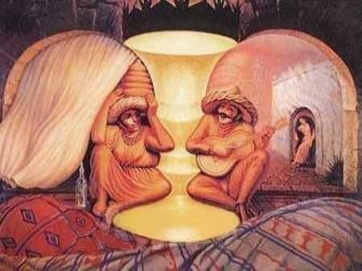
From what perspective? Click to see what this means
What did you notice first?
How many figures do you see?
What is missing?
Notes:
Raise your hand if you saw an old woman? Raise your hand if you saw the old woman first?
Raise your hand if you was a woman in a sombrero?
Raise your hand if you saw a vase? Think about what attracted you to the image you saw first. Each of your answers to what is missing shows the way in which you generating possibilities to test within this case.
Now I will add the remainder of this picture and please record your first observation.

Slide 18
Alternative Realities are Possible
What I was told
Alternatives Realities
You must publish single authored texts in mainstream journals
Write your personal statement in your promotion and tenure (or other review) portfolio
Yes … but when the Dean knows your work
I have on 3-4 single authored texts and 3 major grants
My philosophic perspective is social constructionism – my dean explained this to the campus committee.
You need to articulate your perspective to dean
Be able to map the directions you are taking (Order for publishing)
Empirical Research publications
Teacher oriented publications (peer reviewed)
Popular press (not peer reviewed)

Slide 19
What I was told
Resources & Strategies
You must have an extensive body of grants
Some Suggestions
Do your homework
Meet or connect with program officers
Search grants awarded
U of Iowa Grant Bulletin https://grantbulletin.research.uiowa.eduIn R1 – research is 25-50%
In Teaching – not always required but part of grant counts
Participant in grant and co-author
Engage in Action Research and publish own studies
There are small teacher’s grants at foundations, including STEM, others, professional organizations

Slide 20
Alternative Realities
What I was told
Alternatives Realities
You must publish single authored texts in mainstream journals
Write yourself into freedom
My advisor said just write a good article and it will be published
W R O N G ! ! !
ALWAYS have outsiders read your work so you can hear their
Problem with your grammar
The places that your logic breaks down
Where they need clarification
Where they need further contextual information
ACKNOWLEDGE their editorial work in a footnote

Slide 21
Alternative Realities
Stated Requirements
Alternatives Realities
You must publish single authored texts in mainstream journals
You can publish versions of same article in 3 different levels
empirical (top-rated) is first
Teacher oriented is next
Popular press
Reports count
My experience as author and editor
When not accepted locate another journal
Acceptance rates – place in tenure & promotion document and note rankings and organization
In 4 years as RRQ editor
no article was accepted on first round
Revise and resubmit (often 2 times)
2-3 yrs to print
Even when invited not certain
Be open to search for other options – submit to top journal if you match their editorial goals

Slide 22
Alternative Realities
Stated Requirements
Alternatives Realities
You must publish single authored texts in mainstream journals
Write yourself into freedom
My experience as author and editor
First publication as teacher
Writing in HE is a different genre or really genres
RTE vs Language Arts
RRQ vs Reading Teacher
ER vs AERJ vs RRE
JARST vs Science Teaching
When not accepted locate another journal

Slide 23
Alternative Realities
Stated Requirements
Alternatives Realities
You must publish single authored texts in mainstream journals
Write yourself into freedom
My experience as author and editor
AERA Standards for publishing http://www.aera.net/Publications/Standards-for-Research-Conduct
Empirical social science research’
Humanities-oriented research
As author I need to read the editorial by last three editorial teams
Each has a particular direction
Review last 10 years of articles not just present

Slide 24
Alternative Realities
Stated Requirements
Alternatives Realities
Record your publications in different ways
On inscribing self and career directions
Did you know that you will need to map your career for
Job search
Merit, tenure and promotion
Personal statement
Your website
Volunteering for professional organizations
Consulting with other organizations
NOT JUST A FACEBOOK BIO/PROFILE

Slide 25
On Constructing a Multiple Selves
Often said
Alternate Realities
Be yourself
You have academic freedom
Be professional
Yes but… how do you do this and still maintain your goals for your career within an organizational setting
AERA as an example of different directions for careers
AERA.net
12 divisions
125+ Special Interest Groups
YOU (re)construct a discipline self in communities of scholars
You construct a future self
University of Leuven to students not just faculty
In an ever-changing global world, how do you see your future and disciplinary self?
How do others see you?
Craft you own self and locate the cracks when door seem to close

Slide 26
On learning what counts
Adopting a reflexive perspective

Slide 27
John Gumperz in Month 1
John Gumperz as cultural guide
J: Give me two years of your life and you will begin to understand.
Me: 18 years later I understood what
he wanted me to understand and
developed Interactional Sociolinguistics with colleagues
Whose shoulders do you stand on?
Notes:
Later, the teacher tells Doug that she engages students in multiple “cycles of activity.”

Slide 28
Paul Ammon & Millie Almy as Cultural Guides
Paul Ammon (Advisor):
No Green, you’re an inveterate teacher. You absorb everything into your own theory.
J: Your not supposed to (about Piaget)??
Millie Almy (Mentor & founding scholar in Early Childhood Education:
No Judith, what did Piaget say? Mean?
Learning to Step Back from personal interpretation to take the perspective of the author/theorist as a basis for career building as well as research

Slide 29
Dissertations as Lessons, not Lesson, Learned
Dissertation: 4 studies not one – 3 with statistical base
What is the independent and dependent variables? Tests/Recall of Text as independent variables and teacher actions as dependent ones for each system
How do you know that what you created as a discourse system is better than what others do in observing in classrooms.
How do your observations correlate with student outcomes
How do your findings match what district level observers view of effective practice?
How does you conceptual framework related to current theories in the field?

Slide 30
Metaphors
Exploring differences in perspectives is critical to understanding how observing makes a difference in what can be known

Slide 31
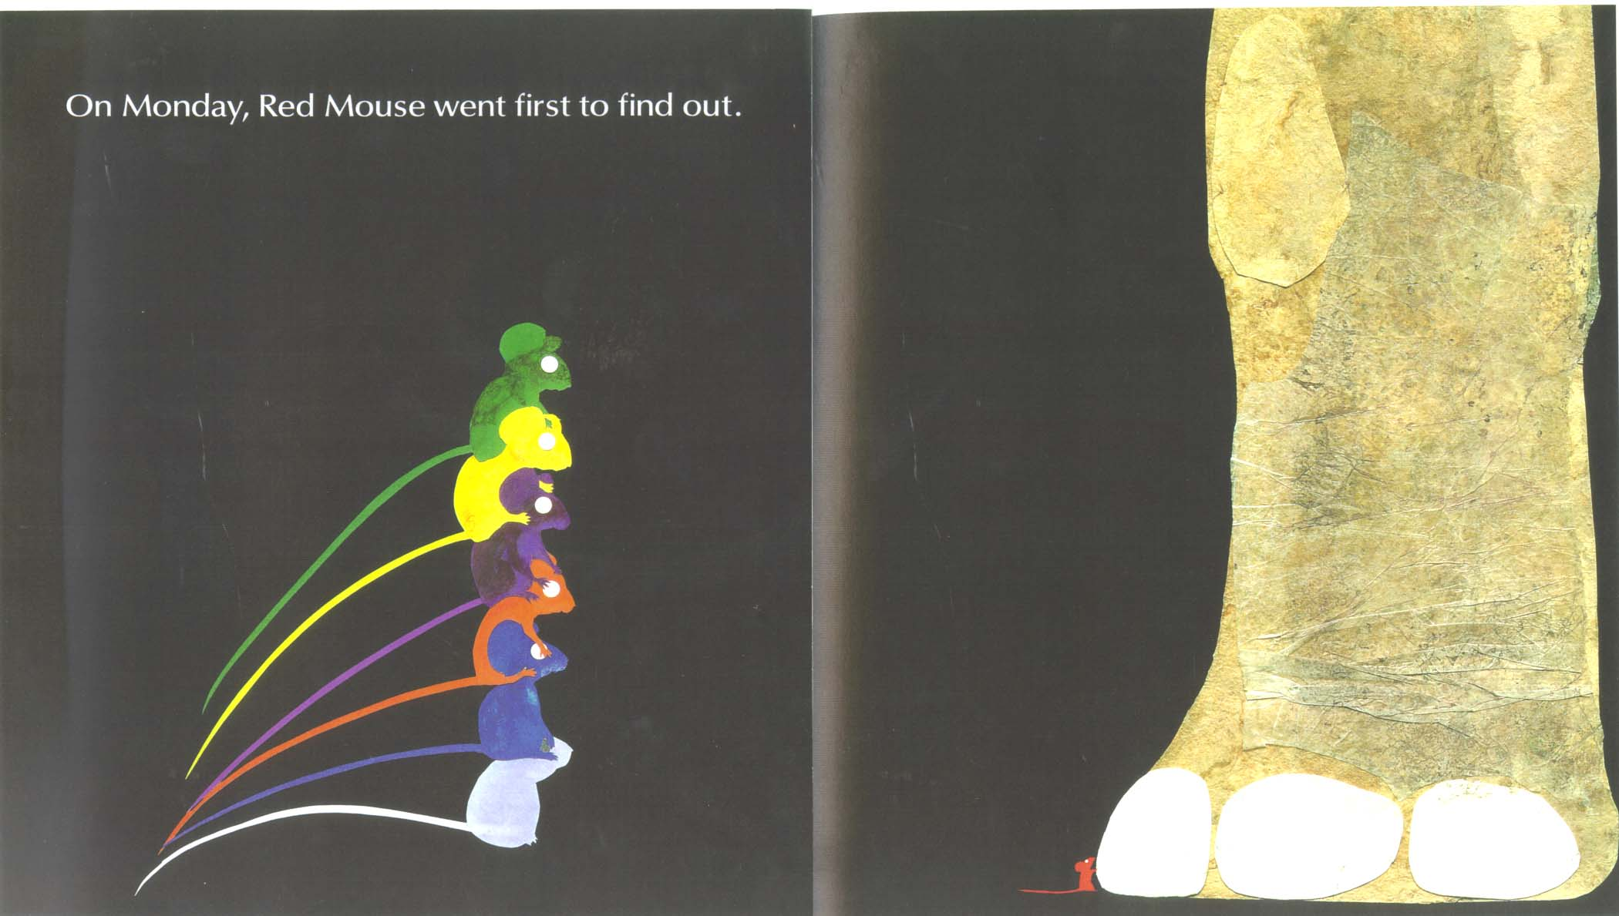

Slide 33
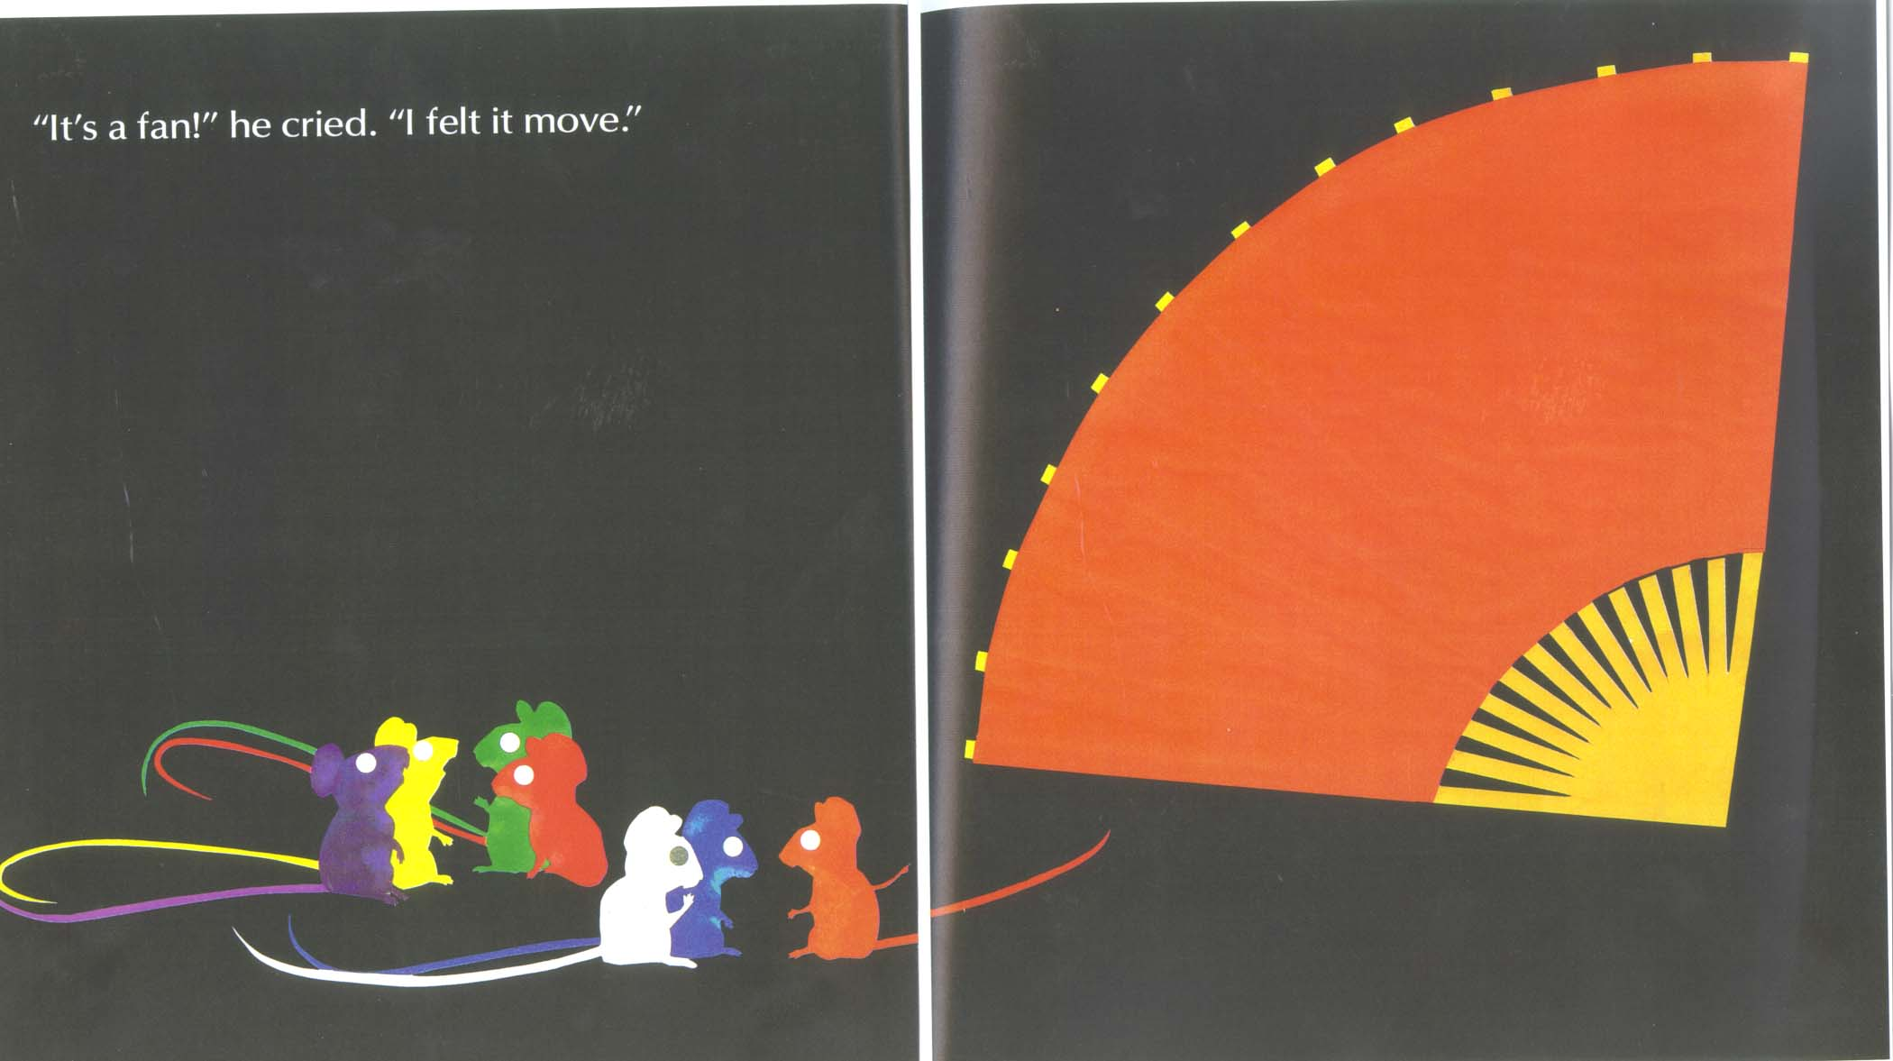

Slide 37
Conceptualizing a perspective in the field
How do different studies you conduct influence your growing understanding and explanations possible through your research program?

Slide 38
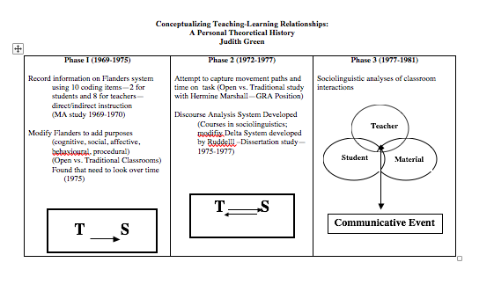

Slide 39
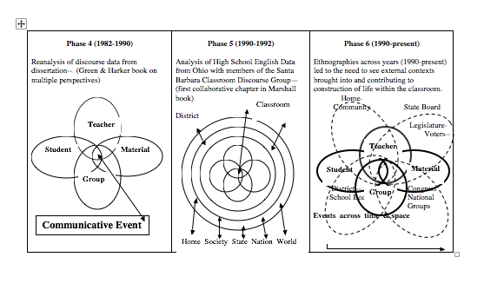

Slide 40
Phase of Engaging in Developing Understandings adapted from Vygotsky’s Thought and Language Reiber & Carton translation and Bruner & Minnick introductions
The following phases are grounded in 25 years of research by members of the Santa Barbara Classroom Discourse Group both in classrooms and in our research community

Slide 41
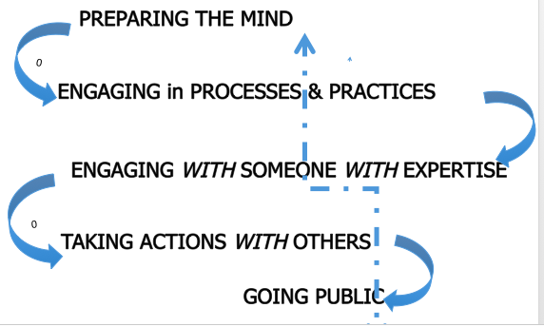

Slide 42
Locating others who share your values even when they don’t share your research direction? Difference as a resource not limit.

Slide 43
Multiple Authors – Single Texts
Ongoing collaborative projects on difference between open education and traditional education
AERA presentations when I left Berkeley to tak e position at Kent (1977)
Continued collaboration led to three peer reviewed articles and jointly published in next period
Continuing collaboration in 1992 led to chapters in Hermine Marshall (Ed), Redefining learning: Roots of educational reform.

Slide 44
On Publishing as a Continuing Collective Pathway
The Kent Years – Career development Phase 3
Collaborative conference (limited funding) on Face to Face Interaction
Gumperz, Cook-Gumperz, Frederiksen, Hutson, Corsaro, Bloome, Wallat, Popkewitz, Garnica, among others – working conference – with open day for others
Led to ethnography and language in Educatinal Settings – 4 years later

Slide 45
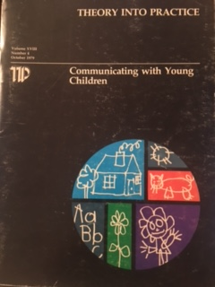
Interdisciplinary volume 1981
1979 OSU journal

Slide 46
Making Professional Connections The Delaware Years Career Path 4
Traveling, collaborating and multiple conferences – Making new connections
Continuing at AERA
Continuing IRA
NRC now LRA
International meetings on Ethnography
Fulbright in Brazil
I Connected with NYU, Indiana, and other literacy educators and was invited to their campuses
Brought Research on Teaching scholars to campus – local funding – building new community within AERA
Hosted a dinner with faculty and graduate students
This led to invitation for Handbook of Research on Teaching with Carolyn Evertson, who worked with me for 2 years to bring our perspectives together to review field not just our perspectives on different ways of recording observations

Slide 47
Professional Editing Years Created 2 Series
Language & Human Service Professions
Cynthia Wallat
Language & Social Processes
Carol Dixon and Ginger Weade
The Making of a Reader
Marily Cochran-Smith
Language Assessment in the Early Years
Genishi & Dyson
The Discourse of Medicine:
Dialectics of Medical Interviews
Elliott Mishler
Talking Science
Jay Lemke
Became Discourse & Social Processes with Lesley Rex, editor
McVee, Brock, & Galicia
Friendship and Peer Culture in the Early Years
William Corsaro

Slide 48
Organizational publishing AERA/IRA
1991-1995
1998-2006

Slide 49
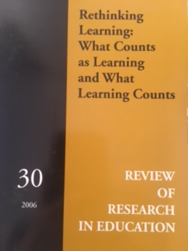
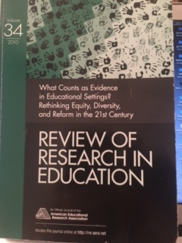
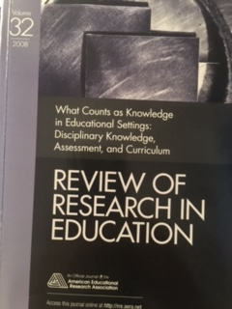
AERA Co-Editor
2008
2010
2006

Slide 50
Building a Program of Research
Selecting journals to publish in requires
Exploring the editorial statement, which changes with each editorial team change
Examining membership on the editorial advisory board since many will be reviewers
Reviewing topics, authors, and research traditions the editors have published

Slide 51
Try the international – global
world of research
Suggested starting points internationally
International Journal of Education Research
Pedagogies
Journal of Teaching and Teacher Education
Forum for Qualitative Social Research (FQS)
Suggest a special issue – supports you and others

Slide 52
From the local to the Global
New directions in researching higher education and technology-enabled education in global contexts
Collaborative publication between
engineering education and education research

Slide 53
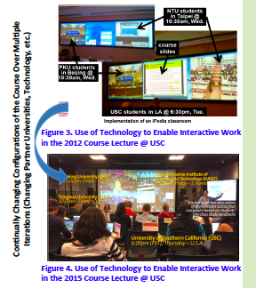

Slide 54
Transdisciplinarity-Interdisciplinarity
Movements in a 21st C world
From the website of the
Swiss Academy of Arts and Sciences

Slide 55
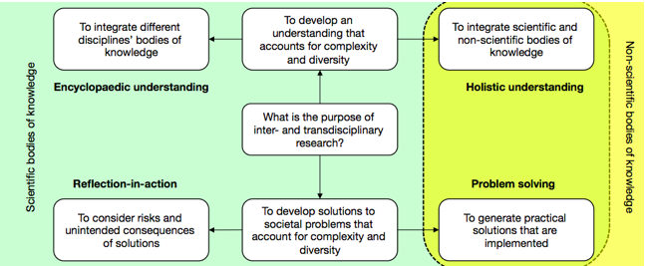

Slide 56
Education as reflection-in-action
practice as a basis for research and writing
Practice as theory but which one –
formal, grounded –personal

Slide 57
Creating an ongoing dialogue requires risk taking but it is worth the risk
Explore your opportunities

Slide 58
When I finished my PHD, I met people who invited me to talk to their students and faculty in 13 different universities and research settings.
That was the start of a developing but always changing network in which I am learning about multiple worlds to make informed decisions for my many career phases
I have been on this journey for the past 5+ decades, and thank Dr. Brock, Dr. Akpovo, Dean Ray Reutzel, and all of you for inviting me to learn with and from you about your developing interests and how you envision your careers developing in your next phases

