Slide 1
Lab Experiment Proposal
Outline
Insects for Teachers
June 2017

Slide 2

Scientific Method: The Basics
Make observations
Form questions
Pick the “best” question
Generate a hypothesis
Design a way to test your hypothesis
    (Experiment!!!)

Slide 3
What is a hypothesis?
It is a predicted outcome based on:
  Previous experience
  Research
A hypothesis should be:
  A strong, straightforward statement
A hypothesis is NEVER proven, only supported (accepted) or unsupported (rejected)

Slide 4
What an Experiment Needs
A Control (not a constant)
Replication (not repetition)
Simpler IS usually better ☺
Materials, supplies, equipment…

Slide 5
What YOUR Proposal Needs:
Hypothesis, with reasons for it.
Materials and supplies needed
Experimental design (controls, replicates…)
Procedure for your experiment
References (if you cited anything to support your hypothesis)

Slide 6
Lab Experiment Proposal
is NOT
a Lesson Plan!

Slide 7
Ideas for Materials and Supplies
Carolina Biological Supply
  http://www.carolina.com
BioQuip
  http://www.bioquip.com
Bug Guide
  http://bugguide.net

Slide 8
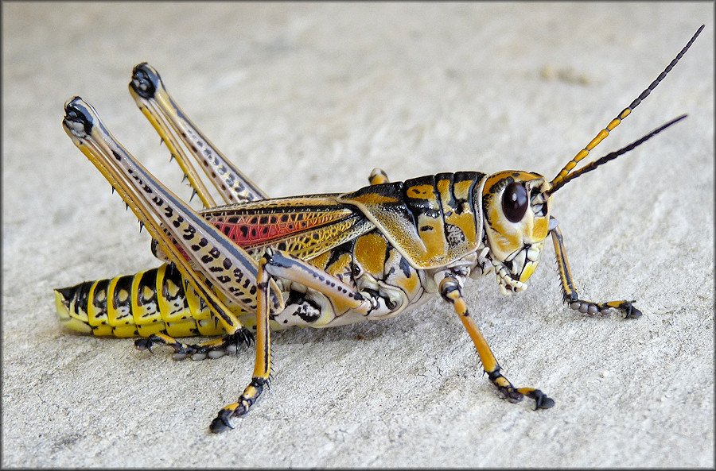
Eastern Lubber Grasshoppers
Romalea microptera:
Ideas for projects
How do lubbers find food?
What do lubbers eat?
How do they react to heat?

