Slide 1
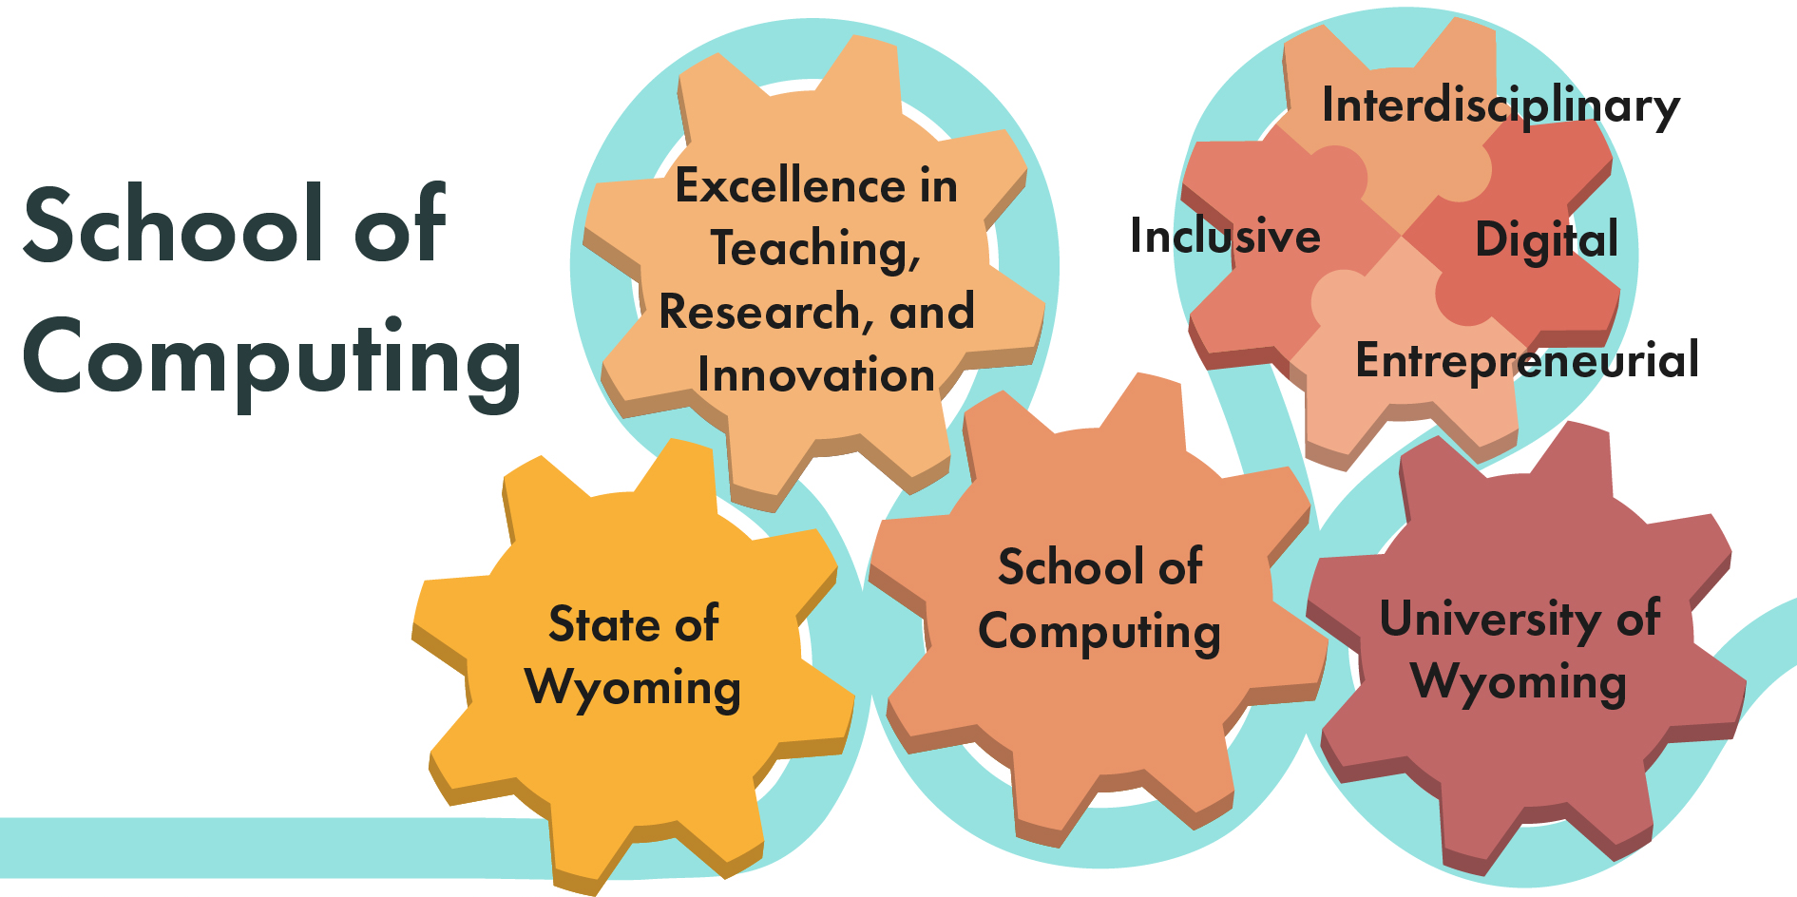
School of Computing (SoC)
Gabrielle Allen
Bryan Shader
September 27, 2021

Slide 2
History
Academic Plan 1999-2004: President Dubois suggests developing School of Computing
2010: NCAR Wyoming Computing Center comes to Wyoming
2012: Tier 1-Engineering: computing throughout curriculum
2020: President Seidel describes emphasis for UW to be more digital
February 2021: Working group on Digital Pillar of 30 + faculty across disciplines appointed by Provost
Summer 2021: Summer SoC working group

Slide 3
Why a SoC?
Do I have enough computing experience to have the career I want?
I took a basic programming class as a freshman, I didn't realize I would need more.
For our students!
All disciplines, all industries, all aspects of society need computing.
My friends at other universities know much more about computing than I do.
No one advised me on the value of taking more computing classes or getting more computing experiences.

Slide 4

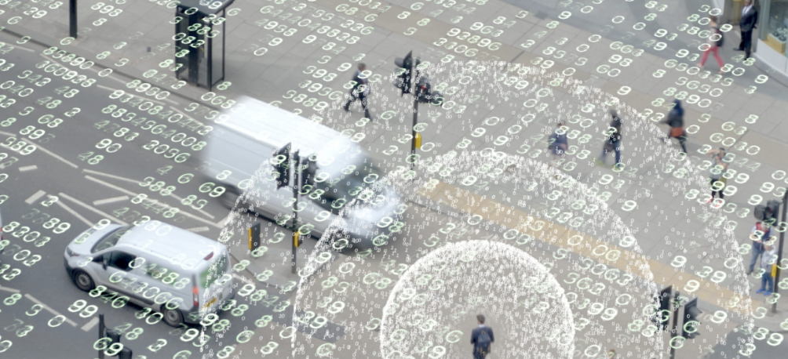
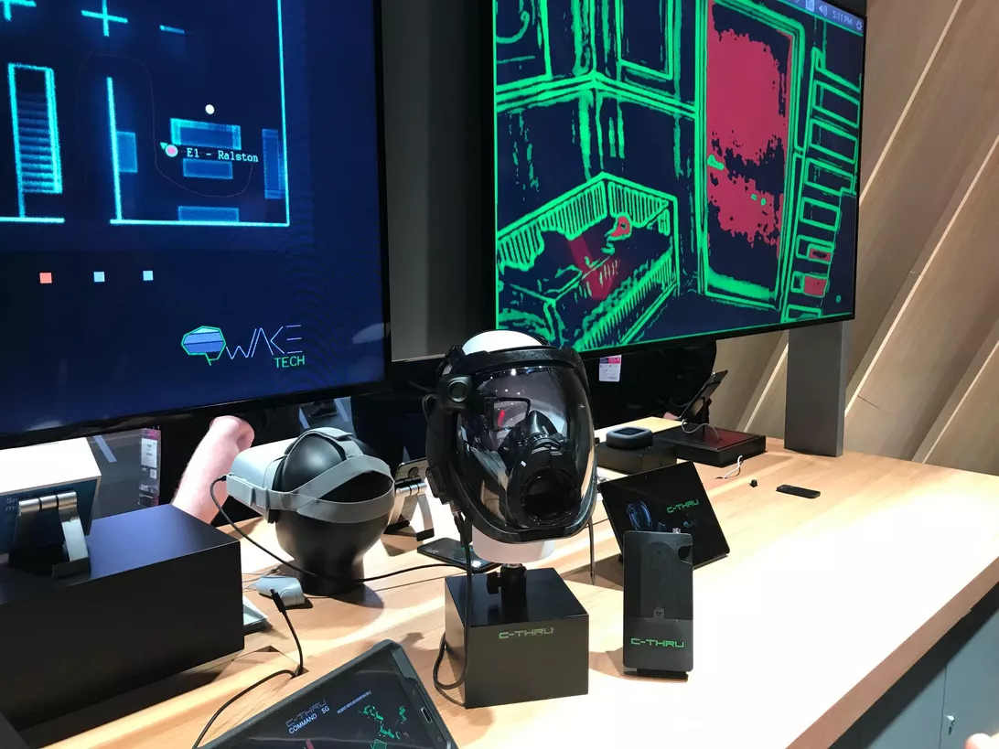
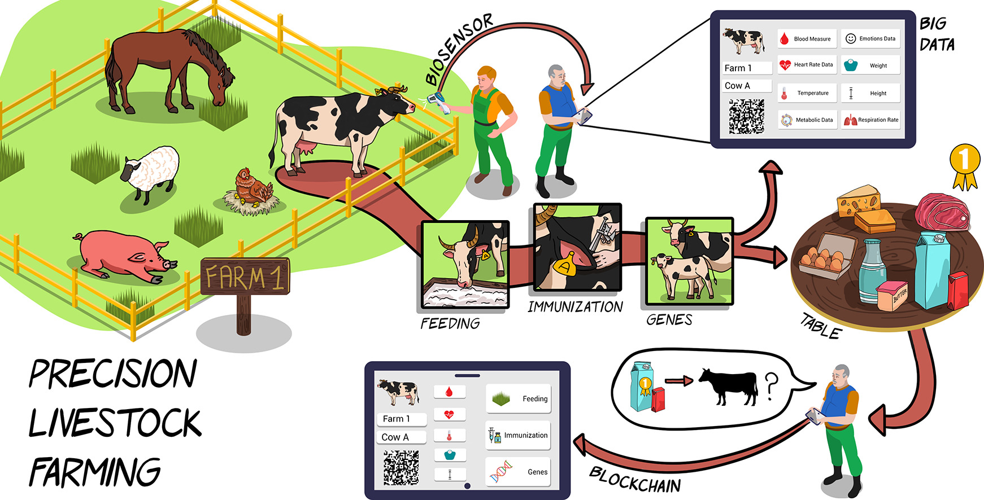
Why a SoC?
Gives students skills to address societal problems.
Water management
Human trafficking
Wild-fire management
Precision Livestock Farming
Medical implants

Slide 5
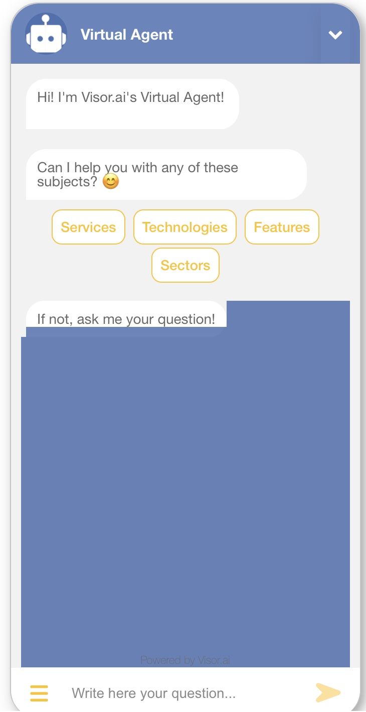
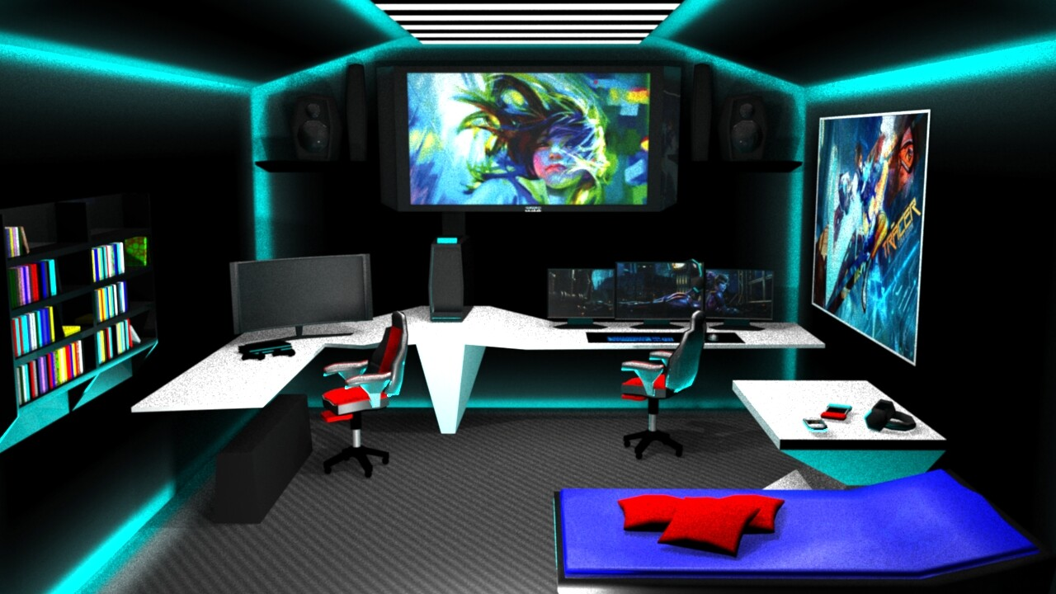

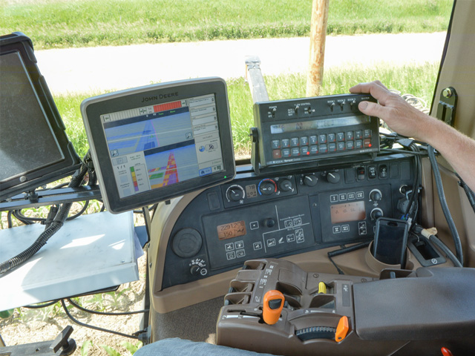
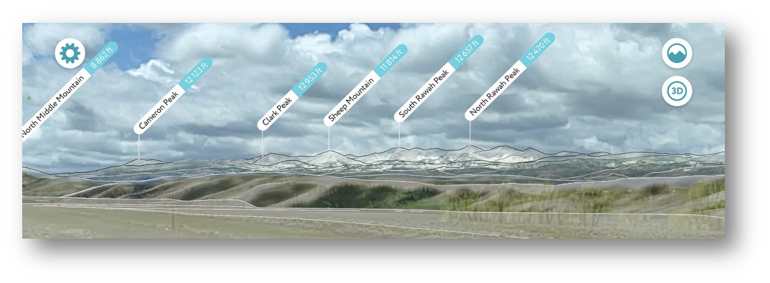

Why a SoC?
Digital is transforming all careers; being digitally savvy can enhance one’s career.
AI-enabled HR
Creative industries
Fintech
Smart tourism
Blockchain for books
Agriculture
Notes:
Creative industries……. Entertainment industy. Open up with a question for them. Fintech/cybersecurity….

Slide 6
Why a SoC?
We’d like to relocate our company to Wyoming, what educational opportunities related to computing are there?
We have immediate openings for 5 data scientists in our company in Casper. Can you recommend UW students?
For our state!
By 2030 Rural communities that already face high levels of job insecurity will come under additional strain due to AI’s explosive use.
I’m committed to continue to keep our tech company in Wyoming–if you can help by provide the workforce.
Wyoming can become a global leader in fin-tech. How do we prepare our graduates to be part of this?

Slide 7
The SoC benefits Wyoming!
Will supply a workforce with 21st century skills (in all areas)
Will promote innovation
Will help all sectors of Wyoming economy be more competitive
Will catalyze new businesses in Wyoming
Will transform the way Wyoming operates
Will help preserve the Wyoming we love by resolving complex problems facing us.

Slide 8
Why a SoC?
Provide excellent opportunities for broad, multidisciplinary coverage and increased research funding
Computing, along with theory and experiments, is needed to study today’s grand challenges
For our faculty!
Will provide new expertise to enable faculty to better pursue their research and scholarship
As an artist how can I give better and more meaningful interactions online?
My research on drug trafficking could be enhanced if I knew some ML. Help!

Slide 9
The SoC benefits UW and CC faculty
Added expertise, person-power (12-16 faculty, 8 research scientists)
Affiliated faculty programs to foster collaborations and learning opportunities
Will be the engine for half a dozen or more ”grand challenge” research clusters
Will be hub for innovation and entrepreneurship

Slide 10
Purpose
The purpose of the SoC is to nurture computing curiosity across disciplines and backgrounds, to enhance interdisciplinarity, and to capitalize upon emerging innovations for teaching, research, and economic diversification.

Slide 11
Vision for UW's SoC
Our vision is to create a unique and inspirational School of Computing (SoC) with national impact and global reach, providing Wyoming and the world with agile and ethical computing professionals, empowered to address societal challenges that are inherently interdisciplinary.

Slide 12
SoC Curricula
BA or BS in Computing
Disciplinary Minor + Computing
Digital for All

Slide 13
Characteristics of the BA and BS programs in computing
Computing in Context
Diversity in interests and student body
Focus on the use of computing/technology to analyze and solve problems and to innovate
Experiential, project-based with internship opportunities.
Multiple pathways to meet student interest and career goals
  (e.g. rather than required 12 hours in science take 12 hours in some discipline; rather than Calculus focused quantitative courses offer range of pertinent quantitative courses)
Collaborative with opportunities to work with different stakeholders
Agile to adapt to emerging topics and opportunities in the workplace

Slide 14
Characteristics of the minors in Computing
Driven by chosen discipline
Multiple on-ramps
Career enhancing computing courses
Entreprenurial and collaborative opportunities
Badges, certificates to indicate competency in specific areas being explored

Slide 15







Partner Dept
Partner Dept
e.g. CS/ECE & Math/Stats
SoC Affiliate Faculty
Tenure home in any partnering dept
Enrich SoC and provide bridges to Depts/Colleges
e.g. Social sciences, Arts, Humanities
Partner Dept
Partner Dept
SoC
e.g. Agriculture
e.g. Physical & Life Sciences
Partner Dept
Partner Dept
e.g. Engineering
e.g. Health sciences

Slide 16

Partner Dept
Partner Dept
e.g. CS/ECE & Math/Stats
SoC Research Scientists/Profs
Mainly funded by soft money (start up funds requested from ARP)
Engine for strategic projects, corporate engagement
PI-capable researchers
e.g. Social sciences, Arts, Humanities
Partner Dept
Partner Dept
SoC
e.g. Agriculture
e.g. Physical & Life Sciences
Partner Dept
Partner Dept
e.g. Engineering
e.g. Health sciences

Slide 17

Partner Dept
Partner Dept
e.g. CS/ECE & Math/Stats
Close Partnerships
ARCC, 3D Viz, WyGISC, etc
e.g. Social sciences, Arts, Humanities
Partner Dept
Partner Dept
SoC
Research problems
e.g. Agriculture
e.g. Physical & Life Sciences
New research & tools
ARCC
Computing professionals, software developers
Partner Dept
Partner Dept
e.g. Engineering
Training, ramp to national resources
e.g. Health sciences

Slide 18
New Revenue Sources
Interdisciplinary computing projects
Corporate partnerships
Ready and nimble to capitalize on opportunities
Partner Dept
Partner Dept
e.g. CS/ECE & Math/Stats
e.g. Social sciences, Arts, Humanities
Partner Dept
Partner Dept
Example:
Ranch of the Future
Robotics
AI
Modeling
Blockchain
RFIDs
Automation
Climate
Water
SoC
e.g. Agriculture
e.g. Physical & Life Sciences
Partner Dept
Partner Dept
e.g. Engineering
e.g. Health sciences

Slide 19
Implementation Timeline
Phase 0: 3-6 months
Establish mission, values, structure and metrics.
Phase 1: Years 1 and 2
Recruit
Develop undergrad curricula
Establish partnerships
Raise funds for Phase 2
Commence operational programs!​
Phase 2: Years 3-5
Secure funding & partnerships
Expand faculty & research staff​
Expand academic programs
Catalyze research across UW
​

Slide 20
Initial Outcomes
World-class team of faculty (12) and research scientists (8)
Impactful research on Wyoming's
Grand Challenges
Increased funding and corporate partnerships
Cutting-edge, widely
accessible curricula
A tech-savvy workforce for Wyoming
Active engagement throughout Wyoming
Estimated Costs:
  Year 1: $ 3,548,294
  Year 2: $ 8,285,149
  Year 3: $10,525,087
  Year 4: $ 9,628,514
Proposed funding from re-org*, WIP, ARP, Trustees Strategic Fund
New revenues from grants & corporate partnerships

Slide 21
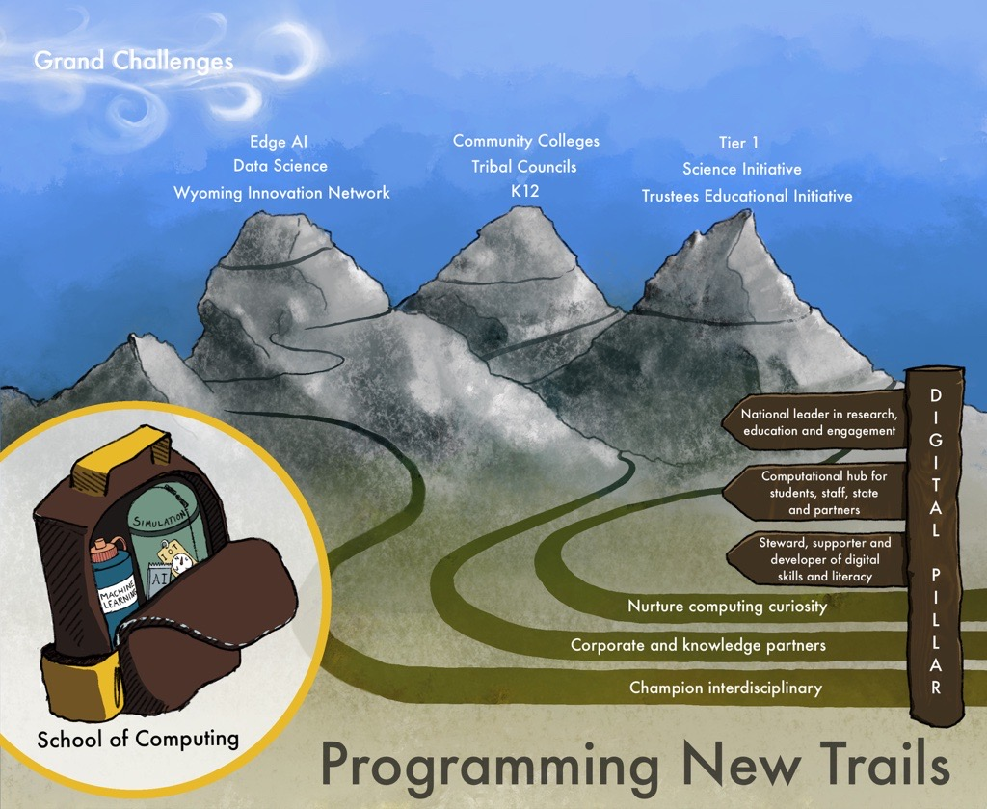
Through the SoC, UW
envisions forging new trails that will enable UW to become a national leader in education, engagement and research.
QUESTIONS?

